Slide 1
Universal
Adversarial
Perturbations
Author: M.A. Kiani, Mohammad Parsa Dini
Mentor: M.R. Rahmani
Instructor: Dr. Yassaee
1

Slide 2
Acknowledgments
M.A. Kiani
B.Sc.C.E.
m.a.kiani@gmail.com
Mohammad Parsa Dini
B.Sc.E.E.
mohammadparsadinithefirst@gmail.com
2

Slide 3
Introduction to
Definitions & Motivations
1
2
Problem
Setting & other
approaches
Key idea &
Solutions for
Adversary
3
4
Our contribution
& Experiments
5
Conclusion
3

Slide 4
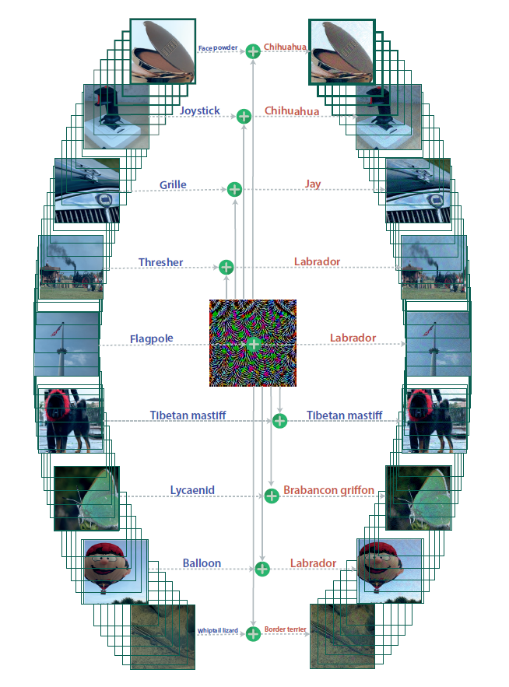
Definition:
Can we find a universal (image-agnostic) and very small perturbation vector
that causes natural images to be misclassified with high probability?
4

Slide 5
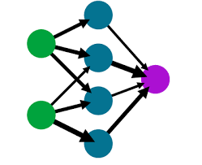
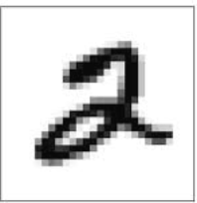
Preliminaries:
2
Feeding an image to the deep neural network and receive a softmax vector and then by decision-making we output the most probable label.
5

Slide 6
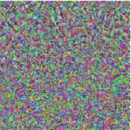
Preliminaries:
Anything but 2
(Untargeted)
A specific label like 3
(Targeted)
There are two categories in adversary models, targeted and untargeted attacks.
6

Slide 7
Preliminaries:
2
The attacks can access and use gradient and weigths (White Box) or otherwise (Black Box).
7

Slide 8
Introduction to
Definitions & Motivations
1
2
Problem setting
& other
approaches
Key idea &
Solutions for
Adversary
3
4
Our contribution
& Experiments
5
Conclusion
8

Slide 9
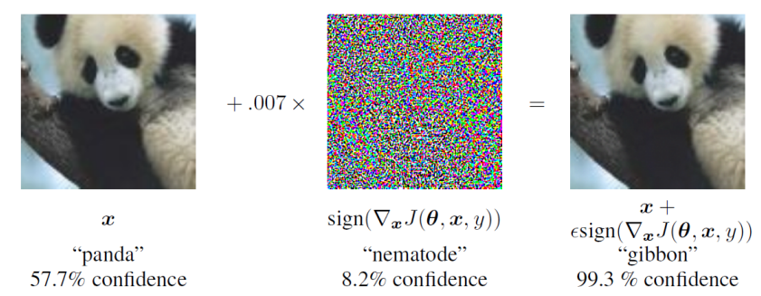

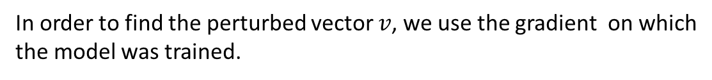
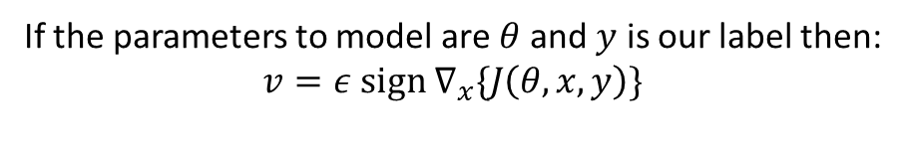
FGSM & L-BFGS
In order to find the perturbed vector $v$, we use the gradient on which
the model was trained.
If the parameters to model are $θ$ and $y$ is our label then:
$$v=ε sign ∇_{x}\{J\left(θ,x, y\right)\}$$
Given an image x, their method finds a different image x that is similar
to x under L2 distance, yet is labeled differently by the classifier.
9

Slide 10
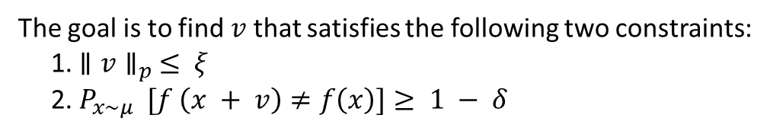
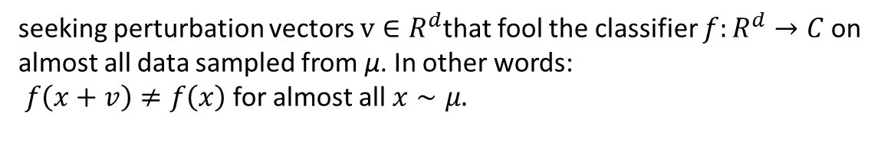
UAP
$μ$ is the distribution of images in $R^{d}$. $χ=\{ x_{1}, …,x_{m}\}$ is the dataset.
seeking perturbation vectors $v∈R^{d}$that fool the classifier $f:R^{d}→C$on
almost all data sampled from μ. In other words:
$f\left(x+v\right)≠f\left(x\right)$ for almost all $x∼μ.$
The goal is to find$v$that satisfies the following two constraints:
1. $∥v∥_{p} ≤ ξ$
2. $P_{x∼μ } [f \left(x + v\right)≠f\left(x\right)]≥ 1 − δ$
10

Slide 11
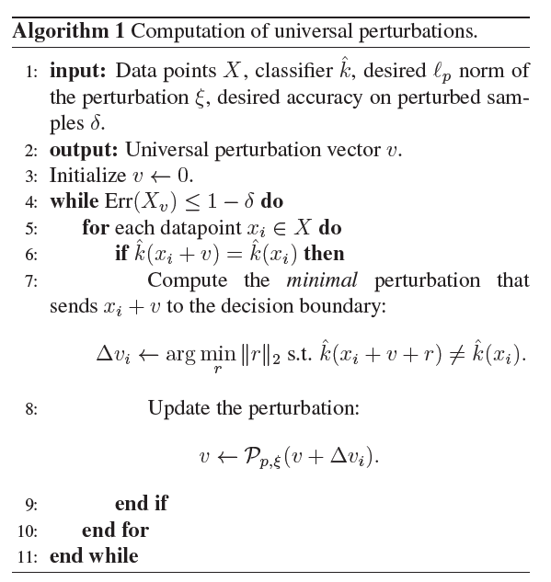


UAP Algorithm
11

Slide 12
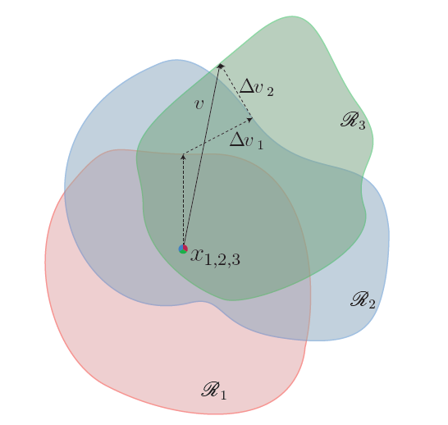
Visualization
This gradient indicates the direction in which the perturbation should be adjusted to increase the loss.

Slide 13
Introduction to
Definitions & Motivations
1
2
Problem setting
& approaches
Robustifying via
Randomized
smoothness
3
4
Our contribution
& Experiments
& Bounds
5
Conclusion
13

Slide 14
The space of perturbed vectors
Diversity of universal perturbations for the GoogLeNet architecture. The five perturbations are generated using different random shufflings of the set X. Note that the normalized inner products for any pair of universal perturbations does not exceed 0.1, which highlights the diversity of such perturbations
14

Slide 15
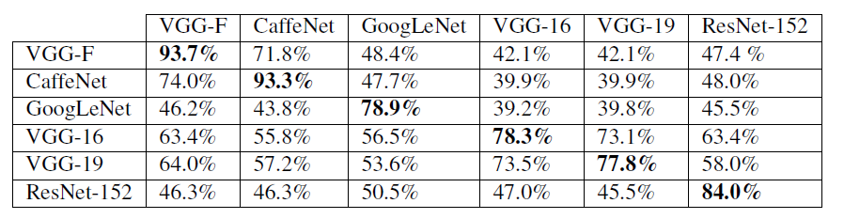
How does the norm effect the attack?
15

Slide 16
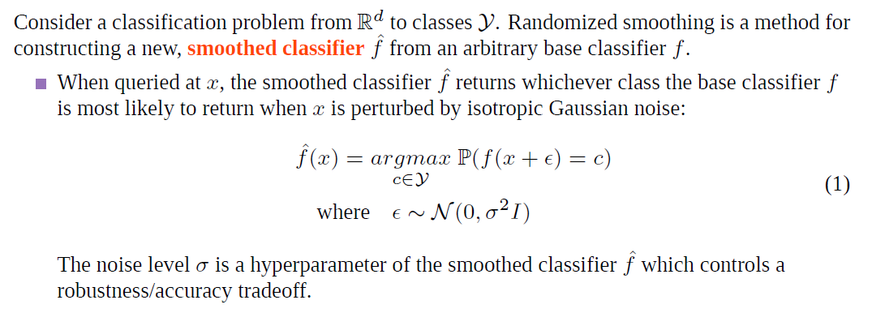
Randomized Smoothing

Slide 17
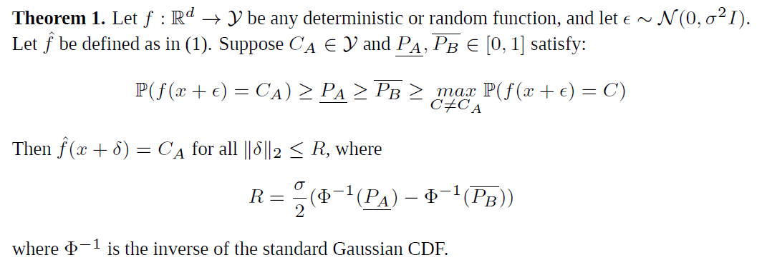
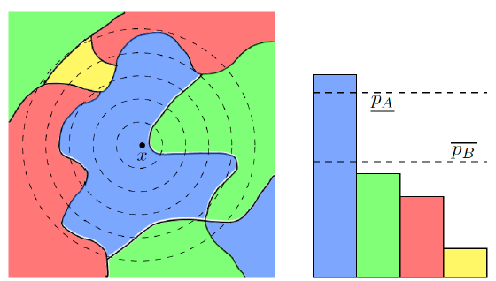
Theorem 1

Slide 18
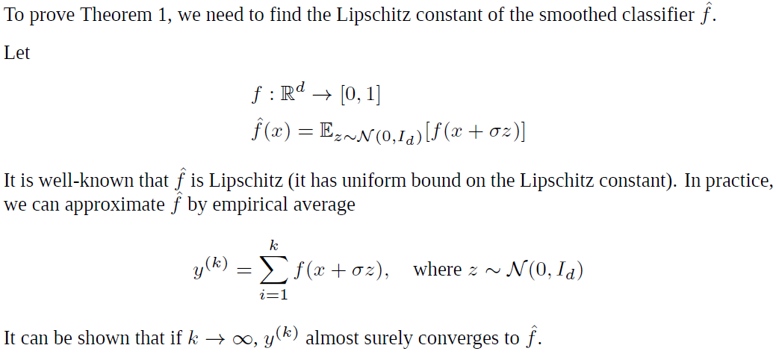
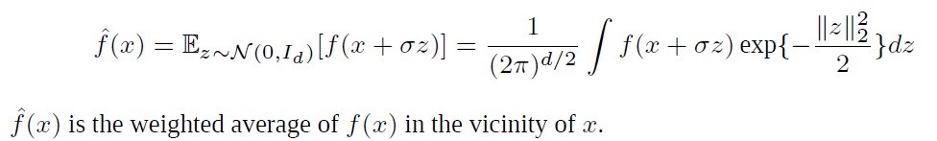
Proof of Thrm 1:

Slide 19
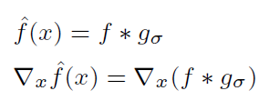

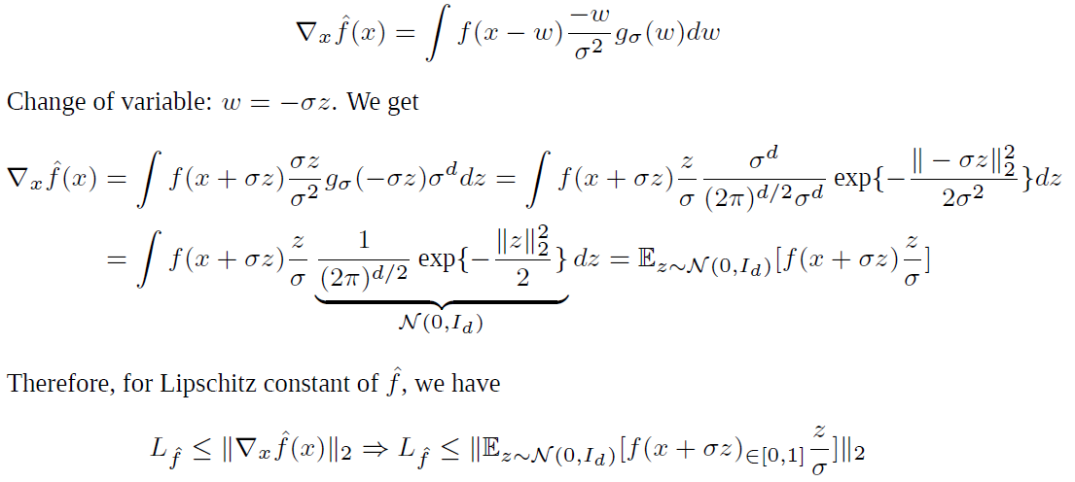
Proof of Thrm 1:

Slide 20
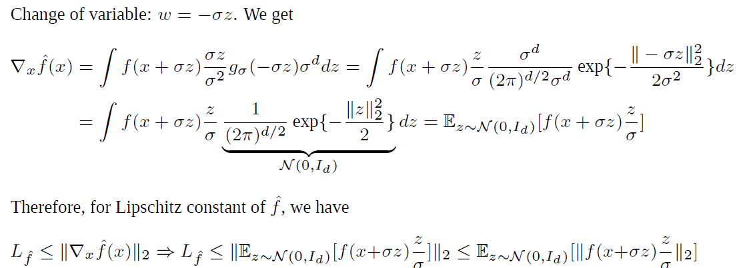
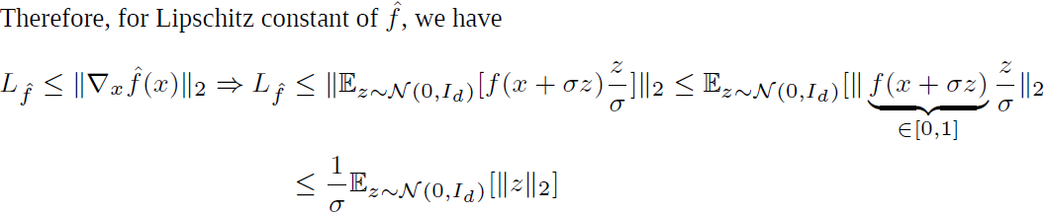
Proof of Thrm 1:

Slide 21
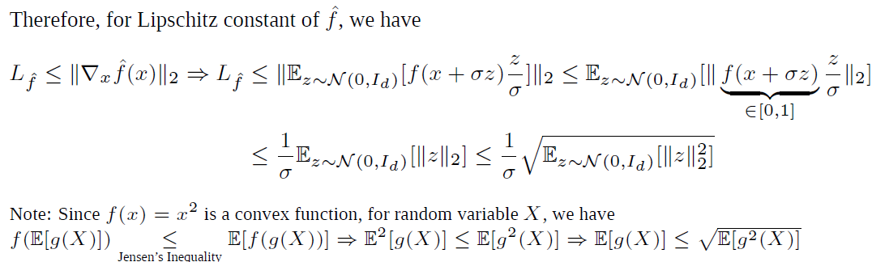


Proof of Thrm 1:

Slide 22
Introduction to
Definitions & Motivations
1
2
Problem setting
& other
approaches
Key idea &
Solutions for
Adversary
3
4
Our contribution
& Experiments
5
Conclusion
22

Slide 23
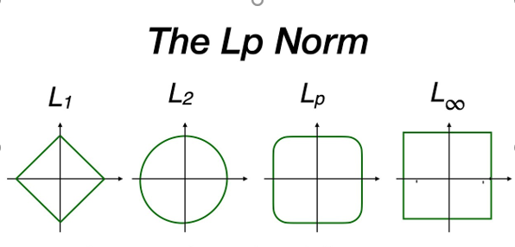
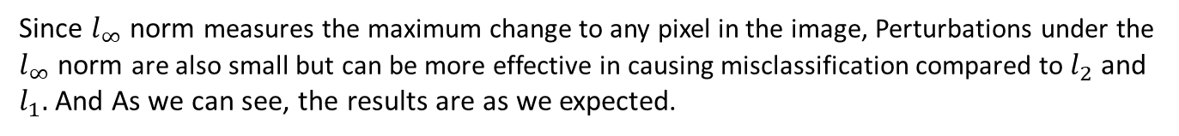
How does the norm effect the attack?
Since $l_{∞}$ norm measures the maximum change to any pixel in the image, Perturbations under the
$l_{∞}$ norm are also small but can be more effective in causing misclassification compared to $l_{2}$ and $l_{1}.$ And As we can see, the results are as we expected.
23

Slide 24
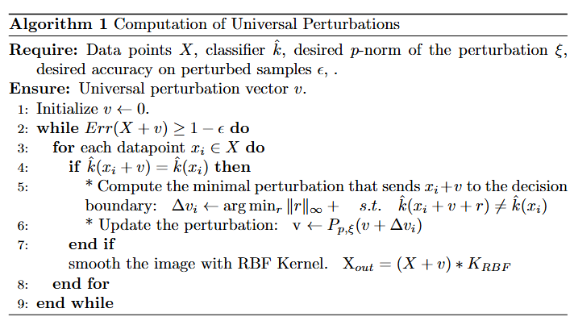
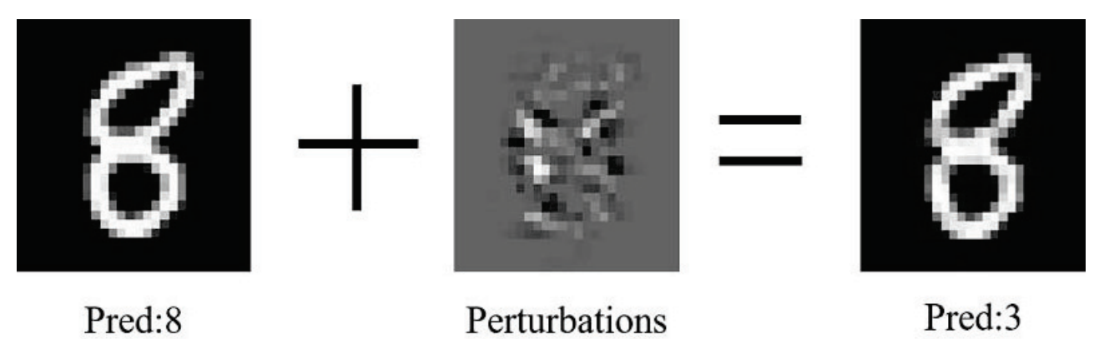
Our method’s algorithm

Slide 25
Accuracy dump after attack on LeNet model &
Model | Acc. Before attack | Acc. After Attack
FGSM | 94.2% | 18.3%
PGD | 94.2% | 21.7%
LBFGS | 94.2% | 27.6%
UAP | 94.2% | 29.1%
Our prop. method | 94.2% | 38.5%

Slide 26
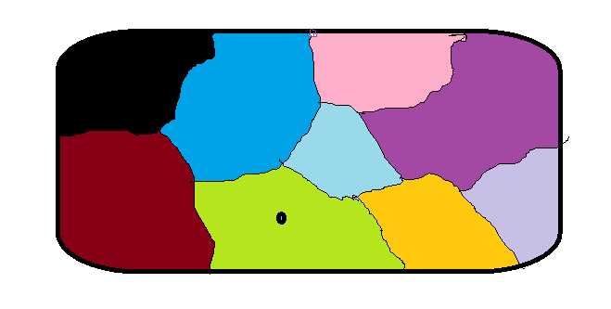
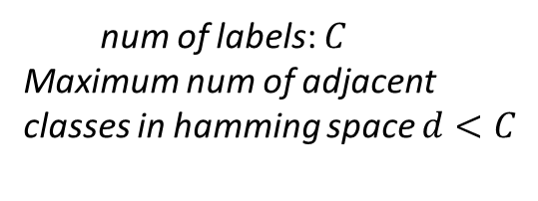

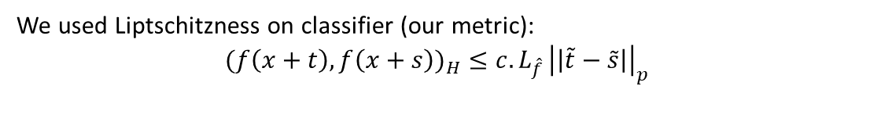

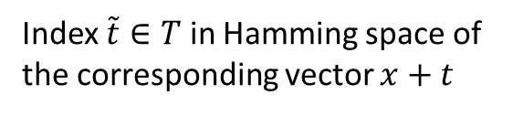

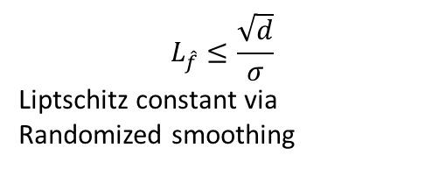
$$E_{X∼P_{X}\left(x\right)}\left\{\sup_{\tilde{t}∈T}H\left(\hat{f}\left(x+t\right)\right)−H\left(\hat{f}\left(x\right)\right)\right\}≤\int_{0}^{∞}{\sqrt{log⁡(N(m,d,χ)}} dm$$
$$L_{\hat{f}}≤\frac{\sqrt{d}}{σ}$$
Liptschitz constant via
Randomized smoothing
$$χ$$
$$X_{0}$$
$$\vec{t}$$
Index $\tilde{t}∈T$ in Hamming space of the corresponding vector $x+t$
num of labels: $C$
Maximum num of adjacent classes in hamming space $d<C$
We used Liptschitzness on classifier (our metric):
$$(f\left(x+t\right),f\left(x+s\right))_{H}≤c.L_{\hat{f} }{\left|\left|\tilde{t}−\tilde{s}\right|\right|}_{p}$$

Slide 27
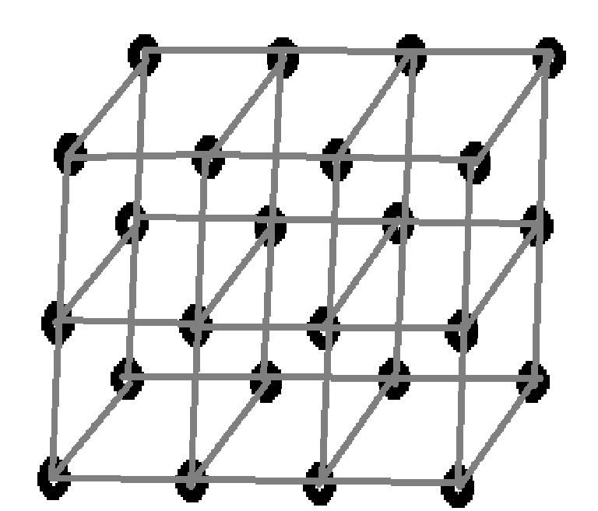
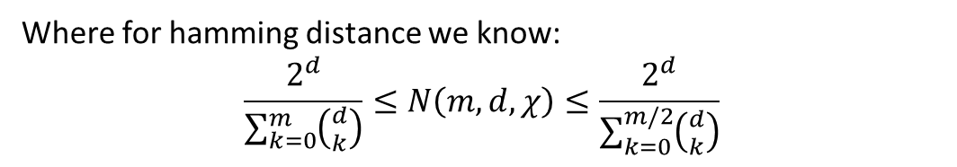

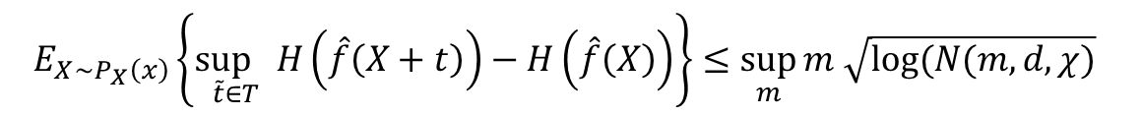

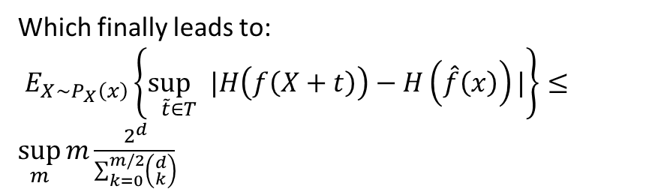
$$E_{X∼P_{X}\left(x\right)}\left\{\sup_{\tilde{t}∈T}H\left(\hat{f}\left(X+t\right)\right)−H\left(\hat{f}\left(X\right)\right)\right\}≤\sup_{m}{m \sqrt{log⁡(N(m,d,χ)}}$$
$$T$$
Where for hamming distance we know:
$$\frac{2^{d}}{\sum_{k=0}^{m}{\left({d \atop k}\right)}}≤N\left(m,d,χ\right)≤\frac{2^{d}}{\sum_{k=0}^{m/2}{\left({d \atop k}\right)}}$$
Which finally leads to:
$E_{X∼P_{X}\left(x\right)}\left\{\sup_{\tilde{t}∈T}|H\left(f\left(X+t\right)\right)−H\left(\hat{f}\left(x\right)\right)|\right\}≤\sup_{m}{m\frac{2^{d}}{\sum_{k=0}^{m/2}{\left({d \atop k}\right)}}}$
$$\tilde{t}$$

Slide 28
Introduction to
Definitions & Motivations
1
2
Problem setting
& other
approaches
Key idea &
Solutions for
Adversary
3
4
Our contribution
& Experiments
5
Conclusion
28

Slide 29
Conclusion & Future Works
In this presentation we have reviewed the general literature regarding adverserial attack algorithms and possible defenses against it.
We have simulated a different attacking strategy using some p-norms
and have reached noticing accuracy.
For structural difference images it can adapt itself and have creativity.
There are many more possible future research directions regarding this problem.
For instance, we can assume upper bound on Wasserstein distance between
perturbed and original distributions, and explore the expected adversarial error
for Gaussian smoothing distribution.
29

Slide 30
References
Main Sources
Certified Adversarial Robustness via Randomized Smoothing
arXiv:2310.16047
Universal Adversarial Perturbation (UAP)
arXiv:2310.16047
Additional Resources
itinerai/us_places. https://huggingface.co/datasets/itinerai/us_places.
pcuenq/lsun-bedrooms.
https://huggingface.co/datasets/pcuenq/lsun-bedrooms.
Yaron Cruz, Image Processing, Aug 2024. https://www.slideserve.com/yaron/image-processing.
30

Slide 31
31

