Slide 1
Defense Against Gradient-Based Attacks
via Randomized Smoothing
Erfan Moeini
Mohammad Parsa Dini

Slide 2
A review of the process

Slide 3
gradient-based adversarial attacks

Slide 4
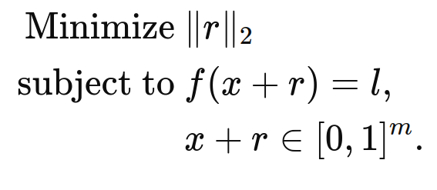
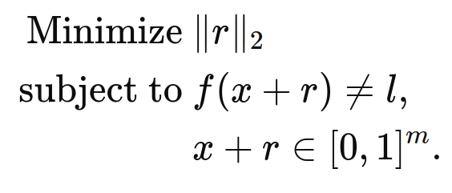
Attack types
Targeted Attack
Untargeted Attack
l is target class
l is base class

Slide 5
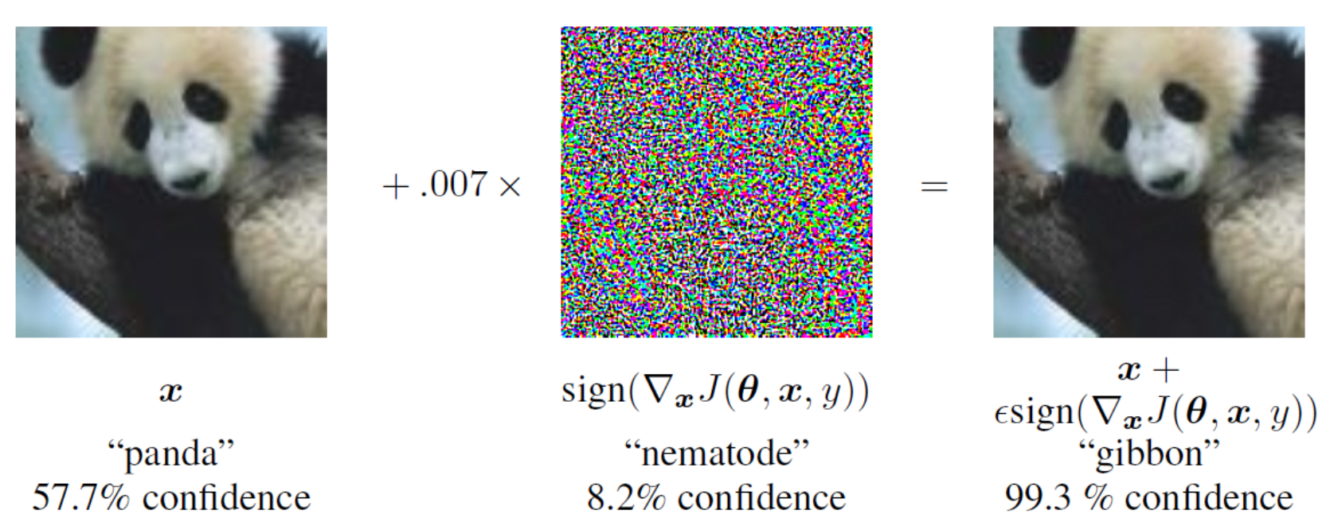
Fast Gradient Sign Method (FGSM)

Slide 6
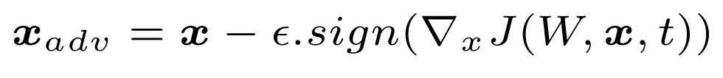
FGSM targeted and untargeted
Untargeted Attack
Targeted Attack

Slide 7
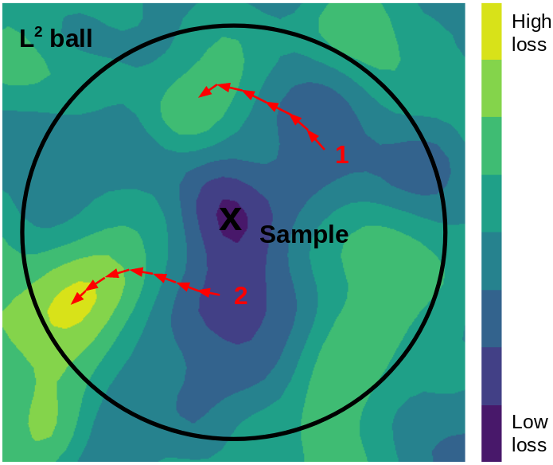
PGD

Slide 8
Randomized Smoothing

Slide 9
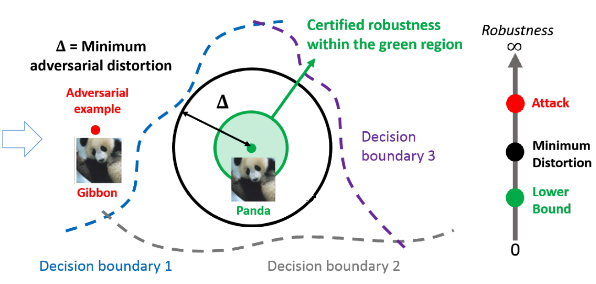
Certifiable Robustness

Slide 10
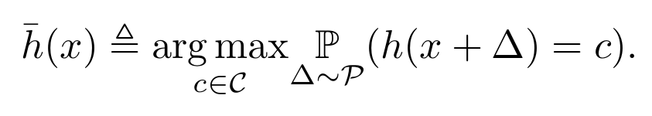
Randomized Smoothed Classifier

Slide 11
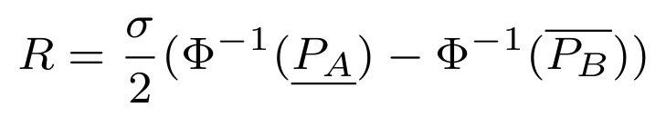
Certified Adversarial Robustness via Randomized Smoothing
proof this radius for gaussian noise
not depend on input dim

Slide 12
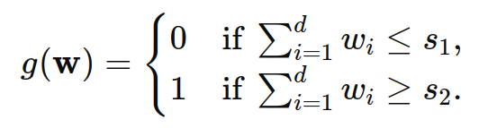
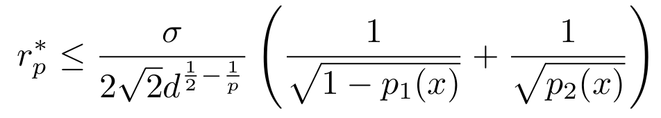
Curse of Dimensionality on Randomized Smoothing for Certifiable Robustness
i.i.d noise to each dimension

Slide 13
Ideas

Slide 14
idea list
Proof of Certified Robustness for Poisson Distribution
Finding a Better Bound with Conditions on the Classifier

Slide 15
Tanks

