Slide 1

INTRODUCTION
HOME
ABOUT
MORE
Intrusion Detection
Advanced AI For Cybersecurity
Supervisors
      Eng . Reem Hatem
      Eng . Mohammad Hallim
      Eng . Hossam Fakher

Slide 2
INTRODUCTION
HOME
ABOUT
MORE
TEAM MEMBERS
MOHAMMAD PRINCE
ADHAM ASHRAF
AHMED ASHRAF
AHMED TAMER

Slide 3
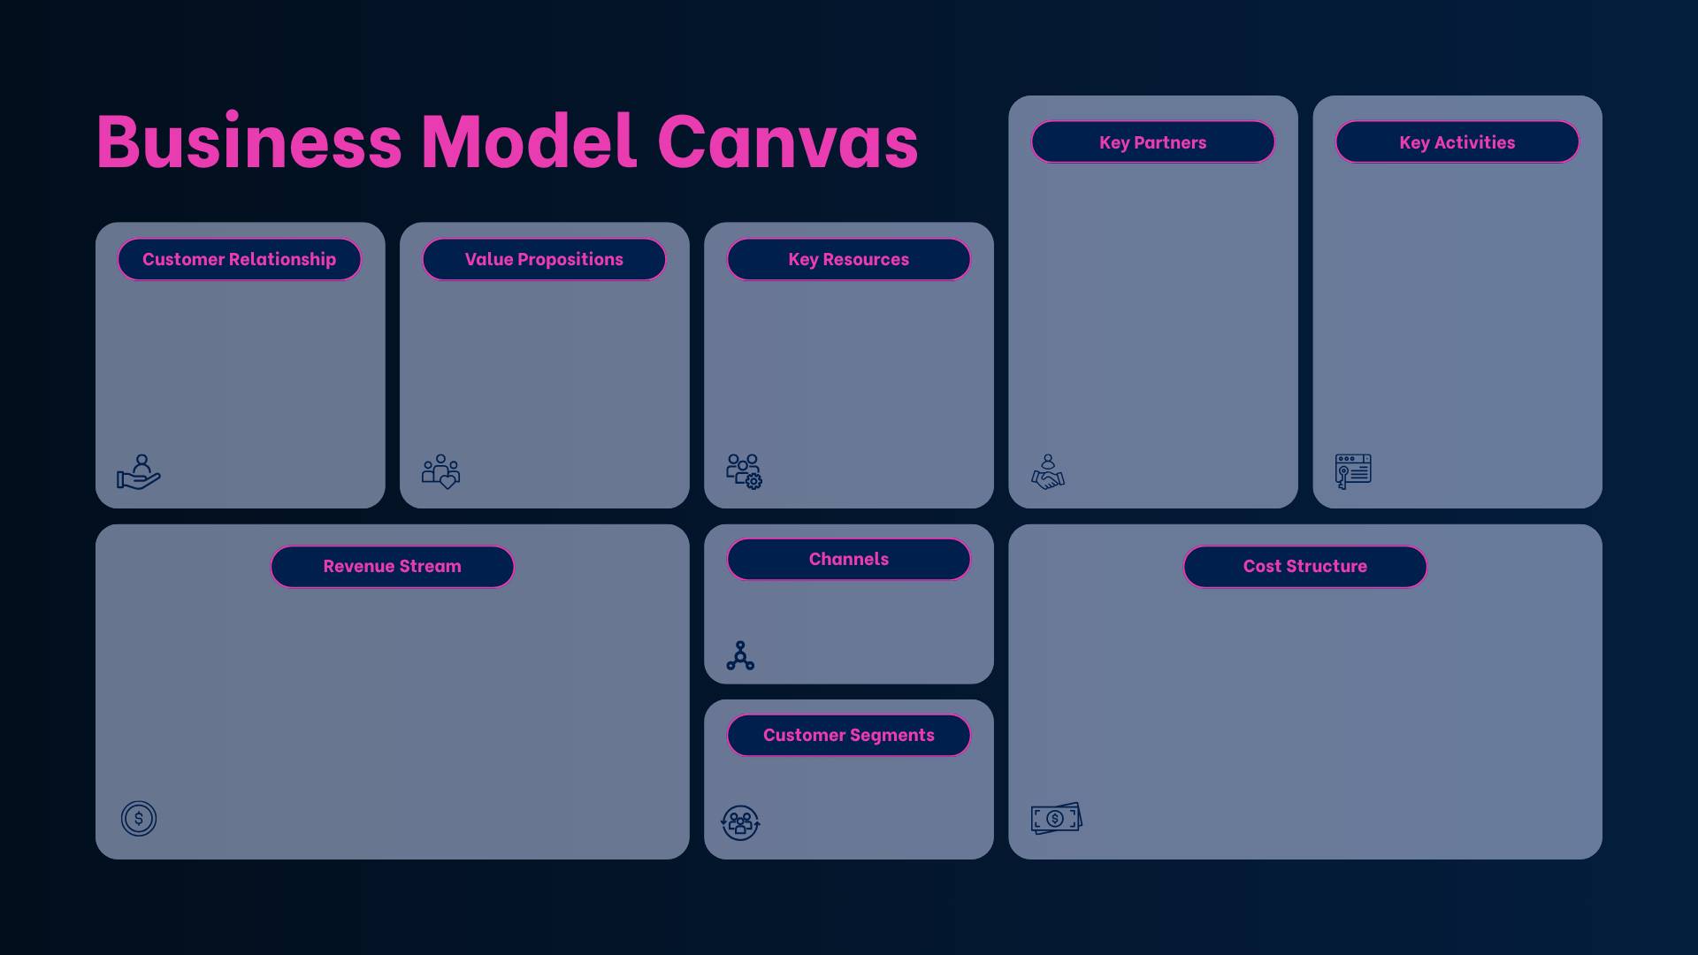
Colab & Kaggle
Github
The Australian Centre for Cyber Security (ACCS)
Cloud
GPU Providers
Data Preprocessing
Feature Engineering
Model Training
Model Evaluation
Continuous model updates.
Providing technical documentation, and user guides.
High-accuracy network intrusion detection
Early identification and categorization of cyber threats
UNSW-NB15 datasets
GPUs , CPUs
(Kaggle , Colab)
Social Media Ads
Banners
Enterprise SaaS subscription or API-based licensing for network monitoring tools.
Paid custom consulting and integration services for corporate networks.
subscription to:
  Colab
  Servers (to host our model)
Companies
Government institutions

Slide 4

PROBLEM
HOME
ABOUT
MORE
What is
Problem ?
Cyber attacks threaten network security through breaches like malware and service disruptions.

Slide 5
PROBLEM
HOME
ABOUT
MORE
Why
Cyber Security
Matters?
Rising Threats
Financial Impact
Personal Risks
Business Risks
Societal Impact
2,200 cyber attacks per day globally
Average data breach costs $4.45M
Identity theft affects 1 in 15 people annually
Downtime, reputation damage, legal penalties
Attacks on critical infrastructure like hospitals or power grids

Slide 6
ML MODEL CREATION
HOME
ABOUT
MORE
Our Model will detect only if the size is attacked or not so
we will create a binary classification model
STEPS
FETCHING THE DATA
EDA
CLEANING THE DATA
BALANCING THE DATA
SCALLING USING LOG
ENCODING
&
SPLITTING
MODEL TRAINING
EVALUATION

Slide 7

FETCHING DATA

Slide 8
FETCHING THE DATA
HOME
ABOUT
MORE
SOURCE OF DATA
We will use a dataset from Kaggle UNSW_NB15
https://www.kaggle.com/competitions/advanced-ai-for-cybersecurity-intrusion-detection-with-unsw-nb-15/data?select=UNSW_NB15_training-set.parquet
Data Description
  This dataset comprises 36 features capturing comprehensive network traffic metrics, including core connection details, packet rates, TCP parameters, and behavioral connection patterns. These attributes are leveraged to train machine learning models that predict the target columns (label and attack_cat), enabling accurate detection of security intrusions and cyber attacks .

Slide 9

EDA

Slide 10
EDA
HOME
ABOUT
MORE
DEFINITION
Understanding the data using describe and some visualizations .
NOTES
  Data has a large number of duplicates .
  Data has no null values .
  Data is imbalanced . (we will solve in the following steps)
  Some Features has very large numbers . (needs scaling)

Slide 11

POWER PI - DASHBOARD

Slide 12

DATA CLEANING & SCALING

Slide 13
DATA CLEANING & SCALING
HOME
ABOUT
MORE
DATA CLEANING
  Removing duplicates and preprocessing the null values .
DATA SCALLING
  Scaling the numerical data using ( log ) before splitting .

Slide 14

DO YOU THINK THERE WILL BE DATA LEAKAGE ??

Slide 15

BALANCING DATA

Slide 16
BALANCING DATA
HOME
ABOUT
MORE
DEFINITION
Balancing the number of samples for each category .
Balancing ways
Adding new samples until balance
Removing samples until balance

Slide 17
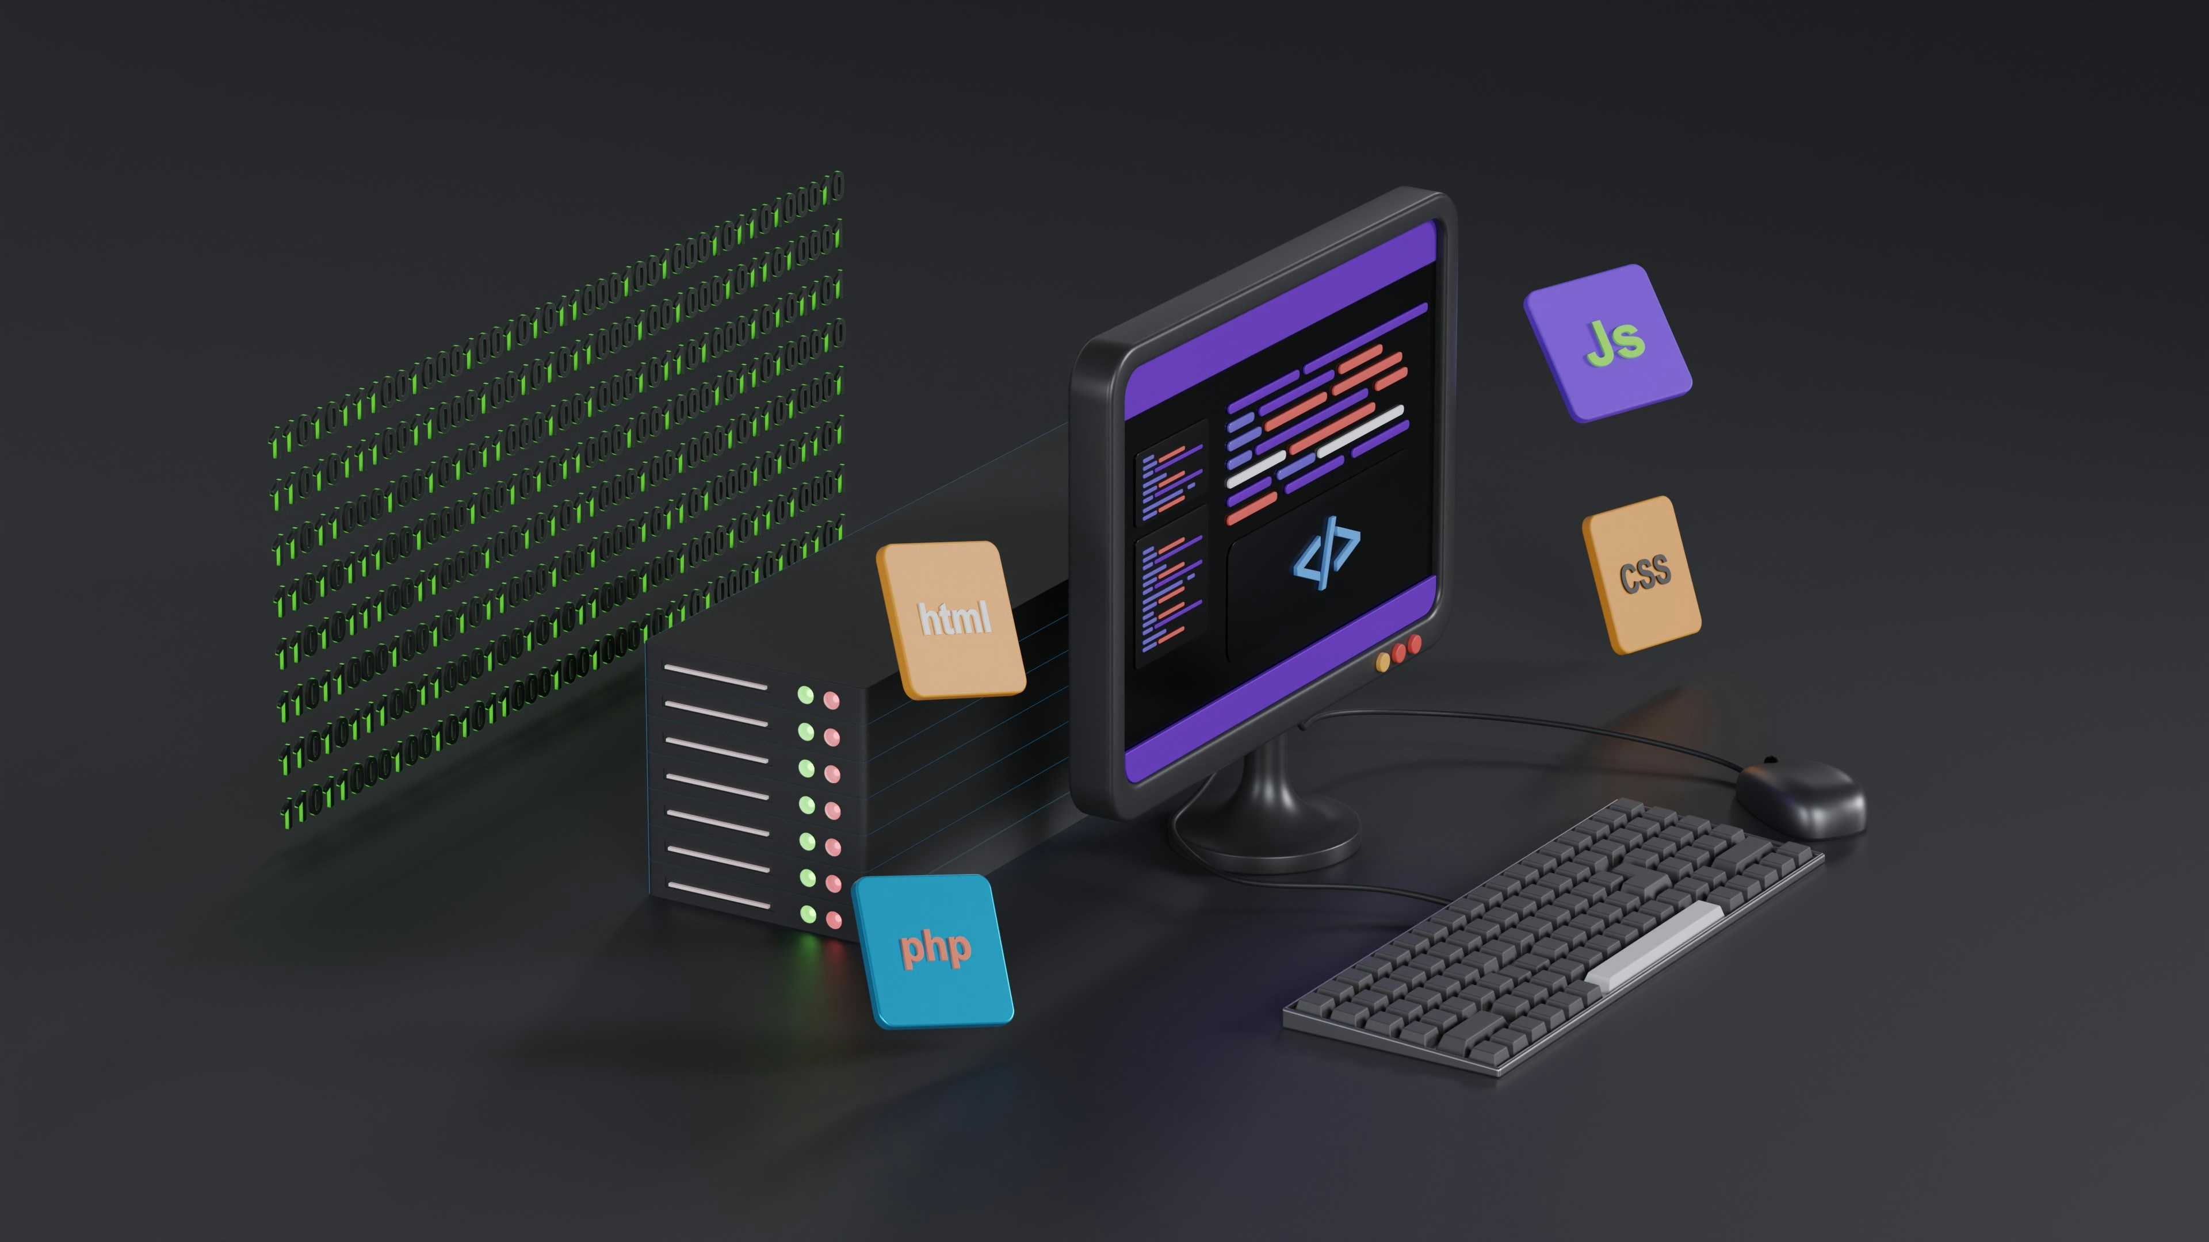
ENCODING & SPLITTING

Slide 18
ENCODING & SPLITTING
HOME
ABOUT
MORE
ENCODING
  We will perform encoding using get_dummies for all categorical features .
SPLITTING THE DATA
  Splitting the data into train variables , test variables to train the model .

Slide 19

MODEL

Slide 20
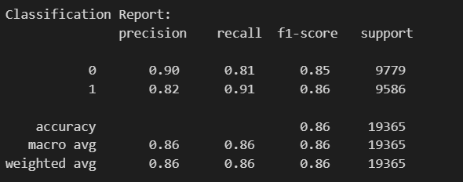
TRYING MULTIPLE MODELS
HOME
ABOUT
MORE
MODEL 1
  We tried LogisticRegression , and gives the least accuracy.
OUR EVALUATION

Slide 21
TRYING MULTIPLE MODELS
HOME
ABOUT
MORE
MODEL 2
  We tried DecisionTree , and gives an accuracy less than base model .
OUR EVALUATION

Slide 22
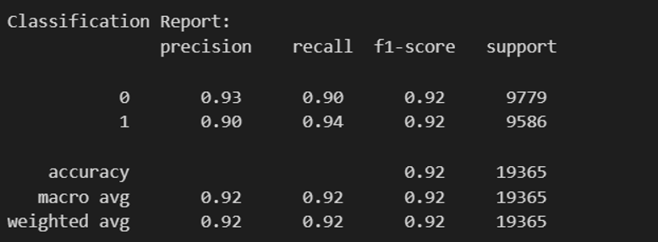
TRYING MULTIPLE MODELS
HOME
ABOUT
MORE
MODEL 3
  we tried RandomForest , and gives the same of base model .
OUR EVALUATION

Slide 23
MODEL TRAINING
HOME
ABOUT
MORE
BASE MODEL
  We will create a classification model , so we prefer to use VotingClassifier to try any num. of models on the data then get take the majority , we have used random forest , decision tree , logistic regression .
EX : -
  We used 3 models and the results of them are :
    LogisticRegression said attacked
    RandomForest said attacked
    DecisionTree said not attaked
  the majority is attacked , so that the model will predict attacked .

Slide 24
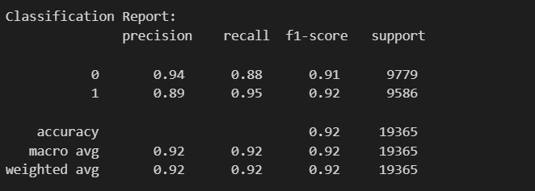
MODEL EVALUATION
HOME
ABOUT
MORE
METHOD
  In classification , we use a classification report and accuracy , f1-scrore , recall to evaluate the model in best way .
OUR EVALUATION

Slide 25

PUBLISHING THE MODEL

Slide 26
PUBLISHING THE MODEL
HOME
ABOUT
MORE
ACTUAL APP
GRADIO UI
FAST API
FLASK
STREAMLIT
OUR OPTION
  We chose FastAPI for its versatility across web and mobile platforms .

Slide 27

THANK YOU

