Slide 2
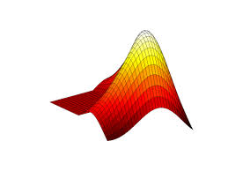
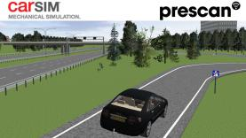
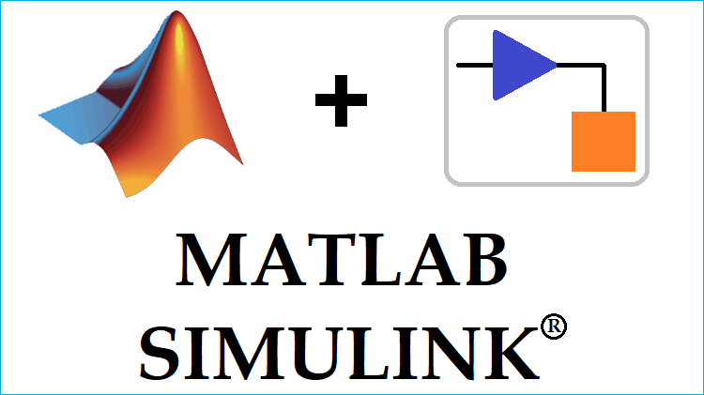



Matlab Engine
Static Data
Dynamic Data

Slide 3

4
Model
Environment
Env (gym)
Algorithm (RL)
1
2
3
5

Slide 4
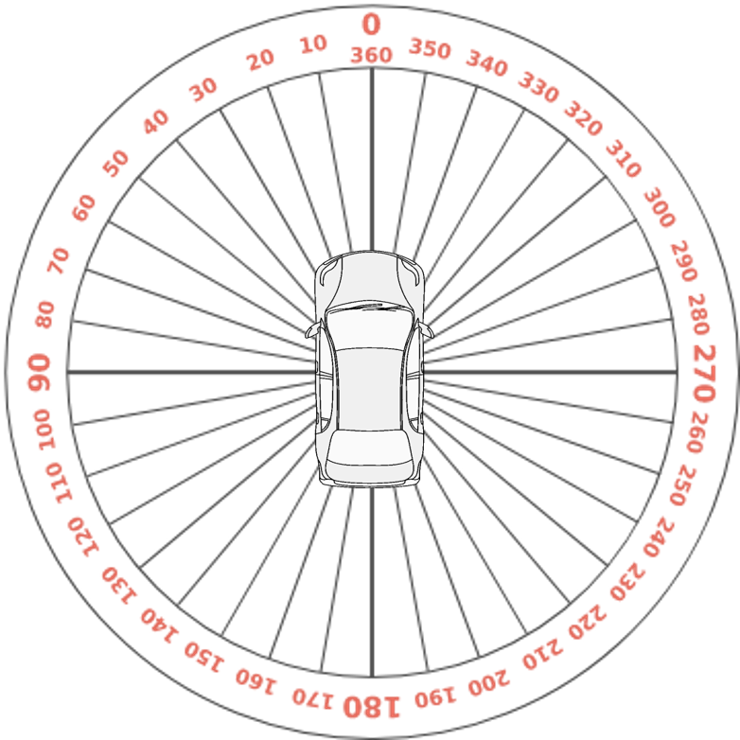

Slide 5
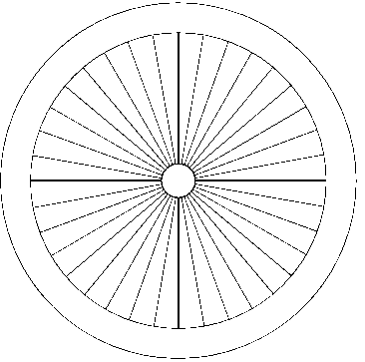
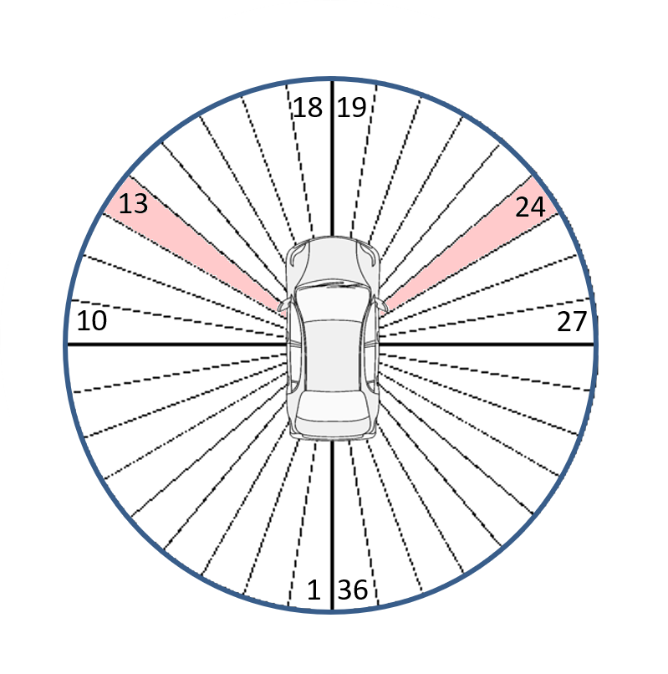
18
19
13
24
10
27
1
36

Slide 6
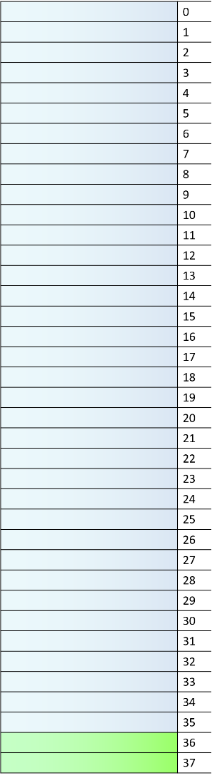
Range & theta
v
y

Slide 7


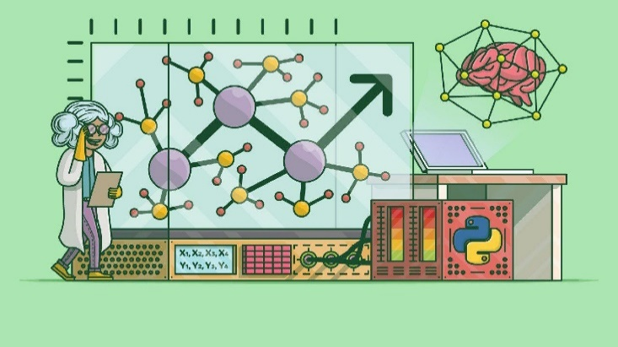
Environment
RL Algorithms

Slide 9
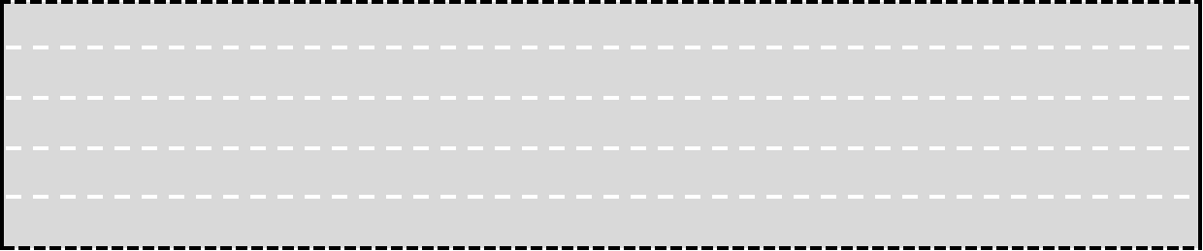

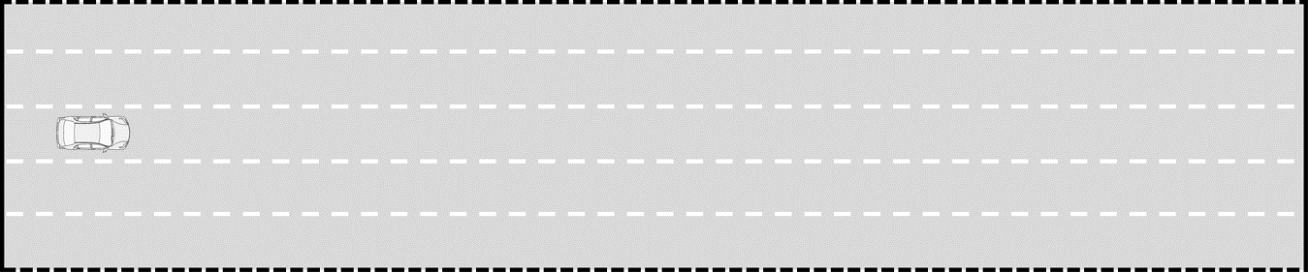
3.5m
750m

Slide 10
-w
22m
0
+w
4m
750m

