Slide 2
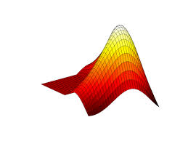
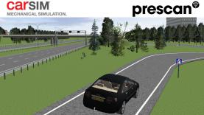
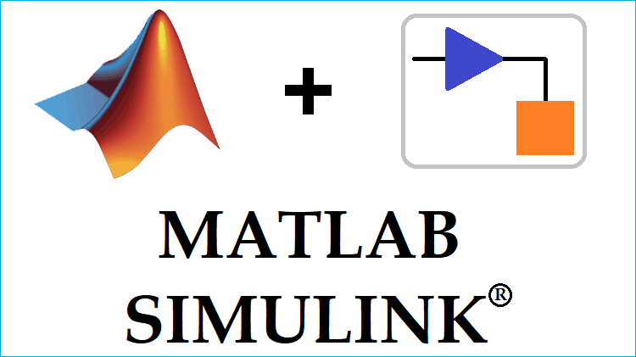



Matlab Engine
Static Data
Dynamic Data

Slide 3
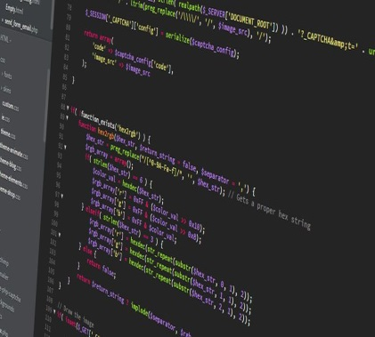
4
Model
Enviroment
Env (gym)
Algorithm
1
2
3
5

