Slide 1


Application of PSO in Electromagnetics
Mohammadreza Arani

Slide 2

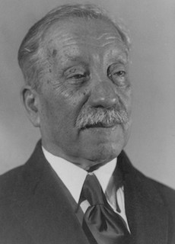
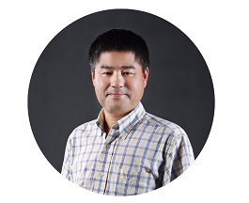
Agenda
What is PSO?
The Article
Results

Slide 3

What is PSO?
Particle Swarm Optimization was proposed by Kennedy and Eberhart in 1995. As mentioned in the original paper, sociobiologists believe a school of fish or a flock of birds that moves in a group “can profit from the experience of all other members”.
In other words, while a bird flying and searching randomly for food, for instance, all birds in the flock can share their discovery and help the entire flock get the best hunt.

Slide 4

PSO is best used to find the maximum or minimum of a function defined on a multidimensional vector space.

Slide 5

The Article
Reconstruction of Hidden Wire Objects Using Complex Time Green's Functions and Particle Swarm Optimization
2013

Slide 6
Team
Reza Faraji Dana
Masoud Roodaki-Lavasani-Fard

Slide 7
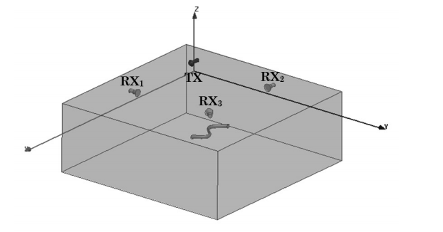
Problem Geometry

Slide 8
Timeline
Problem Formulation
Formulation of basic electromagnetic problem starting from Maxwell’s equations!
Method of Moments
Applying method of Moments in time domain to find currents on the wire object
Green’s Functions
Using Complex Time Green’s Functions in Method of Moments formulation
PSO
Results
Apply PSO to find best parameters of the wire object that minimizes L2 norm of Error!
Show efficiency and accuracy of the results!
Error is defined as difference between measured and calculated scattered field
Define the Inverse Scattering Problem

Slide 9
Inverse Scattering Problem
Definition
Applications
Inverse scattering Problem is defined as the problem of reconstructing the properties for a high scattering objects.
Nondestructive evaluation like medical imaging
Remote sensing
Seismic exploration
Target identification
Geophysics
Optics
Atmospheric sciences

Slide 10

An introduction to inverse scattering and inverse spectral problems (1987)
SIAM

Slide 11
Feed TX
Receive at RXs
Calculate Currents on the wire
Calculate the scattered field
Find the geometry using PSO

Slide 12

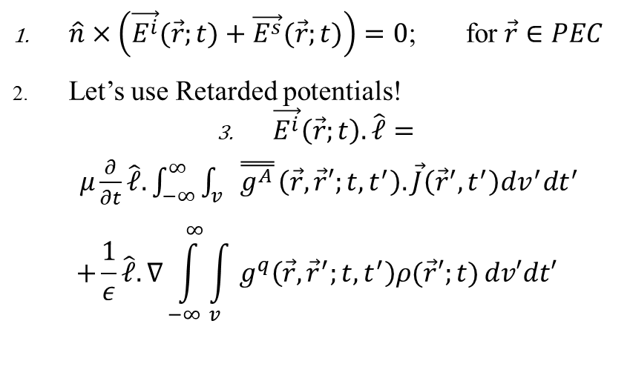
Problem Formulation
Basic Formulation
For a wire parallel to the Surface
$\hat{n}×\left(\vec{E^{i}}(\vec{r};t)+\vec{E^{s}}(\vec{r};t)\right)=0$; for $\vec{r}∈PEC$
Let’s use Retarded potentials!
$\vec{E^{i}}\left(\vec{r};t\right).\hat{𝓁}=μ\frac{∂}{∂t}\hat{𝓁}.\int_{−∞}^{∞}{\int_{v}{\overset{̿}{g^{A}}}\left(\vec{r},\vec{r}′;t,t^{′}\right).\vec{J}\left({\vec{r}}^{′},t^{′}\right)dv^{′}dt^{′}}$
$$+\frac{1}{ε}\hat{𝓁}.∇\int_{−∞}^{∞}{\int_{v}{g^{q}\left(\vec{r},{\vec{r}}^{′};t,t^{′}\right)ρ(\vec{r}′;t)}dv′dt′}$$
$\vec{E^{i}}\left(\vec{r};t\right).\hat{𝓁}=μ\frac{∂}{∂t}\int_{−∞}^{∞}{\int_{𝓁}{I\left(𝓁^{′},t^{′}\right)\left(\hat{l}.{\hat{l}}^{′}\right)g_{xx}^{A}}\left(\vec{r},\vec{r}′;t,t^{′}\right)d𝓁′dt^{′}}$
$$−\frac{1}{ε}\frac{∂}{∂𝓁} \int_{−∞}^{∞}{\int_{𝓁}{\int_{−∞}^{t′}{\frac{∂}{∂𝓁^{′}}I\left(𝓁^{′},τ\right)dτ g_{x}^{q}\left(\vec{r},{\vec{r}}^{′};t,t^{′}\right)d𝓁′dt′}}}$$

Slide 13
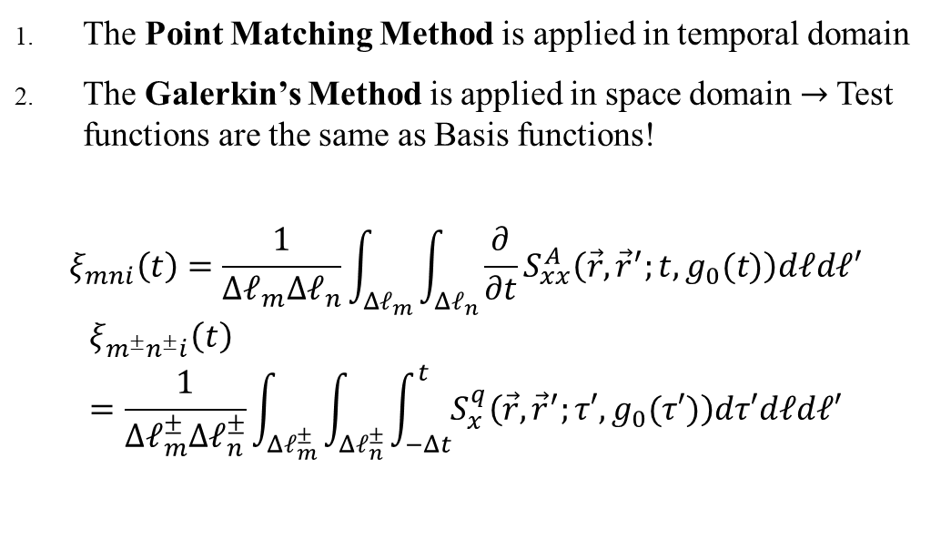
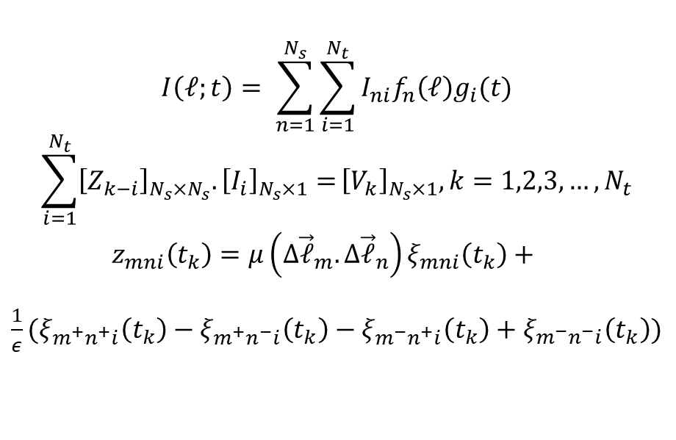
TD-MOM
Let’s apply TD-MOM!
Test Functions
$$I\left(𝓁;t\right)= \sum_{n=1}^{N_{s}}{\sum_{i=1}^{N_{t}}{I_{ni}f_{n}\left(𝓁\right)g_{i}(t)}}$$
$$\sum_{i=1}^{N_{t}}{{\left[Z_{k−i}\right]}_{N_{s}×N_{s}}.{\left[I_{i}\right]}_{N_{s}×1}=}{\left[V_{k}\right]}_{N_{s}×1}, k=1,2,3,…, N_{t}$$
$$z_{mni}\left(t_{k}\right)=μ\left({Δ\vec{𝓁}}_{m}.{Δ\vec{𝓁}}_{n}\right)ξ_{mni}\left(t_{k}\right)+$$
$\frac{1}{ε}(ξ_{m^{+}n^{+}i}\left(t_{k}\right)−ξ_{m^{+}n^{−}i}\left(t_{k}\right)−ξ_{m^{−}n^{+}i}\left(t_{k}\right)+ξ_{m^{−}n^{−}i}\left(t_{k}\right))$
The Point Matching Method is applied in temporal domain
The Galerkin’s Method is applied in space domain $→$Test functions are the same as Basis functions!
$$ξ_{mni}\left(t\right)=\frac{1}{{Δ𝓁}_{m}Δ𝓁_{n}}\int_{Δ𝓁_{m}}{\int_{Δ𝓁_{n}}{\frac{∂}{∂t}S_{xx}^{A}\left(\vec{r},{\vec{r}}^{′};t,g_{0}(t)\right)d𝓁d𝓁′}}$$
$$ξ_{m^{±}n^{±}i}\left(t\right)=\frac{1}{{Δ𝓁}_{m}^{±}Δ𝓁_{n}^{±}}\int_{Δ𝓁_{m}^{±}}{\int_{Δ𝓁_{n}^{±}}{\int_{−Δt}^{t}{S_{x}^{q}\left(\vec{r},{\vec{r}}^{′};τ′,g_{0}(τ′)\right)dτ′d𝓁d𝓁′}}}$$

Slide 14
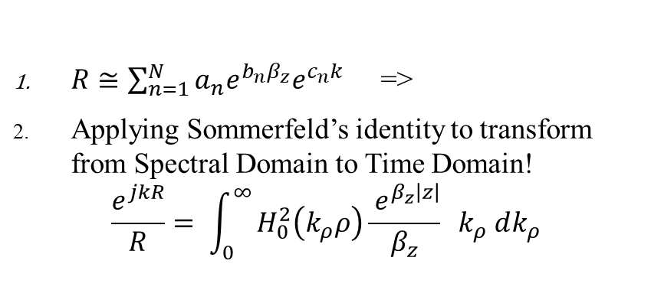
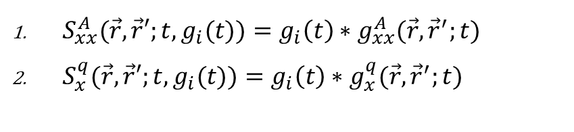
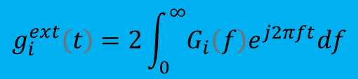
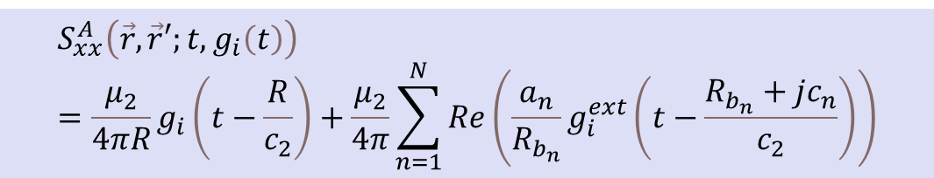
Green’s Functions
$$g_{i}^{ext}\left(t\right)=2\int_{0}^{∞}{G_{i}\left(f\right)e^{j2πft}df}$$
What was S ?
Similar to Complex Images
$S_{xx}^{A}(\vec{r},\vec{r}′;t,g_{i}(t))=g_{i}\left(t\right)∗g_{xx}^{A}(\vec{r},{\vec{r}}^{′};t)$
$S_{x}^{q}(\vec{r},\vec{r}′;t,g_{i}(t))=g_{i}\left(t\right)∗g_{x}^{q}(\vec{r},{\vec{r}}^{′};t)$
$R≅\sum_{n=1}^{N}{a_{n}e^{b_{n}β_{z}}e^{c_{n}k}}$ =>
Applying Sommerfeld’s identity to transform from Spectral Domain to Time Domain!
$$\frac{e^{jkR}}{R}= \int_{0}^{∞}{H_{0}^{2}\left(k_{ρ}ρ\right)\frac{{ e}^{β_{z}\left|z\right|}}{β_{z}} k_{ρ} dk_{ρ}}$$
$$S_{xx}^{A}\left(\vec{r},\vec{r}′;t,g_{i}\left(t\right)\right)=\frac{μ_{2}}{4πR}g_{i}\left(t−\frac{R}{c_{2}}\right)+\frac{μ_{2}}{4π}\sum_{n=1}^{N}{Re\left(\frac{a_{n}}{R_{b_{n}}}g_{i}^{ext}\left(t−\frac{R_{b_{n}}+jc_{n}}{c_{2}}\right)\right)}$$
$$S_{x}^{q}\left(\vec{r},\vec{r}′;t,g_{i}\left(t\right)\right)=\frac{1}{4πε_{2}R}g_{i}\left(t−\frac{R}{c_{2}}\right)+R_{x_{0}}^{q}\frac{1}{4πε_{2}R^{′}}g_{i}\left(t−\frac{R^{′}}{c_{2}}\right) +\frac{1}{4πε_{2}}\sum_{n=1}^{N}{Re\left(\frac{{a′}_{n}}{R_{{b′}_{n}}}g_{i}^{ext}\left(t−\frac{R_{{b′}_{n}}+j{c′}_{n}}{c_{2}}\right)\right)}$$

Slide 15
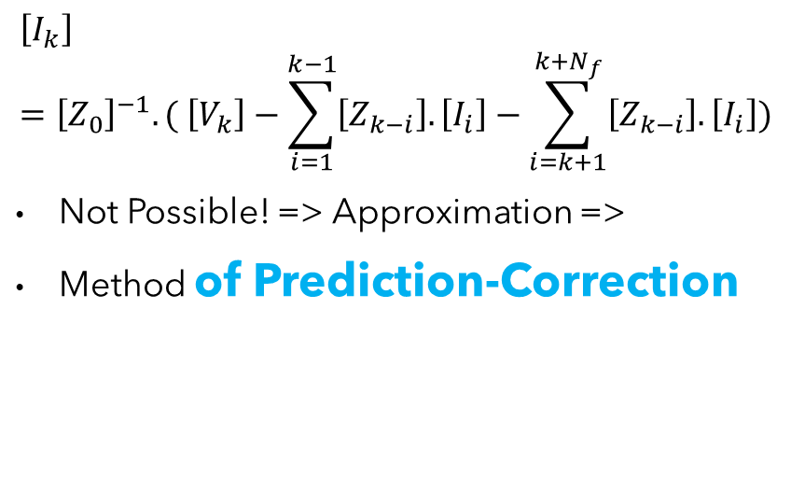
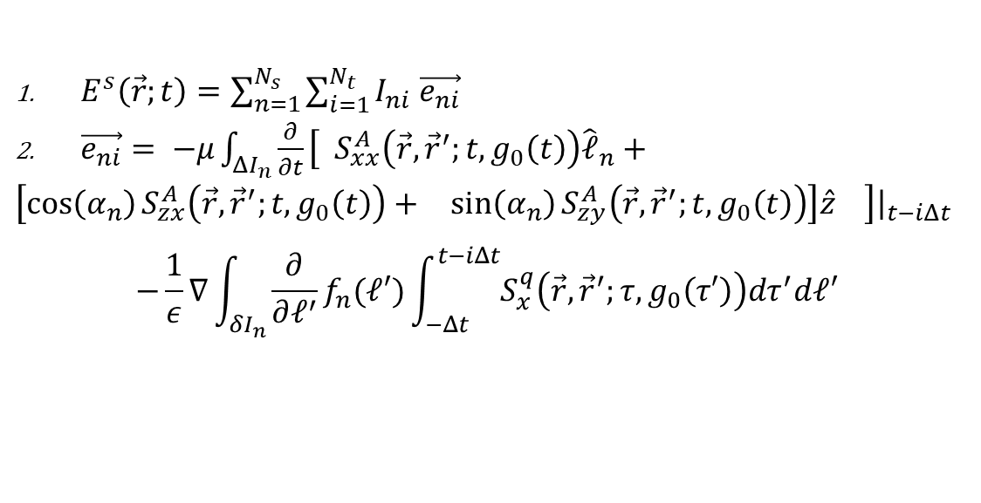
Scattered Field
Marching-on in Time
Similar to MPIE formulation
$$\left[I_{k}\right]={\left[Z_{0}\right]}^{−1}.( \left[V_{k}\right]−\sum_{i=1}^{k−1}{\left[Z_{k−i}\right].\left[I_{i}\right]}−\sum_{i=k+1}^{k+N_{f}}{\left[Z_{k−i}\right].\left[I_{i}\right]})$$
Not Possible! => Approximation =>
Method of Prediction-Correction
$E^{s}\left(\vec{r};t\right)=\sum_{n=1}^{N_{s}}{\sum_{i=1}^{N_{t}}{I_{ni} \vec{e_{ni}} }}$
$\vec{e_{ni}}= −μ\int_{ΔI_{n}}{\frac{∂}{∂t}\left[ S_{xx}^{A}\left(\vec{r},{\vec{r}}^{′};t,g_{0}\left(t\right)\right){\hat{𝓁}}_{n}+\left[\begin{matrix}\cos\left(α_{n}\right)S_{zx}^{A}\left(\vec{r},{\vec{r}}^{′};t,g_{0}\left(t\right)\right)+ & \sin\left(α_{n}\right)S_{zy}^{A}\left(\vec{r},{\vec{r}}^{′};t,g_{0}\left(t\right)\right)\end{matrix}\right]\hat{z} \right]{\left.​\right|}_{t−iΔt} }$
$$−\frac{1}{ε}∇\int_{δI_{n}}{\frac{∂}{∂𝓁^{′}}f_{n}(𝓁′)\int_{−Δt}^{t−iΔt}{S_{x}^{q}\left(\vec{r},{\vec{r}}^{′};τ,g_{0}\left(τ′\right)\right)dτ^{′}d𝓁′}}$$

Slide 16
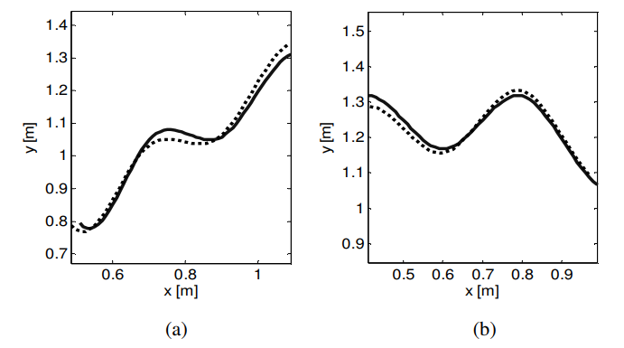
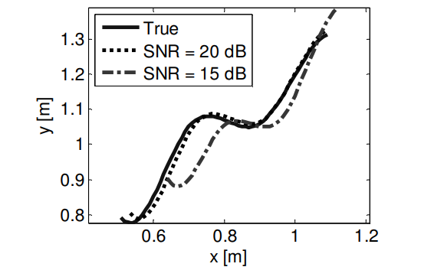
Optimize with PSO
Wire Object Model
Fitness Function
Cubic B-Spline
L2 Norm of Error

Slide 17
Table of PSO Parameters
Parameter | Value
Number of repeats | 35
Number of agents | 12
c1 | 1.49
c2 | 1.49

Slide 18



Summary
Problem Definition
Problem Formulation + Problem Geometry
Applying TD-MoM => Current Distribution
Scattered Field => Compare with Measured=> Error
Apply PSO to find best parameters of wire object to minimize L2 norm of Error!

Slide 19

Thank you
Mohammadreza Arani
mohammadrezaarani@ut.ac.ir

