Slide 1

BSS Paper- Presentation
Mohammadreza Arani

Slide 2

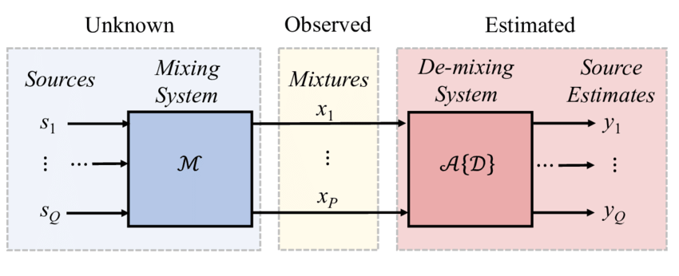
Off-Grid Direction of Arrival Estimation Using Sparse Bayesian Inference 2013
DoA Estimation
Bayesian Inference
On Grid vs Off Grid
OGSBI & OGSBI-SVD
Results

Slide 3
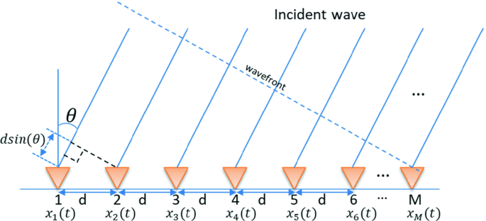
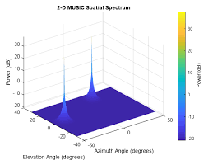
DoA Estimation

Slide 4






On Grid vs Off Grid
Choosing from discrete space of desired steering vectors
Proposed Off Grid Method

Slide 5
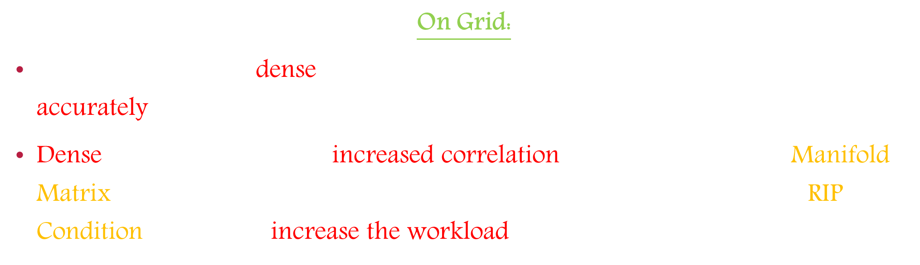
On Grid:
Sampling should be dense so that the desired steering vector is recovered accurately!
Dense sampling will imply increased correlation between columns of Manifold Matrix ($A(θ)$) which is in contrary with the first assumption of having RIP Condition!* → It also increase the workload!
Restricted Isometry Property (RIP) condition that requires all columns of the measurement matrix be highly incoherent.

Slide 6

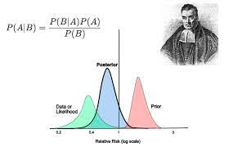
Bayesian Inference
Z. Yang, L. Xie, and C. Zhang, “Bayesian compressed sensing with new sparsity-inducing prior,” [Online]. Available: http://arxiv.org/pdf/1208.6464
2012 <Bayesian Learning>
Introduction

Slide 7
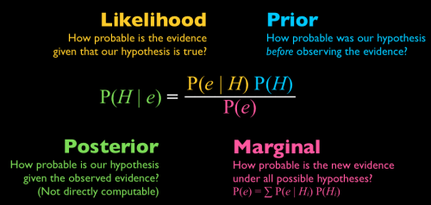
S. Ji, Y. Xue, and L. Carin, “Bayesian compressive sensing,” IEEE Trans. Signal Process., vol. 56, no. 6, pp. 2346–2356, 2008. <Bayesian Learning>

Slide 8
Proposed Method
Bayesian Framework
The sparsity information is exploited by assuming a sparse prior for the signal of interest.
One merit of SBI is its flexibility in modeling sparse signals that can not only promote the sparsity of its solution, but also exploit the possible structure of the signal to be recovered!
Since the Bayesian inference is a probabilistic method and based on heuristics to some extent, one shortcoming of SBI is that it offers fewer guarantees on the signal recovery accuracy as compared with, for example, optimization.
M. Tipping, “Sparse Bayesian learning and the relevance vector machine,” J. Mach. Learn. Res., vol. 1, pp. 211–244, 2001. <Bayesian Learning>
S. Babacan, R. Molina, and A. Katsaggelos, “Bayesian compressive sensing using Laplace priors,” IEEE Trans. Image Process., vol. 19, no. 1, pp. 53–63, 2010. <Bayesian Learning>

Slide 9
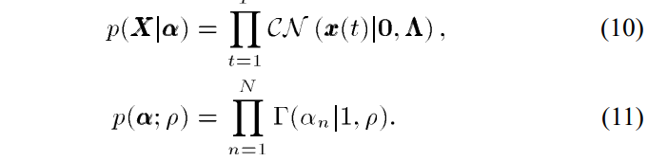

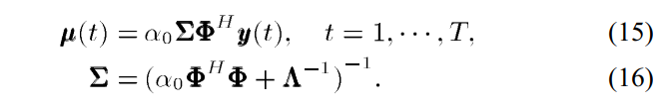
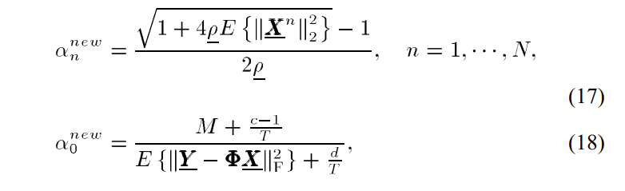
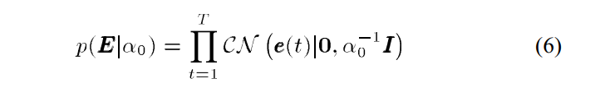

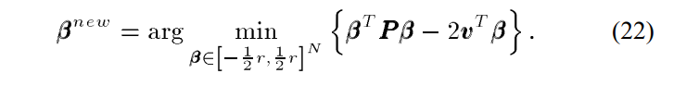

Proposed Method
Iterative Algorithm
Prior Knowledge
Evidence
Posterior Knowledge

Slide 10
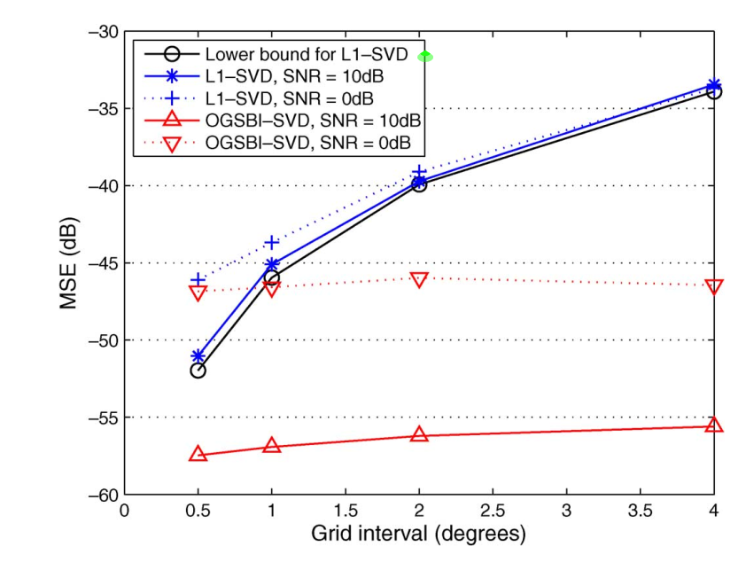






Results
D. Malioutov, M. Cetin, and A. Willsky, “A sparse signal reconstruction perspective for source localization with sensor arrays,” IEEE Trans. Signal Process., vol. 53, no. 8, pp. 3010–3022, 2005. $l_{1}−SVD<Compared wit>$
SVD?
Reduces Signal Space to that of K most important rows so that convergence happens faster!

Slide 11



Summary
A new method for DoA estimation was presented based on Bayesian Inference. This method proves to outperform other available methods in terms of MSE value.
Lihua Xie
Zai Yang

Slide 12

Thank you
Mohammadreza Arani
mohammadrezaarani@ut.ac.ir

