Slide 1

DriverPass
System Design Overview
Mohammad Sadi
Notes:
Today I will summarize how the proposed DriverPass system supports lesson scheduling, online learning, security, and day-to-day business operations.

Slide 2

FUNCTIONAL REQUIREMENTS
• Customers can create accounts, sign in, choose a training package, and book, change, or cancel a two-hour driving lesson.
• Customers can access online learning materials and practice tests when included in their package.
• Staff can maintain customer records and appointments; drivers can view assigned lessons.
• The owner can review and export reports; the IT officer can manage accounts and access.
NONFUNCTIONAL REQUIREMENTS
• The system should work through a current web browser on desktop and mobile devices.
• It should protect information, limit access by role, and keep backups and activity history.
• It should check driver, vehicle, and time-slot availability before confirming a lesson.
System
Requirements
Notes:
Functional requirements describe what the system must do. Customers need to manage their accounts, choose the correct package, reserve a two-hour lesson, and use the online learning features included with that package. Staff need tools for appointments and records, while the owner needs reports and the IT officer needs account controls. Nonfunctional requirements describe how well the system should operate: it should be accessible through a browser, protect private information, keep records recoverable, and prevent double-booking by checking driver, vehicle, and time-slot availability. These choices support DriverPass’s goal of coordinating lessons and learning resources in one place.

Slide 3
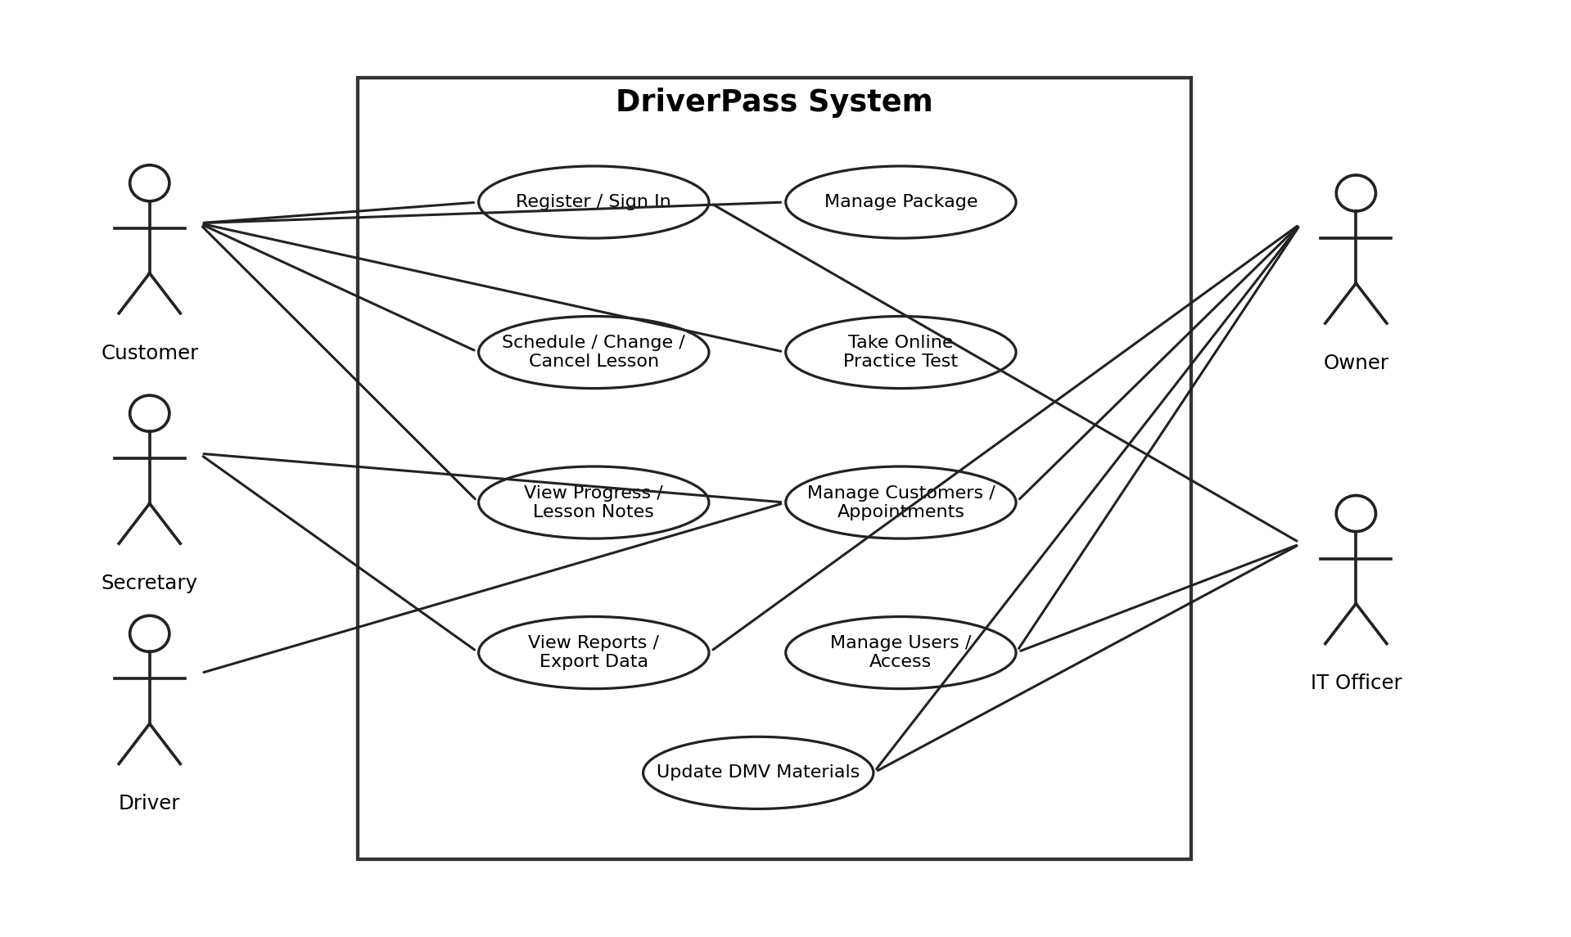
Use Case Diagram
Notes:
This diagram shows the main people who use DriverPass and the tasks each person needs to complete. Customers can register, choose a package, schedule lessons, and take practice tests when those features are included. The secretary manages customer information and appointments, while drivers view their assigned lessons. The owner reviews reports and business activity. The IT officer manages accounts and access. The design gives each person the tools needed for their responsibilities without giving everyone the same permissions.

Slide 4
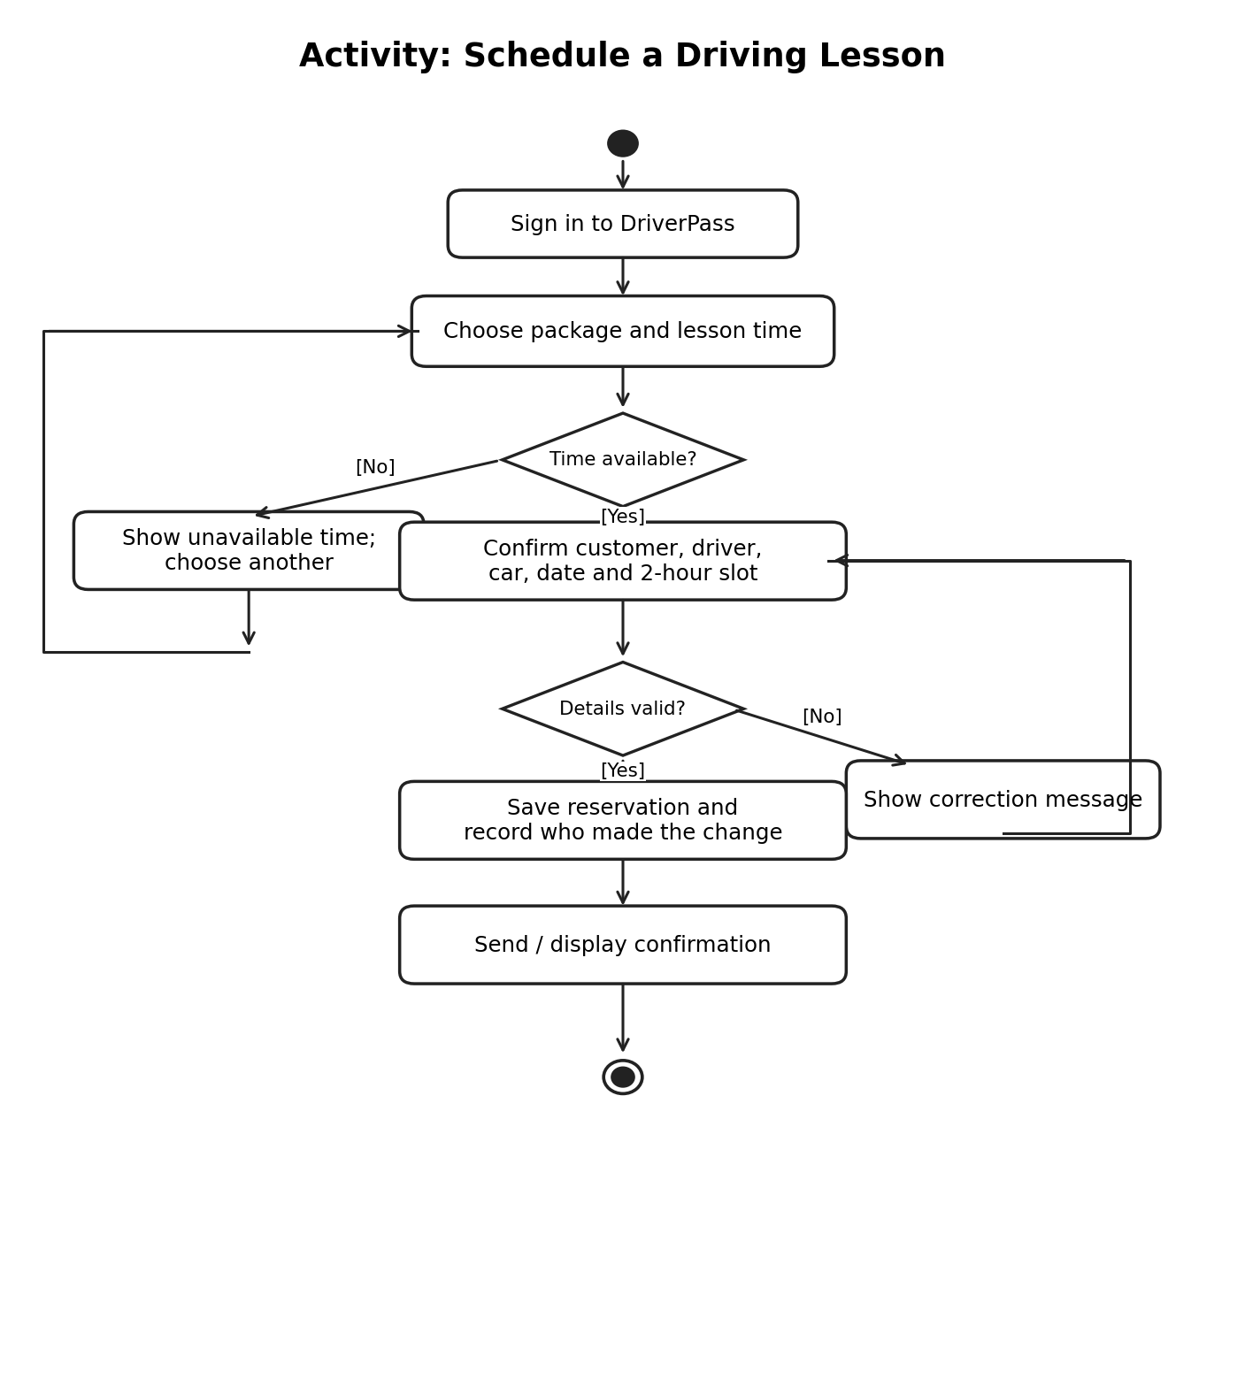
Activity Diagram
Notes:
This diagram walks through booking a driving lesson. A customer signs in, selects a package, and chooses a preferred time. DriverPass checks whether a driver, vehicle, and two-hour time slot are all available. If any part is unavailable, the customer selects another time. If everything is available, the system saves the reservation and shows confirmation. Recording reservation changes also helps staff answer questions and understand what happened if a booking needs to be changed.

Slide 5
Security
• Every customer and staff member uses an individual account.
• Access is limited according to the person’s role and responsibilities.
• The IT officer can reset accounts and disable access when needed.
• Important booking changes and cancellations record who made the change and when.
• Secure connections and managed backups help protect records and support recovery.
• Reports and account-management tools are available only to authorized users.
Notes:
Security is designed to protect customer information and keep business tasks separated. Each person signs in with an individual account, and access is limited to the functions needed for that role. For example, a customer can manage their own reservations but cannot administer employee accounts. The IT officer can reset accounts or disable access when necessary. The system also keeps a record of important reservation changes, including who made them and when. Secure connections and managed backups help protect information and support recovery if records are lost or damaged.

Slide 6
• An internet connection is needed to create or update reservations and records; offline changes are not supported.
• The first release covers the three agreed training packages. New package types or major features may require developer support.
• Staff must review and maintain official DMV learning materials; the system does not automatically certify that content is current.
• Scheduling accuracy depends on staff keeping driver and vehicle availability up to date.
• Exported reports are separate copies; edits made to a downloaded file do not update DriverPass records.
System
Limitations
Notes:
The design has practical limits. An internet connection is needed to create or update bookings and records. The first release supports the three agreed packages, so new package types or major features may need technical work. DriverPass can organize learning materials, but staff still need to review official DMV information and keep it current; the system does not automatically guarantee that every item reflects the latest rules. Accurate scheduling also depends on current driver and vehicle availability. Finally, exported reports are separate copies, so edits made outside DriverPass do not change the original system records.

