Slide 1
Event-Driven Analytics: Industry Fluctuations Analysis

Slide 2
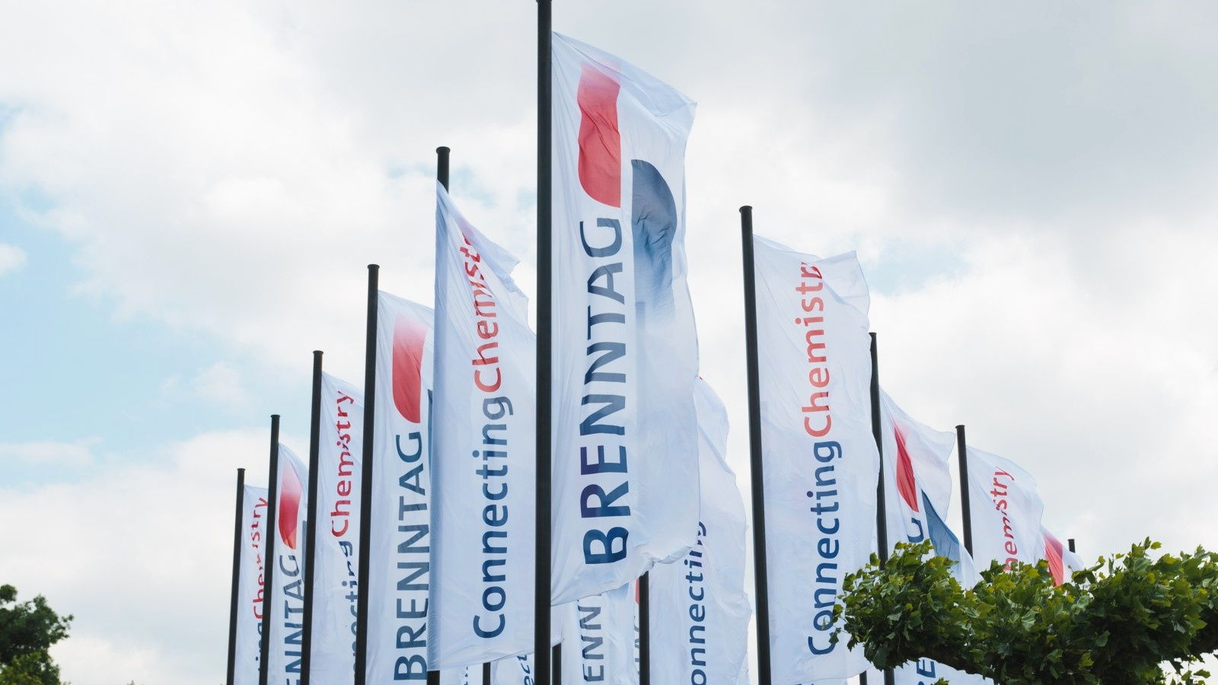
1
2
3
4
5
Understanding of current state
AGENDA
Approach
Solution & Architecture
Advantages & Outcomes
Q&A
| 2 | Jan 2023 | Process Automation & Optimization

Slide 3


UNDERSTANDING OF CURRENT STATE
OBJECTIVES
In today's dynamic business landscape, understanding rapid changes in industries is crucial. Our goal is to identify the top 3 industries experiencing significant fluctuations in the last 24 hours compared to their past 30 days' averages.
Implement a comprehensive data processing pipeline using Azure services, Docker, PySpark, and Databricks, ensuring real-time and batch data integration for accurate trend analysis.
EXPECTED SOLUTION OUTCOMES
Background & Challenges
BUSINESS OUTCOMES
SOLUTION OUTCOMES
Rapidly changing market trends necessitate real-time monitoring of industry fluctuations.
Existing data silos hinder comprehensive insights into industry fluctuations.
Manual data processing leads to delays in identifying critical industry changes.
Traditional batch processing falls short in capturing dynamic real-time fluctuations.
Processing and analyzing vast streams of data in a timely manner to identify trends.
Integrating and harmonizing data for a unified analysis.
Developing an automated solution that enables near-instantaneous data transformation and analysis.
Implementing a hybrid approach that seamlessly combines batch and streaming data processing.
Outcome: A robust data engineering solution that leverages Azure services, Docker, and PySpark for real-time and batch data processing.
Benefits: Provides a streamlined data pipeline, automated data cleansing, accurate trend analysis, and seamless integration for actionable insights.

Slide 4




APPROACH
Data Collection and Ingestion:
Data Transformation and Cleansing:
Stream Processing and Enrichment:
Trend Analysis and Reporting:
Set up Azure Event Hub to receive real-time event data.
Implement a Dockerized Python script to generate and send event data to the Event Hub.
Configure Event Hub's throughput to handle incoming data.
Create a Databricks notebook to transform raw event data into structured Parquet format.
Apply data cleansing operations to handle null values, duplicates, and outliers.
Load cleansed data into the Hive table "cleansed.customers".
Develop a Databricks notebook to stream data from the Event Hub into a PySpark DataFrame.
Perform necessary transformations to extract relevant fields and enrich the data.
Write the enriched data into the "curated.live_orders" Hive table.
Create a Databricks notebook to join "cleansed.customers" and "curated.live_orders" based on customer ID.
Calculate the 30-day rolling average price for each industry.
Calculate the change in prices for the last 24 hours and identify the top 3 industries with the most significant changes.

Slide 5






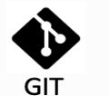

SOLUTION ARCHITECTURE
Data Enrichment
& Store
Batch Data Source
Data Lake
Customer
RAW
CLEANSED
CURATED
Data
Processing
Output
Data Ingestion
& Orchestration
Databricks
Stream Data Source
Orders
Event Hub
Stream Analytics
Support Modules
Highlights :
Batch Data Processed
Real time data processing.

Slide 6






ADVANTAGES & OUTCOMES
Scalability
ELT
Horizontal Scaling: The architecture leverages Azure Event Hub, enabling the addition of more partitions to handle higher throughput as the data load increases.
Parallel Processing: Databricks' distributed computing model allows processing of multiple data streams simultaneously, ensuring efficient utilization of resources.
Load Balancing: Azure services provide automatic load balancing mechanisms to distribute incoming data streams across multiple instances, ensuring even distribution of workloads.
It everages distributed processing for handling large data volumes, ensuring scalability and fast data processing.
Flexibility: IT allows complex transformations directly within the data platform, enabling advanced analytics and reducing data movement.
Real-time & Batch: ELT supports both streaming and batch processing, providing insights from real-time and historical data.
Data Quality: ELT includes data cleansing and transformation, improving data quality for better decision-making.
Streaming Pipelines
Enhanced Data Quality
Automated Workflow: The ETL pipeline incorporates automated workflows using Databricks notebooks, minimizing manual intervention. This boosts productivity by reducing human error.
Structured Notebooks: Databricks notebooks are well-structured and documented, adhering to coding standards and best practices. This enhances code readability, maintainability, and collaboration among team members, leading to improved productivity.
Accurate Insights: Rigorous data validation ensures reliable and accurate insights.
Real-time Decision-Making: Streaming data enables swift responses to changing scenarios.
Resource Efficiency: Cloud utilization optimizes resources for cost-effective processing.
Enhanced Security: Centralized processing boosts data security and compliance measures.
Notes:
-This slide will go to the back-up; but the content will be distributed in the next slides

