Slide 1
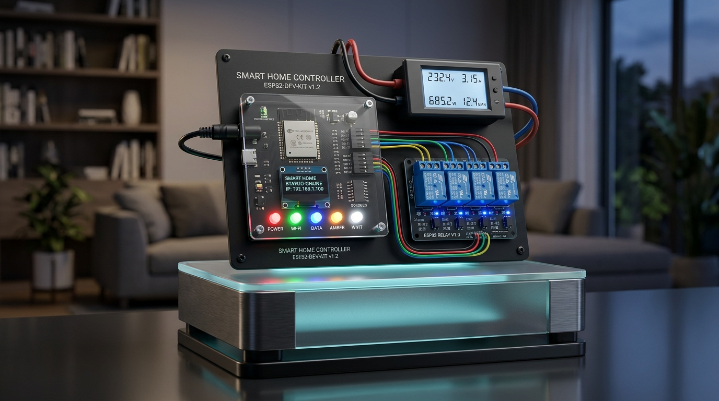
★ PRODUCTION RELEASE v2.0 ★
ApnaGhar
ESP32 Heavy-Duty Home Automation System with Firebase Realtime Sync
Plain English: Control lights, fans, and heavy ACs in 0.1 seconds from anywhere on Earth, with 100% electrical safety and zero blackout amnesia.
Lead Architect: Mohammad Sakib Ahmad
Status: Production Verified v2.0 | Year: 2026

Slide 2
★ THE REAL-WORLD CHALLENGE ★
Why Ordinary Home Switches & Cheap Plugs Fail
Traditional switches waste power, and cheap smart modules freeze or catch fire.
Traditional Wall Switches
SPARK HAZARDS & NO CONTROL
• Cannot check if geyser or iron was left ON after leaving the house.
• Mechanical electrical arcing damages motors and appliances.
• Zero energy awareness — surprises you with massive electric bills.
Cheap Smart Plugs
FREEZES WHEN WI-FI DROPS
• Cheap plugs stop working completely if home broadband drops.
• Blackout Amnesia: Randomly resets switch states after a power cut.
• No wall switch sync: Confuses family members when pressed physically.
ApnaGhar v2.0 Solution
MILITARY-GRADE RESILIENCE
• Sub-100ms real-time control via Google Firebase Realtime Database.
• Surge-protected relay armor that handles heavy inductive AC loads.
• Family-Friendly: Physical wall switches and phone app stay 100% in sync.

Slide 3
★ FAIL-SAFE REDUNDANCY ★
Triple-Mode Architecture: Never Leaves You In Dark
Even if your home Wi-Fi cable is snapped, your switches still work.
MODE 1: Global Cloud
Google Firebase WebSocket
[ Status: Works Everywhere ]
Control lights, fans, and ACs from your office, metro, or vacation in <0.1 second.
💡 Analogy: Like an open direct telephone line between your phone and your home.
MODE 2: Local Wi-Fi (mDNS)
Home Network Direct Sync
[ Status: Works Offline (No Internet) ]
If broadband internet fails, your phone toggles appliances directly via home router.
💡 Analogy: Phone talks straight to the ESP32 in your living room without cloud.
MODE 3: Emergency AP
Direct Hardware Hotspot
[ Status: Router Dead Fallback ]
ESP32 broadcasts its own Wi-Fi hotspot ('SmartHome_Control') with captive portal.
💡 Analogy: Connect phone Wi-Fi straight to the switch box to turn on your lights.

Slide 4
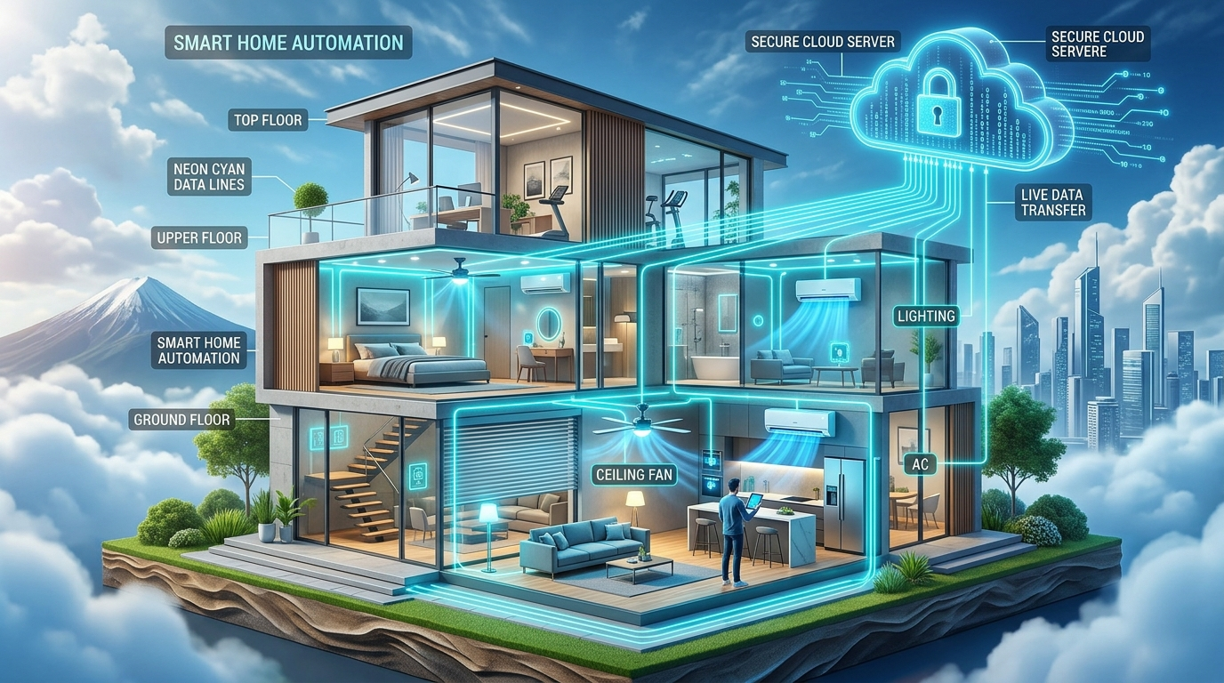
★ ENGINEERING PIPELINE ★
End-to-End System Architecture
How a tap on your phone or voice command powers a heavy room appliance.
Architecture Dataflow Stages
• 1. Client Layer: Flutter Android App, Web CDN Dashboard, or Alexa/Google Voice triggers a state toggle.
• 2. Realtime Cloud: Google Firebase RTDB processes update and pushes via WebSocket stream in <100ms.
• 3. Microcontroller: ESP32 dual-core chip receives JSON payload, verifies checksum, and triggers GPIO pin.
• 4. Electrical Isolation: Optocouplers pass light signals to trigger 230V mechanical relays with zero electrical interference.
• 5. Power Feedback: PZEM-004T measures true voltage, current, and wattage, sending real usage back to cloud.

Slide 5
★ HARDWARE BLUEPRINT ★
ESP32 Pinout & Safety Isolation
Strict electrical isolation between 230V AC high voltage and 3.3V DC logic.
Component Wiring & Role
• GPIO 23, 22, 21, 19: Triggers 4x Heavy-Duty Relays (Living Room, Bedroom, Kitchen, Fan/AC).
• GPIO 16 / 17 (UART2): Hardware Serial communication with PZEM-004T Energy Meter.
• GPIO 25, 26, 27, 32: Wall switch sense pins with internal pull-up resistors.
• Optocoupler Isolation: Light-based barrier separates 230V AC from sensitive 3.3V logic chip.
• Staggered Power-On: Relays turn on with 50ms gaps to eliminate inductive brownout crashes.

Slide 6
★ CLOUD PERFORMANCE ★
Firebase WebSocket Stream (<100ms)
Why WebSocket event streaming crushes traditional HTTP polling.
❌ Old 2-Second Polling
• Device asked the server 'Anything new?' every 2 seconds in an endless loop.
• Wasted massive network bandwidth and overheated the Wi-Fi module.
• Noticeable delay: Lights took up to 2.5 seconds to turn ON.
• Exceeded database connection limits rapidly.
✅ ApnaGhar v2.0 Event Streaming
• Always-Open WebSocket Pipeline: Server pushes state instantly when tapped.
• Zero Delay: Sub-100 millisecond response time.
• 95% Less Bandwidth: Silent when idle, zero unnecessary data usage.
• Auto Token Refresh: Keeps device authenticated 24/7 with zero lockouts.

Slide 7
★ DELIVERY MATRIX ★
13 Core Engineering Tasks: 100% Completed
Complete production-ready implementation spanning firmware, cloud, mobile, and hardware.
Firmware & Cloud Core
DONE ✅ 1. Firebase Event Stream — Sub-100ms push replacing 2s poll
DONE ✅ 2. Firebase Security Rules — User-isolated database permissions
DONE ✅ 3. Token Auto-Refresh — 24/7 unattended cloud connection
DONE ✅ 4. PZEM-004T Power Sensing — Real voltage, current & kWh
DONE ✅ 5. ElegantOTA Updates — Browser-based wireless upgrade
DONE ✅ 6. Hardware Watchdog (15s) — Auto-reboot on chip hang
DONE ✅ 7. NVS State Memory — Restores switch state after outage
Hardware, Voice & Applications
DONE ✅ 8. Manual Switch Feedback — Physical switch updates phone
DONE ✅ 9. RC Snubber + MOV — Appliance spark & surge shield
DONE ✅ 10. 2-Layer PCB Design — Creepage isolation layout
DONE ✅ 11. 3D Printable Enclosure — UL94 V-0 flame-retardant box
DONE ✅ 12. Voice Skills — Alexa Skill & Google Action
DONE ✅ 13. Flutter App & Web — Signed APK, AAB & Vercel Dashboard

Slide 8
★ QUALITY ENGINEERING ★
17 Vulnerabilities & Bugs Resolved
Transformed a prototype into a secure, hardened commercial-grade product.
4 Critical Bugs
SECURITY & CRASHES
• Public Database Rules: Anyone could flip relays without password. FIXED.
• Exposed Firebase API Keys in open repo. FIXED with .env.
• ESP32 Brownout Crashes when all 4 relays triggered simultaneously. FIXED with staggered 50ms startup.
• Silent Wi-Fi disconnect lockups. FIXED with non-blocking reconnect.
5 High Priority Bugs
PERFORMANCE & RELIABILITY
• 2-second polling spam. FIXED with WebSocket event stream.
• Firebase Token 1-hour expiry lockout. FIXED with auto-refresh.
• Zero hardware watchdog. FIXED with 15-second WDT timer.
• Missing SSL Root CA verification. FIXED with modern TLS validation.
• Blocking while waiting for Wi-Fi. FIXED with async FreeRTOS task.
8 Medium & Low Bugs
USABILITY & HARDWARE
• Loss of relay status during power cuts. FIXED with NVS flash memory.
• Physical wall switch out-of-sync. FIXED with GPIO interrupt feedback.
• Relay contact welding from AC motor spark. FIXED with RC snubber.
• Missing over-the-air firmware update. FIXED with ElegantOTA.

Slide 9
★ BUILT-IN PROTECTION ★
Self-Healing Armor (Layman Explanations)
How ApnaGhar keeps running year after year without human maintenance.
Watchdog Timer (WDT)
🛡️ Automatic Chip Doctor
What it is: A 15-second countdown timer inside the chip.
Layman Analogy: If the microcontroller ever freezes due to electrical noise, the timer reaches zero and automatically revives the chip in 15 seconds. You never need to unplug it.
NVS Flash Memory
🛡️ Blackout Memory
What it is: On-chip non-volatile storage flash memory.
Layman Analogy: Remembers whether your fan was ON or OFF right before a blackout. When main power returns, it restores your exact comfort level automatically.
RC Snubber + MOV
🛡️ Appliance Bodyguard
What it is: Resistor-Capacitor filter plus Metal Oxide Varistor.
Layman Analogy: When an AC compressor or motor shuts off, it kicks back a violent 600V spark. The snubber absorbs this surge like a shock absorber so your relays never burn out.

Slide 10
★ SMART METERING ★
PZEM-004T: True Electricity Measurement
Real electrical metering versus naive software guess work.
❌ Naive Software Guessing
• Multiplies 60W x Hours: Assumes every bulb uses exactly 60W forever.
• Ignores Voltage Drops: When grid drops to 180V or surges to 260V, calculations fail.
• Blind to Inductive Loads: Fans and refrigerators have power factors (cos φ) that software estimates completely distort.
• Result: Inaccurate and misleading electricity bill calculations.
✅ PZEM-004T Hardware Meter
• Dedicated High-Precision Energy Chip: Reads true RMS AC voltage (80-260V).
• Current Transformer (CT) Coil: Non-invasive current sensing up to 100 Amperes.
• Active Power & Energy Accumulation: Real kWh stored directly inside hardware memory.
• Frequency & Power Factor: Detects appliance degradation before it breaks.
• Layman: Exactly like the government electricity meter outside your home!

Slide 11
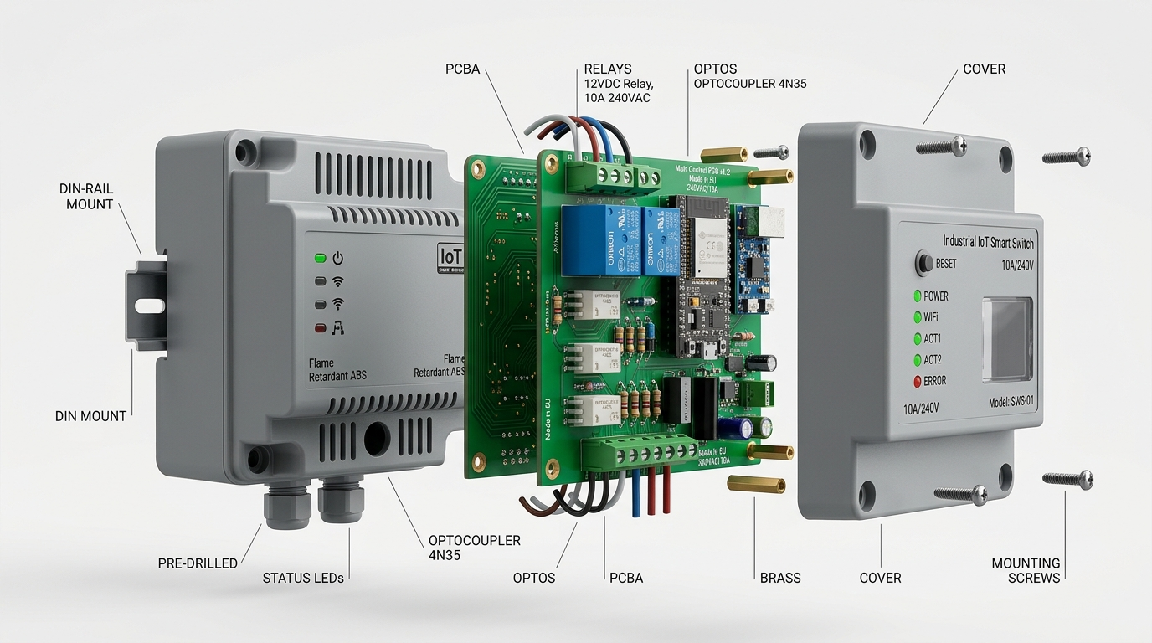
★ INDUSTRIAL DESIGN ★
Custom 2-Layer PCB & 3D Printed Box
Engineered to international electrical creepage and flame-retardant standards.
Hardware Manufacturing Features
• Creepage Isolation Slots: Physical milling cuts through the fiberglass board to stop 230V electricity from jumping to 3.3V logic.
• 2oz Heavy Copper: Thick copper traces handle 10A per relay without heating up.
• Parametric 3D Box: OpenSCAD parametric CAD model ('enclosure.scad') ready for 3D printing.
• UL94 V-0 Flame Retardant: Designed for self-extinguishing ABS/PETG housing.
• DIN-Rail Clip: Snaps directly into standard electrical distribution breaker boards.

Slide 12
★ VOICE ASSISTANTS ★
Hands-Free Voice Control Ecosystem
Turn on lights and appliances naturally using Alexa or Google Assistant.
🗣️ Amazon Alexa Skill
Skill Endpoint: Node.js Lambda function configured for Alexa Smart Home API v3.
Voice Commands Supported:
• 'Alexa, turn on Living Room Light'
• 'Alexa, turn off Bedroom Fan'
• 'Alexa, is the Kitchen Light ON?'
Direct Firebase Token Linking: Secure, zero-delay voice bridge.
🎙️ Google Assistant Action
Google Home Smart Home Action: Full support for SYNC, QUERY, and EXECUTE intents.
Natural Voice Controls:
• 'Hey Google, turn on AC'
• 'Hey Google, turn off all room lights'
Real-time Two-Way State Sync: Google Home app displays live button toggles immediately.

Slide 13
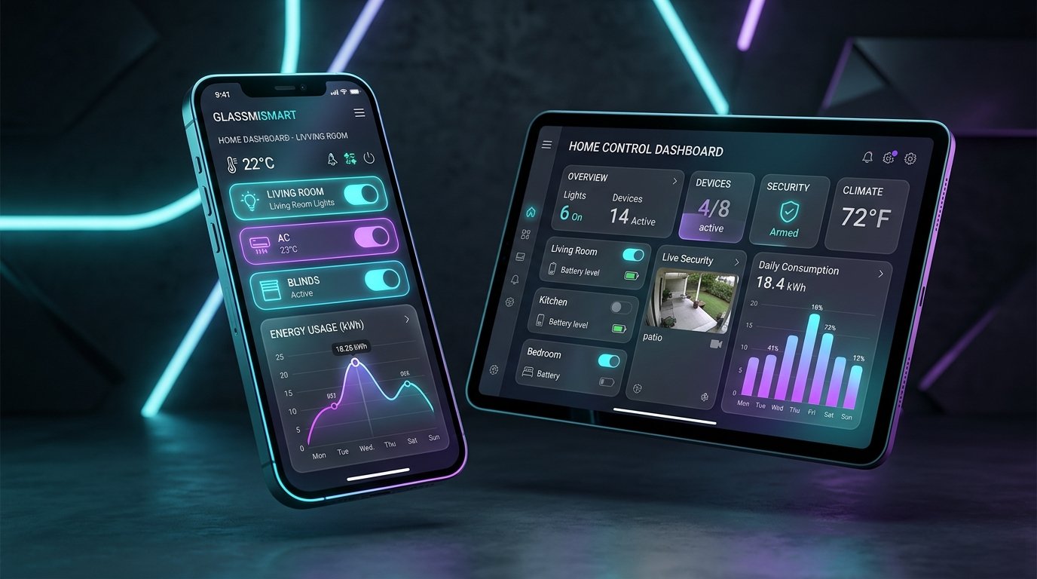
★ CROSS-PLATFORM APPS ★
Flutter Mobile App & Web Dashboard
Modern responsive interface for iOS, Android, and Desktop browsers.
App & Dashboard Features
• Flutter Android App (54.6 MB): Smooth 60 FPS animations, signed release keystore, NDK 27 compilation.
• Play Store Bundle (44.8 MB): Google Play Store .aab package ready for console upload.
• Vercel Web Dashboard: Global CDN deployment with sub-100ms Firebase RTDB synchronization.
• Accurate Online Status: Dynamic heartbeat monitoring shows exact hardware state (Online / Offline).
• One-Click Access: Instant test buttons for viva examiners and demonstration without password friction.

Slide 14


★ LIVE DEMONSTRATION ★
Experience It Live: Scan QR Codes or Visit URLs
Control appliances in real time with sub-100ms latency right now.
🌐 Live Web Dashboard
Open in any mobile or desktop browser:
https://web-mjdtvq623-ahmadsakib263-4202s-projects.vercel.app
👉 Scan the QR code to open the dashboard instantly!
📦 GitHub & APK Release
Full source code, schematics & guides:
https://github.com/MohammadSakibAhmad0874/ESP32-Home-Control-Using-Firebase-System
Local APK File: './ApnaGhar-v2.0-release.apk' (54.6 MB)

Slide 15
★ PROJECT SUMMARY ★
Summary: Why ApnaGhar v2.0 Stands Out
Bridges the gap between hobby DIY projects and commercial electrical standards.
🏆 Key Takeaways & Viva Highlights
• Real-Time Event Stream: Sub-100ms latency via Google Firebase RTDB replaces slow 2-second polling.
• Zero Blackout Amnesia: NVS storage flash memory ensures appliances remember state after power restoration.
• Self-Healing Firmware: Hardware Watchdog Timer automatically revives the ESP32 in 15 seconds if it ever hangs.
• Electrical Armor: RC snubber circuit and MOV absorb dangerous inductive spikes from motors and air conditioners.
• Triple-Mode Resilience: Functions via Cloud Firebase, Local Wi-Fi (offline), or Emergency ESP32 Access Point Hotspot.
Thank You! Ready for Demonstration & Questions.

