Slide 1
Babysitter services
Group: G6
team: project killer
 | Students Role | Students Name | Students Number
1 | secretary | Anas karakra | 1200467
2 | programmer | Feras Barghothi | 1201921
3 | Project manager | Yousef Sharbi | 1202057
4 | Technical architect | Mohammad Salem | 1200651
5 | QA | Salah abuAwada | 1202699

Slide 2





Yousef sharbi | Anas Karakra | Salah AbuAwada | Mohammad Salem | Feras Albarghothi

Slide 3
What is our business?
Our business is a professional babysitting service that aims to provide parents with reliable and secure childcare solutions, the purpose of our services is to connect experienced babysitters with families that needs safe care for their children, creating a secure and dependable environment at home, ensuring parents can go about their responsibilities with peace of mind.
How our business work (functional Requirements)?
Our business work through a shared platform that serves both parents and babysitters in easy process. The process involves:
Create account: Parent and babysitter shall create account for them-selfs.
Parent choose Babysitter: Parents should choose a babysitter based on:
specific child care certifications 5. cost per hour
experience 6. Parent preferences
available time slots 7. other parent's reviews
location
Parent book Babysitter: Parent shall book Babysitter and pay by credit card or cash.
Parent and Babysitter send report: Parent and Babysitter shall send report to IT Support to report issue.
Parent and Babysitter provide Feedback about system: Parent and Babysitter shall provide feedback about system.
Parent rating and review babysitter: Parent should provide rating and review for babysitter.
Manager maintains the system: Manager shall review book process, payment process, reports and feedback which manager maintains the system as mentioned.
What are the non-functional Requirements that our business provides?
To ensure that our business introduce success and special babysitting services, we have implemented these non-functional Requirements:
Easy of learning and user friendliness: Our system is created to be easy to use and it use little of clicking to make all steps to booking and can be good of use it on 10 mins of training.
Security: Our system prompts any user will create an account on the system has a strong and secure password, also our system will delete all information of credit card details after the Parent made the transaction method.
Availability: The Babysitter service system should have an uptime of at least 99% over any given month, allowing for scheduled maintenance windows of no more than 1% of the total time.

Slide 4
Scenario (Payment process)
Initial assumption:
Parents and babysitters have a secure transactions facilitated by the bank for the babysitting services provided, or by pay cash.
Normal (~successful outcome):
Parent Em-Sameer, after booking the babysitter, proceeds to the payment section. The system securely prompts Em-Sameer to enter credit card details for payment. Em-Sameer inputs the correct credit card information, including card number, expiration date, and CVV code. The system validates the information and processes the payment successfully. Em-Sameer receives an instant payment confirmation, and the transaction status is marked as completed and then update the payment information.
Alternative (~successful outcome):
Parent Em-Sammer chooses to send payment in cash. The system allows this option, Upon the babysitter's departure, Em-Sammer hands over the agreed-upon cash payment to Babysitter. The system updates the transaction status, marking it as completed and then update the payment information.
Error (~unsuccessful outcome):
Parent Em-Rami, attempting to make a credit card payment, faces an issue as the system verifies the lack of sufficient funds in the linked bank account. The system displays an error message indicating insufficient funds.
Error (~unsuccessful outcome):
Parent Em-Rami, after choosing to send payment in cash, encounters a discrepancy in the agreed-upon amount. The system, however, marks the transaction as completed. Realizing the error, Em-Rami contacts the babysitter to address the issue.
Other Activities:
After completing a successful payment transaction, both the parent and babysitter receive automated email receipts containing detailed information about the transaction. The receipt includes a summary of the babysitting job, the total payment amount, the service fee breakdown, and the payment method used. This email receipt serves as a record for both parties and facilitates transparency in financial transactions.

Slide 5
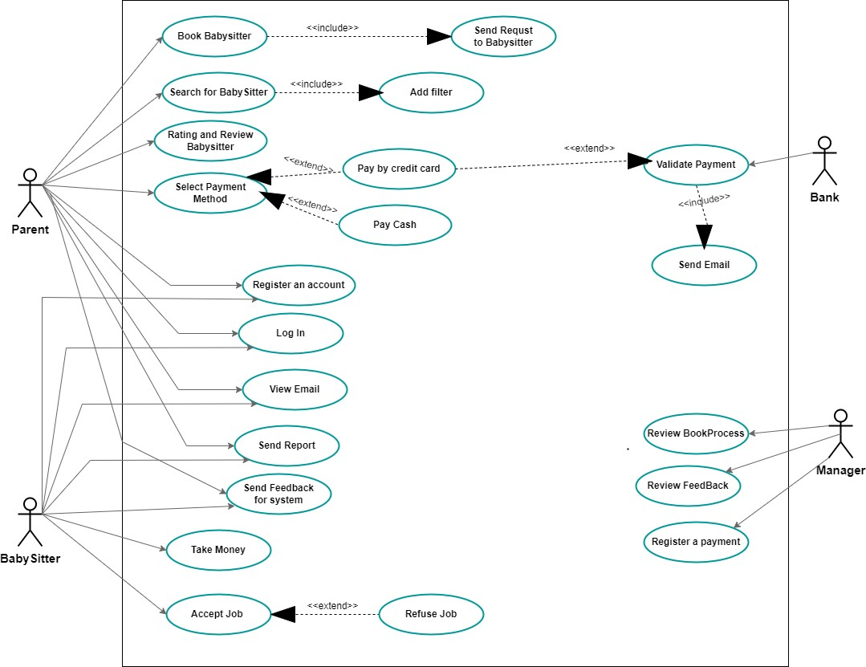
Use-case diagram

Slide 6
Detailed description (Payment process)
Actors | Parent, Babysitter, Bank
Description | This use case outlines the process of handling payment transactions for babysitting services, considering various scenarios such as credit card payments or cash transactions.
Pre-conditions | Parent book babysitter and the babysitter accept it. Payment method include credit card or cash.
Sequence/Flow of Events | The parent initiates the payment process after booking the babysitter. If the payment method is credit card: a) The system securely prompts the parent to enter credit card details. b) The parent inputs correct credit card information (card number, expiration date, CVV code). c) The bank validates the information. d) If successful, the payment is processed, and the transaction status is marked as completed and update information of payment. As an alternative way, if the payment method is cash: a) The parent chooses to send payment in cash. b) Upon the babysitter's departure, the parent hands over the agreed-upon cash payment. c) The system updates the transaction status, marking it as completed and update information of payment.
Data | Parent and babysitter details, Credit card information, Cash payment details
Stimulus/Trigger | User command initiated by the parent booking and the babysitter accept it.
Post-conditions/Response | For credit card payment: - The system processes the payment successfully. - The parents and the babysitter receive an email payment confirmation. - The transaction status is marked as completed and update information of payment and save it on database. For cash payment: - The system updates the transaction status and save it on database, The parent and the babysitter receives an email payment confirmation, marking it as completed and update information of payment.
Comments | In case of credit card payment errors (insufficient funds), the system displays an appropriate error message. In case of cash payment errors (discrepancy in the amount), the system marks the transaction as completed, and it is the responsibility of the involved parties to address the issue. Automated email receipts are sent to both the parent and babysitter after a successful transaction, providing detailed information for record-keeping and transparency.

Slide 7
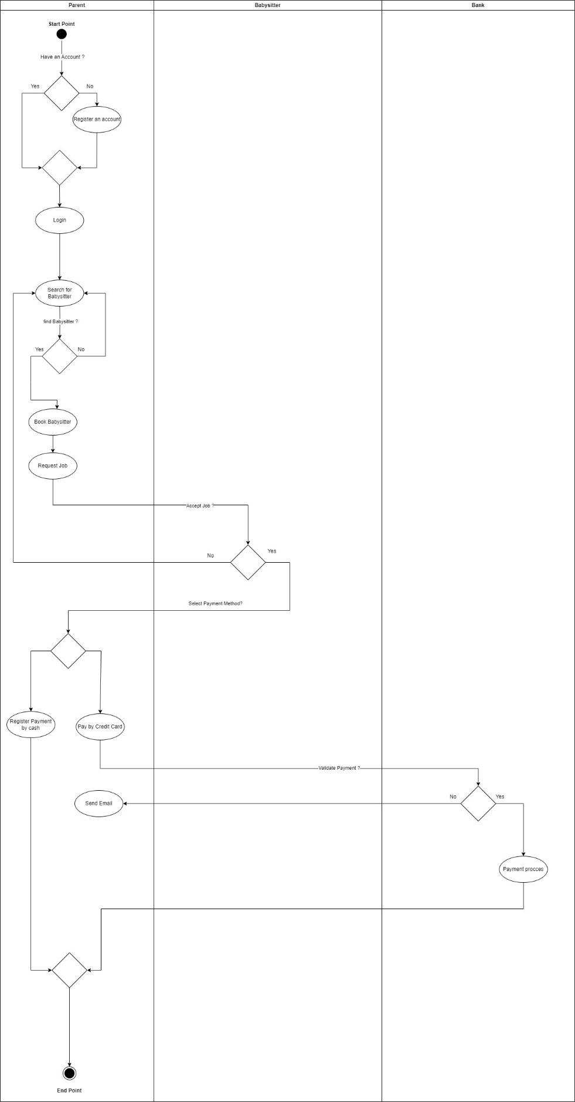
Overall activity diagram

Slide 8
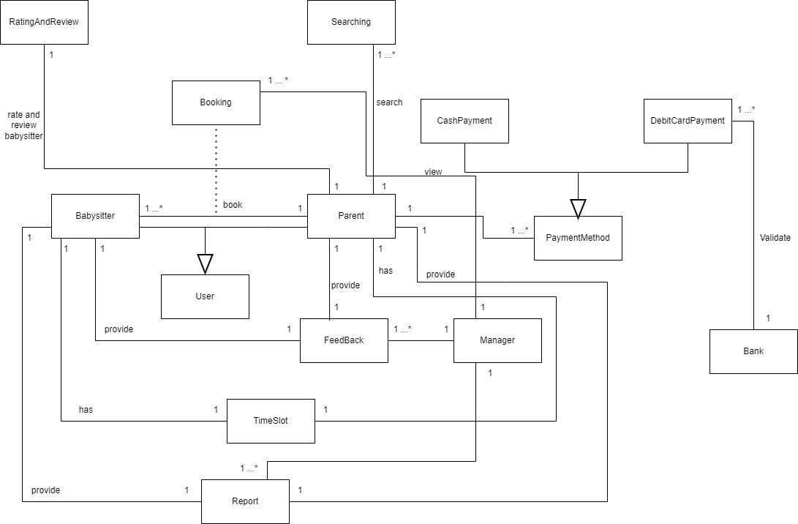
Overall analysis diagram

Slide 9
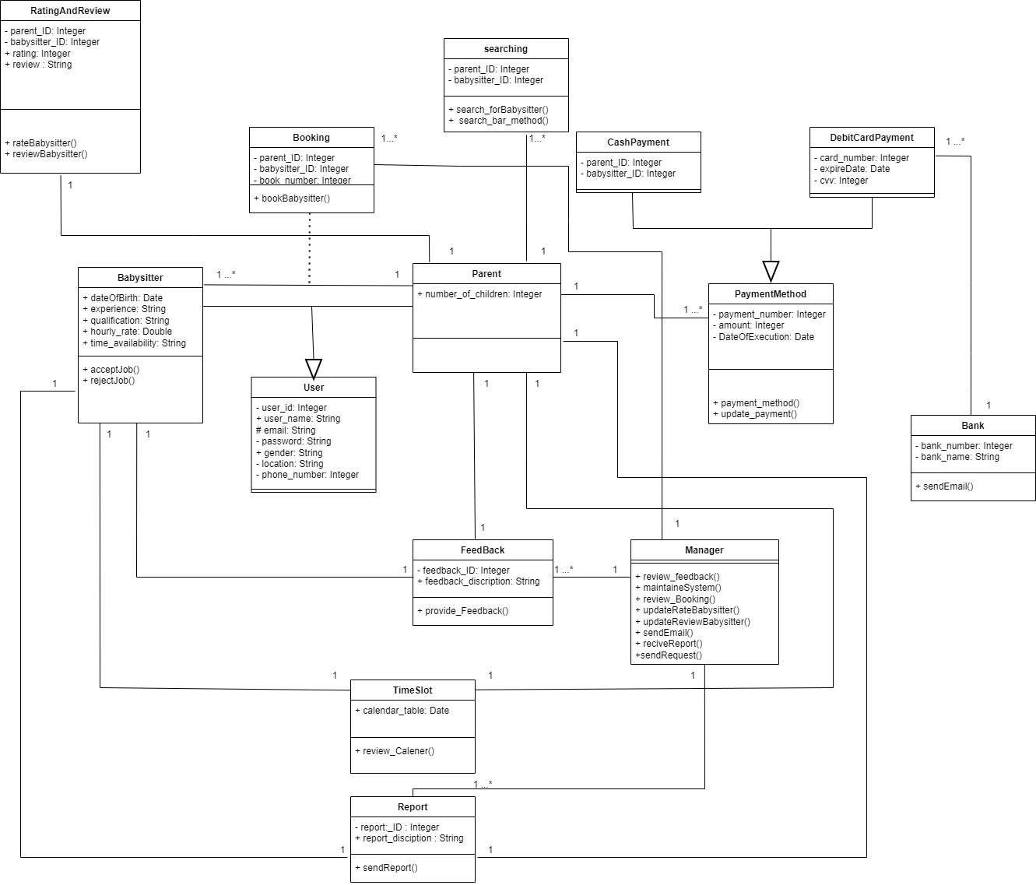
Detailed class model diagram

Slide 10
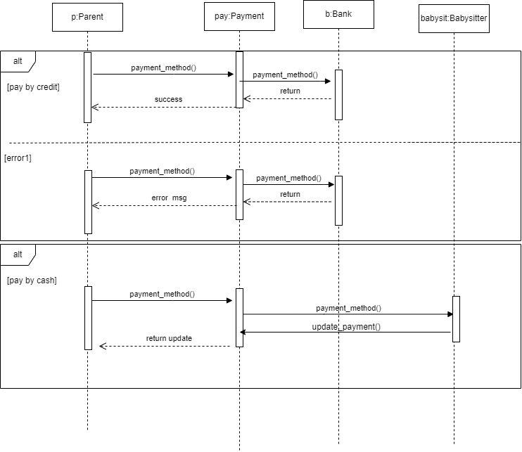
Sequence diagram (Payment process)

Slide 11
Design goals
High cohesion | We shall put the classes and the methods that have most interact together and have dependency on a one component.
Low coupling | We shall put the classes and the methods that less interaction together in a separated component.
Ease of learning And user friendliness | Our website is created to be easy to use and use a little of clicking to make all steps to booking and can be good of use it on 10 mins of training.
Robustness and security | Our website will delete all information of credit card details after the actor made the transaction method and for robustness our data will be stored in a cloud back-up Database

Slide 12
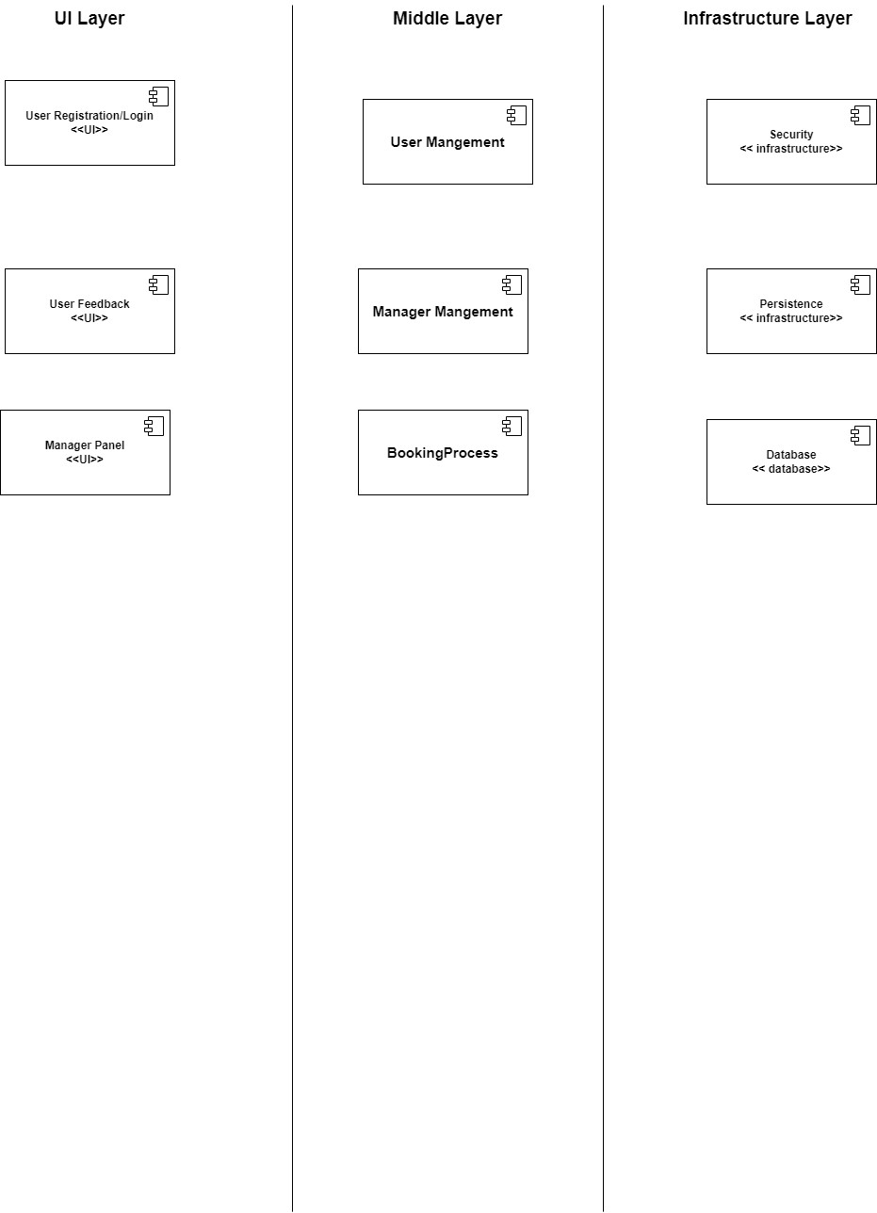
Overall Architectural design

Slide 13
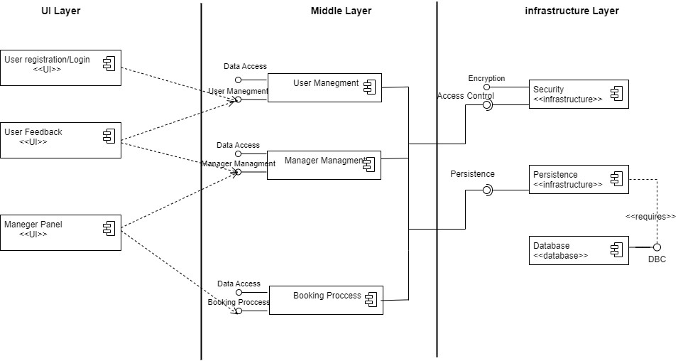
Component diagram

Slide 14
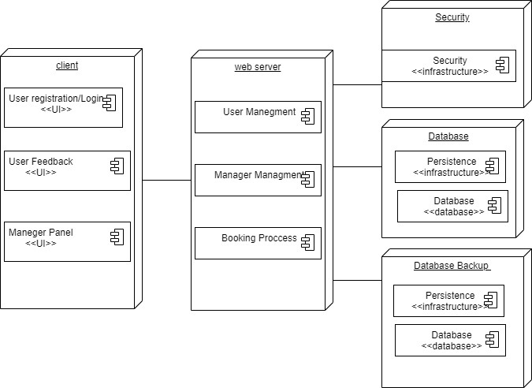
Deployment diagram

