Slide 1
1/15
🦜
CocoByte
A Custom Interpreted Programming Language
STUDENT
Mohammad Salhab 202302753
SUPERVISOR
Aya Yaman
UNIVERSITY
Beirut Arab University
COURSE
COMP452 | Compiler Lab
🦜 Named in memory of Coco, my grey African parrot lost during the war on Lebanon, 2024

Slide 2
2/15
What is CocoByte?
A bird-themed interpreter built from scratch
🦜
Interpreter, not a compiler executes code directly, no output file generated
# CocoByte code
nest x = 10
nest y = 20
peek x < y then
squawk("y is bigger!")
land
flap 3 times
squawk("Squawk!")
land
🔤
Custom language bird-inspired keywords like squawk, nest, peek, flap
⚙️
4 pipeline stages Scanner → Parser → Semantic Analyzer → Executor
🌐
Web-based visualizer step through each phase live in the browser
💡 Compiler = translates to machine code. Interpreter = reads & runs directly. CocoByte is an interpreter.

Slide 3
3/15
The CocoByte Language
Every keyword inspired by parrot behavior 🦜
CocoByte 🦜
Standard Language
Why This Name?
nest
let / int / var
A parrot stores things in its nest
squawk 🗣️
print / output
A parrot squawks to speak
peek 👀
if / condition
A parrot peeks before acting
then
then
Follows the condition
land 🛬
end / close block
A parrot lands to finish
flap
for / loop
A parrot flaps wings repeatedly
times
times (loop count)
Number of repetitions
teach 🎓
function / def
You teach a parrot a trick
give
return
The parrot gives back a value
true/false
boolean values
Standard logic

Slide 4
4/15
The 4-Stage Pipeline
How CocoByte processes your code from text to output
📝
🔍
🌳
🧠
⚡
Source
Code
▶
Scanner
▶
Parser
▶
Semantic
Analyzer
▶
Executor
🔍 Scanner
🌳 Parser
🧠 Semantic Analyzer
⚡ Executor
Breaks raw source code into a flat list of tokens using regular expressions. Identifies keywords, identifiers, numbers, strings, and operators.
Takes the token list and builds an Abstract Syntax Tree (AST) using recursive descent parsing based on a Context-Free Grammar.
Walks the AST without executing. Checks for undeclared variables, wrong argument counts, and logical errors.
Walks the AST and actually runs the program. Manages scope with an Environment chain. Handles recursion via ReturnSignal.

Slide 5
5/15
Stage 1: Scanner
Tokenizes raw source code using regular expressions
Reads source code character by character left to right
TOKEN_RE = re.compile(
r'(?P<STRING>"...")'
r'|(?P<NUMBER>\d+)'
r'|(?P<OP><=|>=|==|!=|...)'
r'|(?P<WORD>[a-zA-Z_]\w*)'
...
)
Uses a single master regex with named groups to match token types
Skips whitespace, newlines, and comments (#)
Example Output: nest x = 10
Classifies words: KEYWORD if in the keywords set, else IDENTIFIER
TYPE
VALUE
LINE
KEYWORD
nest
1
Returns a flat list of Token objects: { type, value, line }
IDENTIFIER
x
1
OPERATOR
=
1
NUMBER
10
1

Slide 6
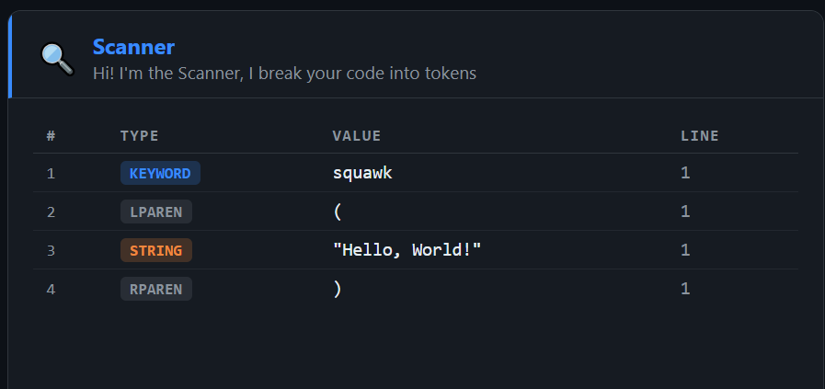
6/15
Stage 1: Scanner
Tokenizes raw source code using regular expressions

Slide 7
Stage 2: Parser
7/15
Builds an Abstract Syntax Tree via recursive descent
Takes the token list from the Scanner as input
# AST for: nest x = 10
{
"node": "Assign",
"name": "x",
"value": {
"node": "Number",
"value": 10
},
"line": 1
}
Uses recursive descent parsing based on a Context-Free Grammar
FIRST sets guide which rule to call at each decision point
Operator precedence: or → and → not → compare → add → multiply
Outputs a nested JSON dictionary which is the AST

Slide 8
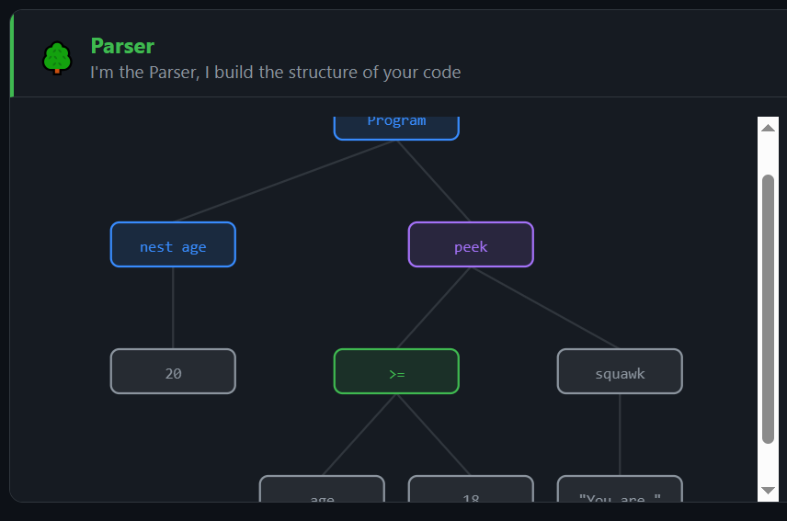
Stage 2: Parser
8/15
Builds an Abstract Syntax Tree via recursive descent

Slide 9
9/15
Stage 3: Semantic Analyzer
Checks meaning, not just structure
Walks the entire AST without executing any code
✅ All checks passed then your code looks good!
Maintains a scope stack, one dictionary per block level
❌ ERROR
Catches: undeclared variables before they are used
Undeclared variable 'score' at line 3
Function 'add' expects 2 args but got 1
Catches: calling functions with wrong number of arguments
Scope Stack:
Catches: using give (return) outside of a function
Global Scope { x, y, fibonacci }
Returns a list of errors/warnings and an ok: true/false flag
Function Scope { n }
If Block Scope { }

Slide 10
10/15
Stage 4: Executor
Walks the AST and runs the program
Receives the verified AST from the Semantic Analyzer
Environment Chain
Global Env
Uses an Environment class, a linked chain of variable tables
vars: fibonacci, x, y
↓ parent
Each scope (function call, if block, loop) creates a child Environment
Call Env: fibonacci(5)
vars: n = 5
Variables looked up by walking the parent chain until found
↓ parent
Call Env: fibonacci(4)
vars: n = 4
Functions stored as: AST node + their closure environment
⚡ ReturnSignal Exception
Return uses a ReturnSignal exception to unwind the call stack cleanly
Raised by give, caught by the function caller, cleanly unwinds nested recursion

Slide 11
The Web Visualizer
11/15
Step through every phase live in the browser
📝 Code Editor
🔍 Scanner
nest x = 10
peek x > 5 then
squawk("hello")
land
teach fib(n) then
...
land
← Back Next →
🌳 Parser
← Back Next →
🧠 Semantic
← Back Next →
⚡ Output
← Back Next →
▶ Run
📂 Load Example... ▼
✓ Phase-by-phase stepper
✓ Live SVG AST tree
✓ 6 preloaded examples
✓ Angry parrot on errors 🦜

Slide 12
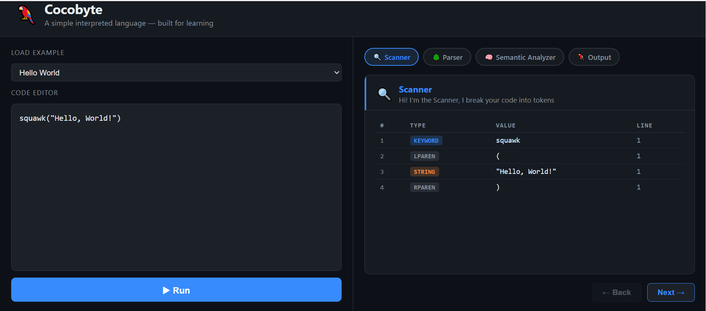
The Web Visualizer
12/15
✓ Phase-by-phase stepper
✓ Live SVG AST tree
✓ 6 preloaded examples
✓ Angry parrot on errors 🦜

Slide 13
13/15
Live Demo (Later on): Fibonacci🦜
Recursive function: the ultimate compiler test
Why Fibonacci matters:
teach fibonacci(n) then
peek n <= 1 then
give n
land
give fibonacci(n-1) + fibonacci(n-2)
land
squawk(fibonacci(10))
🔁
Tests recursion function calls itself twice
📚
Tests the call stack. Environment chains stack up
🛑
Tests the base case, peek n <= 1 must stop recursion
⚡
Tests ReturnSignal unwinding through nested calls
🦜 Output: 55
🧠
Tests semantic scope, n must be local to each call
0, 1, 1, 2, 3, 5, 8, 13, 21, 34, 55 ← fibonacci(10)

Slide 14
14/15
Challenges & Lessons Learned
What was hard, and how it was solved
⚖️ Operator Precedence
🔁 Recursive Functions
Solved by chaining grammar rules: or → and → not → comparison → additive → multiplicative → unary → primary. Each level is its own function in the recursive descent parser.
Each function call creates a fresh child Environment with its own n. ReturnSignal exception unwinds cleanly through nested fibonacci(n-1) + fibonacci(n-2) calls without breaking the executor.
🔭 Scope Chain
🌳 AST Visualization
The Environment class walks the parent pointer chain to find variables. Inner scopes can read outer variables, but each function call is isolated — preventing variable pollution across calls.
Rendering the tree as SVG required a two-pass algorithm: first measure the width of each subtree bottom-up, then position nodes top-down centering each parent over its children.

Slide 15
🦜
15/15
CocoByte
Thank you
squawk("Squawk responsibly.") 🦜
Mohammad Salhab 202302753 | Supervisor: Aya Yaman | BAU | COMP452
Named in memory of Coco 🦜, lost during the war on Lebanon, 2024

