Slide 1
CodeGuard AI
Code Plagiarism Detection Using AST and Behavioural Fingerprinting
Mohd Saqlain Hussain · Vanshika Uppal · Trisha · Shubham
Guide: Mr. Ashish Sharma
B.Tech CSE, Invertis University · AY 2026-27
Notes:
An evidence system, not a verdict machine. That phrase is the whole project and it should be said in the first thirty seconds.

Slide 2
Plagiarism is three problems, not one
Collusion
Outsourcing
Machine generation
Two students hand in the same work.
Two copies exist, and both are in the cohort.
This is what MOSS and JPlag detect.
Work written by a paid third party.
One copy exists. The author is not enrolled.
No pairwise tool can see it.
Work produced by a language model.
Again one copy, again nothing to compare against.
Every widely deployed tool compares submissions against each other. That design detects collusion and is structurally incapable of detecting the other two.
Our scope covers all three. The third is addressed by documenting why it was excluded.
Notes:
Press the structural point: pairwise comparison can only ever find collusion, however good the algorithm is.

Slide 3
Why a similarity percentage is the wrong output
“Tools do not find plagiarism regardless of how good they are.”
Novak, Joy and Kermek — ACM Transactions on Computing Education, 2019
Similarity is not plagiarism. Students taught one algorithm, in one language, on a tight specification, write similar code.
A percentage above a threshold is a judgement the tool is not entitled to make, in a format that invites mechanical action.
The cost of acting mechanically falls on honest students, who have no second copy to point at in their defence.
So the output is a ranking with its evidence attached, and a human decides.

Slide 4
What we built
Three tiers, one detection service, two detection layers in production

Slide 5
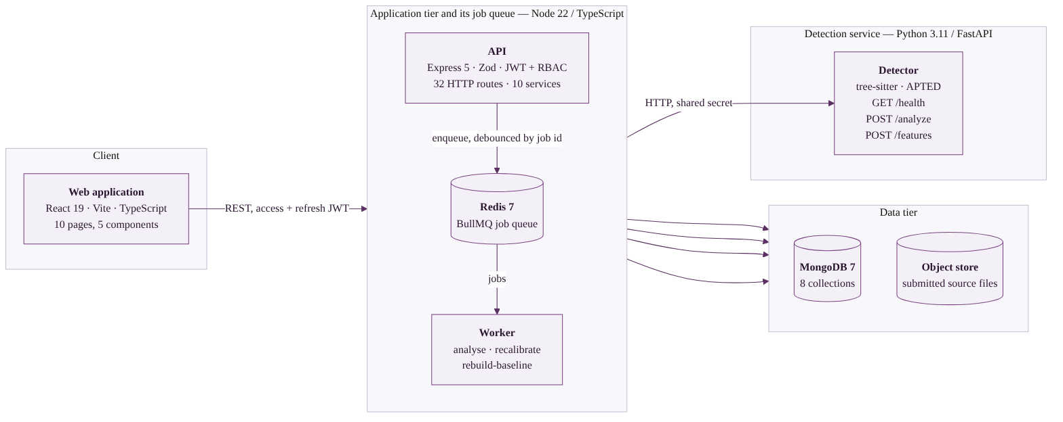
Architecture
The web application never reaches the detector or any data store. Everything goes through the API, which holds the only credentials in the system.

Slide 6
Two layers, two different questions
Layer 1 — structural
Layer 2 — behavioural
“Does this resemble another submission?”
Normalised abstract syntax trees compared with tree edit distance (APTED).
Renaming, reordering and reformatting change the token stream and leave the tree intact.
Candidates are shortlisted by label-bag overlap; at most 10 get the expensive comparison.
“Does this resemble its own author's previous work?”
Four style features z-scored against the student's own baseline.
Needs no second copy anywhere, which is the only route to outsourced work.
This is the project's research contribution, and Chapter 7 reports what it does and does not do.
Layer 3, for machine-generated code, was specified and deliberately not built. Slide 13 says why.

Slide 7
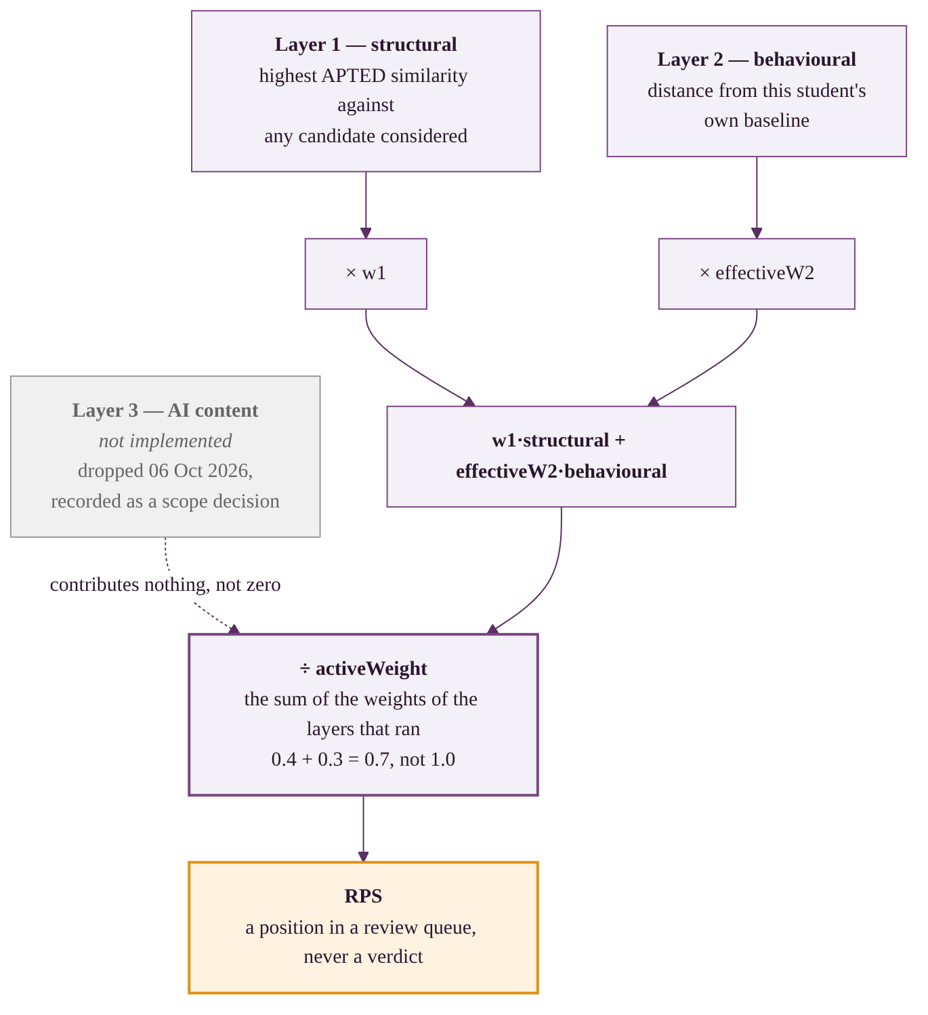
Composing the score
Renormalised over the layers that ran
The configured weights are 0.4 / 0.3 / 0.3.
With Layer 3 absent the divisor is 0.7, so they act as 0.571 / 0.429.
The headline weights are never the applied ones, and the evidence page renders the arithmetic rather than asserting it.
An absent layer contributes nothing, not zero
A zero is a finding: it says the layer looked and found nothing.
An absent layer has not looked.
Treating absence as zero would drag every score down by a third and make two-layer and three-layer results incomparable.

Slide 8
Protecting the honest student
Layer 2's failure mode is not a missed detection. It is a wrong baseline accusing someone who did nothing.
1
Anchor provenance
Only invigilated work, or work a student nominates and faculty accept, may describe their style.
2
Minimum anchor count
Below three anchors the layer declines to score rather than guessing.
3
Baseline confidence
A thin baseline attenuates the layer's weight instead of being trusted at full strength.
4
Low-variance flag
A student who varies less than the cohort is penalised by z-scoring, and the result says so.
5
Cohort saturation flag
When the pooled spread collapses, the layer has stopped discriminating. The result says that too.
Four of the five report that the system cannot tell, instead of emitting a number that looks like an answer.

Slide 9
Does it work?
Every figure that follows comes from a committed script that can be re-run

Slide 10
How we measured it
327 source files, zero parse failures: 204 Python across 15 repositories, 123 Java across 11.
A labelled corpus built for the purpose: 214 spliced pairs in which part of one author's file is replaced by another's.
Nine committed measurement scripts. Every figure reported as a range over 25 draws, not a point estimate.
A positive control in every experiment, so a null result can be told apart from a broken rig.
Sampling ranges and fixed author counts exist because single samples and raw lift both proved unreliable here. Several published claims were retracted on measurement.
327
214
94
25
files measured
labelled pairs
independent sources
draws per figure

Slide 11
Layer 1 detects copying
Positive control: the donor's own file is inside the comparison pool, so there is something to find.
Share of file copied | Separation | Paired sign test | precision@10
10% | +0.0150 | 42 of 60, p = 0.0027 | 0.700
25% | +0.0335 | 53 of 80, p = 0.0049 | 0.800
50% | +0.0706 | 47 of 73, p = 0.0186 | 1.000
Monotonic in how much was copied, significant at every fraction, and perfect ranking at the top ten when half the file is someone else's.
This is what licenses the next slide: the apparatus detects what it is supposed to detect.

Slide 12
Layer 2 does not detect partial outsourcing
Donor excluded — the actual threat model: outsourced work with no second copy in the cohort.
Share copied | Layer 2 separation | precision@10, Layer 1 | precision@10, L1 + L2
10% | -0.0124 | 0.500 | 0.500
25% | -0.0176 | 0.700 | 0.400
50% | -0.0090 | 0.700 | 0.500
The separation is negative at every fraction. That is the wrong direction, not merely a small effect.
Adding Layer 2 to Layer 1 degrades ranking precision every time, below chance at the 25% fraction.
No dose-response: +0.022 measured continuously against the actual share copied.
Notes:
Do not soften this. The positive control on the previous slide is what makes it credible rather than a broken experiment. The mechanism is on the next slide and it is the strong part.

Slide 13
Why not — and every link is measured
The donors do differ
The splice does move them
But the direction is a coin flip
Median reach is 0.9 cohort standard deviations. There is somewhere to move.
Realisation 0.89 to 1.00 for three of the four features. Mixing behaves exactly as modelled.
The donor sits above the student in 0.462 to 0.500 of pairs. None distinguishable from chance.
The score is a magnitude of deviation from the student's baseline. A displacement of predicted size and arbitrary sign, applied to a point already off centre, moves it closer about as often as further away.
Separately: max_block_depth is a maximum, and a maximum is not a mixable statistic. It is unchanged in 57 of 61 pairs at the smallest fraction.
Neither failure is a tuning problem. A whole-file magnitude cannot detect a partial, signed substitution.

Slide 14
What we are not claiming
Layer 3 was dropped, on requirements grounds
Layer 1's precision and recall are unknown
Published CodeBERT classifiers improve when training data resembles the target. That needs a labelled corpus of student work from the course being policed.
No such corpus exists, and synthesising one would mean treating invented submissions as ground truth.
No labelled corpus of genuine student plagiarism exists.
What we measured is the distribution over honest work by different authors, which is a different claim and is reported as one.
214 pairs come from 94 distinct source files, so 94 is the number the statistics rest on.
The ablation is Python only, and two features behave oppositely across the two languages.
This is open-source library code, not coursework. Project conventions are a confound.
Several claims were retracted during the project when a better measurement contradicted them.
A layer that emits a number nobody can characterise is worse than an absent one, in a system whose premise is auditable evidence.

Slide 15
How we know the code works
278
19
2
35
automated tests, all in
the CI gate
deliberate mutations
introduced
that the suite did
not catch
endpoints across
API and detector
Mutation testing is the part worth asking us about.
A passing suite shows the tests agree with the code. It does not show the tests would notice if the code were wrong. So we broke the implementation deliberately, nineteen times, and checked that something failed.
Two mutations survived: one reached a code path no test exercised, one changed an ordering nothing asserted on. The finding is not “nineteen of nineteen eventually caught” — it is that a suite can be green, substantial, and blind in a specific direction.

Slide 16
Where this goes next
1. Redesign Layer 2
2. Build Layer 3
Per-function or windowed features, so a spliced region is isolated instead of averaged into its host.
And a signed comparison, so moving toward another author's typical values is itself the signal.
This follows directly from the mechanism. No precondition — buildable now, and the corpus to test it exists.
Precondition: a labelled corpus of student submissions from the course the system will police.
Without it the layer can be built but never characterised.
The precondition is the work, not the model.
3. Reconsider the feature set
4. A labelled plagiarism corpus
Nine of ten features clear F = 1 in Python, not four. Using every applicable feature beats the fixed four in both languages.
Should follow the redesign, since aggregation level is the larger problem.
What would turn Layer 1's distribution into a precision and recall figure.
Precondition is an ethics process, not an engineering task: adjudicated cases, consent, anonymisation.

Slide 17
Who did what
Saqlain
API, detector, web interface, Layer 1, score composition, the report
MERN platform and the AST core
Vanshika
Behavioural scoring, the style-shift corpus, the ablation study and its follow-ups
Data science: Layer 2 and evaluation
Trisha
Layer 3 dropped on requirements grounds; aggregation work reassigned
Layer 3 and transparent aggregation
Shubham
Kotlin and Jetpack Compose. Not started — stated here rather than implied otherwise
Mobile application
Where one person built another's vertical, this report says so.

Slide 18
An evidence system, not a verdict machine
A working two-layer system that ranks submissions and shows its reasoning.
Layer 1 detects copying, measured against a passing positive control.
Layer 2 does not detect partial outsourcing — a negative result with a measured mechanism and a named fix.
No output of this system constitutes a finding of academic misconduct.
Notes:
Close on the negative result deliberately. A measured null with a diagnosed mechanism and a specific remedy is a stronger final-year outcome than an unverified positive, and that is the line to use if challenged.

