Slide 1
CodeGuard AI
An Authorship-Evidence System for Code Integrity in the AI Era
Mohd Saqlain Hussain · Vanshika Uppal · Shubham Raghav · Trisha Bharadwaj
Guide: Mr. Ashish Sharma
Dept. of CSE, Invertis University · AY 2026–27
Notes:
Saqlain, lead. One line: CodeGuard does not judge students. It gives faculty ranked, explainable evidence about who to review first.

Slide 2
A thirty-year assumption just broke
the_problem.md
The old threat (1990–2022)
The new threat (2023 →)
Student copies from another student.
Student copies from public GitHub.
There are always two copies, and both are findable.
MOSS and JPlag were built exactly for this, and they work.
Student prompts an LLM. Student hires a freelancer.
The code is original. No similarity match exists anywhere.
MOSS and JPlag find nothing. The student passes.
Institutions are losing the ability to verify who actually wrote a piece of work.
Both new threats share one property: there is only one copy, and its author is not in the class. Any tool that works by comparing submissions to each other is blind to them by design.

Slide 3
An evidence system, not a cheating detector
the_core_design_decision
✘ Detector framing — rejected
✔ Evidence framing — ours
Output: “Integrity Score 0.87” — a verdict.
A wrong score is a falsely accused student.
“What if it is wrong?” has no good answer.
One bad number ends the project.
Output: a Review Priority Score that only orders the review queue.
A wrong score costs five wasted minutes, not an accusation.
Each layer's evidence is shown separately.
The human always makes the final call.
CodeGuard AI is a metal detector at an airport. It does not arrest anyone — it beeps so a trained human knows where to look. We beep; faculty decide.
This decision is why no output of the system is a finding of misconduct, and why a student never sees a score.

Slide 4
Our research thesis — and we tested it
thesis.md
“A per-student longitudinal coding-style baseline provides a detection signal orthogonal to similarity matching — and it stays informative when the submitted code is original.”
How we said we would prove it
What we did
What it said
An ablation study: measure detection with and without Layer 2, on synthetic style-shift data.
If it adds signal, the thesis holds.
Built the corpus: 214 pairs from 94 source files.
Ran the ablation with a positive control.
Exactly the method we promised.
The thesis did not hold for partial outsourcing.
We can show precisely why, and name the fix.
We committed to a falsifiable test, ran it, and report the answer it gave. That is the project's strongest claim.
Notes:
If one slide is remembered, make it this one. We did not quietly drop the thesis when it failed; we measured it, and the mechanism is understood.

Slide 5
The three-layer model, as built
detect.py
01 Structural
02 Behavioural
03 AI-content
“Is this the same shape as someone else's code?”
Parse to a syntax tree, strip names, compare shapes with tree edit distance.
Beats renaming, reformatting and reordering.
BUILT and measured.
“Does this match this student's usual style?”
Four style features, scored against the student's own history.
Needs no second copy — the only route to outsourced work.
BUILT and measured.
“Does this look LLM-generated?”
A corpus built from scratch, and a measured baseline.
MEASURED but NOT DEPLOYED. CodeBERT itself is specified and untrained.
The layers are independent, which is the point: they fail differently. Measured correlation between Layer 1 and Layer 2 is −0.042.
Because Layer 3 is not deployed, the score is renormalised over the layers that are. Trisha's section shows the arithmetic.

Slide 6
@saqlain — MERN platform + AST core
The web platform, the detection engine, the score, the tests, and the evaluation

Slide 7
What I own
ownership.md
The detector
The API
The web interface
Python service. Parsing, normalisation, unit extraction, the prefilter, tree comparison, feature extraction.
Node and TypeScript. 32 routes, 8 collections, authentication, roles, uploads, the job queue, the worker.
React. 10 pages and 5 components, including the evidence view and the review queue.
Score composition
Baseline integrity
Verification
Combining the layers into the RPS, with renormalisation, and storing the weights that produced each result.
The five mitigations that stop a wrong baseline accusing an honest student.
278 automated tests, the CI gate, mutation testing, and the 71-page evaluation report.
Two of these — score composition and baseline integrity — were not in my original vertical. I built them because they were the parts that made the output defensible.

Slide 8
Layer 1 — how it actually works
layer1_ast.py
source → parse → normalise → split into units → shortlist → tree edit distance
Why a tree beats text
Why it is affordable
Renaming a variable changes every line of text and nothing about the tree's shape.
Normalisation throws away names, literals and formatting, keeping only structure. That is what makes the common tricks invisible.
Tree edit distance is expensive, so it runs on at most 10 candidates.
A cheap first pass ranks candidates by how many node kinds they share, and only the top 10 get the real comparison — whatever the class size.
Evidence is filtered: a match under 10 nodes is not shown, because two one-line functions resemble each other by being one line long.
The shortlist nominates from both directions, so a unit nobody happens to pick is not starved of a partner.
The parser returns a tree even when the code is broken, so every caller checks the ok flag, not the tree.

Slide 9
My files — the detector
apps/detector/app/
parsing.py
Turns source text into a syntax tree. Returns a tree even on broken code.
normalise.py
Strips names, literals and formatting. This is what defeats renaming.
units.py
Splits a file into functions and classes, and compares them with APTED.
prefilter.py
The cheap first pass that picks which 10 candidates deserve the expensive comparison.
features.py
Extracts the ten style numbers that Layer 2 scores.
main.py
The three HTTP endpoints: health, analyze, features.
Six files. Between them they answer one question: how close are these two pieces of code, in a way a student cannot defeat by renaming things.
Written in Python because the two libraries this needs — tree-sitter for parsing and APTED for tree distance — are Python libraries.

Slide 10
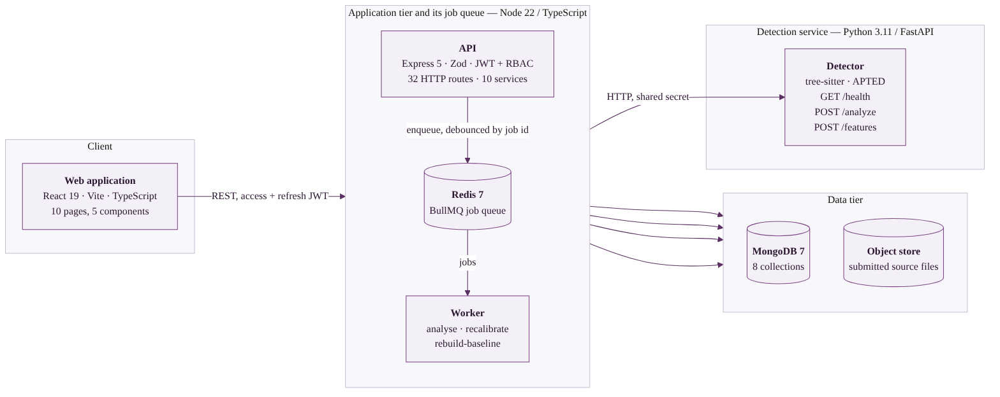
The platform I built around it
architecture.yaml
The web app holds no credentials and never touches a database. Everything goes through the API, which is the only tier that can reach MongoDB, Redis or the file store. The worker is the same code as the API on a different entry point, so a queued job and a live request can never drift apart.

Slide 11
My files — the API
apps/api/src/
routes/ + controllers/
The 32 endpoints: accounts, courses, assignments, submissions, results.
models/
The 8 MongoDB collections, including the audit log.
middleware/validate.ts
Checks every request with Zod and replaces it with the clean version.
services/detection.ts
Combines the layers into the RPS and stores the weights used.
services/behavioural.ts
Layer 2's scoring maths.
services/anchors.ts
Decides which past work is trustworthy enough to describe a student.
services/baseline.ts
Builds the student's style profile from those anchors.
queue/detectionQueue.ts
Puts detection jobs on Redis, debounced so a deadline rush collapses.
worker.ts
Runs those jobs in the background.
The validation file is also the security boundary: because every query parameter is forced to a declared type, injected query operators never reach the database.

Slide 12
My files — the interface
apps/web/src/
EvidencePage.tsx
The most important screen. Caveats before the number, and it refuses to print its own equation if the arithmetic disagrees.
QueuePage.tsx
The review queue, ranked, with names and roll numbers.
MyResultPage.tsx
The student's view. Shows status and any decision — and no score, deliberately.
FingerprintRadar.tsx
The four-axis style chart, drawn from the stored evidence.
PrintHeader.tsx
Makes the evidence page print to a clean PDF for a hearing.
SubmitPage.tsx
Upload, with type and size checks.
ManagePage.tsx / AdminPeople.tsx
Courses, enrolment, accounts, detection weights.
LoginPage.tsx / AuthProvider.tsx
Sign-in and role-based access.
A student never sees a score because the endpoint behind their page does not return one. That is enforced by the API, not by the page choosing not to display it.

Slide 13
Protecting the honest student
integrity.ts
Layer 2's failure mode is not a missed cheat. It is a wrong baseline accusing someone who did nothing. Five mitigations exist for that.
1
Anchor provenance
Only invigilated work, or work a student nominates and faculty accept, may describe their style.
2
Minimum anchor count
Below three anchors the layer declines to score rather than guessing.
3
Baseline confidence
A thin baseline reduces the layer's influence instead of being trusted fully.
4
Low-variance flag
A student who varies less than the class is penalised by z-scoring. The result says so.
5
Cohort saturation flag
When the class spread collapses, the layer has stopped discriminating. The result says that too.
Four of the five make the system say it cannot tell, instead of producing a number that looks like an answer.

Slide 14
How I know the code works
verify.sh
278
19
2
35
automated tests,
all in the CI gate
deliberate mutations
introduced
that the suite
did not catch
endpoints across
API and detector
Mutation testing — ask me about this one.
A passing suite proves the tests agree with the code. It does not prove the tests would notice if the code were wrong. So I broke the implementation on purpose, nineteen times, and checked that something failed each time.
Two survived: one reached a code path no test exercised, one changed an ordering nothing asserted on. Both gaps were then closed. The finding is not “19 of 19 caught” — it is that a suite can be green, large, and blind in one direction.

Slide 15
@vanshika — behavioural fingerprinting
Layer 2: the style baseline, the corpus it was tested on, and the result it returned

Slide 16
What Layer 2 asks
behavioural.ts
“Does this submission look like the way this particular student normally writes?”
Four scored features
Scored against themselves
Combined, then capped
blank_line_ratio
avg_line_length
max_block_depth
comment_density
Ten are extracted; four survived the check that they separate authors at all.
Each feature becomes a z-score: how far this file sits from the student's own past work, measured in the cohort's spread.
No second copy is needed. That is the whole point.
score = min(1, rms(z) / 3)
The root-mean-square across the four, saturated at three standard deviations so one extreme feature cannot dominate.
This is the only layer that can see work which was outsourced rather than copied — because an outsourced file has no twin anywhere to match against.
Nothing here is trained. It is descriptive statistics over a student's own history, which is what lets the evidence page explain a score to the student it describes.

Slide 17
The corpus we built to test it
style_shift.py
214
94
3
24
spliced pairs
built and labelled
distinct source files
behind them
splice fractions
0.10 / 0.25 / 0.50
authors
represented
Why 94 matters more than 214.
81 source files were reused across the three fractions, producing byte-identical clean copies. Treating all 214 pairs as independent would overstate every significance test in the study.
So every figure is reported stratified by fraction — 61 / 80 / 73 pairs — within which each source appears at most once. The honest denominator is stated beside every number.
A methodology error was found and corrected mid-study: the first pass bucketed on the requested fraction rather than the achieved one, and those buckets overlap. Correcting it did not change the conclusion.

Slide 18
The result — and it is negative
results.json
Splice fraction | Layer 2 gap | precision@10, L1 alone | precision@10, L1 + L2
0.10 | −0.0124 | 0.500 | 0.500
0.25 | −0.0176 | 0.700 | 0.400
0.50 | −0.0090 | 0.700 | 0.500
Layer 2 scores spliced files LOWER than clean ones, at every fraction. Adding it to Layer 1 makes the ranking worse, not better.
ROC AUC — the single number
The control that makes it credible
Layer 2: 0.4772, below the 0.5 chance line.
Layer 1: 0.5402 donor-excluded, 0.6128 donor-included.
Layer 2 does not rank weakly. It ranks the wrong way.
With the donor file in Layer 1's pool, the gap rises with how much was copied: +0.015, +0.034, +0.071, significant at all three fractions.
The harness measures what it claims to.

Slide 19
Why it fails — and it is structural, not a tuning problem
suppression.py
1. An rms distance is direction-blind
2. A maximum is not a mixable statistic
The score is a magnitude: how far the file sits from the student's baseline, with no sign.
A splice moves the file about 0.44 sd in a direction set by wherever the donor happens to sit — which is random. A point already 0.6 sd out, pushed 0.44 sd at random, moves closer as often as further.
max_block_depth has reach 0.694, so donors do differ on it.
Its realisation is −0.000: replacing some functions cannot lower a maximum unless the deepest one is replaced, and a donor only raises it if it is deeper. The feature does not mix, in either direction.
The direction is not argued — it is measured. Donors sit above the student in:
blank_line_ratio | avg_line_length | comment_density | max_block_depth
102 / 214 = 0.477 | 107 / 214 = 0.500 | 85 / 174 = 0.489 | 96 / 208 = 0.462
Four coin flips. The displacement carries no information, which is exactly what failure 1 requires.
The fix is named, not hand-waved: per-function features instead of whole-file, and a signed comparison against the population rather than a distance from the student's own mean. That is a design change, not a reweighting.

Slide 20
@trisha — Layer 3 and aggregation
Machine-generated code detection, the ablation study, and how the layers combine into one score

Slide 21
Layer 3 — building the corpus nobody had
ai_corpus.py
The original objection to Layer 3 was that it needs a labelled corpus of student code, and none existed. We built one instead of assuming it away.
Human class — 96 files
AI class — 60 files
Three edit grades
25 GitHub student repositories: mini-projects, management systems, coursework.
Every file kept only if THAT FILE's last commit predates 2023. Repository age is not enough.
Dates span 2017 to Nov 2022.
Matched to the human corpus on task mix AND on style rates.
Models write docstrings and type hints on everything; students do so on 11%. Unmatched, a classifier learns formatting, not authorship.
1 raw model output
2 renamed, comments stripped
3 one AI function spliced into a human file
Grade 2 is the realistic case: a student covering their tracks.
The trap we avoided: if only the AI class is disguised, the classifier detects the disguise. On a run with deliberately false labels that produced 100% recall on grade 2 that meant nothing.
Fix: disguised copies of human files go into the human class too, so the transformation cannot be a class cue. With false labels and matching in place, recall fell to 0% — the correct answer when there is nothing to find.

Slide 22
Layer 3 — what it scores
baseline_classifier.py
0.952
88%
80%
37%
ROC AUC
overall
recall — raw
generated code
recall — renamed,
comments stripped
recall — one function
spliced in
Wholesale generation is caught. Partial insertion is not — and that is the result worth reporting.
It agrees with Layer 2
Two confounds tested and rejected
Layer 2 could not see partial substitution either, for structural reasons.
Two layers, two methods, two corpora, one conclusion. That agreement is harder to attack than any single accuracy figure.
Era: f-strings 17% vs 25%, type hints 9% vs 12%. No gap — not a date classifier.
Boilerplate: the main guard alone scores 0.75, but removing it changes nothing (0.952 → 0.962).
Not claimed: CodeBERT is untrained and no CodeBERT figure appears anywhere. These are logistic-regression numbers on 351 items — small, with wide error bars, Python only.

Slide 23
The ablation — the one research promise kept in full
ablation.py
The question: does Layer 2 add detection signal beyond Layer 1? The method was fixed in the proposal before any result was known.
The positive control — it passes
The actual test — it fails
With the donor file placed in Layer 1's pool, the system SHOULD find it, and does.
Gaps rise with how much was copied: +0.0150, +0.0335, +0.0706.
p = 0.0027 / 0.0049 / 0.0186.
precision@10 reaches 1.000 at the largest fraction.
With the donor removed, which is the real outsourcing scenario, Layer 2's contribution is negative at every fraction.
Layer 1 and Layer 2 are independent — Pearson −0.042 — so the weighting assumption holds. Independence is not evidence that combining helps.
A control that passes is what makes a negative result credible. Without it, the null is indistinguishable from a broken harness.
No dose-response against the achieved splice fraction: +0.022, measured continuously.
Length is not the confound: |Δ lines| against Δ RPS is −0.131, under 2% of variance.
An earlier reported AUC pair, 0.766 / 0.909, matched no script in the repository and was retracted rather than quietly corrected.

Slide 24
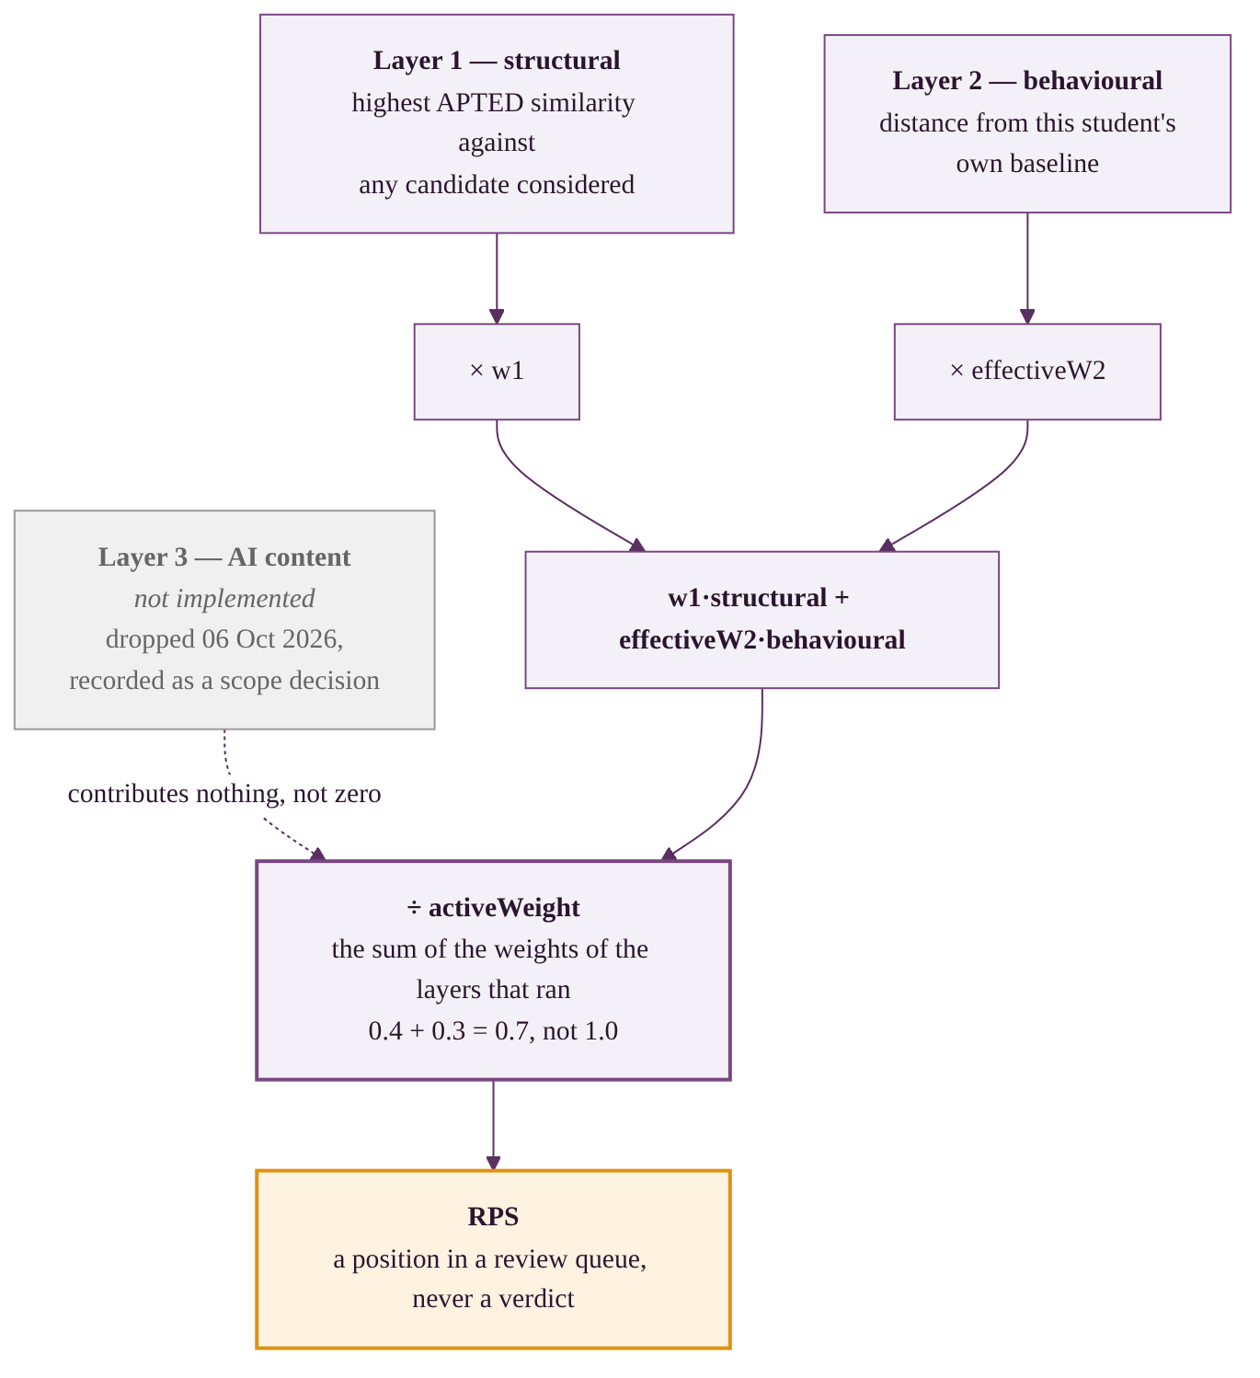
Transparent aggregation — the Review Priority Score
aggregate.py
Simple on purpose
A weighted sum, not a learned model. A student appeal must be able to follow the maths; a black box cannot be defended in a hearing.
Weights are set per course by faculty and stored on every result, so a result stays readable after the settings change.
The renormalisation
Configured 0.4 / 0.3 / 0.3. With Layer 3 not deployed the divisor is 0.7, so they act as 0.571 / 0.429.
An absent layer contributes nothing, not zero. A zero says the layer looked and found nothing; an absent layer never looked.
Why there is no SHAP plot: SHAP approximates a trained model's output. Nothing here is trained, so Layer 2's score decomposes exactly instead — each feature's share is z²/Σz², which sums to 1 and is not an estimate. An exact attribution beats an approximation of the same quantity.

Slide 25
@shubham — app management / mobile
The Android client: what it is for, what it may show, and what it needs to begin

Slide 26
What the app is for
mobile_scope.md
Faculty — triage away from a desk
Students — status, never a score
The review queue, ranked, on a phone.
Open one case, read its evidence, and record a decision between classes.
The queue is where the system's value actually lands, and it is the screen most likely to be wanted on the move.
Submission state, deadline, attempts remaining, and any decision recorded about them.
No Review Priority Score. Not hidden by the app — the endpoint behind the student view does not return one.
The app is a second client for an API that already exists. It adds no detection logic, no scoring, and no storage of its own.
This was the planned droppable vertical — the proposal's risk slide named it as the piece to cut if time ran short. It was cut, and this is the scope it resumes from.
Kotlin + Jetpack Compose, talking to the same REST API the web interface uses, with the same JWT and the same role rules.

Slide 27
The contract — what the app talks to
api_contract.md
POST /api/auth/login
Returns a JWT and the account's role. Everything else needs that token.
GET /api/assignments/:id/results
The ranked review queue. Staff only — a student gets 404, not 403.
GET /api/submissions/:id/result
The evidence: both layers, the weights used, the caveats.
PATCH /api/submissions/:id/review
Record a decision. The note is required and is audited.
GET /api/submissions/:id/student-view
The student view. Status and decision — and no score.
POST /api/assignments/:id/submissions
Upload. Type and size are enforced server-side.
Six of the API's 32 endpoints cover the whole app. They already exist, are already tested, and are already used by the web client — so the contract is fixed and will not move under the Android work. The full spec is in docs/openapi.yaml.
Two rules the app must not break: the student view never displays a score, and a decision is written through the API so the audit log records who made it. Both are enforced server-side, so the app cannot violate them by accident — but it should not try.

Slide 28
What I need to start
handover.md
The API base URL, and the Docker Compose stack running locally so the app has something to talk to.
Three seeded test accounts — one student, one faculty, one admin — with their passwords.
A saved JSON response from GET /api/results/:id, so the evidence screen can be laid out against real data rather than a guess.
The token lifetime and the refresh behaviour, so session expiry is handled rather than discovered.
The error shape the API returns, so failures render as messages instead of crashes.
Confirmation of the minimum Android version to target.
All six are things the team already has. None of them require new backend work, which is why this vertical can restart without blocking anyone else.
The one genuine dependency is the evidence JSON. The evidence screen is the hardest part of the app to design, because it has to carry the same caveats the web page does — a score shown without its caveats is exactly the failure mode the whole project is built to avoid.

Slide 29
How it gets built
milestones.md
1
Shell and sign-in
Project set up, login against the real API, token stored, role read from the response.
2
The queue
The ranked list, pull to refresh, tap through to a case. Faculty role only.
3
The evidence screen
Both layers' evidence, the caveats shown before the number, the weights that produced it.
4
Decisions
Record an outcome, with the reason field the audit log requires.
5
The student view
Status, deadline, attempts. Explicitly no score.
Milestones 1 and 2 are a working demo on their own: sign in, see the ranked queue, open a case. That is the smallest thing worth showing, and it is the target.

Slide 30
Planned against delivered — honestly
scope.md
Promised in the proposal | Status | Why
Layer 1, AST structural detection | Delivered | Measured, with a passing positive control
Layer 2, per-student baseline | Delivered, and disproved | Built, then measured; the thesis did not hold
Layer 3, AI-content detection | Measured, not deployed | Corpus built, baseline scores 0.952; CodeBERT untrained
Ablation study | Delivered | The research promise kept in full, with its control
ROC / PR curves, base-rate analysis | Delivered | Added once Layer 3 gave something to plot
SHAP | Shown not to apply | Nothing is trained; Layer 2 decomposes exactly instead
Mobile app | Scoped, not started | The planned droppable vertical; scope and contract now fixed
Prose mode, C++ as a third language | Not built | Scope reduced to code, Python and Java, to finish properly
The proposal called this “ambitious scope, tiered delivery” and planned for exactly this. Two of the three tiers shipped, and the third now has measurements rather than an excuse.

Slide 31
What we used, and who owned it
stack.json
Layer | Chosen | Owner
web frontend | React 19 + TypeScript + Vite | @saqlain
api tier | Node + Express 5 + Mongoose + Zod + JWT | @saqlain
detection | Python + FastAPI + tree-sitter + APTED | @saqlain
storage and devops | MongoDB + Redis + MinIO + Docker + GitHub Actions | @saqlain
behavioural measurement | Python + numpy, committed measurement scripts | @vanshika
Layer 3 and aggregation | Python + scikit-learn; CodeBERT specified, untrained | @trisha
mobile | Kotlin + Jetpack Compose | @shubham
Nothing in the RUNNING system is a trained model. The fingerprint is statistics over a student's own history — which is also why a student can be told why they were flagged.
Dropped from the original stack: RoBERTa, Sentence-BERT, spaCy, Monaco, Tailwind. PyTorch and CodeBERT remain specified for Layer 3 but are not in the deployed system.

Slide 32
Three findings, and what they cost us to get
findings.md
01 Layer 1 works
02 The thesis failed
03 And Layer 3 agrees
Structural detection catches copying, and the positive control proves the harness measures what it claims.
Gaps rise with how much was copied, significant at every fraction, precision@10 reaching 1.000.
A per-student style baseline does NOT survive partial substitution. ROC AUC 0.4772 — below chance.
We can name both structural reasons, and the fix. We did not quietly drop it when it failed.
Generated code is separable at 0.952 overall — but only 37% when a single function is spliced in.
A different method, a different corpus, the same boundary.
The convergent finding: this class of system catches wholesale substitution and misses partial substitution.
Two independent layers, two methods, two corpora, one boundary. That is a statement about the problem rather than a score for our implementation — and it is the claim that is hardest to argue with.
What it is not: a labelled corpus of real plagiarism, a precision figure for Layer 1 on known-copied work, a trained CodeBERT, or anything measured on more than one language.

Slide 33
We beep. Faculty decide.
A working two-layer evidence system that ranks submissions and shows its reasoning.
Layer 1 detects copying, measured against a positive control that passes.
Layer 2 does not detect partial outsourcing — and we can show exactly why, and name the fix.
Layer 3 is measured but not deployed, and it finds the same boundary Layer 2 did.
We set a falsifiable test, ran it, and published the answer it gave.
No output of this system constitutes a finding of academic misconduct.

Slide 34
Thank you
Mohd Saqlain Hussain · Vanshika Uppal · Shubham Raghav · Trisha Bharadwaj
Guided by Mr. Ashish Sharma · Dept. of CSE, Invertis University · AY 2026–27
Detection, AST, platform, score, tests → Saqlain Behavioural layer and corpus → Vanshika
Layer 3, ablation, aggregation → Trisha Mobile client → Shubham

