Slide 1

Libra Summer School and Workshop 2024
TSH: Part 2
Alexey Akimov
University at Buffalo, SUNY
July 9, 2024

Slide 2
TSH in the nutshell
Initialization
Nuclear dynamics
$\dot{p_{i}}=−\frac{∂H}{∂r_{i}}$ $\dot{r_{i}}=\frac{∂H}{∂p_{i}}$
Stationary adiabatic states
$${\hat{H}}_{el}ψ_{i}=E_{i}ψ_{i}$$
Non-adiabatic Couplings
$$d_{ij}=\frac{\left\langle ψ_{i}(t) | ψ_{j}(t+dt)\right\rangle −\left\langle ψ_{i}(t+dt) | ψ_{j}(t)\right\rangle }{2dt}$$
Electronic Dynamics
$$Ψ\left(r,R,t\right)=\sum_{i}{c_{i}\left(t\right)ψ_{i}(r;R(t))}$$
$$iℏ\frac{∂c_{i}(t)}{∂t}=\sum_{j}{\left(E_{i}δ_{ij}−iℏd_{ij}\right)}c_{j}$$
NBRA
Decoherence 1
$$c_{i}→c_{i}\exp\left(−\frac{Δt}{τ_{ij}}\right), ∀i≠j$$
as in SDM
Proposed Hops
Decoherence 2
$$P_{i→j}=Δt∗Re\left(\frac{2{\frac{p}{m}d}_{ij}c_{i}^{∗}c_{j}}{c_{i}^{∗}c_{i}}\right)$$
or as in DISH
based on energy conservation or
$$P_{i→f}^{A}=\min\left(1, \exp\left(−\frac{ΔE}{k_{B}T}\right)\right)$$
Accept Hops
Change of state/Velocity rescaling
change active electronic state, rescale velocity

Slide 3
Integrators and Local Diabatization

Slide 4
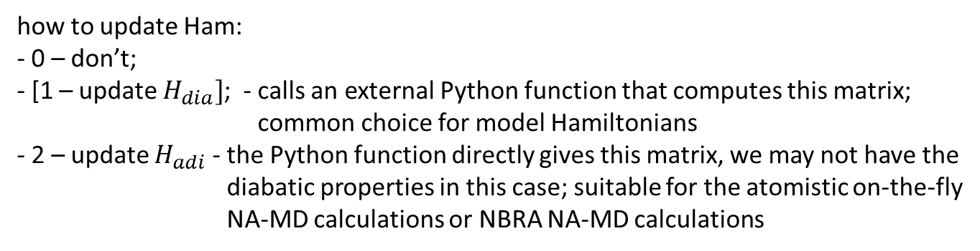
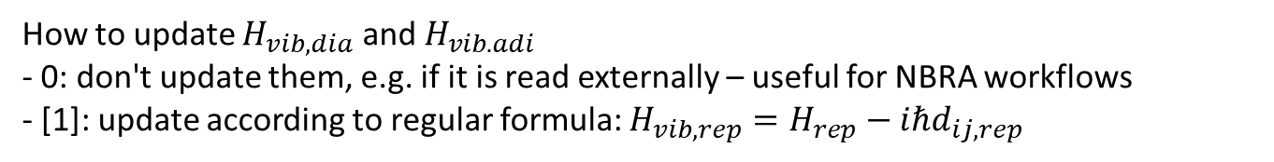
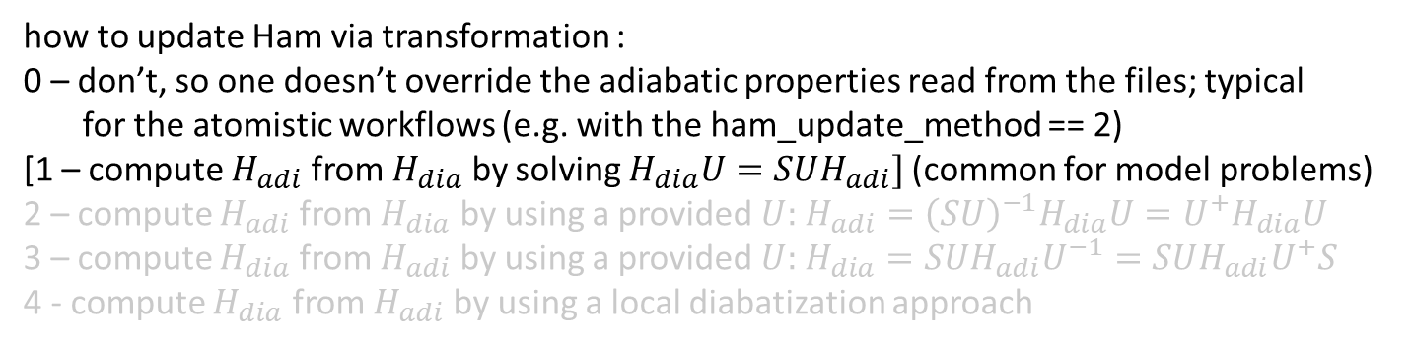
Options for the Dynamics: TD-SE and Hamiltonian
dyn_control_params
rep_tdse
ham_update_method
ham_transform_method
hvib_update_method
how to evolve electronic DOFs: 0 - $C_{dia}$; [1 - $C_{adi}]$; 2 - $P_{dia}$; 3 - $P_{adi}$
how to update Ham:
- 0 – don’t;
- [1 – update $H_{dia}]$; - calls an external Python function that computes this matrix;
common choice for model Hamiltonians
- 2 – update $H_{adi}$ - the Python function directly gives this matrix, we may not have the
diabatic properties in this case; suitable for the atomistic on-the-fly
NA-MD calculations or NBRA NA-MD calculations
how to update Ham via transformation :
0 – don’t, so one doesn’t override the adiabatic properties read from the files; typical
for the atomistic workflows (e.g. with the ham_update_method == 2)
[1 – compute $H_{adi}$ from $H_{dia}$ by solving $H_{dia}U=SUH_{adi}]$ (common for model problems)
2 – compute $H_{adi}$ from $H_{dia}$ by using a provided $U:$ $H_{adi}={\left(SU\right)}^{−1}H_{dia}U=U^{+}H_{dia}U$
3 – compute $H_{dia}$ from $H_{adi}$ by using a provided $U:$ $H_{dia}=SUH_{adi}U^{−1}=SUH_{adi}U^{+}S$
4 - compute $H_{dia}$ from $H_{adi}$ by using a local diabatization approach
To be implemented
How to update $H_{vib,dia}$ and $H_{vib. adi}$
- 0: don't update them, e.g. if it is read externally – useful for NBRA workflows
- [1]: update according to regular formula: $H_{vib,rep}=H_{rep}−iℏd_{ij,rep}$

Slide 5
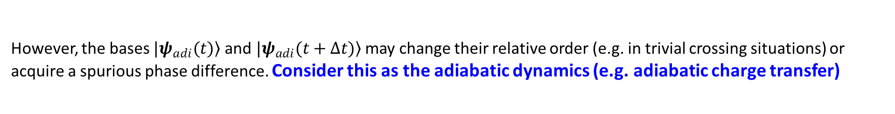
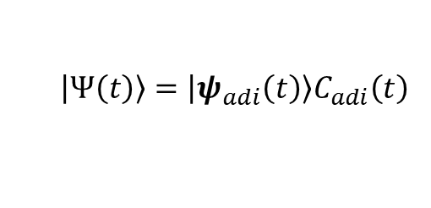
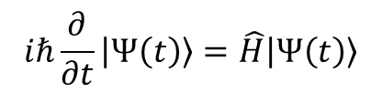
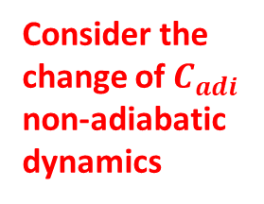
Trivial Crossing Problem
Shakiba, M.; Akimov, A. V. Theor Chem Acc 2023, 142 (8), 68.
We want to solve
$$iℏ\frac{∂}{∂t}\left.\left|Ψ\left(t\right)\right.\right\rangle =\hat{H}\left.\left|Ψ\left(t\right)\right.\right\rangle$$
in the adiabatic basis:
$$\left.\left|Ψ\left(t\right)\right.\right\rangle =\left.\left|ψ_{adi}\left(t\right)\right.\right\rangle C_{adi}\left(t\right)$$
Formal solution:
$$\left.\left|Ψ\left(t+Δt\right)\right.\right\rangle =\left[\int_{0}^{Δt}{dτ}\exp\left(−\frac{iτ}{ℏ}\hat{H}\left(t+τ\right)\right)\right]\left.\left|Ψ\left(t\right)\right.\right\rangle =\left.\left|ψ_{adi}\left(t+Δt\right)\right.\right\rangle C_{adi}\left(t+Δt\right)$$
Consider the change of $C_{adi}$ non-adiabatic dynamics
After projection:
$$C_{adi}\left(t+Δt\right)=\left\langle ψ_{adi}\left.\left(t+Δt\right)\right|\right.\left[\int_{0}^{Δt}{dτ}\exp\left(−\frac{iτ}{ℏ}\hat{H}\left(t+τ\right)\right)\right]\left.\left|ψ_{adi}\left(t\right)\right.\right\rangle C_{adi}\left(t\right)$$
However, the bases $\left.|ψ_{adi}(t)\right\rangle$ and$\left.|ψ_{adi}(t+Δt)\right\rangle$ may change their relative order (e.g. in trivial crossing situations) or acquire a spurious phase difference. Consider this as the adiabatic dynamics (e.g. adiabatic charge transfer)

Slide 6
Trivial Crossing Problem
Arises because of finite $Δt$ or due to inconsistency of energy and NAC (due to approximations)
Not accounting for state tracking can result in – unphysical long-distance charge transfer (e.g. bad carrier mobilities)
Giannini, S.; Carof, A.; Blumberger, J. JPCL 2018, 9, 3116–3123; Bai, X.; Qiu, J.; Wang, L. JCP 2018, 148, 104106.

Slide 7

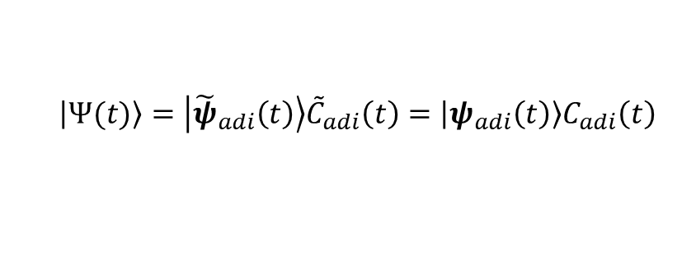

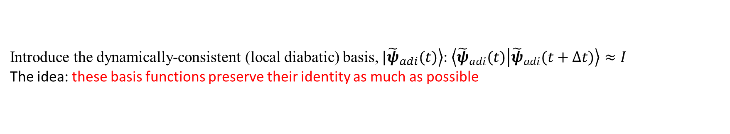


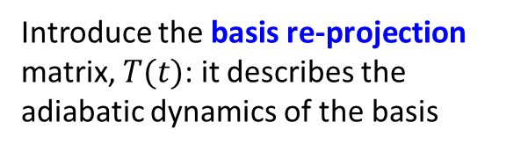

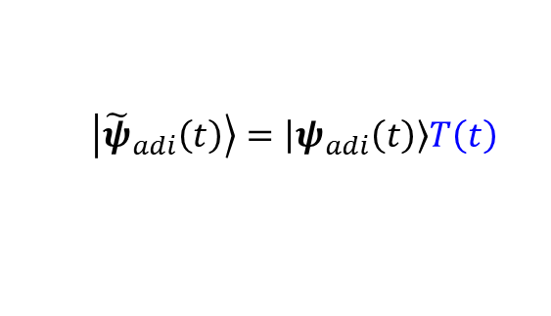
Local Diabatization (LD) Approach
Introduce the dynamically-consistent (local diabatic) basis, $\left.|{\tilde{ψ}}_{adi}(t)\right\rangle$: $\left\langle {\tilde{ψ}}_{adi}(t) | {\tilde{ψ}}_{adi}(t+Δt)\right\rangle ≈I$
The idea: these basis functions preserve their identity as much as possible
Closely related to the one in the LD of Granucci et al.
Introduce the basis re-projection matrix, $T(t)$: it describes the adiabatic dynamics of the basis
$$\left.\left|{\tilde{ψ}}_{adi}\left(t\right)\right.\right\rangle =\left.\left|ψ_{adi}\left(t\right)\right.\right\rangle T\left(t\right)$$
$$T=T_{LD}^{−1}$$
Granucci G, Persico M, Toniolo A J. Chem. Phys. 2001, 114, 10608
The wavefunction should stay invariant w.r.t. the choice of the basis:
$$\left.\left|Ψ(t)\right.\right\rangle =\left.\left|{\tilde{ψ}}_{adi}\left(t\right)\right.\right\rangle {\tilde{C}}_{adi}\left(t\right)=\left.\left|ψ_{adi}\left(t\right)\right.\right\rangle C_{adi}\left(t\right)$$
$$C_{adi}\left(t\right)=T\left(t\right){\tilde{C}}_{adi}\left(t\right)$$
Use the definitions above:
$$T^{+}\left(t\right)\left\langle ψ\left(t\right) | ψ\left(t+Δt\right)\right\rangle T\left(t+Δt\right)=T^{+}\left(t\right)P\left(t , t+Δt\right)T\left(t+Δt\right)≈I$$
Time-overlap (transition density matrix):
$$P\left(t,t+Δt\right)=\left\langle ψ\left(t\right) | ψ\left(t+Δt\right)\right\rangle$$
Solving for the re-projection matrix:
$$T\left(t+Δt\right)={\left[T^{+}\left(t\right)P\left(t,t+Δt\right)\right]}^{−1}$$
but this leads to fast accumulation of errors
so, should not evolve the re-projection matrix globally, only locally:
$$T\left(t\right)=I$$
$$T(t+Δt)=P^{−1}(t,t+Δt)$$
Local diabatization assumption

Slide 8
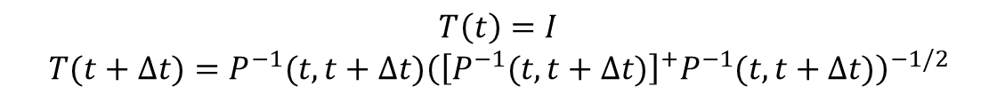
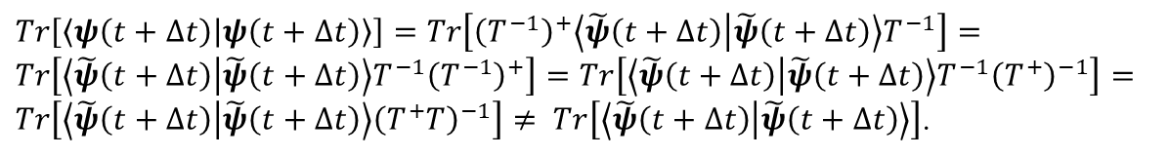
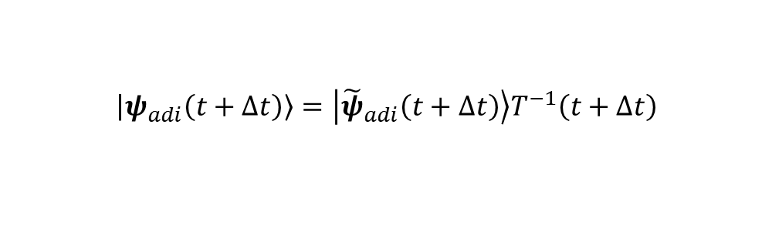
Lowdin normalization in the LD approach
However, this transformation will not preserve the wavefunction norm:
$$T\left(t+Δt\right)={\left[P\left(t,t+Δt\right)\right]}^{−1}$$
$$\left.\left|ψ_{adi}\left(t+Δt\right)\right.\right\rangle =\left.\left|{\tilde{ψ}}_{adi}\left(t+Δt\right)\right.\right\rangle T^{−1}\left(t+Δt\right)$$
$Tr\left[\left\langle ψ\left(t+Δt\right) | ψ\left(t+Δt\right)\right\rangle \right]=Tr\left[{\left(T^{−1}\right)}^{+}\left\langle \tilde{ψ}\left(t+Δt\right) | \tilde{ψ}\left(t+Δt\right)\right\rangle T^{−1}\right]=Tr\left[\left\langle \tilde{ψ}\left(t+Δt\right) | \tilde{ψ}\left(t+Δt\right)\right\rangle T^{−1}{\left(T^{−1}\right)}^{+}\right]=Tr\left[\left\langle \tilde{ψ}\left(t+Δt\right) | \tilde{ψ}\left(t+Δt\right)\right\rangle T^{−1}{\left(T^{+}\right)}^{−1}\right]=Tr\left[\left\langle \tilde{ψ}\left(t+Δt\right) | \tilde{ψ}\left(t+Δt\right)\right\rangle {\left(T^{+}T\right)}^{−1}\right]≠ Tr\left[\left\langle \tilde{ψ}\left(t+Δt\right) | \tilde{ψ}\left(t+Δt\right)\right\rangle \right]$.
Normalize the $T$ matrix: $T→\tilde{T}=TA$ such that ${\tilde{T}}^{+}\left(t+Δt\right)\tilde{T}\left(t+Δt\right)=A^{+}T^{+}\left(t+Δt\right)T\left(t+Δt\right)A=I$
The matrix $A$ can be chosen as: $A={\left(T^{+}\left(t+Δt\right)T\left(t+Δt\right)\right)}^{−1/2}$
So the normalized matrix is: $\tilde{T}\left(t+Δt\right)=T\left(t+Δt\right){\left(T^{+}\left(t+Δt\right)T\left(t+Δt\right)\right)}^{−1/2}$
$$T\left(t\right)=I$$
$$T(t+Δt)=P^{−1}(t,t+Δt){\left({\left[P^{−1}(t,t+Δt)\right]}^{+}P^{−1}(t,t+Δt)\right)}^{−1/2}$$
Local diabatization with Lowdin normalization

Slide 9
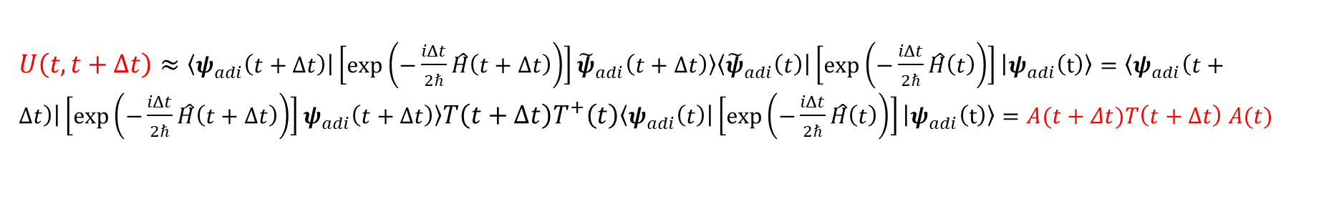
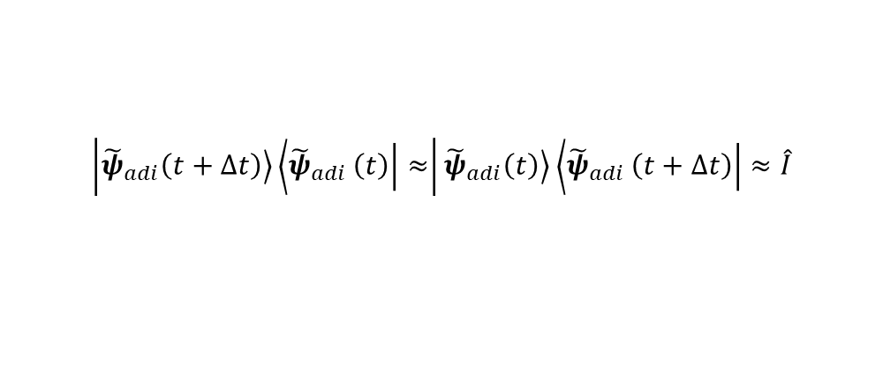
Back to Integrating the TD-SE
$$U\left(t,t+Δt\right)=\left\langle ψ_{adi}\left.\left(t+Δt\right)\right|\right.\left[\int_{0}^{Δt}{dτ}\exp\left(−\frac{iτ}{ℏ}\hat{H}\left(t+τ\right)\right)\right]\left.\left|ψ_{adi}\left(t\right)\right.\right\rangle$$
$$\left[\int_{0}^{Δt}{dτ}\exp\left(−\frac{iτ}{ℏ}\hat{H}\left(τ\right)\right)\right]≈\left[\exp\left(−\frac{iΔt}{2ℏ}\left[\hat{H}\left(t\right)+\hat{H}\left(t+Δt\right)\right]\right)\right]≈\left[\exp\left(−\frac{iΔt}{2ℏ}\hat{H}\left(t+Δt\right)\right)\right]\left[\exp\left(−\frac{iΔt}{2ℏ}\hat{H}\left(t\right)\right)\right]$$
Crude splitting:
$$U\left(t,t+Δt\right)≈\left\langle ψ_{adi}\left.\left(t+Δt\right)\right|\right.\left[\exp\left(−\frac{iΔt}{2ℏ}\hat{H}\left(t+Δt\right)\right)\right]\left[\exp\left(−\frac{iΔt}{2ℏ}\hat{H}\left(t\right)\right)\right]\left.\left|ψ_{adi}\left(t\right)\right.\right\rangle$$
Using properties of the local-diabatic basis:
$$\left|\left.{\tilde{ψ}}_{adi}\left(t+Δt\right)\right\rangle \left\langle {\tilde{ψ}}_{adi}\left.\left(t\right)\right|\right.≈\right|\left.{\tilde{ψ}}_{adi}\left(t\right)\right\rangle \left\langle {\tilde{ψ}}_{adi}\left.\left(t+Δt\right)\right|\right.≈\hat{I}$$
$U\left(t,t+Δt\right)≈\left\langle ψ_{adi}\left.\left(t+Δt\right)\right|\right.\left[\exp\left(−\frac{iΔt}{2ℏ}\hat{H}\left(t+Δt\right)\right)\right]\left.{\tilde{ψ}}_{adi}\left(t+Δt\right)\right\rangle \left\langle {\tilde{ψ}}_{adi}\left.\left(t\right)\right|\right.\left[\exp\left(−\frac{iΔt}{2ℏ}\hat{H}\left(t\right)\right)\right]\left.\left|ψ_{adi}\left(t\right)\right.\right\rangle =\left\langle ψ_{adi}\left.\left(t+Δt\right)\right|\right.\left[\exp\left(−\frac{iΔt}{2ℏ}\hat{H}\left(t+Δt\right)\right)\right]\left.ψ_{adi}\left(t+Δt\right)\right\rangle T\left(t+Δt\right)T^{+}\left(t\right)\left\langle ψ_{adi}\left.\left(t\right)\right|\right.\left[\exp\left(−\frac{iΔt}{2ℏ}\hat{H}\left(t\right)\right)\right]\left.\left|ψ_{adi}\left(t\right)\right.\right\rangle =A(t+Δt)T\left(t+Δt\right)$ $A(t)$
$$A\left(t\right)=\left\langle ψ_{adi}\left.\left(t\right)\right|\right.\left[\exp\left(−\frac{iΔt}{2ℏ}\hat{H}\left(t\right)\right)\right]\left.\left|ψ_{adi}\left(t\right)\right.\right\rangle =\exp\left(−\frac{iΔt}{2ℏ}H\left(t\right)\right)$$
Note: this should be the electronic Hamiltonian, not the vibronic Hamiltonian!

Slide 10
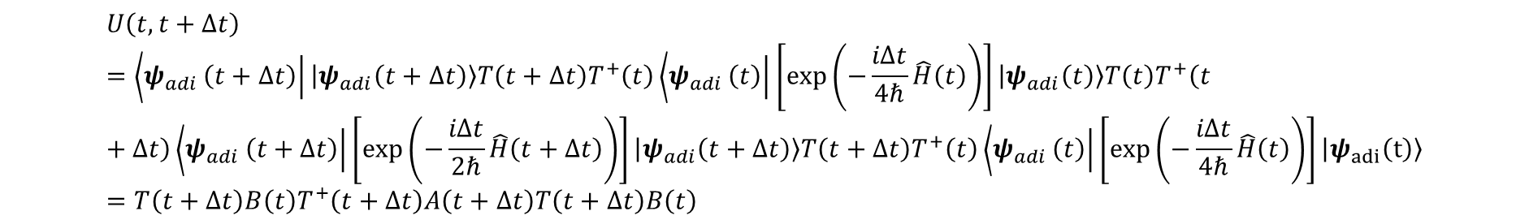
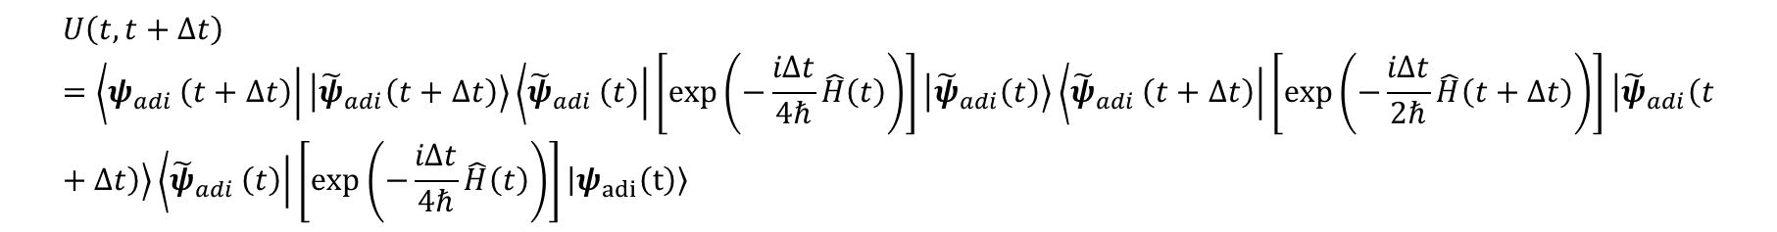
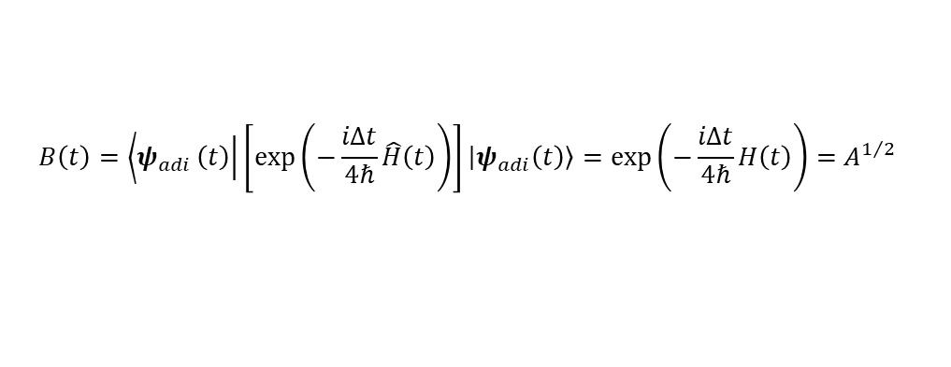
Back to Integrating the TD-SE: Another integrator
$$U\left(t,t+Δt\right)=\left\langle ψ_{adi}\left.\left(t+Δt\right)\right|\right.\left[\exp\left(−\frac{iΔt}{4ℏ}\hat{H}\left(t\right)\right)\right]\left[\exp\left(−\frac{iΔt}{2ℏ}\hat{H}\left(t+Δt\right)\right)\right]\left[\exp\left(−\frac{iΔt}{4ℏ}\hat{H}\left(t\right)\right)\right]\left.\left|ψ_{adi}\left(t\right)\right.\right\rangle$$
Symmetric splitting:
$$U\left(t,t+Δt\right)=\left\langle ψ_{adi}\left.\left(t+Δt\right)\right|\right.\left.\left|{\tilde{ψ}}_{adi}\left(t+Δt\right)\right.\right\rangle \left\langle {\tilde{ψ}}_{adi}\left.\left(t\right)\right|\right.\left[\exp\left(−\frac{iΔt}{4ℏ}\hat{H}\left(t\right)\right)\right]\left.\left|{\tilde{ψ}}_{adi}\left(t\right)\right.\right\rangle \left\langle {\tilde{ψ}}_{adi}\left.\left(t+Δt\right)\right|\right.\left[\exp\left(−\frac{iΔt}{2ℏ}\hat{H}\left(t+Δt\right)\right)\right]\left.\left|{\tilde{ψ}}_{adi}\left(t+Δt\right)\right.\right\rangle \left\langle {\tilde{ψ}}_{adi}\left.\left(t\right)\right|\right.\left[\exp\left(−\frac{iΔt}{4ℏ}\hat{H}\left(t\right)\right)\right]\left.\left|ψ_{adi}\left(t\right)\right.\right\rangle$$
$$U\left(t,t+Δt\right)=\left\langle ψ_{adi}\left.\left(t+Δt\right)\right|\right.\left.\left|ψ_{adi}\left(t+Δt\right)\right.\right\rangle T\left(t+Δt\right)T^{+}\left(t\right)\left\langle ψ_{adi}\left.\left(t\right)\right|\right.\left[\exp\left(−\frac{iΔt}{4ℏ}\hat{H}\left(t\right)\right)\right]\left.\left|ψ_{adi}\left(t\right)\right.\right\rangle T\left(t\right)T^{+}\left(t+Δt\right)\left\langle ψ_{adi}\left.\left(t+Δt\right)\right|\right.\left[\exp\left(−\frac{iΔt}{2ℏ}\hat{H}\left(t+Δt\right)\right)\right]\left.\left|ψ_{adi}\left(t+Δt\right)\right.\right\rangle T\left(t+Δt\right)T^{+}\left(t\right)\left\langle ψ_{adi}\left.\left(t\right)\right|\right.\left[\exp\left(−\frac{iΔt}{4ℏ}\hat{H}\left(t\right)\right)\right]\left.\left|ψ_{adi}\left(t\right)\right.\right\rangle =T\left(t+Δt\right)B\left(t\right)T^{+}\left(t+Δt\right)A\left(t+Δt\right)T\left(t+Δt\right)B\left(t\right)$$
$$B\left(t\right)=\left\langle ψ_{adi}\left.\left(t\right)\right|\right.\left[\exp\left(−\frac{iΔt}{4ℏ}\hat{H}\left(t\right)\right)\right]\left.\left|ψ_{adi}\left(t\right)\right.\right\rangle =\exp\left(−\frac{iΔt}{4ℏ}H\left(t\right)\right)=A^{1/2}$$

Slide 11
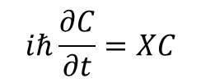
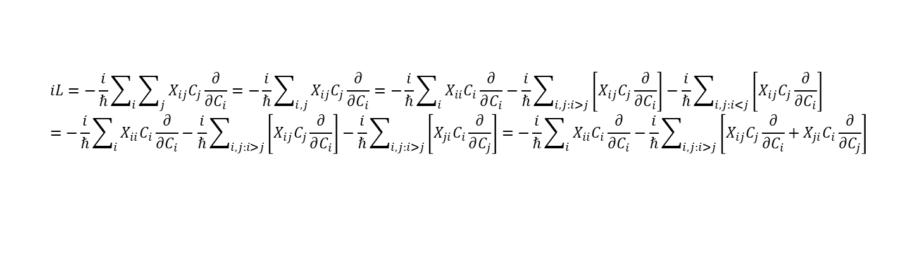
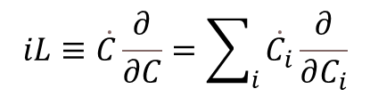
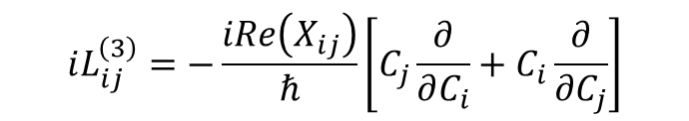

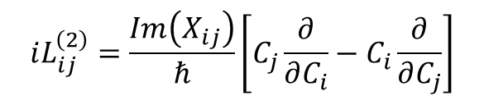

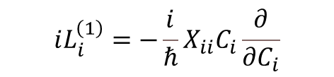
Rotation-based Integrators for TD-SE
$$iℏ\frac{∂C}{∂t}=XC$$
$$X_{ij}=Re\left[X_{ij}\right]+iIm\left[X_{ij}\right]$$
$C\left(t+Δt\right)=exp⁡(iLΔt)C(t)$.
$$iL≡\dot{C}\frac{∂}{∂C}=\sum_{i}{\dot{C_{i}}\frac{∂}{∂C_{i}}}$$
$$iL=−\frac{i}{ℏ}\sum_{i}{\sum_{j}{X_{ij}C_{j}}\frac{∂}{∂C_{i}}}=−\frac{i}{ℏ}\sum_{i,j}{X_{ij}C_{j}\frac{∂}{∂C_{i}}}=−\frac{i}{ℏ}\sum_{i}{X_{ii}C_{i}\frac{∂}{∂C_{i}}}−\frac{i}{ℏ}\sum_{i,j:i>j}{\left[X_{ij}C_{j}\frac{∂}{∂C_{i}}\right]}−\frac{i}{ℏ}\sum_{i,j:i<j}{\left[X_{ij}C_{j}\frac{∂}{∂C_{i}}\right]}=−\frac{i}{ℏ}\sum_{i}{X_{ii}C_{i}\frac{∂}{∂C_{i}}}−\frac{i}{ℏ}\sum_{i,j:i>j}{\left[X_{ij}C_{j}\frac{∂}{∂C_{i}}\right]}−\frac{i}{ℏ}\sum_{i,j:i>j}{\left[X_{ji}C_{i}\frac{∂}{∂C_{j}}\right]}=−\frac{i}{ℏ}\sum_{i}{X_{ii}C_{i}\frac{∂}{∂C_{i}}}−\frac{i}{ℏ}\sum_{i,j:i>j}{\left[X_{ij}C_{j}\frac{∂}{∂C_{i}}+X_{ji}C_{i}\frac{∂}{∂C_{j}}\right]}$$
$$iL=−\frac{i}{ℏ}\sum_{i}{X_{ii}C_{i}\frac{∂}{∂C_{i}}}−\frac{i}{ℏ}\sum_{i,j:i>j}{\left[Re\left(X_{ij}\right)\left[C_{j}\frac{∂}{∂C_{i}}+C_{i}\frac{∂}{∂C_{j}}\right]+iIm\left(X_{ij}\right)\left[C_{j}\frac{∂}{∂C_{i}}−C_{i}\frac{∂}{∂C_{j}}\right]\right]}=\sum_{i}{iL_{i}^{\left(1\right)}}+\sum_{i,j:i>j}{iL_{ij}^{\left(2\right)}}+\sum_{i,j:i>j}{iL_{ij}^{\left(3\right)}}$$
$$iL_{ij}^{\left(2\right)}=\frac{Im\left(X_{ij}\right)}{ℏ}\left[C_{j}\frac{∂}{∂C_{i}}−C_{i}\frac{∂}{∂C_{j}}\right]$$
$$iL_{ij}^{\left(3\right)}=−\frac{iRe\left(X_{ij}\right)}{ℏ}\left[C_{j}\frac{∂}{∂C_{i}}+C_{i}\frac{∂}{∂C_{j}}\right]$$
$$iL_{i}^{\left(1\right)}=−\frac{i}{ℏ}X_{ii}C_{i}\frac{∂}{∂C_{i}}$$

Slide 12
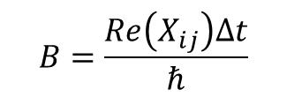
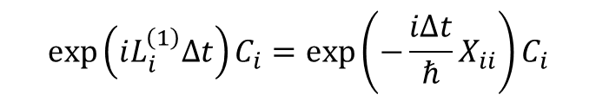
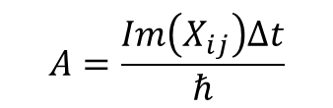
Rotation-based Integrators for TD-SE: Action of the operators
$$\exp\left(iL_{i}^{\left(1\right)}Δt\right)C_{i}=\exp\left(−\frac{iΔt}{ℏ}X_{ii}\right)C_{i}$$
$$A=\frac{Im\left(X_{ij}\right)Δt}{ℏ}$$
$$B=\frac{Re\left(X_{ij}\right)Δt}{ℏ}$$
$$\exp\left(iL_{ij}^{\left(2\right)}Δt\right)\left(\begin{matrix}C_{i} \\ C_{j}\end{matrix}\right)=\left(\begin{matrix}C_{i} \\ C_{j}\end{matrix}\right)+A\left(\begin{matrix}C_{j} \\ {−C}_{i}\end{matrix}\right)+\frac{A^{2}}{2!}\left(\begin{matrix}−C_{i} \\ {−C}_{j}\end{matrix}\right)+\frac{A^{3}}{3!}\left(\begin{matrix}−C_{j} \\ C_{i}\end{matrix}\right)+\frac{A^{4}}{4!}\left(\begin{matrix}C_{i} \\ C_{j}\end{matrix}\right)…=\left(\begin{matrix}1−\frac{A^{2}}{2!}+\frac{A^{4}}{4!}… & A−\frac{A^{3}}{3!}+… \\ −A+\frac{A^{3}}{3!}+… & 1−\frac{A^{2}}{2!}+\frac{A^{4}}{4!}…\end{matrix}\right)\left(\begin{matrix}C_{i} \\ C_{j}\end{matrix}\right)=\left(\begin{matrix}\cos\left(A\right) & \sin\left(A\right) \\ −\sin\left(A\right) & \cos\left(A\right)\end{matrix}\right)\left(\begin{matrix}C_{i} \\ C_{j}\end{matrix}\right)$$
$$\exp\left(iL_{ij}^{\left(3\right)}Δt\right)\left(\begin{matrix}C_{i} \\ C_{j}\end{matrix}\right)=\left(\begin{matrix}C_{i} \\ C_{j}\end{matrix}\right)−iB\left(\begin{matrix}C_{j} \\ C_{i}\end{matrix}\right)+\frac{{\left(−iB\right)}^{2}}{2!}\left(\begin{matrix}C_{i} \\ C_{j}\end{matrix}\right)+\frac{{\left(−iB\right)}^{3}}{3!}\left(\begin{matrix}C_{j} \\ C_{i}\end{matrix}\right)+\frac{{\left(−iB\right)}^{4}}{4!}\left(\begin{matrix}C_{i} \\ C_{j}\end{matrix}\right)+…=\left(\begin{matrix}1−\frac{B^{2}}{2!}+\frac{B^{4}}{4!}+… & −iB+\frac{\left(−i{\left.B\right)}^{3}\right.}{3!}+… \\ −iB+\frac{\left(−i{\left.B\right)}^{3}\right.}{3!}+… & 1−\frac{B^{2}}{2!}+\frac{B^{4}}{4!}+…\end{matrix}\right)\left(\begin{matrix}C_{i} \\ C_{j}\end{matrix}\right)=\left(\begin{matrix}\cos\left(B\right) & −i\sin\left(B\right) \\ −i\sin\left(B\right) & \cos\left(B\right)\end{matrix}\right)\left(\begin{matrix}C_{i} \\ C_{j}\end{matrix}\right)$$

Slide 13
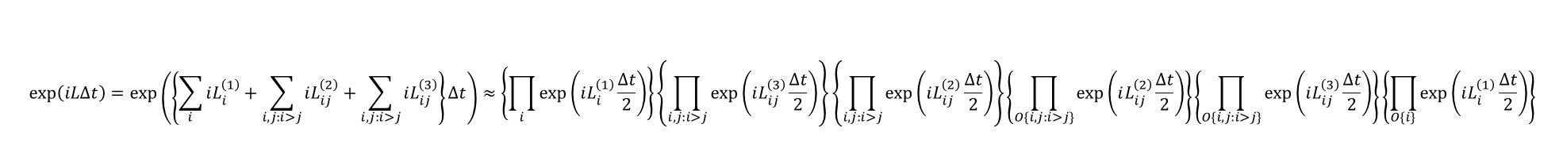
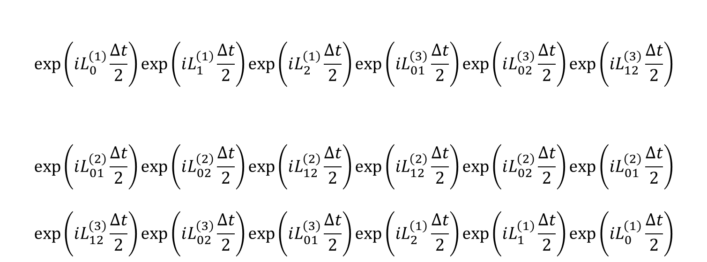
Rotation-based Integrators for TD-SE: Overall Factorization
$$\exp\left(iLΔt\right)=\exp\left(\left\{\sum_{i}{iL_{i}^{\left(1\right)}}+\sum_{i,j:i>j}{iL_{ij}^{\left(2\right)}}+\sum_{i,j:i>j}{iL_{ij}^{\left(3\right)}}\right\}Δt\right)≈\left\{\prod_{i}{\exp\left(iL_{i}^{\left(1\right)}\frac{Δt}{2}\right)}\right\}\left\{\prod_{i,j:i>j}{\exp\left(iL_{ij}^{\left(3\right)}\frac{Δt}{2}\right)}\right\}\left\{\prod_{i,j:i>j}{\exp\left(iL_{ij}^{\left(2\right)}\frac{Δt}{2}\right)}\right\}\left\{\prod_{O\{i,j:i>j\}}{\exp\left(iL_{ij}^{\left(2\right)}\frac{Δt}{2}\right)}\right\}\left\{\prod_{O\{i,j:i>j\}}{\exp\left(iL_{ij}^{\left(3\right)}\frac{Δt}{2}\right)}\right\}\left\{\prod_{O\{i\}}{\exp\left(iL_{i}^{\left(1\right)}\frac{Δt}{2}\right)}\right\}$$
$$\exp\left(iL_{0}^{\left(1\right)}\frac{Δt}{2}\right)\exp\left(iL_{1}^{\left(1\right)}\frac{Δt}{2}\right)\exp\left(iL_{2}^{\left(1\right)}\frac{Δt}{2}\right)\exp\left(iL_{01}^{\left(3\right)}\frac{Δt}{2}\right)\exp\left(iL_{02}^{\left(3\right)}\frac{Δt}{2}\right)\exp\left(iL_{12}^{\left(3\right)}\frac{Δt}{2}\right)$$
$$\exp\left(iL_{01}^{\left(2\right)}\frac{Δt}{2}\right)\exp\left(iL_{02}^{\left(2\right)}\frac{Δt}{2}\right)\exp\left(iL_{12}^{\left(2\right)}\frac{Δt}{2}\right)\exp\left(iL_{12}^{\left(2\right)}\frac{Δt}{2}\right)\exp\left(iL_{02}^{\left(2\right)}\frac{Δt}{2}\right)\exp\left(iL_{01}^{\left(2\right)}\frac{Δt}{2}\right)$$
$$\exp\left(iL_{12}^{\left(3\right)}\frac{Δt}{2}\right)\exp\left(iL_{02}^{\left(3\right)}\frac{Δt}{2}\right)\exp\left(iL_{01}^{\left(3\right)}\frac{Δt}{2}\right)\exp\left(iL_{2}^{\left(1\right)}\frac{Δt}{2}\right)\exp\left(iL_{1}^{\left(1\right)}\frac{Δt}{2}\right)\exp\left(iL_{0}^{\left(1\right)}\frac{Δt}{2}\right)$$

Slide 14

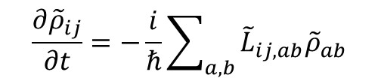

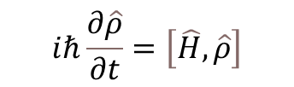
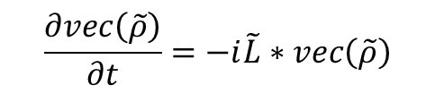




Working the Liouville’s space: propagation of density matrix
$$iℏ\frac{∂\hat{ρ}}{∂t}=\left[\hat{H},\hat{ρ}\right]$$
Vectorized form of the QCLE
$${\tilde{L}}_{ij,ab}={\tilde{H}}_{ia}δ_{bj}−{\tilde{H}}_{bj}δ_{ai}$$
$$\frac{∂{\tilde{ρ}}_{ij}}{∂t}=−\frac{i}{ℏ}\sum_{a,b}{{\tilde{L}}_{ij,ab}{\tilde{ρ}}_{ab}}$$
$$\frac{∂vec\left(\tilde{ρ}\right)}{∂t}=−i\tilde{L}∗vec\left(\tilde{ρ}\right)$$
$$\tilde{H}=\left\langle \tilde{ψ} | \hat{H} | \tilde{ψ}\right\rangle =T^{+}\left\langle ψ | \hat{H} | ψ\right\rangle T$$
$N×N$ matrix
$N^{2}×N^{2}$ matrix
$N^{2}×1$ vector
For the “closed” quantum systems, there is a direct correspondence between wavefunction and density matrix, so:
$$ρ_{adi}=C_{adi}C_{adi}^{+}=T{\tilde{C}}_{adi}{\tilde{C}}_{adi}^{+}T^{+}=T{\tilde{ρ}}_{adi}T^{+}$$
$${\tilde{ρ}}_{adi}=T^{−1}ρ_{adi}{\left(T^{+}\right)}^{−1}=T^{+}ρ_{adi}T$$
$$ρ\left(t+Δt\right)=T\left(t+Δt\right)vec^{−1}\left\{\left[\int_{0}^{Δt}{dτ}\exp\left(−\frac{iτ}{ℏ}\tilde{L}\left(t+τ\right)\right)\right]vec\left(ρ\left(t\right)\right)T\right\}T^{+}\left(t+Δt\right)$$
So, the final expression:

Slide 15
Overview of Electronic Integrators
dyn_control_params
electronic_integrator
rep_tdse = 0 (diabatic):
rep_tdse = 1 (adiabatic):
rep_tdse = 2 ( diabatic, density matrix formalism):
-1 - No propagation
0 - LD, with crude splitting, with exp_ [ default ]
1 - LD, with symmetric splitting, with exp_
2 - LD, original, with exp_
3 - 1-point, Hvib integration, with exp_
4 - 2-points, Hvib integration, with exp_
5 - 3-points, Hvib, integration with the second-point correction of Hvib, with exp_
6 - same as 4, but without projection matrices (T_new = I)
10 - same as 0, but with rotations
11 - same as 1, but with rotations
12 - same as 2, but with rotations
13 - same as 3, but with rotations
14 - same as 4, but with rotations
15 - same as 5, but with rotations
0 - mid-point Hvib with the second-point correction of Hvib
-1 - No propagation
0 - Lowdin exp_ with 2-point Hvib_dia
1 - based on QTAG propagator
2 - based on modified QTAG propagator (Z at two times)
3 - non-Hermitian integrator with 2-point Hvib_dia
rep_tdse = 3 ( adiabatic, density matrix formalism):
0 - mid-point Hvib with the second-point correction of Hvib
1 - Zhu Liouvillian
10 - same as 0, but with rotations

Slide 16
Additional flags for the Integrators
dyn_control_params
assume_always_consistent
ampl_transformation_method
If set to True (1), we will force the reprojection matrix T_new to be the identity matrix. This effectively removes basis-reprojection (local diabatization) approach and turns on the "naive" approach where no trivial crossings exist.
- [0]: No - we do want to use the LD approaches by default.
- 1: Yes - one may need to turn on additional state tracking and phase correction methods
Whether transform the amplitudes by the T transformation matrix
- 0: do not transform by the T matrix (naive, but potentially correct approach)
- 1: do transform it (as in LD, but maybe not needed if we directly transform basis)

