Slide 1

Libra Summer School and Workshop 2024
TSH: Part 3
Alexey Akimov
University at Buffalo, SUNY
July 9, 2024

Slide 2
TSH in the nutshell
Initialization
Nuclear dynamics
$\dot{p_{i}}=−\frac{∂H}{∂r_{i}}$ $\dot{r_{i}}=\frac{∂H}{∂p_{i}}$
Stationary adiabatic states
$${\hat{H}}_{el}ψ_{i}=E_{i}ψ_{i}$$
Non-adiabatic Couplings
$$d_{ij}=\frac{\left\langle ψ_{i}(t) | ψ_{j}(t+dt)\right\rangle −\left\langle ψ_{i}(t+dt) | ψ_{j}(t)\right\rangle }{2dt}$$
Electronic Dynamics
$$Ψ\left(r,R,t\right)=\sum_{i}{c_{i}\left(t\right)ψ_{i}(r;R(t))}$$
$$iℏ\frac{∂c_{i}(t)}{∂t}=\sum_{j}{\left(E_{i}δ_{ij}−iℏd_{ij}\right)}c_{j}$$
NBRA
Decoherence 1
$$c_{i}→c_{i}\exp\left(−\frac{Δt}{τ_{ij}}\right), ∀i≠j$$
as in SDM
Proposed Hops
Decoherence 2
$$P_{i→j}=Δt∗Re\left(\frac{2{\frac{p}{m}d}_{ij}c_{i}^{∗}c_{j}}{c_{i}^{∗}c_{i}}\right)$$
or as in DISH
based on energy conservation or
$$P_{i→f}^{A}=\min\left(1, \exp\left(−\frac{ΔE}{k_{B}T}\right)\right)$$
Accept Hops
Change of state/Velocity rescaling
change active electronic state, rescale velocity

Slide 3
Trajectory Surface Hopping (TSH) methods
in Libra

Slide 4
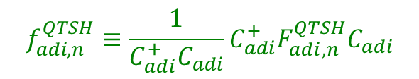
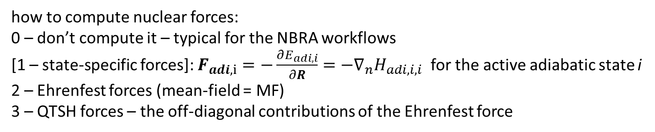
Options for the Dynamics: Forces
dyn_control_params
force_method
rep_force
how to compute nuclear forces:
0 – don’t compute it – typical for the NBRA workflows
[1 – state-specific forces]: $F_{adi,i}=−\frac{∂E_{adi, i}}{∂R}=−∇_{n}H_{adi,i,i}$ for the active adiabatic state i
2 – Ehrenfest forces (mean-field = MF)
3 – QTSH forces – the off-diagonal contributions of the Ehrenfest force
$$f_{adi, n}^{QTSH}≡\frac{1}{C_{adi}^{+}C_{adi}}C_{adi}^{+}F_{adi,n}^{QTSH}C_{adi}$$
0 – using only diabatic properties; [1 – using adiabatic properties]
$$f_{n}^{MF}≡f_{n,dia}^{MF}=\frac{1}{C_{dia}^{+}SC_{dia}}C_{dia}^{+}F_{dia,n}^{HF}C_{dia}=f_{n,adi}^{MF}=\frac{1}{C_{adi}^{+}C_{adi}}C_{adi}^{+}F_{adi,n}^{HF}C_{adi}$$
nHamiltonian
Ehrenfest_forces_dia
Ehrenfest_forces_adi
Ehrenfest_forces_tens_dia
Ehrenfest_forces_tens_adi
$$F_{dia,n}^{MF}=−\left\langle ψ_{dia} | ∇_{n}H | ψ_{dia}\right\rangle =\left[−∇_{n}H_{dia}+D_{dia,n}^{+}S^{−1}H_{dia}+H_{dia}S^{−1}D_{dia,n}\right]$$
$$F_{adi,n}^{MF}=−\left\langle ψ_{adi} | ∇_{n}H | ψ_{adi}\right\rangle =\left[−∇_{n}H_{adi}+D_{adi,n}^{+}H_{adi}+H_{adi}D_{adi,n}\right]$$
$$F_{adi,n}^{QTSH}=−\left\langle ψ_{adi} | ∇_{n}H | ψ_{adi}\right\rangle =\left[D_{adi,n}^{+}H_{adi}+H_{adi}D_{adi,n}\right]$$

Slide 5
Options for the Dynamics: Forces
Note on the Ehrenfest force calculations:
In the normal approach, when we rely on the TD-SE integrator that uses NACs, the force tensor is computed as:
$$F_{adi,n}^{MF}=−\left\langle ψ_{adi} | ∇_{n}H | ψ_{adi}\right\rangle =\left[−∇_{n}H_{adi}+D_{adi,n}^{+}H_{adi}+H_{adi}D_{adi,n}\right]$$
However, when the local diabatization integrators are used, the NACs vanish,$D_{adi}≈0$, so the force tensor becomes just:
$$F_{adi,n}^{MF, LD}=−\left\langle ψ_{adi} | ∇_{n}H | ψ_{adi}\right\rangle ≈−∇_{n}H_{adi}$$
dyn_control_params
enforce_state_following
enforced_state_index
Whether we want to enforce nuclear dynamics to be on a given state, regardless of the TSH transitions: [0 – no]; 1 – yes (the dynamics is governed by the given PES, but the hopping may still be happening). The option 1 can be used for NBRA for the excited-state surfaces.
If we enforce the nuclear dynamics to be on a given state, what is the index of that state [any integer > 0, default = 0 ]
The default value of 0 enforces the nuclear dynamics to be on the ground state.

Slide 6
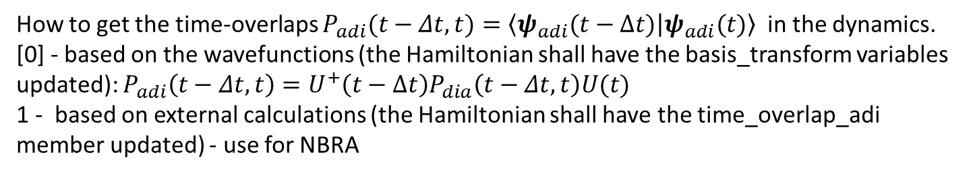
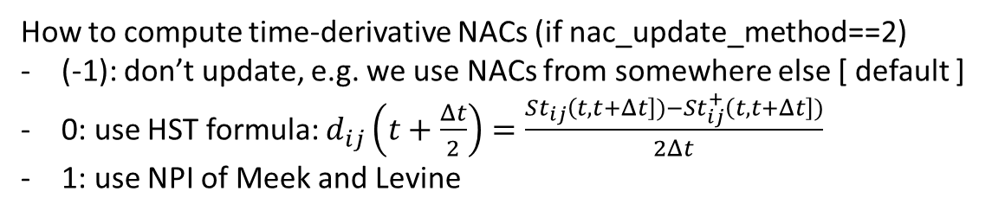
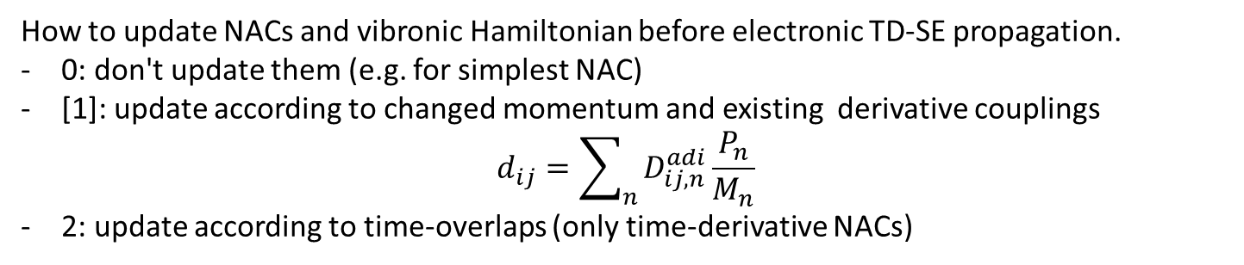
Options for the Dynamics: Time-overlaps and NACs
dyn_control_params
time_overlap_method
nac_update_method
nac_algo
How to get the time-overlaps $P_{adi}(t−Δt,t)=\left\langle ψ_{adi}(t−Δt) | ψ_{adi}(t)\right\rangle$ in the dynamics.
[0] - based on the wavefunctions (the Hamiltonian shall have the basis_transform variables updated): $P_{adi}\left(t−Δt,t\right)=U^{+}\left(t−Δt\right)P_{dia}\left(t−Δt,t\right)U(t)$
1 - based on external calculations (the Hamiltonian shall have the time_overlap_adi member updated) - use for NBRA
How to update NACs and vibronic Hamiltonian before electronic TD-SE propagation.
0: don't update them (e.g. for simplest NAC)
[1]: update according to changed momentum and existing derivative couplings
$$d_{ij}=\sum_{n}{D_{ij,n}^{adi}\frac{P_{n}}{M_{n}}}$$
2: update according to time-overlaps (only time-derivative NACs)
How to compute time-derivative NACs (if nac_update_method==2)
(-1): don’t update, e.g. we use NACs from somewhere else [ default ]
0: use HST formula: $d_{ij}\left(t+\frac{Δt}{2}\right)=\frac{St_{ij}\left(t,t+Δt\right])−St_{ij}^{+}\left(t,t+Δt\right])}{2Δt}$
1: use NPI of Meek and Levine
$$T\left(t+Δt\right)=S′\left(t,t+Δt\right)=\left\langle ψ\left(t\right) | ψ\left(t+Δt\right)\right\rangle$$
$$d\left(t+\frac{Δt}{2}\right)≈\frac{1}{Δt}\int_{0}^{dt}{\left\langle ψ\left(t^{′}\right) | \frac{∂}{∂t^{′}} | ψ\left(t^{′}\right)\right\rangle dt^{′}}= \frac{1}{Δt}\int_{0}^{dt}{T^{+}\left(t^{′}\right)\frac{∂}{∂t^{′}}T\left(t^{′}\right)dt^{′}}=\frac{log\left[T\left(t+Δt\right)\right]}{Δt}$$
Meek, G. A.; Levine, B. G. J. Phys. Chem. Lett. 2014, 5, 2351.

Slide 7
Hop Proposal Probability
dyn_control_params
tsh_method
FSSH:
Tully, J. C. J. Chem. Phys. 1990, 93, 1061
GFSH:
Wang, L.; Trivedi, D.; Prezhdo, O. V. JCTC 2014, 10, 3598
- [-1]: adiabatic dynamics, no hops [ default ]
- 0: Fewest Switches Surface Hopping (FSSH)
- 1: Global Flux Surface Hopping (GFSH)
- 2: Markov-State Surface Hopping (MSSH)
- 3: Landau-Zener (LZ) options
- 4: Zhu-Nakamura (ZN) options
- 5: DISH (see decoherence)
- 6: MASH
- 7: FSSH2
- 8: FSSH3
MSSH:
Akimov, A. V.; Trivedi, D.; Wang, L.; Prezhdo, O. V. J. Phys. Soc. Jpn. 2015, 84, 094002
MASH:
(1)Mannouch, J. R.; Richardson, J. O. A JCP 2023, 158, 104111
(2)Runeson, J. E.; Manolopoulos, D. E. A JCP 2023, 159, 094115.
(3)E. Runeson, J.; P. Fay, T.; E. Manolopoulos, D. PCCP 2024, 26, 4929–4938.
FSSH3:
Akimov, A. V. Mol. Phys. 2024, to appear in press
FSSH2:
Araujo, L.; Lasser, C.; Schmidt, B. J. Chem. Theory Comput. 2024, 20, 3413–3419
ZN:
Zhu, C., Nakamura, H., Re, N., Aquilanti, V., 1992. J. Chem. Phys. 97, 1892
Hanasaki, K., Kanno, M., Niehaus, T.A., Kono, H., 2018. J. Chem. Phys. 149. 244117
Yu, L., Xu, C., Lei, Y., Zhu, C., Wen, Z., 2014. Phys. Chem. Chem. Phys. 16. 25883.
LZ:
Tully, J. C. J. Chem. Phys. 1990, 93, 1061, 1071
Belyaev, A. K.; Lebedev, O. V. Phys. Rev. A 2011, 84, 014701

Slide 8

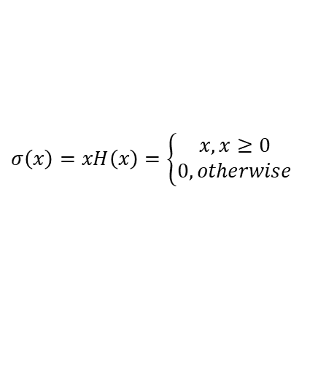
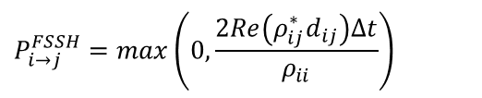
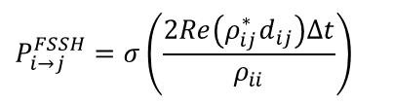

FSSH and MSSH Hop Proposal Probability
FSSH
$$P_{i→∗}\left(t,t+Δt\right)=σ\left(\frac{ρ_{ii}\left(t\right)−ρ_{ii}\left(t+Δt\right)}{ρ_{ii}\left(t\right)}\right)≈σ\left(\frac{−{\dot{ρ}}_{ii}\left(t\right)Δt}{ρ_{ii}\left(t\right)}\right)=σ\left(−\frac{Δρ_{ii}\left(t\right)}{ρ_{ii}\left(t\right)}\right)=σ\left(−\frac{ρ_{ii}\left(t+Δt\right)−ρ_{ii}\left(t\right)}{ρ_{ii}\left(t\right)}\right)$$
$$σ\left(x\right)=xH\left(x\right)=\left\{\begin{matrix}x,x≥0 \\ 0, otherwise\end{matrix}\right.$$
$$P_{i→∗}\left(t,t+Δt\right)≈σ\left(\frac{−{\dot{ρ}}_{ii}\left(t\right)Δt}{ρ_{ii}\left(t\right)}\right)=2σ\left(\frac{\sum_{j=0}^{N−1}{Re\left(ρ_{ij}^{∗}d_{ij}\right)}Δt}{ρ_{ii}}\right)≈\sum_{j=0}^{N−1}{σ\left(\frac{2Re\left(ρ_{ij}^{∗}d_{ij}\right)Δt}{ρ_{ii}}\right)}$$
References:
$$P_{i→j}^{FSSH}=σ\left(\frac{2Re\left(ρ_{ij}^{∗}d_{ij}\right)Δt}{ρ_{ii}}\right)$$
Tully, J. C. J. Chem. Phys. 1990, 93, 1061
Fabiano, E.; Keal, T. W.; Thiel, W. Chem. Phys. 2008, 349 (1), 334–347.
$$P_{i→j}^{FSSH}=max\left(0, \frac{2Re\left(ρ_{ij}^{∗}d_{ij}\right)Δt}{ρ_{ii}}\right)$$
$$P_{i→j}^{P}=max\left(0,\frac{Δt}{ℏP_{ii}}Im\left[P_{i,j}H_{j,i }^{vib} −H_{i,j }^{vib}P_{j,i}\right]\right)$$
MSSH
$$P_{i→f}^{P,MSSH}(t,t+Δt)=P_{ff}(t+Δt)$$
Akimov, A. V.; Trivedi, D.; Wang, L.; Prezhdo, O. V. J. Phys. Soc. Jpn. 2015, 84, 094002

Slide 9

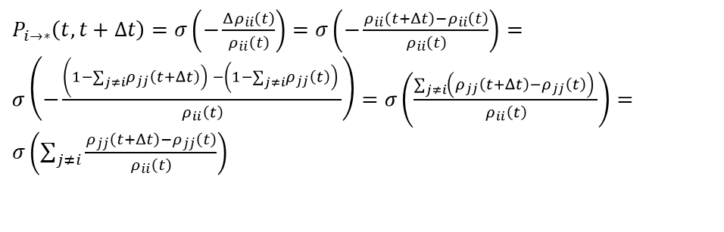
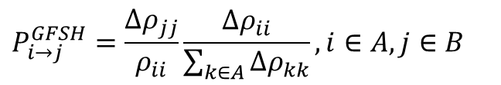

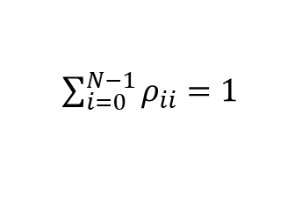
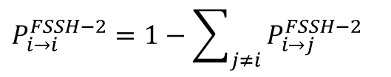
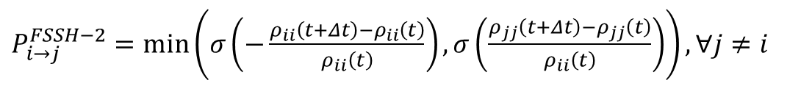

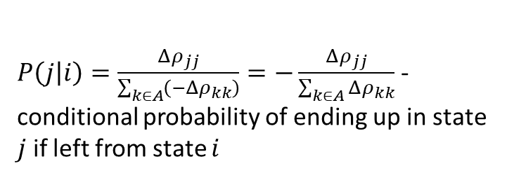




GFSH and FSSH-2 Hop Proposal Probability
FSSH-2
GFSH – starts with considering the changes of populations of all states
Total flux out of state $i$ is the same as in the FSSH
$P_{i→∗}\left(t,t+Δt\right)≈σ\left(\frac{−{\dot{ρ}}_{ii}\left(t\right)Δt}{ρ_{ii}\left(t\right)}\right)=σ\left(−\frac{Δρ_{ii}\left(t\right)}{ρ_{ii}\left(t\right)}\right)$
$\sum_{i=0}^{N−1}{ρ_{ii}}=1$
$$Δρ_{ii}\left(t\right)=ρ_{ii}\left(t+Δt\right)−ρ_{ii}\left(t\right)$$
$$i∈A:Δρ_{ii}<0$$
$P_{i→∗}\left(t,t+Δt\right)=σ\left(−\frac{Δρ_{ii}\left(t\right)}{ρ_{ii}\left(t\right)}\right)=σ\left(−\frac{ρ_{ii}\left(t+Δt\right)−ρ_{ii}\left(t\right)}{ρ_{ii}\left(t\right)}\right)=σ\left(−\frac{\left(1−\sum_{j≠i}{\left.ρ_{jj}\left(t+Δt\right)\right) }−\left(1−\sum_{j≠i}{\left.ρ_{jj}\left(t\right)\right) }\right.\right.}{ρ_{ii}\left(t\right)}\right)=σ\left(\frac{\sum_{j≠i}{\left(ρ_{jj}\left(t+Δt\right)−ρ_{jj}\left(t\right)\right) }}{ρ_{ii}\left(t\right)}\right)=σ\left(\sum_{j≠i}{\frac{ρ_{jj}\left(t+Δt\right)−ρ_{jj}\left(t\right)}{ρ_{ii}\left(t\right)}}\right)$
$$i∈B:Δρ_{ii}>0$$
$$P_{i→j}^{GFSH}=\frac{Δρ_{jj}}{ρ_{ii}}\frac{Δρ_{ii}}{\sum_{k∈A}{Δρ_{kk}}}, i∈A,j∈B$$
$P_{i→∗}=−\frac{Δρ_{ii}}{ρ_{ii}}$ - total flux out of state $i$
$P_{i→j}^{FSSH−2}=\frac{ρ_{jj}\left(t+Δt\right)−ρ_{jj}\left(t\right)}{ρ_{ii}\left(t\right)}$ - the interpretation is
$P\left(j\left|i\right.\right)=\frac{Δρ_{jj}}{\sum_{k∈A}{\left(−Δρ_{kk}\right)}}=−\frac{Δρ_{jj}}{\sum_{k∈A}{Δρ_{kk}}}$ - conditional probability of ending up in state $j$ if left from state $i$
$P_{i→j}^{FSSH−2}=\min\left(−\frac{ρ_{ii}\left(t+Δt\right)−ρ_{ii}\left(t\right)}{ρ_{ii}\left(t\right)},\frac{ρ_{jj}\left(t+Δt\right)−ρ_{jj}\left(t\right)}{ρ_{ii}\left(t\right)}\right)$ - the correction
$P_{i→j}^{FSSH−2}=\min\left(σ\left(−\frac{ρ_{ii}\left(t+Δt\right)−ρ_{ii}\left(t\right)}{ρ_{ii}\left(t\right)}\right),σ\left(\frac{ρ_{jj}\left(t+Δt\right)−ρ_{jj}\left(t\right)}{ρ_{ii}\left(t\right)}\right)\right),∀j≠i$
$$P_{i→j}^{GFSH}=P\left(j|i\right)P_{i→∗}$$
$$P_{i→i}^{FSSH−2}=1−\sum_{j≠i}{P_{i→j}^{FSSH−2}}$$
Wang, L.; Trivedi, D.; Prezhdo, O. V. JCTC 2014, 10, 3598
Araujo, L.; Lasser, C.; Schmidt, B. J. Chem. Theory Comput. 2024, 20, 3413–3419

Slide 10





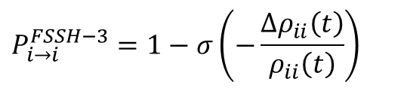

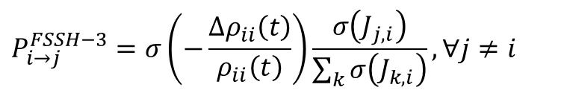

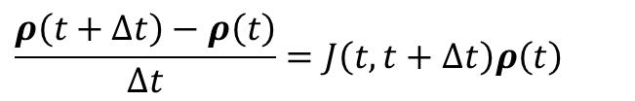


FSSH-3 Hop Proposal Probability
Akimov, A. V. Mol. Phys. 2024, to appear in press
FSSH-3
$$ρ\left(t\right)={\left(ρ_{00}\left(t\right),ρ_{11}\left(t\right),…,ρ_{N−1,N−1}\left(t\right)\right)}^{T}$$
$y=Jx$ - the problem to solve
$J_{0}=\min_{J}{{\left\|y−Jx\right\|}_{2}^{2}}$ - solve the optimization problem
$$\frac{ρ\left(t+Δt\right)−ρ\left(t\right)}{Δt}=J\left(t,t+Δt\right)ρ\left(t\right)$$
$J_{0}=\left(yx^{T}\right){\left(xx^{T}\right)}^{−1}$ - the formal solution
$$P_{i→j}^{FSSH−3}=σ\left(−\frac{Δρ_{ii}\left(t\right)}{ρ_{ii}\left(t\right)}\right)\frac{σ\left(J_{j,i}\right)}{\sum_{k}{σ\left(J_{k,i}\right)}},∀j≠i$$
There are two options:
$x=ρ(t)$.
$y=\frac{Δρ}{Δt}=\frac{ρ\left(t+Δt\right)−ρ(t)}{Δt}$
Initial guess for $J=0$
$$P_{i→i}^{FSSH−3}=1−σ\left(−\frac{Δρ_{ii}\left(t\right)}{ρ_{ii}\left(t\right)}\right)$$
$x=ρ(t)$.
$y=ρ(t+Δt)$
Initial guess for $J=I$
The size of the vectorized density matrix in equations to determine hopping probabilities/fluxes
- 0: N elements - only populations; the matrices are overdetermined [ default ]
- 1: N^2 elements - first N elements are populations, then Re and Im parts of upper-triangular coherences
that is rho_{0,1}, rho_{0,2}, ... rho_{0,N-1}, rho_{1,2}, ... rho_{1,N-1}, ... rho_{N-2,N-1}
dyn_control_params
fssh3_size_option
fssh3_approach_option
fssh3_dt
fssh3_max_steps
fssh3_err_tol
The approach to determine the hopping probabilities:
- 0: based on master equation, rho(t+dt) = J * rho(t); J matrix contains hopping probabilities directly [ default ]
- 1: based on kinetic approach, drho/dt = J * rho; J matrix contains fluxes
The time-step of the optimization procedure in the FSSH3 calculations. Default: 0.001
The maximal number of steps in the FSSH3 optimization step. Default: 1000
FSSH3 error tolerance. Default: 1e-7

Slide 11
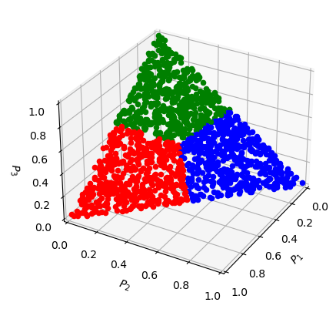
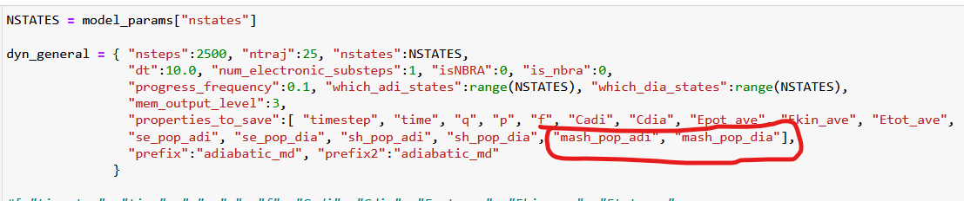

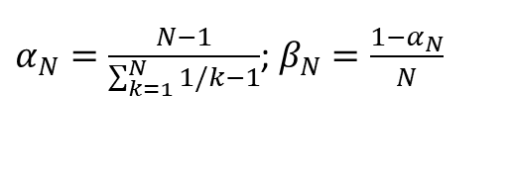

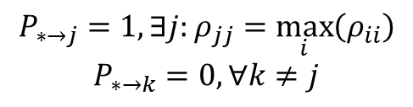
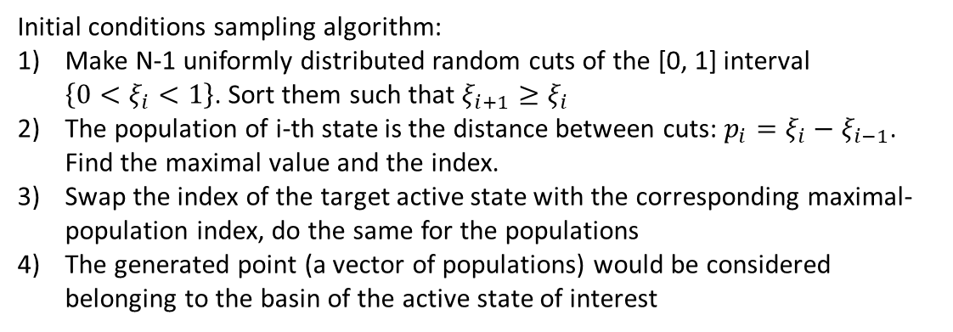
MASH Hop Proposal Probability
1. Initialization of electronic amplitudes:
Initial conditions sampling algorithm:
Make N-1 uniformly distributed random cuts of the [0, 1] interval $\left\{0<ξ_{i}<1\right\}$. Sort them such that $ξ_{i+1}≥ξ_{i}$
The population of i-th state is the distance between cuts: $p_{i}=ξ_{i}−ξ_{i−1}$. Find the maximal value and the index.
Swap the index of the target active state with the corresponding maximal-population index, do the same for the populations
The generated point (a vector of populations) would be considered belonging to the basin of the active state of interest
2. Hop proposal probability:
$$P_{∗→j}=1, ∃j:ρ_{jj}=\max_{i}\left(ρ_{ii}\right)$$
$$P_{∗→k}=0,∀k≠j$$
(1)Mannouch, J. R.; Richardson, J. O. A JCP 2023, 158, 104111
(2)Runeson, J. E.; Manolopoulos, D. E. A JCP 2023, 159, 094115.
(3)E. Runeson, J.; P. Fay, T.; E. Manolopoulos, D. PCCP 2024, 26, 4929–4938.
Proposed hops to the states with the largest population
3. Observables (population estimators):
$$P_{n}^{MASH,rep}=α_{N}{\left|c_{n}^{rep}\right|}^{2}+β_{N}$$
These are the SE populations
$P_{n}^{SH,adi}=\frac{N_{n}}{N}$ - works in adiabatic basis
$P_{n}^{SH,dia}$ - works if the adiabatic SH population is transformed according to Tempelaar
$α_{N}=\frac{N−1}{\sum_{k=1}^{N}{1/k}−1}$; $β_{N}=\frac{1−α_{N}}{N}$

Slide 12

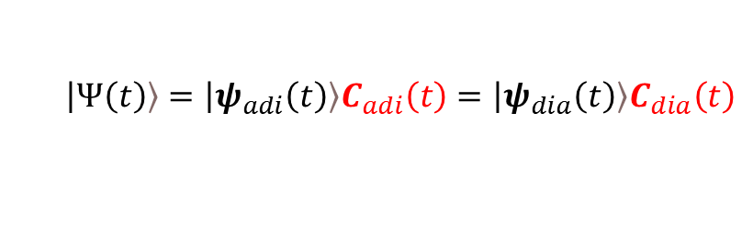


Computing state populations in Libra
Diagonal elements of the density matrices $P_{rep}$:$p_{n}^{SE,rep}=P_{rep,n,n}$
$p_{n}^{SE,adi}={\left|c_{n,adi}\right|}^{2}$ - adiabatic SE populations – “quantum” populations
$p_{n}^{SE,dia}={\left|c_{n,dia}\right|}^{2}$ - diabatic SE populations – “quantum” populations
$$\left.\left|Ψ\left(t\right)\right.\right\rangle =\left.\left|ψ_{adi}\left(t\right)\right.\right\rangle C_{adi}\left(t\right)=\left.\left|ψ_{dia}\left(t\right)\right.\right\rangle C_{dia}\left(t\right)$$
$$H_{dia}U=SUH_{adi}$$
$C_{adi}C_{adi}^{+}=P_{adi}$ ➔ $P_{dia}=U^{+}SP_{adi}SU$
$p_{n}^{SH,adi}=\frac{N_{n}}{N}$ - adiabatic SH populations – counting trajectories
$p_{n}^{SH,dia}$ - ???
This is a mixture of the SH populations and SE coherences
For each trajectory: $P_{dia}=U^{+}S{\tilde{P}}_{adi}SU$
$${\tilde{P}}_{adi,k,l}=δ_{k,l}δ_{k,a}+\left(1−δ_{k,l}\right)c_{k}c_{l}^{∗}$$
Active state index for the given trajectory
Tempelaar, R.; Reichman, D. R. JCP 2018, 148, 102309.
Bondarenko, A. S.; Tempelaar, R. JCP 2023, 158, 054117.

Slide 13
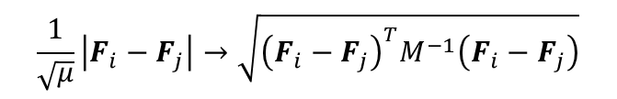
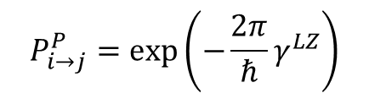
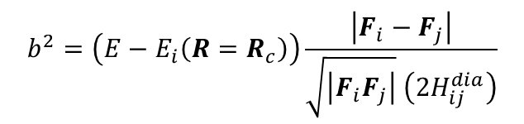
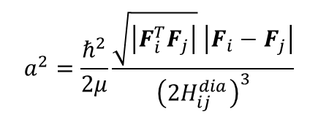
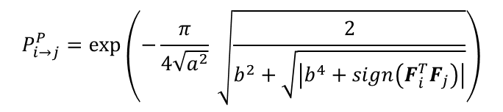
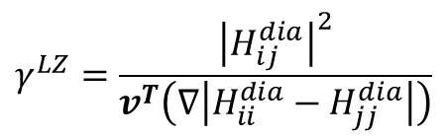
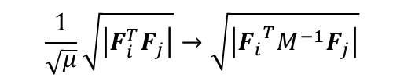
Hop Proposal Probability
Landau-Zener (LZ):
Tully, J. C. J. Chem. Phys. 1990, 93, 1061, 1071
Belyaev, A. K.; Lebedev, O. V. Phys. Rev. A 2011, 84, 014701
dyn_control_params
rep_lz
Hopping only at the gap minimum!
$$P_{i→j}^{P}=\exp\left(−\frac{2π}{ℏ}γ^{LZ}\right)$$
The representation to compute LZ probabilities.
Options:
- 0: diabatic, Eq. 1 of the Belyaev-Lebedev paper, crossing point is determined
by the sign change of the diabatic gap [ default ]
- 1: adiabatic, Eq. 3 of the Belyaev-Lebedev paper, crossing point is determined
by the sign change of the diabatic gap
- 2: adiabatic, Eq. 3 of the Belyaev-Lebedev paper, crossing point is determined
by the sign change of the NAC
$$γ^{LZ}=\frac{{\left|H_{ij}^{dia}\right|}^{2}}{v^{T}\left(∇\left|H_{ii}^{dia}−H_{jj}^{dia}\right|\right)}$$
Zhu, C., Nakamura, H., Re, N., Aquilanti, V., 1992. J. Chem. Phys. 97, 1892
Hanasaki, K., Kanno, M., Niehaus, T.A., Kono, H., 2018. J. Chem. Phys. 149. 244117
Yu, L., Xu, C., Lei, Y., Zhu, C., Wen, Z., 2014. Phys. Chem. Chem. Phys. 16. 25883.
Zhu-Nakamura (ZN):
$$P_{i→j}^{P}=\exp\left(−\frac{π}{4\sqrt{a^{2}}} \sqrt{\frac{2}{b^{2}+\sqrt{\left|b^{4}+sign\left(F_{i}^{T}F_{j}\right)\right|}}}\right)$$
Hopping only at the gap minimum!
$$a^{2}=\frac{ℏ^{2}}{2μ}\frac{\sqrt{\left|F_{i}^{T}F_{j}\right|} \left|F_{i}−F_{j}\right|}{{\left(2H_{ij}^{dia}\right)}^{3}}$$
$$\frac{1}{\sqrt{μ}}\left|F_{i}−F_{j}\right|→\sqrt{{\left(F_{i}−F_{j}\right)}^{T}M^{−1}\left(F_{i}−F_{j}\right)}$$
$$b^{2}=\left(E−E_{i}\left(R=R_{c}\right)\right)\frac{\left|F_{i}−F_{j}\right|}{\sqrt{\left|F_{i}F_{j}\right|} \left(2H_{ij}^{dia}\right)}$$
Multidimensional version
$$\frac{1}{\sqrt{μ}}\sqrt{\left|F_{i}^{T}F_{j}\right|}→\sqrt{\left|{F_{i}}^{T}M^{−1}F_{j}\right|}$$

Slide 14
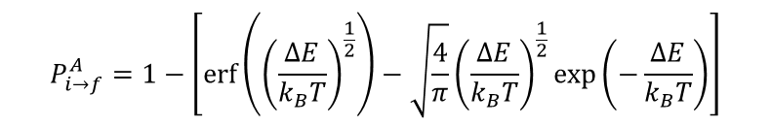



Hop Acceptance Probabilities
dyn_control_params
hop_acceptance_algo
Options:
- 0: accept all proposed hops [ default ]
- 10: based on adiabatic energy - accept only those hops that can obey the energy conservation with
adiabatic potential energies
- 11: based on diabatic energy - same as 10, but we use diabatic potential energies
- 20: based on derivative coupling vectors - accept only those hops that can obey the energy conservation
by rescaling nuclear velocities along the directions of derivative couplings for the quantum nuclear DOFs
- 21: based on difference of state-specific forces - same as 20, but the rescaling is done along the vector
parallel to the difference of adiabatic forces on initial and target states
- 31: accept hops with the probability taken from the quantum Boltzmann distribution
- 32: accept hops with the probability taken from the classical Maxwell-Boltzmann distribution
- 33: accept hops with the probability taken from the updated quantum Boltzmann distribution (experimental)
- 40: based on possibility to conserve energy using tcnbra_ekin variables (experimental for TC-NBRA)
$$P_{i→f}^{A}=1$$
Tully, J. C. J. Chem. Phys. 1990, 93, 1061
$$P_{i→f}^{A}=Θ\left(E_{kin}+E_{f}−E_{f}\right)$$
Prezhdo, O. V.; Duncan, W. R.; Prezhdo, V. V. Prog. Surf. Sci. 2009, 84, 30
$$P_{i→f}^{A}=\min\left(1, \exp\left(−\frac{ΔE}{k_{B}T}\right)\right)$$
Smith, B.; Akimov, A. V. J. Chem.Phys. 2019, 151, 124107
$$P_{i→f}^{A}=1−\left[\operatorname{erf}\left({\left(\frac{ΔE}{k_{B}T}\right)}^{\frac{1}{2}}\right)−\sqrt{\frac{4}{π}}{\left(\frac{ΔE}{k_{B}T}\right)}^{\frac{1}{2}}\exp\left(−\frac{ΔE}{k_{B}T}\right)\right]$$
$$P_{i→f}^{A}=Θ\left(E_{i\left(t+Δt\right)}^{tr}\left(t+Δt\right)+e_{kin,i}^{tr}\left(t+Δt\right)−e_{kin,j}^{tr}(t+Δt)\right)$$
Akimov, A. V. J. Phys. Chem. Lett. 2023, 14, 11673–11683

Slide 15
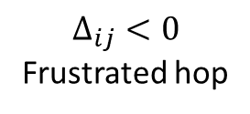


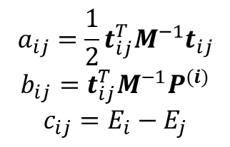
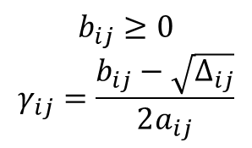

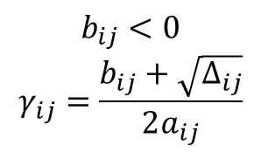

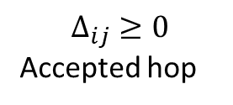
Momentum Rescaling
dyn_control_params
momenta_rescaling_algo
$$P_{n}^{(j)}=P_{n}^{(i)}−γt_{n,ij}$$
$$Δ_{ij}=b_{ij}^{2}+4a_{ij}c_{ij}$$
$$a_{ij}=\frac{1}{2}t_{ij}^{T}M^{−1}t_{ij}$$
$$b_{ij}=t_{ij}^{T}M^{−1}P^{(i)}$$
$$c_{ij}=E_{i}−E_{j}$$
$$Δ_{ij}<0$$
Frustrated hop
$$Δ_{ij}≥0$$
Accepted hop
Options:
- 0: don't rescale [ default ]
- 100: based on adiabatic energy, don't reverse on frustrated hops
- 101: based on adiabatic energy, reverse on frustrated hops
- 110: based on diabatic energy, don't reverse on frustrated hops
- 111: based on diabatic energy, reverse on frustrated hops
- 200: along derivative coupling vectors, don't reverse on frustrated hops
- 201: along derivative coupling vectors, reverse on frustrated hops
- 210: along difference of state-specific forces, don't reverse on frustrated hops
- 211: along difference of state-specific forces, reverse on frustrated hops
- 40: does not rescale velocities, but rescales tcnbra_ekin variables
$$b_{ij}<0$$
$$γ_{ij}=\frac{b_{ij}+\sqrt{Δ_{ij}}}{2a_{ij}}$$
$$b_{ij}≥0$$
$$γ_{ij}=\frac{b_{ij}−\sqrt{Δ_{ij}}}{2a_{ij}}$$
Reversal or not
$$t_{n,ij}=D_{adi,ij}^{n}$$
$$t_{n,ij}=F_{adi,i}^{n}−F_{adi,j}^{n}$$
$$e_{kin}^{tr}\left(t\right)→e_{kin}^{tr}\left(t+Δt\right)=e_{kin}^{tr}\left(t\right)+E_{i(t)}−E_{i(t+Δt)}$$
TC-NBRA rescaling of effective kinetic energy:
Akimov, A. V. J. Phys. Chem. Lett. 2023, 14, 11673–11683

Slide 16
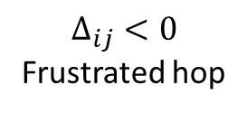
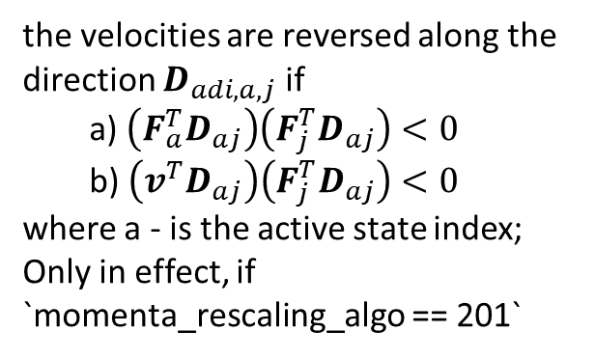
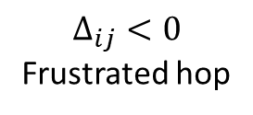
Momentum Reversal on Frustrated Hops: Jasper-Truhlar Criterion
Jasper, A. W.; Truhlar, D. G. Chem. Phys. Lett. 2003, 369, 60− 67
dyn_control_params
use_Jasper_Truhlar_criterion
Options:
- 0: don't use this criterion (naive handling)
- 1: use it [ default ]
use_Jasper_Truhlar_criterion = 1
$$Δ_{ij}<0$$
Frustrated hop
use_Jasper_Truhlar_criterion = 0
the velocities are reversed along the direction $D_{adi,a,j}$ if
a) $\left(F_{a}^{T}D_{aj}\right)\left(F_{j}^{T}D_{aj}\right)<0$
b) $\left(v^{T}D_{aj}\right)\left(F_{j}^{T}D_{aj}\right)<0$
where a - is the active state index;
Only in effect, if `momenta_rescaling_algo == 201`
$$Δ_{ij}<0$$
Frustrated hop
Otherwise
No reversal for momenta_rescaling_algo:
100, 110, 200, 210
Reversal for momenta_rescaling_algo:
101, 111, 201, 211
Reversal
No Reversal

Slide 17
Decoherence Options
dyn_control_params
decoherence_algo
SDM: Granucci, G.; Persico, M. J. Chem. Phys. 2007, 126, 134114.
mSDM: Smith, B.; Akimov, A. V. J. Chem. Phys. 2019, 151, 124107.
ID-A: Nelson, T.; Fernandez-Alberti, S.; Roitberg, A. E.; Tretiak, S. J. Chem. Phys. 2013, 138, 224111.
ID-F: Zhang, Q.; Shao, X.; Li, W.; Mi, W.; Pavanello, M.; Akimov, A. V. J. Phys.: Condens. Matter 2024, 36, 385901.
A-FSSH:
Landry, B. R.; Subotnik, J. E. The Journal of Chemical Physics 2012, 137, 22A513.
Jain, A.; Herman, M. F.; Ouyang, W.; Subotnik, J. E. The Journal of Chemical Physics 2015, 143, 134106.
Jain, A.; Alguire, E.; Subotnik, J. E. J. Chem. Theory Comput. 2016, 12, 5256–5268.
BCSH: Xu, J.; Wang, L. J. Chem. Phys. 2019, 150, 164101.
MF-SD: Bedard-Hearn, M. J.; Larsen, R. E.; Schwartz, B. J. J. Chem. Phys. 2005, 123, 234106.
DISH:
Jaeger, H. M.; Fischer, S.; Prezhdo, O. V. J. Chem. Phys. 2012, 137, 22A545
Akimov, A. V. J. Chem. Phys. 2021, 155, 134106.
- [-1]: no decoherence [ default ]
- 0: SDM and alike
- 1: instantaneous decoherence options (ID-S, ID-A, ID-C, ID-F)
- 2: AFSSH
- 3: BCSH of Linjun Wang
- 4: MF-SD of Bedard-Hearn, Larsen, Schwartz
- 5: SHXF of Min
- 6: MQCXF
- 7: DISH, rev2023
- 8: diabatic IDA, experimental
DISH_rev2023: Zhang, Q.; Shao, X.; Li, W.; Mi, W.; Pavanello, M.; Akimov, A. V. J. Phys.: Condens. Matter 2024, 36, 385901.
SHXF and MQCXF:
Ha, J.-K.; Lee, I. S.; Min, S. K. J. Phys. Chem. Lett. 2018, 9, 1097
Han, D.; Akimov, A.V. J. Chem. Theory Comput. 2024, 20, 5022–5042

Slide 18
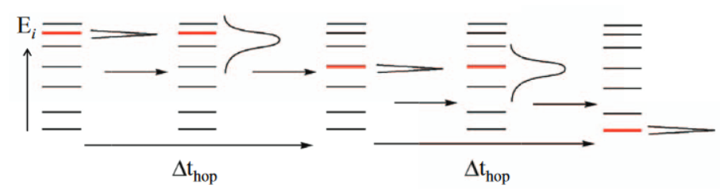
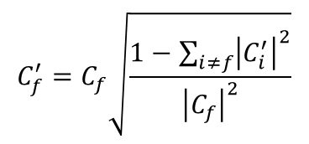
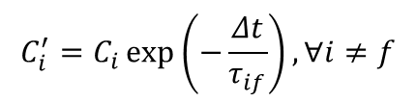

Decoherence: SDM and ID
SDM
Granucci, G.; Persico, M. J. Chem. Phys. 2007, 126, 134114.
dyn_control_params
sdm_norm_tolerance
gradually change the amplitudes
Corresponds to the "tol" parameter in the sdm function. It controls how much the norm of the old state can be larger than 1.0 before the code stops with the error message [ default: 0.0 ]
Note: only matters if decoherence_algo == 0
$$C_{f}^{′}=C_{f}\sqrt{\frac{1−\sum_{i≠f}{{\left|C_{i}^{′}\right|}^{2}}}{{\left|C_{f}\right|}^{2}}}$$
$$C_{i}^{′}=C_{i}\exp\left(−\frac{Δt}{τ_{if}}\right), ∀i≠f$$
ID-A
Nelson, T.; Fernandez-Alberti, S.; Roitberg, A. E.; Tretiak, S. J. Chem. Phys. 2013, 138, 224111.
Wavefunction reduction
$$C_{f}=1, C_{i}=0, ∀i≠f$$
dyn_control_params
collapse_option
instantaneous_decoherence_variant
How to collapse wavefunction amplitudes in the decoherence schemes:
- 0: by rescaling the magnitude of the amplitude vector elements, but preserving "phase" [ default ]
- 1: by resetting the amplitudes to 1.0+0.0j. This option changes phase
Zhang, Q.; Shao, X.; Li, W.; Mi, W.; Pavanello, M.; Akimov, A. V. J. Phys.: Condens. Matter 2024, 36, 385901.
Option to control the instantaneous decoherence methodology, only used with decoherence_algo == 1
- 0: ID-S – on the successful hop
- 1: ID-A [default] - if the proposed hop is not successful, we project back to the initial state if the proposed hop is accepted - we project onto that state
- 2: ID-C - consistent ID - an experimental algorithm
- 3: ID-A, new: if the proposed hop is not successful, we project out the proposed states if the proposed hop is accepted - we project onto that state
- 4: ID-F, new: if the proposed hop is not successful, we project out the proposed states but we don't do anything if the hop is successful

Slide 19
Decoherence: A-FSSH
Landry, B. R.; Subotnik, J. E. The Journal of Chemical Physics 2012, 137, 22A513.
Jain, A.; Herman, M. F.; Ouyang, W.; Subotnik, J. E. The Journal of Chemical Physics 2015, 143, 134106.
Jain, A.; Alguire, E.; Subotnik, J. E. J. Chem. Theory Comput. 2016, 12, 5256–5268.
Propagate extra set of variables
These variables define the rates for wavefunction collapse

Slide 20
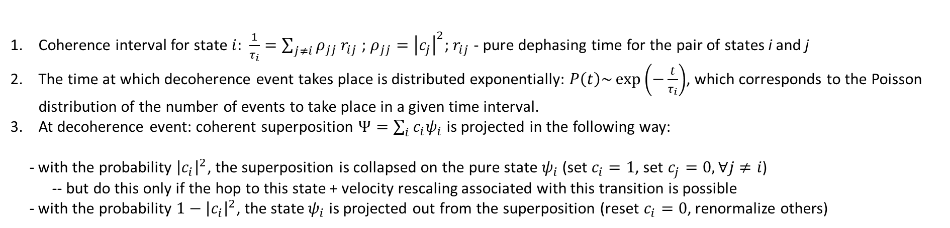
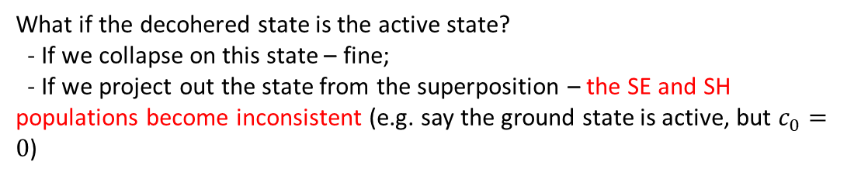
Decoherence: DISH
Jaeger, H. M.; Fischer, S.; Prezhdo, O. V. J. Chem. Phys. 2012, 137, 22A545
Hops are the consequences of decoherence
Coherence interval for state $i:$ $\frac{1}{τ_{i}}=\sum_{j≠i}{ρ_{jj}}r_{ij}$ ; $ρ_{jj}={\left|c_{j}\right|}^{2}$; $r_{ij}$- pure dephasing time for the pair of states i and j
The time at which decoherence event takes place is distributed exponentially: $P\left(t\right)\sim \exp\left(−\frac{t}{τ_{i}}\right)$, which corresponds to the Poisson distribution of the number of events to take place in a given time interval.
At decoherence event: coherent superposition $Ψ=\sum_{i}{c_{i}ψ_{i}}$ is projected in the following way:
- with the probability ${\left|c_{i}\right|}^{2}$, the superposition is collapsed on the pure state $ψ_{i}$ (set $c_{i}=1$, set $c_{j}=0, ∀j≠i$)
-- but do this only if the hop to this state + velocity rescaling associated with this transition is possible
- with the probability $1−{\left|c_{i}\right|}^{2}$, the state $ψ_{i}$ is projected out from the superposition (reset $c_{i}=0$, renormalize others)
What if the decohered state is the active state?
- If we collapse on this state – fine;
- If we project out the state from the superposition – the SE and SH populations become inconsistent (e.g. say the ground state is active, but $c_{0}=0$)
Akimov, A. V. J. Chem. Phys. 2021, 155, 134106.
if the decohered state turns out to be the active one, we project the corresponding amplitude out only if a successful hop to any other state can occur. The hop to any other state j is proposed with the probability ${\left|c_{j}\right|}^{2}$ and if the hop into this state is successful, the superposition is collaped onto this new state and the hop occurs.
Note: DISH is invoked by tsh_method==5 (hopping scheme) and decoherence_algo==-1 (no additional decoherence)

Slide 21
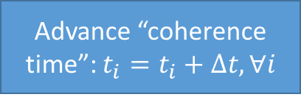
DISH
Initialize “coherence time” for each state $t_{i}=0, ∀i$
Advance “coherence time”: $t_{i}=t_{i}+Δt, ∀i$
Initialize set of “decohering” states: $D=∅$
For all states $i$:
compute coherence interval for this state $τ_{i}^{−1}=\sum_{j≠i}{ρ_{jj}(t)τ_{ij}^{−1}}$
If $t_{i}≥T[τ_{i}]$, add $i$ to set $D$: $D=D∪\{i\}$
int dish_decoherence_event_option;
0 – direct compare
1 -Poisson
$$D≠∅$$
No (B)
Continue coherent evolution:
$$c\left(t+Δt\right)=\exp\left(−\frac{iH}{ℏ}Δt\right)c\left(t\right)$$
Yes (A)
Select a single decohered state, $i$, our of the set randomly
reset $t_{i}=0$
don’t change the variables for other states
Yes
…
Yes (1)
Is $i$ active state?
No (2)
…
Finish scheme in panel (b)

Slide 22
DISH
Yes (1)
Is $i$ active state?
No (2)
$$ξ<{\left|c_{i}\right|}^{2}$$
$$ξ<{\left|c_{i}\right|}^{2}$$
Yes (1.1)
No (1.2)
Yes (2.1)
No (2.2)
Collapse onto state $i$:
$c_{i}=\text{"1}“$; $c_{j}=0$
Stay on the active state $i$
Exit
$P=\left\{all\right\}/\{i\}$ becomes a set of proposed states
$i$ becomes a proposed state
Project out state $i$:
$c_{i}=0$; $c_{j}→\tilde{c_{j}};j≠i$
Exit
Yes (1.2.1)
$P=∅$?
Do nothing
Exit
Is hop accepted?
No (1.2.2)
No (2.1.2)
Select $j$ randomly with prob.~ ${\left|c_{j}\right|}^{2},$ $j∈P$
Mark $j$ as a proposed hop
Do nothing
Exit
Yes (2.1.1)
Yes (1.2.2.1)
Is hop accepted?
Collapse onto state $i$, $c_{i}=\text{"1}“$, $c_{j}=0;j≠i$
Hop onto $i$
Exit
Project out state $i$, $c_{i}=0$, $c_{k}→\tilde{c_{k}}, k≠i$
Hop onto $j$
Exit
No (1.2.2.2)
Exclude state $j$ from $P$

Slide 23
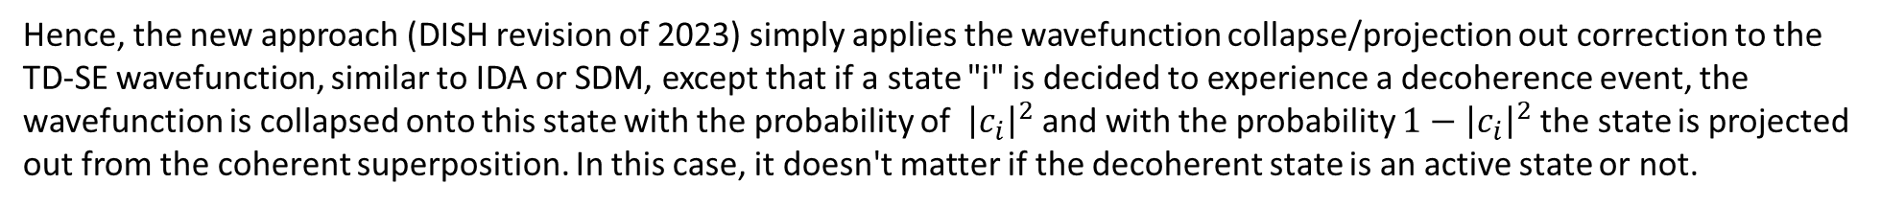
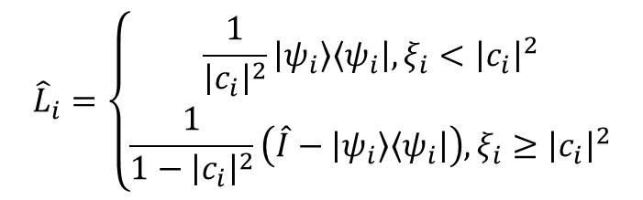
Decoherence: DISH_rev2023
Zhang, Q.; Shao, X.; Li, W.; Mi, W.; Pavanello, M.; Akimov, A. V. J. Phys.: Condens. Matter 2024, 36, 385901.
Another problem:
In the limit of infinite decoherence time (overcoherent, or FSSH limit), no decoherence events would be determined and hence no hops would be happening.
In this situation, the TD-SE populations could indicate the population transfer, but the TSH populations won't change.
Hence, the new approach (DISH revision of 2023) simply applies the wavefunction collapse/projection out correction to the TD-SE wavefunction, similar to IDA or SDM, except that if a state "i" is decided to experience a decoherence event, the wavefunction is collapsed onto this state with the probability of ${\left|c_{i}\right|}^{2}$ and with the probability $1−{\left|c_{i}\right|}^{2}$ the state is projected out from the coherent superposition. In this case, it doesn't matter if the decoherent state is an active state or not.
Projector operator introduced in the original DISH paper of Jaeger et al.:
$${\hat{L}}_{i}=\left\{\begin{matrix}\frac{1}{{\left|c_{i}\right|}^{2}}\left|ψ_{i}\right\rangle \left\langle ψ_{i}\right|,ξ_{i}<{\left|c_{i}\right|}^{2} \\ \frac{1}{1−{\left|c_{i}\right|}^{2}}\left(\hat{I}−\left|ψ_{i}\right\rangle \left\langle ψ_{i}\right|\right), ξ_{i}≥{\left|c_{i}\right|}^{2}\end{matrix}\right.$$
DISH_rev2023 only applies this operator to the electronic part (regardless whether the projection can be consistent with the energy conservation, which is already broken in the NBRA anyways)

Slide 24
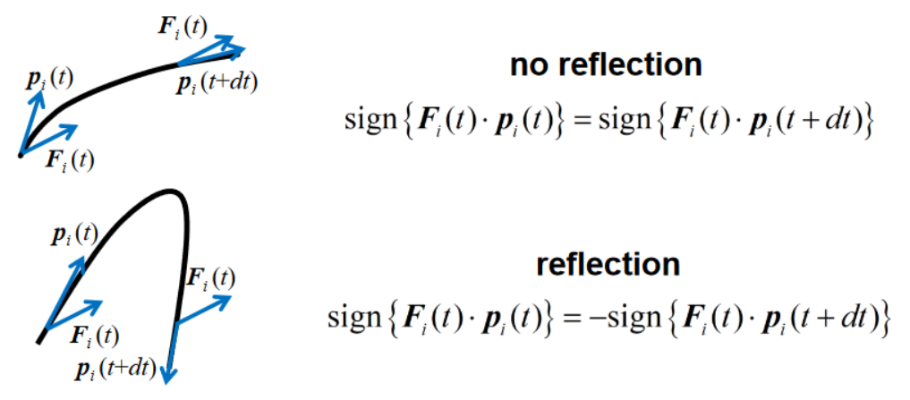
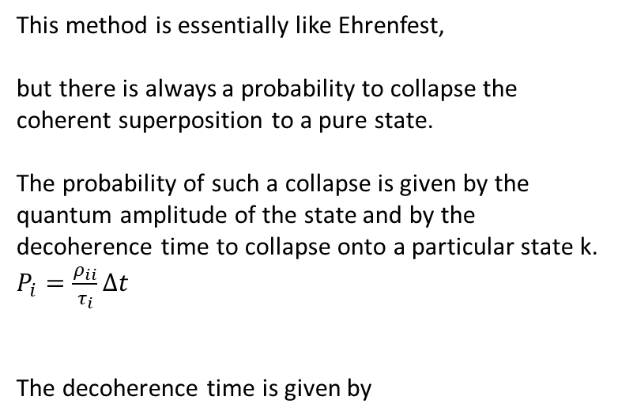
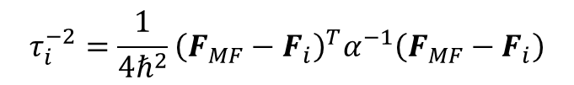
Decoherence: BCSH and MF-SD
BCSH
MF-SD
Xu, J.; Wang, L. J. Chem. Phys. 2019, 150, 164101.
Bedard-Hearn, M. J.; Larsen, R. E.; Schwartz, B. J. J. Chem. Phys. 2005, 123, 234106.
In this approach, decoherence correction is interpreted as a way to enforce the self-consistency of the TD-SE with the quantum-classical trajectories rather than as a common view of a decay of overlap of wavepackets moving on different PE surfaces. Namely:
at every nonadiabatic interaction region, there is a possibility of the wavepacket branching into reflecting and transmitting wavepackets on different surfaces.
the idea is to eliminate the wavepackets that go in the opposite direction with the main wavepacket on the active state.
the correction is applied only at the reflection points (not the reflection of active trajectory, but the reflection of the wavepacket on other surfaces in comparison to that of the active surface)
the reflection is judged as:
This method is essentially like Ehrenfest,
but there is always a probability to collapse the coherent superposition to a pure state.
The probability of such a collapse is given by the quantum amplitude of the state and by the decoherence time to collapse onto a particular state k. $P_{i}=\frac{ρ_{ii}}{τ_{i}}Δt$
The decoherence time is given by
$$τ_{i}^{−2}=\frac{1}{4ℏ^{2}}{\left(F_{MF}−F_{i}\right)}^{T}α^{−1}\left(F_{MF}−F_{i}\right)$$

Slide 25















Decoherence: XFSH and MQCXF
Original: Ha, J.-K.; Lee, I. S.; Min, S. K. J. Phys. Chem. Lett. 2018, 9, 1097
Libra implementation: Han, D.; Akimov, A.V. J. Chem. Theory Comput. 2024, 20, 5022–5042
$$iℏ\frac{d}{dt}\left|Φ_{R}\left(t\right)\right\rangle =\left[{\hat{H}}_{BO}\left(R\left(t\right)\right)+{\hat{H}}_{XF}\left(R , t\right)\right]\left|Φ_{R}\left(t\right)\right\rangle$$
$$\dot{P}=F$$
$$F\left(R,t\right)=F^{MF}\left(R,t\right)+F^{XF}\left(R,t\right)$$
$$H_{XF}=−\sum_{ν}{\frac{iℏ𝒫_{ν}}{M_{ν}}⋅\left(∇_{ν}CC^{†}+C∇_{ν}C^{†}\right) }=\sum_{ν}{\frac{𝒫_{ν}}{M_{ν}}⋅\left(φ_{ν}CC^{†}−CC^{†}φ_{ν}\right) }=−\sum_{ν}{\frac{𝒫_{ν}}{M_{ν}}⋅\left(ρφ_{ν}−φ_{ν}ρ\right) }$$
$$F^{MF}\left(R,t\right)=−\left\langle Φ_{R}\left(t\right)\left|∇{\hat{H}}_{BO}\right|Φ_{R}\left(t\right)\right\rangle$$
$${\left(H_{XF}\right)}_{ab}=\sum_{ν}{ρ_{ab}\left(φ_{ν,aa}−φ_{ν,bb}\right)\frac{𝒫_{ν}}{M_{ν}}}$$
$$F_{ν}^{XF}=−\frac{i}{ℏ }\sum_{a,b}{ρ_{aa}ρ_{bb}}\sum_{μ}{\left(φ_{ν,bb}−φ_{ν,aa}\right)\left(φ_{μ,bb}−φ_{μ,aa}\right)\frac{𝒫_{μ}}{M_{μ}}}$$
$$C_{j}\left(R\right)=\left|C_{j}\left(R\right)\right|\exp\left(iθ_{j}{\left(R\right)}/ℏ\right)$$
$$∇_{ν}θ_{j}=\frac{i}{ℏ}φ_{jν}$$
$$𝓟\left(R,t\right)=−iℏ\frac{∇\left|χ\left(R,t\right)\right|}{\left|χ\left(R,t\right)\right|}=−iℏ\frac{∇{\left|χ\right|}^{2}}{2{\left|χ\right|}^{2}}=\frac{iℏ}{2}σ^{−2}\left(R−〈R〉\right)≈\frac{iℏ}{2}σ^{−2}\sum_{i}{ρ_{ii}}\left(R_{a}−R_{i}\right)$$
Both ${\hat{H}}_{BO}\left(R(t)\right)$ and ${\hat{H}}_{XF}(R,t)$ are used
MFXF, aka EhXF
Only $F^{MF}\left(R,t\right)$
Both ${\hat{H}}_{BO}\left(R(t)\right)$ and ${\hat{H}}_{XF}(R,t)$ are used
SHXF (DISH-XF)
Adiabatic forces of the active state
Both ${\hat{H}}_{BO}\left(R(t)\right)$ and ${\hat{H}}_{XF}(R,t)$ are used
MQCXF
Both $F^{MF}\left(R,t\right)$and $F^{XF}\left(R,t\right)$ are used

Slide 26






Decoherence times
DISH
dyn_control_params
decoherence_times_type
Decoherence interval
$$τ_{i}^{−1}=\sum_{j≠i}{P_{jj}τ_{ij}^{−1}}$$
[-1]: set all dephasing rates to zero [ default ]
0: use the rates read out from the input
1: use the energy-based decoherence method (EDC)
2: Schwartz - mean-field Force-based decoherence
3: Schwartz - pair-wise-based decoherences
Jaeger, H. M.; Fischer, S.; Prezhdo, O. V. J. Chem. Phys. 2012, 137, 22A545
SDM/EDC
Granucci, G.; Persico, M. JCP 2007, 126, 134114.
$$τ_{ij}^{EDC}=\frac{ℏ}{\left|E_{i}−E_{j}\right|}\left(C+\frac{ε}{E_{kin}}\right)$$
Bedard-Hearn, M. J.; Larsen, R. E.; Schwartz, B. J. JCP 2005, 123, 234106.
MF-SD
dyn_control_params
decoherence_C_param
decoherence_eps_param
$$τ_{i}^{−2}=\frac{1}{4ℏ^{2}}{\left(F_{MF}−F_{i}\right)}^{T}α^{−1}\left(F_{MF}−F_{i}\right)$$
Phase-informed Decoherence times
Sifain, A. E.; Wang, L.; Tretiak, S.; Prezhdo, O. V.
dyn_control_params
- schwartz_decoherence_inv_alpha
$$τ_{ij}^{−1,PI}=τ_{ij}^{−1}\frac{\left|E_{i}−E_{j}\right|}{\left\langle \left|E_{i}−E_{j}\right|\right\rangle }$$
mSDM
$$τ_{ij}^{−1}=\sqrt{\frac{5〈δE_{ij}^{2}〉}{12ℏ^{2}}}$$
dyn_control_params
- dephasing_informed
- 0: don't apply [ default ]
- 1: use it
$$τ_{ij}^{−2}=\frac{1}{ℏ^{2}}{\left(F_{i}−F_{j}\right)}^{T}α^{−1}\left(F_{i}−F_{j}\right)$$
Akimov, A. V.; Prezhdo, O. V. JPCL, 2013, 4, 3857
Smith, B.; Akimov, A. V. JCP 2019, 151, 124107
Independent stochastic pairwise decoherence (ISPD)
Esch, M. P.; Levine, B. G. JCP 2020, 152, 234105.

Slide 27











Other ways of computing Decoherence times
$$\frac{1}{τ_{ij}^{NDM}}=\frac{ℏ}{\left|H_{ii}^{dia}−H_{jj}^{dia}\right|}\frac{E_{tot}}{E_{vib}}$$
2001, Hack, Truhlar
Natural decay of mixing
$$τ_{ij}^{SCDM}=\frac{ℏ}{\left|H_{ii}^{dia}−H_{jj}^{dia}\right|}+\frac{ℏ}{4E_{vib}}$$
Hack, M.D., Truhlar, D.G., 2001, JCP 114, 9305.
2004, Zhu, Jasper, Truhlar
Self-consistent decay of mixing
Zhu, C., Jasper, A.W., Truhlar, D.G., 2004, JCP 120, 5543.
2005, Jasper, Truhlar
$$χ_{a}=\frac{1}{{\left(2πσ_{a}^{2}\right)}^{1/4}}\exp\left(−\frac{{\left(x−x_{a}\right)}^{2}}{4σ_{a}^{2}}−\frac{iP_{a}x}{ℏ}\right)$$
$$O_{ab}\left(t\right)=\left\langle χ_{a} | χ_{b}\right\rangle$$
$${\dot{O}}_{ab}=−k_{ab}O_{ab}$$
$$\frac{1}{τ_{ab}}=k_{ab}=\frac{\left(x_{a}−x_{b}\right)\left(P_{a}−P_{b}\right)}{2m\left(σ_{a}^{2}+σ_{b}^{2}\right)}+\frac{2σ_{a}^{2}σ_{b}^{2}\left(P_{a}−P_{b}\right)\left(F_{a}−F_{b}\right)}{ℏ^{2}\left(σ_{a}^{2}+σ_{b}^{2}\right)}$$
$$\frac{1}{τ_{ab}}=k_{ab}=\frac{π}{2}\frac{\left|F_{a}−F_{b}\right|}{\left|\overline{P}\right|}+\sqrt{\frac{{\left(P_{a}−P_{b}\right)}^{2}\left|E_{a}−E_{b}\right|}{4mℏ^{2}π^{2}}+{\left(\frac{π}{2}\frac{\left|F_{a}−F_{b}\right|}{\left|\overline{P}\right|}\right)}^{2}}$$
Classical GWP center motion, etc.
$$\overline{P}=\frac{P_{a}+P_{b}}{2}$$
Jasper, A.W., Truhlar, D.G., 2005, JCP 123, 064103
Parallel surfaces
$$τ_{ab}^{Truhlar}=\frac{ℏ}{\left|E_{a}−E_{b}\right|}\sqrt{\frac{\left|\overline{P}\right|}{\left|P_{a}−P_{b}\right|}}$$
2006, Larsen, Bedard-Hearn, Schwartz
$$\frac{1}{τ_{i}^{BLS,}}=\sqrt{\frac{1}{4ℏ^{2}}{\left(F^{MF}−F_{i}\right)}^{T}A^{−1}\left(F^{MF}−F_{i}\right)}$$
Larsen, R.E., Bedard-Hearn, M.J., Schwartz, B.J., 2006, JPCB 110, 20055.
$$τ_{ij}^{SDM}=\frac{ℏ}{\left|E_{i}−E_{j}\right|}\left(1+\frac{C}{E_{kin}}\right)$$
2007, Granucci, Persico
Simplified decay of mixing
Granucci, G., Persico, M., 2007, JCP, 126, 134114

Slide 28















Other ways of computing Decoherence times
$$τ_{ij}^{SCDM′}=\frac{C_{1}πℏ}{\left|H_{ii}^{dia}−H_{jj}^{dia}\right|}+\frac{C_{2}ℏ}{4E_{vib}}$$
2008, Cheng, Truhlar, et al
2-parameters self-consistent decay of mixing
Cheng, S.C., Zhu, C., Liang, K.K., Lin, S.H., Truhlar, D.G., 2008 JCP 129. 024112
$$χ_{a}={\left(\frac{2Re\left[α_{a}\right]}{π}\right)}^{1/4}\exp\left(−α{\left(x−x_{a}\right)}^{2}+\frac{iP_{a}x}{ℏ}\right)$$
2011, Shenvi, Subotnik, Yang
Exclude the momentum difference terms
$$\left|σ_{ij}\right|=\left|\frac{Re{\left[2α_{i}\right]}^{1/4}Re{\left[2α_{j}\right]}^{1/4}}{{\left(α_{i}+α_{j}^{∗}\right)}^{1/2}}\right|\exp\left(−Re\left[\frac{α_{i}α_{j}^{∗}{\left(x_{i}−x_{j}\right)}^{2}}{α_{i}+α_{j}^{∗}}\right]\right)$$
Shenvi, N., Subotnik, J.E., Yang, W., 2011, JCP 134. 144102.
$$\frac{1}{τ_{ij}^{SSY}}=−\frac{1}{\left|σ_{ij}\right|} \frac{d\left|σ_{ij}\right|}{dt}=Re\left[\frac{α_{i}α_{j}^{∗}{\left(x_{i}−x_{j}\right)}^{2}}{α_{i}+α_{j}^{∗}}\left(\dot{x_{i}}−\dot{x_{j}}\right)\right]$$
2012, Jaeger, Fisher, Prezhdo
DISH
2013,Akimov, Prezhdo
$$\frac{1}{τ_{i}^{DISH}}=\sum_{j≠i}{k_{ij}^{deph}{\left|c_{j}\right|}^{2}}$$
$$k_{ij}^{deph}=\frac{1}{ℏ}\sqrt{\frac{5}{12}〈δ^{2}E_{ij}〉}$$
$$\frac{1}{τ_{0}^{DISH}}=\frac{{\left|c_{1}\right|}^{2}}{ℏ}\sqrt{\frac{5}{12}〈δ^{2}E_{01}〉}$$
So:
Jaeger, H.M., Fischer, S., Prezhdo, O.V., 2012, JCP 137. 22A545.
Akimov, A.V., Prezhdo, O.V., 2013, JPCL 4, 3857.
2017, Gu and Franco
As a purity decay rate
$$σ\left(t\right)=Tr_{S}\left\{ρ\right\}=\sum_{i}{p_{i}\left.\left|i\right.\right\rangle \left\langle \left.i\right|\right.}$$
$$P(t)=Tr_{S}\left\{σ^{2}\left(t\right)\right\}=\exp\left(−\frac{t^{2}}{τ_{d}^{2}}\right)$$
$$τ_{d}=\frac{ℏ}{\sqrt{2\sum_{ab}{Δ_{ab}^{S}×Δ_{ab}^{B}}}}$$
Gu, B., Franco, I., 2017, JPCL 8, 4289.
Gu, B., Franco, I., 2018, JPCL 9, 773
$$\hat{H}={\hat{H}}_{S}+{\hat{H}}_{B}+{\hat{H}}_{SB}$$
$${\hat{H}}_{SB}=\sum_{a}{{\hat{S}}_{a}⨂{\hat{B}}_{a}}$$
$$Δ_{ab}^{X}=〈{\hat{X}}_{a}{\hat{X}}_{b}〉−〈{\hat{X}}_{a}〉〈{\hat{X}}_{b}〉, X=S, B$$
For a 2-level system with constant diabatic coupling = pure dephasing limit:
$$\frac{1}{k^{deph}}=\frac{ℏ}{\left|c_{0}\right|\left|c_{1}\right|\sqrt{2〈δ^{2}E_{01}〉}}$$
$$\frac{1}{τ_{d}^{Gu−Franco}}=\frac{\left|c_{0}\right|\left|c_{1}\right|}{ℏ}\sqrt{2〈δ^{2}E_{01}〉}$$
So:

Slide 29





Other ways of computing Decoherence times
$$k_{ij}^{deph}=\frac{1}{ℏ}\sqrt{\frac{5}{12}〈δ^{2}E_{ij}〉}$$
is a problematic at the points of zero gap (where coherence times should be infinite)
2019, Sifain, Wang, Tretiak, Prezhdo
Dephasing-informed correction
$$k_{ij}^{deph,corr}\left(t\right)=k_{ij}^{deph}\frac{\left|E_{i}\left(t\right)−E_{j}\left(t\right)\right|}{〈\left|E_{i}−E_{j}\right|〉}$$
Sifain, A.E., Wang, L., Tretiak, S., Prezhdo, O.V., 2019, JCP 150. 194104.
$$\frac{1}{τ_{ij}^{Esch−Levine}}=\sqrt{\frac{1}{4ℏ^{2}}{\left(F_{i}−F_{j}\right)}^{T}A^{−1}\left(F_{i}−F_{j}\right)}$$
2020, Esch, Levine
Pairwise decoherence scheme
2021, Vindel-Zandbergen et al.
In the context of exact factorization approach
$$τ_{i}^{SHXF,−1}=\sum_{j}{Q^{T}M^{−1}\left(F_{i}−F_{j}\right){\left|c_{j}\right|}^{2}}$$
$$Q=−ℏ\frac{∇\left|χ\right|}{\left|χ\right|}$$
Vindel-Zandbergen, P., Ibele, L.M., Ha, J.-K., et al., 2021 JCTC 17, 3852.

Slide 30





Phase corrections
2011, Shenvi-Subotnik-Yang
int do_ssy
A Gaussian $g_{n}(x)$ moving on the surface $n$ would acquire an additional phase with respect to Gaussian $g_{m}(x)$ moving on the surface $m$ such that: $\frac{g_{m}\left(x=x_{n}\left(t\right)\right)}{g_{n}(x=x_{n}\left(t\right))}=\exp\left(Δφ\right)=\exp\left(iℏt P_{n}^{T}M^{−1}\left(P_{m}−P_{n}\right)\right)$.
Shenvi, N., Subotnik, J.E., Yang, W., 2011. J. Chem. Phys. 135. 024101.
Such a phase difference can also be acquired if the effective Hamiltonian used in the TD-SE (coherent dynamics) is constructed as: $H(state n is active)=\left(\begin{matrix}−P_{n}^{T}M^{−1}P_{n} & −iℏP_{n}^{T}d_{nm} \\ iℏP_{n}^{T}d_{nm} & −P_{n}^{T}M^{−1}P_{m}\end{matrix}\right)$
$E_{n}+\frac{1}{2}P_{n}^{T}M^{−1}P_{n}=E_{m}+\frac{1}{2}P_{m}^{T}M^{−1}P_{m}$.
2019, Miao, Subotnik: Generalization to multiple states:
Miao, G., Subotnik, J., 2019. J. Phys. Chem. A 123, 5428.
$$H_{ij}\left(state n is active\right)=−P_{n}^{T}M^{−1}P_{i}δ_{ij}−iℏP_{n}^{T}M^{−1}D_{ij}$$
$$P_{n}=\left\{\begin{matrix}sign\left(P\right) \sqrt{P^{T}P+2m\left(E_{i}\left(R\right)−E_{n}\left(R\right)\right)}, if P^{T}P+2m\left(E_{i}\left(R\right)−E_{n}\left(R\right)\right)≥0 \\ 0, otherwise\end{matrix}\right.$$
2016, Zhu: in terms of QCLE
rep_tdse = 3; electronic_integrator=1
rep_tdse = 3; electronic_integrator=0
$$iℏ\frac{dρ_{nm}}{dt}=2\left(\sqrt{E−E_{m}}−\sqrt{E−E_{n}}\right)\sqrt{E−E_{eff}}ρ_{nm}−iℏ\sum_{i}{\left[ρ_{im}d_{ni}−ρ_{ni}d_{im}\right]}$$
$$iℏ\frac{dρ_{nm}\left(R,P\right)}{dt}=\sum_{i}{\left[\left[E_{n}δ_{ni}−iℏd_{ni}\right]ρ_{im}−ρ_{ni}\left[E_{m}δ_{im}−iℏd_{im}\right]\right]}=\left(E_{n}−E_{m}\right)ρ_{nm}−iℏ\sum_{i}{\left[ρ_{im}d_{ni}−ρ_{ni}d_{im}\right]}$$
$$E_{eff}=\sum_{i}{ρ_{ii}E_{i}}$$
Zhu, C., 2016. Sci. Rep. 6. 24198.

