Slide 1
Hands-on Tutorials for the Nonadiabatic Dynamics based on Exact Factorization with Libra
Daeho Han
Department of Chemistry,
University at Buffalo, SUNY
July 10, 2024

Slide 2
Copy the exact calculation file and extract it to the XF tutorial directory.
cp /vscratch/grp-alexeyak/daehohan/TUT_XF/DVR_data.tar.bz2 /your_Tutorial_Libra/ 6_dynamics/1_trajectory_based/11_model_xf/
tar –xvf DVR_data.tar.bz2
Change the path accordingly according to your vscratch path.

Slide 3
Objectives
Understand the set of parameters for running the XF methods with the Libra package
Run the nonadiabatic dynamics calculations with the XF and conventional methods with 1D model Hamiltonians
Visualize the dynamics results including the XF quantities
Compare the results with the exact DVR dynamics

Slide 4

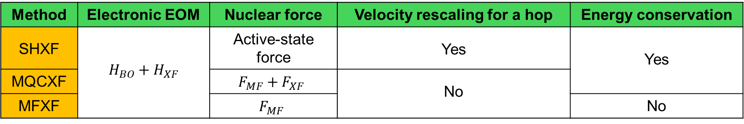
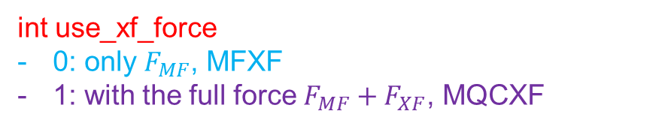
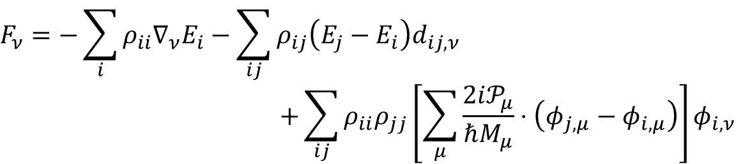
Setting the XF dynamics
Parameters for the XF methods
Method | Electronic EOM | Nuclear force | Velocity rescaling for a hop | Energy conservation
SHXF | $$H_{BO}+H_{XF}$$ | Active-state force | Yes | Yes
MQCXF |  | $$F_{MF}+F_{XF}$$ | No
MFXF |  | $$F_{MF}$$ |  | No
SHXF
int decoherence_algo == 5
MQCXF and MFXF
int decoherence_algo == 6
$$F_{ν}=−\sum_{i}{ρ_{ii}∇_{ν}E_{i}}−\sum_{ij}{ρ_{ij}\left(E_{j}−E_{i}\right)d_{ij,ν}}$$
$$+\sum_{ij}{ρ_{ii}ρ_{jj}\left[\sum_{μ}{\frac{2i𝒫_{μ}}{ℏM_{μ}}}⋅\left(φ_{j,μ}−φ_{i,μ}\right)\right]φ_{i,ν}}$$
$$F_{ν}=F_{a,ν}$$
int use_xf_force
0: only $F_{MF}$, MFXF
1: with the full force $F_{MF}+F_{XF}$, MQCXF

Slide 5
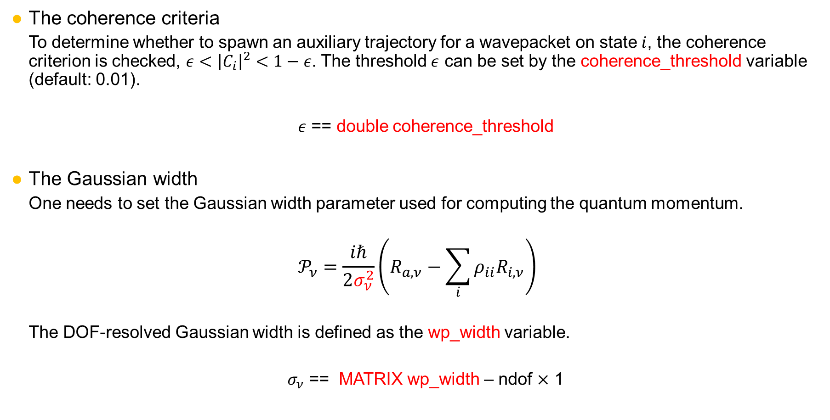
Setting the XF dynamics
The coherence criteria
To determine whether to spawn an auxiliary trajectory for a wavepacket on state $i$, the coherence criterion is checked, $ε<{\left|C_{i}\right|}^{2}<1−ε$. The threshold $ε$ can be set by the coherence_threshold variable (default: 0.01).
$ε$ == double coherence_threshold
The Gaussian width
One needs to set the Gaussian width parameter used for computing the quantum momentum.
$$𝒫_{ν}=\frac{iℏ}{2σ_{ν}^{2}}\left(R_{a,ν}−\sum_{i}{ρ_{ii}R_{i,ν}}\right)$$
The DOF-resolved Gaussian width is defined as the wp_width variable.
$σ_{ν}$ == MATRIX wp_width – ndof $×$ 1

Slide 6
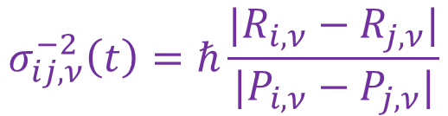
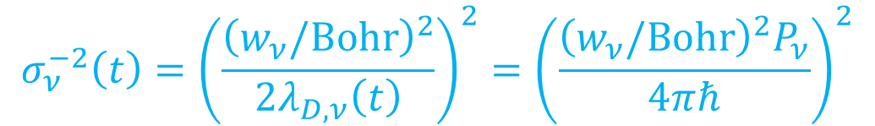

Setting the XF dynamics
The time-dependent width approximations
The time-dependent width can be set by the use_td_width parameter.
int use_td_width
0: frozen Gaussian [default]
1: free-particle Gaussian approximation
2: the Schwartz scheme
3: the Subotnik scheme
The Schwartz width [Bedard-Hearn, M. J.; Larsen, R. E.; Schwartz, B. J. JCP. 2005, 123 (23), 234106.]
$$σ_{ν}^{−2}\left(t\right)={\left(\frac{{\left(w_{ν}/Bohr\right)}^{2}}{2λ_{D,ν}\left(t\right)}\right)}^{2}={\left(\frac{{\left(w_{ν}/Bohr\right)}^{2}P_{ν}}{4πℏ}\right)}^{2}$$
The Subotnik width [Subotnik, J. E. JPCA. 2011, 115 (44), 12083–12096.]
$$σ_{ν}^{−2}\left(t\right)=\frac{1}{N−1}\sum_{\begin{aligned}i,j=0, \\ i<j\end{aligned}}^{N−1}{σ_{ij,ν}^{2}(t)}$$
$$σ_{ij,ν}^{−2}\left(t\right)=ℏ\frac{|R_{i,ν}−R_{j,ν}|}{|P_{i,ν}−P_{j,ν}|}$$

Slide 7


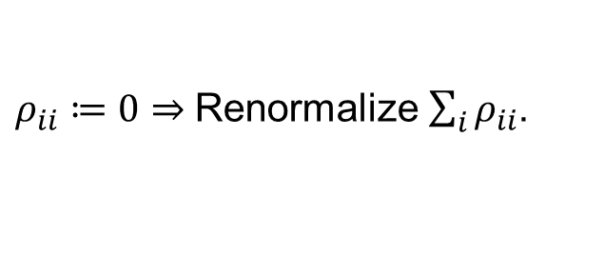


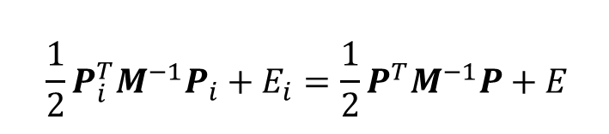



Setting the XF dynamics
Turning-point algorithms
Case I. An auxiliary trajectory encounters the turning point.
$$\frac{1}{2}P_{i}^{T}M^{−1}P_{i}+E_{i}=\frac{1}{2}P^{T}M^{−1}P+E$$
int project_out_aux
0, Fix that aux. trajectory by $α_{i}=0$
Anyway, the sign of relative position ($R−⟨R⟩$) and momentum difference ($Δφ$) is maintained, so the decoherence correction directs the dynamics as it have done.
1 [default], BC1: Project out the corresponding state density and initialize aux. trajectories.
Clearly, the real trajectory would lose the density on the aux. trajectory due to the reflection. Thus, clean it in the BCSH-fashion.
$$P_{i}=α_{i}P$$
$$R$$
$$R$$
$$E_{tot}$$
Aux. trajectory
$ρ_{ii}≔0⇒$Renormalize $\sum_{i}{ρ_{ii}}$.
$$R$$
Real trajectory
$$R$$

Slide 8


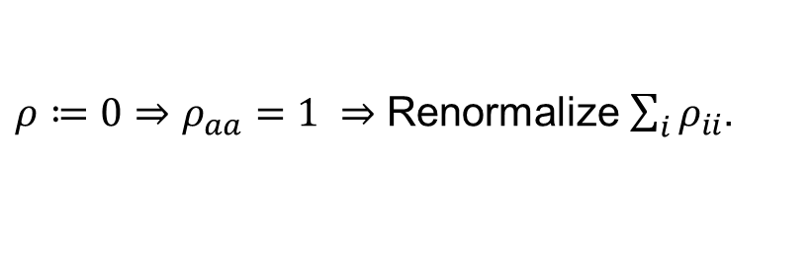



Setting the XF dynamics
Turning-point algorithms
Case II. The real trajectory encounters the turning point.
$$\frac{1}{2}P_{i}^{T}M^{−1}P_{i}+E_{i}=\frac{1}{2}P^{T}M^{−1}P+E$$
int tp_algo
0, don’t use the turning-point algorithm
1 [default], BC2: Collapse the state into the active state.
2: Fix the aux. trajectory
3: Keep the last momenta in aux. trajectory
$$P_{i}=α_{i}P$$
$ρ≔0⇒ρ_{aa}=1 ⇒$ Renormalize $\sum_{i}{ρ_{ii}}$.
$$R$$
$$E_{tot}$$
Aux. trajectory
$$R$$
$$R$$
Real trajectory
fixed
fixed
$$R$$
$$R$$
$$R$$

Slide 9
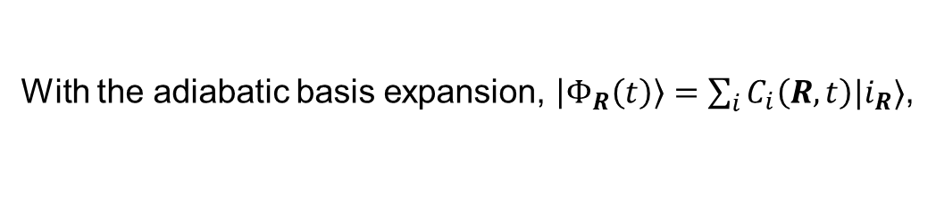
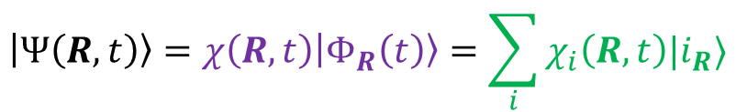


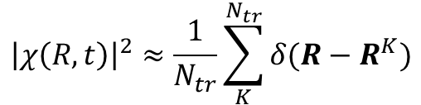
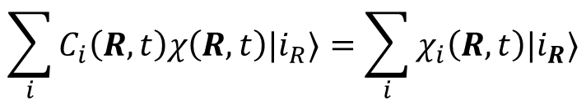

Comparison with the DVR dynamics
Population and coherence expressed by the DVR amplitude
XF ansatz
DVR ansatz
$$\left|Ψ\left(R,t\right)\right\rangle =χ\left(R,t\right)\left|Φ_{R}\left(t\right)\right\rangle =\sum_{i}{χ_{i}\left(R,t\right)|i_{R}⟩}$$
With the adiabatic basis expansion, $\left|Φ_{R}\left(t\right)\right\rangle =\sum_{i}{C_{i}\left(R,t\right)|i_{R}⟩}$,
$$\sum_{i}{C_{i}\left(R,t\right)χ\left(R,t\right)|i_{R}⟩}=\sum_{i}{χ_{i}\left(R,t\right)|i_{R}⟩}$$
$$C_{i}\left(R,t\right)χ\left(R,t\right)=χ_{i}(R,t)$$
or
$$C_{i}\left(R,t\right)=χ_{i}(R,t)/χ\left(R,t\right)$$
For a local observable, $\hat{A}(R,t)$, its time-resolved average is the following.
$$\left\langle A\left(t\right)\right\rangle =\int{dR\left\langle Ψ\left(R,t\right)\left|\hat{A}\left(R,t\right)\right|Ψ\left(R,t\right)\right\rangle }=\int{dR}{\left|χ\left(R,t\right)\right|}^{2}\left\langle Φ_{R}\left(t\right)\left|\hat{A}\left(R,t\right)\right|Φ_{R}(t)\right\rangle =\int{dR{\left|χ\left(R,t\right)\right|}^{2}A(R,t)}$$
$${\left|χ\left(R,t\right)\right|}^{2}≈\frac{1}{N_{tr}}\sum_{K}^{N_{tr}}{δ(R−R^{K})}$$
$$\left\langle \hat{A}\left(t\right)\right\rangle ≈\frac{1}{N_{tr}}\sum_{K}^{N_{tr}}{A^{K}(t)}$$
In the MQC approach,

Slide 10
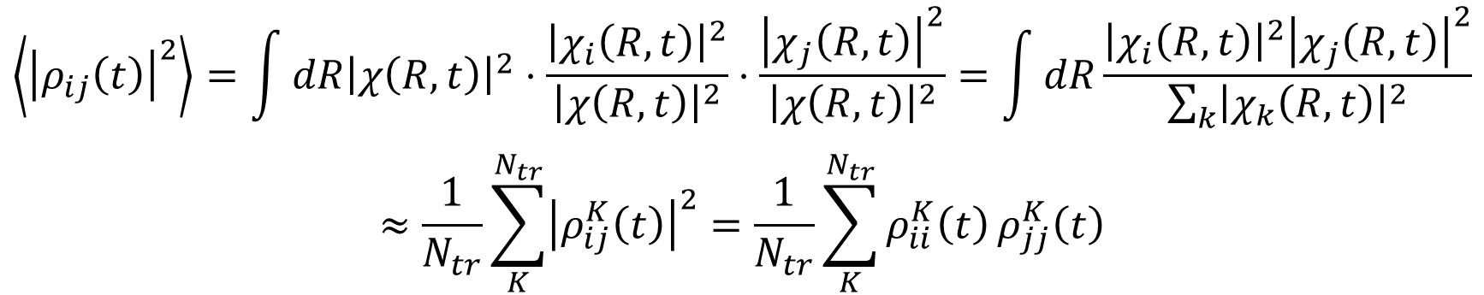
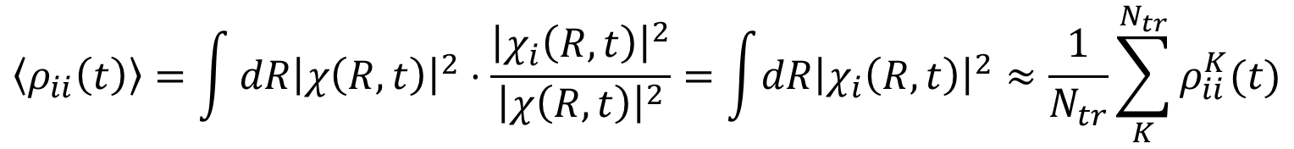
Comparison with the DVR dynamics
Population and coherence expressed by the DVR amplitude
Population
$$\left\langle ρ_{ii}\left(t\right)\right\rangle =\int{dR{\left|χ\left(R,t\right)\right|}^{2}⋅\frac{{\left|χ_{i}\left(R,t\right)\right|}^{2}}{{\left|χ\left(R,t\right)\right|}^{2}}}=\int{dR{\left|χ_{i}\left(R,t\right)\right|}^{2}}≈\frac{1}{N_{tr}}\sum_{K}^{N_{tr}}{ρ_{ii}^{K}(t)}$$
Coherence
$$\left\langle {\left|ρ_{ij}\left(t\right)\right|}^{2}\right\rangle =\int{dR{\left|χ\left(R,t\right)\right|}^{2}⋅\frac{{\left|χ_{i}\left(R,t\right)\right|}^{2}}{{\left|χ\left(R,t\right)\right|}^{2}}}⋅\frac{{\left|χ_{j}\left(R,t\right)\right|}^{2}}{{\left|χ\left(R,t\right)\right|}^{2}}=\int{dR\frac{{\left|χ_{i}\left(R,t\right)\right|}^{2}{\left|χ_{j}\left(R,t\right)\right|}^{2}}{\sum_{k}{{\left|χ_{k}\left(R,t\right)\right|}^{2}}}}$$
$$≈\frac{1}{N_{tr}}\sum_{K}^{N_{tr}}{{\left|ρ_{ij}^{K}\left(t\right)\right|}^{2}}=\frac{1}{N_{tr}}\sum_{K}^{N_{tr}}{ρ_{ii}^{K}\left(t\right)}ρ_{jj}^{K}\left(t\right)$$

Slide 11
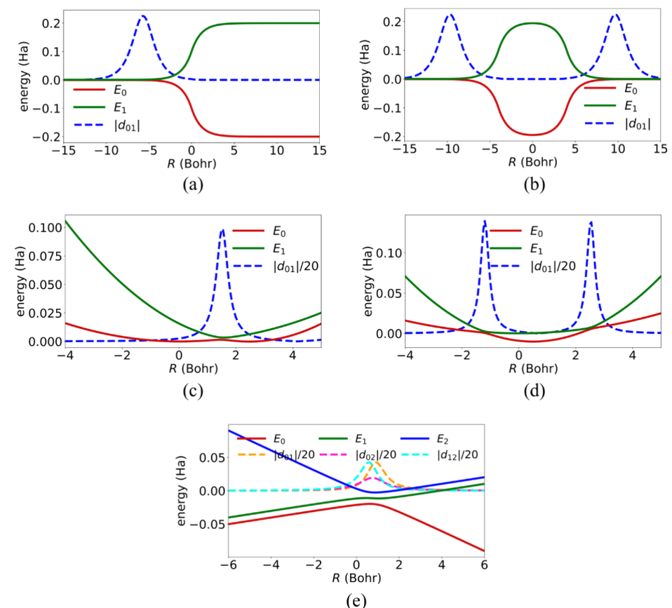
Model Hamiltonians
Tully’s extended crossing with reflection (ECWR)
Subotnik’s double arch geometry (DAG)
Single- and double-crossing Holstein (SC, DC Holstein)
3-state Esch-Levine model

Slide 12
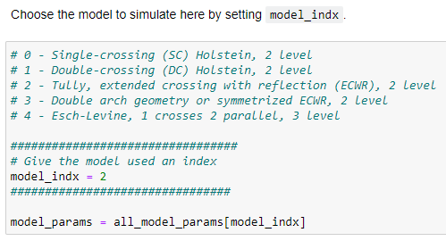
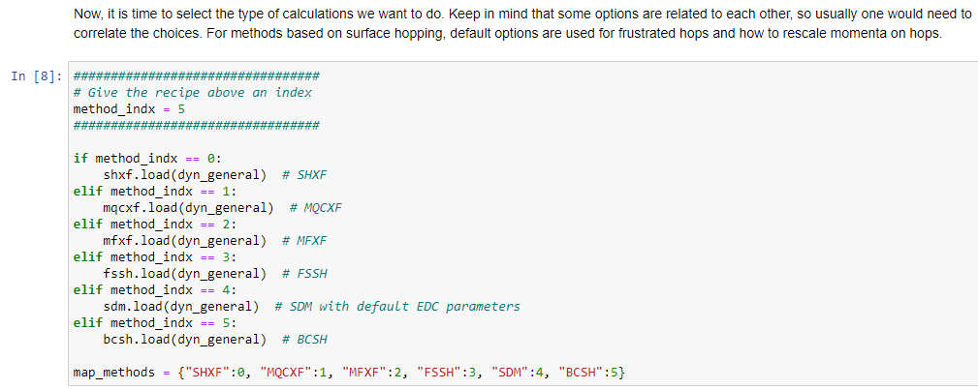
TUT1. Run the XF dynamics
ECWR | DAG | SC H | DC H | SHXF | MQCXF | FSSH | BCSH
0 | 1 | 2 | 3 | 0 | 1 | 3 | 5
Section 1-7
Run the nonadiabatic dynamics on the ECWR, DAG, Holstein models with the SHXF, MQCXF, FSSH and BCSH methods (30 min).
In Section 3,
In Section 4,
model_indx = 0, 1, 2, 3
method_indx = 0, 1, 3, 5

Slide 13
TUT2. Run the DVR dynamics and comparison
ECWR | DAG | SC H | DC H | SHXF | MQCXF | FSSH | BCSH
0 | 1 | 2 | 3 | 0 | 1 | 3 | 5
Section 8
Run the DVR dynamics on the ECWR, DAG, Holstein models and visualize the population and coherence (5 min).
In Section 3,
In Section 8,
Run the DVR dynamics
Compare the results from the DVR and MQC dynamics
model_indx = 0, 1, 2, 3

Slide 14
TUT3. Plot phase-space diagrams
ECWR | DAG | SC H | DC H | SHXF | MQCXF | FSSH | BCSH
0 | 1 | 2 | 3 | 0 | 1 | 3 | 5
Section 9
Use the make_phase_space_movie function to visualize the nuclear propagation in the phase space. This GIF file is saved to each dynamics result directory (8 min).
Ex.
ECWR, SHXF
_model_indx = 0, 1, 2, 3
State 0
_method_indx = 0, 1, 3, 5
State 1
Set _qlim, _plim to [-15, 15] and [0,40] for ECWR and DAG
Set _qlim, _plim to [-5, 5] and [-10,10] for the Holstein models

Slide 15
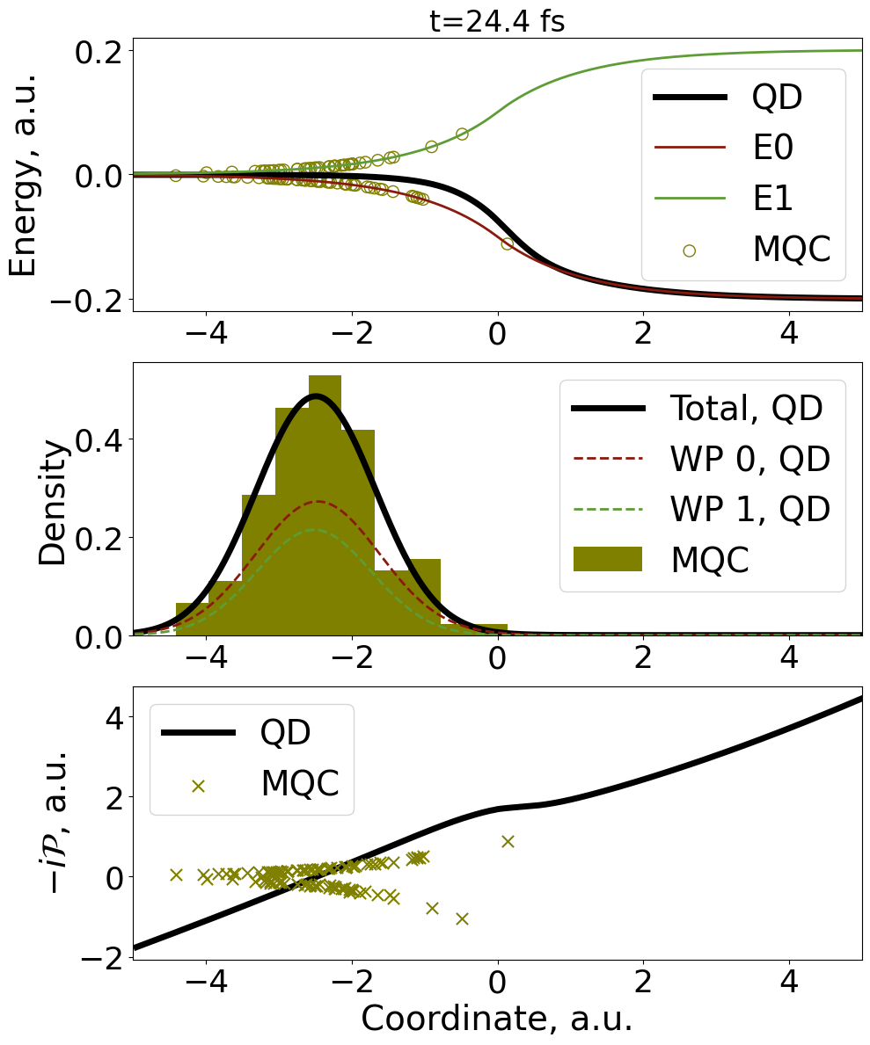
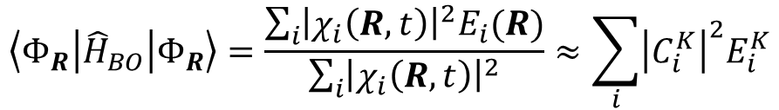
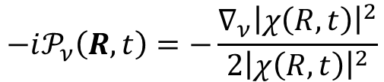
TUT4. Plot the dynamics snapshots
ECWR | DAG | SC H | DC H | SHXF | MQCXF | FSSH | BCSH
0 | 1 | 2 | 3 | 0 | 1 | 3 | 5
Section 10
Compare the TDPES, nuclear density, and quantum momenta from the DVR and MQC trajectories (10 min).
Ex. ECWR, SHXF
_model_indx = 0, 1, 2, 3
_method_indx = 0, 1 (for the XF methods)
R window can be between [-25, 25] for the Holstein models, and [-35, 35] for ECWR and DAG!
$$\left\langle Φ_{R}\left|{\hat{H}}_{BO}\right|Φ_{R}\right\rangle =\frac{\sum_{i}{{\left|χ_{i}\left(R,t\right)\right|}^{2}E_{i}(R)}}{\sum_{i}{{\left|χ_{i}\left(R,t\right)\right|}^{2}}}≈\sum_{i}{{\left|C_{i}^{K}\right|}^{2}E_{i}^{K}}$$
TDPES
Quantum momentum
$$−i𝒫_{ν}\left(R,t\right)=−\frac{∇_{ν}{\left|χ\left(R,t\right)\right|}^{2}}{2{\left|χ\left(R,t\right)\right|}^{2}}$$

Slide 16
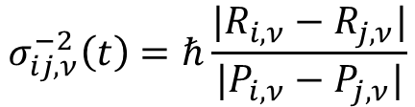
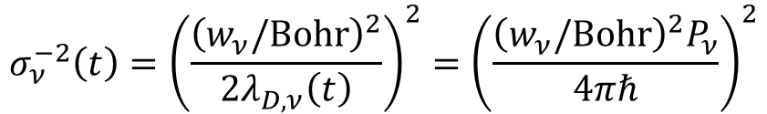


TUT5. Use the TD Gaussian scheme
ECWR | DAG | SC H | DC H | SHXF | MQCXF | FSSH | BCSH
0 | 1 | 2 | 3 | 0 | 1 | 3 | 5
Section 1-7, 11
Run the XF dynamics with the TD Gaussians, check the behavior of the TD widths and population/coherence (25 min).
model_indx = 2, 3
method_indx = 0, 1 (for the XF methods)
param_indx = 3, 4, 5 (for the XF methods)
$$σ_{ν}^{−2}\left(t\right)={\left(\frac{{\left(w_{ν}/Bohr\right)}^{2}}{2λ_{D,ν}\left(t\right)}\right)}^{2}={\left(\frac{{\left(w_{ν}/Bohr\right)}^{2}P_{ν}}{4πℏ}\right)}^{2}$$
$w_{0}=1.0 Bohr$
param_indx = 3
Schwartz width
$w_{0}=4.0 Bohr$
param_indx = 4
$$σ_{ij,ν}^{−2}\left(t\right)=ℏ\frac{|R_{i,ν}−R_{j,ν}|}{|P_{i,ν}−P_{j,ν}|}$$
Subotnik width
param_indx = 5
For population and coherence,
compare_pop(3, _param_indx=5, which_methods=["SHXF", "MQCXF"]); compare_coh(3, _param_indx=5, which_methods=["SHXF", "MQCXF"])

