Slide 1

Libra Summer School and Workshop 2024
HEOM
Alexey Akimov
University at Buffalo, SUNY
July 9, 2024

Slide 2
Fundamentals of HEOM with Libra
See here
https://compchem-cybertraining.github.io/Cyber_Training_Workshop_2021/files/Jain-HEOM.pdf

Slide 3

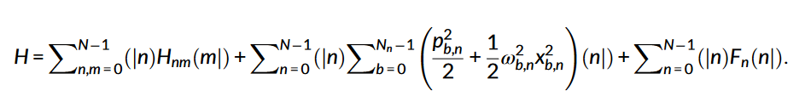
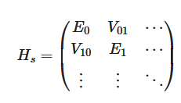


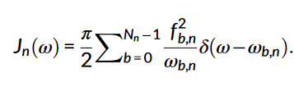

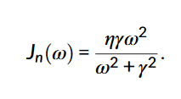

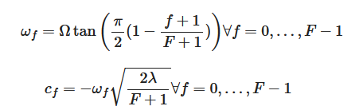



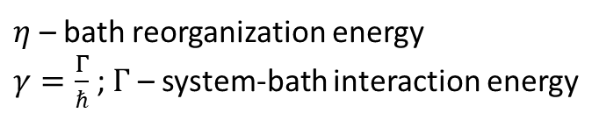
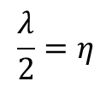

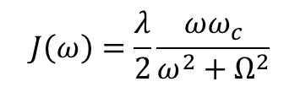
System-bath Hamiltonian for HEOM
Temen, S.; Jain, A.; Akimov, A. V. IJQC 2020, 120, e26373.
$$J\left(ω\right)=\frac{λ}{2}\frac{ωω_{c}}{ω^{2}+Ω^{2}}$$
Debye spectral density
$η$ – bath reorganization energy
$γ=\frac{Γ}{ℏ}$ ; $Γ$ – system-bath interaction energy
$λ$ – bath reorganization energy
$$γ=Ω$$
$$\frac{λ}{2}=η$$
$$f_{b,n}=s_{n}c_{n,f}$$
$$ω_{c}=Ωω$$
Wu, D.; Hu, Z.; Li, J.; Sun, X. JCP 2021, 155, 224104

Slide 4






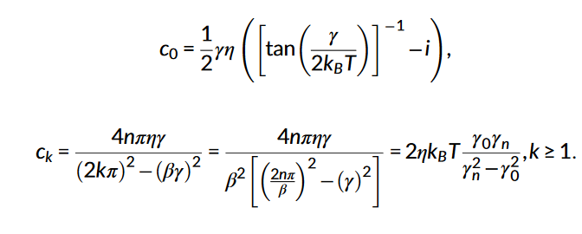
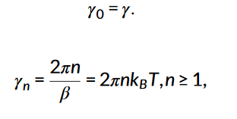
The Hierarchy of Equations
Temen, S.; Jain, A.; Akimov, A. V. IJQC 2020, 120, e26373.
J. Strümpfer, K. Schulten, J. Chem. Theory Comput. 2012, 8, 2808;
Q. Shi, L. Chen, G. Nan, R.-X. Xu, Y. Yan, J. Chem. Phys. 2009, 130, 084105;
L. Chen, R. Zheng, Q. Shi, Y. Yan, J. Chem. Phys. 2009, 131, 094502.
Quantum correlation function;
Matsubara expansion coefficients
Matsubara frequencies

Slide 5


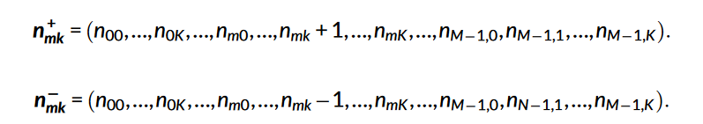
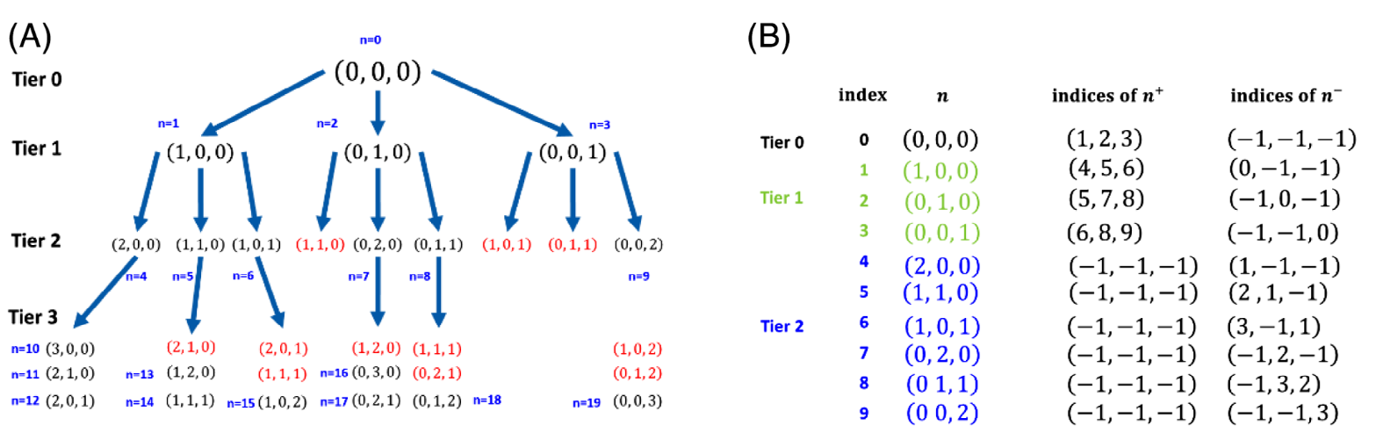
The indexing system
Temen, S.; Jain, A.; Akimov, A. V. IJQC 2020, 120, e26373.
Depth of hierarchy
M – the number of system levels;
K – the number of Matsubara frequencies

Slide 6
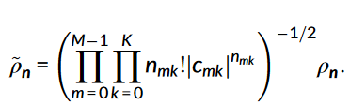

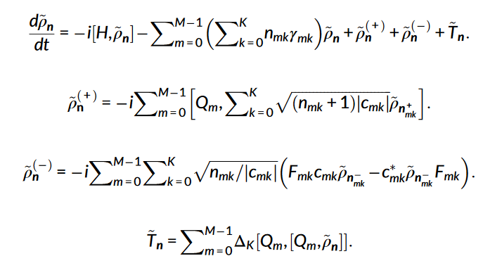


Scaled HEOM
Q. Shi, L. Chen, G. Nan, R.-X. Xu, Y. Yan, J. Chem. Phys. 2009, 130, 084105;
Same as the original equations
But converges faster than the original equations

Slide 7
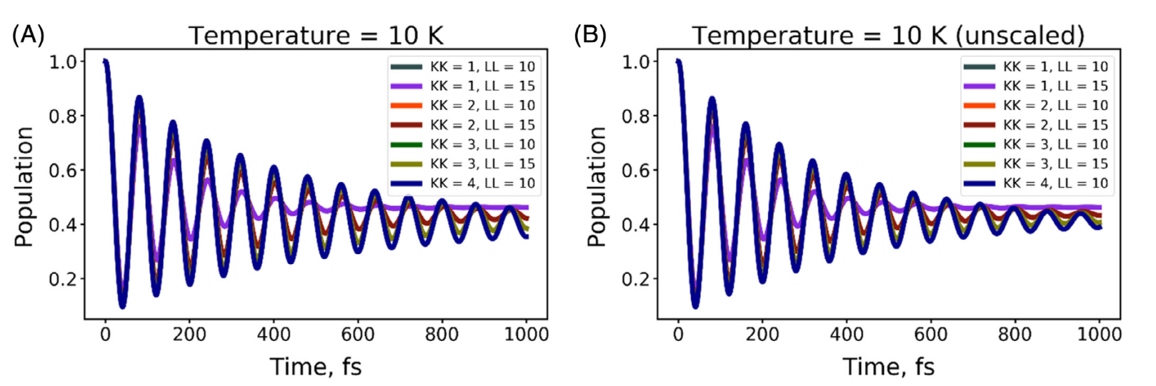
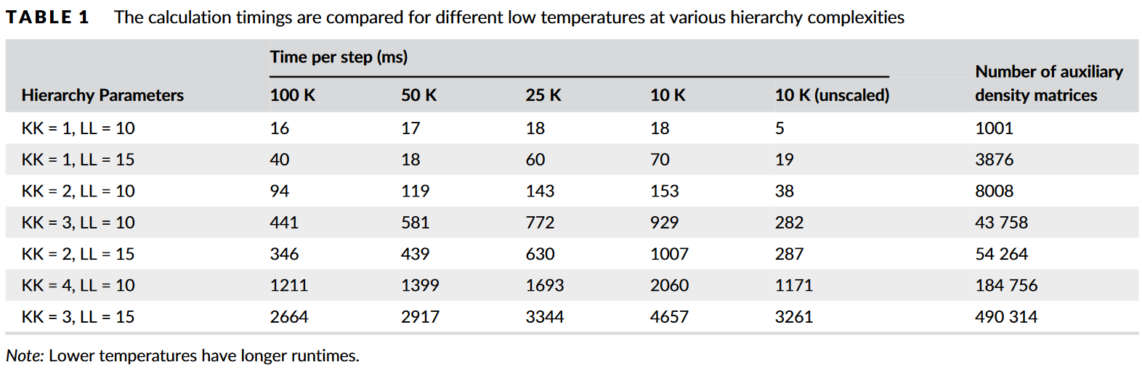
Convergence and complexity of the HEOM calculations
Temen, S.; Jain, A.; Akimov, A. V. IJQC 2020, 120, e26373.

Slide 8


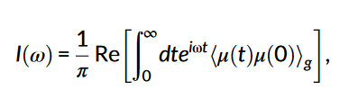
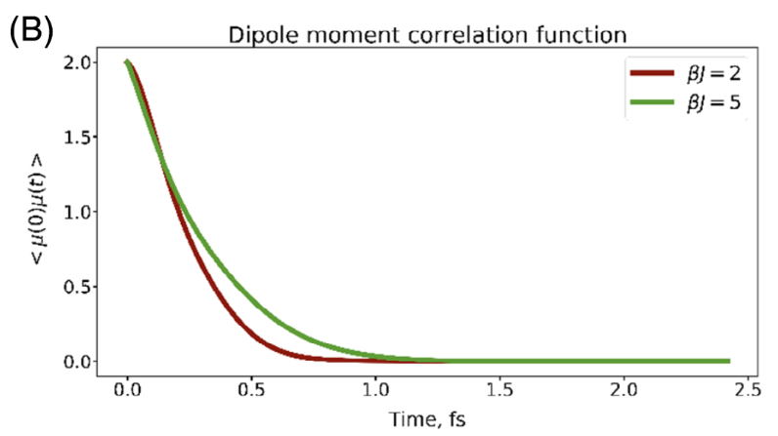
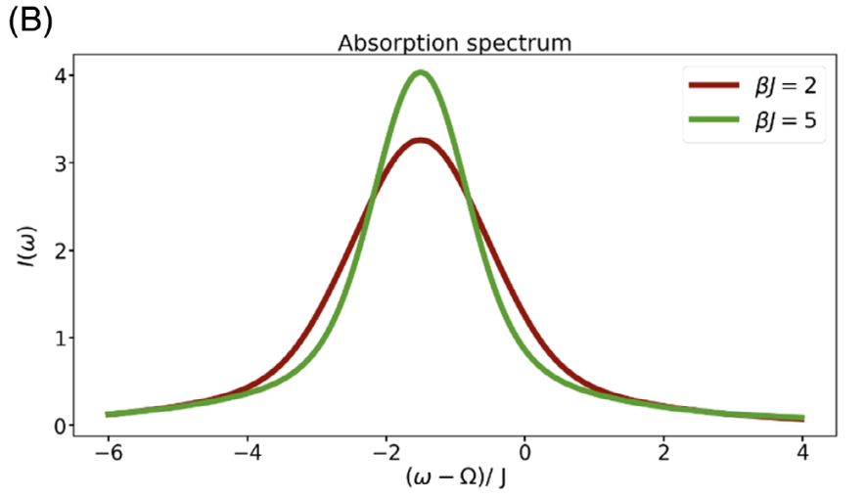
Spectra calculations
Temen, S.; Jain, A.; Akimov, A. V. IJQC 2020, 120, e26373.
Initial condition:

