Slide 1

Libra Summer School and Workshop 2024
Alexey Akimov
University at Buffalo, SUNY
July 9, 2024

Slide 2
Defining Hamiltonians in Libra

Slide 3
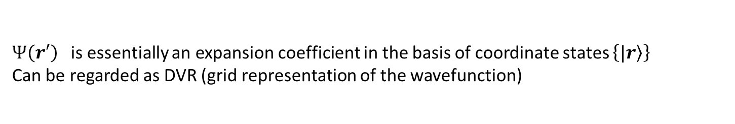
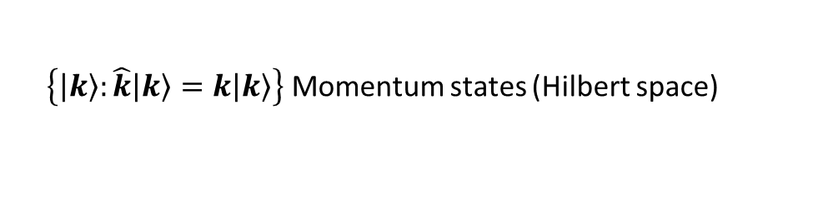
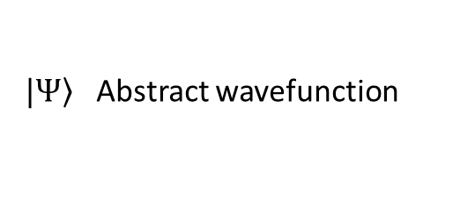
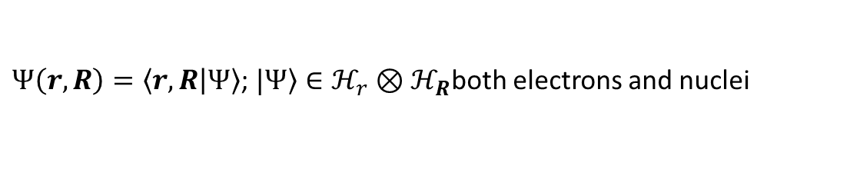
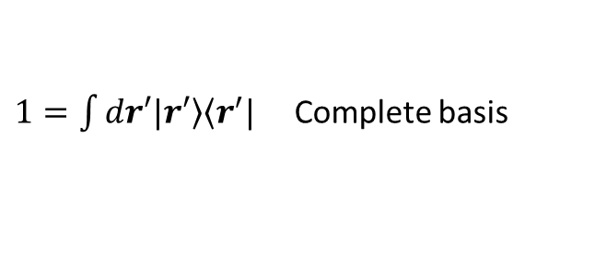
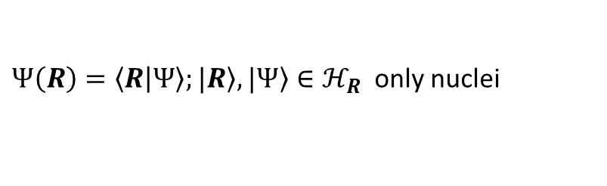
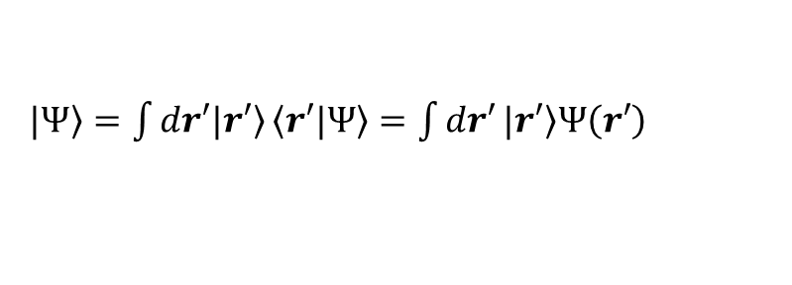
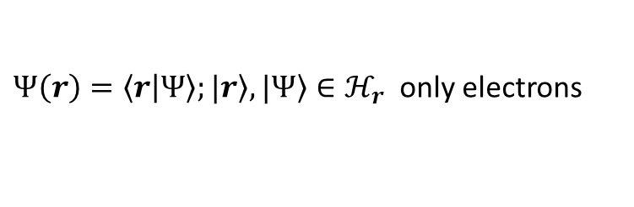
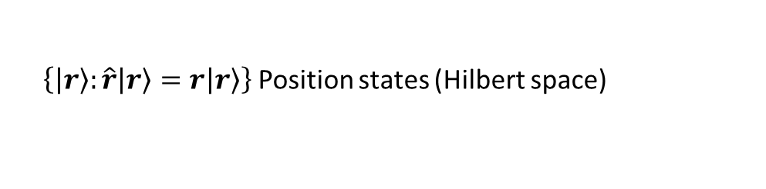
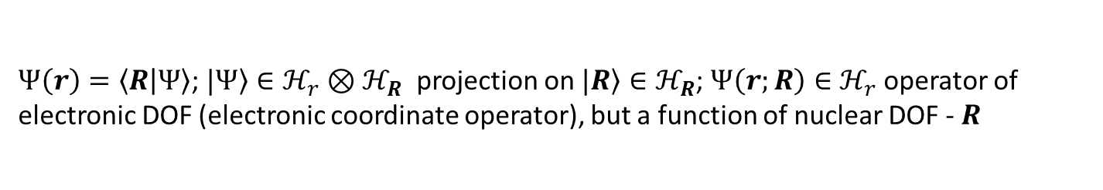
Wavefunction and selection of representation
Akimov, A. V. Fundamentals of Trajectory-Based Methods for Nonadiabatic Dynamics. In Comprehensive Computational Chemistry; Elsevier, 2024; pp 235–272. https://doi.org/10.1016/B978-0-12-821978-2.00034-9.
$\left.|Ψ\right\rangle$ Abstract wavefunction
$\left\{\left.\left|r\right.\right\rangle :\hat{r}\left.\left|r\right.\right\rangle =r\left.\left|r\right.\right\rangle \right\}$ Position states (Hilbert space)
$\left\{\left.\left|k\right.\right\rangle :\hat{k}\left.\left|k\right.\right\rangle =k\left.\left|k\right.\right\rangle \right\}$ Momentum states (Hilbert space)
$Ψ\left(r\right)=\left\langle r | Ψ\right\rangle$ Wavefunction in a position representation – representation in the basis of position states
$1=\int{dr′\left.|r′\right\rangle \left\langle r^{′}|\right.}$ Complete basis
Indeed
$\left.|Ψ\right\rangle =\int{dr′\left.|r′\right\rangle }\left\langle r′|\left.Ψ\right\rangle \right.=\int{dr′}\left.|r′\right\rangle Ψ\left(r′\right)$
$Ψ\left(r′\right)$ is essentially an expansion coefficient in the basis of coordinate states $\left\{\left.|r\right\rangle \right\}$
Can be regarded as DVR (grid representation of the wavefunction)
$Ψ\left(k\right)=\left\langle k | Ψ\right\rangle$ Likewise, the momentum representation of a wavefunction
$Ψ\left(r\right)=\left\langle r | Ψ\right\rangle ;\left.|r\right\rangle ,\left.|Ψ\right\rangle ∈ℋ_{r}$ only electrons
$Ψ\left(R\right)=\left\langle R | Ψ\right\rangle ;\left.|R\right\rangle ,\left.|Ψ\right\rangle ∈ℋ_{R}$ only nuclei
Different Hilbert spaces:
$Ψ\left(r,R\right)=\left\langle r,R | Ψ\right\rangle$; $\left.|Ψ\right\rangle ∈ℋ_{r}⊗ℋ_{R}$both electrons and nuclei
$Ψ\left(r\right)=\left\langle R | Ψ\right\rangle$; $\left.|Ψ\right\rangle ∈ℋ_{r}⊗ℋ_{R}$ projection on $\left.|R\right\rangle ∈ℋ_{R}$; $Ψ\left(r;R\right)∈ℋ_{r}$ operator of electronic DOF (electronic coordinate operator), but a function of nuclear DOF - $R$

Slide 4



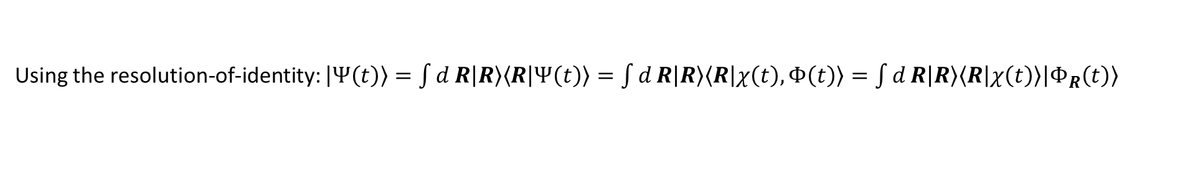
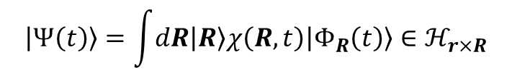


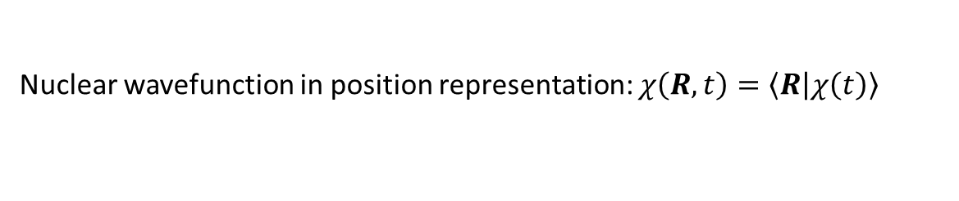


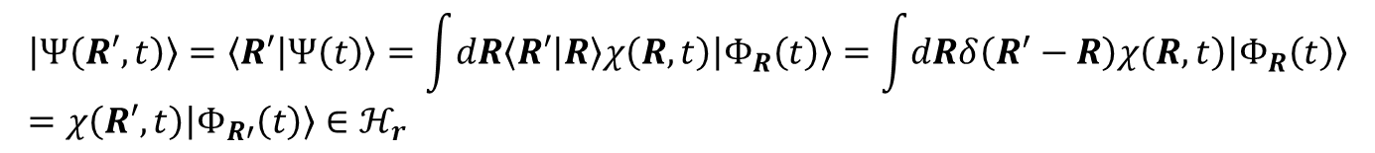
Working in Different Hilbert Spaces: Exact-Factorization Example
Han, D.; Akimov, A.V. J. Chem. Theory Comput. 2024, 20, 5022–5042
electron-nuclear state $\left|Ψ\left(t\right)\right\rangle ∈ℋ_{r×R}=ℋ_{r}⨂ℋ_{R}$
$$\left|Ψ\left(t\right)\right\rangle =\left|χ\left(t\right),Φ\left(t\right)\right\rangle$$
$$\left|R\right\rangle ∈ℋ_{R}$$
$$\left|r\right\rangle ∈ℋ_{r}$$
Electronic Hilbert space
Electronic Hilbert space
Using the resolution-of-identity: $\left|Ψ\left(t\right)\right\rangle =\int{d}R\left|R\right\rangle \left\langle R | Ψ\left(t\right)\right\rangle =\int{d}R\left|R\right\rangle \left\langle R | χ\left(t\right),Φ\left(t\right)\right\rangle =\int{d}R\left|R\right\rangle \left\langle R | χ\left(t\right)\right\rangle \left|Φ_{R}\left(t\right)\right\rangle$
marginal nuclear state $\left|χ\left(t\right)\right\rangle ∈ℋ_{R}$
conditional electronic state $\left|Φ_{R}\left(t\right)\right\rangle ∈ℋ_{r}$
Nuclear wavefunction in position representation: $\left.χ\left(R,t\right)=\left\langle R\right|χ\left(t\right)\right\rangle$
Electronic wavefunction for fixed nuclear geometry: $Φ\left(r,t;R\right)=\left\langle r\right|Φ_{R}(t)⟩$
$$\left|Ψ\left(t\right)\right\rangle =\int{dR\left|R\right\rangle χ\left(R,t\right)\left|Φ_{R}\left(t\right)\right\rangle }∈ℋ_{r×R}$$
$$\left|Ψ\left(R′,t\right)\right\rangle =\left\langle R′ | Ψ\left(t\right)\right\rangle =\int{dR\left\langle R′\left|R\right\rangle χ\left(R,t\right)\left|Φ_{R}\left(t\right)\right\rangle \right.}=\int{dRδ\left(R^{′}−R\right)χ\left(R,t\right)\left|Φ_{R}\left(t\right)\right\rangle }=χ\left(R′,t\right)\left|Φ_{R′}\left(t\right)\right\rangle ∈ℋ_{r}$$
molecular state $\left|Ψ\left(R,t\right)\right\rangle$

Slide 5
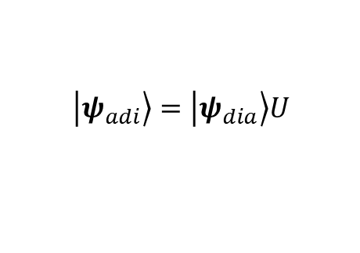
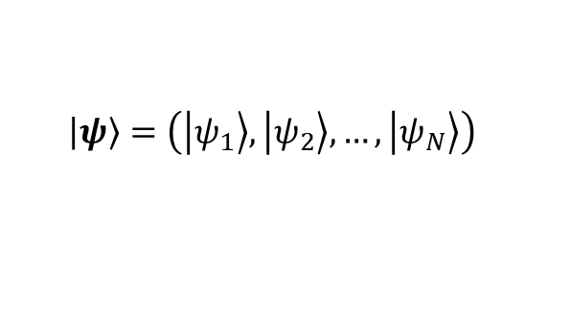
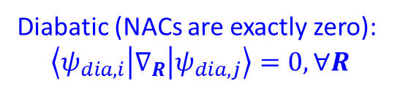

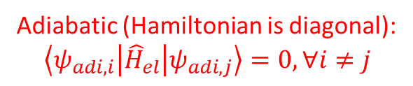

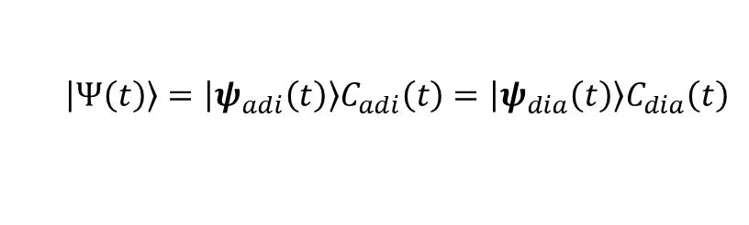



Shorthand notation. Adiabatic and Diabatic Representations
$ψ_{i}\left(r\right)=\left\langle r | i\right\rangle =\left\langle r | ψ_{i}\right\rangle$ electronic coordinates, i-th basis state
Shorthand notation for the entire basis:
$$\left.\left|ψ\right.\right\rangle =\left(\left.\left|ψ_{1}\right.\right\rangle ,\left.\left|ψ_{2}\right.\right\rangle ,…, \left.\left|ψ_{N}\right.\right\rangle \right)$$
Matrix elements
(scalars)
Matrix
$$A_{ij}=\left\langle ψ_{i} | \hat{A} | ψ_{j}\right\rangle ↔A=\left\langle ψ | \hat{A} | ψ\right\rangle$$
Basis:
Adiabatic (Hamiltonian is diagonal):
$$\left\langle ψ_{adi, i} | {\hat{H}}_{el} | ψ_{adi,j}\right\rangle =0, ∀i≠j$$
Diabatic (NACs are exactly zero):
$$\left\langle ψ_{dia,i} | ∇_{R} | ψ_{dia,j}\right\rangle =0, ∀R$$
$$\left.\left|ψ_{adi}\right.\right\rangle =\left.\left|ψ_{dia}\right.\right\rangle U$$
$$H_{adi}=\left\langle ψ_{adi} | {\hat{H}}_{el} | ψ_{adi}\right\rangle$$
Hamiltonians
$$H_{dia}=\left\langle ψ_{dia} | {\hat{H}}_{el} | ψ_{dia}\right\rangle$$
Transformation between bases
$$H_{dia}U=SUH_{adi}$$
$$H_{adi}=U^{+}H_{dia}U={\tilde{H}}_{dia}$$
Wavefunction should be invariant
w.r.t. the basis representation
$$\left.\left|Ψ\left(t\right)\right.\right\rangle =\left.\left|ψ_{adi}\left(t\right)\right.\right\rangle C_{adi}\left(t\right)=\left.\left|ψ_{dia}\left(t\right)\right.\right\rangle C_{dia}\left(t\right)$$

Slide 6
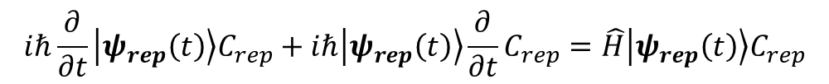
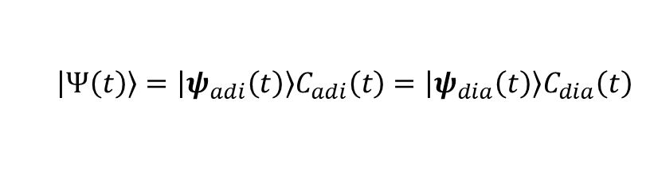

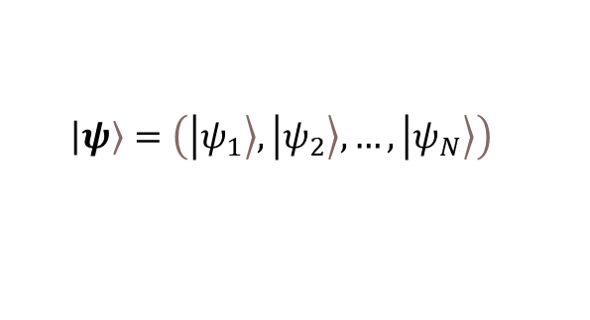

TD-SE in the Shorthand notation
Wavefunction should be invariant
w.r.t. the basis representation
$$\left.\left|Ψ\left(t\right)\right.\right\rangle =\left.\left|ψ_{adi}\left(t\right)\right.\right\rangle C_{adi}\left(t\right)=\left.\left|ψ_{dia}\left(t\right)\right.\right\rangle C_{dia}\left(t\right)$$
$$iℏ\frac{∂}{∂t}\left.\left|Ψ\left(t\right)\right.\right\rangle =\hat{H}\left.\left|Ψ\left(t\right)\right.\right\rangle$$
$$\left.\left|ψ\right.\right\rangle =\left(\left.\left|ψ_{1}\right.\right\rangle ,\left.\left|ψ_{2}\right.\right\rangle ,…, \left.\left|ψ_{N}\right.\right\rangle \right)$$
$$C={\left(c_{1},c_{2},…,c_{N}\right)}^{T}$$
$$iℏ\frac{∂}{∂t}\left.\left|ψ_{rep}\left(t\right)\right.\right\rangle C_{rep}+iℏ\left.\left|ψ_{rep}\left(t\right)\right.\right\rangle \frac{∂}{∂t}C_{rep}=\hat{H}\left.\left|ψ_{rep}\left(t\right)\right.\right\rangle C_{rep}$$
Projecting:
$$iℏ\left\langle ψ_{rep}(t)|\right.\frac{∂}{∂t}\left.\left|ψ_{rep}\left(t\right)\right.\right\rangle C_{rep}+iℏ\left\langle ψ_{rep}(t)\right.\left.\left|ψ_{rep}\left(t\right)\right.\right\rangle \frac{∂}{∂t}C_{rep}=\left\langle ψ_{rep}(t)|\right.\hat{H}\left.\left|ψ_{rep}\left(t\right)\right.\right\rangle C_{rep}$$
$$iℏS_{rep}\frac{∂}{∂t}C_{rep}=\left[\left\langle ψ_{rep}(t)|\right.\hat{H}\left.\left|ψ_{rep}\left(t\right)\right.\right\rangle −iℏ\left\langle ψ_{rep}(t)|\right.\frac{∂}{∂t}\left.\left|ψ_{rep}\left(t\right)\right.\right\rangle \right]C_{rep}$$

Slide 7
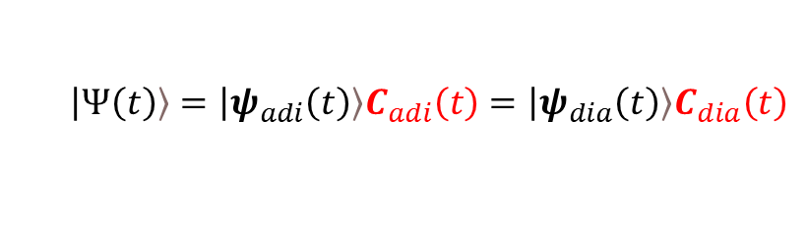
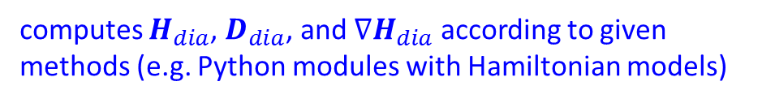

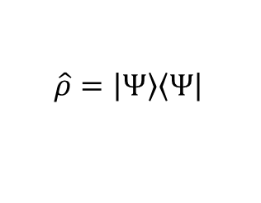
Implementation in Libra classes
Wavefunction language
$$\left.\left|Ψ\left(t\right)\right.\right\rangle =\left.\left|ψ_{adi}\left(t\right)\right.\right\rangle C_{adi}\left(t\right)=\left.\left|ψ_{dia}\left(t\right)\right.\right\rangle C_{dia}\left(t\right)$$
dyn_variables
ndia, nadi, ndof, ntraj
ampl_dia, ampl_adi
dm_adi, dm_dia
Density matrix language
$$\hat{ρ}=\left.\left|Ψ\right.\right\rangle \left\langle \left.Ψ\right|\right.$$
$$P_{adi}=\left\langle ψ_{adi} | \hat{ρ} | ψ_{adi}\right\rangle =\left\langle ψ_{adi} | ψ_{adi}\right\rangle C_{adi}C_{adi}^{+}\left\langle ψ_{adi} | ψ_{adi}\right\rangle =IC_{adi}C_{adi}^{+}I=C_{adi}C_{adi}^{+}$$
$$P_{dia}=\left\langle ψ_{dia} | \hat{ρ} | ψ_{dia}\right\rangle =\left\langle ψ_{dia} | ψ_{dia}\right\rangle C_{dia}C_{dia}^{+}\left\langle ψ_{dia} | ψ_{dia}\right\rangle =SC_{dia}C_{dia}^{+}S$$
So the conversions of the density matrices is:
${UP}_{dia}U^{+}=U^{+}SC_{dia}C_{dia}^{+}SU=C_{adi}C_{adi}^{+}=P_{adi}$ ➔ $P_{dia}=U^{−1}P_{adi}{\left(U^{−1}\right)}^{+}=U^{+}SP_{adi}{\left(U^{+}S\right)}^{+}=U^{+}SP_{adi}SU$
Coefficient transformation:
nHamiltonian
ampl_dia2adi
ampl_adi2dia
compute_adiabatic()
compute_diabatic()
$$C_{dia}=UC_{adi}↔C_{adi}=U^{−1}C_{dia}↔C_{adi}=U^{+}SC_{dia}$$
$$H_{dia}U=SUH_{adi}$$
and also computes derivative couplings and adiabatic gradients
computes $H_{dia}$, $D_{dia}$, and $∇H_{dia}$ according to given methods (e.g. Python modules with Hamiltonian models)

Slide 8
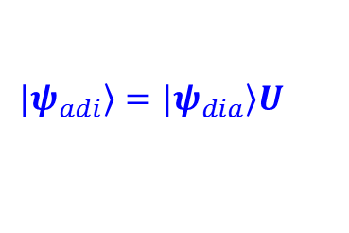







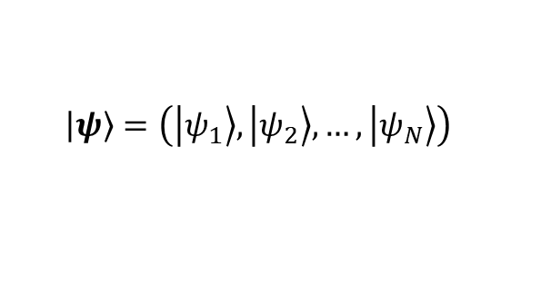




Implementation in the nHamiltonian class
$$\left.\left|ψ\right.\right\rangle =\left(\left.\left|ψ_{1}\right.\right\rangle ,\left.\left|ψ_{2}\right.\right\rangle ,…, \left.\left|ψ_{N}\right.\right\rangle \right)$$
$$D_{dia}=\left\langle ψ_{dia} | \frac{∂}{∂t} | ψ_{dia}\right\rangle$$
$$H_{dia}=\left\langle ψ_{dia} | \hat{H} | ψ_{dia}\right\rangle$$
Scalar NACs
Hamiltonian matrix elements
nHamiltonian
CMATRIX* ham_dia, nac_dia, hvib_dia
CMATRIX* ham_adi, nac_adi, hvib_adi
CMATRIX* ovlp_dia, time_overlap_dia
CMATRIX* ovlp_adi, time_overlap_adi
CMATRIX* basis_transform
vector<CMATRIX*> dc1_adi, dc1_dia
vector<CMATRIX*> d1ham_adi, d1ham_dia
compute_adiabatic()
$$D_{adi}=\left\langle ψ_{adi} | \frac{∂}{∂t} | ψ_{adi}\right\rangle$$
“Vibronic” Hamiltonian
$$H_{adi}=\left\langle ψ_{adi} | \hat{H} | ψ_{adi}\right\rangle$$
$$H_{vib, dia}=H_{dia}−iℏD_{dia}$$
Unitary (similarity) transformation
$$H_{vib, adi}=H_{adi}−iℏD_{adi}$$
$$H_{adi}=U^{+}H_{dia}U={\tilde{H}}_{dia}$$
Time-overlaps (transition density matrices)
$$\left\langle ψ_{dia}(t−Δt) | ψ_{dia}(t)\right\rangle =St_{dia}\left(t−Δt,t\right)≈I$$
$$\left.|ψ_{adi}\right\rangle =\left.|ψ_{dia}\right\rangle U$$
$$\left\langle ψ_{adi}(t−Δt) | ψ_{adi}(t)\right\rangle =St_{adi}\left(t−Δt,t\right)$$
First-order derivative coupling vectors
$$D_{adi}≡\left\langle ψ_{adi} | ∇ψ_{adi}\right\rangle$$
$$\left\langle ψ_{dia} | ψ_{dia}\right\rangle =S$$
The diabatic basis is not necessarily orthonormal
$$D_{dia}≡\left\langle ψ_{dia} | ∇ψ_{dia}\right\rangle$$
$$\left\langle ψ_{adi} | ψ_{adi}\right\rangle =I$$
How to compute NACs?
$$U^{+}∇H_{dia}U−\left({\tilde{D}}_{dia}^{+}H_{adi}+H_{adi}{\tilde{D}}_{dia}\right)=∇H_{adi}−\left(D_{adi}^{+}H_{adi}+H_{adi}D_{adi}\right)$$
Then use special structure of the matrix
$$\tilde{∇H_{dia}}−\left({\tilde{D}}_{dia}^{+}{\tilde{H}}_{dia}+{\tilde{H}}_{dia}{\tilde{D}}_{dia}\right)=∇H_{adi}−\left(D_{adi}^{+}H_{adi}+H_{adi}D_{adi}\right)$$

Slide 9





Nonadiabatic Couplings
Properties of the NACs
$${\overline{D}}_{dia}^{+}+{\overline{D}}_{dia}=∇S$$
$${\overline{D}}_{adi}+{\overline{D}}_{adi}^{+}=∇S_{adi}=0→{\left(D_{adi}^{α}\right)}^{+}=−D_{adi}$$
This is a well-known property!
$$D_{adi}^{α}={\tilde{D}}_{dia}^{α}+U^{+}S∇_{α}U$$
$D_{rep,ij}^{α}≡\left\langle ψ_{rep,i} | ∇_{α}ψ_{rep, j}\right\rangle$ is a scalar
$D_{rep,ij}≡\left\langle ψ_{rep,i} | ∇ψ_{rep, j}\right\rangle$ understood as a column-vector
${\overline{D}}_{rep}≡\left\langle ψ_{rep} | ∇ψ_{rep }\right\rangle$ understood as a vector of matrices $D_{rep}^{α}=\left\langle ψ_{rep} | ∇_{α}ψ_{rep }\right\rangle$
Important observations
the equation becomes an identity when $U=I$
$$\tilde{∇_{α}H_{dia}}−\left({\left(D_{adi}^{α}\right)}^{+}{\tilde{H}}_{dia}+{\tilde{H}}_{dia}{\tilde{D}}_{dia}^{α}\right)=∇_{α}H_{adi}−\left({\left(D_{adi}^{α}\right)}^{+}H_{adi}+H_{adi}D_{adi}^{α}\right)$$
$$U^{+}\left\langle ψ_{dia} | ∇_{α}H | ψ_{dia}\right\rangle U$$
$$\left\langle ψ_{adi} | ∇_{α}H | ψ_{adi}\right\rangle$$

Slide 10
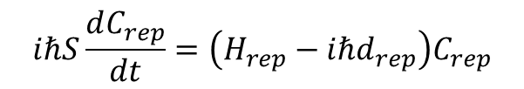
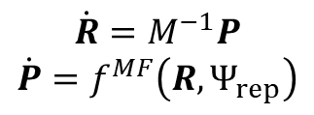
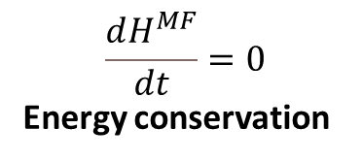
Quantum-Classical Hamiltonian and Ehrenfest forces
$$H^{MF}\left(R,P;Ψ\right)=\frac{\left\langle Ψ | H^{qc}\left(R,P\right) | Ψ\right\rangle }{\left\langle Ψ | Ψ\right\rangle }=\frac{1}{2}P^{T}M^{−1}P+\frac{C_{adi}^{+}H_{adi}C_{adi}}{C_{adi}^{+}C_{adi}}=\frac{1}{2}P^{T}M^{−1}P+\frac{C_{dia}^{+}H_{dia}C_{dia}}{C_{dia}^{+}SC_{dia}}$$
nHamiltonian
Ehrenfest_energy_adi
Ehrenfest_energy_dia
TD-SE for the amplitudes
$$iℏS\frac{dC_{rep}}{dt}=\left(H_{rep}−iℏd_{rep}\right)C_{rep}$$
$$\frac{dH^{MF}}{dt}=0$$
Energy conservation
$$\dot{R}=M^{−1}P$$
$$\dot{P}=f^{MF}\left(R,Ψ_{rep}\right)$$
Enforcing the “classical” form of equations of motion for nuclear DOFs
$$f_{n}^{MF}≡f_{n,adi}^{MF}=\frac{1}{C_{adi}^{+}C_{adi}}C_{adi}^{+}F_{adi,n}^{HF}C_{adi}=f_{n,dia}^{MF}=\frac{1}{C_{dia}^{+}SC_{dia}}C_{dia}^{+}F_{dia,n}^{HF}C_{dia}$$
nHamiltonian
Ehrenfest_forces_adi
Ehrenfest_forces_dia
Ehrenfest_forces_tens_adi
Ehrenfest_forces_tens_dia
$$F_{adi,n}^{HF}=−\left\langle ψ_{adi} | ∇_{n}H | ψ_{adi}\right\rangle =\left[−∇_{n}H_{adi}+D_{adi,n}^{+}H_{adi}+H_{adi}D_{adi,n}\right]$$
$$F_{dia,n}^{MF}=−\left\langle ψ_{dia} | ∇_{n}H | ψ_{dia}\right\rangle =\left[−∇_{n}H_{dia}+D_{dia,n}^{+}S^{−1}H_{dia}+H_{dia}S^{−1}D_{dia,n}\right]$$

Slide 11
More on the nHamiltonian class.
Making Interfaces

Slide 12

How `compute_dynamics` works
C++
Python
Transformations
User-defined
Hamiltonian
Ham_adi
Ham_dia
d1Ham_adi
d1Ham_dia
…
…
Dynamical Algorithm
$$q←q+\frac{p}{m}dt$$
User calls dynamics
ham.compute_diabatic(bp::object py_funct, bp::object q, bp::object params)
ham.compute_adiabatic(int lvl)
Output
$$p←p+f\frac{dt}{2}$$

Slide 13
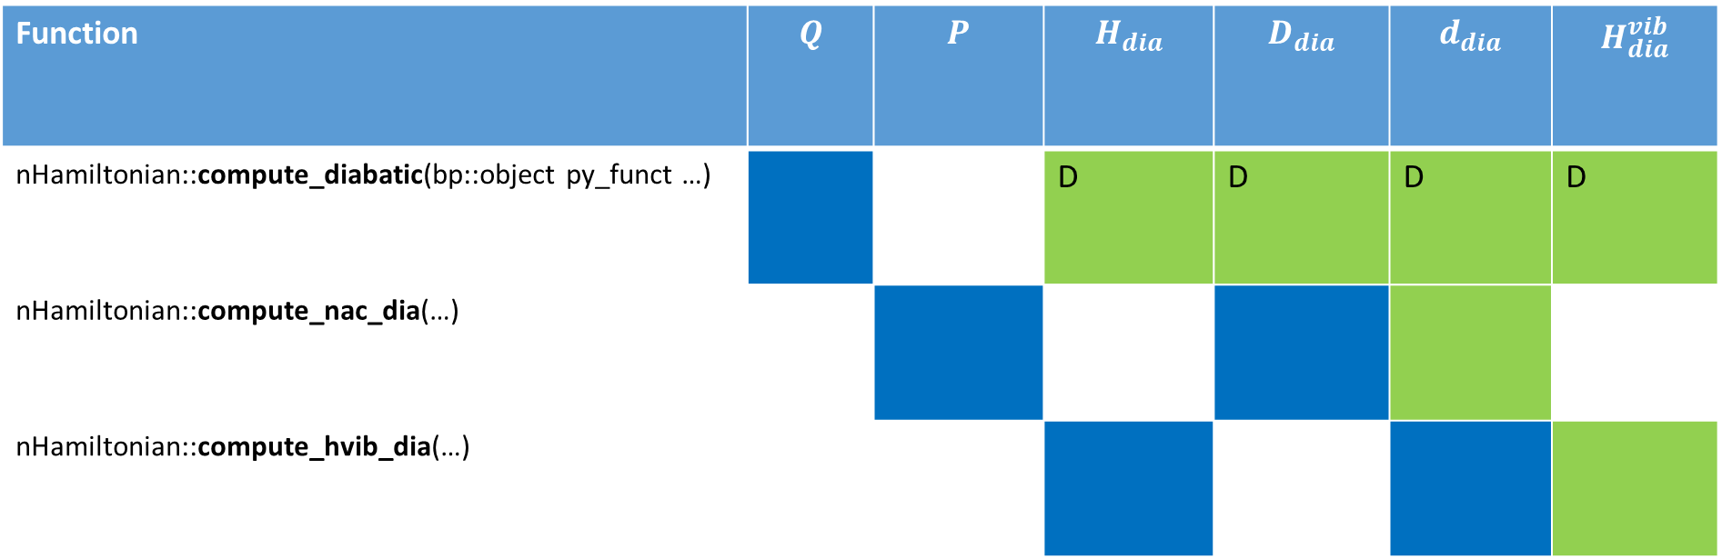
Different ways of computing matrix elements. Example of $H_{dia}^{vib}$
Blue = Required Input
Green = Output
Green with D = Can be set up directly via Python function call
Function | $$Q$$ | $$P$$ | $$H_{dia}$$ | $$D_{dia}$$ | $$d_{dia}$$ | $$H_{dia}^{vib}$$
nHamiltonian::compute_diabatic(bp::object py_funct …) |  |  | D | D | D | D
nHamiltonian::compute_nac_dia(…)
nHamiltonian::compute_hvib_dia(…)

Slide 14
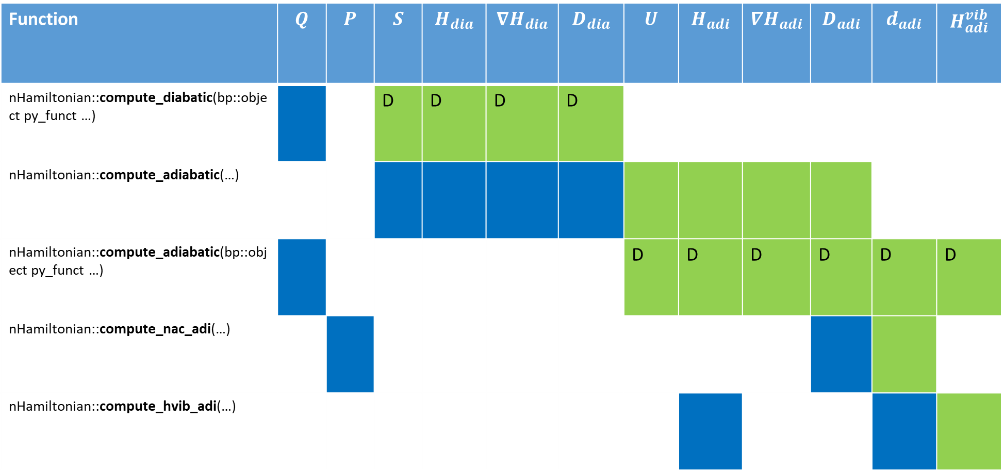
Different ways of computing matrix elements. Example of $H_{adi}^{vib}$
Function | $$Q$$ | $$P$$ | $$S$$ | $$H_{dia}$$ | $${∇H}_{dia}$$ | $$D_{dia}$$ | $$U$$ | $$H_{adi}$$ | $$∇H_{adi}$$ | $$D_{adi}$$ | $$d_{adi}$$ | $$H_{adi}^{vib}$$
nHamiltonian::compute_diabatic(bp::object py_funct …) |  |  | D | D | D | D
nHamiltonian::compute_adiabatic(…)
nHamiltonian::compute_adiabatic(bp::object py_funct …) |  |  |  |  |  |  | D | D | D | D | D | D
nHamiltonian::compute_nac_adi(…)
nHamiltonian::compute_hvib_adi(…)

Slide 15
nHamiltonian class as a hierarchical data type to handle multiple trajectories
nHamiltonian
level
id
nHamiltonian* parent
vector<nHamiltonian*> children
nnucl, nadi, ndia
CMATRIX* ham_dia, nac_dia, hvib_dia
CMATRIX* ham_adi, nac_adi, hvib_adi
CMATRIX* ovlp_dia, time_overlap_dia
CMATRIX* ovlp_adi, time_overlap_adi
CMATRIX* basis_transform
vector<CMATRIX*> dc1_adi, dc1_dia
vector<CMATRIX*> d1ham_adi, d1ham_dia
ampl_dia2adi
ampl_adi2dia
Level 0
Level 1
…
Level 2
…
…
int entanglement_opt
A selector of a method to couple the trajectories in this ensemble.
- 0: no coupling [ default ]
- 1: ETHD
- 2: ETHD3 (experimental)
- 22: another flavor of ETHD3 (experimental)

Slide 16
Packing variables for multiple trajectories
Swarm of uncoupled trajectories
Swarm of coupled trajectories
Individual trajectory

Slide 17
Keep the Dynamical Workflow Fixed
User defines how to
run the dynamical simulation
for i in range(500):
propagate_el(Cdia, Cadi, Hvib, Sdia, 0.5*dt, rep)
p = p + 0.5*f*dt
q = q + dt*p/m
compute_model(model, Hdia, Sdia, d1ham_dia, dc1_dia, q, params)
ham.compute_adiabatic(1);
f = compute_frc(ham, Cdia, Cadi, rep)
p = p + 0.5*f*dt
Hvib = compute_Hvib(Hdia, Hadi, dc1_dia, dc1_adi, p, m, rep)
propagate_el(Cdia, Cadi, Hvib, Sdia, 0.5*dt, rep)
Etot = compute_etot(ham, p, Cdia, Cadi, m, rep)
User defines what function to use to compute entries in the
Hamiltonian object (diabatic/adiabatic Ham, overlap matrix, derivatives, etc.) - NEXT

Slide 18
Example: Model Calculations
def model2(q, params):
obj = tmp()
obj.ham_dia = CMATRIX(2,2); obj.ovlp_dia = CMATRIX(2,2);
obj.d1ham_dia = CMATRIXList(); obj.d1ham_dia.append( CMATRIX(2,2))
obj.dc1_dia = CMATRIXList(); obj.dc1_dia.append( CMATRIX(2,2))
x = q.get(0)
x0,k,D,V = params["x0"], params["k"], params["D"], params["V"]
obj.ovlp_dia.set(0,0, 1.0+0.0j); obj.ovlp_dia.set(0,1, 0.0+0.0j);
obj.ovlp_dia.set(1,0, 0.0+0.0j); obj.ovlp_dia.set(1,1, 1.0+0.0j);
obj.ham_dia.set(0,0, k*x*x*(1.0+0.0j) ); obj.ham_dia.set(0,1, V*(1.0+0.0j));
obj.ham_dia.set(1,0, V*(1.0+0.0j)); obj.ham_dia.set(1,1, (k*(x-x0)**2 + D)*(1.0+0.0j));
for i in [0]:
obj.d1ham_dia[i].set(0,0, 2.0*k*x*(1.0+0.0j) ); obj.d1ham_dia[i].set(0,1, 0.0+0.0j);
obj.d1ham_dia[i].set(1,0, 0.0+0.0j); obj.d1ham_dia[i].set(1,1,2.0*k*(x-x0)*(1.0+0.0j));
obj.dc1_dia[i].set(0,0, 0.0+0.0j); obj.dc1_dia[i].set(0,1,-0.1+0.0j);
obj.dc1_dia[i].set(1,0, 0.1+0.0j); obj.dc1_dia[i].set(1,1, 0.0+0.0j);
return obj
Initialize Python objects
Set matrix elements according to
your model

Slide 19
Example: Atomistic Calculations
def model_atomistic(q, params, indx):
natoms = params["natoms"]; ndof = q.num_of_rows; ndia = params[ "ndia" ]
params[ "output_filename" ] = "detailed.out“
obj = tmp()
obj.ham_dia = CMATRIX(1,1);
obj.ovlp_dia = CMATRIX(1,1); obj.ovlp_dia.set(0,0, 1.0+0.0j)
obj.d1ham_dia = CMATRIXList();
for i in xrange(ndof):
obj.d1ham_dia.append( CMATRIX(1,1) )
os.system("mkdir wd/job_"+str(indx))
os.system("cp dftb_in.hsd wd/job_"+str(indx)) #+"/dftb_in.hsd")
os.chdir("wd/job_"+str(indx))
create_input.update_coordinates(q, params)
os.system("srun %s < dftb_in.hsd > out" % (exe_name) ) # DFTB calculations are run here!
dftb_forces = parse_output.get_forces(params)
os.chdir("../../")
for i in xrange(ndof):
obj.d1ham_dia[i].set(0,0, dftb_forces[i]*(-1.0+0.0j) )
obj.dc1_dia[i].set(0, 0, 0.0+0.0j)
return obj
Initialize Python objects
Prepare and Run external program
Set matrix elements according to
your model

