Slide 1

Libra Summer School and Workshop 2024
Alexey Akimov
University at Buffalo, SUNY
July 9, 2024

Slide 2
Exact quantum dynamics on grid with Libra

Slide 3

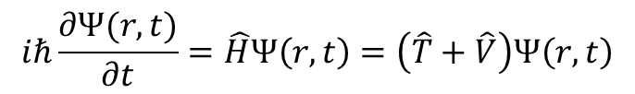
Solution of the TD-SE: Direct methods (finite differences)
$$iℏ\frac{∂Ψ(r,t)}{∂t}=\hat{H}Ψ\left(r,t\right)=\left(\hat{T}+\hat{V}\right)Ψ\left(r,t\right)$$
These are essentially the wavefunction amplitudes at those points in space and time
$$∂_{t}Ψ_{i}\left(r_{n},t_{m}\right)=\frac{1}{2Δt}\left[Ψ_{i}\left(r_{n},t_{m+1}\right)−Ψ_{i}\left(r_{n},t_{m−1}\right)\right]$$
$$∇_{r_{α}}Ψ_{i}\left(x_{n},t_{m}\right)=\frac{1}{2Δr_{α}}\left[Ψ_{i}\left(r_{α, n+1},t_{m}\right)−Ψ_{i}\left(r_{α, n−1},t_{m}\right)\right]$$
Finite difference evaluation of the derivatives
$$∇_{r_{α}}^{2}Ψ_{i}\left(x_{n},t_{m}\right)=\frac{1}{4Δr_{α}^{2}}\left[Ψ_{i}\left(r_{α, n+2},t_{m}\right)−Ψ_{i}\left(r_{n},t_{m}\right)−[Ψ_{i}\left(r_{n},t_{m}\right)−Ψ_{i}\left(r_{α, n−2},t_{m}\right)]\right]=\frac{1}{4Δr_{α}^{2}}\left[Ψ_{i}\left(r_{α, n+2},t_{m}\right)−2Ψ_{i}\left(r_{n},t_{m}\right)+Ψ_{i}\left(r_{α, n−2},t_{m}\right)\right]$$
$$\frac{iℏ}{2Δt}\left[Ψ_{i}\left(r_{n},t_{m+1}\right)−Ψ_{i}\left(r_{n},t_{m−1}\right)\right]=−\sum_{α}{\frac{ℏ^{2}}{8m_{α}Δr_{α}^{2}}\left[Ψ_{i}\left(r_{α, n+2},t_{m}\right)−2Ψ_{i}\left(r_{n},t_{m}\right)+Ψ_{i}\left(r_{α, n−2},t_{m}\right)\right]}+\sum_{j}{V_{ij}}\left(r_{n}\right)Ψ_{j}(r_{n},t_{m})$$
$$Ψ_{i}\left(r_{n},t_{m+1}\right)=Ψ_{i}\left(r_{n},t_{m−1}\right)+\sum_{α}{\frac{iΔtℏ}{4m_{α}Δr_{α}^{2}}\left[Ψ_{i}\left(r_{α, n+2},t_{m}\right)−2Ψ_{i}\left(r_{n},t_{m}\right)+Ψ_{i}\left(r_{α, n−2},t_{m}\right)\right]}−\frac{2iΔt}{ℏ}\sum_{j}{V_{ij}}\left(r_{n}\right)Ψ_{j}(r_{n},t_{m})$$

Slide 4

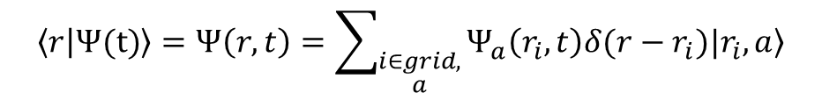
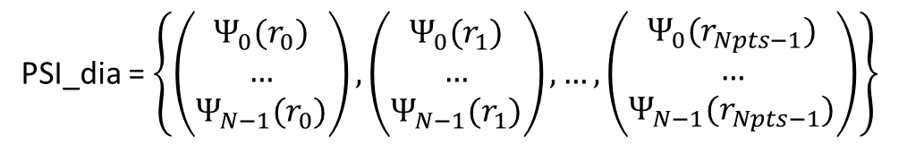
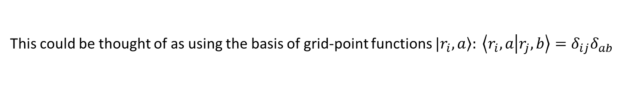
Wavefunction is discretized on a grid
Wavefunction is discretized on a grid
PSI_dia = $\left\{\left(\begin{matrix}Ψ_{0}(r_{0}) \\ … \\ Ψ_{N−1}(r_{0})\end{matrix}\right),\left(\begin{matrix}Ψ_{0}(r_{1}) \\ … \\ Ψ_{N−1}(r_{1})\end{matrix}\right),…,\left(\begin{matrix}Ψ_{0}(r_{Npts−1}) \\ … \\ Ψ_{N−1}(r_{Npts−1})\end{matrix}\right)\right\}$
$$\left\langle r | Ψ(t)\right\rangle =Ψ\left(r,t\right)=\sum_{\begin{aligned}i∈grid, \\ a\end{aligned}}{Ψ_{a}\left(r_{i},t\right)\left.δ(r−r_{i})|r_{i},a\right\rangle }$$
In Libra, any N-dimensional grid is “linearized” this way via a mapping function
This could be thought of as using the basis of grid-point functions $\left.|r_{i},a\right\rangle : \left\langle r_{i},a | r_{j},b\right\rangle =δ_{ij}δ_{ab}$
Overlaps
$$\left\langle Ψ | Ψ\right\rangle =\sum_{a,b,i,j}{\int{drΨ_{a}^{∗}\left(r_{i}\right)Ψ_{b} \left(r_{j}\right)δ(r−r_{i})δ(r−r_{j})\left\langle r_{i},a | r_{j},b\right\rangle }}=Δr\sum_{a,i}{Ψ_{a}^{∗}\left(r_{i}\right)Ψ_{a} \left(r_{i}\right)}$$
Matrix elements of operators
$$\left\langle Ψ | \hat{A} | Ψ\right\rangle =\sum_{a,b,i,j}{\int{drΨ_{a}^{∗}\left(r_{i}\right)A_{ab}(r_{i},r_{j})Ψ_{b} \left(r_{j}\right)δ\left(r−r_{i}\right)δ\left(r−r_{j}\right) }}=Δr\sum_{a,b,i}{Ψ_{a}^{∗}\left(r_{i}\right)A_{ab}(r_{i})Ψ_{a} \left(r_{i}\right)}$$
$$A_{ab}\left(r_{i},r_{j}\right)=\left\langle r_{i},a\right|\hat{A}|r_{j},b⟩$$
That is in the coordinate representation, the operators that depend only on coordinate have block-diagonal form!

Slide 5

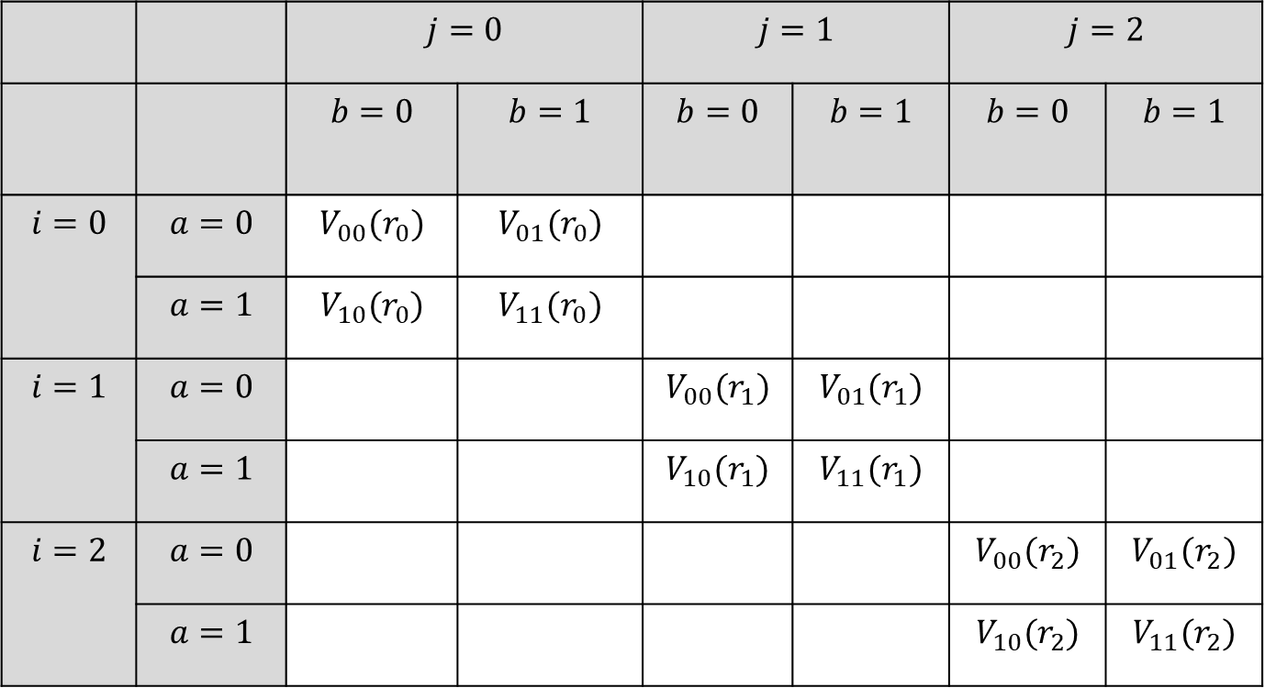
Operators in the grid basis: Real space
Potential energy, $\hat{V}$ (aka diabatic Hamiltonian)
Electronic state index
$$V_{ab}\left(r_{i},r_{j}\right)=\left\langle r_{i},a\right|\hat{V}\left|r_{j},b\right\rangle =\left\langle a\right|\hat{V}\left|b\right\rangle \left(r_{i}\right)δ_{ij}=V_{ab}\left(r_{i}\right)δ_{ij}$$
 |  | $$j=0$$ |  | $$j=1$$ |  | $$j=2$$
 |  | $$b=0$$ | $$b=1$$ | $$b=0$$ | $$b=1$$ | $$b=0$$ | $$b=1$$
$$i=0$$ | $$a=0$$ | $$V_{00}(r_{0})$$ | $$V_{01}(r_{0})$$
 | $$a=1$$ | $$V_{10}(r_{0})$$ | $$V_{11}(r_{0})$$
$$i=1$$ | $$a=0$$ |  |  | $$V_{00}(r_{1})$$ | $$V_{01}(r_{1})$$
 | $$a=1$$ |  |  | $$V_{10}(r_{1})$$ | $$V_{11}(r_{1})$$
$$i=2$$ | $$a=0$$ |  |  |  |  | $$V_{00}(r_{2})$$ | $$V_{01}(r_{2})$$
 | $$a=1$$ |  |  |  |  | $$V_{10}(r_{2})$$ | $$V_{11}(r_{2})$$
Grid point
index

Slide 6

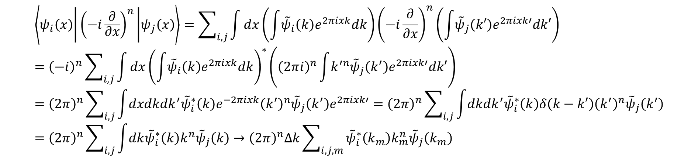
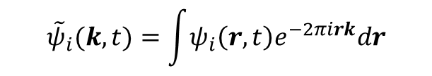
Momentum representation
Real-space (coordinate) wavefunction
Reciprocal-space (momentum) wavefunction
$$ψ_{a}(r,t)=\int{{\tilde{ψ}}_{a}\left(k,t\right)e^{2πirk}dk}$$
$${\tilde{ψ}}_{i}(k,t)=\int{ψ_{i}\left(r,t\right)e^{−2πirk}dr}$$
$$\left\langle ψ_{i}\left(x\right) | {\left(−i\frac{∂}{∂x}\right)}^{n} | ψ_{j}\left(x\right)\right\rangle =\sum_{i,j}{\int{dx\left(\int{{\tilde{ψ}}_{i}\left(k\right)e^{2πixk}dk}\right){\left(−i\frac{∂}{∂x}\right)}^{n}\left(\int{{\tilde{ψ}}_{j}\left(k′\right)e^{2πixk′}dk′}\right)}}={\left(−i\right)}^{n}\sum_{i,j}{\int{dx{\left(\int{{\tilde{ψ}}_{i}\left(k\right)e^{2πixk}dk}\right)}^{∗}\left({\left(2πi\right)}^{n}\int{k^{′n}{\tilde{ψ}}_{j}\left(k^{′}\right)e^{2πixk′}dk′}\right)}}={\left(2π\right)}^{n}\sum_{i,j}{\int{dxdkdk^{′}{\tilde{ψ}}_{i}^{∗}\left(k\right)e^{−2πixk}{\left(k^{′}\right)}^{n}{\tilde{ψ}}_{j}\left(k^{′}\right)e^{2πixk′}}}={\left(2π\right)}^{n}\sum_{i,j}{\int{dkdk^{′}{\tilde{ψ}}_{i}^{∗}\left(k\right)δ\left(k−k′\right){\left(k^{′}\right)}^{n}{\tilde{ψ}}_{j}\left(k^{′}\right)}}={\left(2π\right)}^{n}\sum_{i,j}{\int{dk{\tilde{ψ}}_{i}^{∗}\left(k\right)k^{n}{\tilde{ψ}}_{j}\left(k\right)}}→{\left(2π\right)}^{n}Δk\sum_{i,j,m}{{\tilde{ψ}}_{i}^{∗}\left(k_{m}\right)k_{m}^{n}{\tilde{ψ}}_{j}\left(k_{m}\right)}$$
That is in the momentum representation, the kinetic energy and NAC operators have block-diagonal form!

Slide 7

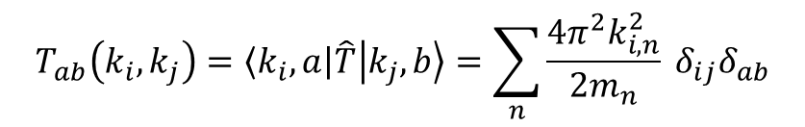
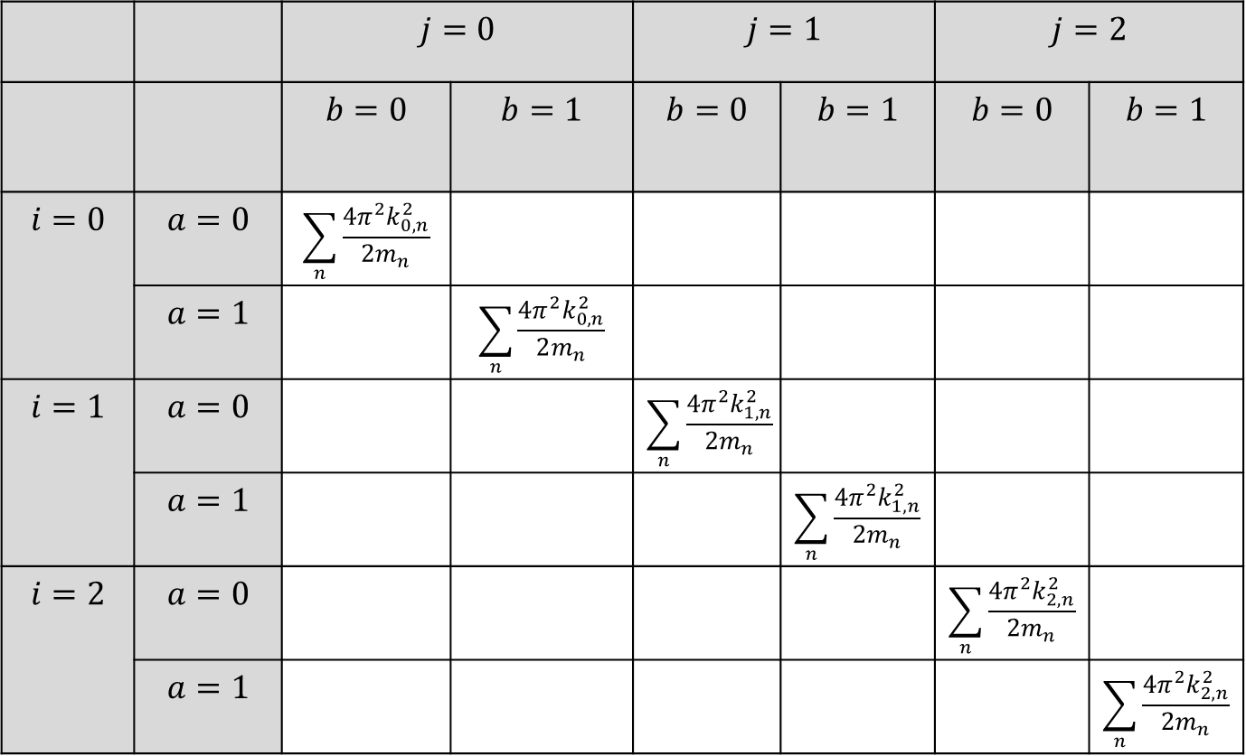
Operators in the grid basis: Real space
Nuclear kinetic energy, $\hat{T}$
Electronic state index
$$T_{ab}\left(k_{i},k_{j}\right)=\left\langle k_{i},a\right|\hat{T}\left|k_{j},b\right\rangle =\sum_{n}{\frac{{4π^{2}k}_{i,n}^{2}}{2m_{n}}} δ_{ij}δ_{ab}$$
 |  | $$j=0$$ |  | $$j=1$$ |  | $$j=2$$
 |  | $$b=0$$ | $$b=1$$ | $$b=0$$ | $$b=1$$ | $$b=0$$ | $$b=1$$
$$i=0$$ | $$a=0$$ | $$\sum_{n}{\frac{{4π^{2}k}_{0,n}^{2}}{2m_{n}}}$$
 | $$a=1$$ |  | $$\sum_{n}{\frac{{4π^{2}k}_{0,n}^{2}}{2m_{n}}}$$
$$i=1$$ | $$a=0$$ |  |  | $$\sum_{n}{\frac{{4π^{2}k}_{1,n}^{2}}{2m_{n}}}$$
 | $$a=1$$ |  |  |  | $$\sum_{n}{\frac{{4π^{2}k}_{1,n}^{2}}{2m_{n}}}$$
$$i=2$$ | $$a=0$$ |  |  |  |  | $$\sum_{n}{\frac{{4π^{2}k}_{2,n}^{2}}{2m_{n}}}$$
 | $$a=1$$ |  |  |  |  |  | $$\sum_{n}{\frac{{4π^{2}k}_{2,n}^{2}}{2m_{n}}}$$
Grid point
index

Slide 8
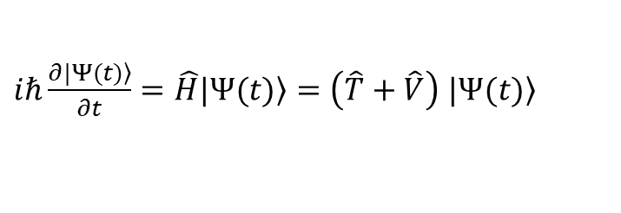
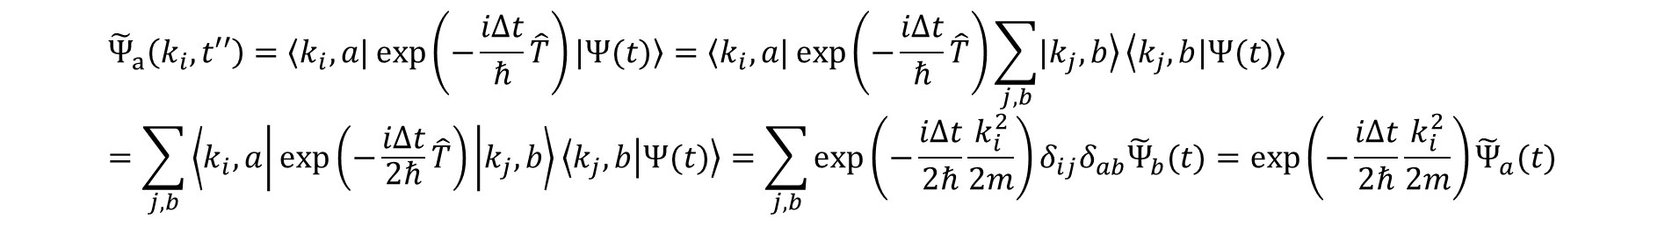
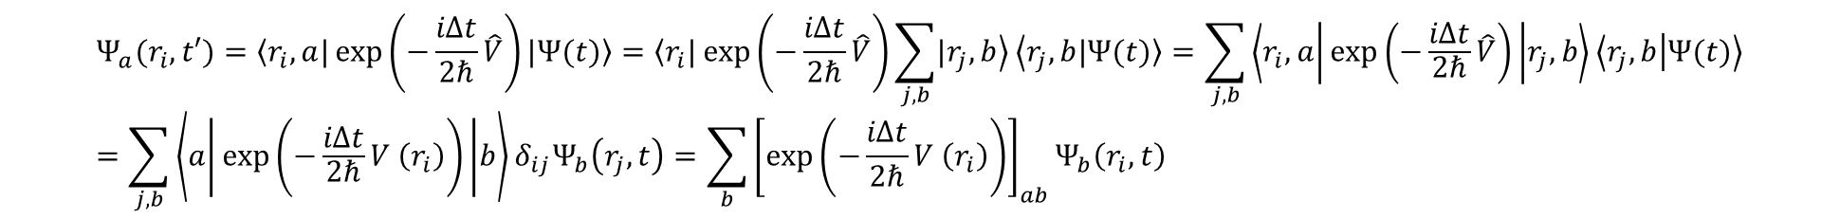
Solution of the TD-SE: Split-Operator Fourier Transform (SOFT)
Kosloff, D.; Kosloff, R. A F Journal of Computational Physics 1983, 52, 35–53.
$iℏ\frac{∂\left.|Ψ(t)\right\rangle }{∂t}=\hat{H}\left.|Ψ(t)\right\rangle =\left(\hat{T}+\hat{V}\right)$ $\left.|Ψ(t)\right\rangle$
$$\left.|Ψ(t+Δt)\right\rangle =\exp\left(−\frac{iΔt}{ℏ}\hat{H}\right)\left.|Ψ(t)\right\rangle =\exp\left(−\frac{iΔt}{ℏ}\left(\hat{T}+\hat{V}\right)\right)\left.|Ψ(t)\right\rangle ≈\exp\left(−\frac{iΔt}{2ℏ}\hat{V}\right)\exp\left(−\frac{iΔt}{ℏ}\hat{T}\right)\exp\left(−\frac{iΔt}{2ℏ}\hat{V}\right)\left.|Ψ(t)\right\rangle$$
$$Ψ_{a}(r_{i},t′)=\left\langle r_{i},a|\right.\exp\left(−\frac{iΔt}{2ℏ}\hat{V}\right)\left.|Ψ(t)\right\rangle =\left\langle r_{i}|\right.\exp\left(−\frac{iΔt}{2ℏ}\hat{V}\right)\sum_{j,b}{\left.|r_{j},b\right\rangle }\left\langle r_{j},b\right.\left.|Ψ(t)\right\rangle =\sum_{j,b}{\left\langle r_{i},a | \exp\left(−\frac{iΔt}{2ℏ}\hat{V}\right) | r_{j},b\right\rangle \left\langle r_{j},b | Ψ(t)\right\rangle }=\sum_{j,b}{\left\langle a | \exp\left(−\frac{iΔt}{2ℏ}V \left(r_{i}\right)\right) | b\right\rangle δ_{ij}Ψ_{b}\left(r_{j},t\right)}=\sum_{b}{{\left[\exp\left(−\frac{iΔt}{2ℏ}V \left(r_{i}\right)\right)\right]}_{ab}Ψ_{b}\left(r_{i},t\right)}$$
$${\tilde{Ψ}}_{a}\left(k_{i},t′′\right)=\left\langle k_{i},a|\right.\exp\left(−\frac{iΔt}{ℏ}\hat{T}\right)\left.|Ψ(t)\right\rangle =\left\langle k_{i},a|\right.\exp\left(−\frac{iΔt}{ℏ}\hat{T}\right)\sum_{j,b}{\left.|k_{j},b\right\rangle }\left\langle k_{j},b\right.\left.|Ψ(t)\right\rangle =\sum_{j,b}{\left\langle k_{i},a | \exp\left(−\frac{iΔt}{2ℏ}\hat{T}\right) | k_{j},b\right\rangle \left\langle k_{j},b | Ψ(t)\right\rangle }=\sum_{j,b}{\exp\left(−\frac{iΔt}{2ℏ}\frac{k_{i}^{2}}{2m}\right)δ_{ij}δ_{ab}{\tilde{Ψ}}_{b}(t)}=\exp\left(−\frac{iΔt}{2ℏ}\frac{k_{i}^{2}}{2m}\right){\tilde{Ψ}}_{a}(t)$$

Slide 9


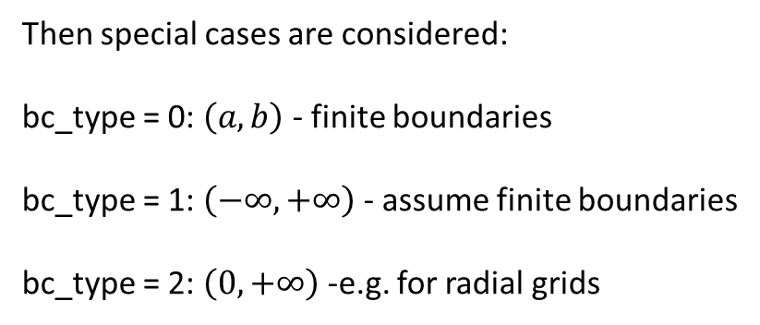
Solution of the TD-SE: Colbert-Miller
Colbert, D. T.; Miller, W. H. A The Journal of Chemical Physics 1992, 96, 1982–1991.
DVR grid points: $x_{i}=a+\frac{b−a}{N}i, i=1,2,…N−1$
Associated DVR functions: $φ_{n}\left(x\right)=\sqrt{\frac{2}{b−a}}\sin\left(\frac{πn\left(x−a\right)}{b−a}\right) ,n=1,2,…N−1$ – particle-in-the-box eigenfunctions
Boundary conditions: $φ_{n}\left(x_{0}=a\right)=φ_{n}\left(x_{N}=b\right)=0$
$$T_{i,j}=−\frac{ℏ^{2}}{2m}Δx\sum_{n=1}^{N−1}{φ_{n}\left(x_{i}\right)φ_{n}^{′′}\left(x_{j}\right)}=\frac{ℏ^{2}}{2m}{\left(\frac{2}{b−a}\right)}^{2}\frac{2}{N}\sum_{n=1}^{N−1}{n^{2}\sin\left(\frac{nπi}{N}\right)\sin\left(\frac{nπj}{N}\right)}=\left\{\begin{matrix}\frac{ℏ^{2}}{2m}\frac{{\left(−1\right)}^{i−j}}{{\left(b−a\right)}^{2}}\frac{π^{2}}{2} \left\{\frac{1}{\sin^{2}\left(π(i−j)/2N\right)}−\frac{1}{\sin^{2}\left(π(i+j)/2N\right)}\right\} \\ \frac{ℏ^{2}}{2m}\frac{1}{{\left(b−a\right)}^{2}}\frac{π^{2}}{2} \left\{\left(2N^{2}+1\right)/3−\frac{1}{\sin^{2}\left(πi/2N\right)}\right\},i=j\end{matrix},i≠j\right.$$
Then special cases are considered:
bc_type = 0: $\left(a,b\right)$ - finite boundaries
bc_type = 1: $\left(−∞,+∞\right)$ - assume finite boundaries
bc_type = 2: $\left(0,+∞\right)$ -e.g. for radial grids
This is the default for 1D case
In principle, need a more general implementation
BC can be different for each DOF

