Slide 1
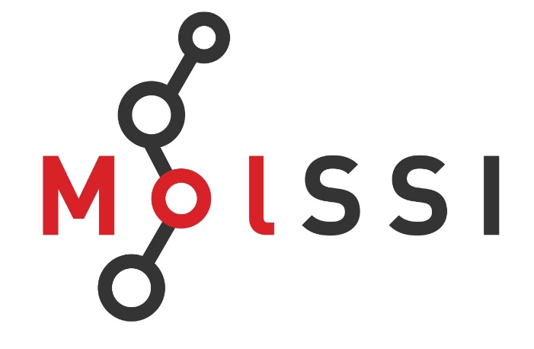

MolSSI Workshop
”Modular Software Infrastructure
For
Excited State Dynamics”
June 8-11, 2018
Notes:
One of the motivations for the development of this package has been my continued interest in studying methodological aspects of chemical dynamics.

Slide 2
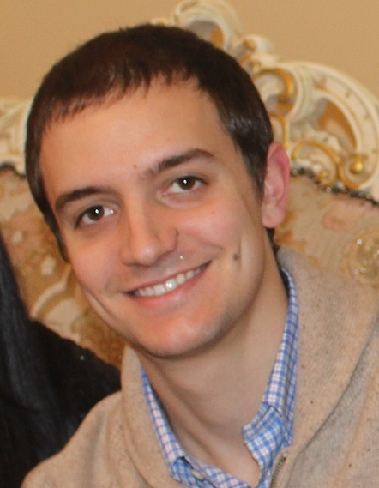
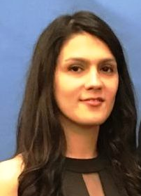
Workshop Assistants
Brendan Smith
Mahsa Jabbar

Slide 3
Workshop Objectives
What software for excited states/quantum dynamics do we have?
What are the limitations/capabilities of the existing software?
What do the existing software need for future sustainability?
What methods for excited states/quantum dynamics are available?
Which of them are implemented and which are still need to be implemented?
What are the possible strategies for software/methods interoperability?
What practices exist for the community code development/quality control,
validation, dissemination, etc.? How can they be improved?

Slide 4
To Maximize the Impact
Collaborative document
(shared google document, with pre-filled sections)
- feel free to add you sections
- your presentation-stimulated notes
- references/links on the codes/implementations
methods to be implemented
- your vision of possible connections between
software and components
- this will help to produce a report to MolSSI, which will also be available
Video recording of presentations
(via Panopto software, on Alexey’s laptop)
- please, use the laptop cursor, so that it is clear what you discuss
when watching video
- will be available on MolSSI website unless you don’t allow
Lecture slides
- will be available on MolSSI website unless you don’t allow

Slide 5
Presentation Format Requests/Suggestions
Please:
keep a software/methodology-centric approach in mind
mention, the capabilities, useful implementation details of your software/modules
provide/suggest the key references on methods that you’ve implemented or want
to be implemented (by you or others, in your or others’ software)
indicate the future plans on your developments, possible connections with other
software/methods
indicate which methods/implementations you need for your software/methodology
development purposes (dependencies)
indicate which methods/implementations you may need for further improvements
of your software/methodology development (needs)
raise questions for the audience to respond to (e.g. in the online document)

