Slide 1
Electronic excitation in semiconductor nanoparticles: A real-space quasiparticle perspective
Mike Bayne and Ari Chakraborty
Department of Chemistry
Syracuse University
Funding: NSF, ACS-PRF, Syracuse University

Slide 2
Overview of this talk
Objective:
To describe electron-hole screening without using unoccupied states
Motivation:
Calculation of unoccupied states are expensive. Judicious elimination of these states can lead to faster algorithm
(e.g. WEST method by Galli et al.)
Strategy:
Treating electron correlation in real-space representation by using explicitly correlated operators
Chemical applications:
The developed method was used for calculations of optical gap and exciton binding energies
Notes:
Levels are spin orbitals and no degeneracy is assumed a priori

Slide 3
Charge-neutral excitation energy
Matrix equation for excitation energies
Electron-hole interaction kernel (Keh)
Can be obtained using linear-response (LR-TDDFT), MBPT (BSE), equation-of-motion methods (EOM-CC, EOM-GF), CIS, ADC,…
Two important considerations:
[1] Choice of 1-particles basis functions
[2] Choice for treating e-e correlation
Notes:
Levels are spin orbitals and no degeneracy is assumed a priori

Slide 4
Effective single-particle Hamiltonian
Non-interaction system
Interacting system
Can be:
Goal of today’s talk:

Slide 5
Definitions: Correlation operator
Intermediate normalization condition
Electron-electron correlated is treated by operators that are local in real-space representation
G is a two-body operator and is represented by a linear combination of Gaussian-type geminal functions

Slide 6
Definitions: Correlation operator
Intermediate normalization condition

Slide 7
Definitions: Correlation operator
Intermediate normalization condition
Electron-electron correlated is treated by operators that are local in real-space representation

Slide 8
Definitions: Correlation operator
Intermediate normalization condition
Electron-electron correlated is treated by operators that are local in real-space representation
G is a two-body operator and is represented by a linear combination of Gaussian-type geminal functions
See also: geminal correlator (Rassolov et al.), NEO-XCHF (Hammes-Schiffer et al.), geminal MCSCF (Varganov & Martinez), trans-correlated Hamiltonian, Jastrow functions in VMC…

Slide 9
Connection to Configuration Interaction (CI)
Configuration interaction (CI):
Explicitly correlated wave function:
(must be a functional of G)
The explicitly correlated wave function is an infinite-order CI expansion with constrained CI coefficients

Slide 10
Electron-hole interaction kernel
The excitation energies for the interacting and non-interacting system are related by the W operator

Slide 11
Electron-hole interaction kernel
The excitation energies for the interacting and non-interacting system are related by the W operator
Expressing in terms of non-interacting states using (G)

Slide 12
Electron-hole interaction kernel
The excitation energies for the interacting and non-interacting system are related by the W operator
Expressing in terms of non-interacting states using (G)
Expressing in term of vacuum expectation value
Can be simplified using diagrammatic techniques

Slide 13
Contribution from the linked terms
Only fully contracted terms have non-zero contribution to this term (Wick’s theorem)
The set of all resulting Hugenholtz diagrams, can be factored into sets of linked and unlinked diagrams
Subset #1: All linked diagrams (all vertices are connected)
Subset #2: All unlinked diagrams
Because (algebraically):
Bayne, Chakraborty, JCTC, ASAP (2018)

Slide 14
Contribution from the linked terms
Only fully contracted terms have non-zero contribution to this term (Wick’s theorem)
The set of all resulting Hugenholtz diagrams, can be factored into sets of linked and unlinked diagrams
Subset #1: All linked diagrams (all vertices are connected)
Subset #2: All unlinked diagrams
Unlinked diagrams in excited state are exactly canceled by the ground state contributions
(Important point used in the next slide)
Bayne, Chakraborty, JCTC, ASAP (2018)

Slide 15
Elimination of unlinked diagrams
Adding zero to the expression…
Only linked terms contribute in the following expression
Expression for the excitation energy
Depends on particle-hole states
Depends only on occupied states

Slide 16
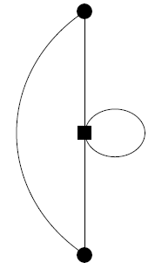
Generalized Hugenhotlz vertices
Product of two two-body operators generates 2, 3, and 4-body operators

Slide 17
Contributing diagrams to the excitation energy

Slide 18
Contributing diagrams to the excitation energy
Key result:
Only connected diagrams contribute to the exciting energy and electron-hole interaction kernel
Bayne, Chakraborty, JCTC, ASAP (2018)

Slide 19
Contributing diagrams to the excitation energy
(effective 1-body)
(effective 2-body)

Slide 20
Contributing diagrams to the excitation energy
Contribution from different treatment of e-e correlation for ground and excited state wave function
Impacts excitation energy
Does not impact electron-hole interaction kernel
Is zero if G_{n} = G₀

Slide 21
Contributing diagrams to the excitation energy
Effective 1-body (quasi) electron and hole operators
Renormalizes quasiparticle energy levels due to e-e correlation
Depends only on excited-state correlation operator G_{n}
Impacts excitation energy
Does not impact electron-hole interaction kernel

Slide 22
Contributing diagrams to the excitation energy
It is an 2-particle operator that simultaneous operate on both (quasi) electron and hole states
The loops represent renormalization of 3- and 4-body operators as effective 2-body operators
All diagrams contribute to the electron-hole interaction kernel
Depends only on excited-state correlation operator G_{n}
(eh screening is a consequence of ee correlation)

Slide 23
Interpretation of the closed-loops diagrams
Closed-loops represent summation over occupied-state
They represent effective 2-body operators generated from a 4-body operator by treating the additional coordinates at mean-field level

Slide 24
Interpretation of the closed-loops diagrams
Closed-loops represent summation over occupied-state
They represent effective 2-body operators generated from a 4-body operator by treating the additional coordinates at mean-field level

Slide 25
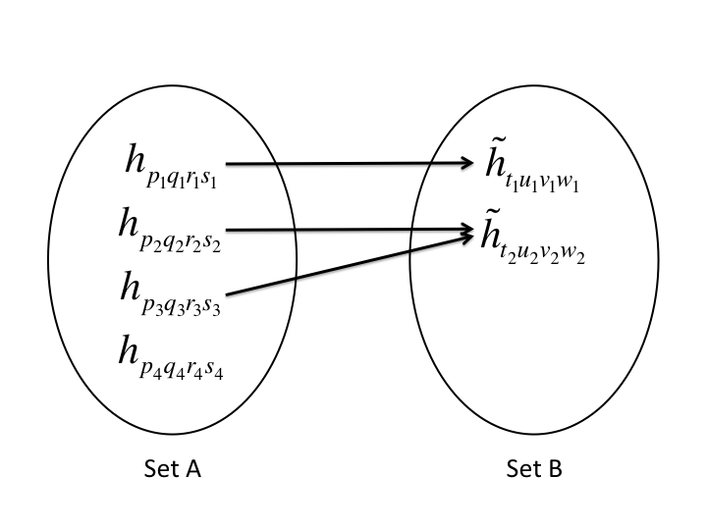
Just-in-time (JIT) source code generation
Numerically zero mo integrals are eliminated
Non-unique values are mapped to unique terms
All non-zero & unique mo integerals are assigned a unique id
The unique id of the mo integrals are used to consolidate terms in the reduction step
Many-to-one map
Key point: Incorporating molecular integrals in the reduction step

Slide 26
Computer assisted Wick’s contraction
The strings of second quantized operators were evaluated using generalized Wick’s theorem
Strategy#1: All contractions are performed computationally
Strategy#2: Contractions are performed diagrammatically and the implementation is done computationally

Slide 27
Just-in-time (JIT) source code generation
Disadvantages:
Source code is generated every time the mo integrals are updated
(new system and change of basis)
Can be impractical for large codes that have long compilation time
Advantages:
The generated source code is optimized for the specific system
Can reduce the overall memory footprint

Slide 28
Chemical application using first-order diagrams
Bayne, Chakraborty, JCTC, ASAP (2018)

Slide 29
Application to chemical systems
Excitation energies in small molecules and clusters
System | Energy difference in eV
Ne | 0.06
H₂O | 0.03
System | Energy difference in eV
Cd₆Se₆ | 0.04 (Ref. 1 & 3)
Cd₂₀Se₁₉ | -0.04 (Ref. 2 & 3)
Results from this work show reasonable agreement with many-body methods that use unoccupied states
1 Noguchi, Sugino, Nagaoka, Ishii, Ohno, JCP, 137, 024306 (2012)
2 Wang, Zunger, PRB, 53, 9579 (1996)
3 Bayne, Chakraborty, to be submitted (this work)
Bayne, Chakraborty, JCTC, ASAP (2018)

Slide 30
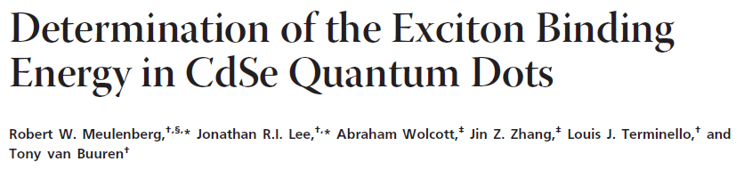

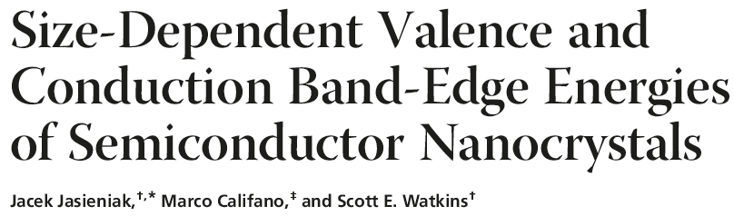
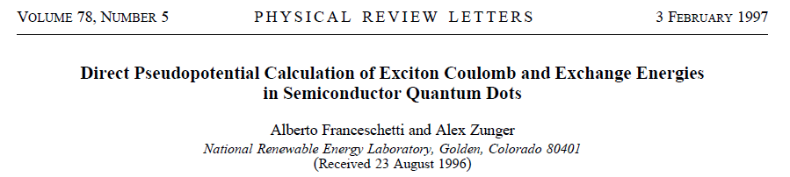
Exciton binding energies in CdSe clusters
Conduction band
Exciton binding (EBE) gap
1st exciton level
Quasiparticle energy gap
Optical absorption (OA) gap
Valence band

Slide 31
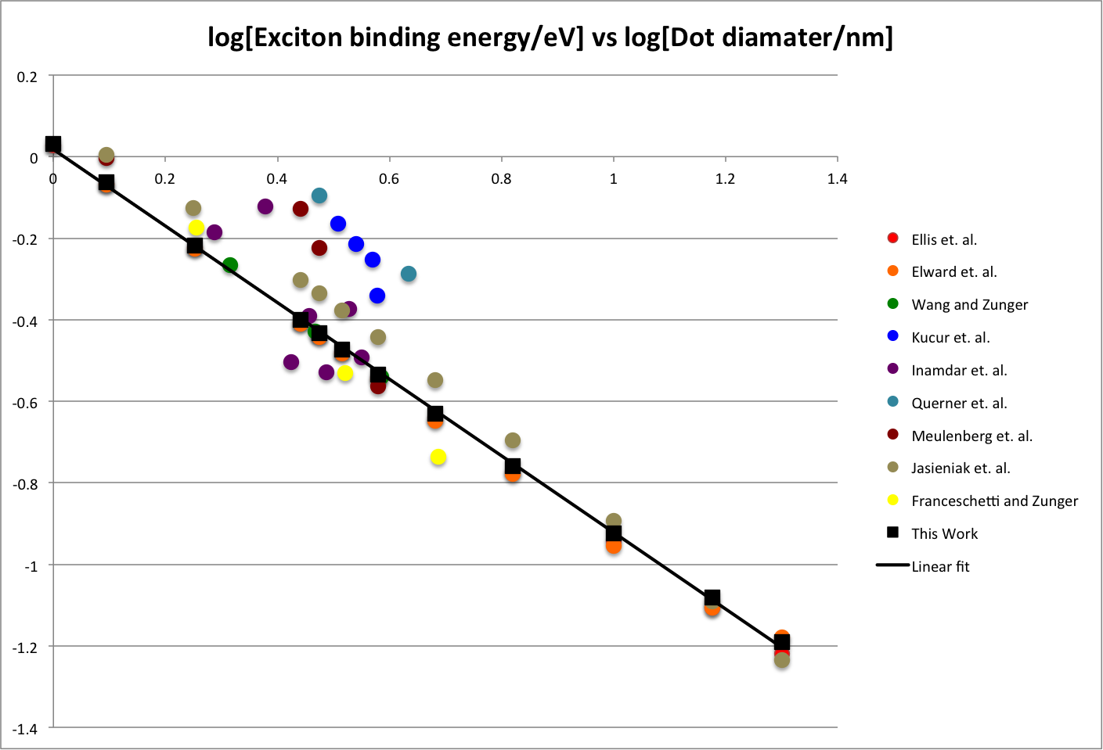
Exciton binding energies in CdSe quantum dots

Slide 32
Exciton binding energies in CdSe quantum dots
experiment
This work
theory

Slide 33
Summary
It was shown that the electron-hole interaction kernel (eh-kernel) can be expressed without using unoccupied states.
The derivation was performed using a two-body correlation operator which is local in real-space representation.
Using diagrammatic techniques, it was shown that the eh-kernel can be expressed only in terms of linked-diagrams.
The derived expression provides a route to make additional approximations to the eh-kernel
The 1st order approximation of eh-kernel was used for calculating electron-hole binding energies and excitation energies in atoms, molecules, clusters, and quantum dots.

Slide 34
Title here

Slide 35
Deformation potential: Which basis?
Space-filling basis functions
Examples: plane-waves, real-space grid, distributed Guassian functions, Harmonic osc. basis, particle-in-box basis
Both deformed and reference Hamiltonian use identical basis functions
Atom-centered basis functions
Deformed and reference Hamiltonian use different basis functions
We transform into the eigenbasis of the reference Hamiltonian

Slide 36
Transformation to ref. eigenbasis-I
Step #1: Get quantities from the converged SCF calculation on reference structure
Step #2: Perform symmetric or orthogonal transformation such that the S matrix is diagonal in that basis
(single tilde transformation)
Step #3: Find the U matrix that diagonalizes the transformed Fock matrix
(double tilde transformation)
The U⁰ matrix is the matrix needed to transform operators in the eigenbasis of the reference structure

Slide 37
Transformation to ref. eigenbasis-II
Step #4: Get quantities from the converged SCF calculation on the deformed structure
Step #5: Perform orthogonal transformation
Step #6: Transform the Fock in the eigenbasis of the reference Hamiltonian
Step #7: Calculate the deformation potential

Slide 38
Info#: Contributing diagrams to the excitation energy

Slide 39
Info#: Determination of geminal parameters
For quantum dots, G was obtained from parabolic QD
For small molecules and clusters, G was obtained varaitionally

Slide 40
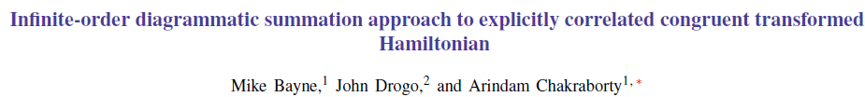
If we are ready to admit unoccupied states
Phys. Rev. A 89, 032515 (2014)
Challenge: Avoiding 3, 4, 5, 6-particle integrals
Step 1: Project the correlation function in a finite basis
Step 2: Write the energy expression term of diagrams
Step 3: Obtain a renormalized 2-body operator by performing infinite-order summation over a subset of diagrams

Slide 41
Partial infinite-order diagrammatic summation
All diagrams are added to infinite order
Some diagrams are added to infinite order
All diagrams are added to finite order

Slide 42
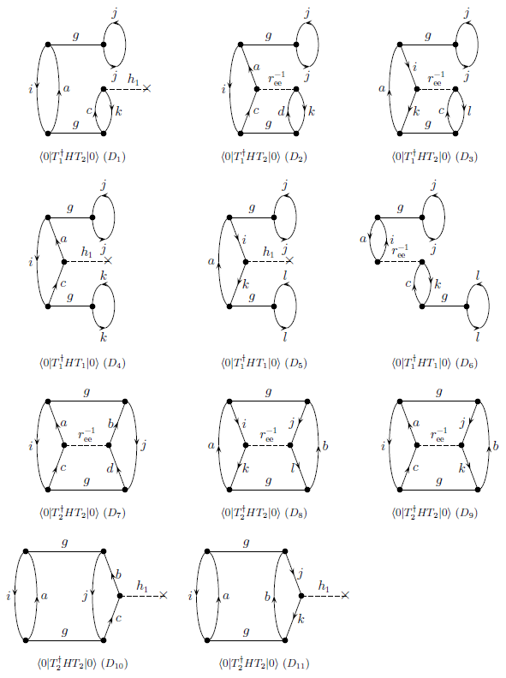
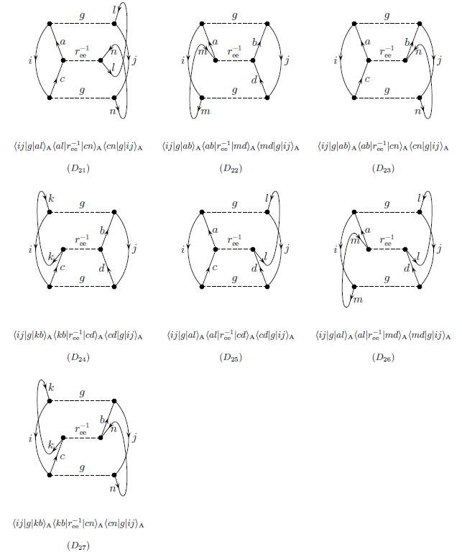
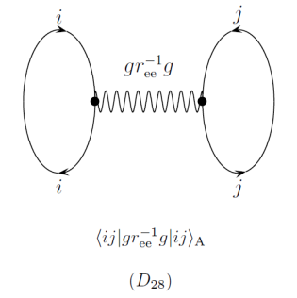
Info#: Summation over intermediate particle-hole states
Phys. Rev. A 89, 032515 (2014)

Slide 43
Comparison of the three methods
Infinite number of terms
Finite number of terms
Infinite number of terms
Unconstrained optimization over infinite domain
Unconstrained optimization over finite domain
Constrained optimized over infinite domain
Infinite and independent
Finite and independent
Infinite and dependent

Slide 44
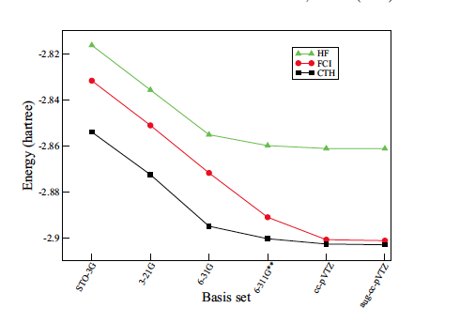
Ground state energy of helium atom
3 Key Points
FCI - multi-determinant
minimization.
XCHF - single determinant
minimization.
XCHF gives lower
energy than FCI for all
the basis sets shown.
XCHF converges much
faster with respect to size 1-particle basis
1. Elward, Hoja, Chakraborty Phys. Rev. A. 86, 062504 (2012)
See also: Geminal augmented MCSCF for H2, QMC calculations on H2O
Varganov and Martinez, JCP, 132, 054103 (2010) ; Xu and Jordan, JPCA, 114, 1365 (2010)

Slide 45
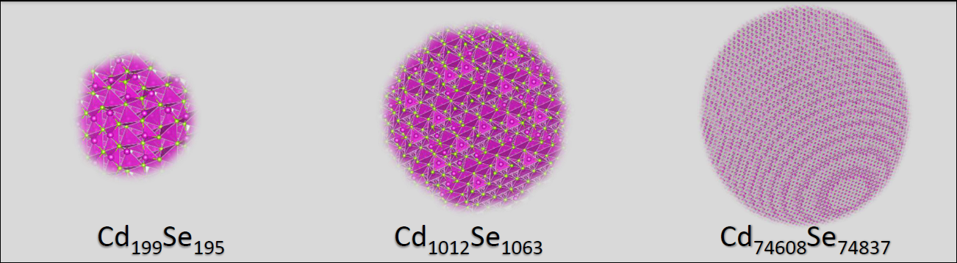
Statement of the problem
Excited electronic states in semiconductor quantum dots
Density functional theory
Pseudopotential
Tight-binding
This talk
Effective mass Hamiltonian

Slide 46

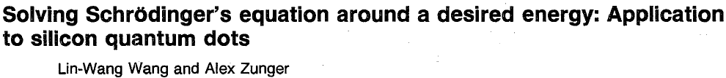
Interior eigenvalue problem
Filter diagonalization
Folded-spectrum method
Implemented in open-source PESCAN code distributed from Nano Science Group at Lawrence Berkeley National Laboratory

Slide 47
Electron-hole Hamiltonian
Coulomb attraction term is responsible for electron-hole coupling
Configuration interaction (CI): Zunger, Efros, Sundholm, Wang, Bester, Rabani, Franceschetti, Califano, Bittner, Hawrylak,…
Many-body perturbation theory (MBPT): Baer, Neuhauser, Galli,...
Quantum Monte Carlo method (QMC): Hybertsen, Shumway,…
GW+BSE: Louie,Chelikowsky, Galli, Rohlﬁng , Rubio, …
All-electron TDDFT/DFT: Prezhdo, Tretiak, Kilina, Akimov, Ullrich, Li,….
This talk:
Explicitly correlated Hartree-Fock

