Slide 1




eQE tutorial
Pavanello Research Group at Rutgers University-Newark
@MikPavanello
QE developers workshop, Penn State
May 2018

Slide 2
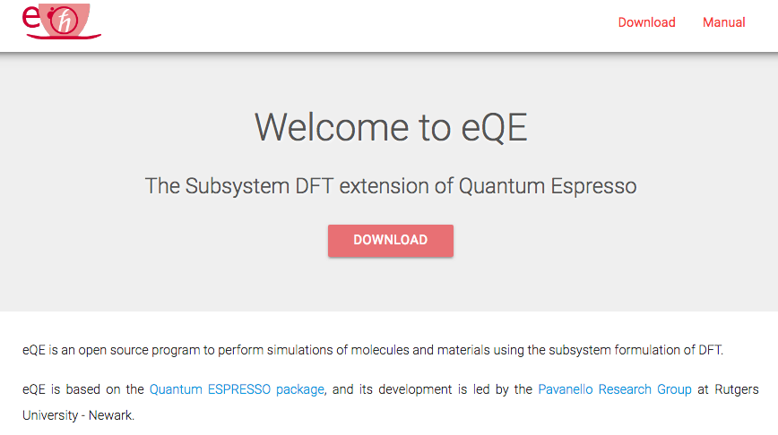
Download & Compile eQE
http://eqe.rutgers.edu/
Fill out the Google form.
Untar: tar -xzvf eqe.tar.gz
Compile: ./configure will work on most systems. Might need to force certain choices, such as:
./configure MPIF90=mpiifort F90=ifort --with-scalapack=no
Make: make pw

Slide 3
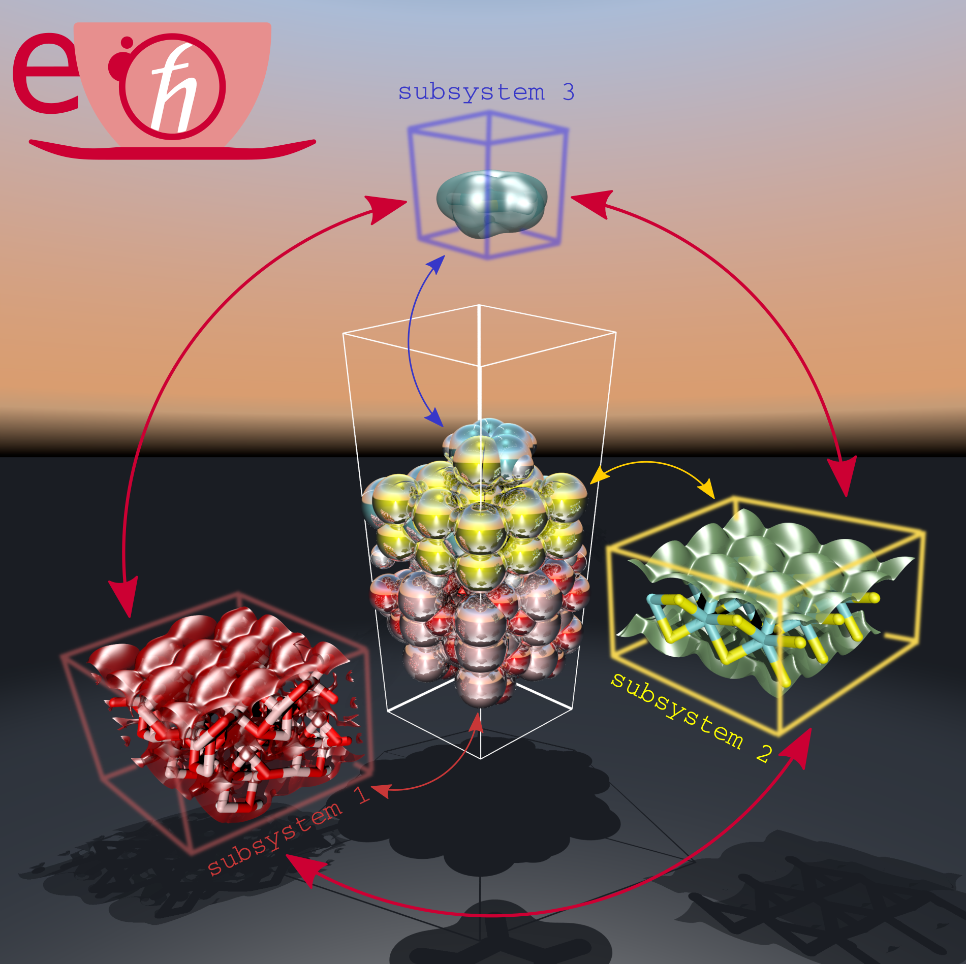
eQE: the ultimate goals of this tutorial
Compile the source code
Split the system into subsystems
Optimize the load balance over available CPUs
Find appropriate subsystem simulation cells
Find appropriate k-point sampling
Remedy problems of electron-leak to nearby subsystems
Run AIMD simulations
Understand the eQE workflow

Slide 4
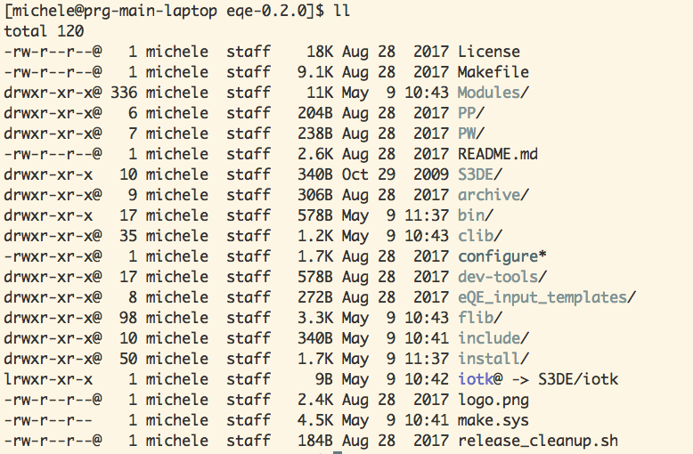
Getting started: folder structure

Slide 5
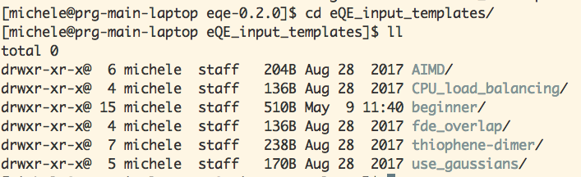
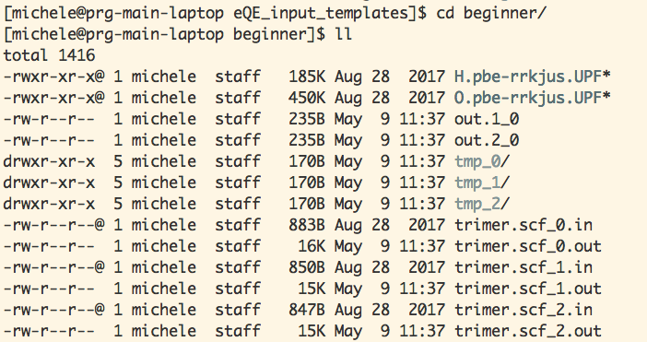
Getting started: “beginner”

Slide 6
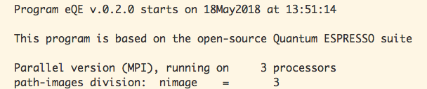
Getting started: “beginner” 2
Let’s run the “beginner” example!
eqe-0.2.0/eQE_input_templates/beginner
mpirun -np 3 ~/tmp/eqe-0.2.0/bin/fdepw.x -in trimer.scf -ni 3
-in: input file prefix without _0 or _1, etc.
-ni: number of images
In this example the number of CPUs is evenly split over all subsystems (images): 3 CPUs, and 3 subsystems

Slide 7
Getting started: “beginner” 3
Analyze the input file:
All files share EVERYTHING except:
Subsystem’s geometry
Subsystem charge
Subsystem spin
Subsystem k-point sampling
Particularly, subsystem input files share the same PPs, atom types, simulation cell parameters, cutoff, DFT additive and nonadditive functionals, etc…
Analyze the output files:
Next slide

Slide 8
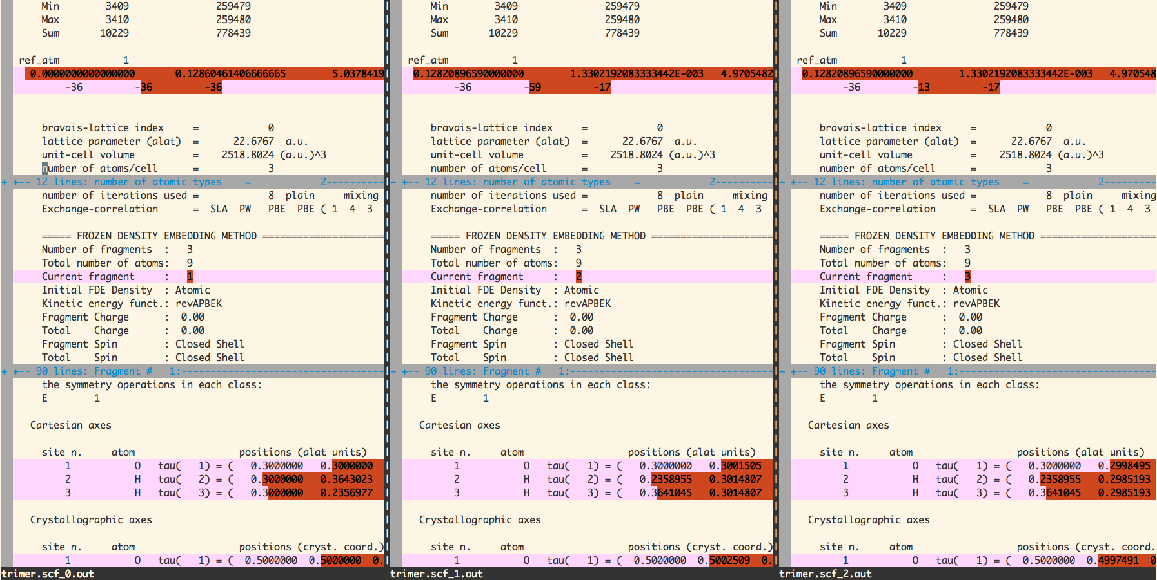
eQE Output files
Reference
atom
Subsystem
geometry

Slide 9
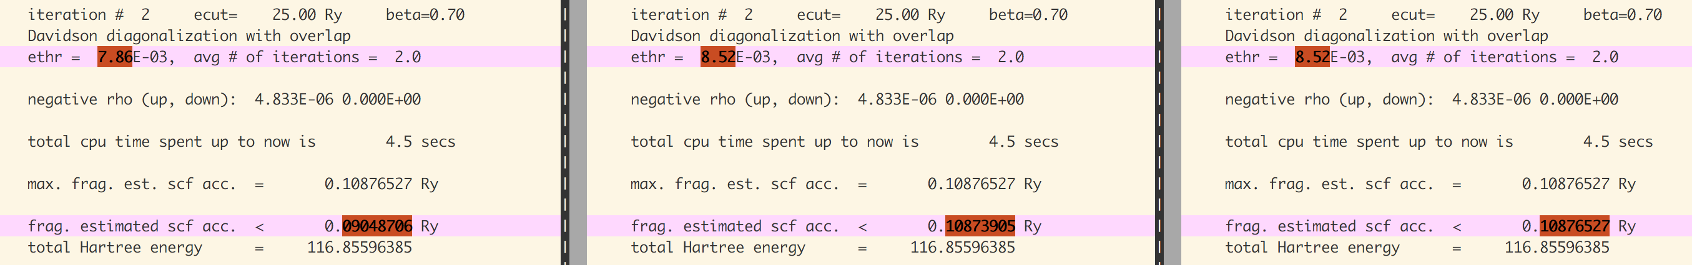
SCF cycles
Each subsystem drives its own SCF cycle
SCF cycles in different subsystems are coupled and influence each other
Keyword fde_split_mix = .true. enables a supersystem DIIS layer and is recommended.
Inspecting max. frag. est. scf acc. and frag. estimated scf acc. gives a glimpse to the convergence trend.

Slide 10
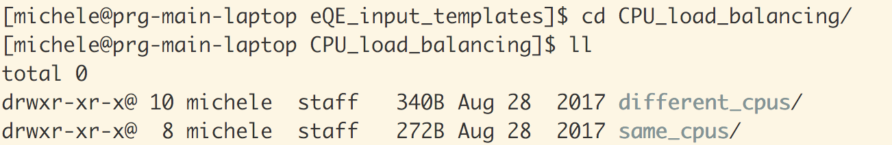
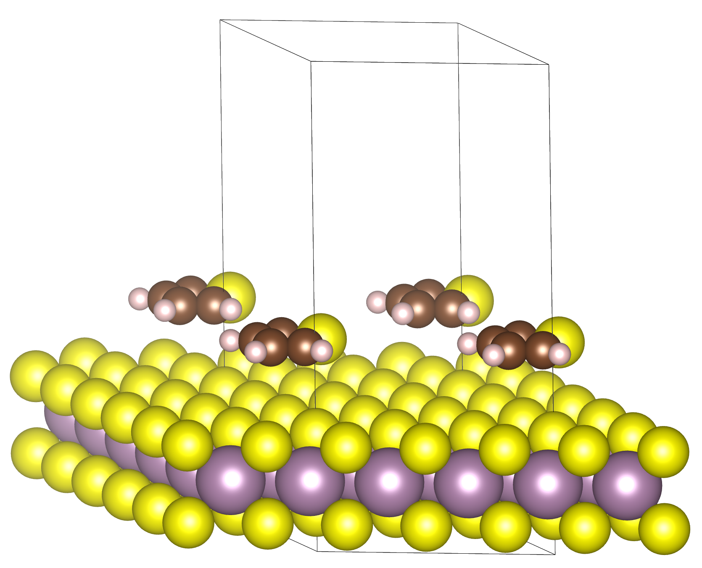
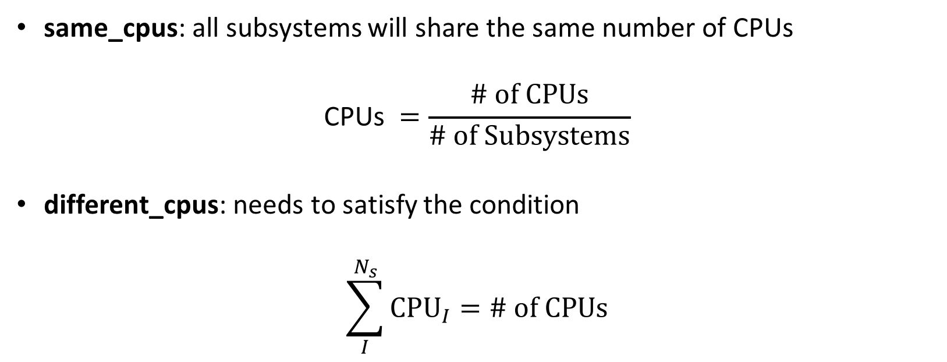
CPU Load Balancing
same_cpus: all subsystems will share the same number of CPUs
$$\text{CPUs} =\frac{\text{\# }\text{of} \text{CPUs}}{\text{\# }\text{of} \text{Subsystems}}$$
different_cpus: needs to satisfy the condition
$$\sum_{I}^{N_{s}}{\text{CP}{\text{U}}_{I}=\text{\# }\text{of} \text{CPUs}}$$

Slide 11
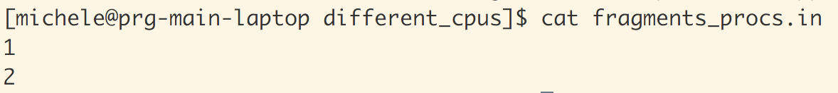
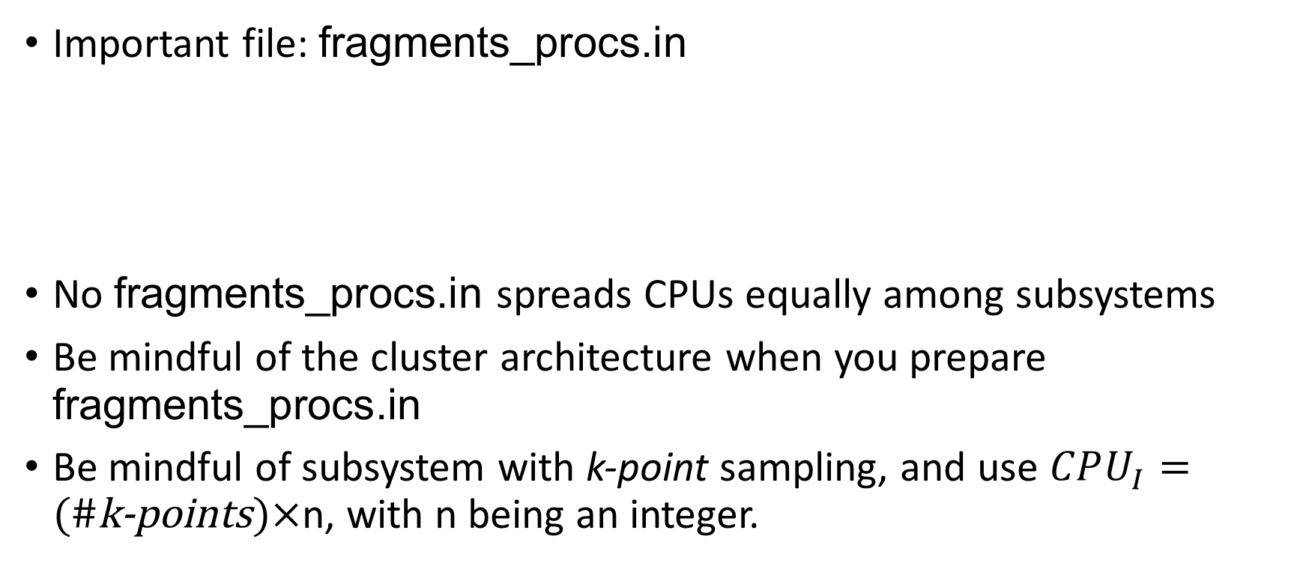
CPU Load Balancing 2
Important file: fragments_procs.in
No fragments_procs.in spreads CPUs equally among subsystems
Be mindful of the cluster architecture when you prepare fragments_procs.in
Be mindful of subsystem with k-point sampling, and use $CPU_{I}=(\text{\#}\text{k}\text{−}\text{points})×$n, with n being an integer.

Slide 12
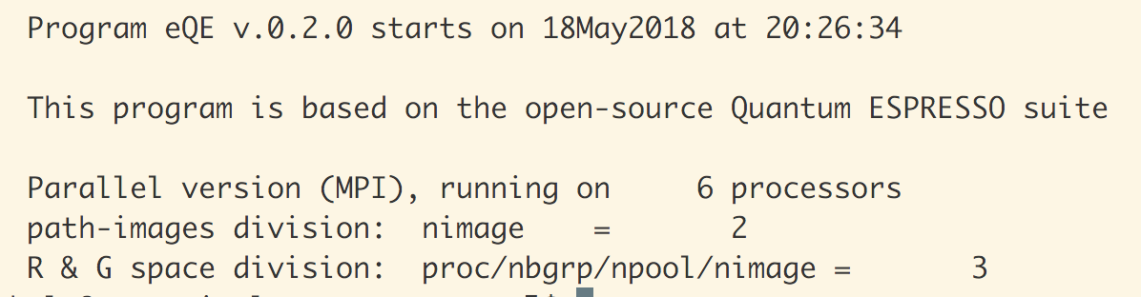
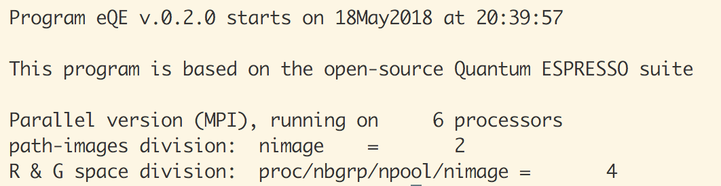
CPU Load Balancing 2
$$CPU_{0}=3, CPU_{1}=3$$
$$CPU_{0}=4, CPU_{1}=2$$
28 cycles later
31 cycles later

Slide 13
Subsystem cells: fde_cell_split(i), i=1, 2, 3
Subsystem’s bands (orbitals) and Hamiltonian are represented on smaller simulation cells.
0 < fde_cell_split < 1, specifically the admissible values are: 1/5, 1/4, 1/3, 2/5, 1/2, 3/5, 2/3, 3/4, 4/5, 1/1
This is the most important keyword of eQE, and was the most painful to code.
How can the value be determined?

Slide 14
Subsystem cells: fde_cell_split 2
Run each subsystem separately with low cutoffs and loose thresholds.
Test the three lattice vector directions separately.
For each subsystem, and for each chosen direction, use different reasonable values of fde_cell_split.
Pick the smallest value that gives a value of “FDE: non additive kinetic” below 1.0e-6.
eQE will automatically move the cell together with the subsystem in a geometry relaxation or a molecular dynamics simulation.

Slide 15
Activity
Determine appropriate fde_cell_split parameters for the water trimer in the “beginner” folder.
Initially reset the fde_cell_split(i) parameters to 1.0, then follow the steps in the previous slide.
Feel free to graph the “FDE: non additive kinetic” vs fde_cell_split values.

Slide 16
eQE based AIMD
eqe-0.2.0/eQE_input_templates/AIMD
Note that thermostat used is velocity rescaling
Other thermostats are not available yet
Can combine fde_cell_split with AIMD
Can run AIMD of spin polarized subsystems embedded in spin-restricted environments
Speedup if spin leaking is negligible
nspin = 1 for closed-shell subsystems and nspin=2 for open-shell subsystems
fde_nspin=2 if even one subsystem is open-shell, otherwise fde_nspin=1

Slide 17
Problem: e⁻ leak to environment
“Active” subsystem
“Frozen” subsystems / environment
electron
nucleus

Slide 18
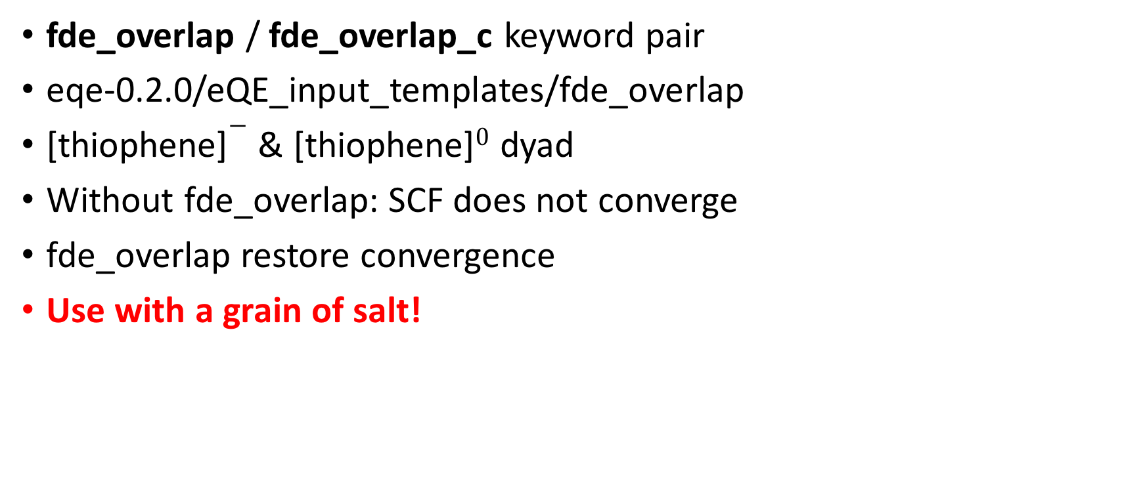
Problem: e⁻ leak to environment (2)
fde_overlap / fde_overlap_c keyword pair
eqe-0.2.0/eQE_input_templates/fde_overlap
[thiophene]$−$ & [thiophene]$0$ dyad
Without fde_overlap: SCF does not converge
fde_overlap restore convergence
Use with a grain of salt!

Slide 19
Thank you!
Feel free to contact me or any of my group members.
Feel free to visit us in Newark!
http://www.michelepavanello.com/

