Slide 1

def test():
q = MATRIX(ndof, 1)
output = metropolis_gau( piab, q, params, ...)
User defines how to
run the MC sampling
vector<MATRIX> metropolis_gau
(Random& rnd,
bp::object target_distribution,
MATRIX& dof,
bp::object distribution_params,
int sample_size, int start_sampling,
double gau_var){
Implementation of the Metropolis algorithm
double p_old =
bp::extract<double>( target_distribution(s_old, distribution_params) );
…
}
Sampling
def piab(q, params):
User defines what probability distribution function is to be sampled
return p # float
C++
Python

Slide 2
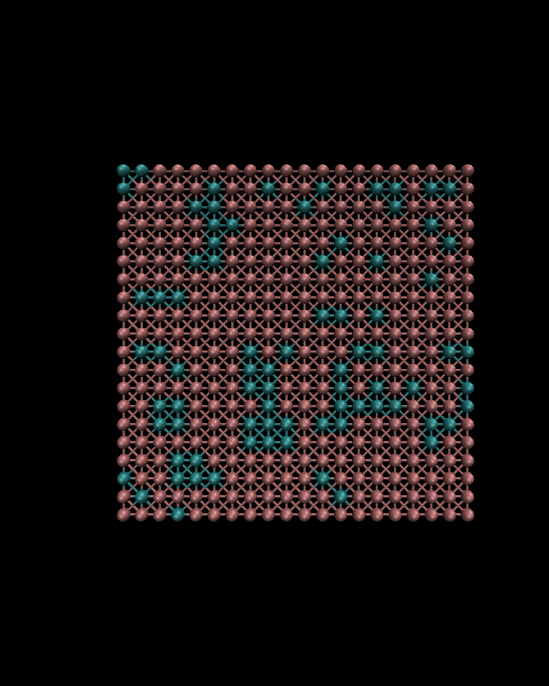
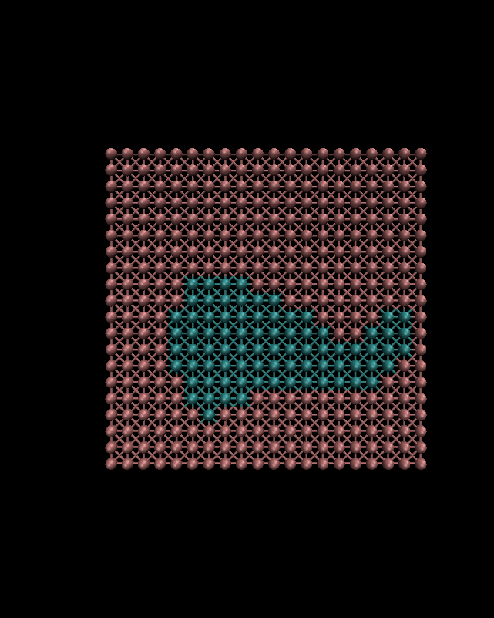
Lattice Monte Carlo

