Slide 1
Title
Agentic Research & Decision Intelligence Platform
Topic: Compare LangGraph, AutoGen, and CrewAI for evidence-grounded research workflows.

Slide 2
Motivation
Complex decisions require planning, evidence, critique, synthesis, and transparent uncertainty—especially in clinical-adjacent settings.

Slide 3
Problem Statement
Transform a broad research topic into a professional evidence-grounded report and presentation with traceability and reproducibility.

Slide 4
Proposed System
Ten specialized agents coordinate through typed WorkflowState, conditional graph edges, SQLite memory, and deterministic mock evidence.

Slide 5
Multi-Agent Architecture
Streamlit UI and FastAPI backend feed a LangGraph-style workflow. Agents call search, citation, visualization, report, presentation, and memory tools.

Slide 6
LangGraph Workflow
Planner → Research → Analyst → Critic → Fact-Check → Visualization → Report → Evaluator → Presentation → Memory.

Slide 7
Conditional Routing
Critic loops back to Research when evidence is weak. Evaluator loops back to Report Writer when quality score Q is below threshold τ = 78.

Slide 8
Agent Roles
Planner decomposes; Research retrieves; Analyst structures; Critic challenges; Fact-Checker grounds; Visualization explains; Writer synthesizes; Evaluator scores.

Slide 9
Implementation Stack
Python, LangGraph-compatible orchestration, FastAPI, Streamlit, SQLite, Matplotlib, LaTeX, Pytest, Docker.

Slide 10
Mock Mode Design
USE_MOCK_LLM=true runs without paid API keys. A local corpus of 21 verified references keeps outputs deterministic for grading.

Slide 11
Report Generation Pipeline
Sources → claim checks → tables → figures → Markdown → LaTeX → PDF → presentation artifacts.

Slide 12
Mathematical Formulation
Task decomposition T = {t₁,…,tₙ}; confidence C = Σwᵢsᵢ/Σwᵢ; quality Q = αF+βR+γS+δC_q; revision when Q < τ.

Slide 13
API Endpoints
GET /health; POST /run; GET /runs/{run_id}; GET /runs/{run_id}/report; GET /runs/{run_id}/report.pdf; GET /runs/{run_id}/presentation; GET /runs/{run_id}/figures.

Slide 14
Evaluation Methodology
Rubric: factuality, relevance, completeness, structure, citation quality, clarity, visual quality, reproducibility (artifact quality, not clinical validity).

Slide 15
Results
Final score: 93.1/100. Confidence: 95.5/100. Sources: 21. Figures: 14. LaTeX PDF and PPTX generated.

Slide 16
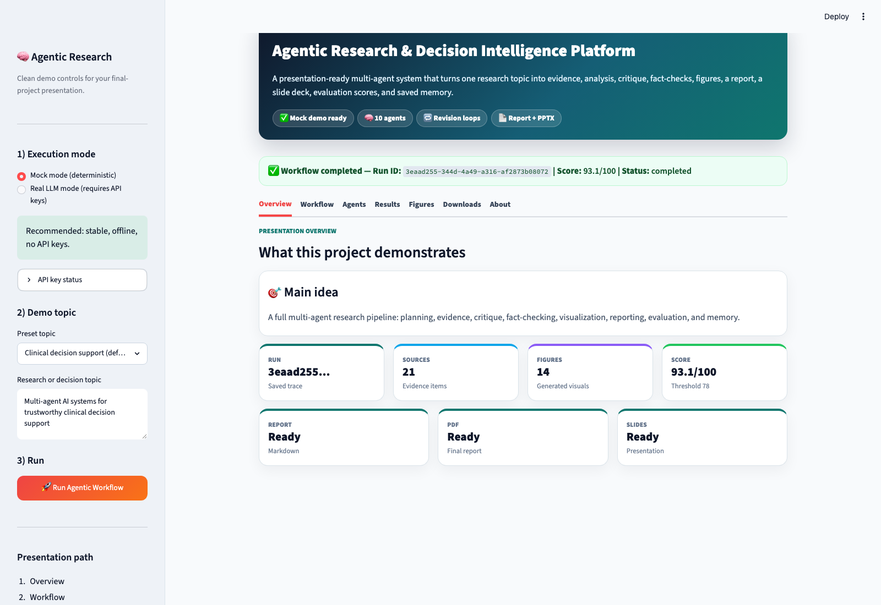
User Interface
Streamlit demo UI with hero header, sidebar controls, and tabs for Overview, Workflow, Agents, Results, Figures, and Downloads.

Slide 17
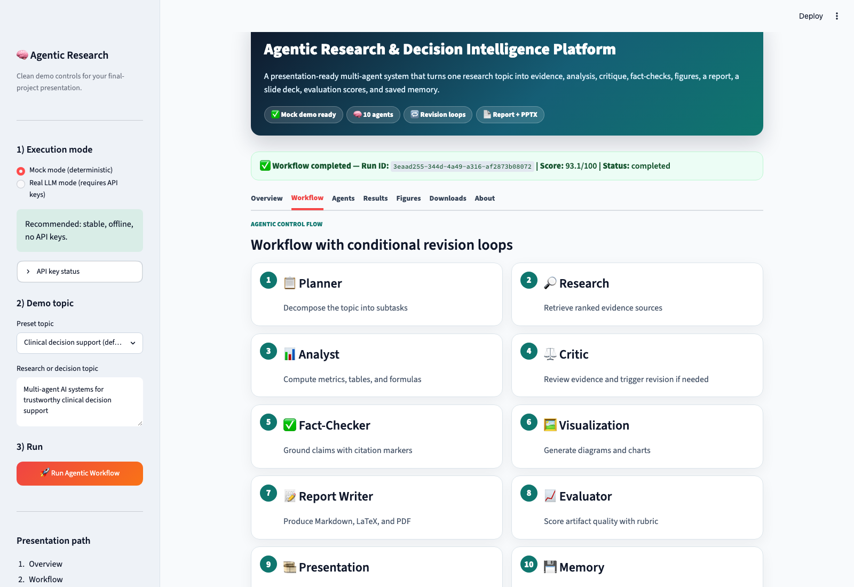
Agent Workflow Interface
Workflow tab shows the ten-agent pipeline and conditional routing (Critic→Research, Evaluator→Report Writer).

Slide 18
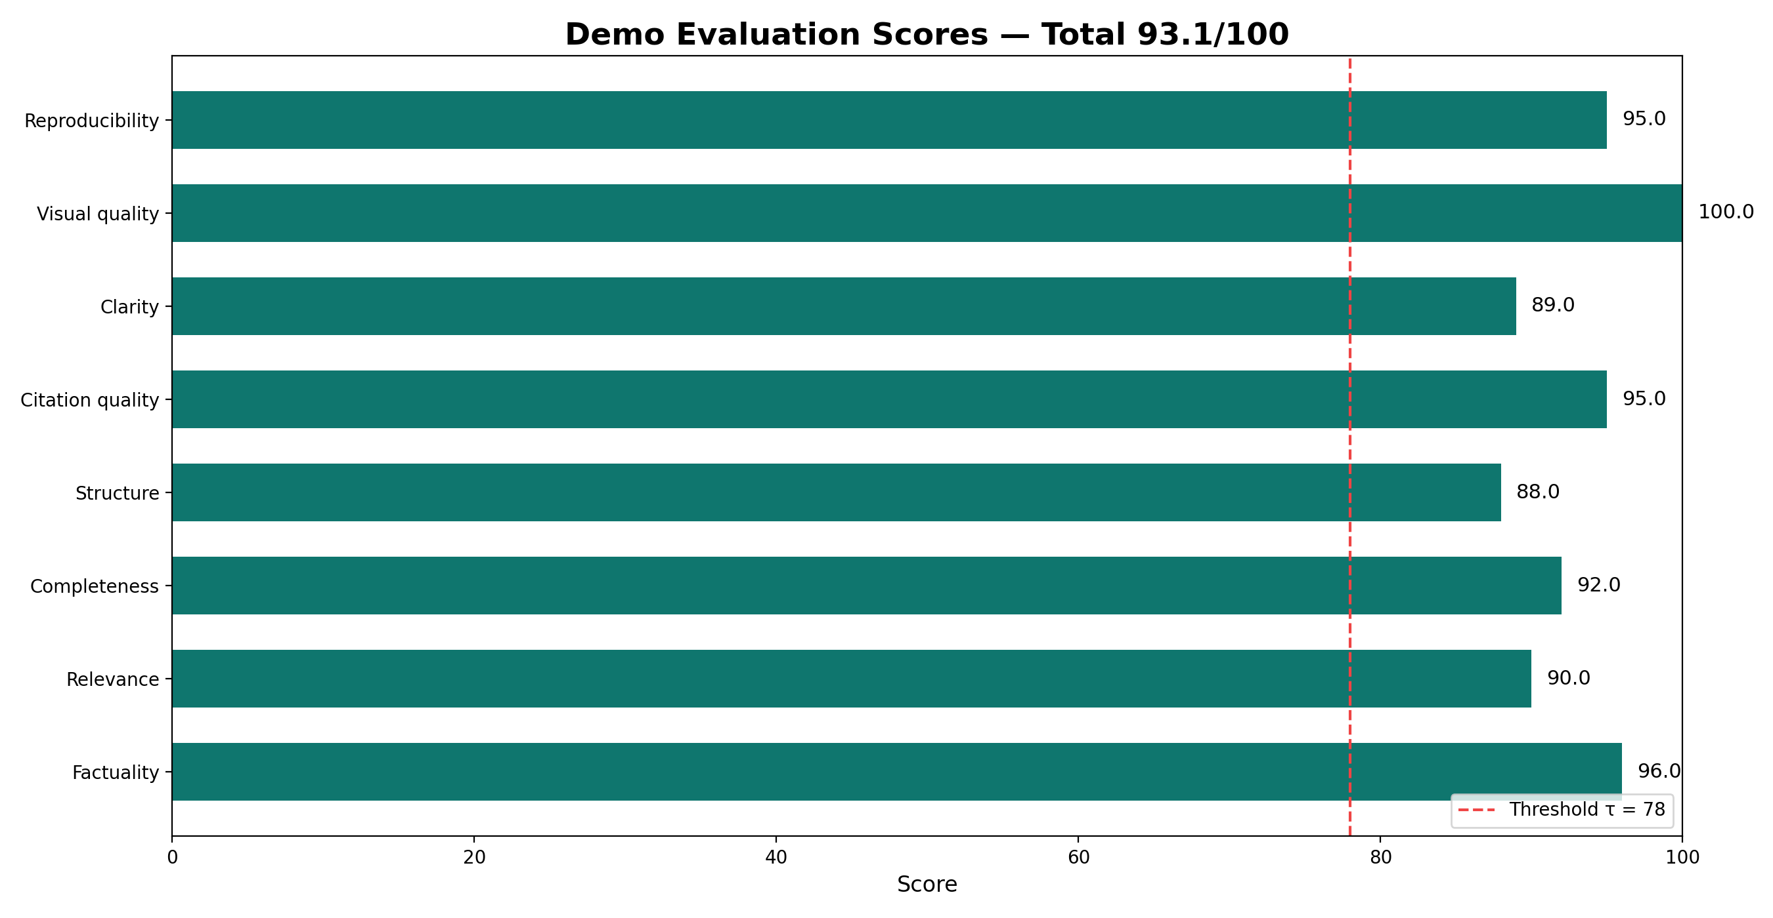
Demo Results
Evaluation 93.1/100; 14 figures; report and presentation generated.

Slide 19
Testing and Reproducibility
pytest -v; python scripts/run_demo.py; python scripts/build_report_pdf.py; python scripts/capture_ui_screenshots.py; Docker Compose.

Slide 20
Limitations
Static mock corpus; metadata-level fact checking; no clinical validation; human review required; not a medical device.

Slide 21
AI Usage and Development Transparency
External AI tools (ChatGPT, Codex-style assistant, Cursor AI, NotebookLM) supported planning, implementation, documentation, and presentation drafting. The implemented system itself contains separate internal runtime agents. The student defined requirements, supervised development, reviewed outputs, tested the system, and prepared final submission. Mock mode and tests support reproducibility.

Slide 22
Future Work
Live retrieval, vector stores, entailment-based fact checking, human-in-the-loop approval, security hardening, formal clinical evaluation.

Slide 23
Conclusion
A reproducible multi-agent prototype that produces inspectable, evidence-grounded academic deliverables suitable for university evaluation.

