Slide 1
Market Sentiment Analysis
Sub-group-meeting 1
02/05/2018 ELEC7080

Slide 2
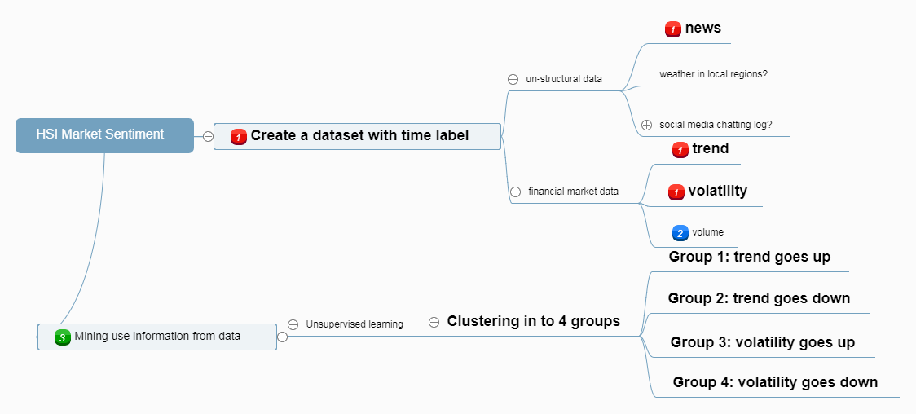
Num. (trend, volatility, volume) X 2(up or down) x 2 (big abs. or small. abs)

Slide 3
Record ID | News keywords combination/score? | Binary Trend score |  | Binary Volatility derivative score | Binary absolute Volatility score | Binary Volume derivative Score | Binary abs. Volume score
1 | Question: Neumerical score? | +1 |  | +1 Go up | +1 High | +1 Go up | +1 Large
2 |  | -1 |  | -1 Go down | -1 Low | -1 Go down | -1 Small
3 |  |  |  | +1 Go up | -1 Low | … | …
4 |  |  |  | -1 Go down | +1 High
5

Slide 4
Time point
Abs.Trend
Abs.Volatility
Abs.Volume
(Trend)’
(Volatility)’
(Volume)’
….

Slide 5
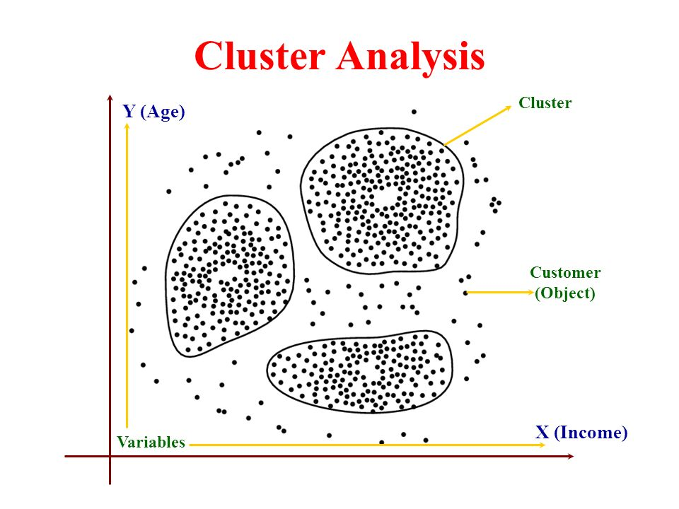
Cluster the vectors

Slide 6
