Slide 1

Encrypted SMS Spam Classifier
Using Machine Learning, Streamlit, Cryptography, and JWT Authentication
Presented by:
Mohammad Furqan 2022R/2021-CS-199
Mohammad Zaid 2022R/2021-CS-214
University of Engineering & Technology, Lahore

Slide 2
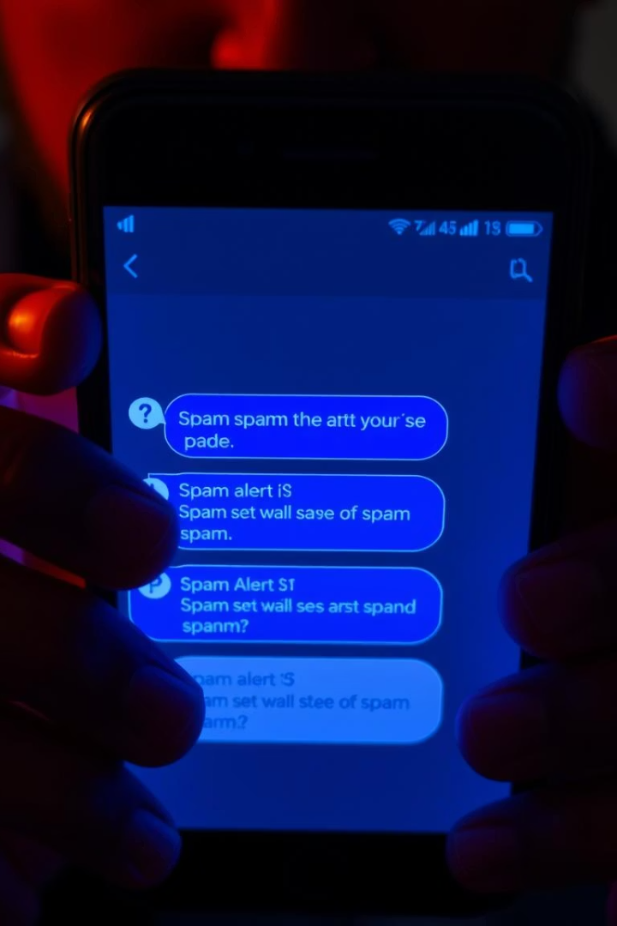
Problem Statement
Prevalence of SMS Spam
Security Risks
Spam can carry malicious links risking user privacy and security.
Spam messages disrupt communication and expose users to scams.
Need for Reliable Filtering
Current solutions often lack encryption and strong user authentication.

Slide 3

Project Objectives
SMS Classification
Message Encryption
Detect spam vs. Ham SMS automatically.
Encrypt messages before classification to protect privacy.
User Authentication
Implement JWT-based login/signup for secure access.

Slide 4
Technology Stack
Languages & Frameworks
Database & Security
Model Management
Python, Streamlit
SQLite for data storage
Pickle for loading ML models and vectorizers
scikit-learn, NLTK
Cryptography for encryption
JWT for authentication

Slide 5







System Architecture & Workflow
User Input
Encryption
Decryption
Preprocessing
Vectorization
Prediction
Result

Slide 6
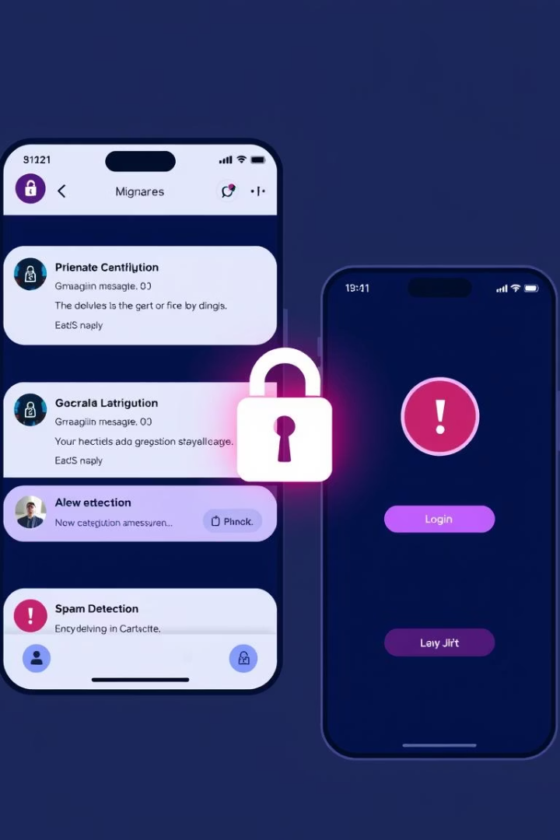
Key Features
Real-Time Prediction
Instant spam detection on user messages.
End-to-End Encryption
Message encrypted with secret key before processing.
User Authentication
JWT token-based login and session handling.
Light Theme UI
Sleek, user-friendly Streamlit interface with Light mode.

Slide 7
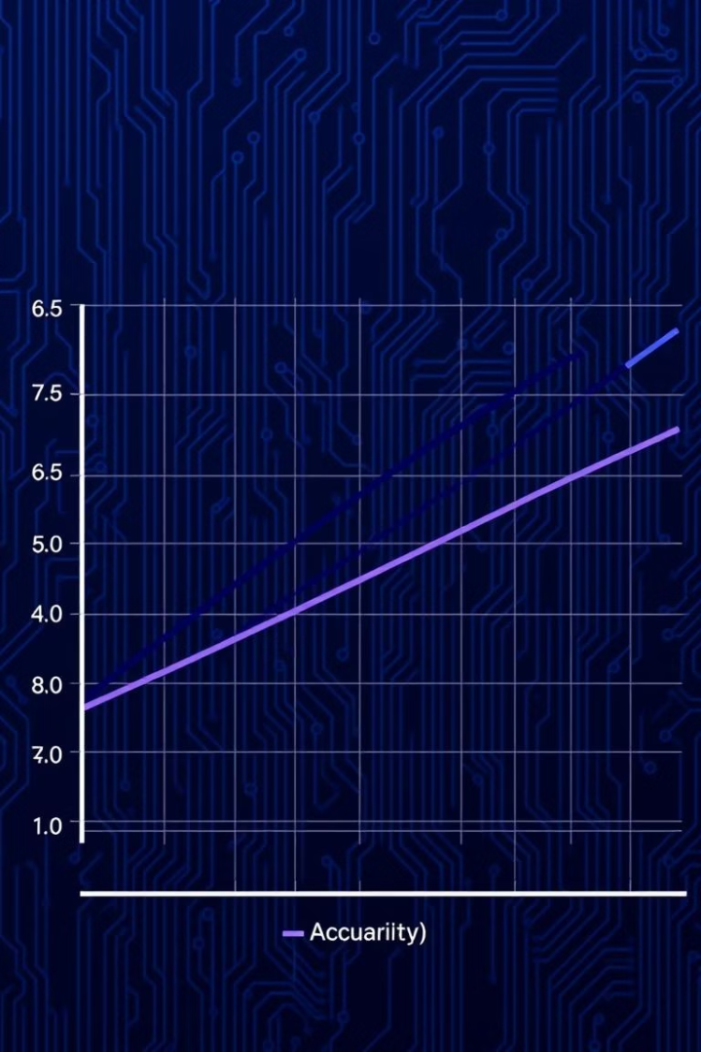
Model Training & Evaluation
Feature Extraction
Used TF-IDF to convert text to numerical features.
Model Selection
Multi-nomial classifier trained on labeled SMS data.
Performance
Achieved high accuracy (~95%) on test samples.

Slide 8
Zero Trust & Conclusion
Zero Trust Security
Conclusion & Future Work
Signup/Login interface with JWT authentication
System secures SMS classification and user sessions effectively.
Encrypted message input and spam classification result
Future improvements: multi-language support, model updates, UI enhancements.

Slide 9

Thank You

