Slide 1

Promise

Slide 2
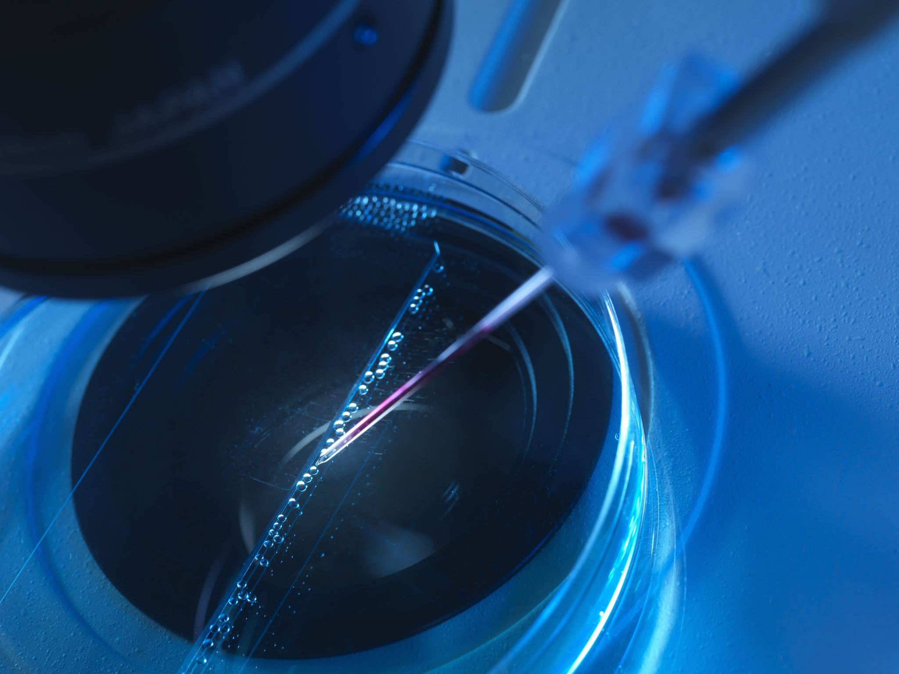
Hybrid Quantum Deep Learning & VQC for Botnet DGA Detection
Quantum Computing Class, 2025
Presented by:
Mohammad Alshurbaji & Fatemah Mazdarani

Slide 3
Who We Are
Mohammad Alshurbaji
MS CS Student with Data Science Concentration, Graduating May 2025
BS in Mechanical Engineering
From Amman, Jordan
Fun Fact: I visited 20 states in less than 2 years!!
Fatemah Mazdarani

Slide 4
Agenda
1. Introduction
2. Methodology
3. Results & Discussion
4. Abstract (Revisited)
5. Future Work

Slide 5
BotNet

Slide 6
• Domain Generation Algorithms (DGAs) in Botnets
• Quantum ML: A new frontier
• Goal: Compare VQC vs. Hybrid Q-DL for DGA Detection

Slide 7
Contributions
This paper was the first research on the VQC algorithm for the cybersecurity botnet DGA classification at that time!
Proposing models to detect DGA-based botnet traffic on two quantum ML approaches:
Hybrid quantum-classical DL
VQC algorithm
Experiment with quantum noise models.
Comparing the performance of the two approaches.

Slide 8
Dataset & Features
• 1.8M domain names
• Legitimate vs. 10 Botnet DGA families
• 7 engineered features (entropy, RE, IRad, etc.)
• Include statistical analysis (entropy, relative entropy, information radius, and reputation score)

Slide 9
Models Compared
1. Variational Quantum Classifier (VQC)
- 4 Feature Maps, 4 Variational Circuits, 12 Optimizers
2. Hybrid Quantum-Classical DL
- Keras + Pennylane Quantum Layer

Slide 10
Quantum Circuit Design (VQC)
• Feature Maps: Pauli, Z, ZZ, Raw
• Variational Forms: Real Amplitudes, EfficientSU2, etc.
• Optimizers: SPSA, COBYLA, etc.

Slide 11
Quantum Circuit Design (Hybrid Q-DL)
• Classical layers + Quantum layer (Angle / IQP Embedding)
• Used Pennylane + Qiskit
• Simulated noise from 8 IBMQ devices

Slide 12
General Results
Leveraging quantum computing to accelerate AI or ML applications remains impractical and cost-inefficient at present.
However, exploring the full potential of quantum machine learning for real-world problems remains a crucial area of research and experimentation.

Slide 13

VQC Results (Based on 192 experiment )
• Max accuracy: 84.4%
• Avg accuracy: ~60.7% Min accuracy: ~40.0%
• Feature map & variational form had major impact
• Weakest: ExcitationPreserving + AQGD (worst accuracy with max of 56.0%)

Slide 14
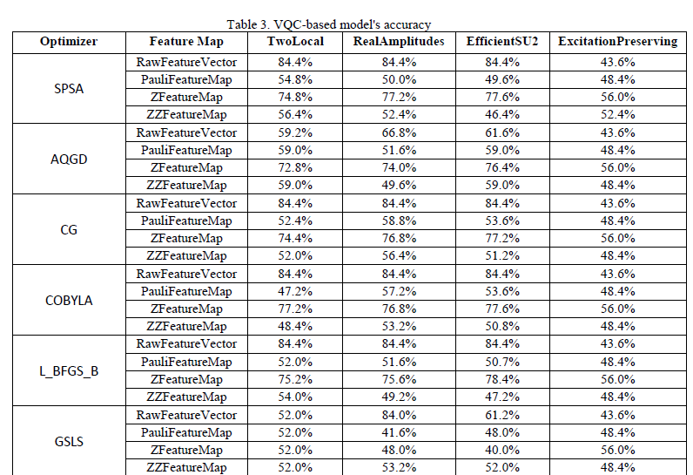

Slide 15
Hybrid Q-DL Results
• Max accuracy: 94.9%
• Best combo: Angle Embedding + Random Layers
• Outperformed VQC across all metrics

Slide 16
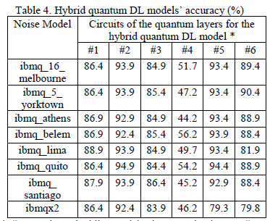

Slide 17
Statistical Evaluation
• ANOVA: Feature maps & variational forms matter
• t-Test: Hybrid Q-DL > VQC (p < 10⁻¹²)

Slide 18
Revisit the Abstract
• Two QML models for DGA detection
• Hybrid Q-DL performed best
• Simulated quantum noise added realism
• Hybrid quantum DL outperforms the VQC-based model (94.9% maximum accuracy)
It’s a GAME CHANGER!!

Slide 19
Thank You
Questions?

Slide 20
Future Work
• Test on Simulators & Real quantum devices
• Apply to other cybersecurity problems (Conceptually)
• Add encryption/confidentiality layers
• Use entropy metrics to tune architectures

