Slide 1
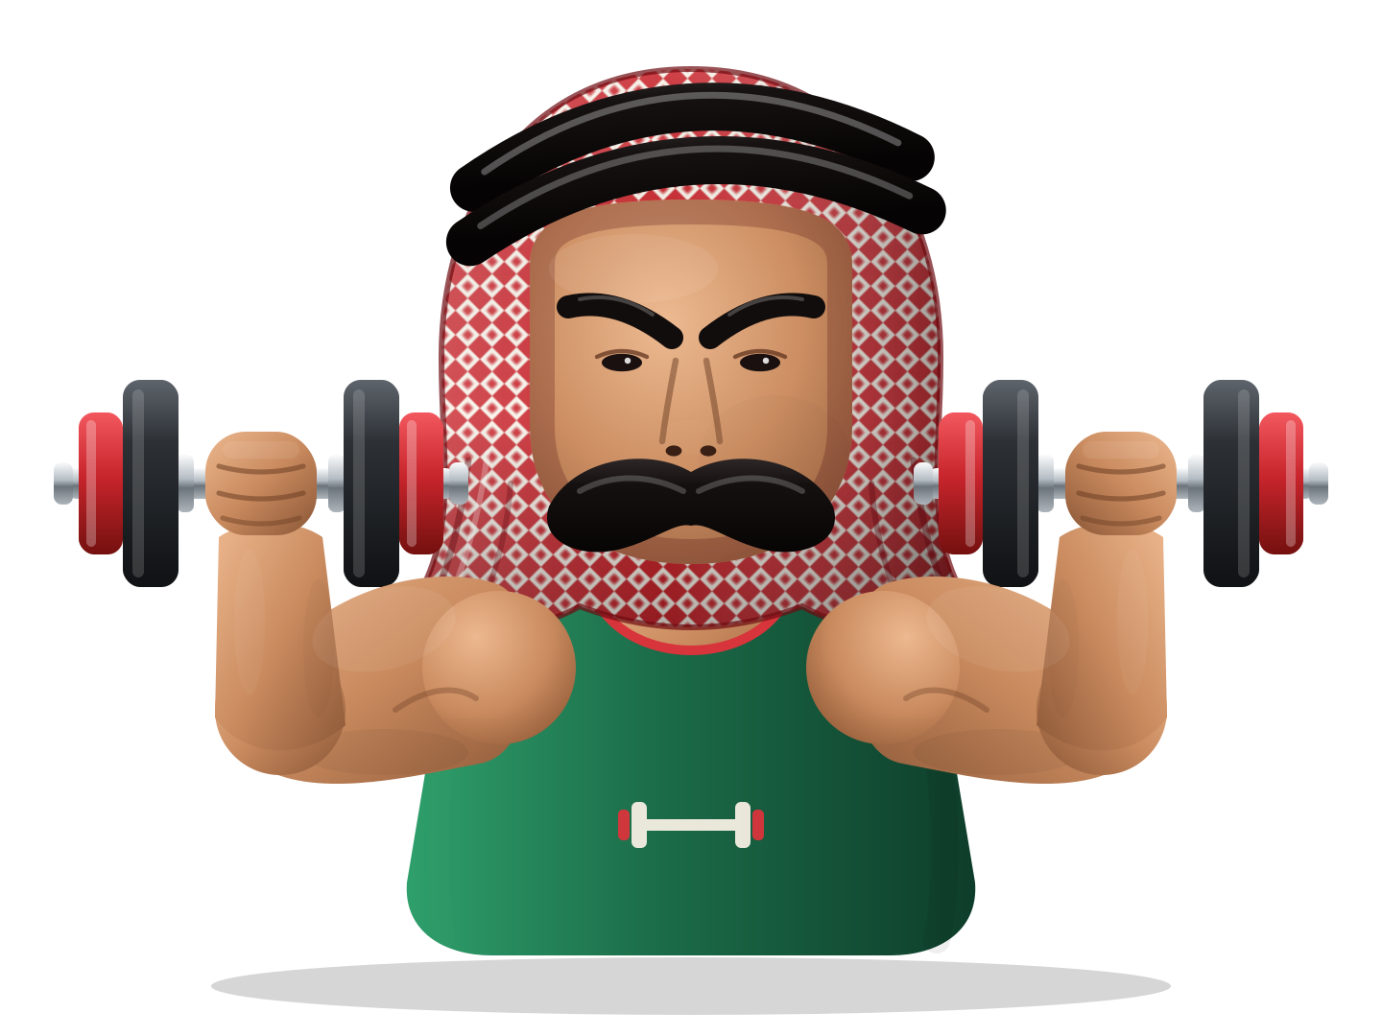

JOFIT
HACKATHON PITCH · AMMAN · OCTOBER 2026
Intelligent health & training that watches your form and pays you back for training safely.
Partnered with Islamic International Arab Bank
Notes:
Open with the mascot on screen. Say the name, then go straight to the questions on the next slide. No feature list yet.

Slide 2
BEFORE WE START, THREE QUESTIONS
1
2
3
How many reps did you do with bad form last week?
Who told you to stop before your knee did?
What did you get for training safely?
Think about your answers. Keep them in your head for the next slide.
Notes:
Ask the room out loud. Pause after each question. Let a few people answer or laugh. This is the hook: everyone who trains has a real answer.

Slide 3
FOR MOST PEOPLE WHO TRAIN, THE HONEST ANSWERS ARE
1 · Reps with bad form
2 · Who told you to stop
3 · Reward for training safely
Too many.
Nobody.
Nothing.
That gap is where gym injuries come from. JOFIT was built to close it.
Notes:
Reveal the answers one by one. The point: nobody watches your form, nobody reads your fatigue, and doing it right earns you nothing. That is the problem in three words.

Slide 4



Three problems, one app
WHY WE BUILT JOFIT
Bad form goes unseen
Fatigue gets ignored
Doing it right pays nothing
A coach can't watch every rep. Mirrors don't measure knee angles. Mistakes repeat until they hurt.
People add weight on a fixed schedule, tired or not. The body says stop long after it should.
Apps reward volume and streaks. None reward a clean, safe rep, so nobody chases one.
Notes:
Map each card to the three questions. Q1 is bad form, Q2 is fatigue and no one stopping you, Q3 is no reward. Then ask: what if your phone could be the coach standing next to you?

Slide 5
JOFIT watches every rep, protects your body, and turns safe training into rewards from the bank.
SO WE ASKED: WHAT IF YOUR PHONE WAS THE COACH?
Health for Wealth
Notes:
This is the one-line pitch. Say it slowly. Everything after this slide proves one part of the sentence.

Slide 6


One loop, from first survey to bank points
HOW IT WORKS
01
02
03
04
05
06
Survey
Plan
Track
Score
Adapt
Reward
Age, body, level, days, injuries, goal
A week built around your injuries
Camera reads your knee angle live
Form score from reps that hit depth
Next session goes up, holds or deloads
Clean reps become bank points
Every step is live in the app on GitHub: Next.js, on-device pose tracking, rule-based plans.
Notes:
Walk the loop left to right. Point out that step 3 is the heart: the camera, and step 6 is why people come back.

Slide 7
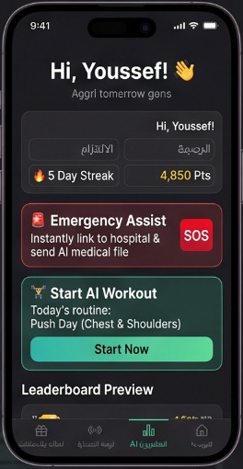
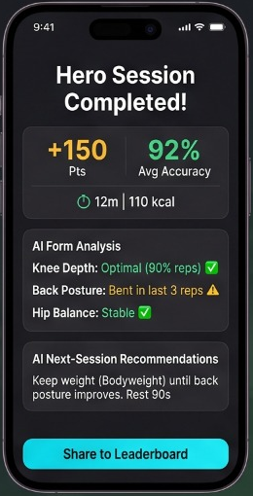
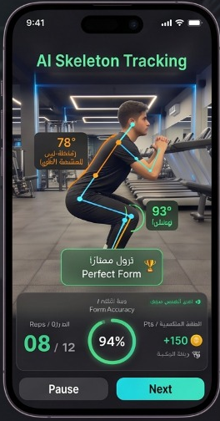
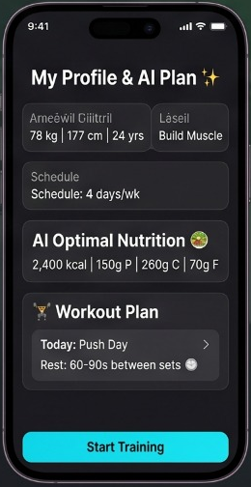
Train smarter
I
THE APP IN 8 SCREENS · ACT I OF II
عربي + English
Any phone browser
01 · Home
03 · Summary
Your day, one glance
02 · AI tracker
Instant report card
04 · Profile & plan
5-day streak, 4,850 Fit Points, today's Push Day and SOS one tap away.
Eyes on every rep
+150 pts, 92% form score, an AI form analysis and next-session advice.
Built from your body
Live joint angles, 8 of 12 reps, 94% form and +150 points mid-set.
Age, height, weight, level and free days shape a weekly AI plan.
Notes:
Intro line: "Let me show you one training day with JOFIT, in eight screens." Screen 1: you open the app and see your streak, your points and today's workout. Screen 2: you press Start and the camera tracks every joint, counting only good reps. Screen 3: when you finish, you get a report card with your form score and advice for next time. Screen 4: your weekly plan is built from your own body and your injuries. Then: "That's training. Now here's why people come back." Next slide.

Slide 8
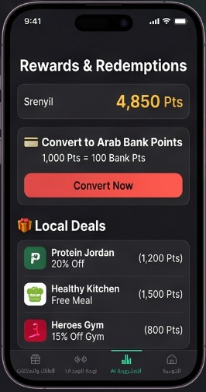
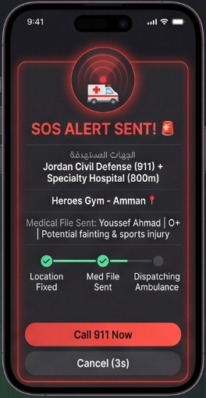
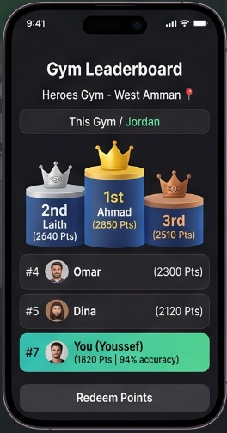
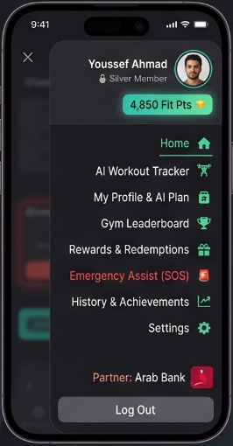
Get rewarded, stay safe
II
THE APP IN 8 SCREENS · ACT II OF II
Dark mode
One-hand design
05 · Rewards
07 · Emergency SOS
Sweat into currency
06 · Leaderboard
Help before you ask
08 · Menu
1,000 Fit Points = 100 bank points, or vouchers with a QR code.
Your gym, your rivals
One tap calls 911, shows first-aid steps and your saved contact.
One swipe to anything
Heroes Gym Hub, this month: a podium, ranks, form scores and your spot.
Every feature, plus our partner: Islamic International Arab Bank.
Notes:
Screen 5: every clean rep becomes points you can turn into Islamic International Arab Bank points or spend on partner vouchers. Screen 6: your gym becomes a league, and you can see exactly where you stand. Screen 7: if something goes wrong, one tap calls 911, Jordan's emergency number, shows first-aid steps and lets you call your saved contact. Screen 8: everything is one swipe away, with Islamic International Arab Bank as our partner. Closing line: "Eight screens. One habit: train safe, get rewarded."

Slide 9
The camera counts only safe reps
FEATURE 01 · REAL CAMERA SQUAT TRACKER
MediaPipe Pose Landmarker runs in the browser on the phone or laptop. It finds the hip, knee and ankle and measures the knee angle on every frame.
Rule | Knee angle
Standing | 160°
Descent starts | 145°
Rep counts (thigh parallel) | ≤ 90°
Knee-safe mode counts from | ≤ 100°
Knee-safe mode warns below | 80°
Drop faster than 400 ms | stumble, not a rep
“Go Lower: Reach 90°”
“Too Deep: Protect Your Knee”
Sound you can hear mid-set: an 880 Hz chime for a clean rep, a 220 Hz buzz for a bad one.
Notes:
If you can, demo it live: open the GitHub app, allow the camera, do two squats, one shallow. The buzz on the shallow rep sells the whole idea. The numbers come straight from squatThresholds.ts.

Slide 10
You only get heavier when your form earns it
FEATURE 02 · PROGRESSIVE OVERLOAD WITH A FORM GATE
OVERLOAD ACHIEVED
FORM GATE
DELOAD
Hit target reps and form 80% or higher
Hit target reps, but form under 80%
Missed the target reps
−10%
+2.5 kg
Hold
Weight × 0.9. Bodyweight: fewer target reps.
Bodyweight: +1 rep. Earns 10 Fit Points per valid rep.
Same weight next time. Zero points for sloppy reps.
Notes:
This is the answer to question 2: who tells you to stop? JOFIT does. Weight goes up only with clean form, and it comes down when you are struggling. Rules are in progressiveOverload.ts.

Slide 11
A plan that works around your injuries
FEATURE 03 · WORKOUT PLAN + SURVEY
The survey asks
Injury swaps, automatically
Age, height and weight
Experience level
Days free: 2 to 5
Injuries: knee, lower back, shoulder
Goal: strength, muscle or mobility
Injury | Instead of | You get
Knee | Walking Lunges | Glute Bridge
Knee | Box Jumps | Hamstring Curl
Lower back | Romanian Deadlift | Hip Thrust
Lower back | Barbell Row | Chest-Supported Row
Shoulder | Barbell Bench Press | Neutral-Grip DB Press
Shoulder | Lateral Raises | Band External Rotations
Rule-based: the same answers always give the same plan, so every choice traces back to a rule. After each workout a summary shows points, form score and the next-session advice.
Notes:
Ask the room: who has a bad knee or back? This slide is for them. The swaps are real rules from planGenerator.ts.

Slide 12
A coach in your pocket that answers in seconds
FEATURE 04 · HEALTH CHATBOT
Powered by Google Gemini
How deep should I squat?
Focused on squat depth, spine and knee safety, overload and Fit Points. Short answers, under 75 words.
JOFIT Coach
Works offline too
Aim for thighs parallel, about 90° at the knee. JOFIT counts a rep at 90° or lower. With a sore knee, knee-safe mode counts from about 100°.
No network or no reply in 8 seconds? A built-in answer bank uses the app's own rules.
Safe by design
Pain means see a physiotherapist. An emergency means call 911 in Jordan.
Notes:
The chat answer on screen is the app's real offline answer, shortened. Mention the fallback: the coach never goes silent in a gym basement with no signal.

Slide 13

Clean reps turn into real rewards
FEATURE 05 · ARABI WALLET
Convert
1,000
Redeem with local partners
Voucher | Points
Heroes Gym, 1-month pass | 2,500
Primal Amman, 25% off meal plan | 1,200
Jordan Nutrition Lab voucher | 3,000
Fit Points
100
Each redemption shows a QR code to scan at the partner. Only reps with 80%+ form earn points.
Islamic International Arab Bank points
Notes:
This answers question 3: what do you get for training safely? Now, something real. Partners and rates are the demo values in mockData.ts; say they are examples for the pitch.

Slide 14
Compete on form, not ego
FEATURE 06 · GYM LEADERBOARD
● LIVE · Heroes Gym Hub · this month
CHAMPION
1
2
4
Wael Haboush
94%
2,410
Zaid Hammad
5
Faris Nasser
88%
2,150
Mohammad Dwiek
3,450
3
3,120
96% form · 120 kg
Abdulla Abu Sair
6
Dana Qasem
95%
1,980
92% form · 110 kg
2,890
7
You
91%
1,760
90% form · 105 kg
22 clean reps to pass Dana
169 clean reps to take the crown
Best form badge
Heaviest squat badge
How you score
Sloppy reps score
Zaid Hammad · 96%
Zaid Hammad · 120 kg
10 pts per rep at 80%+ form
Zero. No shortcuts.
Notes:
Make it a race. Point to the champion first: Zaid leads with 3,450 points, best form and heaviest squat. Then drop to row 7, You, at 1,760. The gold box is the hook: every clean rep is 10 points, so 22 clean reps passes Dana and 169 takes first place. Sloppy reps score nothing, so the only way up is good form. Ties go to the other athlete, so you have to beat them outright. Names and points are the demo data in mockData.ts; the ranking rule is in leaderboard.ts.

Slide 15
Protecting the body before, during and after
THE SAFETY NET · ALL BUILT IN THE APP
BEFORE
DURING
AFTER
Injury-aware plan
Knee-safe mode
Workout summary
Knee, lower-back and shoulder injuries swap risky lifts for safer ones.
Reps count from 100°, with a warning below 80°: "Too Deep, Protect Your Knee".
Points, form score, an AI form analysis and advice for the next session.
BEFORE
DURING
ANYTIME
Health coach
Rest countdown
Emergency SOS
Ask about depth, knees or overload. Works offline too.
A timer between sets, and fast drops under 400 ms never count as reps.
One tap calls 911, shows first-aid steps and your saved contact.
Notes:
Every card here is working in the app today. Read it as a timeline: before you train, the plan and the coach protect you. During the set, knee-safe mode and the rest timer protect you. After, the summary tells you what to fix. And if anything goes wrong, SOS is one tap away. 911 is Jordan's single emergency number.

Slide 16



A real, working web app
HOW IT'S BUILT
App
Vision & sound
AI coach
Next.js 14, React 18, TypeScript, Tailwind CSS, Framer Motion
MediaPipe Tasks Vision pose model, Web Audio API tones
Google Gemini API, with an offline answer bank as backup
Notes:
Keep this short for a non-technical panel. For judges who code, mention the rules live in small, testable files: squatThresholds, progressiveOverload, planGenerator.

Slide 17
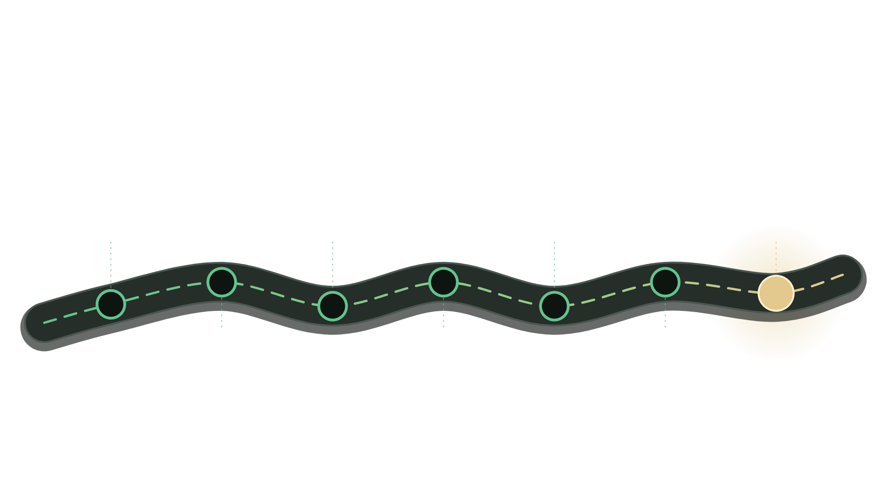

Six highlights, one finish line
CONCLUSION · THE JOFIT ROAD
Smart plan
Form gate
Leaderboard
FINISH LINE
A short survey builds a week around your injuries.
Heavier only when form hits 80%. Deload when tired.
Gym members race on clean reps, not ego.
Fewer injuries. Real rewards.
2
4
6
1
3
5
START
AI squat tracker
Health coach
Arabi wallet
The camera counts only reps at safe depth.
Gemini answers in seconds, even offline.
1,000 Fit Points become 100 bank points.
Notes:
This is the summary. Walk the road from left to right, one stop per click: plan, tracker, form gate, coach, leaderboard, wallet. Each stop is a feature already working in the GitHub app. End on the gold finish line: fewer injuries, real rewards. Then move to the thank-you slide.

Slide 18
JOFIT
THE THREE QUESTIONS, ANSWERED
Bad reps? The camera catches them.
Who tells you to stop? JOFIT does.
What do you get? Real rewards from the bank.
Train safe. Get paid back. Thank you.
TEAM JOFIT
Zaid Hammad · Mohammad Dwiek · Abdulla Abu Sair · Wael Haboush
Notes:
Callback to the opening. Read the three lines, pause, then the thank you. Introduce the team by name and open for questions.

