Slide 1
PSCMR MINDSPRINT 2K25
Tech Terminators
AI Virtual Mouse
Team Members :
P. Rupa Sri Malleswari
Md. Aafrin
M. Charishma
College : Seshadri Rao Gudlavalleru Engineering College

Slide 2
Abstract
A multimodal human–computer interaction system using Hand Gestures, Eye Tracking, and Voice Commands.
Control computer mouse without physical contact
Powered by: Hand Tracking + Deep Learning Gesture Model + Eye Tracking + Voice Control
Provides cursor movement, clicks, scroll, drag-drop, and hybrid controls

Slide 3
Problem Statement
Physical mouse devices are unhygienic in shared spaces.
Touch-based devices are not accessible for differently-abled users.
Need for smart, contactless interfaces for modern computing.

Slide 4
Proposed Solution
AI Virtual Mouse using:
• Hand gesture tracking for cursor & click actions
• AI gesture classifier for accurate recognition
• Eye-tracking for smart scrolling
• Voice commands for system-level operations

Slide 5
System Features
• Cursor Movement – Index finger tracking
• Left / Double / Right Click – AI gesture model
• Scroll Up/Down – Gesture or Eye Tracking
• Drag & Drop – Specific gesture detection
• Voice Commands – Trigger system events
• Eye-based Scroll – Brightness/region detection

Slide 6
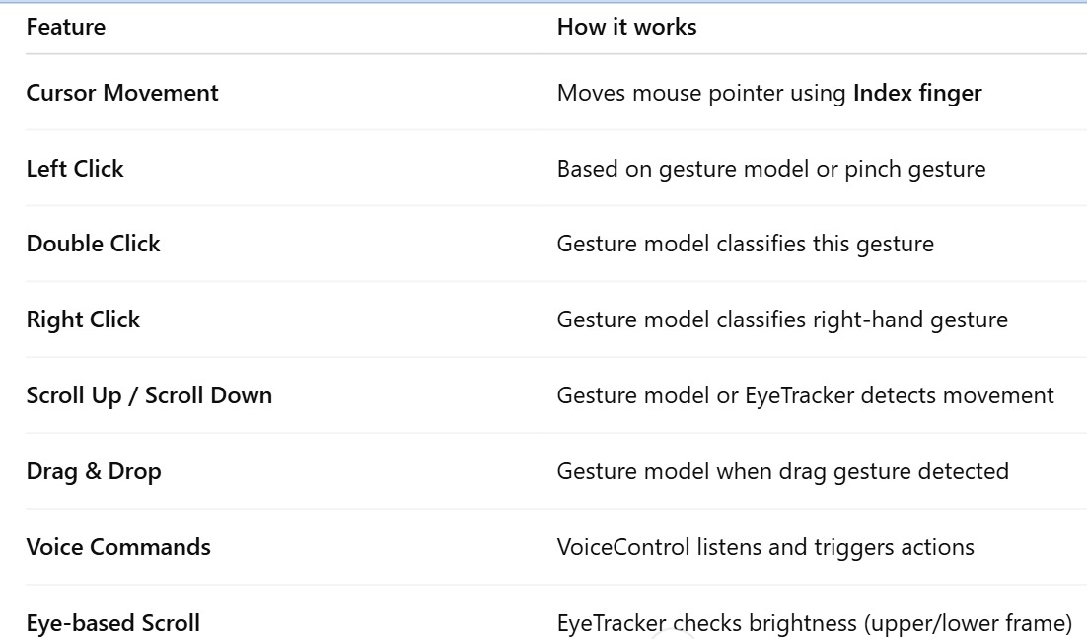
Feature Table

Slide 7
Tech Stack
Python
OpenCV
MediaPipe for Hand Tracking
Deep Learning Gesture Model
PyAutoGUI for Mouse Actions
Voice Recognition
Eye Tracking module

Slide 8
How It Works – Pipeline
1. Webcam captures real-time frames
2. HandTracker detects hand landmarks
3. GestureAIModel predicts gesture class
4. EyeTracker handles scrolling
5. VoiceControl listens and triggers functions
6. GestureController executes mouse actions

Slide 9
Advantages
• Fully touchless
• Accessible for differently-abled people
• Works on any device with a camera
• Real-time, low-latency interaction
• Extensible for AR/VR & gesture-based interfaces

Slide 10
Use Cases
Hospitals (No-contact computing)
Smart Classrooms
Public Kiosks / ATMs
Gaming interfaces
Accessibility technology

Slide 11
Future Enhancements
3D gesture recognition
Multi-hand gesture control
Fully deep-learning based pipeline
AI voice assistant integration
Mobile app version

Slide 12
Conclusion
AI Virtual Mouse is an innovative multimodal interface combining gestures, eye movement, and voice for futuristic computing.

