Slide 1
Determining Chess Board State Using Computer Vision Techniques to Predict Next Best Move
Mohammad Alkhatib Moath Rabeh Khaleel

Slide 2
Outline
Introduction
Approach
Data Description
Experiments
Implementation
Conclusion

Slide 3
Introduction
The objective of this study is to design an image classification system that can determine the state of a chess board.
The state of a chess board can then be fed to a chess engine like Stockfish to determine the next-best-move for a player. Pretrained models will be used as input to a fully connected layer. The optimal architecture found for the system will be discussed in detail.

Slide 4
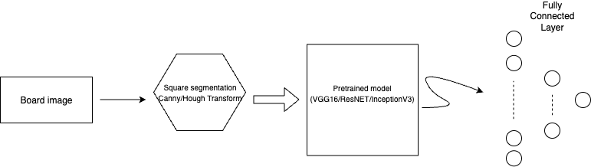
Approach
Figure 1 System Architecture

Slide 5
Approach
Given an image of a chess board, the image can be segmented into 64 squares using Canny edge detection and Hough Transform.
The 64 square images are fed to an image classifier to determine the piece occupying the square. This approach presents the advantage of knowing the location of each square, which helps determine the position of each piece – needed for board state.

Slide 6
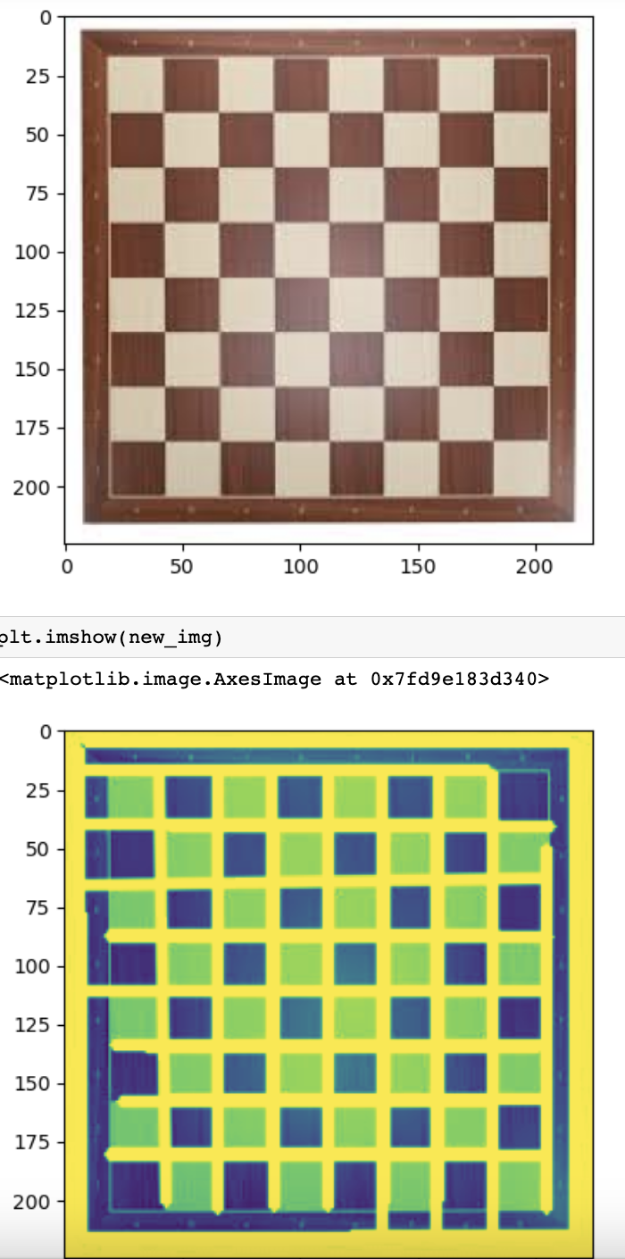
Approach

Slide 7
Approach
Then there is chess-piece detection model Pre-trained models are readily available and can be used for feature extraction. This paper tested popular models including VGG16, InceptionV3, and ResNET.

Slide 8
Data Description
We created the data set which has 2,235 unique images.
The images were divided into 13 distinct classes. The classes are black pawn, white pawn, black castle, white castle, black rock, white rock, black bishop, white bishop, black queen, white queen, black king, white king, and empty square.

Slide 9
Experiments
Labeling The class an image belongs to was labeled using Tensor-flow’s out of the box Image Data Generator. Therefore, the quantitative measurement of the model performance was possible.
Used models VGG16, InceptionV3, and Resnet were among the transfer models used.
Having many layers with fewer neurons was compared with having fewer fully connected layers but with many neurons. Different learning rates and epoch sizes were tested. Different optimizers were used, such as Adam and Stochastic Gradient Descent.

Slide 10
Implementation
The canny edge and Hough transform code used to test segmenting a chess board was.
Creating the dataset, reading them to a Jupiter notebook, cleaning any corrupt files, and writing code for building the sequential model were all done by our team.
The VGG16, InceptionV3, and Resnet models were used as provided by Tensor-flow. The fully connected layer added afterward, as well as any extra pooling and convolution layers used, were added by our team.

Slide 11
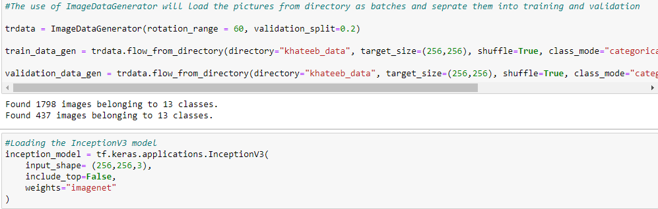
Implementation

Slide 12
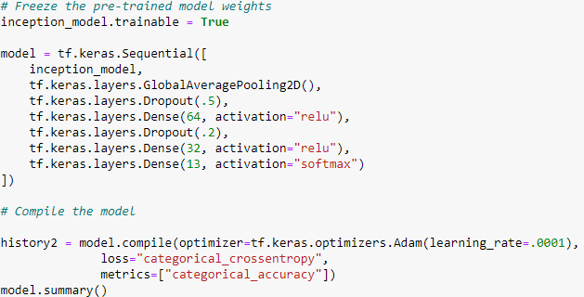
Implementation

Slide 13
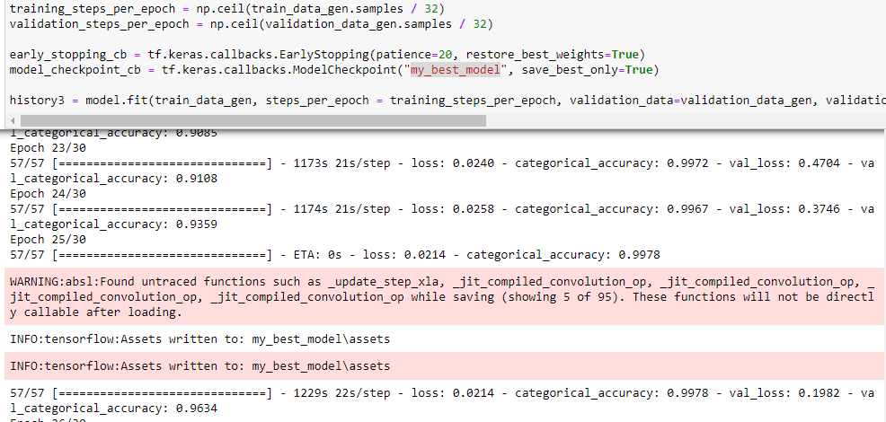
Implementation

Slide 14
Conclusion
The model performed better than most past literature found on the topic. Table I shows the best accuracies that we were able to achieve.
Model | Number of Trainable Parameters | Accuracy | Validation
Transfer learning , InceptionV3 | 21,936,429 | 0.9989 | 0.9725
Transfer learning , (More Layers and neuruns) | 22,341,613 | 0.8326 | 0.9634
Transfer learning , VGG16 | 4,203,917 | 0.9390 | 0.8559
Transfer learning , VGG16(Sparse) | 3,374,849 | 0.9772 | 0.7025

Slide 15
Thank you

