Slide 1
Find My Meds
Done by: Mohammad jouni

Slide 2
Problem & Solution
Patients in Lebanon struggle to find available medications due to frequent shortages and lack of real-time pharmacy inventory information
FindMyMeds shows medication availability across pharmacies in one place as it saves time and helps users find medicines faster

Slide 3
1
System Architecture

Slide 4
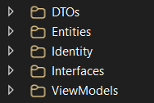
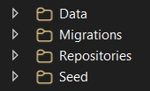
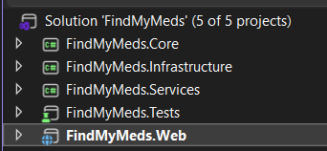


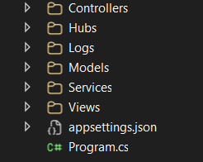
System Architecture

Slide 5
2
ER Diagram

Slide 6
ER Diagram
Medication
Id (PK) FullName Description
1
ApplicationUser
Id (PK) FullName
∞
MedicationSubstitute
Id (PK) PrimaryMedicationId (FK) AlternativeMedicationId (FK) Notes
1
∞
1
1
1
1
∞
Pharmacy
Id (PK) Name City Phone IsApproved LogoPath OwnerUserId (FK)
1
∞
∞
∞
Notification
Id (PK) MedicationId (FK) UserId (FK) Message CreatedAt IsRead
PharmacyMedication
Id (PK) PharmacyId (FK) MedicationId (FK) Quantity ExpiryDate Price LastUpdatedAt
∞

Slide 7
3
UseCase Diagram

Slide 8
UseCase Diagram
Search Medication
Filter by City
View Medication Availability
View Pharmacy Details
View Medication Substitutes Request to Add Pharmacy
Login
Create Pharmacy Profile
Edit Pharmacy Profile
Manage Inventory
Add Medication
Update Quantity
Set Price
Set Expiry Date
View Inventory Status
Receive Notification
Login
Approve Pharmacy Requests
Reject Pharmacy Requests
View All Pharmacies
Manage Medications
Monitor Pharmacies’ Reports
User
Pharmacy Owner
Search Medication «include» Filter by City
Manage Inventory «include» Add Medication
Manage Inventory «include» Update Quantity
Manage Inventory «include» Set Price
Manage Inventory «include» Set Expiry Date
Receive Notification «extend» Mark Notification as Read
Admin

Slide 9
4
Core Features

Slide 10
Core Features
Authentication & role-based authorization
Database integration with EF Core, migrations, and seed data
N-Layer architecture with Repository & Unit of Work pattern
Core business logic in service/manager layer
CRUD operations for main entities
REST API with Swagger documentation
Server-side & client-side validation
Logging & exception handling (Serilog)
Secure MVC & Razor Pages UI
Background hosted services
Real-time updates using SignalR
Optimized queries and DTO-based data access
Notifications and reporting features
File uploads & static file handling
Unit testing for business logic

Slide 11
5
Authentication & Authorization

Slide 12
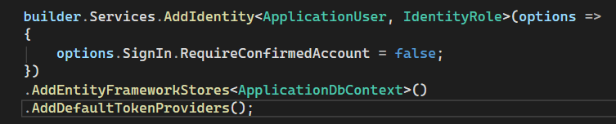


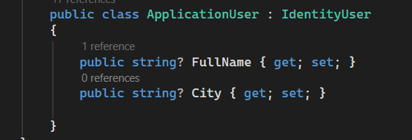
Authentication & Authorization

Slide 13
6
Logging & Exception Handling

Slide 14

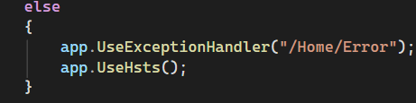
Logging & Exception Handling

Slide 15
7
REST API & Swagger Documentation

Slide 16

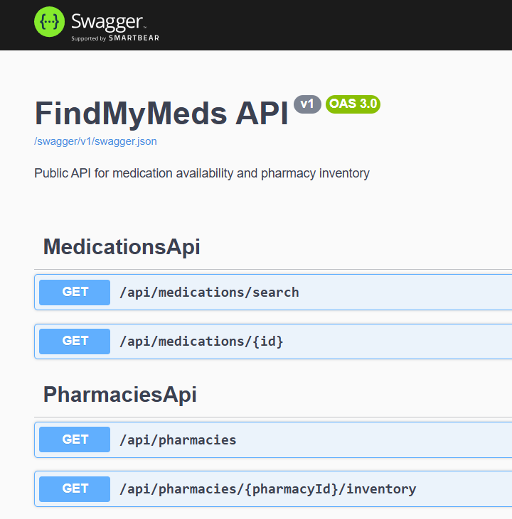

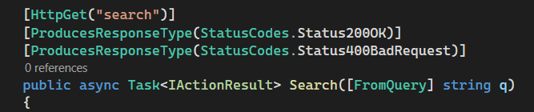
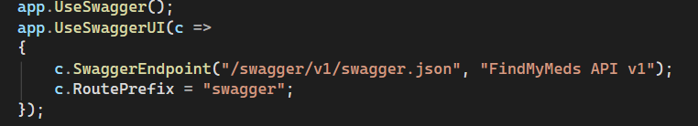
REST API & Swagger Documentation

Slide 17
8
Server-side & client-side validation

Slide 18

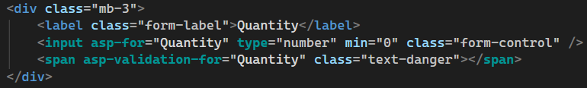


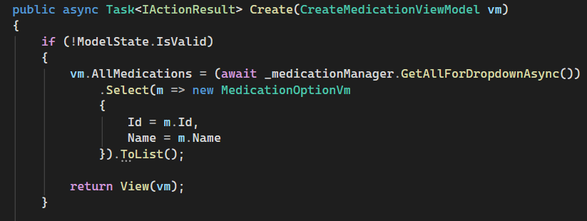
Server-side & client-side validation

Slide 19
9
Background Hosted Services

Slide 20

Background Hosted Services

Slide 21
10
SignalR real-time updates

Slide 22

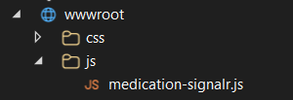
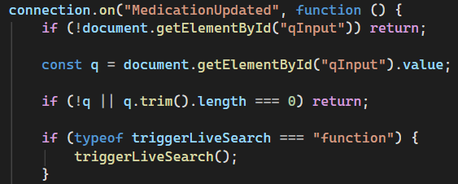

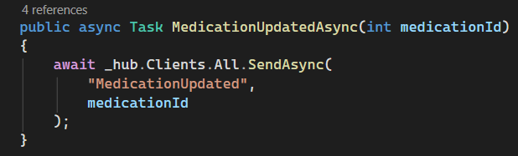
SignalR real-time updates

Slide 23
11
Optimized code and SQL queries

Slide 24
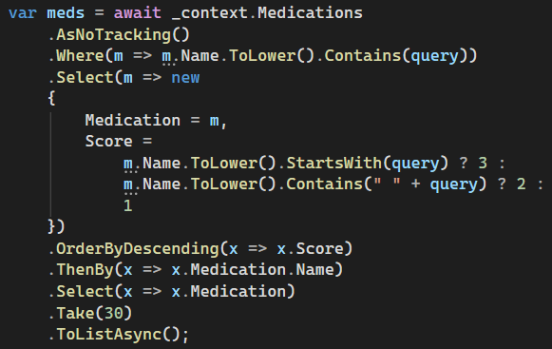
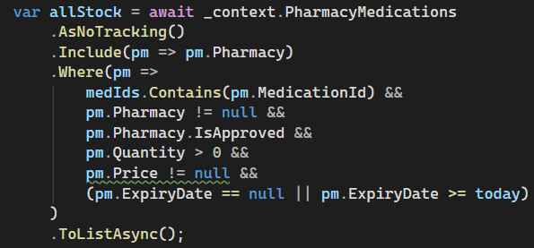
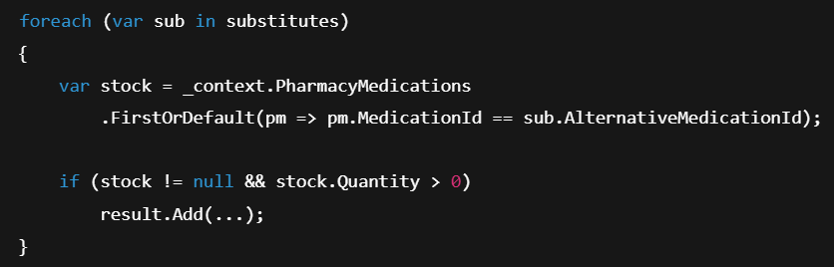
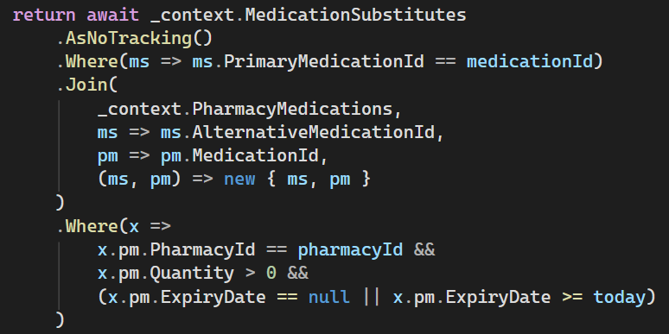
Optimized code and SQL queries

Slide 25
12
Unit Testing

Slide 26

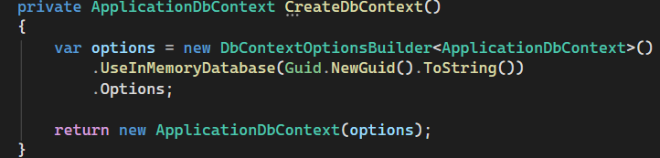
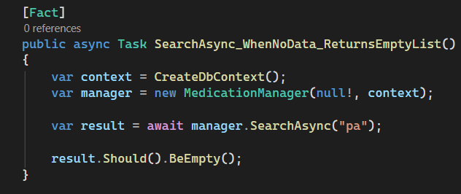
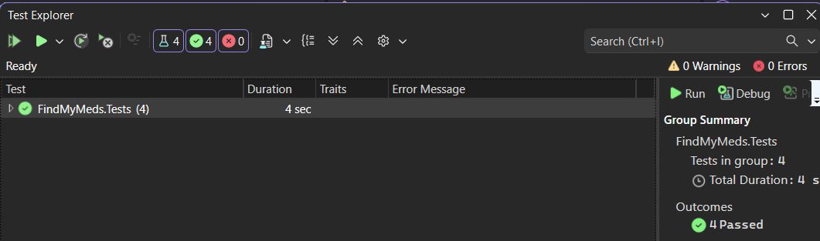
Unit Testing

Slide 27
13
File Upload

Slide 28
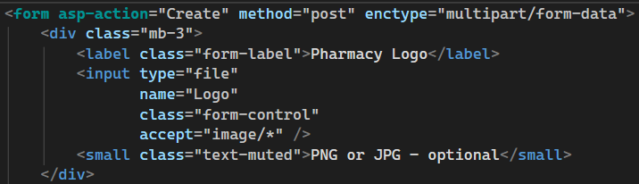
File Upload

Slide 29
One of the most challenging parts of the project was building an efficient medication availability search across different pharmacies. The system had to search by partial medication names and at the same time consider stock quantity, expiry dates, pharmacy approval status, and location. At first, the solution was slow because data was being loaded and filtered in memory, which did not scale well. Solving this required redesigning the database queries to use joins, filtering, and sorting directly at the database level, as well as limiting results early. This significantly improved performance and ensured the search remained fast and reliable even with larger datasets
Challenges

Slide 30
Thanks!

