Slide 1
CSE 3208 — SYSTEM ANALYSIS & DESIGN LAB
RelifMesh
Disaster Relief Coordination System
"One mesh. No duplicates. No household left behind."
Team: Team_Skipper
2101011001 - Abidul Islam, 2101011005 - MD. Kamrul Hassan
2101011013 - Sayeda Mofatteha Ahmed, 2101011038 - Iftekhar Alam Nahid
Supervisor: MD Mynoddin, Assistant Professor, Dept. of CSE, RMSTU
Rangamati Science & Technology University

Slide 2
01
Introduction & Problem Statement
Disaster relief coordination for Union Parishads in flood-prone Bangladesh
RelifMesh coordinates relief distribution across Union Parishad officials, NGOs, Upazila officers, and citizens in real time. August 2024 floods affected 4.5–5.8M people; 92% of mobile towers in Feni went down — cloud-only tools fail exactly when they're needed most.
1
2
3
4
Duplicate Aid
Missed Households
No Real-Time Tracking
Inter-Agency Opacity
Same household served multiple times by different agencies
Vulnerable families skipped with no audit trail
Paper-based logs; days of consolidation delay
NGOs, government & volunteers operate independently
5
6
7
8
Offline Environments
No Visibility
Manual Reporting
Lack of Transparency
92% mobile towers failed in Feni 2024 floods
Nobody can see which areas still need relief
Slow, error-prone data consolidation
Communities cannot verify distribution fairness
RelifMesh · CSE 3208 — System Analysis & Design Lab · RMSTU
2

Slide 3
02
Project Objectives & Scope
SMART objectives grounded in the Feni Floods 2024–2025 case study
S
Specific
Real-time duplicate detection with a 7-day lookback window
M
Measurable
95%+ offline sync success; 90%+ duplicate detection accuracy
A
Achievable
GPS-based household registration with photo evidence
R
Relevant
Transparent public dashboard with an interactive heatmap
T
Time-bound
Complete system deployed within a 3-week development cycle
RelifMesh · CSE 3208 — System Analysis & Design Lab · RMSTU
3

Slide 4
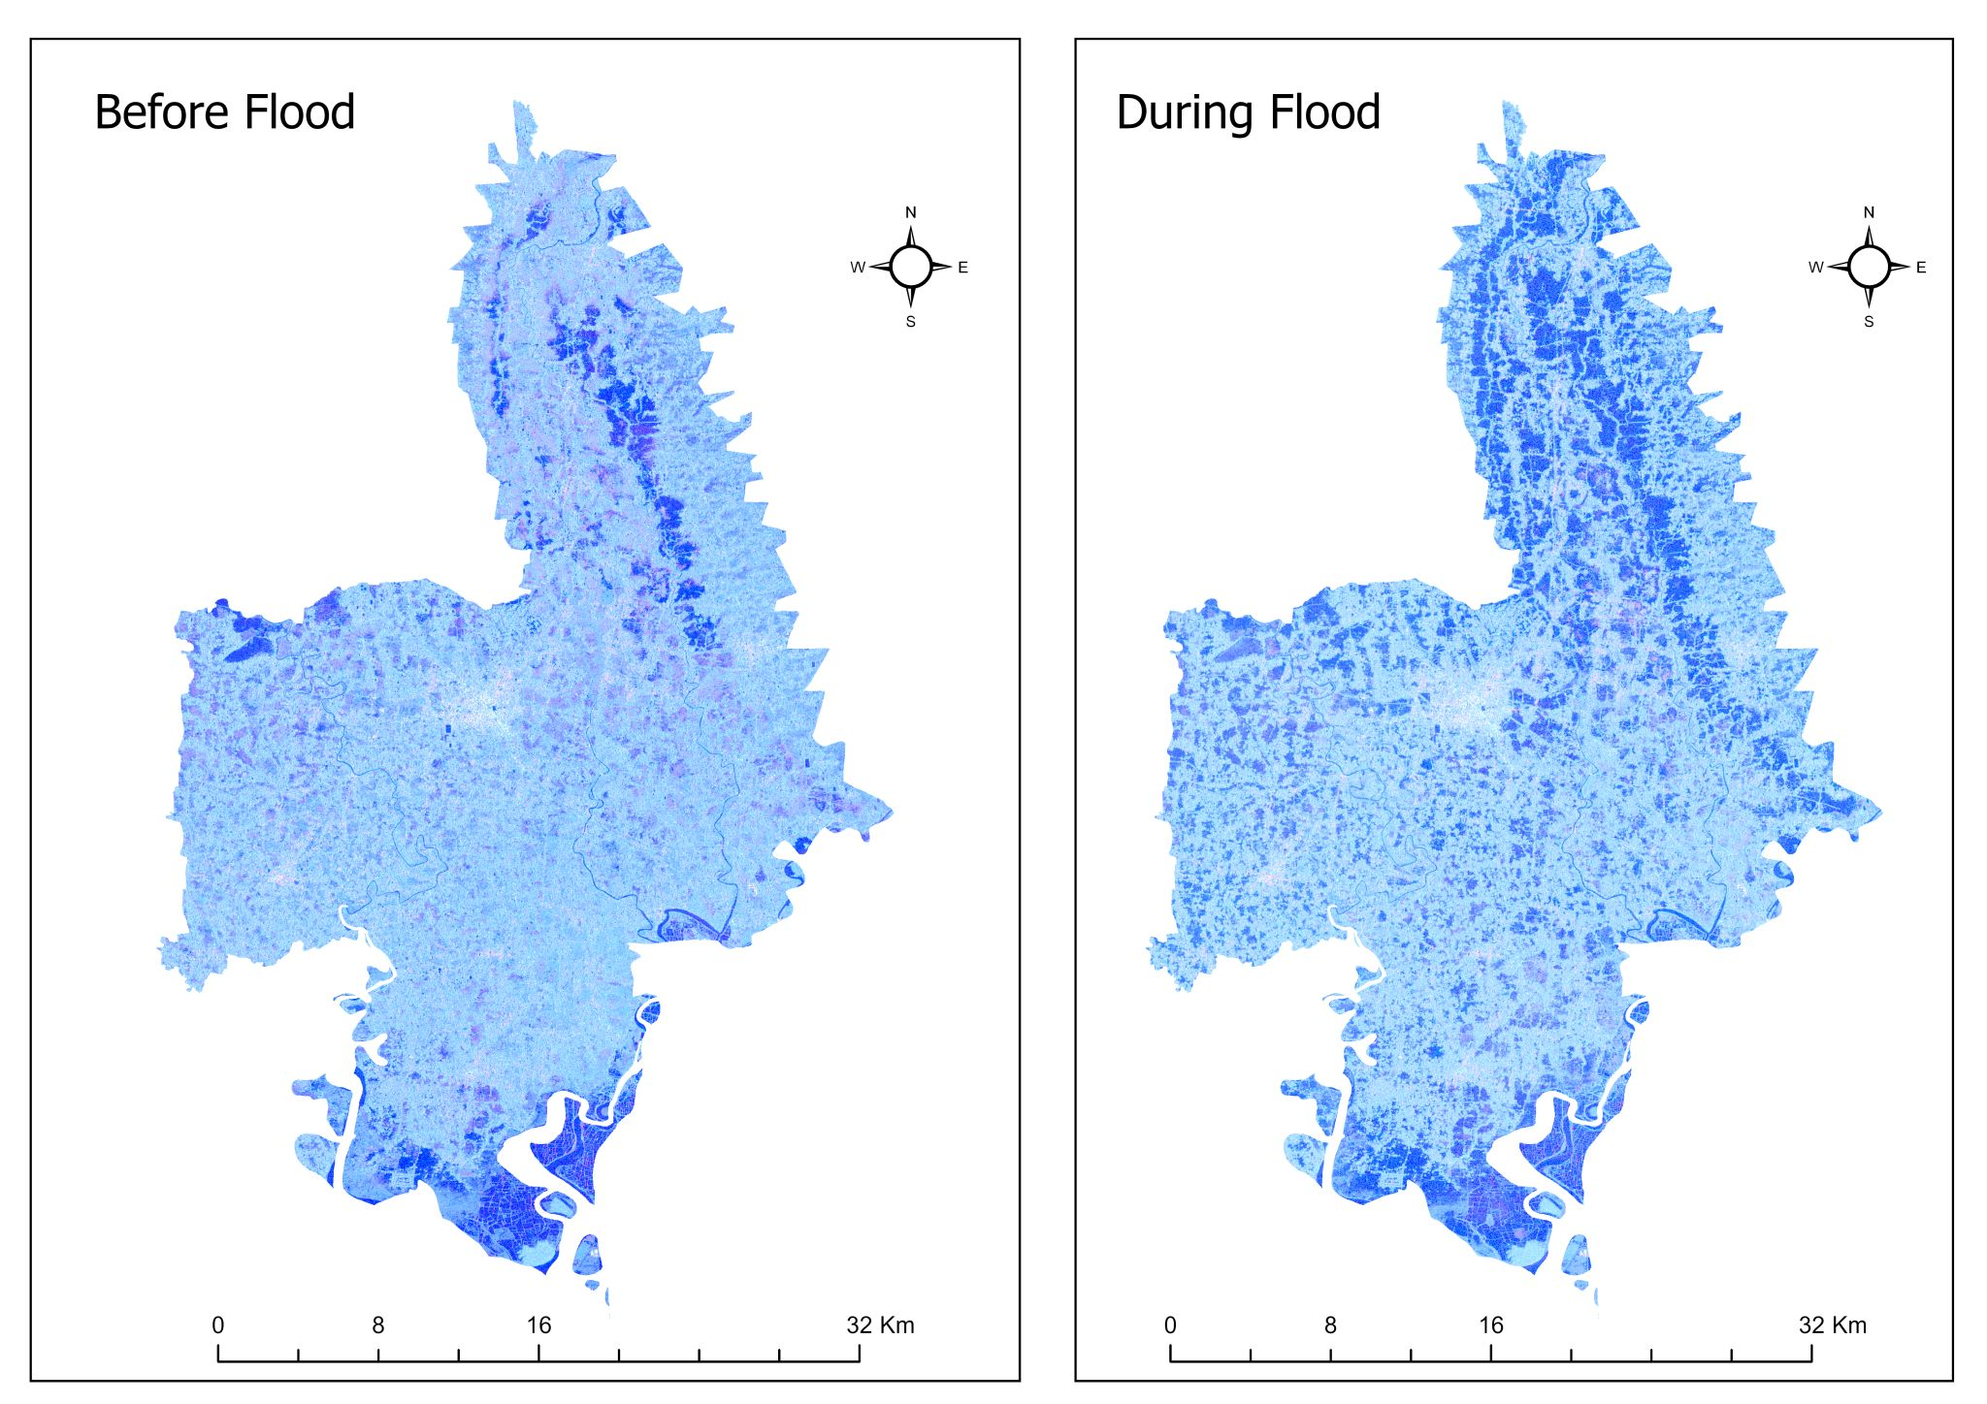
02
Project Objectives & Scope
SMART objectives grounded in the Feni Floods 2024–2025 case study
In Scope
Out of Scope
GPS/photo household registration & relief logging
Rule-based duplicate detection engine
Offline-first entry with sync & conflict resolution
Public dashboard, heatmap & pledge coordination
Financial transactions & procurement
AI-based forecasting & national NID integration
Native mobile apps (PWA only)
Real-time satellite GIS
RelifMesh · CSE 3208 — System Analysis & Design Lab · RMSTU
3

Slide 5
03
Stakeholder Analysis
5 key personas across the relief ecosystem, mapped by power and interest
Power–Interest Grid
Stakeholder | Role | Power | Interest
Upazila Nirbahi Officer | Strategic oversight | High | High
UP Official | Primary operator | High | High
NGO / Aid Worker | Field partner | Low | High
Citizen / Household | Beneficiary | Low | High
Outside Donor | Supporter | Low | Low
System Administrator | Technical | High | High
High Power / High Interest
UNO · UP Official · Admin — engage closely
Low Power / High Interest
Citizens · NGO Workers · Donors — keep informed
High Power / Low Interest
Oversight bodies — keep satisfied
Low Power / Low Interest
General public — monitor minimally
RelifMesh · CSE 3208 — System Analysis & Design Lab · RMSTU
4

Slide 6
04
Functional Requirements
44 functional requirements across 11 feature categories (FR-01 to FR-44)
Category | # | Key Features
Authentication | 5 | Registration, login, RBAC, profile, password reset
Area Management | 3 | Geo hierarchy CRUD (Division → Ward), search
Household Mgmt | 6 | GPS/NID registration, vulnerability flags, CRUD
Distribution | 6 | Item-level logging, photo/GPS proof, CRUD
Duplicate Alerts | 3 | 7-day detection, resolution workflow, dashboard
Need Assessment | 4 | Sphere-standard calculation, override, comparison
Pledge Management | 5 | Multi-source pledges, fulfillment, status lifecycle
Feedback | 3 | Citizen submission, official response, moderation
Reports | 3 | PDF generation, CSV export, filtered queries
Sync | 3 | Offline queue push/pull, conflict resolution
Public Dashboard | 3 | Aggregate stats, heatmap, transparency view
28 Must Have
8 Should Have
5 Could Have
3 Won't Have
RelifMesh · CSE 3208 — System Analysis & Design Lab · RMSTU
5

Slide 7





05
Non-Functional Requirements
15 NFRs spanning performance, reliability, security, compliance & usability
Performance & Scalability
Sub-2s API response time (p95 percentile)
Support for 500+ concurrent users
Reliability & Availability
Offline-first PWA for disconnected areas
99.5% uptime target with graceful degradation
Security
RBAC: 6 roles × 12 permissions matrix
AES-256 encryption; JWT stateless auth
Compliance & Standards
GDPR-compliant PII handling
Sphere humanitarian standards for need calc
Usability & Accessibility
Responsive design for mobile/tablet field use
Bengali language support; basic digital literacy
RelifMesh · CSE 3208 — System Analysis & Design Lab · RMSTU
6

Slide 8
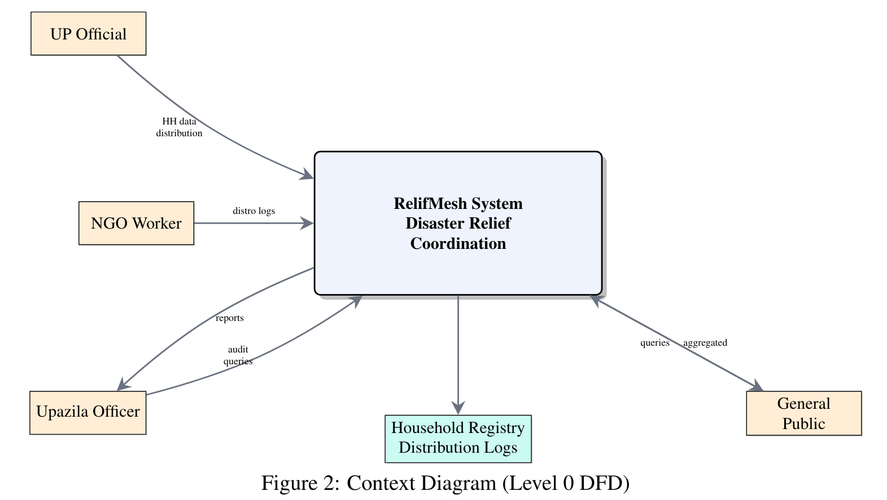
06
System Modeling — Data Flow Diagrams
Context diagram (Level 0)
Figure: DFD level 0
RelifMesh · CSE 3208 — System Analysis & Design Lab · RMSTU
7

Slide 9
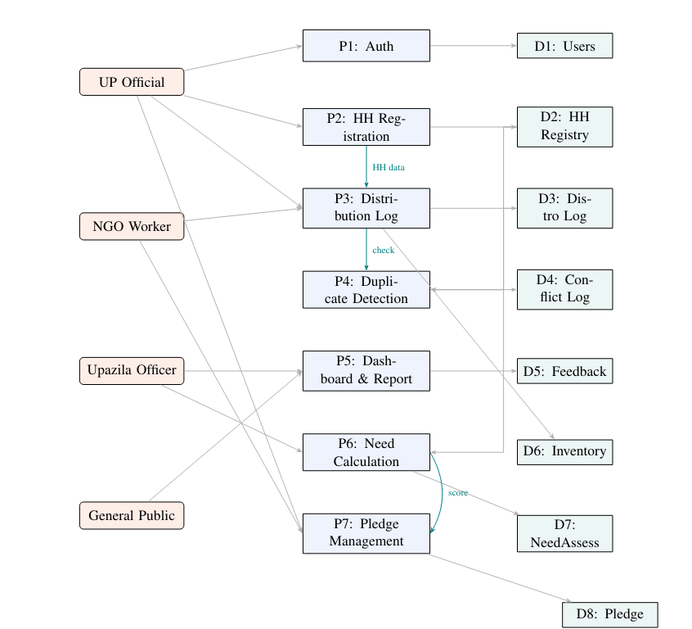
06
System Modeling — Data Flow Diagrams
Context diagram (Level 1)
Figure: DFD level 1
RelifMesh · CSE 3208 — System Analysis & Design Lab · RMSTU
7

Slide 10
07
System Modeling — UML Diagrams
11 diagrams covering all architectural views (draw.io format)
Type | Diagram | Coverage
DFD | Context Diagram (Level 0) | System boundary, 5 external entities
DFD | Level 1 DFD | 6 major processes
UML | Use Case Diagram | 8 use cases across 4 actor roles
UML | Class Diagram | 12 entity classes with relationships
UML | Sequence — Auth & Household Reg. | Registration & login flow
UML | Sequence — Distribution & Alert | Logging + duplicate detection
UML | Sequence — Need Calculation | Sphere-standard computation
UML | Sequence — Pledge Fulfillment | Multi-source pledge lifecycle
UML | Activity — Relief Flow | End-to-end distribution workflow
Other | Entity Relationship Diagram | 12 MongoDB collections
Other | Architecture Diagram | 3-tier system overview
RelifMesh · CSE 3208 — System Analysis & Design Lab · RMSTU
8

Slide 11
08
Database Design & ERD
MongoDB — 12 collections, normalized to 3NF
Collection | Key Fields | Purpose
User | name, email, passwordHash, role, jurisdictionId | Auth & RBAC
GeographicArea | name, level (5-tier), parentId, coordinates | Feni geo hierarchy
Household | headName, NID, GPS, familySize, vulnFlags | Beneficiary registry
DistributionLog | householdId, itemId, quantity, GPS, photoUrl | Aid tracking
ReliefPledge | source_type, areaId, itemCategoryId, qty, status | Multi-source pledges
NeedAssessment | areaId, itemCategoryId, calculated_qty, override | Sphere-standard calc
Inventory | itemCategoryId, totalQuantity, distributedQty | Stock management
Feedback | householdId, category, message, response | Citizen feedback
ReliefRequest | citizenId, items[], priority, status | Aid requests
DuplicateAlert | householdId, priorLog, triggeredLog, resolved | Fraud prevention
SyncConflict | offline_id, changes[], merge_strategy | Offline sync
ItemCategory | name, unit, per_person_per_day_qty | Reference data
Key decisions: All schemas normalized to 3NF · 2dsphere indexes on GPS for proximity queries · Document references (not embedded) for scalability
RelifMesh · CSE 3208 — System Analysis & Design Lab · RMSTU
9

Slide 12



09
System Architecture & Tech Stack
Offline-first 3-tier architecture — PWA + REST API + MongoDB
Client Layer
React 18 · localforage (IndexedDB) · Service Worker
Backend Layer
Express.js · 14 feature modules · Sync Engine
Data Layer
MongoDB Atlas · 12 collections · Geo 2dsphere indexes
Key decisions: Offline-first writes queue in localforage & auto-sync on reconnect · Last-write-wins conflict resolution · Self-seeding DB with Feni data · Role-scoped queries via req.user.jurisdictionId
RelifMesh · CSE 3208 — System Analysis & Design Lab · RMSTU
10

Slide 13
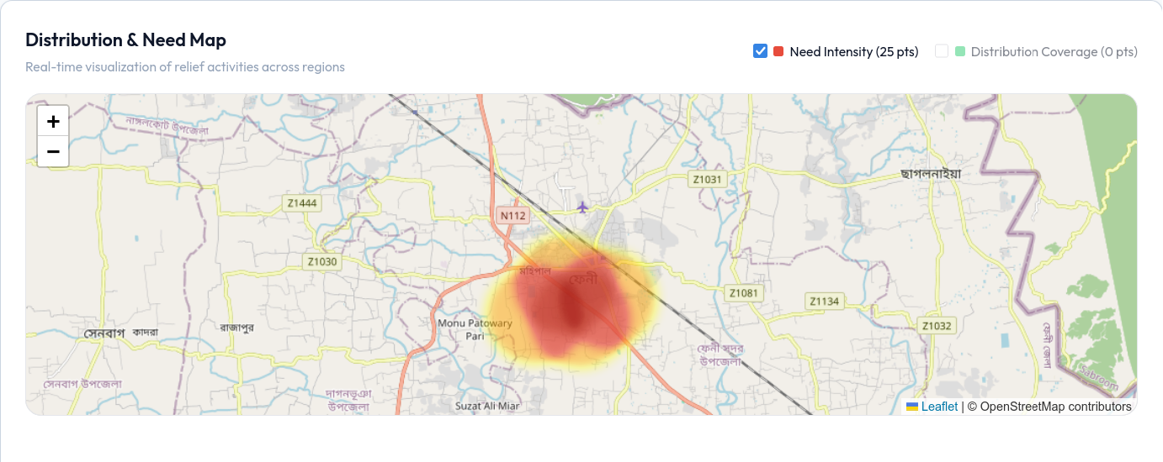
09
Heat map
RelifMesh · CSE 3208 — System Analysis & Design Lab · RMSTU
10

Slide 14

10
UI/UX Design
Design system, key pages, and interface assets
Typography & Color
DM Serif Display (headings) + Outfit (body); light/dark themes, blue primary
Spacing & Layout
4px grid scale; sidebar 260px/64px; 64px topbar; fluid content
Key Pages
Landing Page
Dashboard
Public entry — stats, CTA, hero overview
KPI cards, charts, distributions
Public Dashboard
Households
Interactive heatmap with drill-down
Table, search, photo capture
Distributions
Need Dashboard
Item logging, GPS upload
Sphere-calc vs. actual comparison
RelifMesh · CSE 3208 — System Analysis & Design Lab · RMSTU
11

Slide 15
11
Implementation Plan
30 modules across 6 phases — Agile weekly sprints, 3-week cycle
1
M1–M6
2
M7–M12
3
M13–M18
Data Model & Foundation
Core Operations
Need & Pledge Module
Scaffold, auth, geo hierarchy, DB seed, frontend setup
Household CRUD, distribution, alerts, inventory, feedback
Sphere need engine, pledge lifecycle, reports, heatmap
4
M19–M23
5
M24–M27
6
M28–M30
Public Interface
Offline & Sync
Testing & Docs
Landing page, public dashboard, citizen feedback/requests
Offline queue, push/pull sync, service worker, PWA manifest
Integration tests, security audit, documentation
Methodology: Agile with weekly sprints · Git feature branching · ESLint + Prettier · Peer code reviews
RelifMesh · CSE 3208 — System Analysis & Design Lab · RMSTU
12

Slide 16




12
Testing & Quality Assurance
47/47 tests passing — Unit, Integration & UAT (Jest + Supertest)
28
6
5
47/47
Unit Tests
Integration Tests
UAT Scenarios
All Passing
Module | Tests | Key Coverage
Auth | 5 | Register, login, token, invalid credentials
Household | 5 | CRUD, NID validation, GPS validation
Distribution | 5 | CRUD, GPS/quantity validation
Feedback | 4 | Submit, list, respond, moderation
Sync | 4 | Offline push, pull, conflict resolution
Reports | 3 | PDF generation, CSV export
Alerts | 2 | 7-day duplicate detection window
RelifMesh · CSE 3208 — System Analysis & Design Lab · RMSTU
13

Slide 17
13
Security & Access Control
STRIDE threat model · JWT auth · RBAC across 6 roles
Permission | Admin | UNO | UP Official | NGO | Citizen | Anon.
User Mgmt | ✓ | ✓ | ✓ | ✓ | — | —
Household | — | ✓ | ✓ | — | — | —
Distribution | ✓ | ✓ | ✓ | ✓ | — | —
Reports | ✓ | ✓ | — | ✓ | — | —
Public Dash. | — | — | — | — | — | ✓
Middleware Stack
helmet, cors, express-rate-limit (100/15min)
express-validator input sanitization
authenticate.js (JWT) + authorize.js (RBAC)
Data Protection
GDPR-compliant PII handling; NID encrypted at rest
AES-256 encryption; JWT expiry configurable (24h)
STRIDE model: 11 threat rows analyzed
Auth: JWT (jsonwebtoken) Bearer tokens, bcrypt password hashing, 6 roles × 12 permissions matrix, centralized error handling with no information leakage.
RelifMesh · CSE 3208 — System Analysis & Design Lab · RMSTU
14

Slide 18
14
Deployment & Project Management
Zero-cost cloud deployment · Team_Skipper · 4-week timeline
Deployment
Team_Skipper
Frontend
Netlify — auto-deploy from git
Abidul Islam
Backend Lead
Backend
Railway — Node.js Express API
MD. Kamrul Hassan
Frontend Lead
Sayeda M. Ahmed
Documentation
Database
MongoDB Atlas — free M0 cluster
Iftekhar A. Nahid
Diagrams & DevOps
Maintenance: daily health checks, weekly sync review, monthly patches, quarterly audits.
Timeline
W1
Requirements, architecture, DB design
W2
Core implementation, API development
W3
Frontend, integration, testing
W4
Documentation, submission, defense prep
RelifMesh · CSE 3208 — System Analysis & Design Lab · RMSTU
15

Slide 19
15
Project Statistics & Conclusion
14/14
44
47/47
11
SAD Modules
Functional Reqs
Tests Passing
System Diagrams
12
50+
6
8.5/10
DB Collections
API Endpoints
Impl. Phases
Assessment Score
Conclusion
RelifMesh addresses duplicate aid, invisible need, and offline unusability with a single coordination layer.
Offline-first PWA architecture keeps operations running through network outages.
Built incrementally over 6 phases / 30 modules using Agile methodology; validated by 47/47 passing tests.
All project objectives met: registration, duplicate detection, offline sync, dashboard, RBAC, need assessment, heatmap.
"One mesh. No duplicates. No household left behind."
Team_Skipper | CSE 3208 | RMSTU

