Slide 1
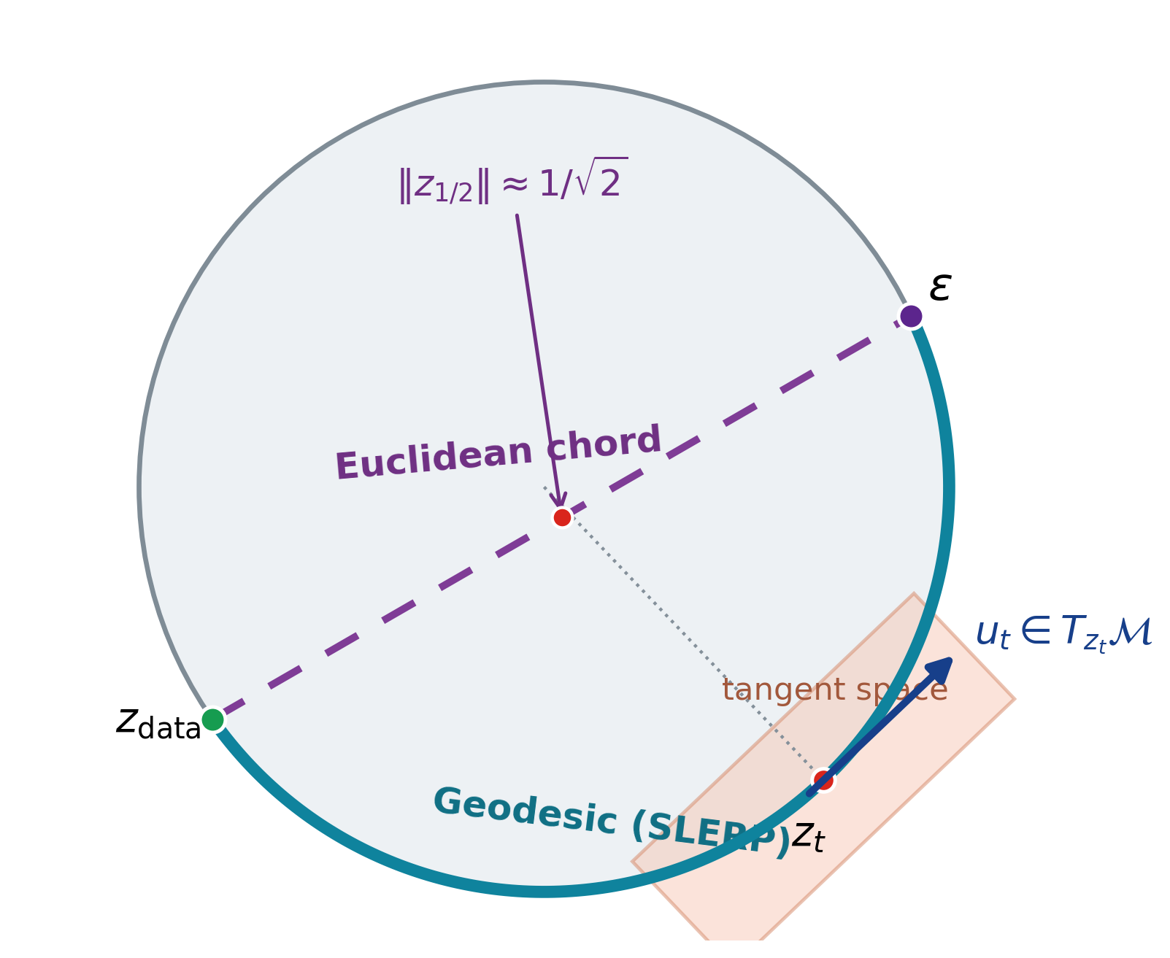
Learning Spatial Unit-Norm Latents with Riemannian Flow Matching
SRUL: Spherical Riemannian Unit-Norm Latents
Motivation
An autoencoder does not have to produce Gaussian latents
Normalization can make token norms nearly constant
(e.g., Transformer + LayerNorm)
The prior can mismatch the latent support
or leave it along the transport path
Main contribution
SRUL learns unit-norm spatial tokens and an RFM prior
on the same latent support
CIFAR-10 • PathMNIST • CelebA-64
ECE 1508 Deep Generative Models | Mohammadreza Tavasoli Naeini
1/5

Slide 2
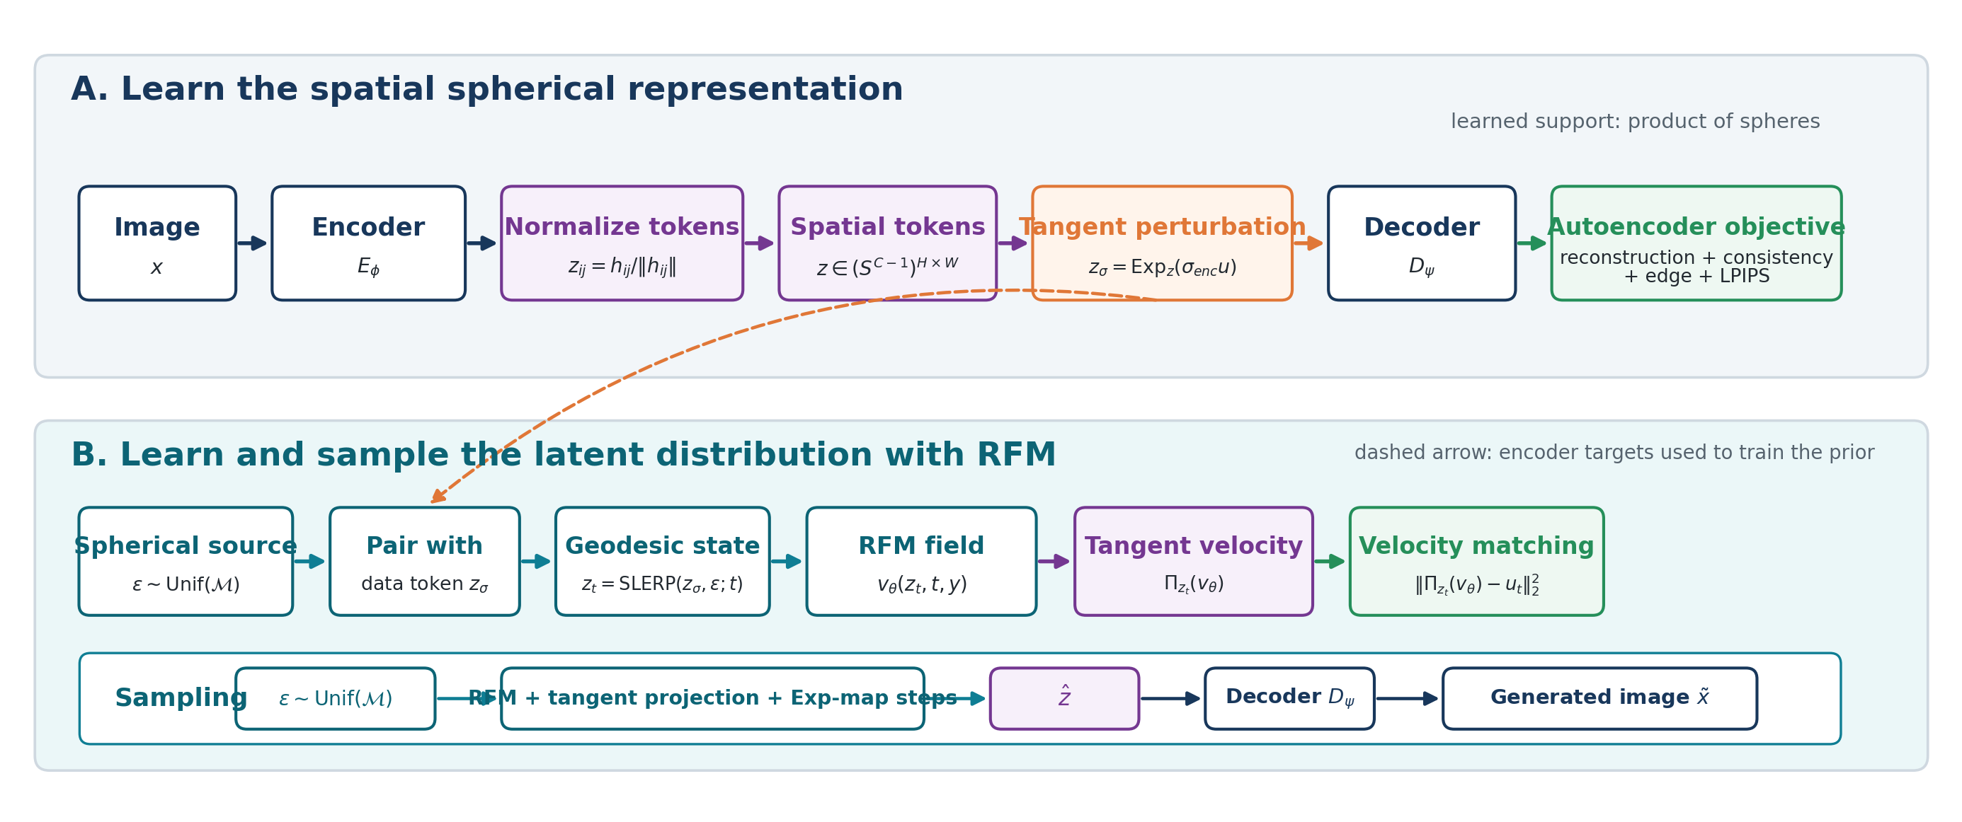
SRUL pipeline
Learn the spherical representation, learn its distribution, then sample on the same manifold
Core geometry: token normalization + tangent perturbation + SLERP + tangent projection + exponential-map integration.
ECE 1508 Deep Generative Models | Mohammadreza Tavasoli Naeini
2/5

Slide 3
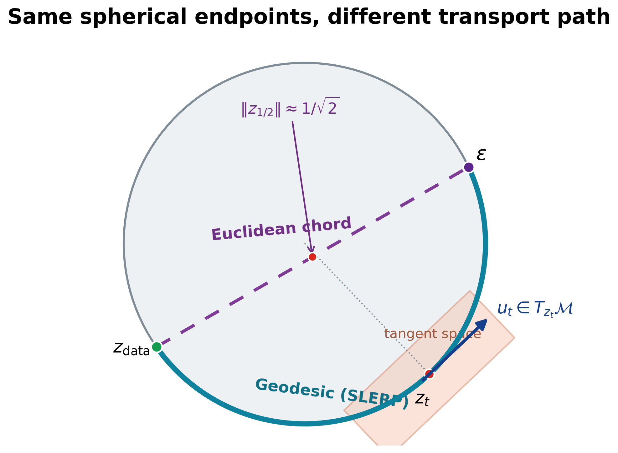
Why the autoencoder and prior must match
Two controlled tests separate path mismatch from support mismatch
1. Path match: same spherical autoencoder
Method | FID | KID | Prec. | Recall | Min norm
Chord | 67.44 | 0.0740 | 0.840 | 0.085 | 0.705
SRUL | 63.84 | 0.0667 | 0.857 | 0.091 | 1.000
2. Support match: SRUL vs. the same VAE with two priors (CFG = 2)
Method | FID | Prec. | Recall
SRUL: spherical AE + RFM | 49.42 | 0.857 | 0.110
VAE + standard FM | 50.70 | 0.855 | 0.091
VAE + projected RFM | 56.04 | 0.848 | 0.063
Same VAE: radius CV = 0.291; mean-radius replacement changes reconstruction FID 16.90 → 22.46.
SRUL learns spherical support before RFM. Projecting a VAE after training removes radius information.
ECE 1508 Deep Generative Models | Mohammadreza Tavasoli Naeini
3/5

Slide 4
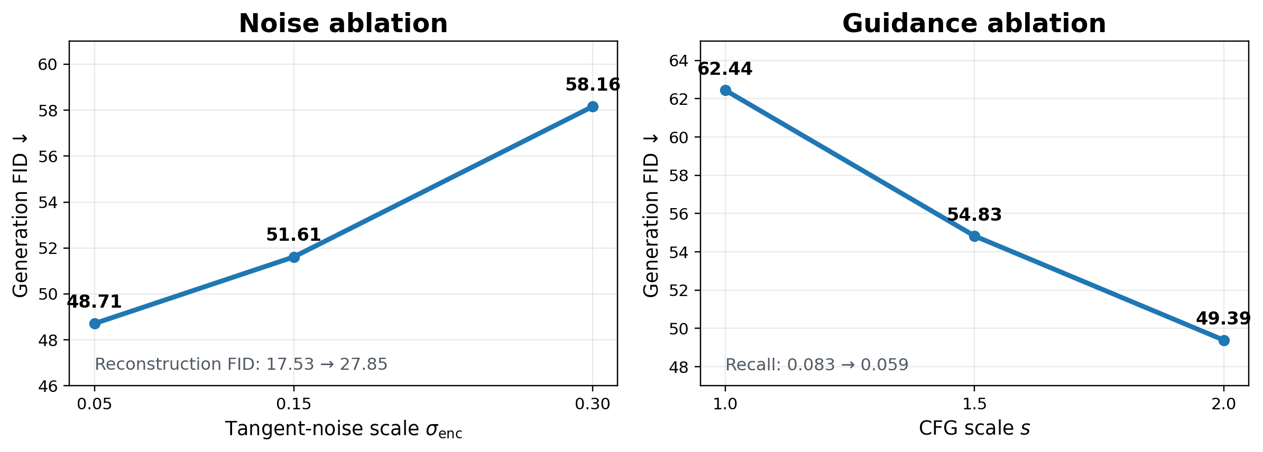
Two controls after the geometry is chosen
Tangent noise changes the latent representation; classifier-free guidance changes sampling
Tangent-noise sweep: σenc = 0.05 gives the best tested reconstruction and generation quality.
CFG sweep: stronger guidance improves FID and precision, while recall decreases.
ECE 1508 Deep Generative Models | Mohammadreza Tavasoli Naeini
4/5

Slide 5
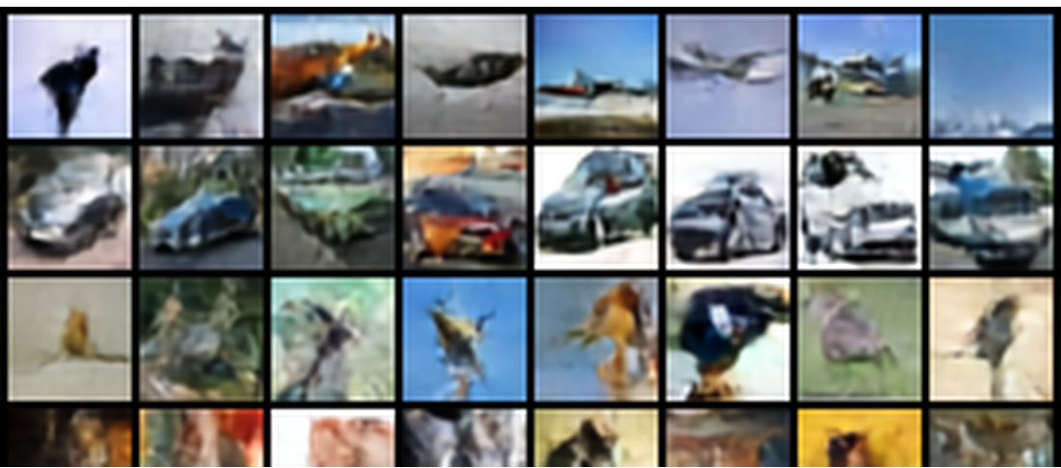
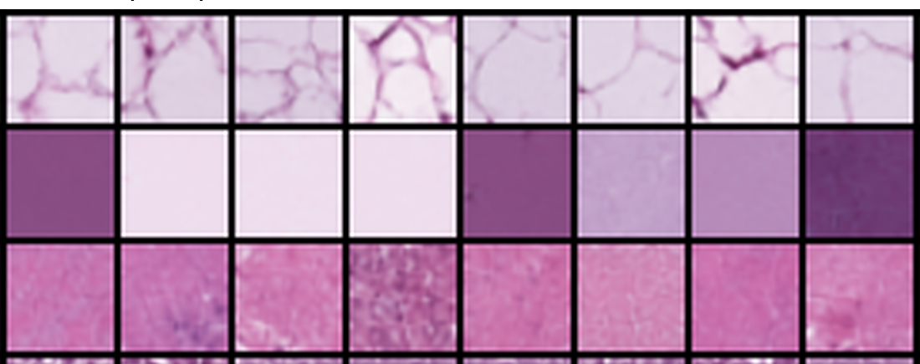
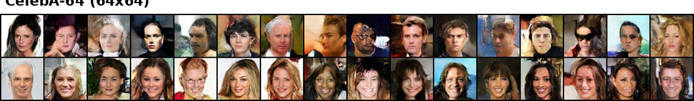
SRUL in three image settings
The same method is tested on different image structure and resolution
CIFAR-10
PathMNIST
CelebA-64
Dataset
Evaluation setting
Grid
Recon. FID
Gen. FID
Prec.
Recall
CIFAR-10
Geometry + sampling ablations
4 × 4
17.53
48.71
0.861
0.090
PathMNIST
Histopathology transfer
4 × 4
7.13
29.36
0.829
0.309
CelebA-64
64 × 64 face generation
8 × 8
9.08
41.22
0.657
0.198
CIFAR-10 tests geometry and controls; PathMNIST tests texture transfer; CelebA-64 tests 64 × 64 faces.
ECE 1508 Deep Generative Models | Mohammadreza Tavasoli Naeini
5/5

