Slide 1
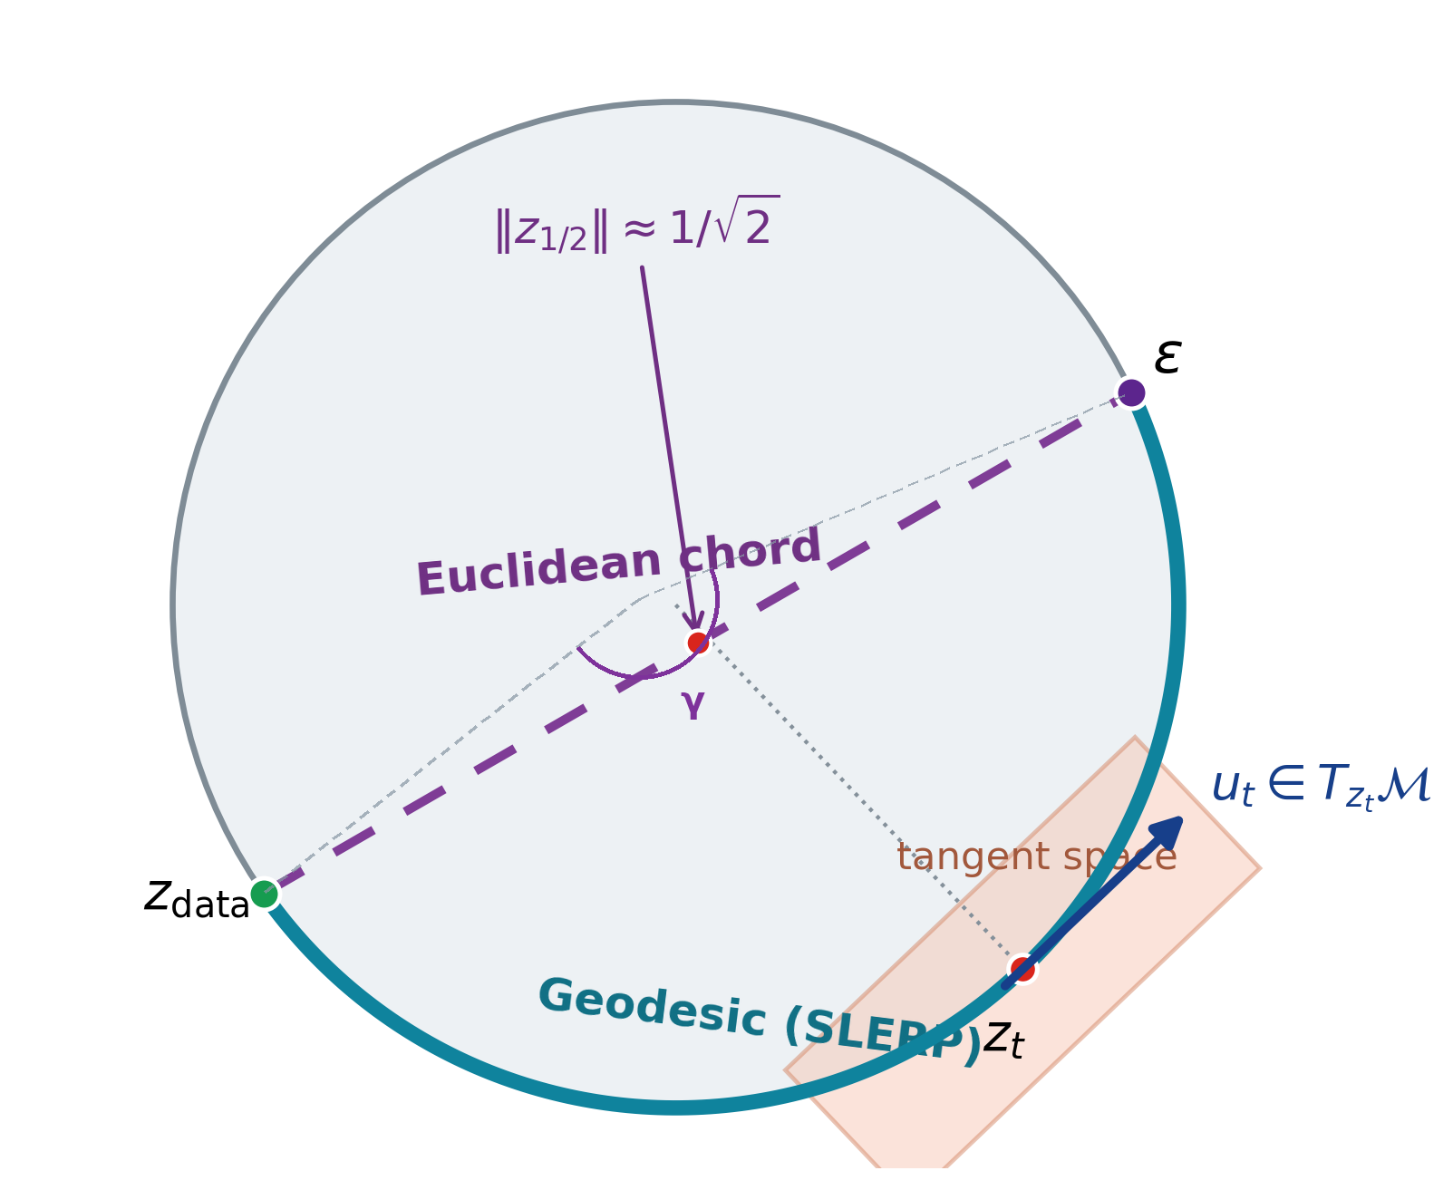
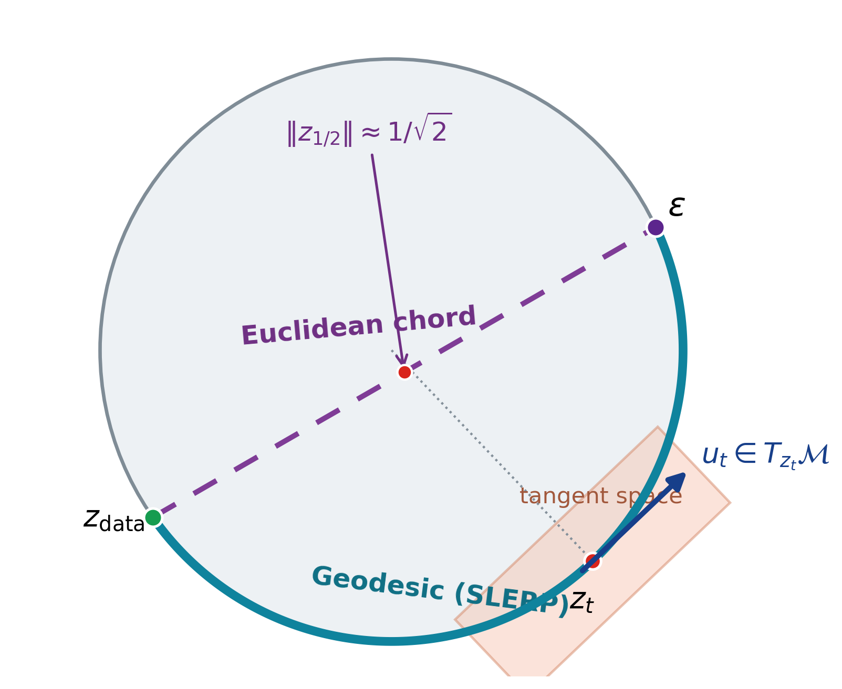
Learning Spatial Unit-Norm Latents with Riemannian Flow Matching
SRUL: Spherical Riemannian Unit-Norm Latents
Mohammadreza Tavasoli Naeini • Raman Mangla | Group 3
Motivation
An autoencoder does not have to produce Gaussian latents
Normalization can make token norms nearly constant
(e.g., Transformer + LayerNorm)
The prior can mismatch the latent support
or leave it along the transport path
Main contribution
SRUL learns spatial unit-norm tokens, controls information with tangent noise, and models the same spherical support using RFM.
CIFAR-10 • PathMNIST • CelebA-64
Selected refs: VAE (Kingma & Welling, 2014); LDM (Rombach et al., 2022); Flow Matching (Lipman et al., 2023).
ECE 1508 Deep Generative Models | Group 3 | Mohammadreza Tavasoli Naeini & Raman Mangla
1/5

Slide 2
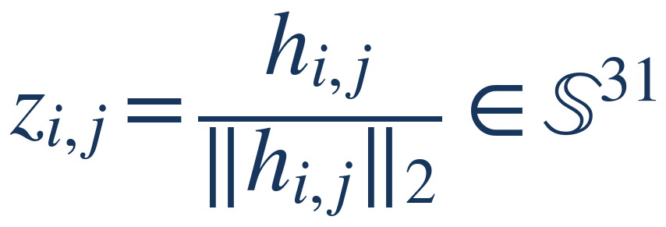
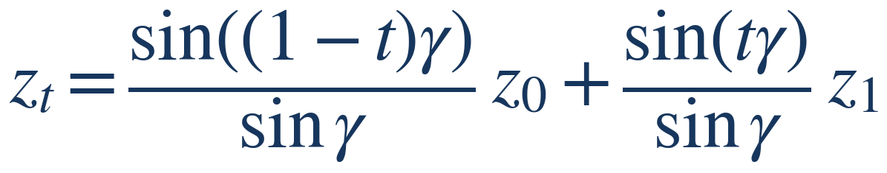
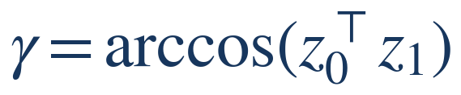

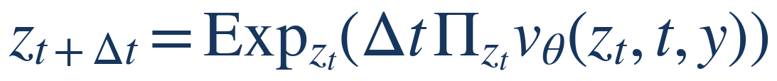
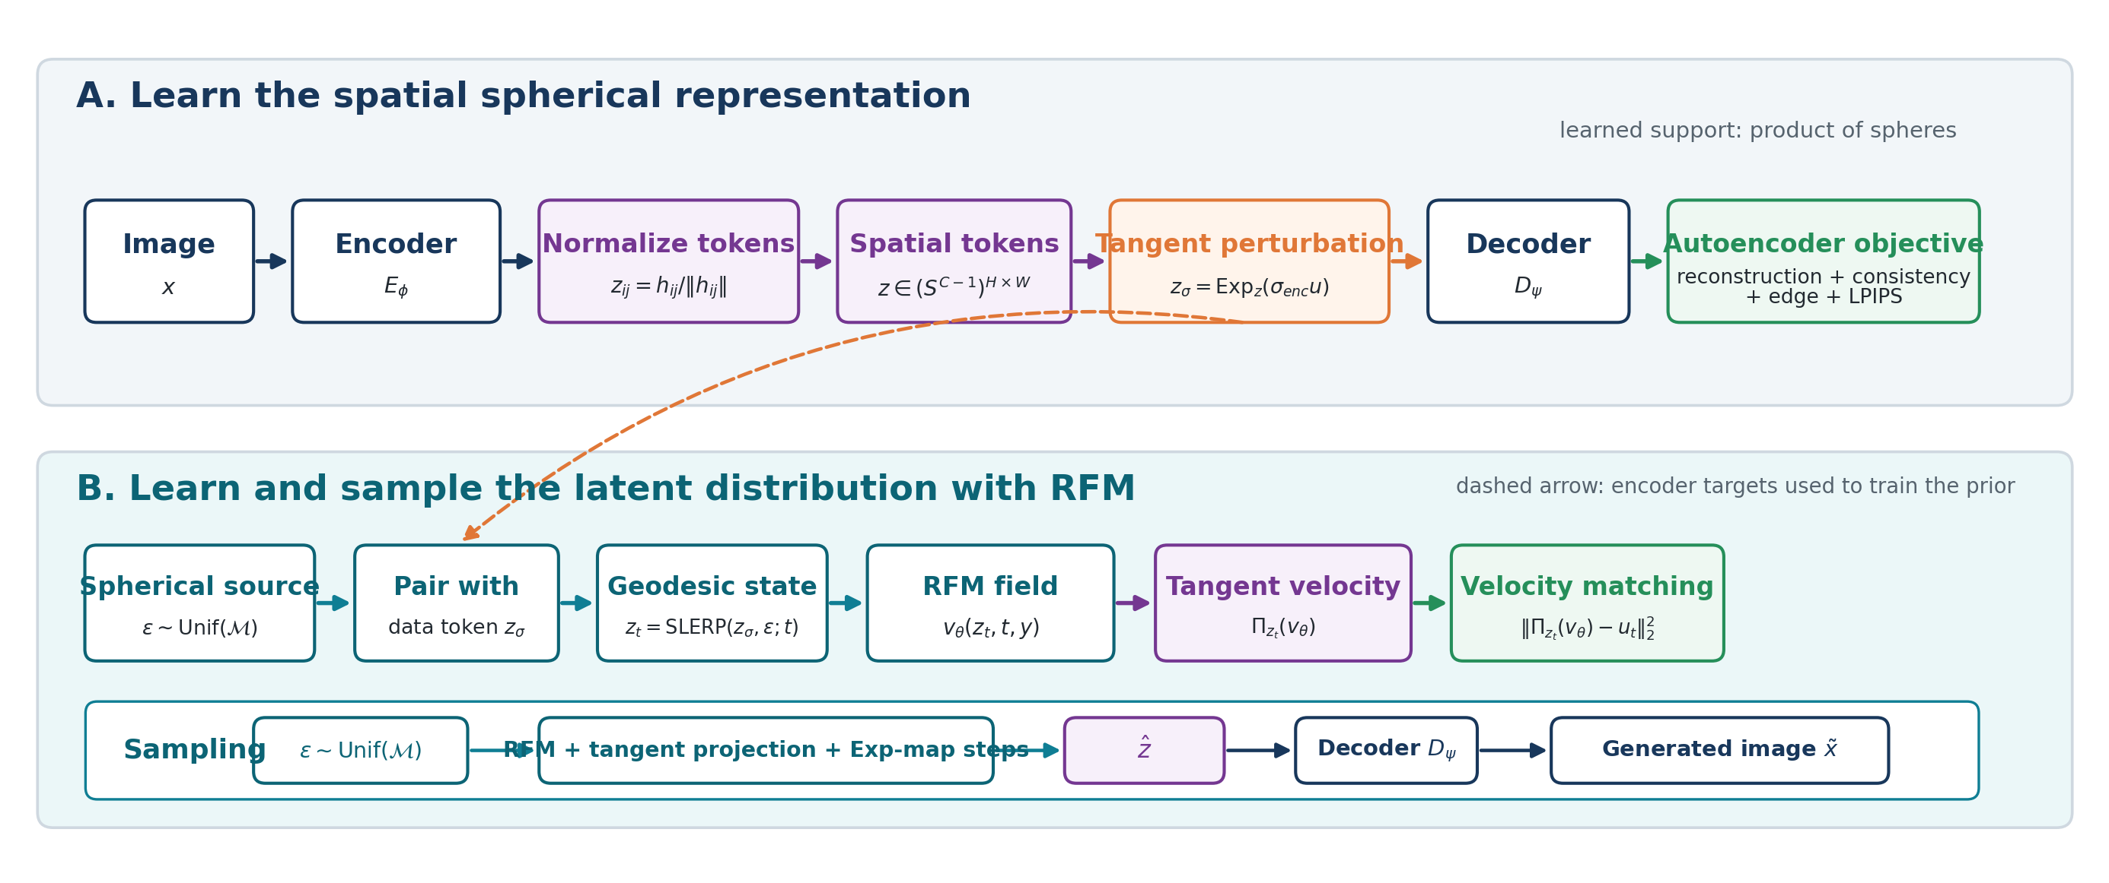








SRUL pipeline and network architecture
CIFAR-10 implementation used for the main geometry and ablation experiments
1 Spatial spherical autoencoder
Key equations
Image
3×32×32
CNN encoder
3→96→192→384→32
32×32 → 4×4
Unit-norm tokens
32×4×4
L2 per token
CNN decoder
32→384→192→96→3
4×4 → 32×32
Unit-norm token
Geodesic training path
2 Class-conditioned convolutional RFM prior
Sphere
noise
32×4×4
SLERP
state zₜ
Conv RFM prior
32→256→32
6 ResBlocks
128-D time + class
Tangent
velocity
Target uₜ
Velocity matching
3 Riemannian ODE sampling and decoding
Manifold-preserving sampling
Noise
100 Exp-map steps
projected velocity
Generated latent
32×4×4
Same CNN
decoder
Image
The encoder support, training path, and sampling update use the same geometry.
Method refs: Sphere Encoder (Yue et al., 2026); Flow Matching (Lipman et al., 2023); Riemannian/RJF flow motivation (Kumar & Patel, 2026).
ECE 1508 Deep Generative Models | Group 3 | Mohammadreza Tavasoli Naeini & Raman Mangla
2/5

Slide 3
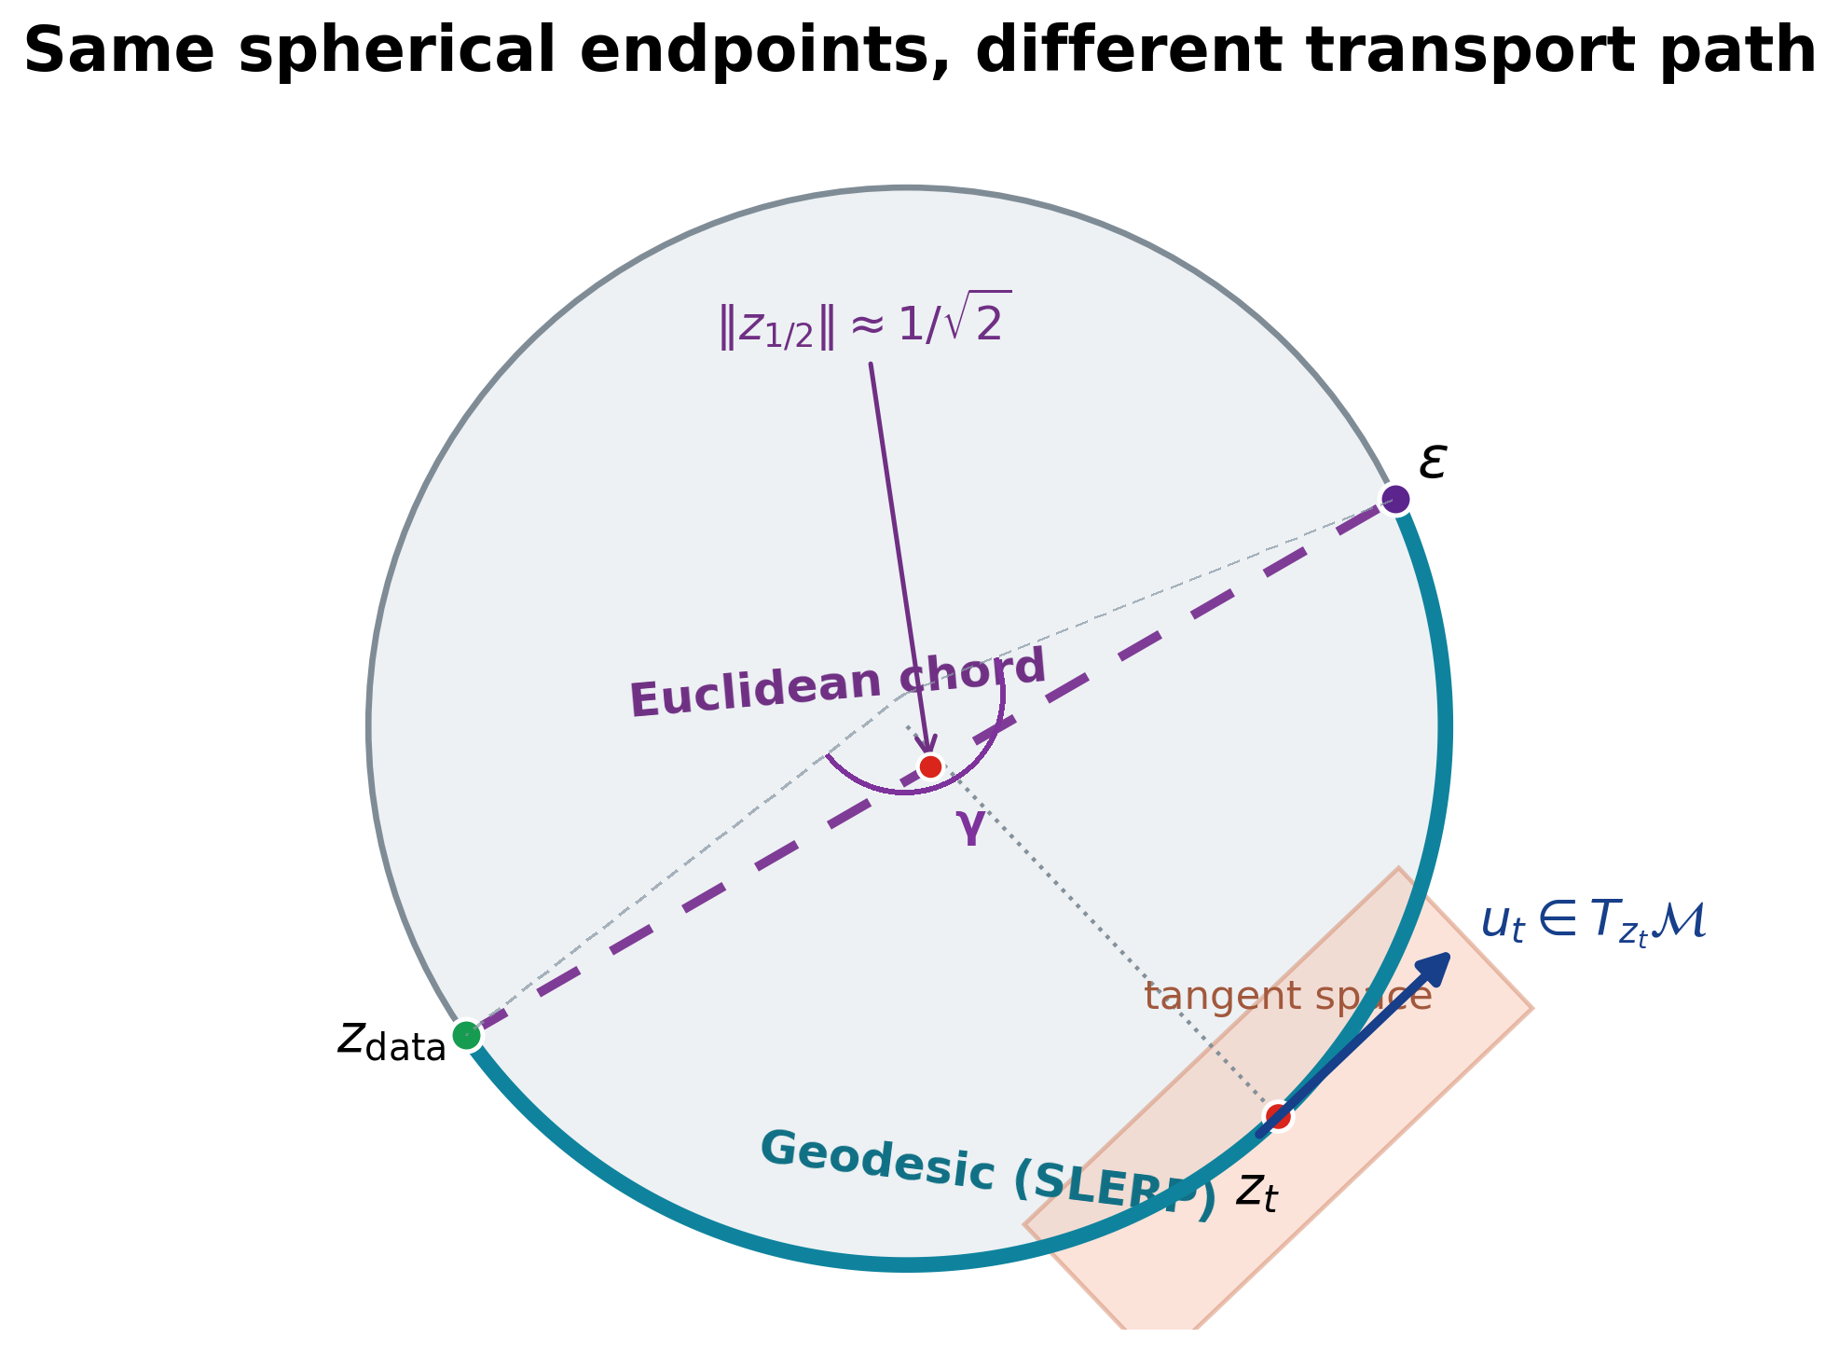
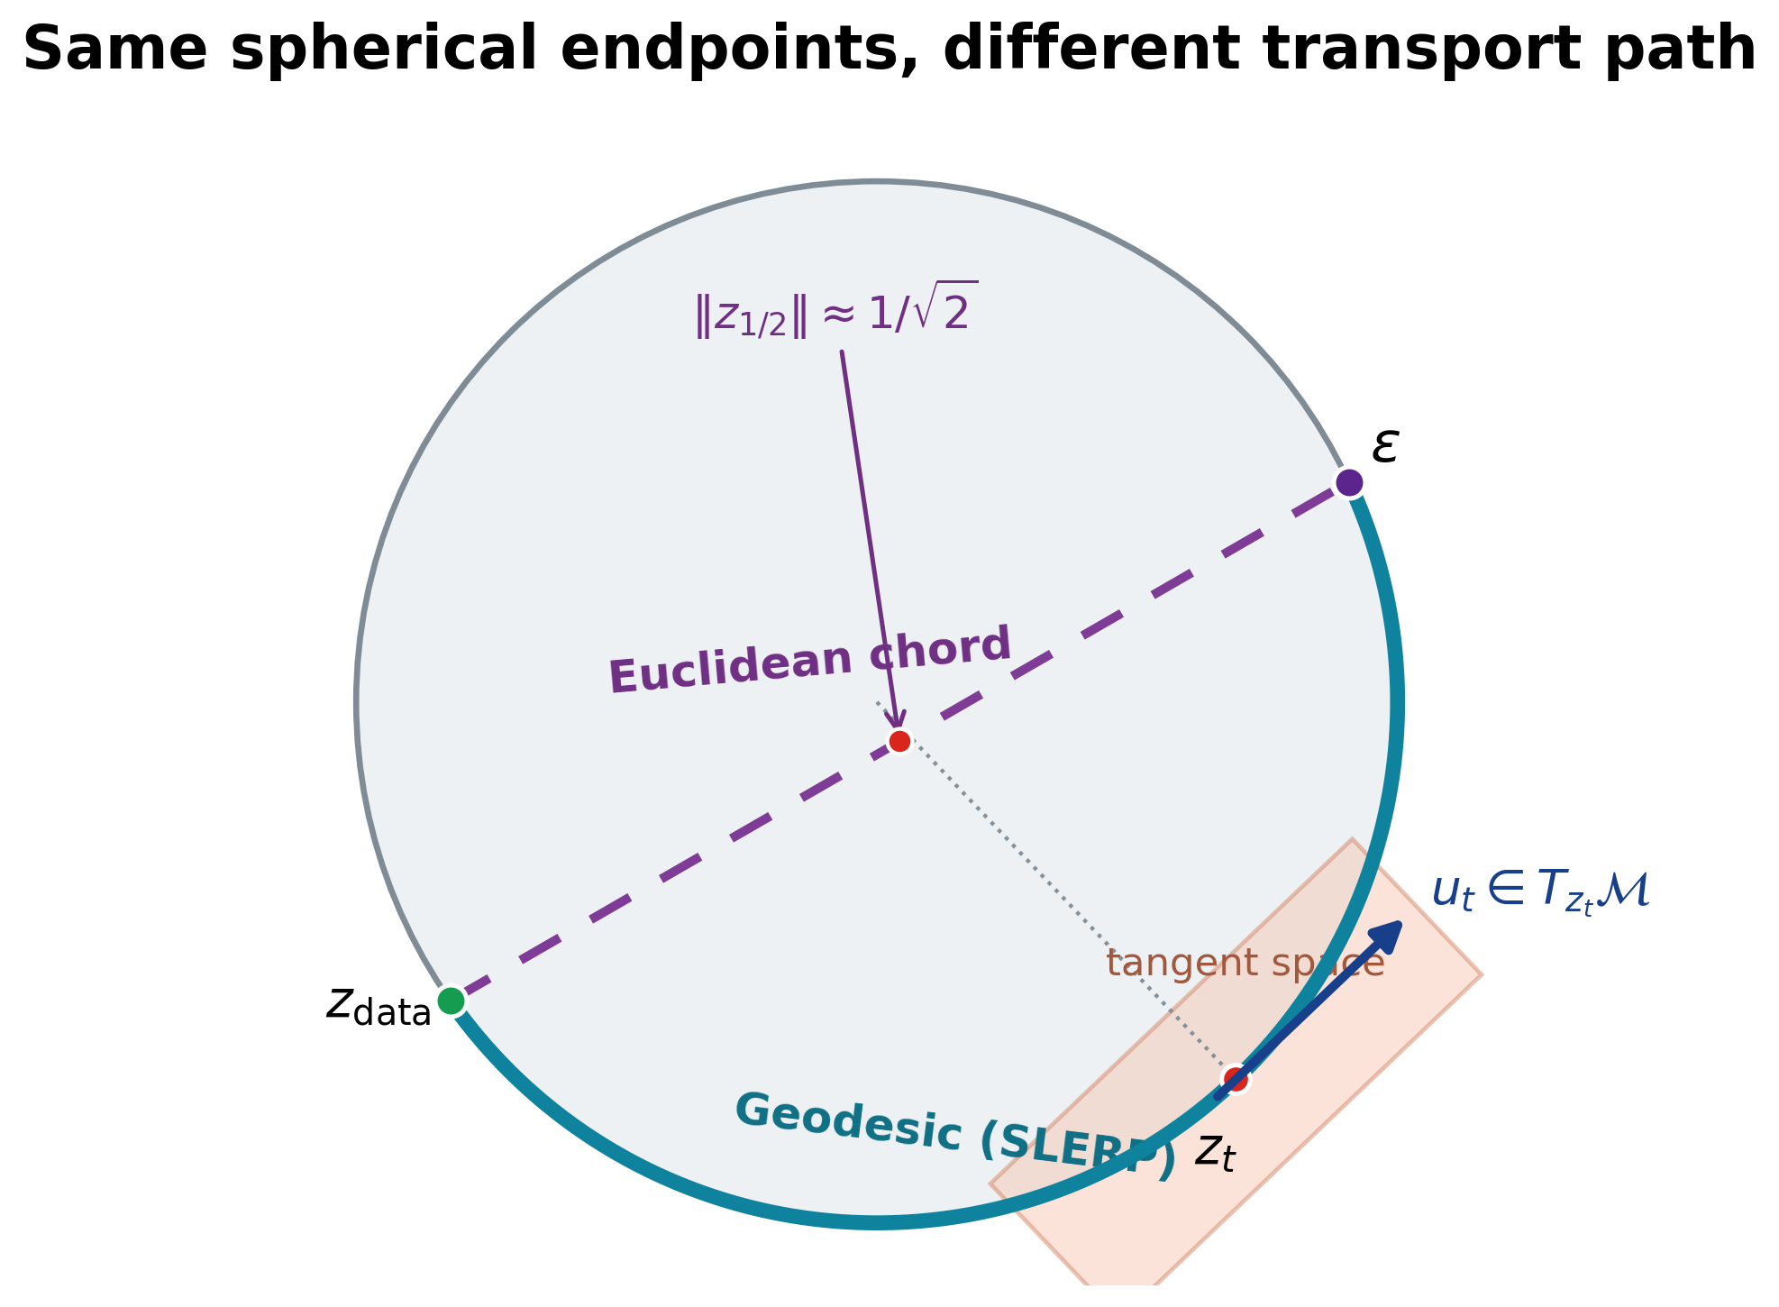
Why the autoencoder and prior must match
Two controlled tests separate path mismatch from support mismatch
1. Path match: same spherical autoencoder
Method | FID | KID | Prec. | Recall | Min norm
Chord | 67.44 | 0.0740 | 0.840 | 0.085 | 0.705
SRUL | 63.84 | 0.0667 | 0.857 | 0.091 | 1.000
2. Support match: SRUL vs. the same VAE with two priors (CFG = 2)
Method | FID | Prec. | Recall
SRUL: spherical AE + RFM | 49.42 | 0.857 | 0.110
VAE + standard FM | 50.70 | 0.855 | 0.091
VAE + projected RFM | 56.04 | 0.848 | 0.063
Same VAE: radius CV = 0.291; mean-radius replacement changes reconstruction FID 16.90 → 22.46.
SRUL learns spherical support before RFM. Projecting a VAE after training removes radius information.
Baselines and metrics build on VAE/LDM latent modeling (Kingma & Welling, 2014; Rombach et al., 2022) and Flow Matching (Lipman et al., 2023).
ECE 1508 Deep Generative Models | Group 3 | Mohammadreza Tavasoli Naeini & Raman Mangla
3/5

Slide 4
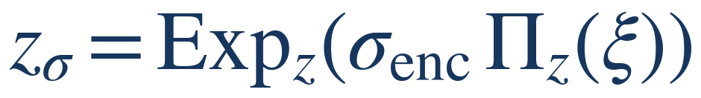

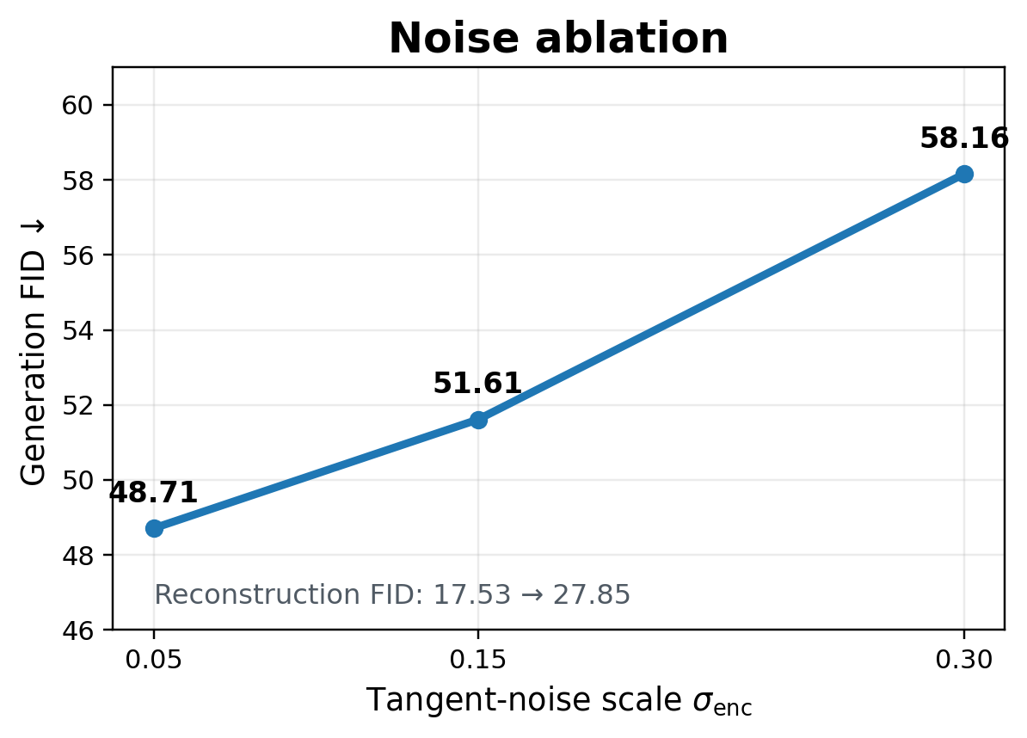
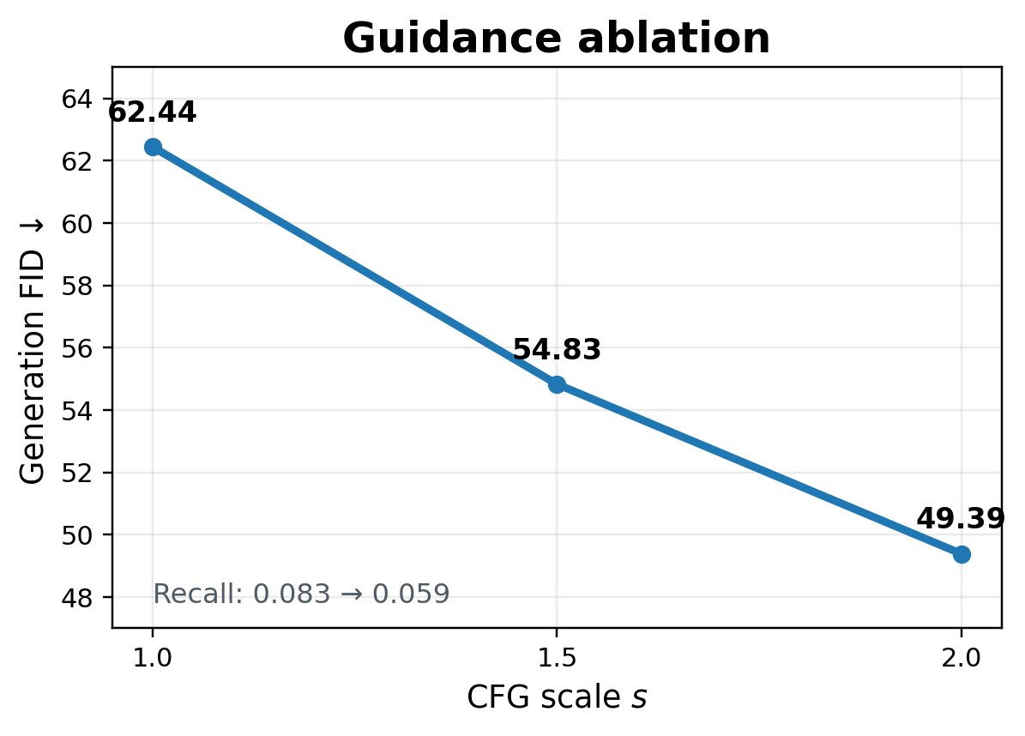
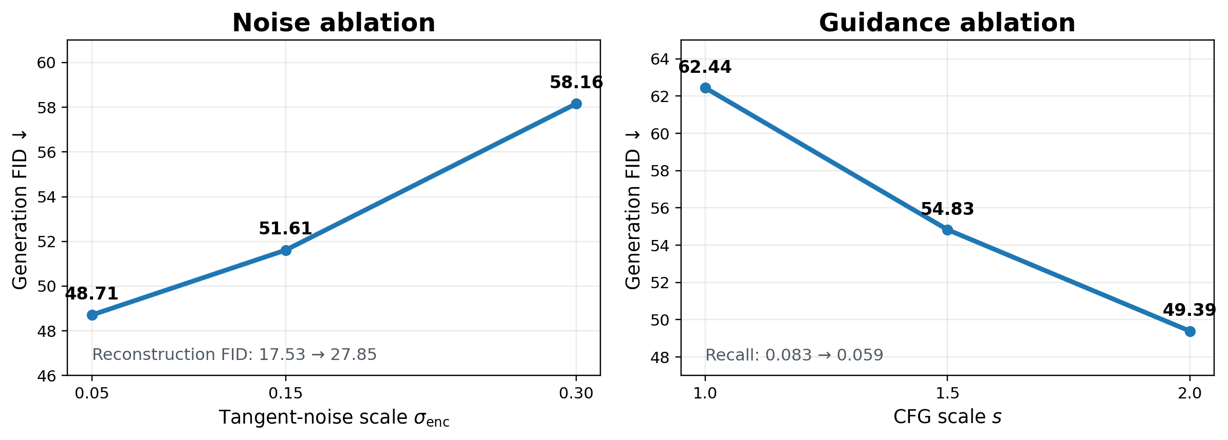



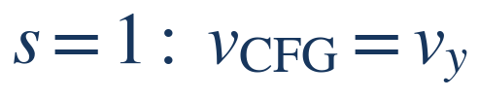
Information control and conditional sampling
Two separate controlled studies on CIFAR-10: left fixes CFG s = 2; right fixes σₑₙc = 0.15
Tangent-noise information control
Classifier-free guidance
At fixed s = 2, σₑₙc = 0.30 degrades all datasets; PathMNIST is slightly best at 0.15.
At fixed σₑₙc = 0.15, CIFAR-10 benefits from stronger guidance; PathMNIST peaks at s = 1.5 and CelebA changes little.
Ablation refs: Unified Latents information-control view (Heek et al., 2026); Classifier-Free Guidance (Ho & Salimans, 2022).
ECE 1508 Deep Generative Models | Group 3 | Mohammadreza Tavasoli Naeini & Raman Mangla
4/5

Slide 5
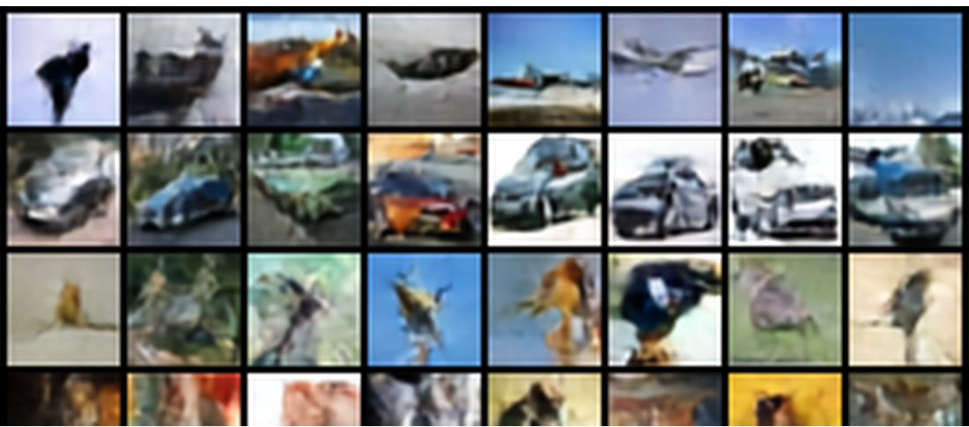
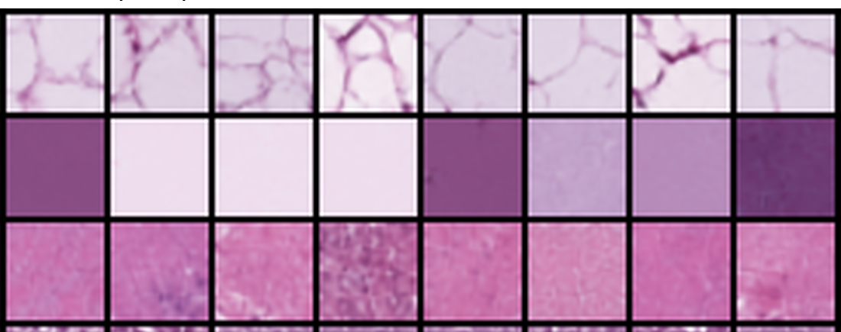
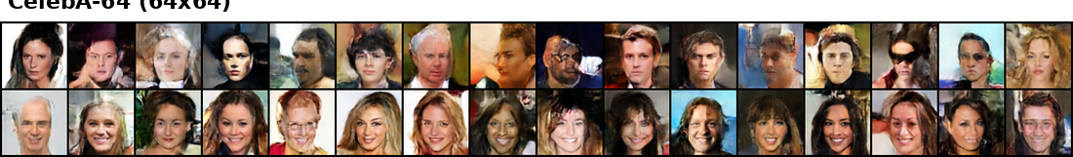
SRUL in three image settings
Same reference setting in every row: σₑₙc = 0.15 and CFG s = 2
CIFAR-10
PathMNIST
CelebA-64
Dataset
Evaluation setting
Grid
Recon. FID
Gen. FID
Prec.
Recall
CIFAR-10
Geometry + sampling ablations
4 × 4
17.31
49.39
0.884
0.059
PathMNIST
Histopathology transfer
4 × 4
7.13
29.36
0.829
0.309
CelebA-64
64 × 64 face generation
8 × 8
9.08
41.22
0.657
0.198
The same pipeline transfers to natural objects, histopathology, and 64 x 64 faces; the controlled sweeps are reported separately.
Dataset refs: CIFAR-10 (Krizhevsky, 2009); MedMNIST v2 / PathMNIST (Yang et al., 2023); CelebA (Liu et al., 2015).
ECE 1508 Deep Generative Models | Group 3 | Mohammadreza Tavasoli Naeini & Raman Mangla
5/5

