Slide 1
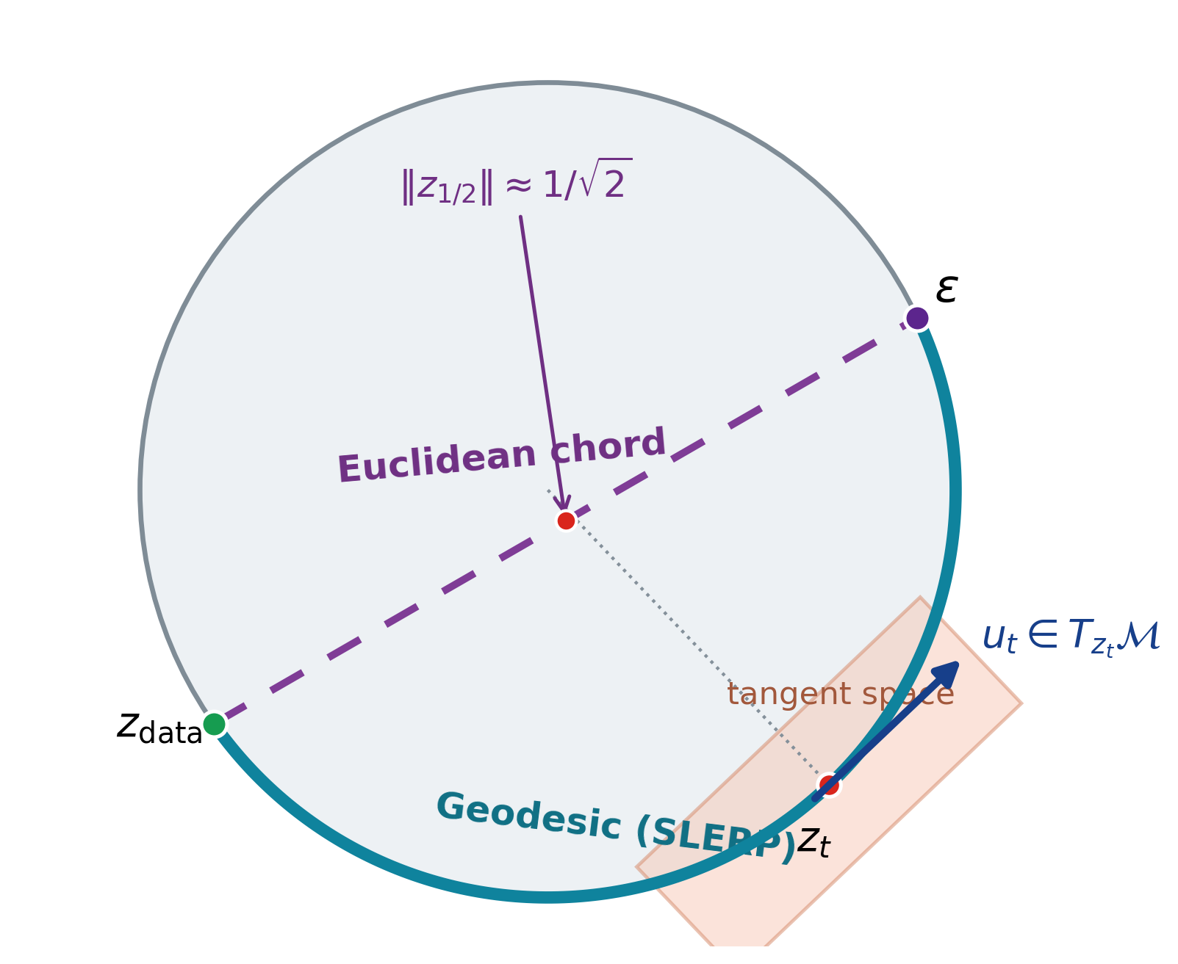
SRUL: Spatial Spherical Latents with Riemannian Flow Matching
Match the prior to the latent support learned by the autoencoder
Motivation
An autoencoder does not have to produce Gaussian latents
Normalization can make token norms nearly constant
(e.g., Transformer + LayerNorm)
The prior can mismatch the latent support
or leave it along the transport path
Main contribution
Train spherical tokens and RFM together
then test path and support mismatch
CIFAR-10 • PathMNIST • CelebA-64
ECE 1508 Deep Generative Models | Mohammadreza Tavasoli Naeini
1/5

Slide 2
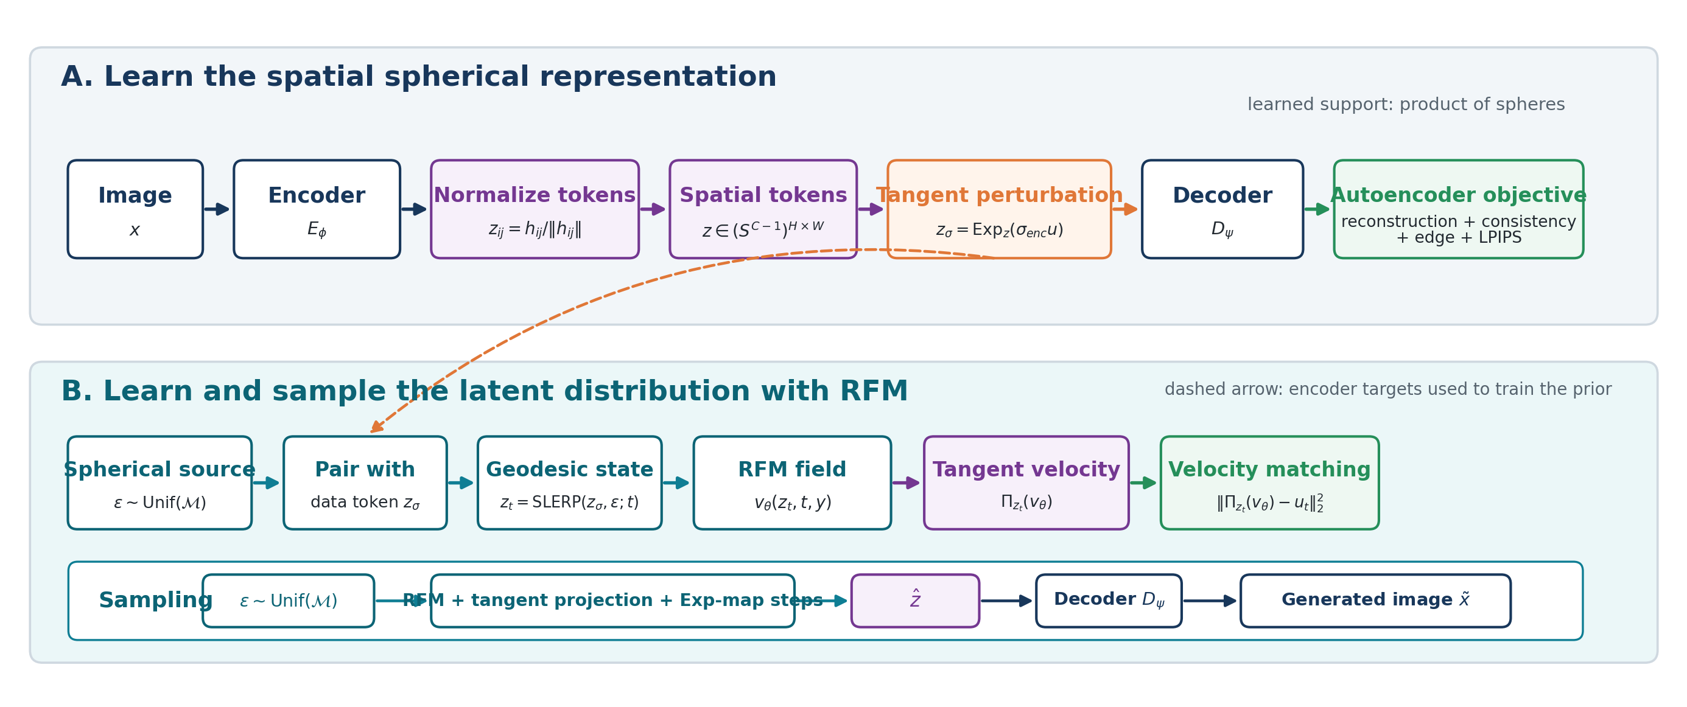
SRUL pipeline
Learn the spherical representation, learn its distribution, then sample on the same manifold
Core geometry: token normalization + tangent perturbation + SLERP + tangent projection + exponential-map integration.
ECE 1508 Deep Generative Models | Mohammadreza Tavasoli Naeini
2/5

Slide 3
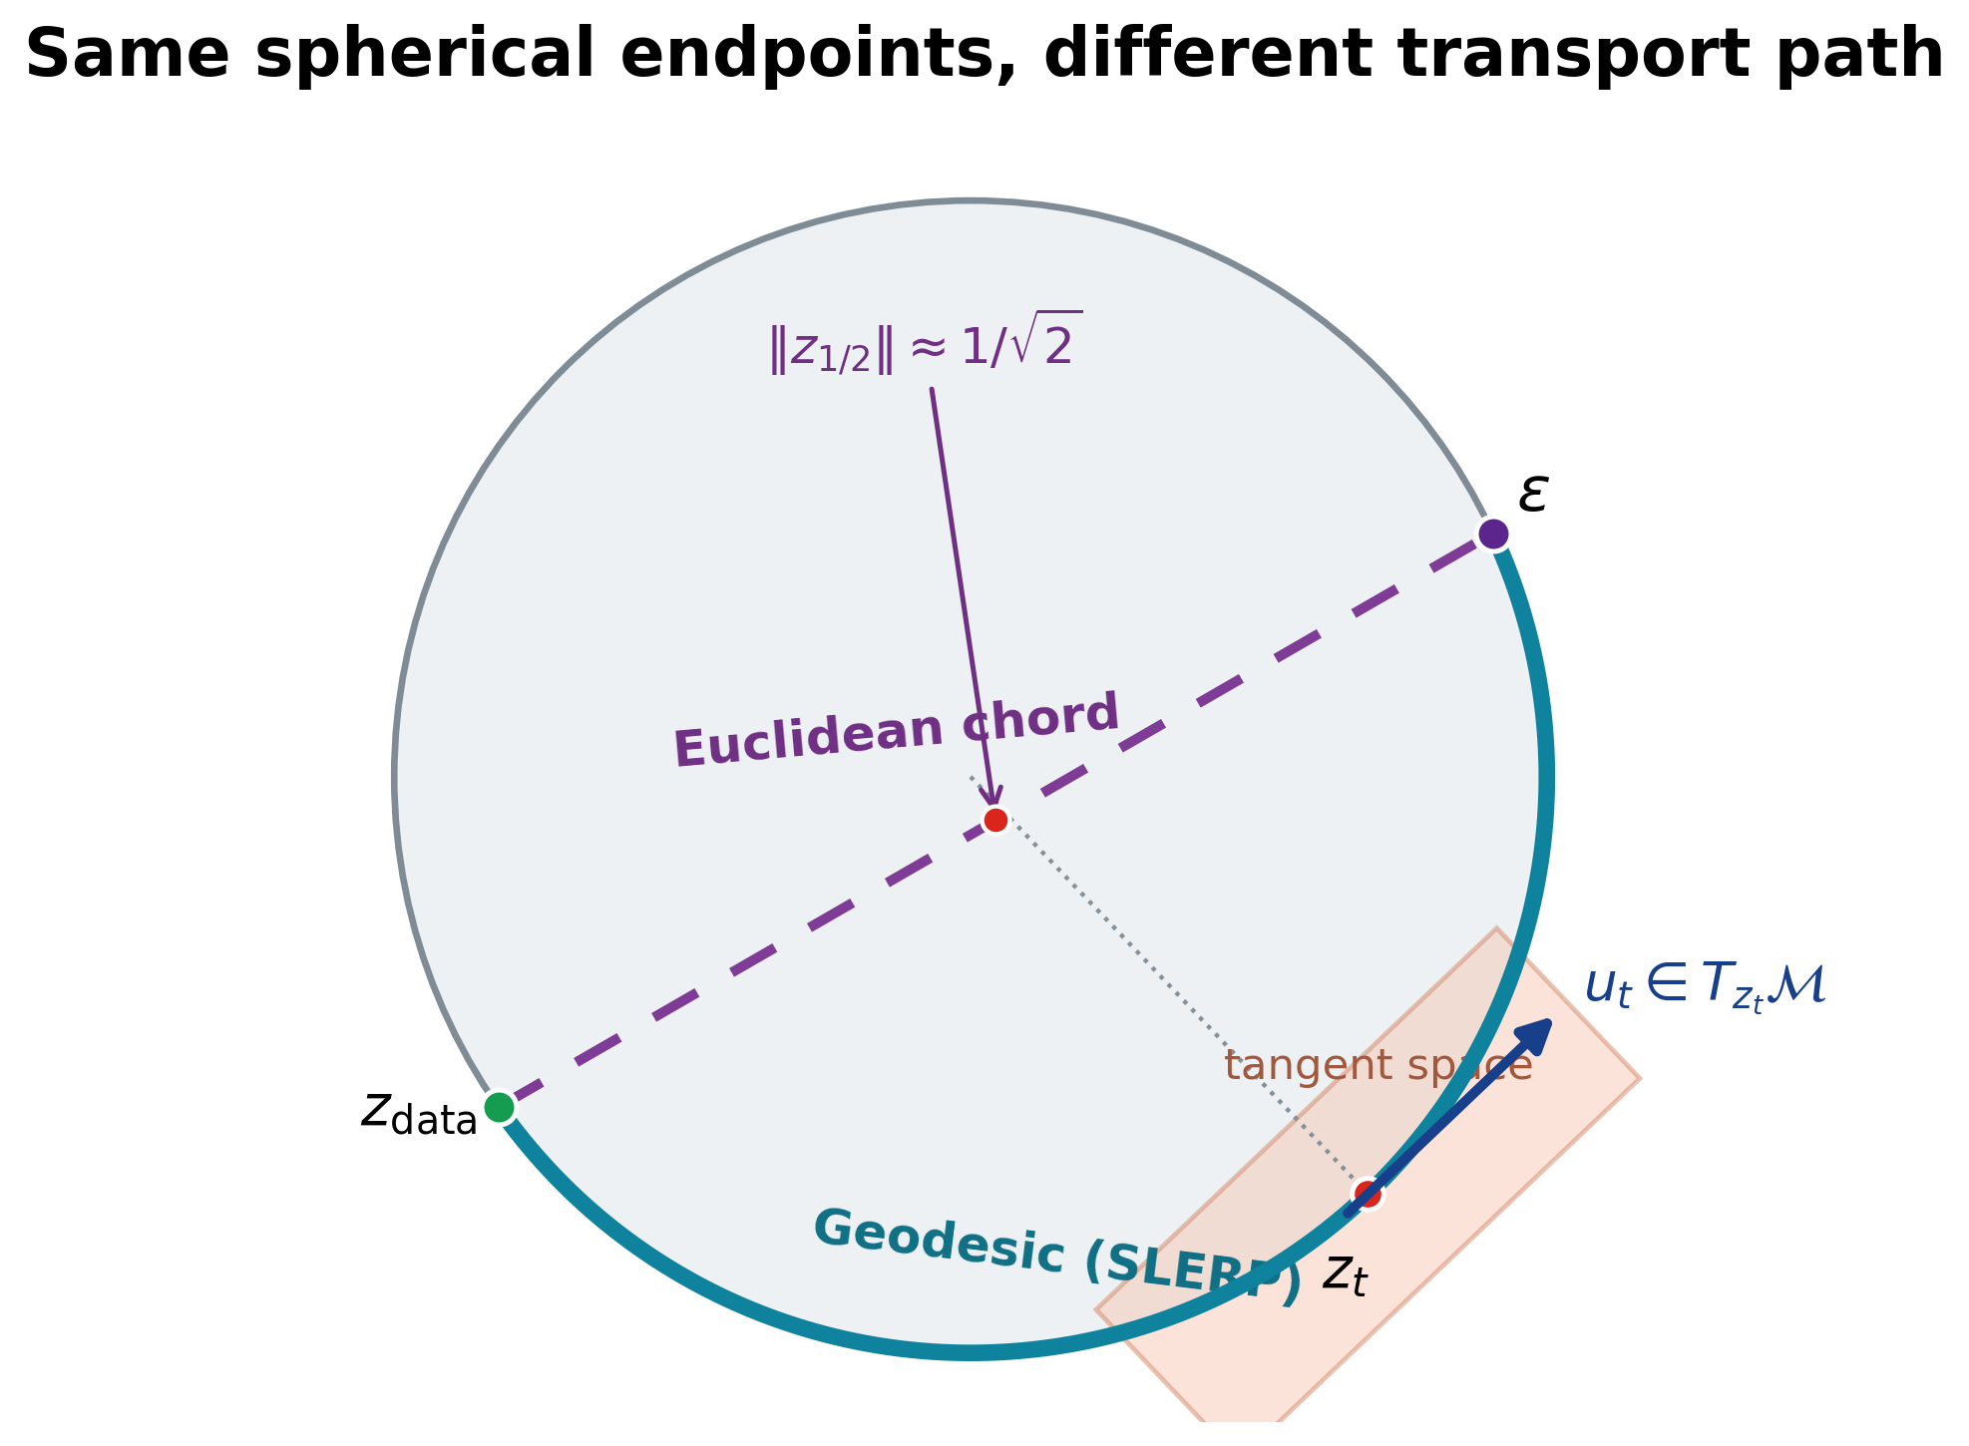
Why the autoencoder and prior must match
Two controlled tests separate path mismatch from support mismatch
1. Path match: same spherical autoencoder
Method | FID | KID | Prec. | Recall | Min norm
Chord | 67.44 | 0.0740 | 0.840 | 0.085 | 0.705
SRUL | 63.84 | 0.0667 | 0.857 | 0.091 | 1.000
2. Support match: SRUL vs. the same VAE with two priors (CFG = 2)
Method | FID | Prec. | Recall
SRUL: spherical AE + RFM | 49.42 | 0.857 | 0.110
VAE + standard FM | 50.70 | 0.855 | 0.091
VAE + projected RFM | 56.04 | 0.848 | 0.063
Same VAE: radius CV = 0.291; mean-radius replacement changes reconstruction FID 16.90 → 22.46.
SRUL learns spherical support before RFM. Projecting a VAE after training removes radius information.
ECE 1508 Deep Generative Models | Mohammadreza Tavasoli Naeini
3/5

Slide 4
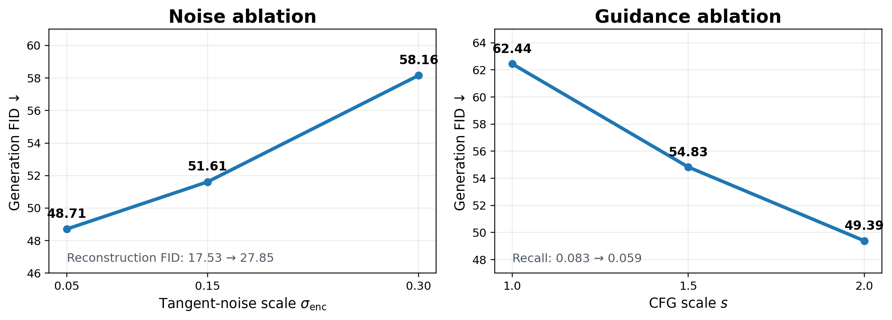
Two controls after the geometry is chosen
Tangent noise changes the latent representation; classifier-free guidance changes sampling
Tangent-noise sweep: σenc = 0.05 gives the best tested reconstruction and generation quality.
CFG sweep: stronger guidance improves FID and precision, while recall decreases.
ECE 1508 Deep Generative Models | Mohammadreza Tavasoli Naeini
4/5

Slide 5
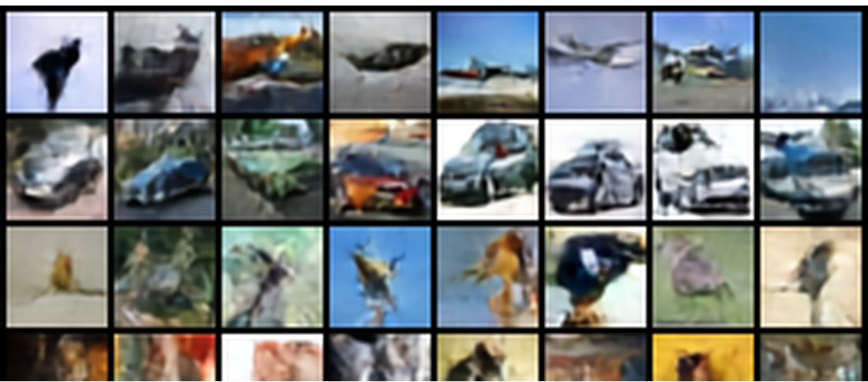
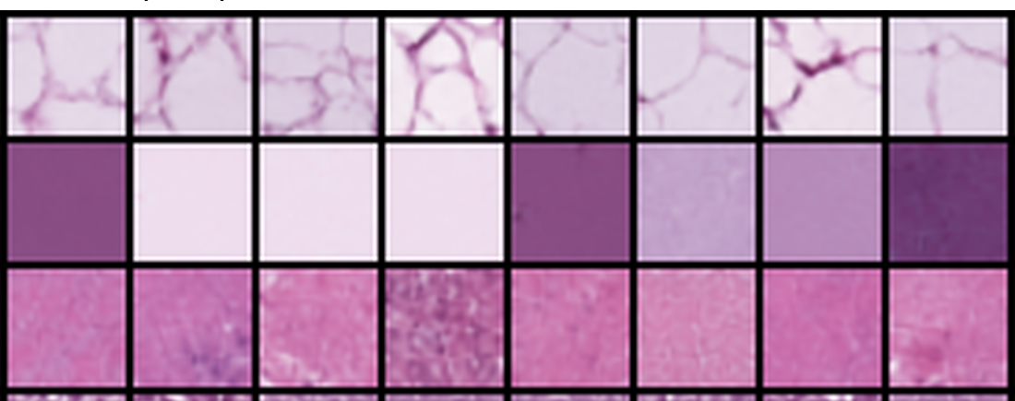
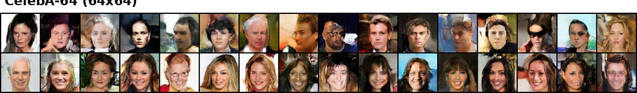
SRUL in three image settings
The same method is tested on different image structure and resolution
CIFAR-10
PathMNIST
CelebA-64
Dataset
Evaluation setting
Grid
Recon. FID
Gen. FID
Prec.
Recall
CIFAR-10
Geometry + sampling ablations
4 × 4
17.53
48.71
0.861
0.090
PathMNIST
Histopathology transfer
4 × 4
7.13
29.36
0.829
0.309
CelebA-64
64 × 64 face generation
8 × 8
9.08
41.22
0.657
0.198
CIFAR-10 tests geometry and controls; PathMNIST tests texture transfer; CelebA-64 tests 64 × 64 faces.
ECE 1508 Deep Generative Models | Mohammadreza Tavasoli Naeini
5/5

