Slide 1
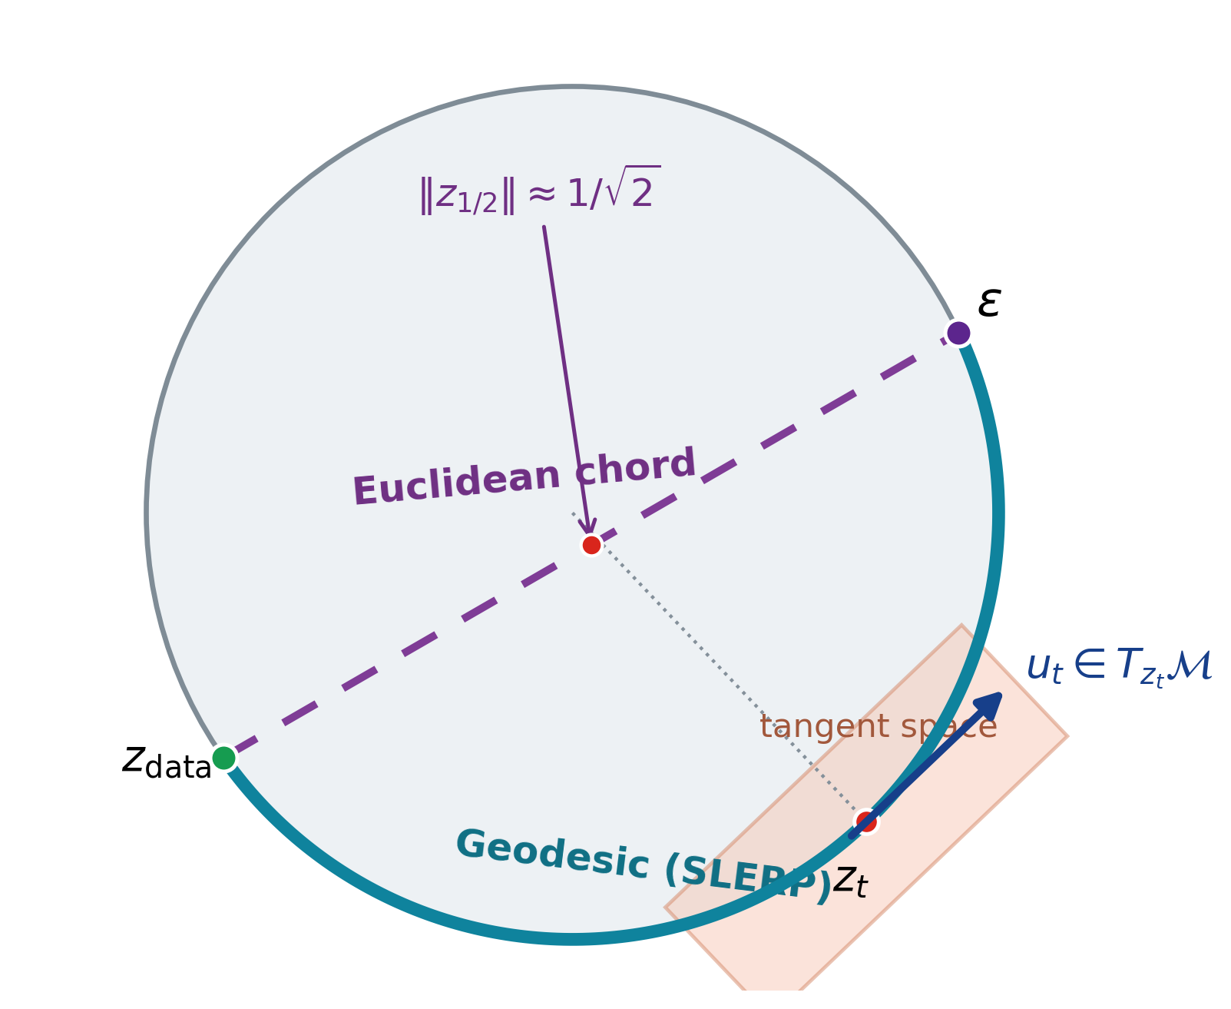
Learning Spatial Unit-Norm Latents with Riemannian Flow Matching
SRUL: Spherical Riemannian Unit-Norm Latents
Motivation
An autoencoder does not have to produce Gaussian latents
Normalization can make token norms nearly constant
(e.g., Transformer + LayerNorm)
The prior can mismatch the latent support
or leave it along the transport path
Main contribution
SRUL learns spherical spatial tokens and uses tangent noise
for information control. RFM models the same latent support.
CIFAR-10 • PathMNIST • CelebA-64
ECE 1508 Deep Generative Models | Mohammadreza Tavasoli Naeini
1/5

Slide 2




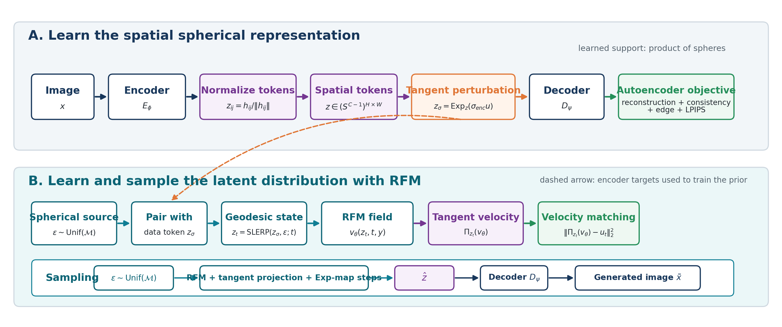
SRUL pipeline
Learn spherical latents, control retained information, then sample on the same manifold
1 Learn the spherical representation
Unit-norm token
Image
Encoder
Unit-norm spatial tokens
Decoder
Geodesic path
2 Train the Riemannian Flow Matching prior
Spherical noise
SLERP state zₜ
RFM field vθ(zₜ,t)
Tangent velocity
Target uₜ
Velocity matching
3 Sample new latents and decode
Noise
Projected velocity + Exp-map steps
Latent
Decoder
Image
Manifold-preserving sampling
The representation, training path, and numerical update use the same geometry.
ECE 1508 Deep Generative Models | Mohammadreza Tavasoli Naeini
2/5

Slide 3
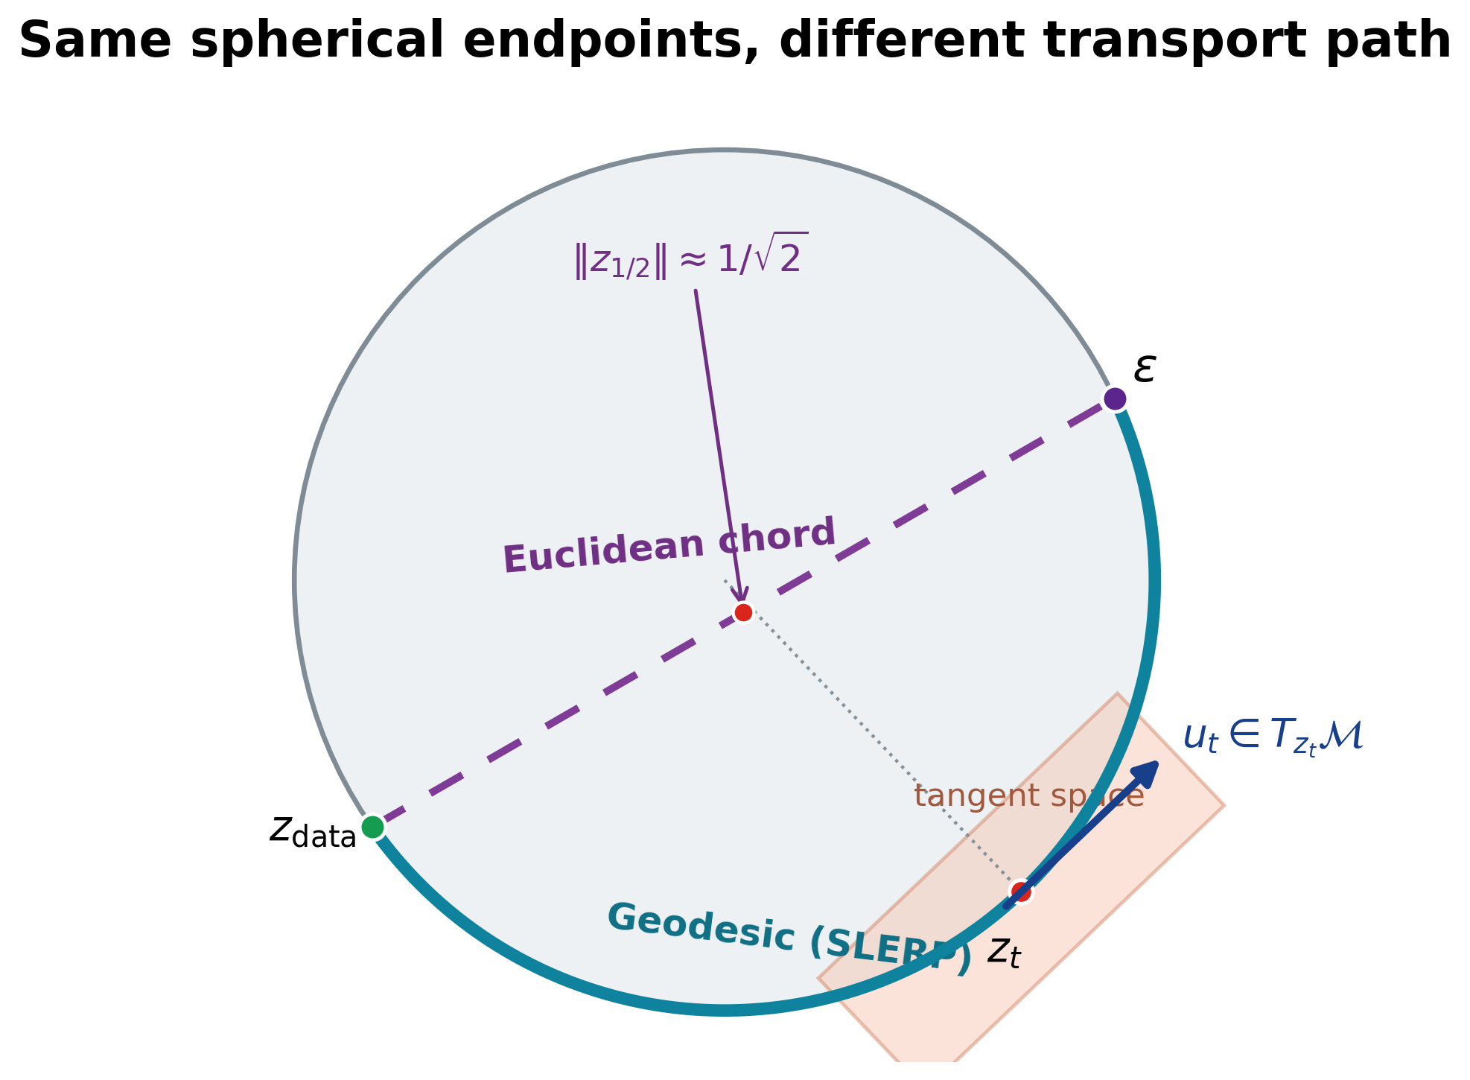
Why the autoencoder and prior must match
Two controlled tests separate path mismatch from support mismatch
1. Path match: same spherical autoencoder
Method | FID | KID | Prec. | Recall | Min norm
Chord | 67.44 | 0.0740 | 0.840 | 0.085 | 0.705
SRUL | 63.84 | 0.0667 | 0.857 | 0.091 | 1.000
2. Support match: SRUL vs. the same VAE with two priors (CFG = 2)
Method | FID | Prec. | Recall
SRUL: spherical AE + RFM | 49.42 | 0.857 | 0.110
VAE + standard FM | 50.70 | 0.855 | 0.091
VAE + projected RFM | 56.04 | 0.848 | 0.063
Same VAE: radius CV = 0.291; mean-radius replacement changes reconstruction FID 16.90 → 22.46.
SRUL learns spherical support before RFM. Projecting a VAE after training removes radius information.
ECE 1508 Deep Generative Models | Mohammadreza Tavasoli Naeini
3/5

Slide 4


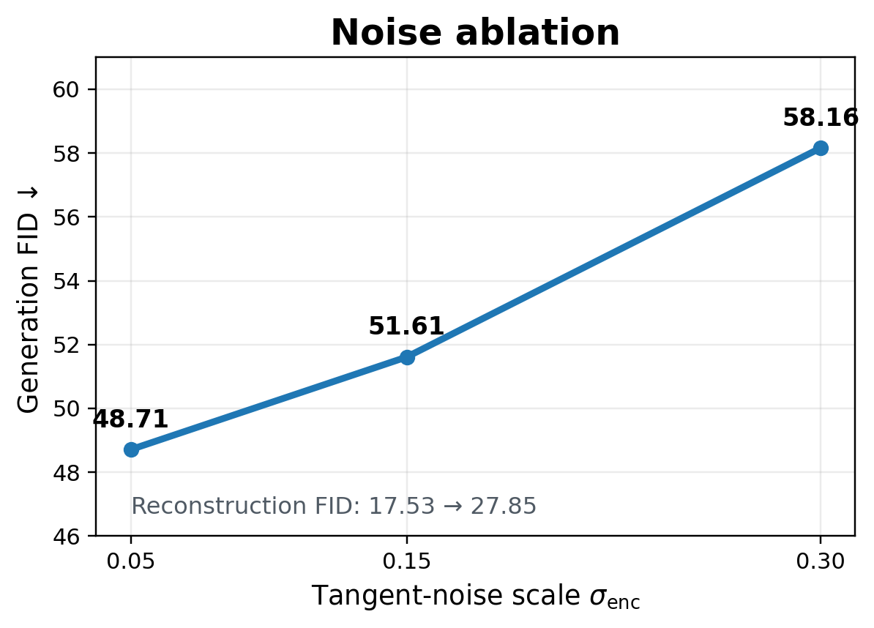
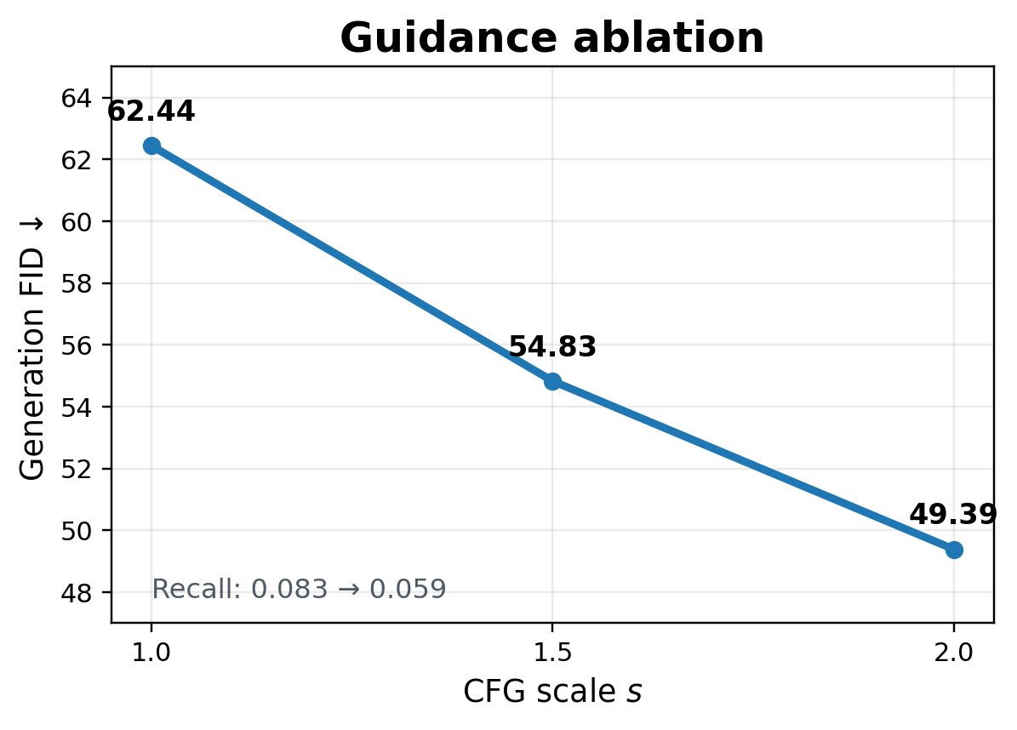
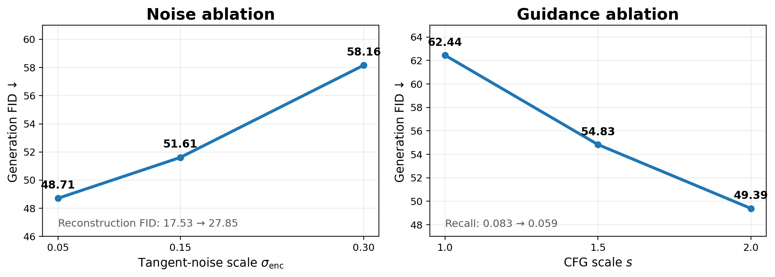
Information control and conditional sampling
σenc controls retained image information; CFG controls class emphasis during sampling
Tangent-noise information control
Classifier-free guidance
σenc = 0.05 gives the best tested balance; larger noise removes too much image information.
Larger s improves FID and precision, but concentrates samples and lowers recall.
ECE 1508 Deep Generative Models | Mohammadreza Tavasoli Naeini
4/5

Slide 5
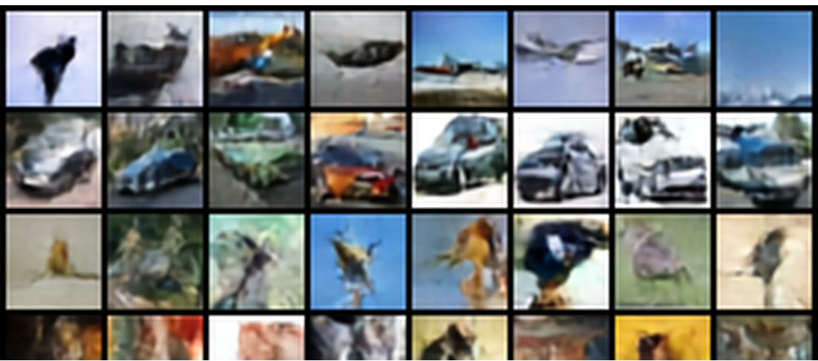
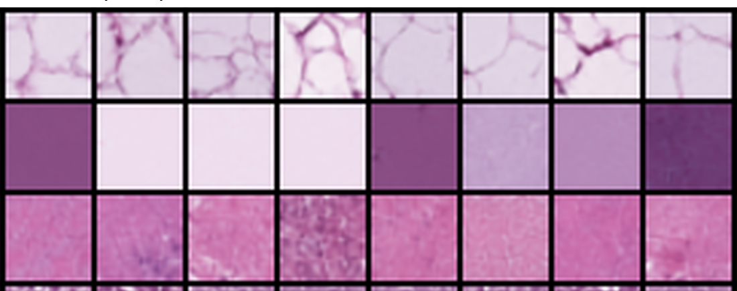
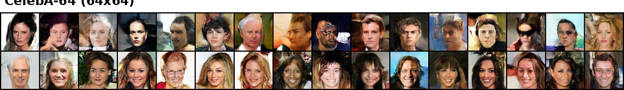
SRUL in three image settings
The same method is tested on different image structure and resolution
CIFAR-10
PathMNIST
CelebA-64
Dataset
Evaluation setting
Grid
Recon. FID
Gen. FID
Prec.
Recall
CIFAR-10
Geometry + sampling ablations
4 × 4
17.53
48.71
0.861
0.090
PathMNIST
Histopathology transfer
4 × 4
7.13
29.36
0.829
0.309
CelebA-64
64 × 64 face generation
8 × 8
9.08
41.22
0.657
0.198
CIFAR-10 tests geometry and information control; PathMNIST tests texture transfer; CelebA-64 tests 64 × 64 faces.
ECE 1508 Deep Generative Models | Mohammadreza Tavasoli Naeini
5/5

