Slide 1
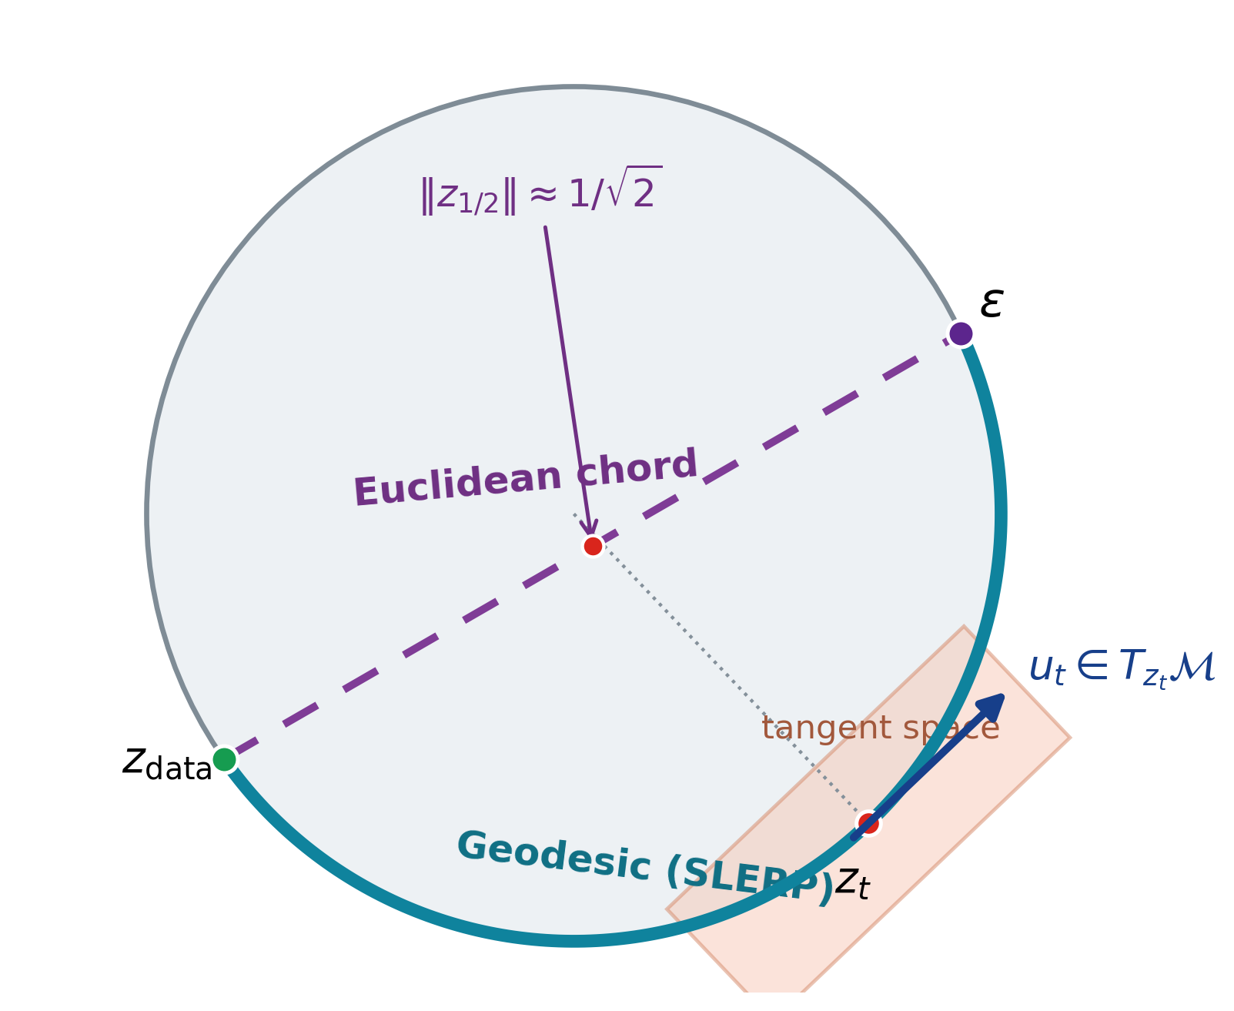
SRUL: Spatial Spherical Latents with Riemannian Flow Matching
Near-spherical latents make Gaussian sources and straight Euclidean paths geometrically mismatched
Why Euclidean latent dynamics are mismatched
Autoencoder latents need not be Gaussian Their geometry depends on architecture and training
Normalization can produce a fixed-radius shell Transformer + LayerNorm is one example
Gaussian noise adds unused radial variation Linear paths cut through the shell
Research question
For spherical tokens, should transport follow the chord or the geodesic?
CIFAR-10 • PathMNIST • CelebA-64
ECE 1508 Deep Generative Models | Mohammadreza Tavasoli Naeini
1/5

Slide 2
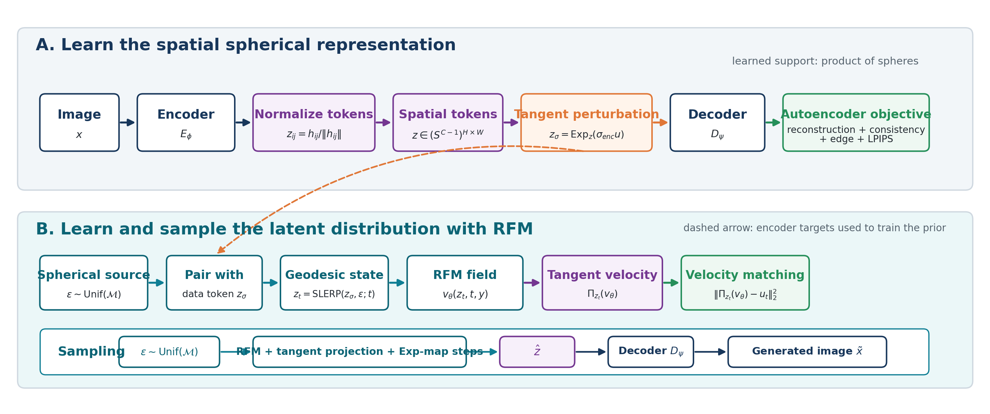
SRUL pipeline
Learn the spherical representation, learn its distribution, then sample on the same manifold
Core geometry: token normalization + tangent perturbation + SLERP + tangent projection + exponential-map integration.
ECE 1508 Deep Generative Models | Mohammadreza Tavasoli Naeini
2/5

Slide 3
Controlled test: same spherical autoencoder, different path
Only the transport path changes: Euclidean chord versus SRUL geodesic
Method
FID
KID
Prec.
Recall
Min norm
Chord
67.44
0.0740
0.840
0.085
0.705
SRUL
63.84
0.0667
0.857
0.091
1.000
Why the chord enters the interior
For nearly orthogonal endpoints, the midpoint norm is 1/√2 ≈ 0.707. The measured value is 0.705.
With a spherical encoder, geodesic transport improves all four image metrics and keeps the full path on-manifold.
ECE 1508 Deep Generative Models | Mohammadreza Tavasoli Naeini
3/5

Slide 4
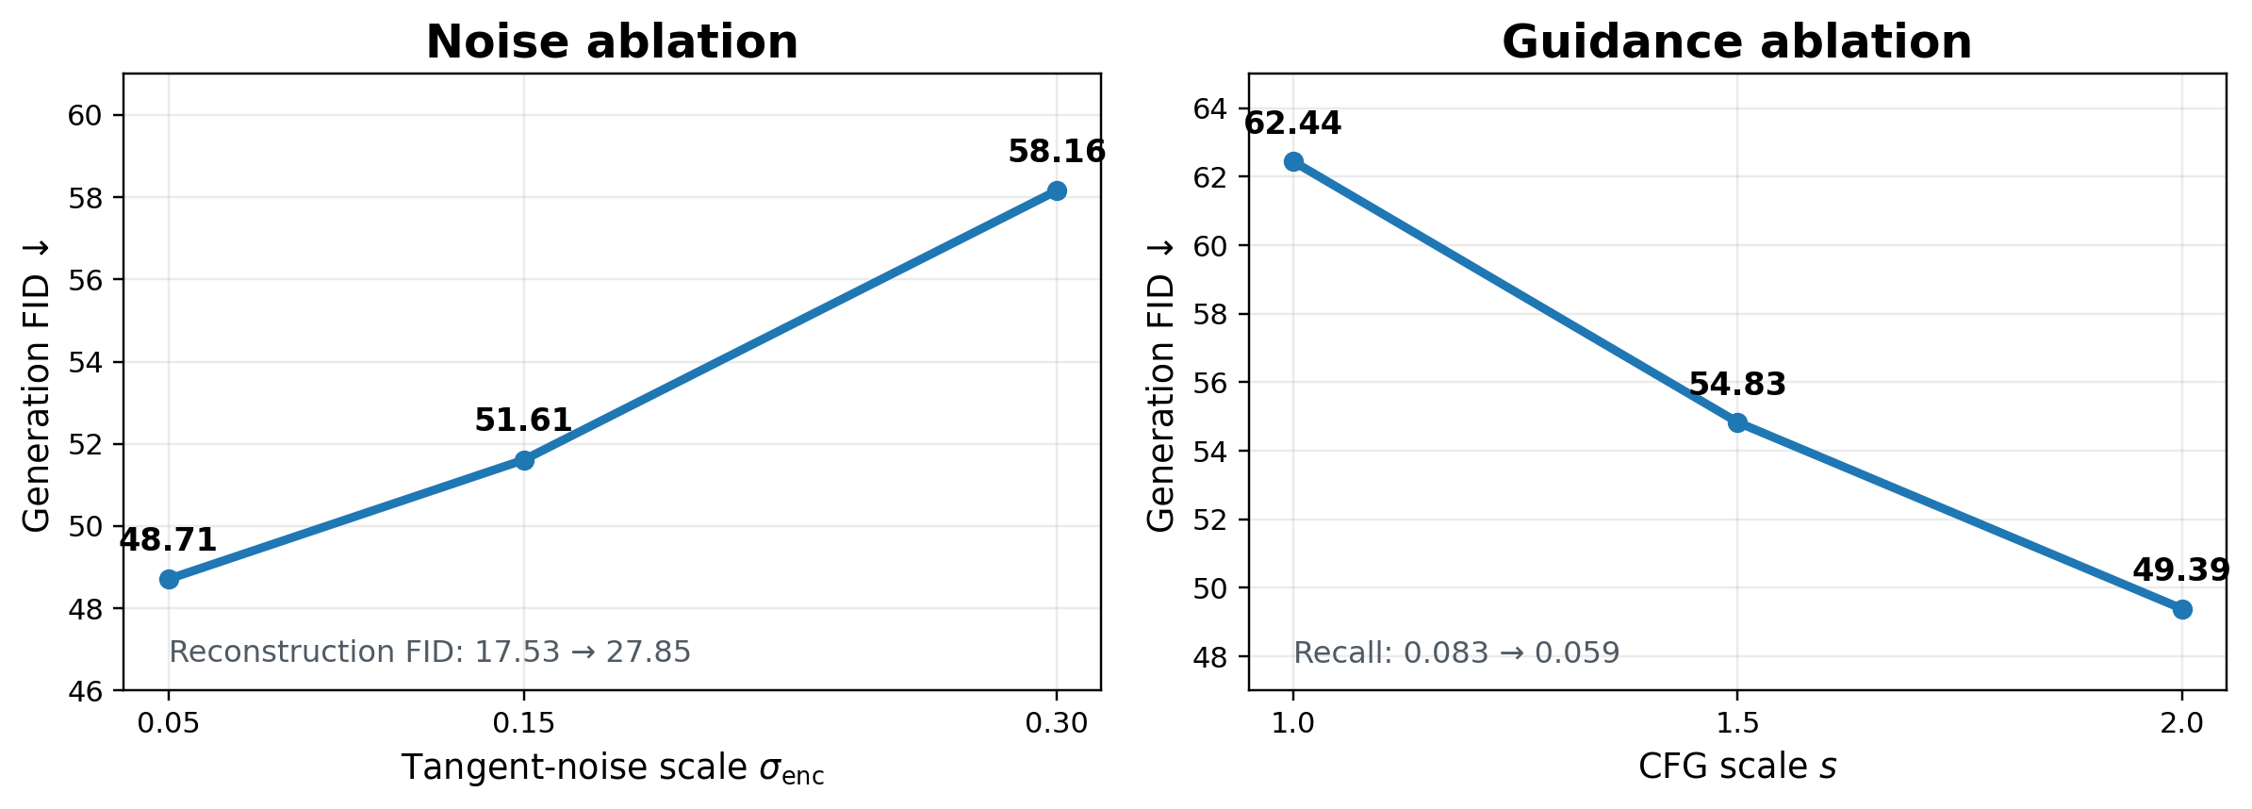
Two independent controls
Tangent noise changes the encoded representation; classifier-free guidance changes conditional sampling
Tangent-noise sweep: σenc = 0.05 gives the best tested reconstruction and generation quality.
CFG sweep: stronger guidance improves FID and precision, while recall decreases.
ECE 1508 Deep Generative Models | Mohammadreza Tavasoli Naeini
4/5

Slide 5
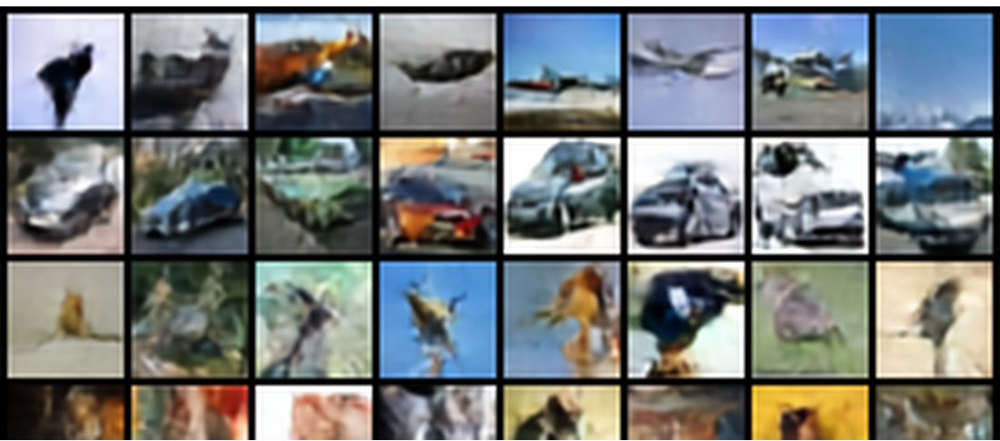
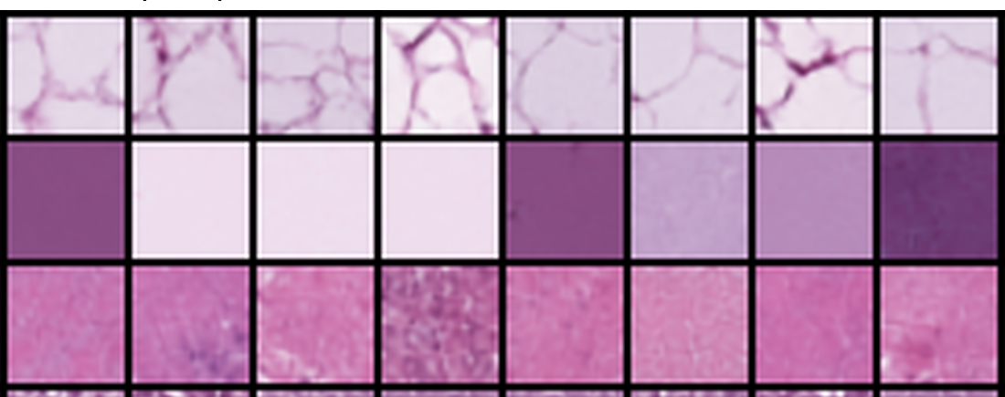
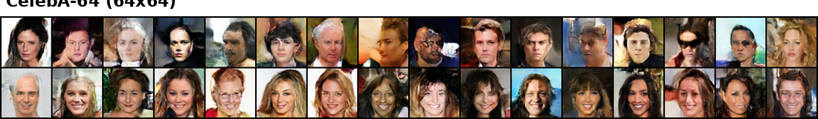
Results across three evaluation settings
Natural objects, histopathology textures, and structured faces
CIFAR-10
PathMNIST
CelebA-64
Dataset
Evaluation setting
Grid
Recon. FID
Gen. FID
Prec.
Recall
CIFAR-10
Geometry + sampling ablations
4 × 4
17.53
48.71
0.861
0.090
PathMNIST
Histopathology transfer
4 × 4
7.13
29.36
0.829
0.309
CelebA-64
64 × 64 face generation
8 × 8
9.08
41.22
0.657
0.198
CIFAR-10 provides the controlled ablations; PathMNIST tests texture transfer; CelebA-64 tests resolution and token-grid scaling.
ECE 1508 Deep Generative Models | Mohammadreza Tavasoli Naeini
5/5

