Slide 1

Node MCU Project
Dr. Mohammad Salah Uddin

Slide 2
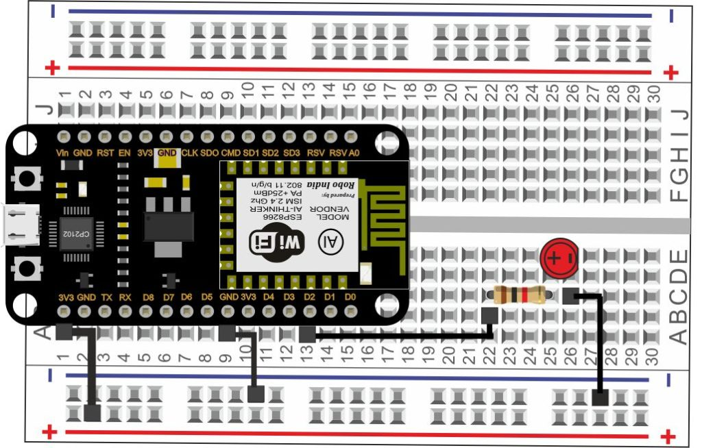
LED Blinking on Arduino IDE
A step by step illustrated very basic tutorial for digital input and output in physical computing. Here we are taking digital output on a LED. This LED remains ON for one second and OFF for another, this loop runs for an infinite time.

Slide 3
LED Blinking on Arduino IDE
int LEDpin = 2; // pin declaration
void setup() {
pinMode(LEDpin, OUTPUT); // pin setup
Serial.begin(115200); // serial port setup
}
void loop() {
digitalWrite(LEDpin,HIGH);
Serial.println("LED is ON");
delay(1000);
digitalWrite(LEDpin, LOW);
Serial.println("LED is OFF");
delay(1000);
}

Slide 4
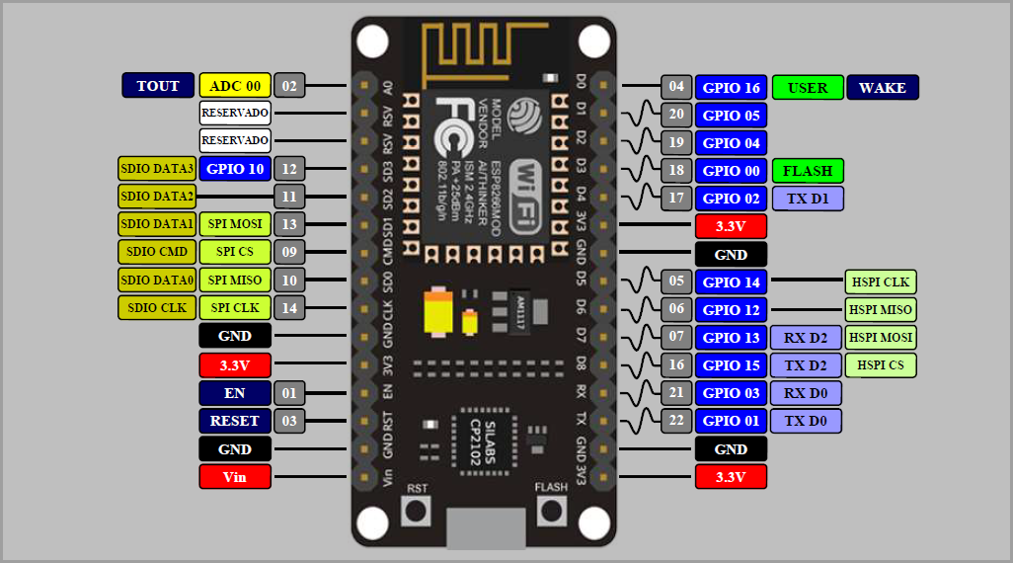
Node MCU (introduction)

Slide 5
Read Analog Data
// Declare the Analog PIN
int analogPin = A0;
int value;
void setup() {
pinMode(analogPin, INPUT);
Serial.begin(115200);
}
void loop() {
Serial.println("Reading Analog Data....");
value = analogRead(analogPin);
Serial.println(value);
delay(1000);
}

Slide 6
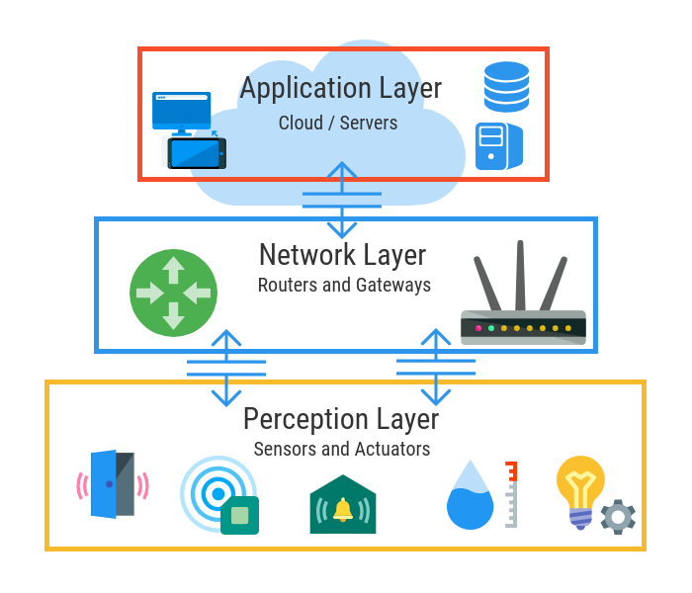
IoT Architecture

Slide 7
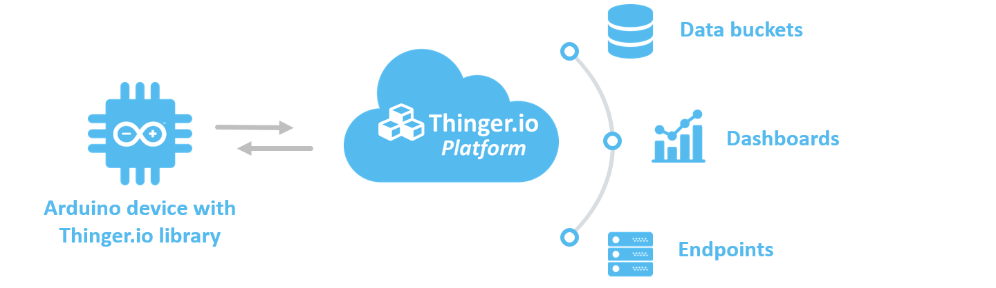
LED On/Off With from IoT Cloud (thinger.io)

Slide 8
LED On/Off With from IoT Cloud (thinger.io)
Create an account in thinger.io
Create Device in Thinger.io
Copy the Device Credentials on a Text File.
Copy the Device Name as well.
Your user name is also needed.
Add the thinger.io library in Arduino IDE
Let’s GO.
To Do List

Slide 9
LED On/Off With from IoT Cloud (thinger.io)
#include <ESP8266WiFi.h>
#include <ThingerESP8266.h>
#define USERNAME "____________________________________"
#define DEVICE_ID "___________________________________"
#define DEVICE_CREDENTIAL "___________________________"
#define SSID "_______________________________________"
#define SSID_PASSWORD "______________________________"
int LED = 2;
ThingerESP8266 thing(USERNAME, DEVICE_ID, DEVICE_CREDENTIAL);

Slide 10
LED On/Off With from IoT Cloud (thinger.io)
void setup() {
pinMode(LED, OUTPUT);
thing.add_wifi(SSID, SSID_PASSWORD);
thing["led"] << digitalPin(LED);
}
void loop() {
thing.handle();
}

Slide 11
Cloud Dashboard for Analog Data
#include <ESP8266WiFi.h>
#include <ThingerESP8266.h>
#define USERNAME "____________________________________"
#define DEVICE_ID "___________________________________"
#define DEVICE_CREDENTIAL "___________________________"
#define SSID "_______________________________________"
#define SSID_PASSWORD "______________________________"
// Declare the Analog PIN
int analogPin = A0;
ThingerESP8266 thing(USERNAME, DEVICE_ID, DEVICE_CREDENTIAL);

Slide 12
Cloud Dashboard for Analog Data
void setup() {
pinMode(analogPin, INPUT);
thing.add_wifi(SSID, SSID_PASSWORD);
thing["analog"] >> outputValue(analogRead(analogPin));
}
void loop() {
thing.handle();
}
Create a Dashboard
By using Thinger.io

Slide 13
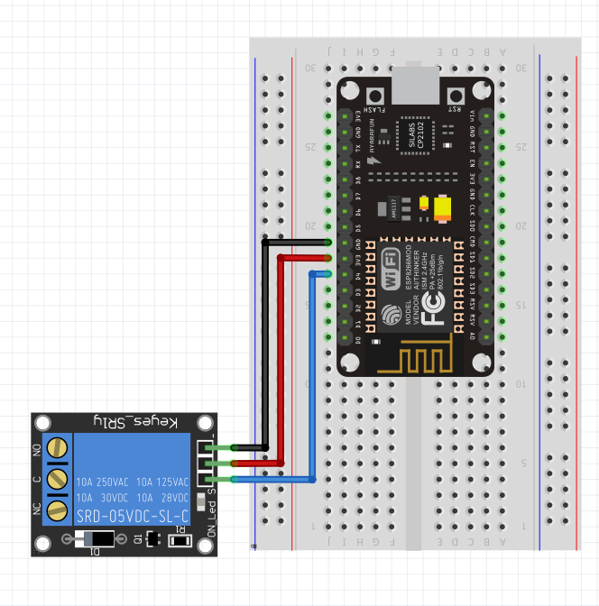
Relay With NodeMCU
Relay NodeMcu
VCC = === 3.3V
GND ==== GND
SIG ==== D4

Slide 14
Relay With NodeMCU
int LEDpin = 2; // pin declaration
void setup() {
pinMode(LEDpin, OUTPUT); // pin setup
Serial.begin(115200); // serial port setup
}
void loop() {
digitalWrite(LEDpin,HIGH);
Serial.println("LED is ON");
delay(1000);
digitalWrite(LEDpin, LOW);
Serial.println("LED is OFF");
delay(1000);
}
Try to control relay via Cloud

Slide 15
Demo
Air Quality Monitoring
Controlling Home Appliances

