Slide 1
E-Commerce Retail Sales & Customer Behavior Analysis
Data-Driven Insights & Executive Dashboard
(12000+ Transaction)
Prepared by: Mohammad Shadab Data Analyst Portfolio

Slide 2
Executive Summary & Key KPIs
$1.39M
12.00K
$115.04
54.82%
88.47%
Total
Revenue
Total
Orders
Avg. Order
Value
Delivery
Success
Repeat Customer
Rate
Revenue Growth & Seasonality: Generated $1.39M total revenue across 12K orders, driven by Q4 holiday seasonality.
Core Revenue Engines: Electronics ($350K+) and Home & Kitchen product categories generate over 45% of total gross sales.
Top Categories: Electronics ($350K+) and Home & Kitchen account for 45%+ of gross sales.
Top Markets: Balanced global sales, with Abu Dhabi ($100K+) & Dubai leading city revenues.
High Retention: Strong 88.5% repeat customer rate reflects excellent brand loyalty.
Logistics Focus: 54.8% delivery rate highlights an opportunity to improve fulfillment & return SLAs.

Slide 3
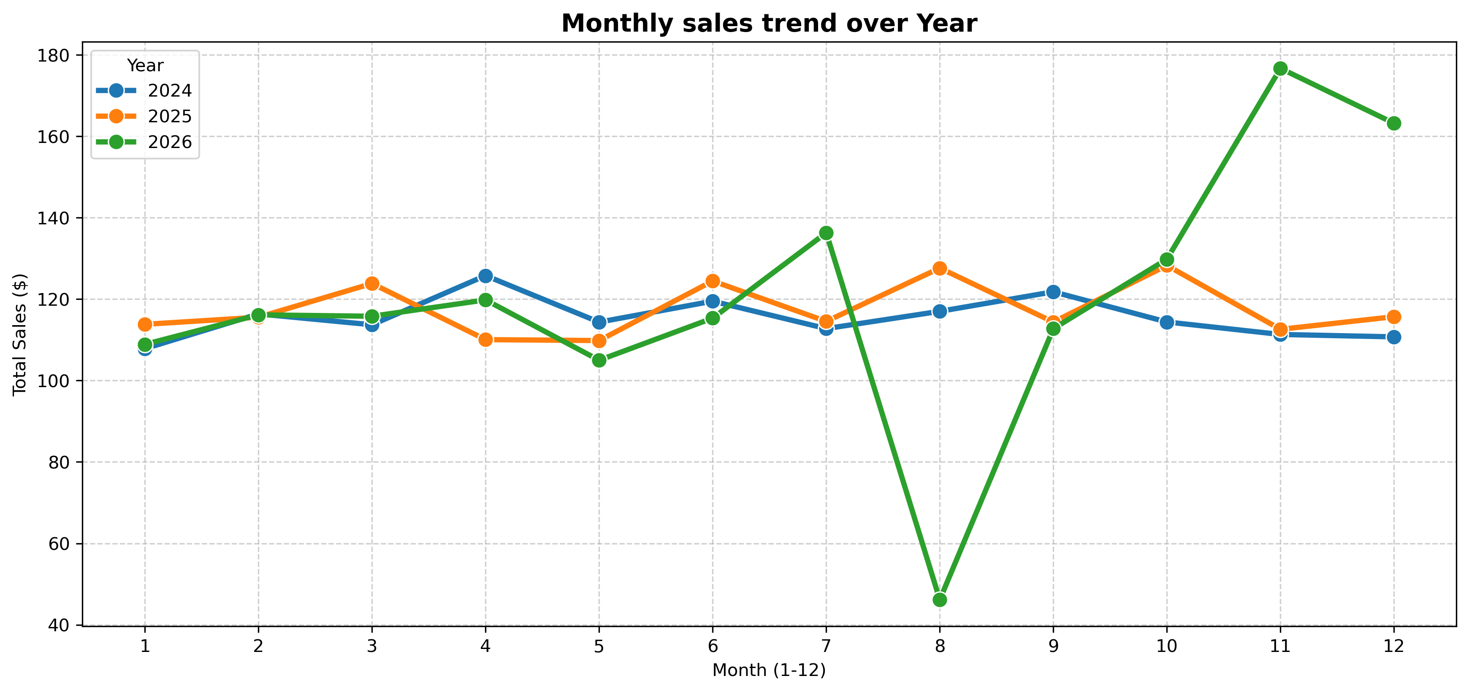
Monthly & Yearly Sales Performance
Key Trend:
Q4 (Nov–Dec)
experiences
peak demand
surge.
Business Action: Ramping up inventory and marketing spend 40% prior to November

Slide 4
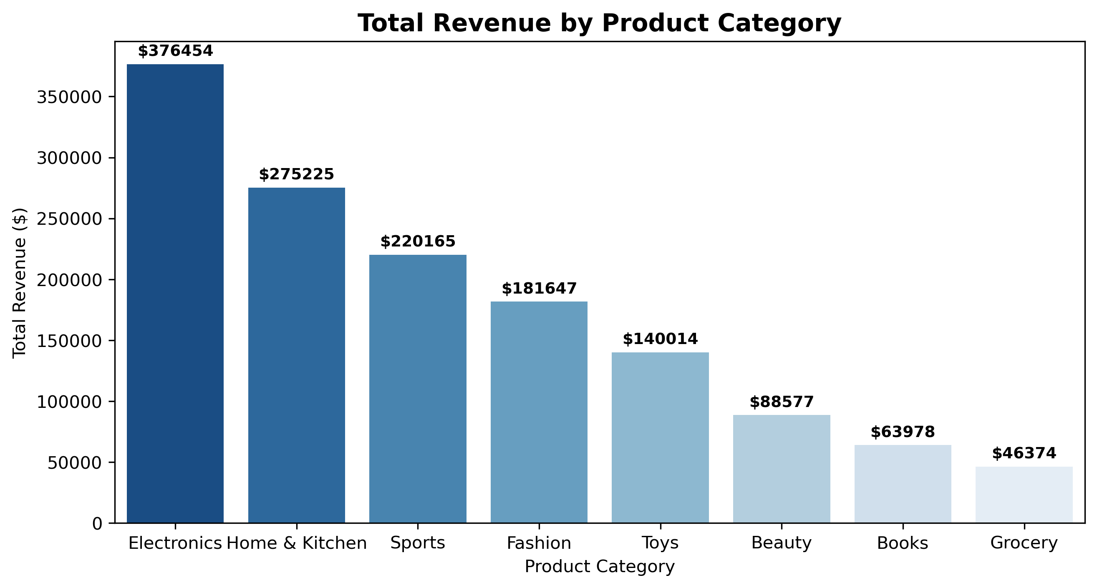
Revenue by Product Category
Top Categories: Electronics ($350K+) and Home & Kitchen account for ~45% of gross revenue
Opportunity: Introduce bundle deals with low-performing categories like Grocery and Books.

Slide 5
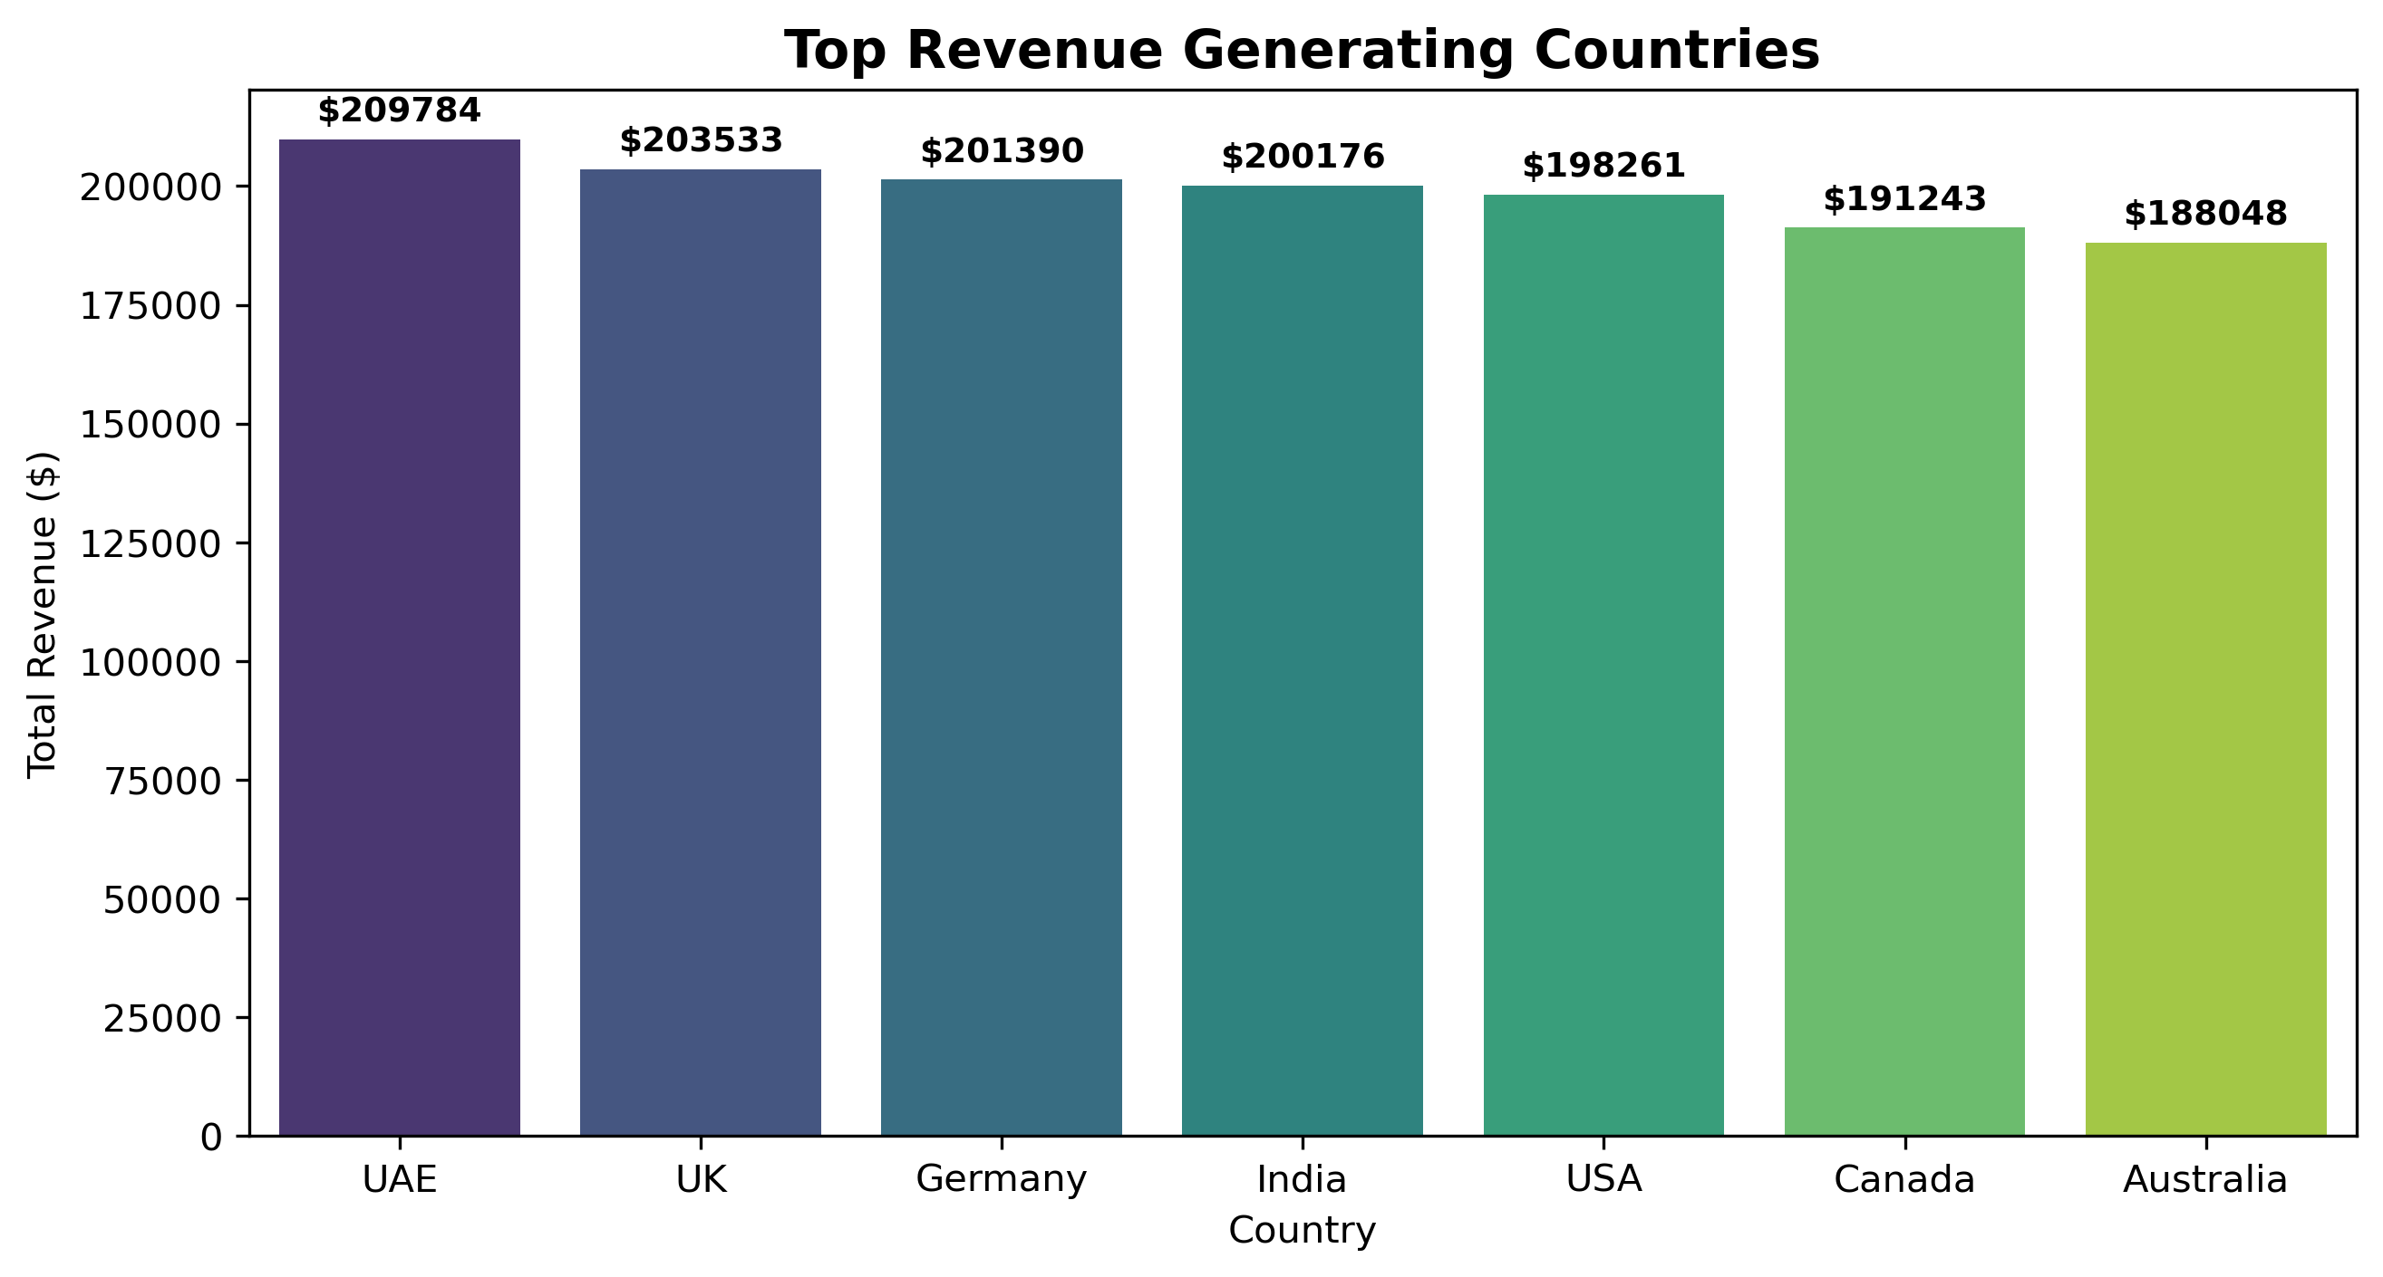
Global Geographical Performance
Balanced Reach: Balanced revenue contribution (~$175K–$200K) across UAE, UK, Germany, India, USA, Canada, and Australia.

Slide 6
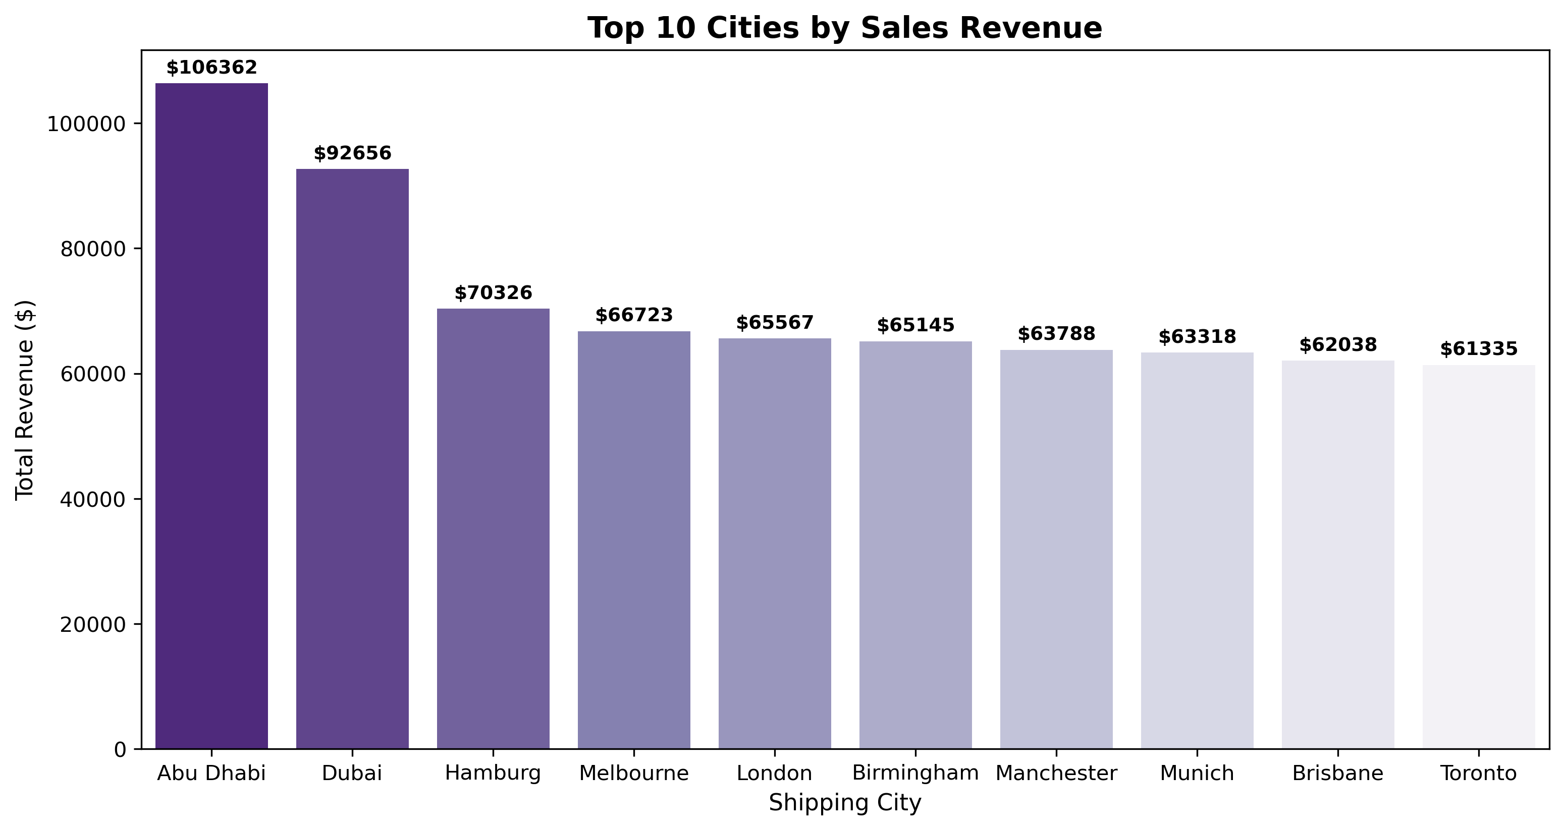
Regional City Hubs Analysis
Top Performing Cities: Abu Dhabi ($100K+) and Dubai ($90K+) are individual top revenue cities.
Action: Establish regional fulfillment centers in UAE to optimize shipping SLAs.

Slide 7
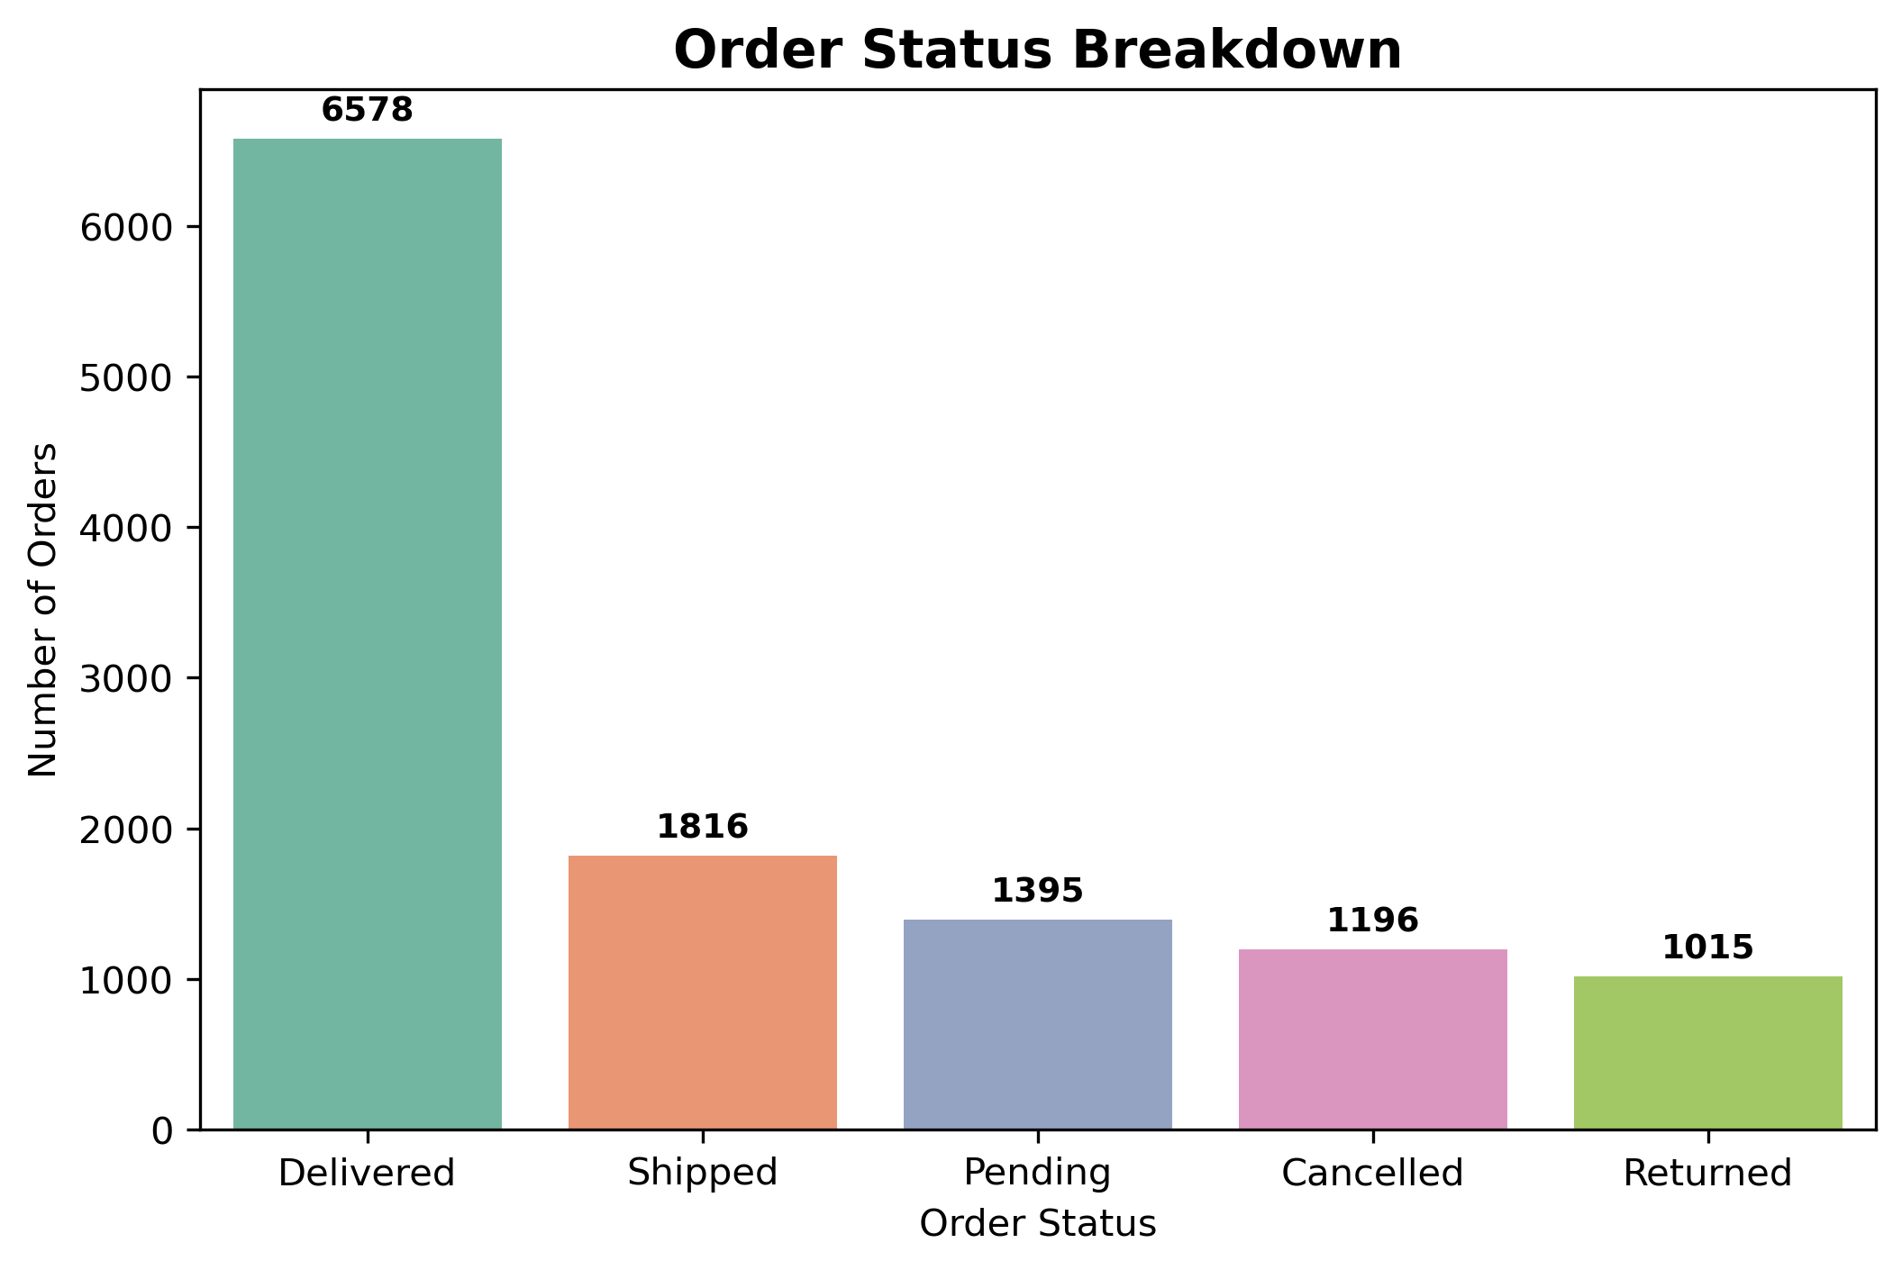
Fulfillment & Order Operations
Success Rate: 54.82% of total orders successfully delivered.
Challenge: High volume in Shipped/Pending/Returned statuses requires courier SLA review.

Slide 8
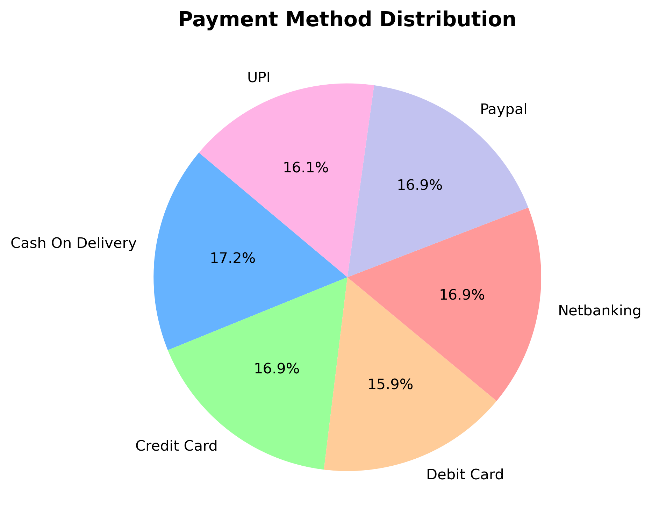
Payment Gateway & Channel Adoption
Uniform Adoption: Cash on Delivery, Netbanking, Cards, and UPI hold equal market share (15%–17% each).

Slide 9
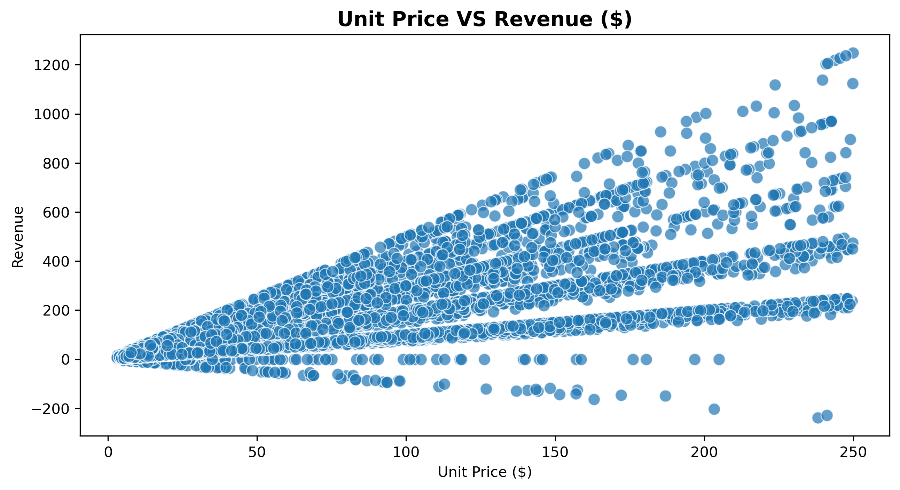
Statistical Correlation & Pricing Strategy
Positive Price-to-Revenue Scaling: Revenue expands linearly as Unit Price increases ($0–$250), confirming high-value products as key revenue drivers.
Return & Refund Anomalies:Data points below the zero line ($0 to -$200) reflect returned orders and customer refund transactions.

Slide 10
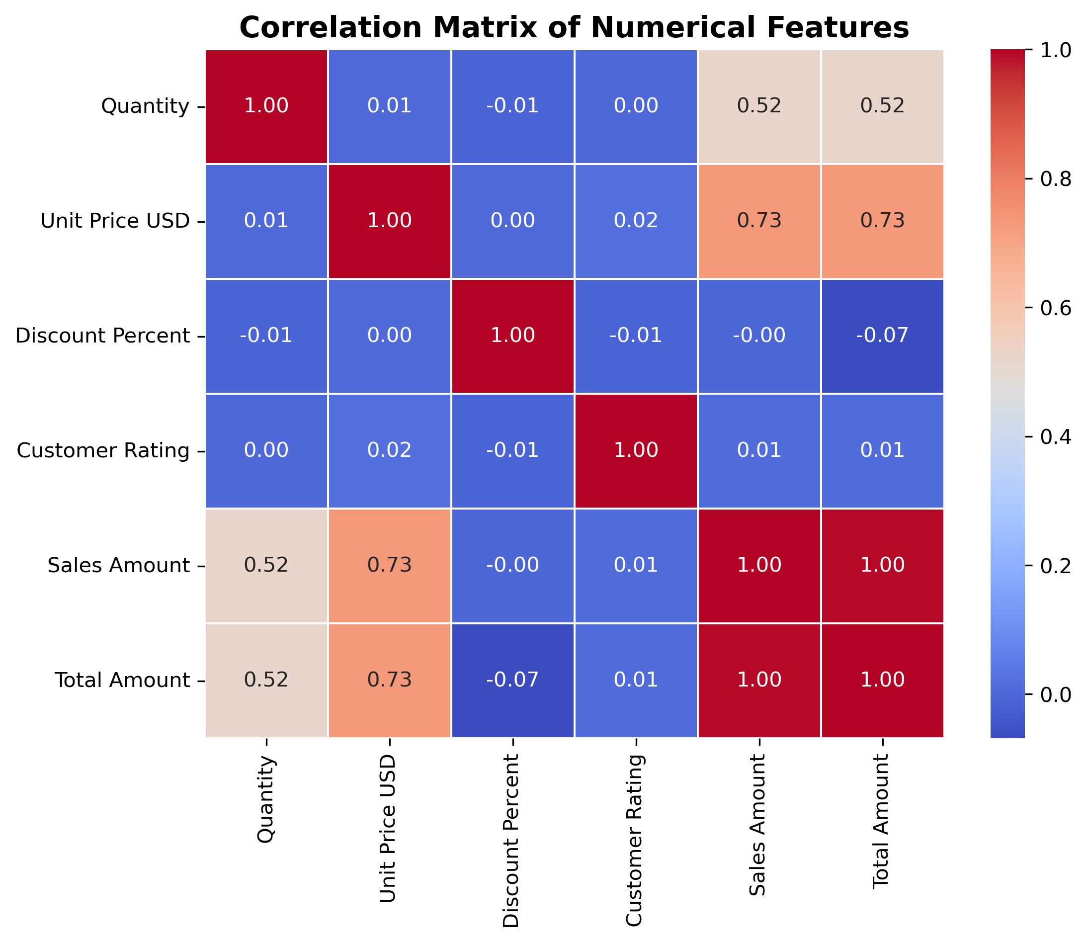
Statistical Correlation & Pricing Strategy
Revenue Drivers: Unit Price (0.73) and Quantity (0.52) are primary growth drivers
Discount Impact: Discounts show minimal correlation (-0.07) with total order value.

Slide 11
Strategic Recommendations & Action Plan
Data-Driven Next Steps to Maximize Revenue & Operational Efficiency
Revenue & Inventory Strategy (Sales & Marketing)
Pricing & Margin Optimization
Operations & Logistics
Demand-Driven Growth:
Pricing & Profitability
Supply Chain Efficiency
Q4 Inventory Scale-Up: Increase stock levels and marketing budget by 40% in September to capture peak Q4 holiday demand.
Leverage Core Categories: Focus promotional campaigns on Electronics ($350K+) and Home & Kitchen, which drive over 45% of total revenue.
Target High-Value Cities: Prioritize performance marketing in top regional hubs like Abu Dhabi ($100K+) and Dubai ($90K+).
Shift Away from Blanket Discounts: Flat discounting shows a weak correlation (-0.07) with total order value and does not increase basket size.
Implement Smart Bundling: Pair slow-moving categories (Grocery/Books) with high-performing Electronics to boost average order value.
Focus on High-Unit-Value Items: Capitalize on Unit Price (0.73 correlation) as the primary positive driver of gross sales.
Improve Delivery Success Rate: Upgrade courier partner SLAs to push the current 54.82% delivery success rate toward industry benchmarks.
Regional Fulfillment Hubs: Establish local fulfillment centers in top-tier cities (Abu Dhabi & Dubai) to shorten shipping times.
Mitigate Order Returns: Audit product descriptions and quality standards to reduce refund/return frequency.
Expected Business Impact: "Implementing these recommendations can improve Q4 revenue capture by 25-30% and boost order delivery rates above 75%."

