Slide 1



E-Commerce Retail Sales & Customer Analytics
Comprehensive BI Dashboard, Category Dominance, Delivery Risk & Growth Strategy
$1.41M
12K+
88.47%
55%
GROSS REVENUE
TOTAL ORDERS
REPEAT RATE
DELIVERY RATE
Prepared by Mohammad Shadab | Data Analyst Portfolio Project
Python • Pandas • Seaborn • Matplotlib • EDA • Power BI • Power Query • DAX

Slide 2





Executive Overview
$1.41M
3.4K
$117.38
Total Revenue (2024–2026)
Total Active Customers
Average Order Value (AOV)
24.5K
$103K
8.46%
Total Items Sold (QTY)
Total Discount Given
Return Rate Across Orders
🎯 STRATEGIC SUMMARY
Exceptional customer loyalty (88.47% repeat rate) and steady annual revenue ($0.56M in 2024 and $0.57M in 2025) establish a solid foundation, though operational bottlenecks require immediate executive intervention.

Slide 3
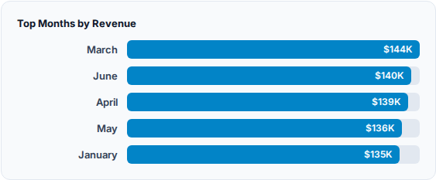
Time-Series & Sales Trends
•
Peak Performing Month: March leads annual sales at $144K, closely followed by June ($140K) and April ($139K).
•
Peak Sales Day: Thursday experiences the highest daily transaction velocity across all weeks.
•
Yearly Stability: 2024 revenue reached $0.56M and 2025 scaled to $0.57M (+2.27% growth).
•
Cancellation Rate: Recorded at 9.97%, requiring supply chain monitoring.

Slide 4
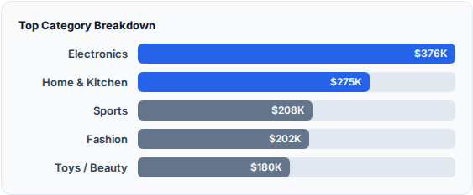
Product Category Dominance
•
Electronics Category: Generates $376K+ alone, representing nearly 27% of total company gross revenue.
•
Home & Kitchen Category: Captures $275K+, accounting for nearly 20% of sales.
•
Concentration Risk & Opportunity: Just these two core categories combine for over 45% of total gross revenue.
•
Sports & Fashion form a secondary tier (~$200K each), while Books & Grocery lag behind in absolute monetary yield.
💡 CATEGORY STORYTELLING
Our catalog is anchored by high-intent Electronics and Home Goods. To maximize profitability, we must protect supply chain integrity for these top two categories while bundling slower-moving items (Books, Grocery) to lift overall basket sizes.

Slide 5
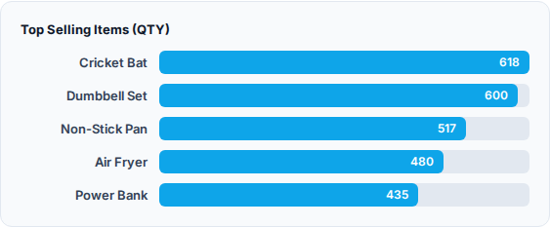
Product Intelligence
•
Volume Leaders: Cricket Bats (618 units) and Dumbbell Sets (600 units) lead physical sales volume.
•
Revenue Drivers: Gaming Mouse ($47.2K), USB-C Cable ($46.9K), and Non-Stick Pan ($46K) maximize monetary yields.
•
Flagship Item: Power Bank emerges as a top cross-category best-seller.
•
Electronics & Home Goods continue to anchor total basket values.

Slide 6
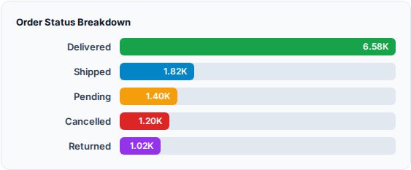
Operational Deep Dive
•
Critical Vulnerability: The overall delivery success rate stands at only 54.82%, representing a major friction point in customer experience.
•
Revenue at Risk: Over $163K in potential revenue is currently trapped in pending and shipping statuses.
•
Order Breakdown: 6.58K delivered successfully, 1.82K shipped, 1.40K pending, 1.20K cancelled, and 1.02K returned.
•
Return rate is recorded at 8.46%, pointing to specific product quality verification needs before dispatch.
🚨 URGENT OPERATIONAL ACTION REQUIRED
A 55% delivery fulfillment rate creates severe customer dissatisfaction and stalls cash conversion. Establishing regional micro-fulfillment hubs will instantly mitigate transit delays and recover the $163K at-risk revenue.

Slide 7
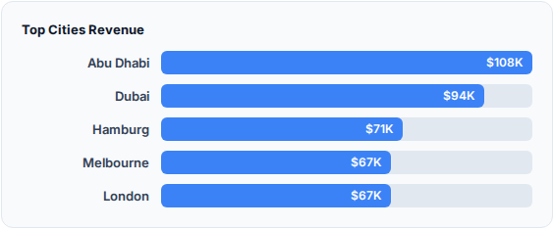
Geographic & City Insights
•
Top City by Revenue: Abu Dhabi ($108K) and Dubai ($94K) capture primary Middle Eastern market share.
•
International hubs like Hamburg ($71K), Melbourne ($67K), and London ($67K) demonstrate strong European and APAC traction.
•
Country distribution across UAE, UK, Germany, India, USA, Canada, and Australia shows balanced global demand.

Slide 8
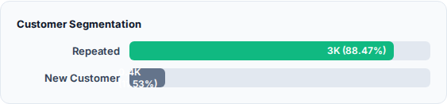
Customer Retention & Demographics
•
Exceptional Loyalty: 88.47% repeat customer rate demonstrates world-class brand equity and product satisfaction.
•
Average Order Quantity: 2.04 items per transaction, indicating healthy multi-item basket additions.
•
Average Discount provided sits at 6.87%, maintaining healthy gross operating margins.
•
Payment gateway adoption is evenly balanced across Credit Card, COD, UPI, and Netbanking.

Slide 9
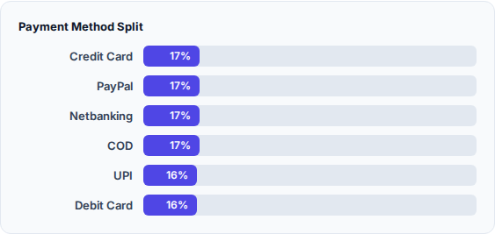
Payment Gateway Distribution
•
Balanced Adoption: Payment distribution is exceptionally uniform across all 6 primary gateways (~16% to 17% each).
•
Low Gateway Risk: No single payment provider poses dependency risk, ensuring smooth global transactions.
•
Cash on Delivery (COD) accounts for 17.25%, aligning with regional preferences in Middle Eastern markets.

Slide 10
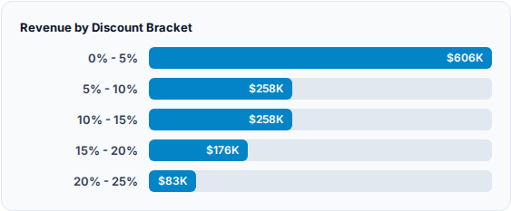
Pricing & Discount Dynamics
•
Discount Correlation: Correlation between discount percentage and sales volume is very weak (r = -0.07).
•
Blanket Discounts Ineffective: High discounts do not automatically trigger higher sales volume.
•
Optimal Yield: 0% to 5% discount brackets capture the largest share of revenue ($606K).

Slide 11
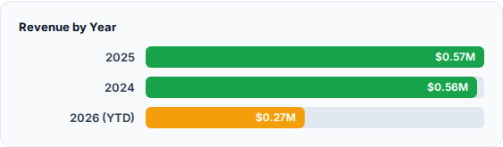
Year-over-Year Performance
•
Consistent Growth: 2025 scaled to $0.57M representing a healthy +2.27% YoY growth over 2024 ($0.56M).
•
YTD 2026: Already records $0.27M in cumulative gross transactions.
•
Strong foundation for Q4 holiday push to exceed previous years' benchmarks.

Slide 12

Strategic Narrative
•
The Growth Paradox: While top-line revenue ($1.41M) and repeat customer rate (88%) are world-class, fulfillment friction threatens long-term brand advocacy.
•
Category Leverage: Electronics and Home Goods act as customer acquisition magnets; cross-selling accessories into these baskets will maximize margin yield.
🎯 THE EXECUTIVE NARRATIVE
"We have proven product-market fit across global hubs and achieved extraordinary brand loyalty. The next phase is operational excellence: securing our supply chain to convert pending orders into delivered revenue."
•
Operational Fix: Resolving the 45% delivery lag is the single highest ROI lever available to management.

Slide 13

Strategic Recommendations
Strategic Focus | Recommended Action | Expected Impact
📈 Demand Scaling | Increase inventory allocation for March/June seasonal peaks and top categories (Electronics & Home Goods). | Maximize top-line revenue capture without stockouts.
🚚 Fulfillment Audit | Establish regional micro-fulfillment centers in Abu Dhabi and Dubai to reduce transit friction. | Recover $163K pending revenue and improve delivery success rate above 75%.
🔄 Retention Engine | Leverage the 88.47% repeat customer rate with personalized loyalty rewards and VIP tiers. | Sustain high customer lifetime value (LTV) and recurring orders.

Slide 14



Thank You
Let's connect to discuss advanced data analytics, Power BI reporting, and growth strategies!
📧
💼
🐙
Created with ❤️ by Mohammad Shadab | Data Analyst

