Slide 1


Prof.Dr.Taysir Hassan A.Soliman Eng.Rofida Gamal Eng.Mena Nagy
Heart Disease

Slide 2
Table of Contents
01
02
03
04
05
Data Description
Introduction
Data Overview
Data Visulazation
ML Model

Slide 3
Introduction
Our dataset focuses on HealthCare Quality Analysis, specifically targeting heart disease prediction. It comprises 14 columns and 1203 rows . We divided our data to 3 collections (patient_info,exercise_info,Target)

Slide 4
01
Data Overview
Number of Entries: The dataset consists of 1203 entries, ranging from index 0 to 1203.
Columns: There are 14 columns in the dataset corresponding to various attributes of the patients and results of tests.
Data Types: Most of the columns (13 out of 14) are of the int64 data type.
Only the oldpeak column is of the float64 data type.
Missing Values: There don't appear to be any missing values in the dataset as each column has 1203non-null entries.

Slide 5
Data Description:
Age:Age of the patient in years
Sex:Gender of the patient: (0 = male, 1 = female)
Cp:Chest pain type: 0: Typical angina 1: Atypical angina 2: Non-anginal pain 3: Asymptomatic
Trestbps: Resting blood pressure in mm Hg
Chol:Serum cholesterol in mg/dl
Fbs:Fasting blood sugar level, categorized as above 120 mg/dl (1 = true, 0 = false)

Slide 6
Conc.
Restecg:Resting electrocardiographic results: 0: Normal 1: Having ST-T wave abnormality
2: Showing probable or definite left ventricular hypertrophy
Thalach:Maximum heart rate achieved during a stress test
Exang:Exercise-induced angina (1 = yes, 0 = no)
Oldpeak:ST depression induced by exercise relative to rest
Slope:Slope of the peak exercise ST segment: 0: Upsloping 1: Flat 2: Downsloping

Slide 7
Conc .
Ca: Number of major vessels (0-4) colored by fluoroscopy
Thal:Thalium stress test result:
0: Normal
1: Fixed defect
2: Reversible defect
3: Not described
Target: Heart disease status : (0 = no disease, 1 = presence of disease)

Slide 8
Data Visualizations
We conducted data analysis using the Dataprep library, which provided us with various visualization results, including heatmaps, box plots, and correlation matrices

Slide 9
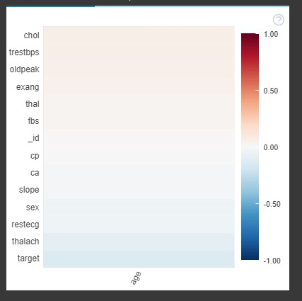
Correlation Matrix
This our correlation matrix between Age and other attributes:
Between Age-thalach it is very low negative correlation
Between Age-Chol very high positive correlation

Slide 10
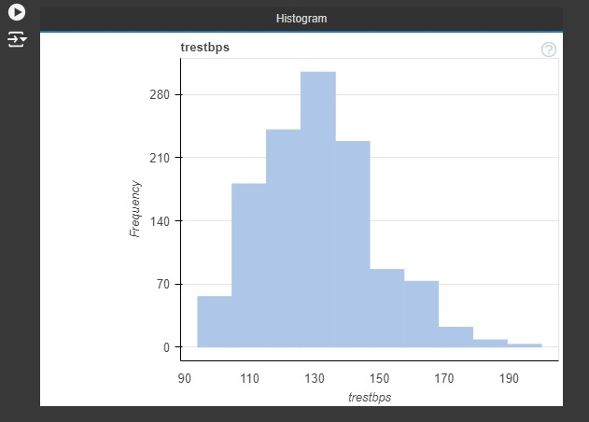
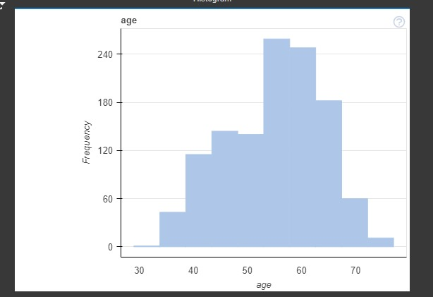
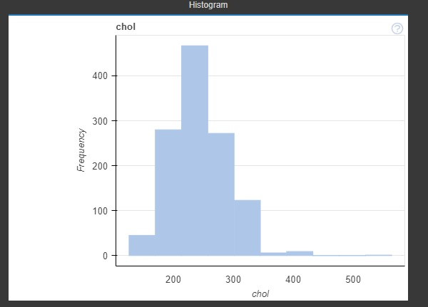
Histograms
Age
chol
trestbps

Slide 11
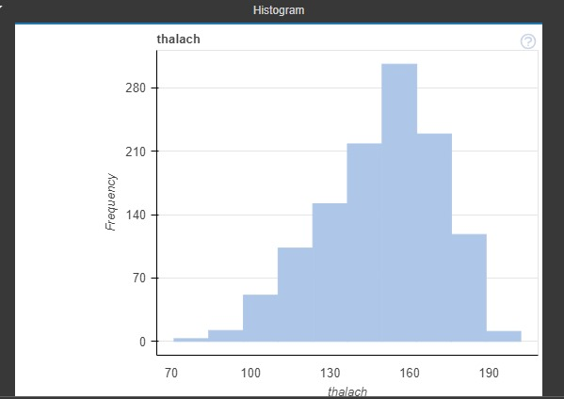
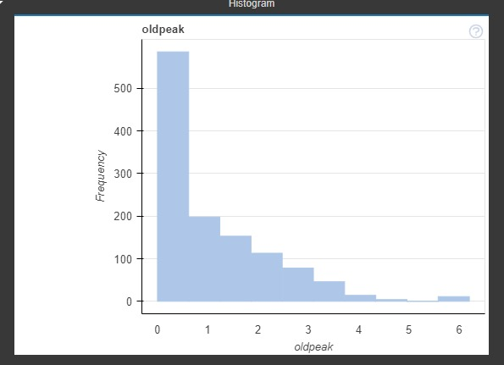
Conc. Histograms
thalach
oldpeak

Slide 12
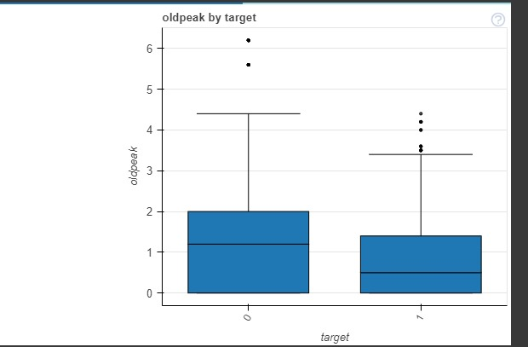
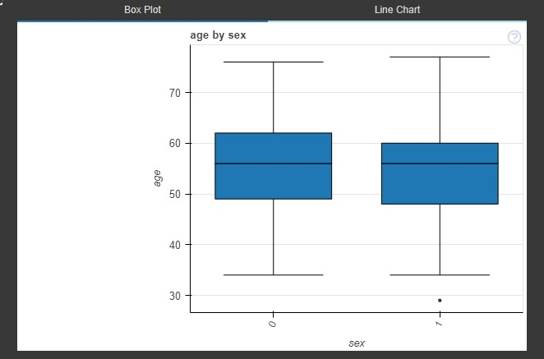
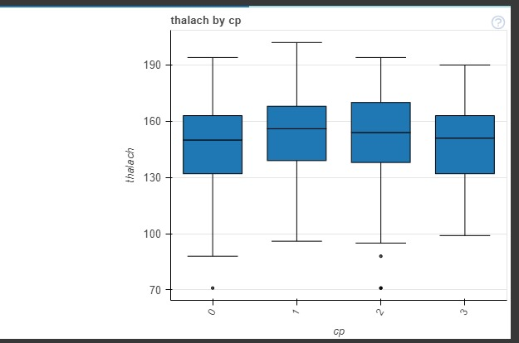
Box plots:
Oldpeak-Target
Age-Sex
Thalach-cp

Slide 13
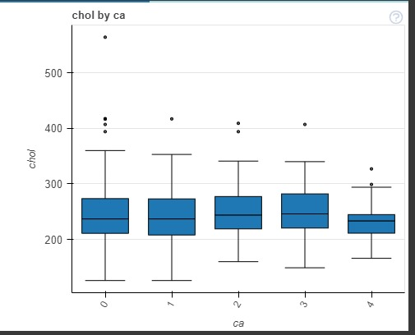
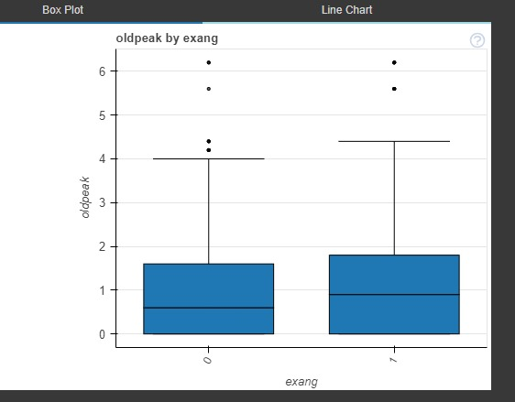
Boxplots conc.
Oldpeak-exang
Chol-ca

Slide 14
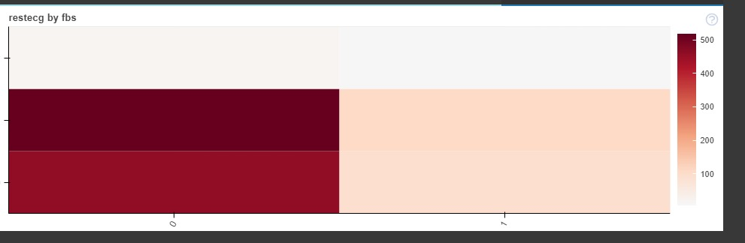
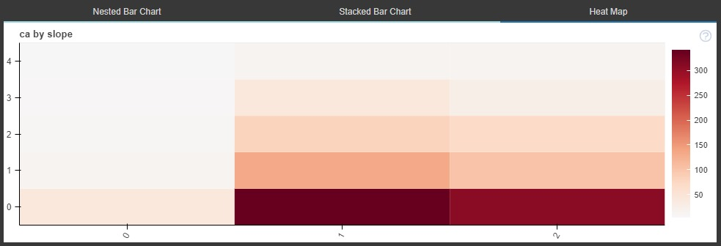
Heatmaps
Restceg-fbs
Ca-slope

Slide 15
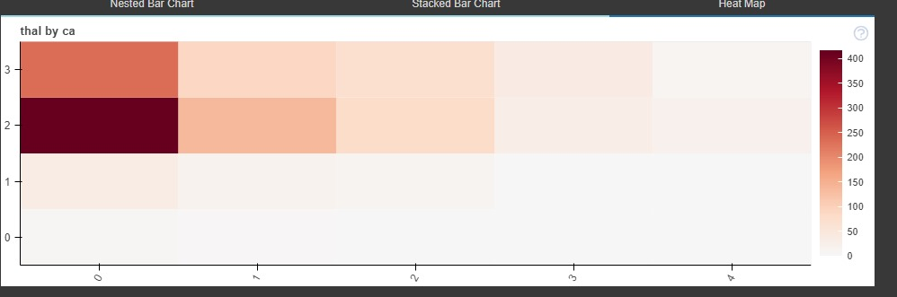
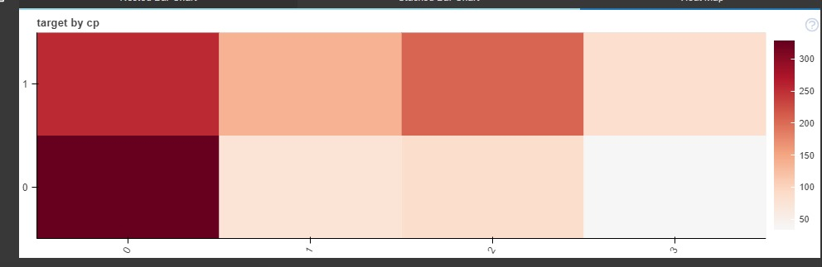
Heatmaps conc.
Thal-ca
Cp-target

Slide 16
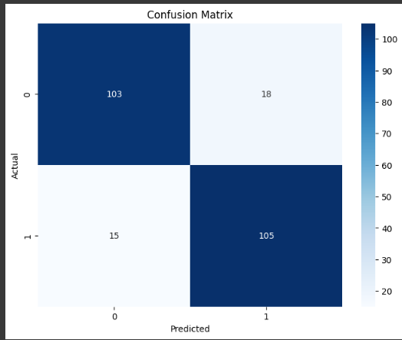
Machine learning model
A random forest model was used to predict heart disease in this dataset.
This visualization shows the performance of a
Random Forest model on a heart disease prediction task. The model achieved an accuracy of 86%.

Slide 17
Team Members
Ezz El-Deen Amer
Eman Osama Hosny
1
4
Mohamed Hossam
Sohila Noaman Mahmoud
2
5
Abdel-Aziz Elsyed
Nader Nagah Mohamed
3
6

Slide 18
Resources
ML model:
https://colab.research.google.com/drive/15kL3hmXYF3weXhCBHjFD5SJh_X7zWoih?usp=sharing
Dataprep:
https://colab.research.google.com/drive/1egR-fSso1SQgd0_Oec-Kc6lMHY0LCrxm#scrollTo=BILqD7m7Z-vO

Slide 19

Thanks

