Slide 1

European Football Leagues
Data Warehouse Project
Supervised: Dr. Ali Zidan
GitHub Repo: github.com/Mohammed-3tef/European_Football_Leagues_DataWarehouse

Slide 2
Project Architecture Overview
The ETL process follows a three-layer architecture:
Source Database (OLTP)
Staging Area (STG)
Data Warehouse (DWH)
Automation Engine: SQL Server Integration Services (SSIS)
Reporting Front-End: Power BI Interactive Dashboards

Slide 3
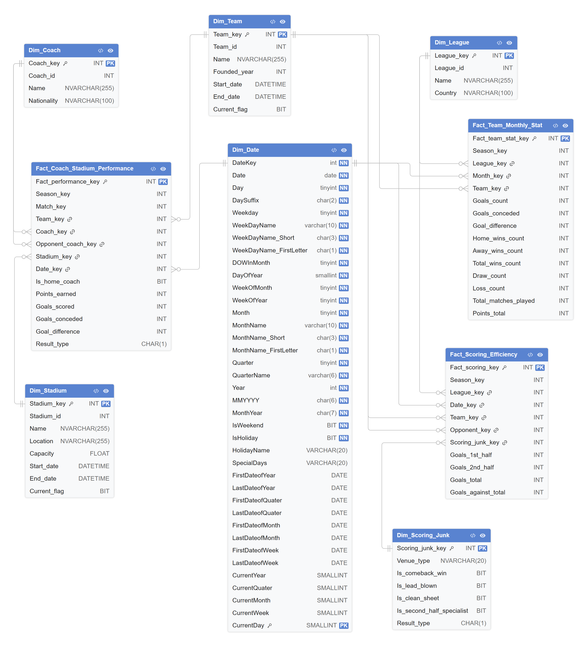
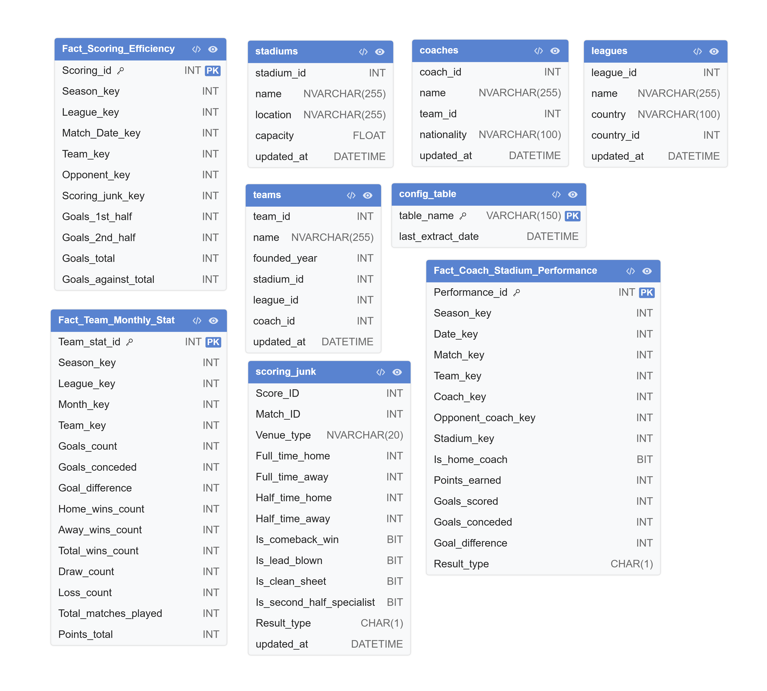
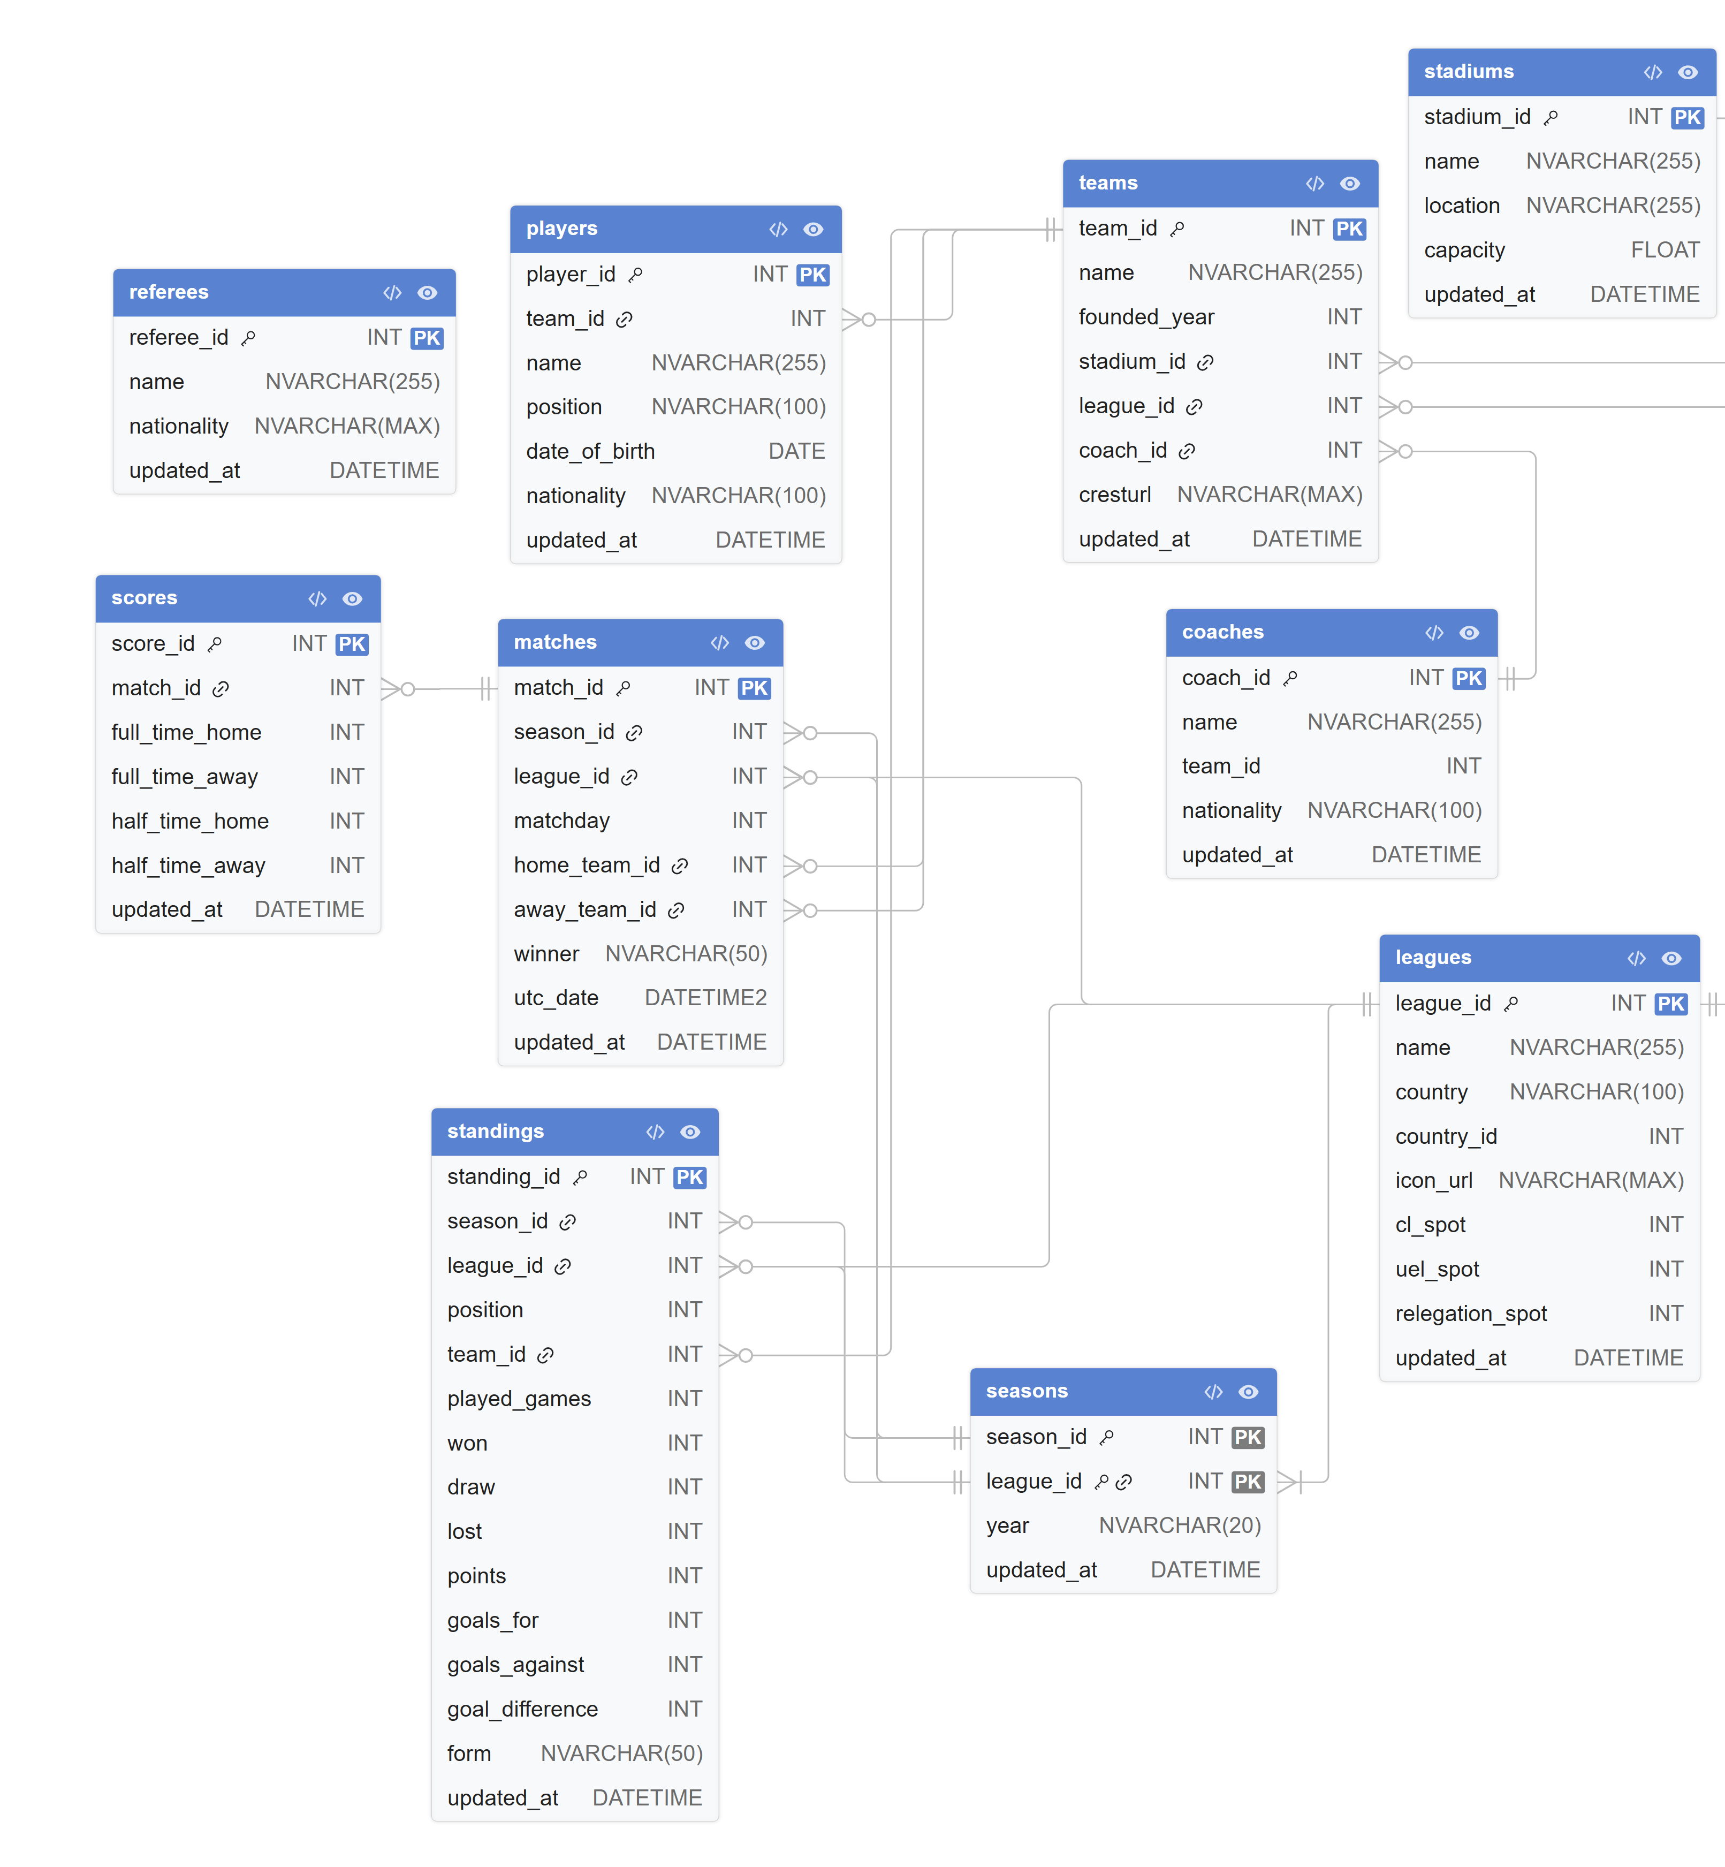
Data Warehouse (DWH)
System Purpose: Centralized analytical engine structured as a Star Schema with conformed dimensions linked to multi-perspective fact tables.
Strategic Objective: Speeds up queries, simplifies complex joins, and tracks historical changes (via SCD Type 2) to power KPIs and Power BI dashboards.
Staging Area (STG)
System Purpose: Acts as a temporary intermediate buffer between the live production database and the data warehouse.
Strategic Objective: Protects the production database by pulling incremental data updates, then cleaning and normalizing it before warehouse loading.
Source Database (OLTP)
System Purpose: Captures daily operational football data across 10 normalized tables (teams, matches, scores, standings).
Strategic Objective: Enforces data integrity and eliminates redundancy; optimized for fast, reliable data writes rather than analytical queries.

Slide 4
Data Warehouse (DWH)
System Purpose: Centralized analytical engine structured as a Star Schema with conformed dimensions linked to multi-perspective fact tables.
Strategic Objective: Speeds up queries, simplifies complex joins, and tracks historical changes (via SCD Type 2) to power KPIs and Power BI dashboards.
Staging Area (STG)
System Purpose: Acts as a temporary intermediate buffer between the live production database and the data warehouse.
Strategic Objective: Protects the production database by pulling incremental data updates, then cleaning and normalizing it before warehouse loading.
Source Database (OLTP)
System Purpose: Captures daily operational football data across 10 normalized tables (teams, matches, scores, standings).
Strategic Objective: Enforces data integrity and eliminates redundancy; optimized for fast, reliable data writes rather than analytical queries.

Slide 5
Data Warehouse (DWH)
System Purpose: Centralized analytical engine structured as a Star Schema with conformed dimensions linked to multi-perspective fact tables.
Strategic Objective: Speeds up queries, simplifies complex joins, and tracks historical changes (via SCD Type 2) to power KPIs and Power BI dashboards.
Staging Area (STG)
System Purpose: Acts as a temporary intermediate buffer between the live production database and the data warehouse.
Strategic Objective: Protects the production database by pulling incremental data updates, then cleaning and normalizing it before warehouse loading.
Source Database (OLTP)
System Purpose: Captures daily operational football data across 10 normalized tables (teams, matches, scores, standings).
Strategic Objective: Enforces data integrity and eliminates redundancy; optimized for fast, reliable data writes rather than analytical queries.

Slide 6
Fact Tables & Analytical Granularity
Fact Table | Grain | Description
Fact_Team_Monthly_Stat | One Team + One League + One Month | Stores aggregated monthly performance statistics for teams
Fact_Scoring_Efficiency | One Team + One Match | Stores detailed scoring and efficiency metrics for every match
Fact_Coach_Stadium_Performance | One Team + One Match | Stores coach and stadium related performance analytics

Slide 7
The ETL Process Architecture
Tool Utilized: SQL Server Integration Services (SSIS).
Core Phases:
Extraction: Pulls incremental deltas utilizing an operational updated_at filter column.
Transformation: Cleans null values, standardizes formats, calculates points/goals, maps surrogate keys, and generates junk indicators.
Loading Sequence: Enforces strict execution paths by loading Dimension Tables first, generating surrogate keys, and finally executing Fact Lookup sequences.

Slide 8
Incremental Load Optimization
Strategy: Employs delta tracking via a specific extraction filter query:
SELECT * FROM teams WHERE updated_at > @LastExtractDate;
Pipeline Advantages:
Dramatically accelerates overall ETL processing runs.
Lowers live server strain and operational database overhead.
Enhances scheduling and multi-season scaling potential.

Slide 9
Power BI Interactive Dashboards

Slide 10
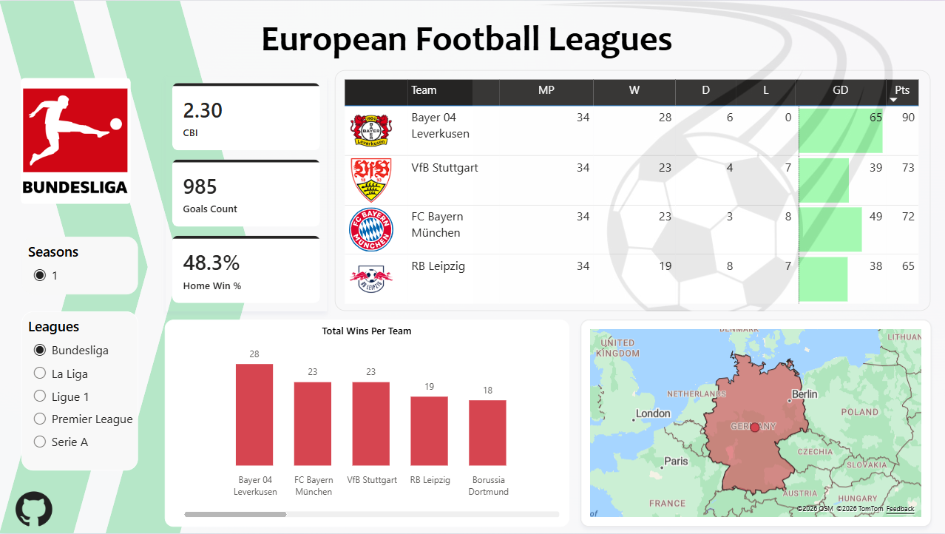
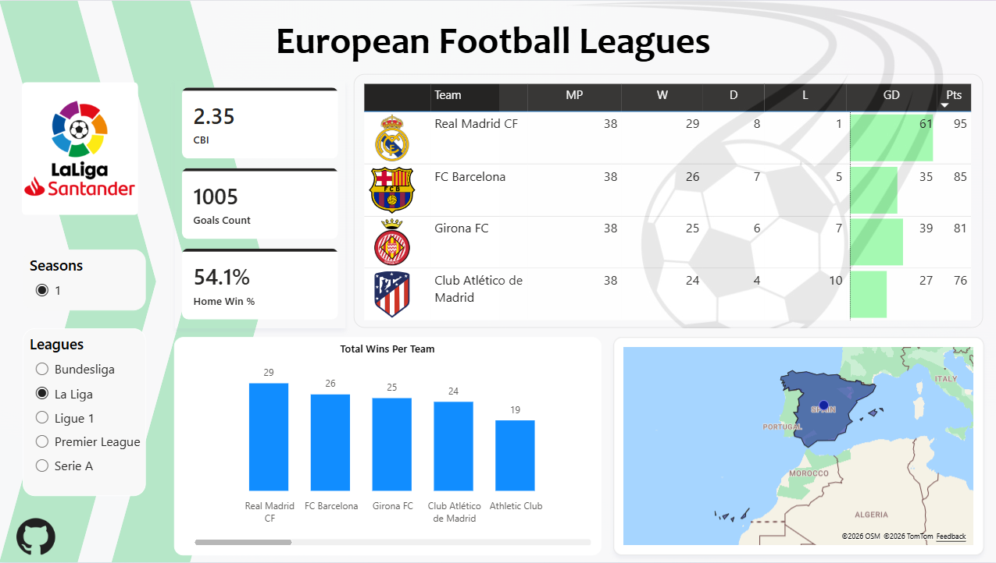

Slide 11
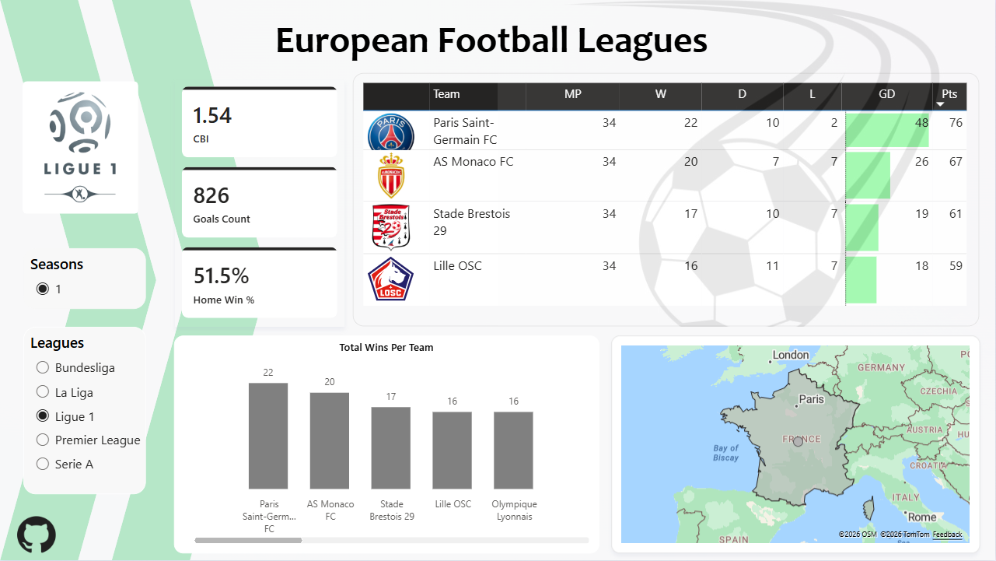

Slide 12
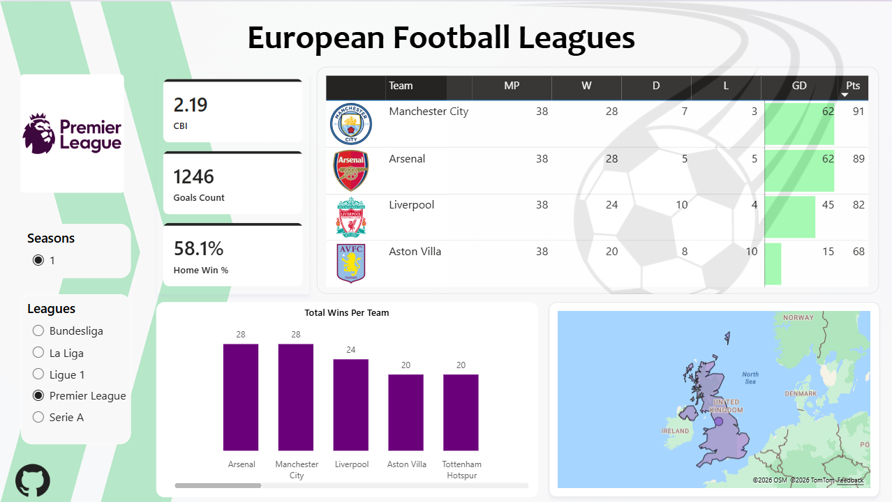

Slide 13
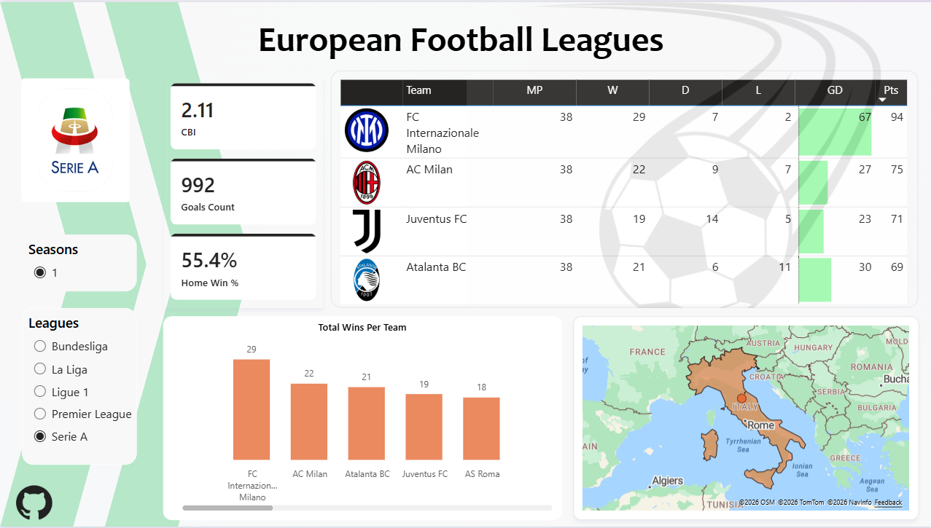

Slide 15
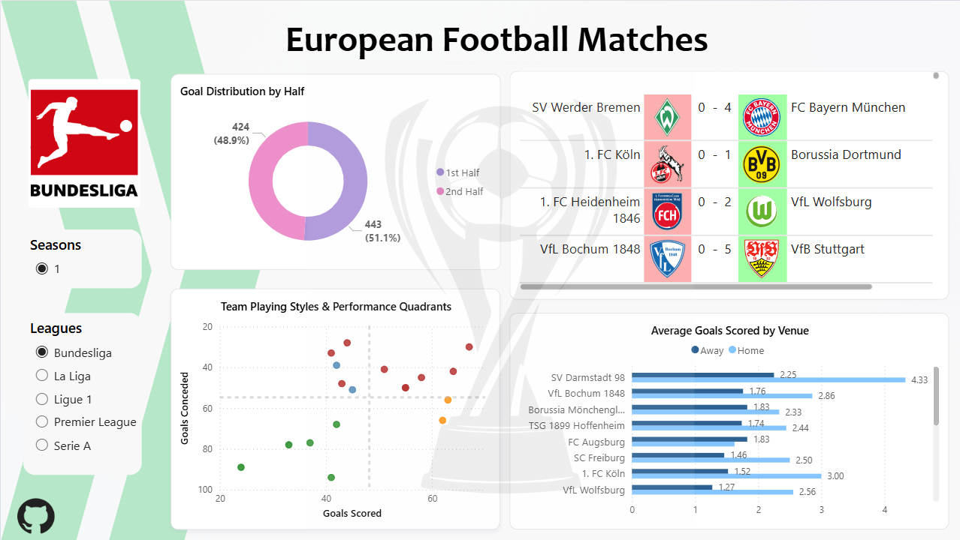
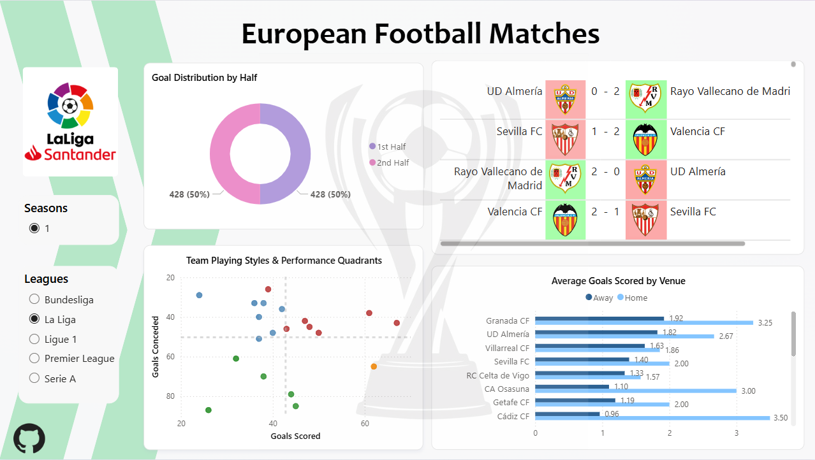

Slide 16
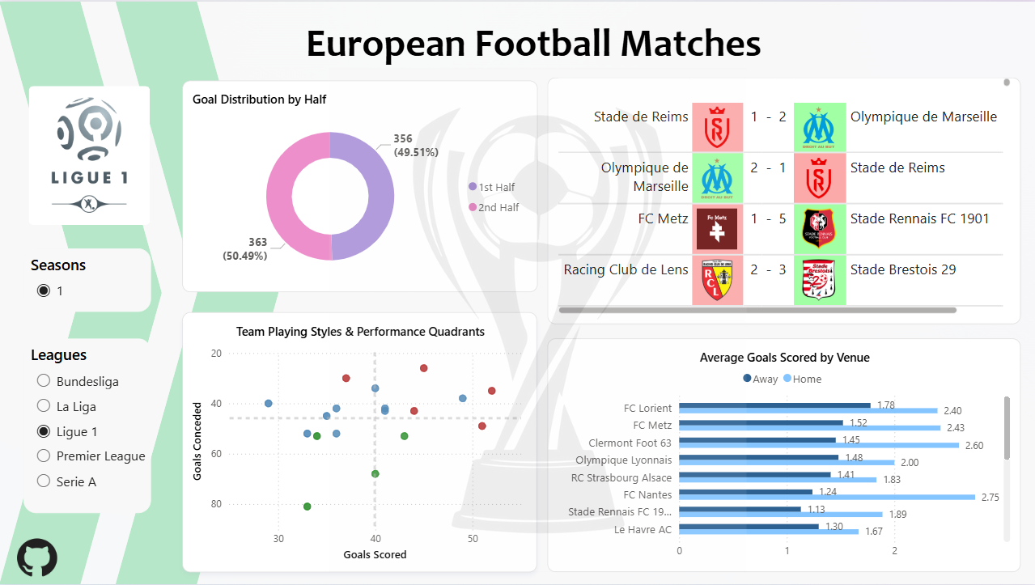

Slide 17
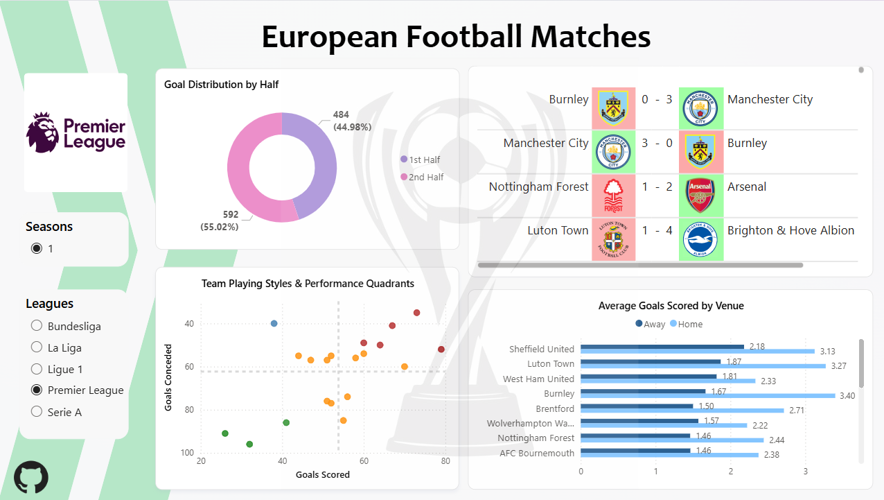

Slide 18
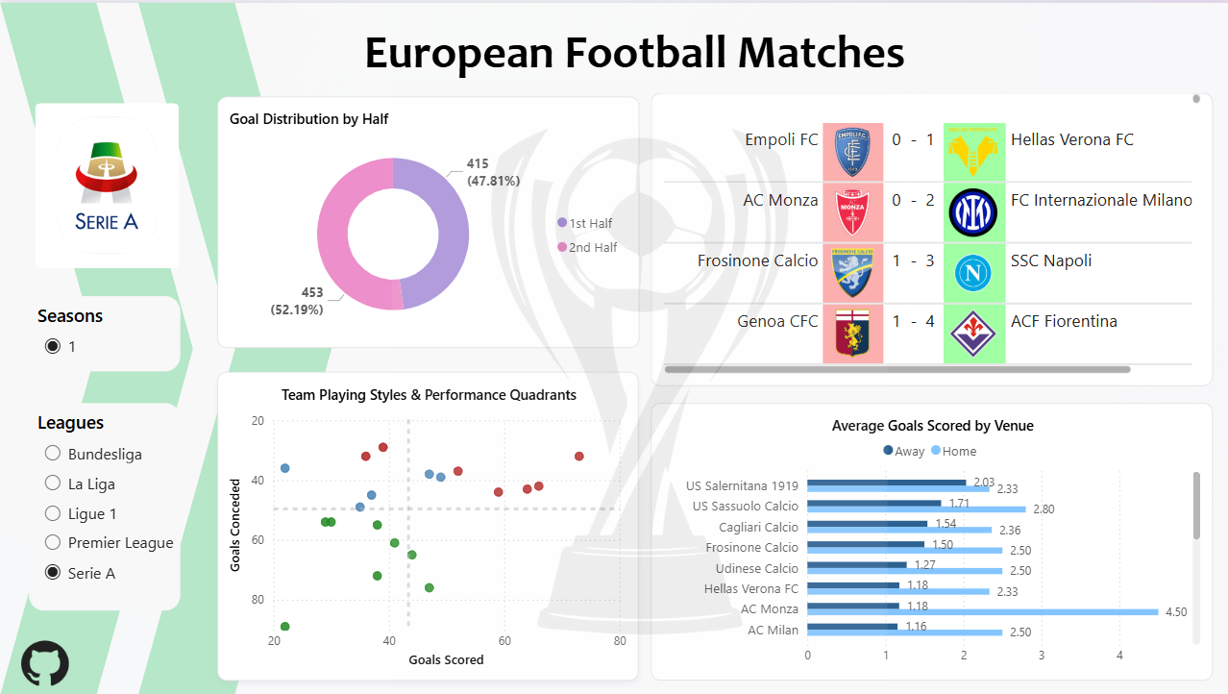

Slide 20
Thank You
Prepared by:
Mohammed Atef:
LinkedIn: in/mohammed-atef-abd-elkader/
GitHub: github.com/Mohammed-3tef
Mohammed Ahmed:
LinkedIn: in/mohamed-ahmed-ba0815307/
GitHub: github.com/mohamedahmed2005
Mostafa Ehab:
LinkedIn: in/mustafa-ehab-aql/
GitHub: github.com/Eng-M0stafaEhab
Mostafa Mahmoud:
LinkedIn: in/mostafa-mahmoud-51b101324/
GitHub: github.com/mostafa-mahmoud-fathy

