Slide 1


NTI
DATA ANALYSIS FINAL PROJECT
RAW DATA TO ACTIONABLE INSIGHTS
AUGEST 2026

Slide 2

OUR TEAM
01
Hla Hany
Exploring The Data
02
Mohammed Atef
Data Processing And Cleaning
03
Mahmoud Hassan
Answering Bussiness Questions
04
Youssef Aly
Dashboard And Reporting

Slide 3
TABLE OF CONTENTS
01
Business Problem & Objectives
05 Final Dashboard
06 Recommendations
Dataset Overview
Data Preparation & Cleaning
Exploratory Analysis

Slide 4






01
BUSINESS PROBLEM & OBJECTIVES
Our Team act as People Analytics analysts for a IBM's HR department, investigating why employees leave and which departments/roles are most affected, to inform retention strategy.
WORKFLOW
EXCEL
1
PYTHON
2
SQL
3
POWER BI
4

Slide 5



01
BUSINESS PROBLEM & OBJECTIVES
Exploring & Cleaning The Data
Understanding the data we are dealing with, exploring dataset inconsistencies, null values, duplicate data, and the kinds of columns we are dealing with, an then cleaning it.
Answering Bussiness Questions
After Cleaning the Dataset , We go on exploring what the data have to offer by answering bussiness questions, discovering patterns And Extracting Important insights
Dashboarding & Reporting
Now that we have explored the dataset and extracted important insights, we can move on to visualizing the data for non-technical people, making the insights easier to understand and communicate.

Slide 6



02
ABOUT THE DATA
Dataset Name
IBM HR Analytics Employee Attrition & Performance
Dataset Source
https://www.kaggle.com/datasets/pavansubhasht/ ibm-hr-analy tics-attrition-dataset
Dataset Format
CSV

Slide 7


ABOUT THE DATA (DATASET AT A GLANCE)
02
1470 35
Employee Records Columns
CORE METRICS / COLUMNS
3
One Value Columns
Job Role
HEALTHCARE REPRESENT. HUMAN RESOURCES LABORATORY TECHNICIAN MANAGER MANUFACTURING DIRECTOR RESEARCH DIRECTOR RESEARCH SCIENTIST
SALES EXECUTIVE
SALES REPRESENTATIVE
Attrition
YES NO
SALES
HUMAN RECOURCES RESEARCH & DEVELOPMENT
EmployeeCount
1 ONLY
Depart.
Marital Statues
Over 18
Y ONLY
SINGLE MARRIED DIVORCED
StandardHours
80 ONLY

Slide 8
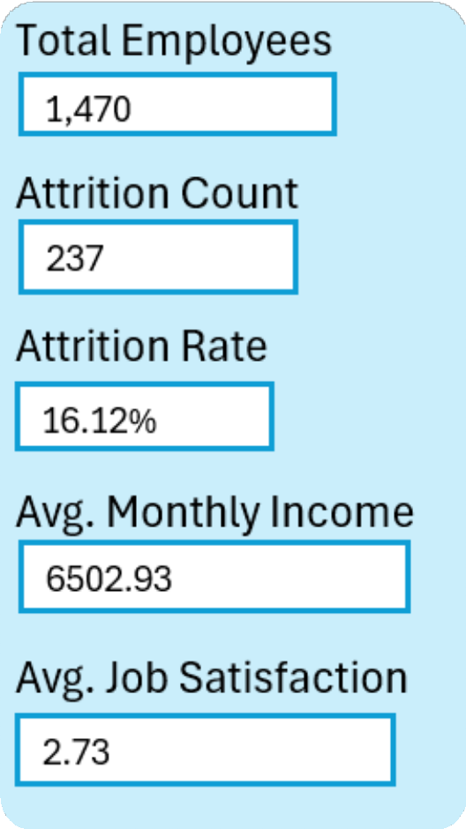
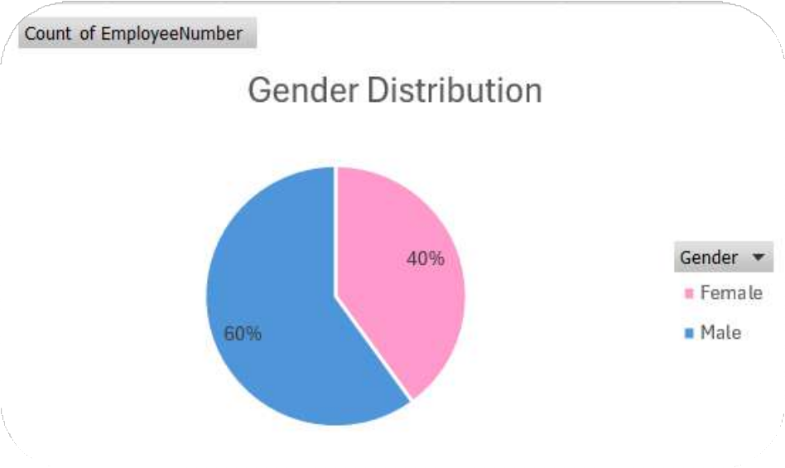
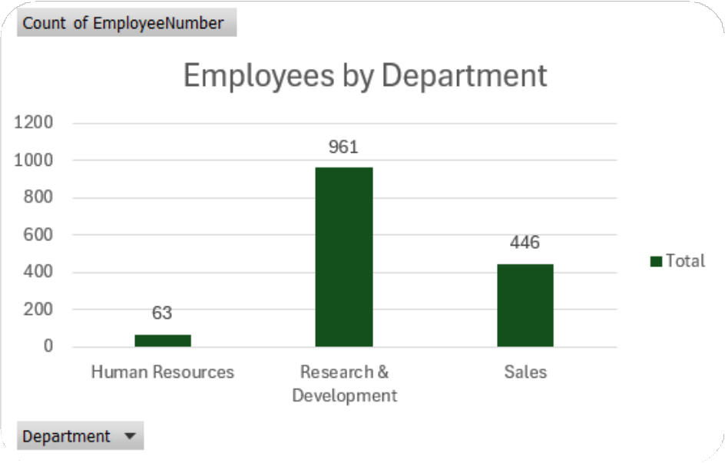
02
ABOUT THE DATA (DATASET AT A GLANCE)
Important KPIs
1
2
How Are Genders Distributed Across the Dataset?
How Are Employees Distributed Across Departments?

Slide 9
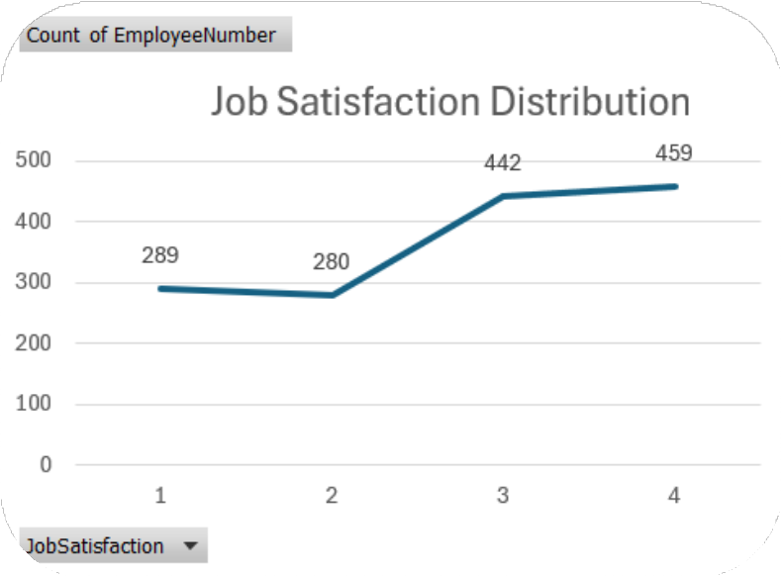
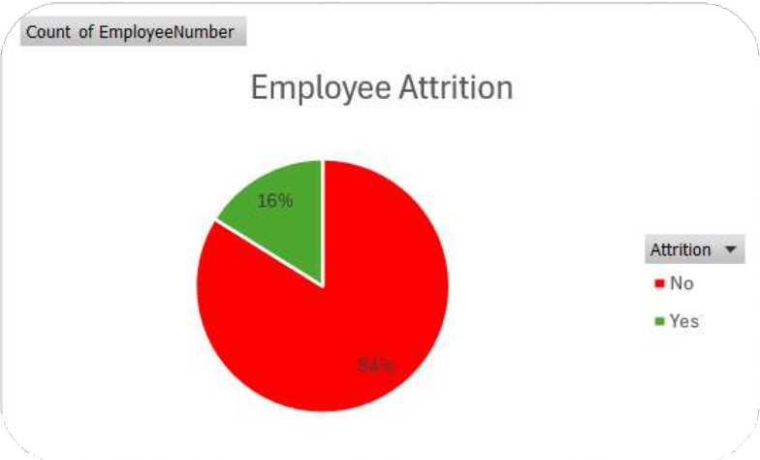
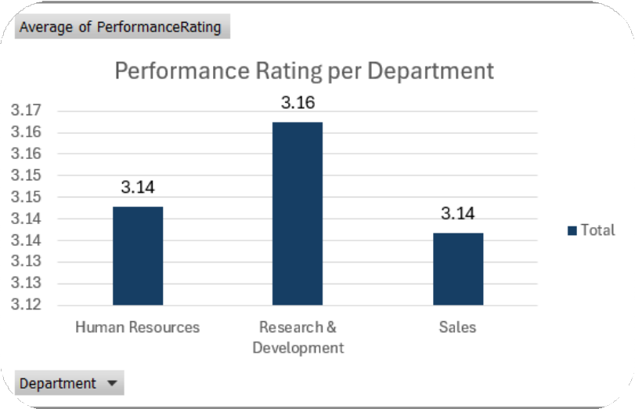
02
ABOUT THE DATA (DATASET AT A GLANCE)
3
What Is the Attrition Rate Distribution?
4
What Is the Preformance Rating Per Department??
5
What is the distribution of job satisfaction levels among employees?

Slide 10



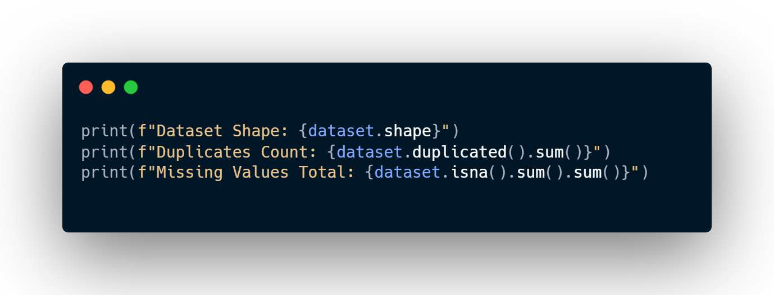
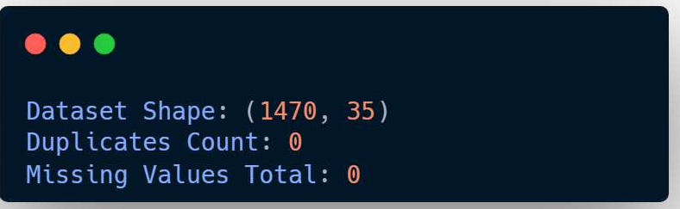
03
DATA CLEANING AND PROCESSING
1 No Duplicates Detected
2 No Nulls Found

Slide 11



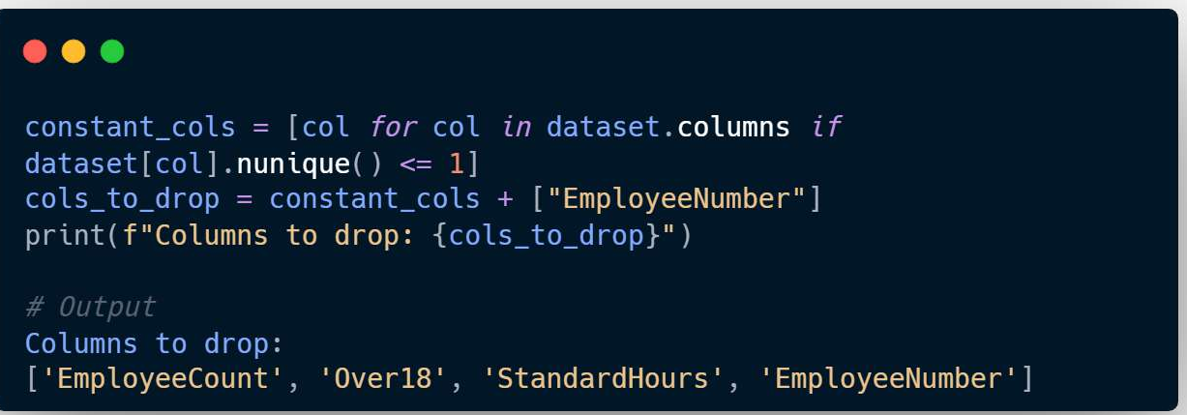
03
DATA CLEANING AND PROCESSING
3
Dropped 4 Columns
*All containing One Value

Slide 12

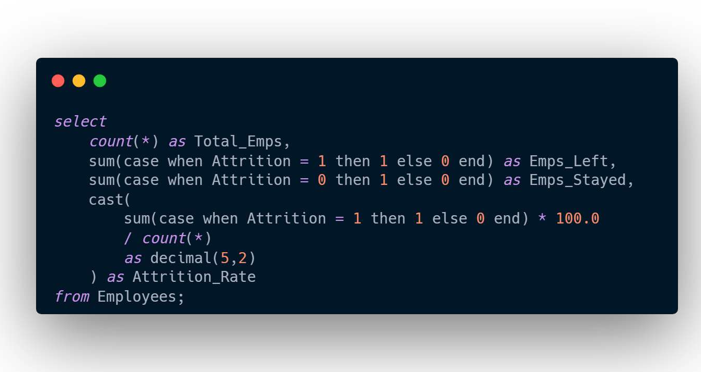
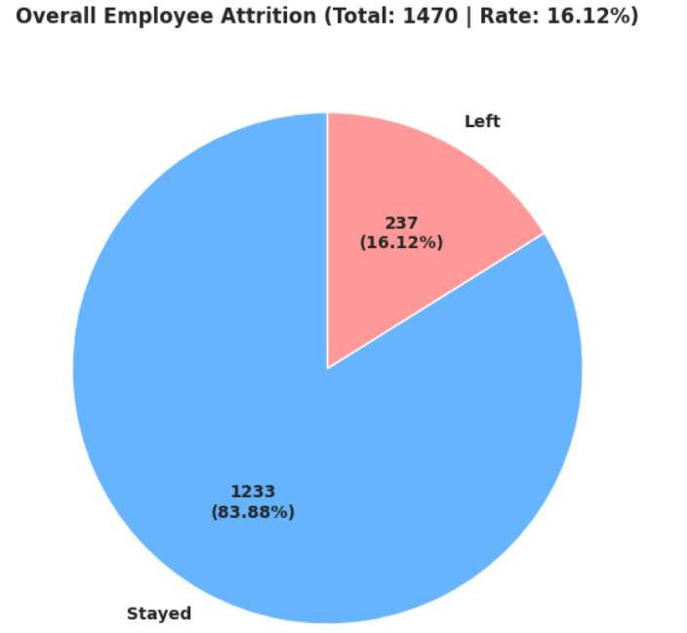
04
EXPLORATORY ANALYSIS
(ANSWERING BUSINESS QUESTIONS)
Understand overall attrition rate and how it varies across departments

Slide 13
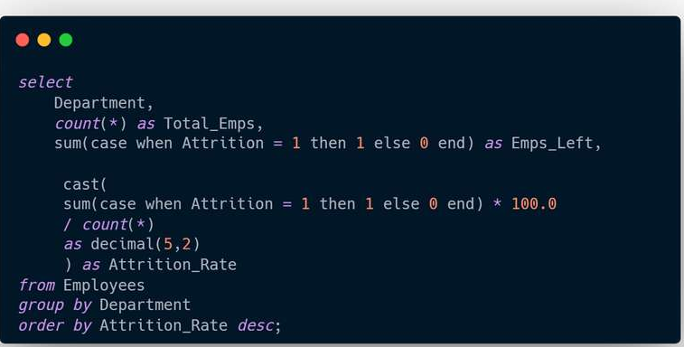
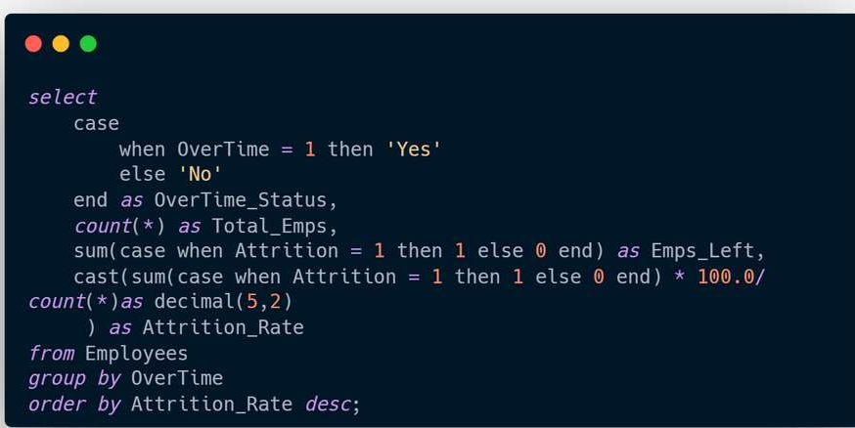
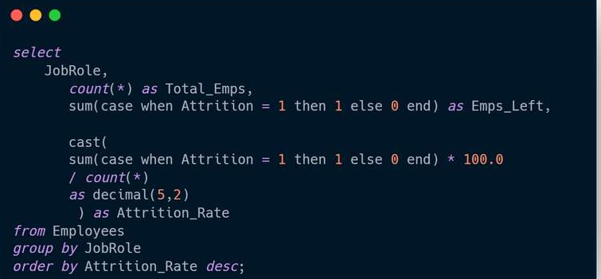
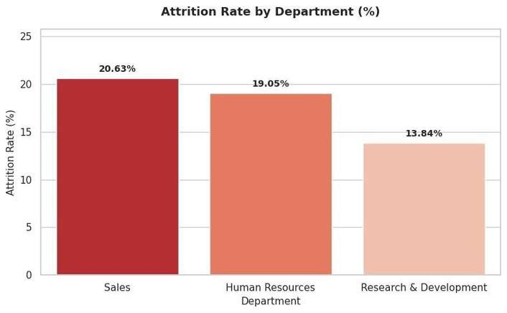
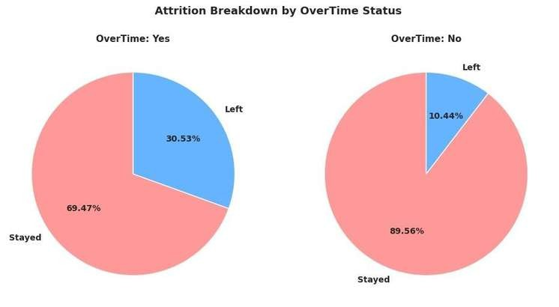
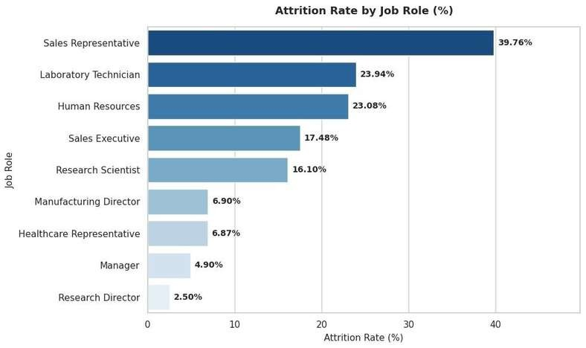
04
EXPLORATORY ANALYSIS
(ANSWERING BUSINESS QUESTIONS)
What is the attrition rate by department, job role, and overtime status?
DEPARTMENT OVERTIME
JOB ROLE

Slide 14
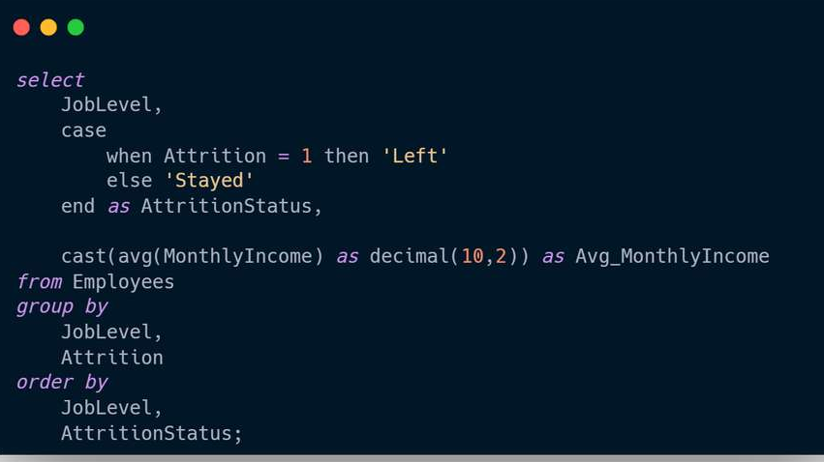
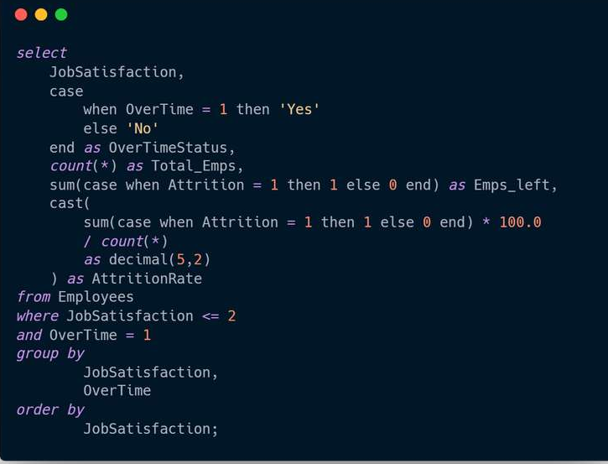
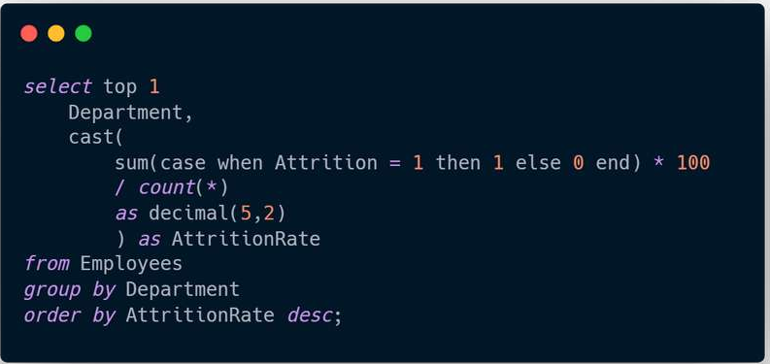

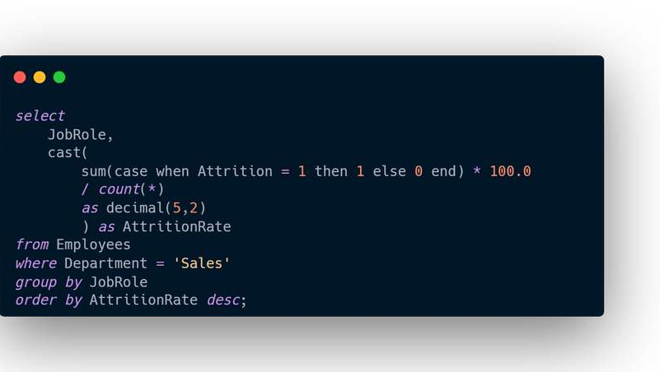
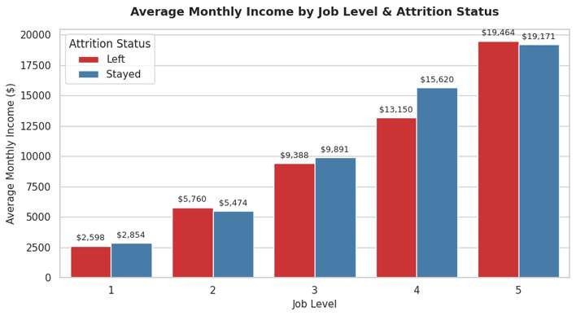
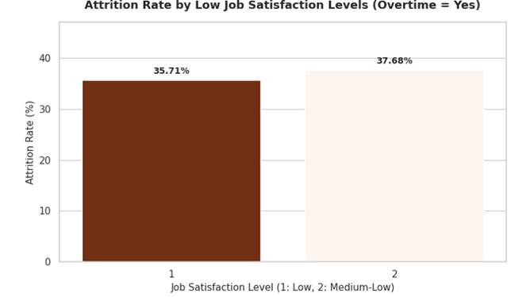
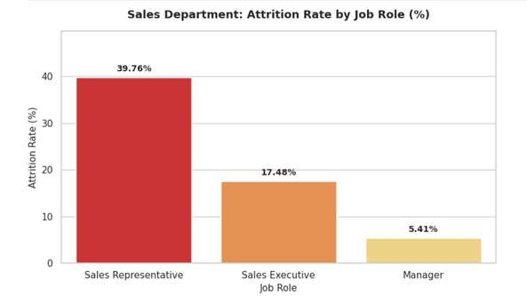
04
EXPLORATORY ANALYSIS
(ANSWERING BUSINESS QUESTIONS)
Which department has the highest attrition, and how does it break down by job role within that department?
+ Diagonstic
What is the average monthly income by job level and attrition status?
Which employees combine low job satisfaction with frequent overtime?

Slide 15
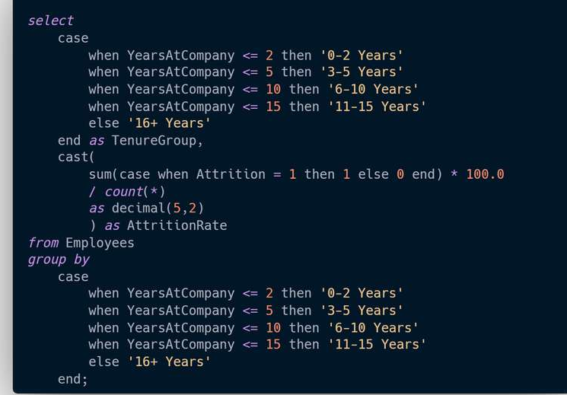
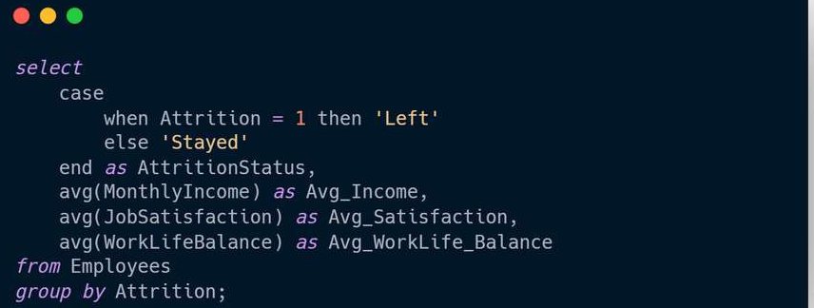
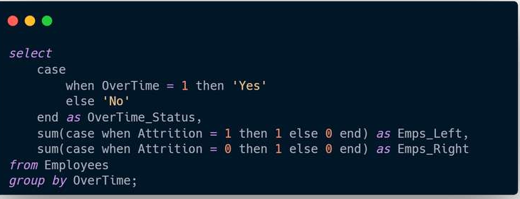
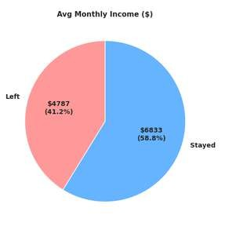
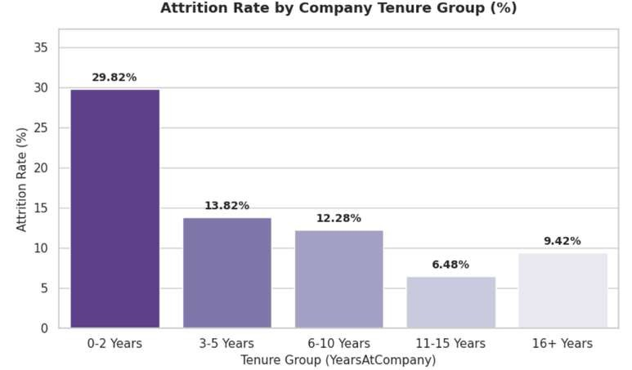

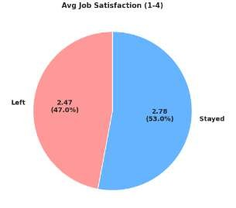
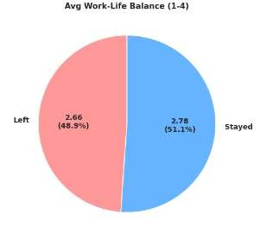
04
EXPLORATORY ANALYSIS
(DIAGNOSTIC ANALYTICS QUESTIONS)
Bucket "years at company" into tenure groups and compute attrition rate per group
Cross-tabulate overtime status against attrition, and job satisfaction score against attrition
Compare average income, satisfaction, and work-life balance scores between employees who left vs. stayed

Slide 16

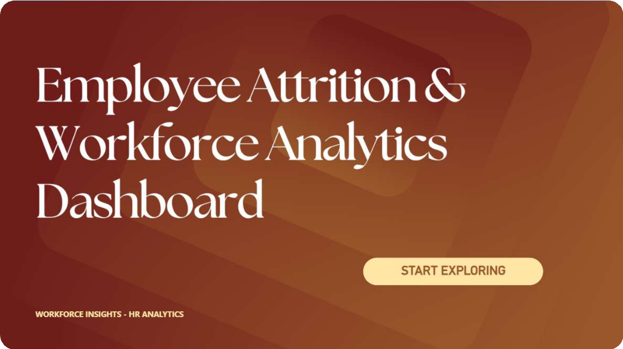
05 DASHBOARDING & REPORTS

Slide 17
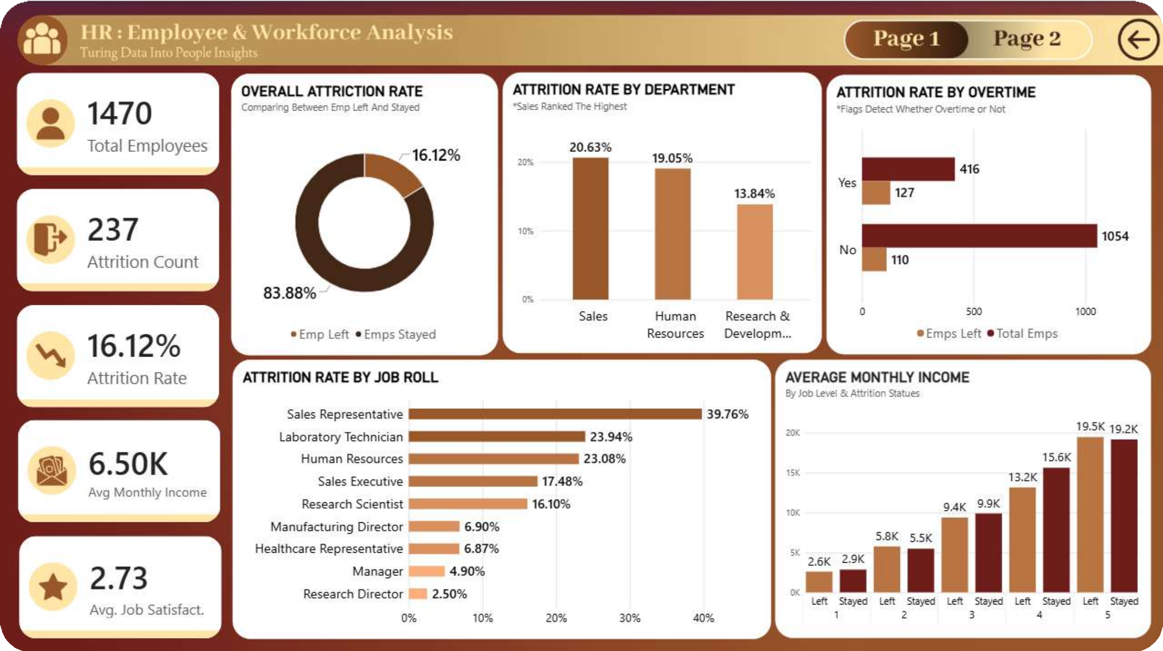
05 DASHBOARDING & REPORTS

Slide 18
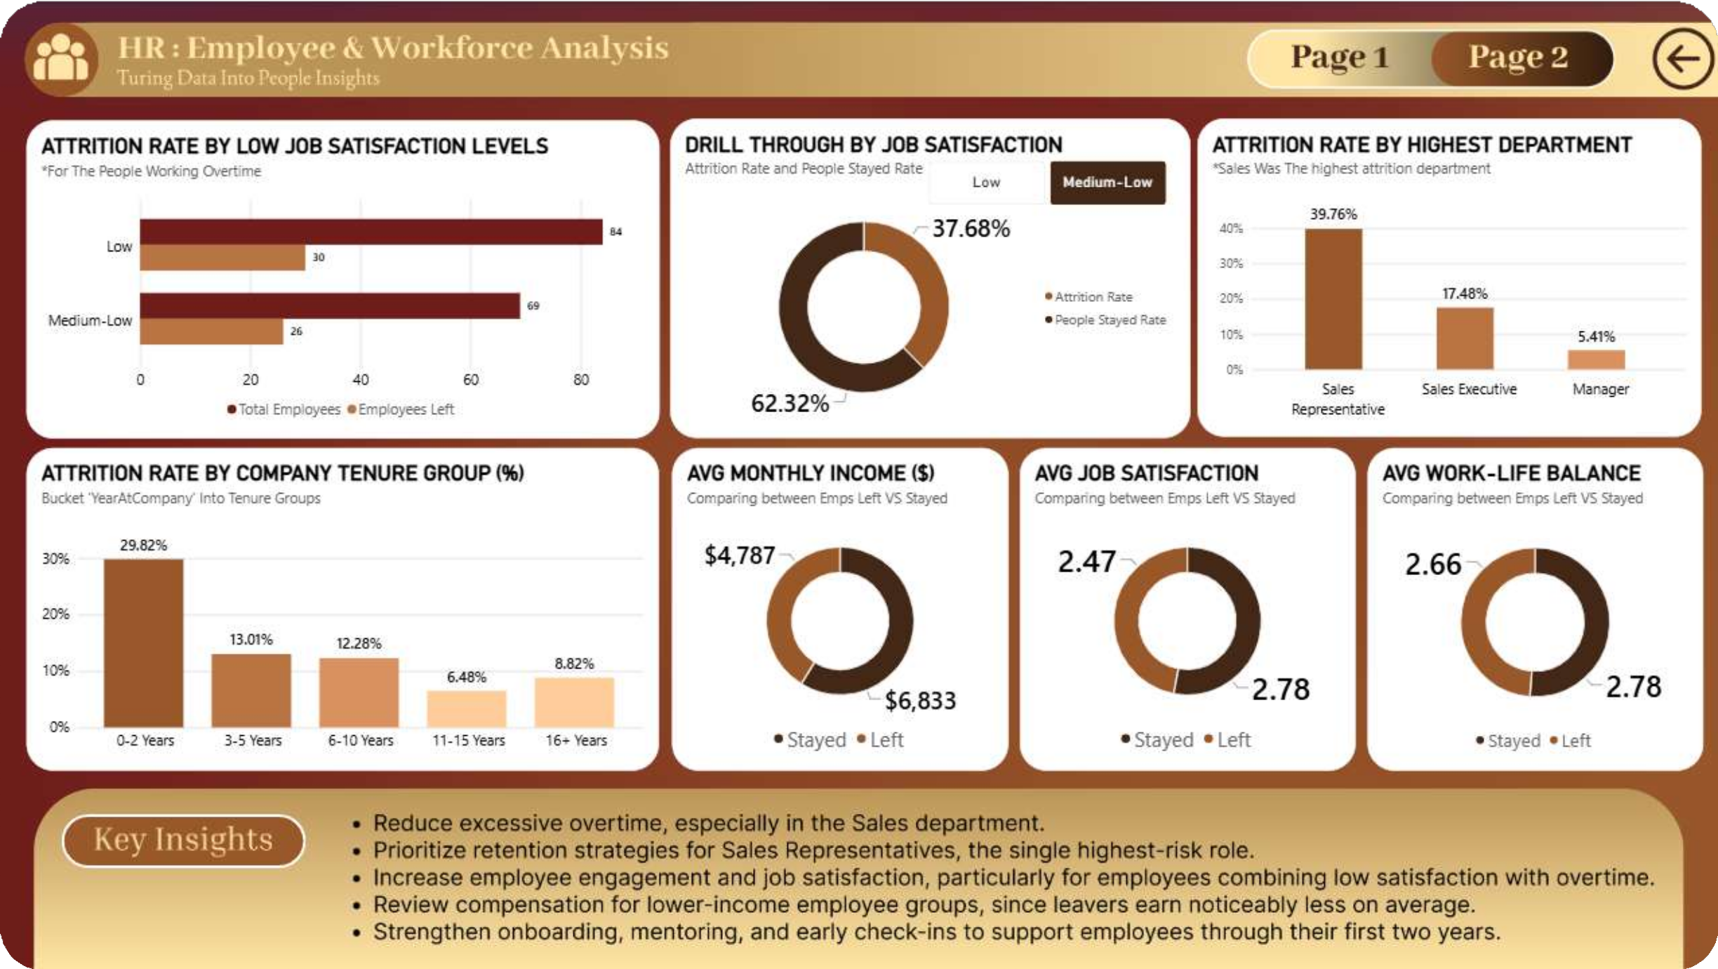
05 DASHBOARDING & REPORTS

Slide 19

THANK YOU!

