Slide 1


Slide 2


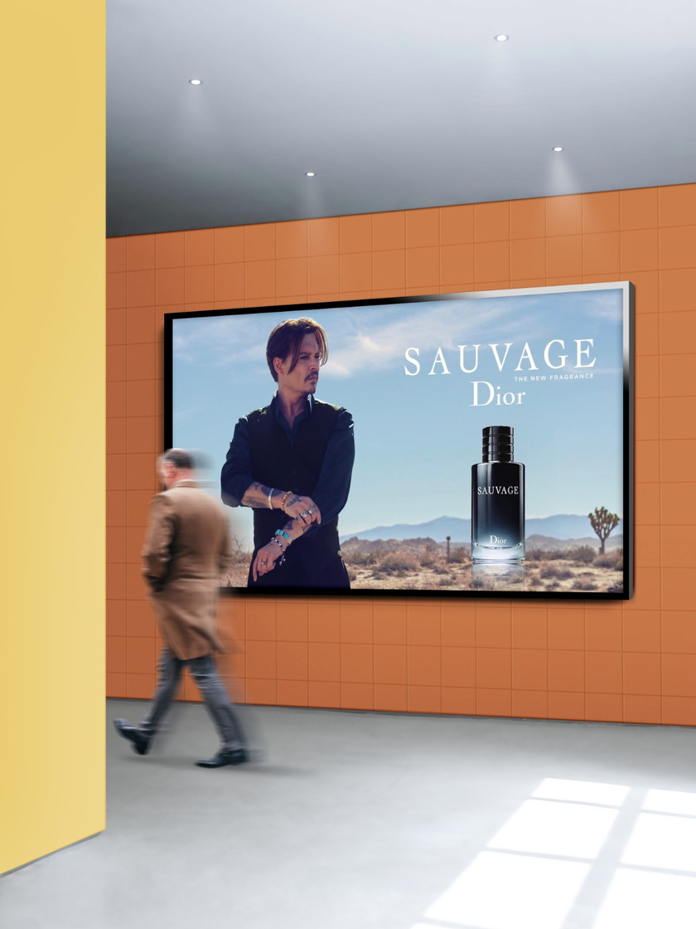
Introduction
Moulen is an AI advertising board that detect the gender and age of a person and shows the best-fit commercial ad.

Slide 3
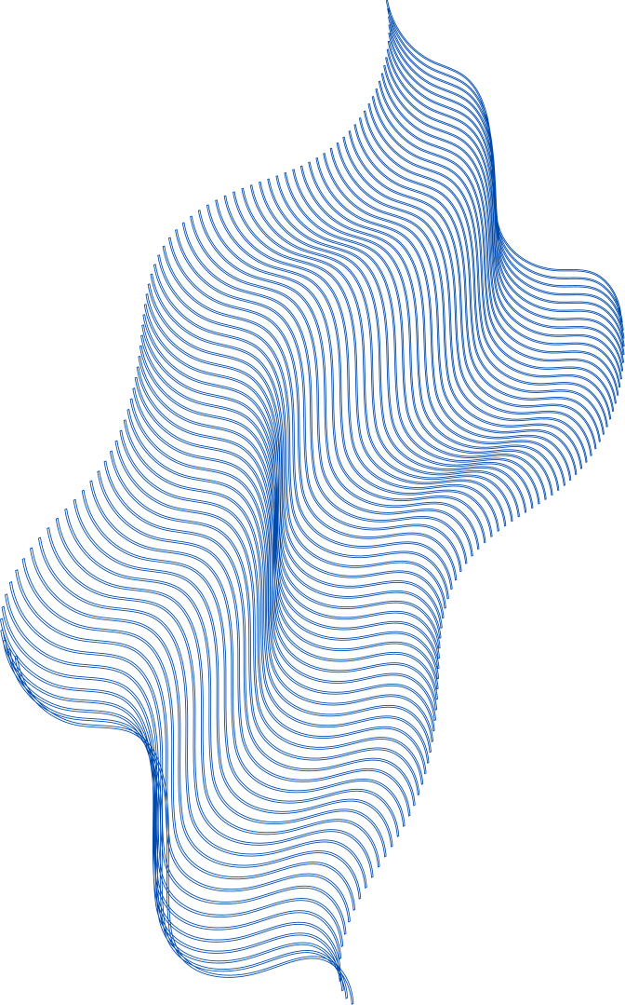
WHY MOULEN IS A MOST HAVE FOR BUSSINESS
1
2
3
4
Cost-effective
Brand awareness
Support for the arts
Promote new products or services
Compared to other forms of advertising, such as TV or radio ads, Moulen can be a more cost-effective option for reaching a large audience.
Moulen are an effective way to increase brand awareness and recognition.
In some cases, Moulen can be used to support public art initiatives or cultural events, providing a platform for artists and performers to showcase their work to a wider audience.
Moulen can be used to generate buzz and excitement around new products or services, helping to increase awareness and drive sales.

Slide 4




OUR GOALS
Increasing brand recognition
Increasing sales
Promoting events or initiatives
Appeal to specific demographics
Moulen can help to increase brand recognition by promoting a business or organization to a wide audience.
Moulen can be used to promote products or services and drive sales by creating a sense of urgency or excitement around a particular promotion or discount.
Moulen can be used to promote events or initiatives, such as concerts, festivals, or charity drives.
By targeting specific demographics with their Moulen campaigns, businesses can differentiate themselves from competitors and establish themselves as a preferred choice among those demographics.
01
02
03
04

Slide 5
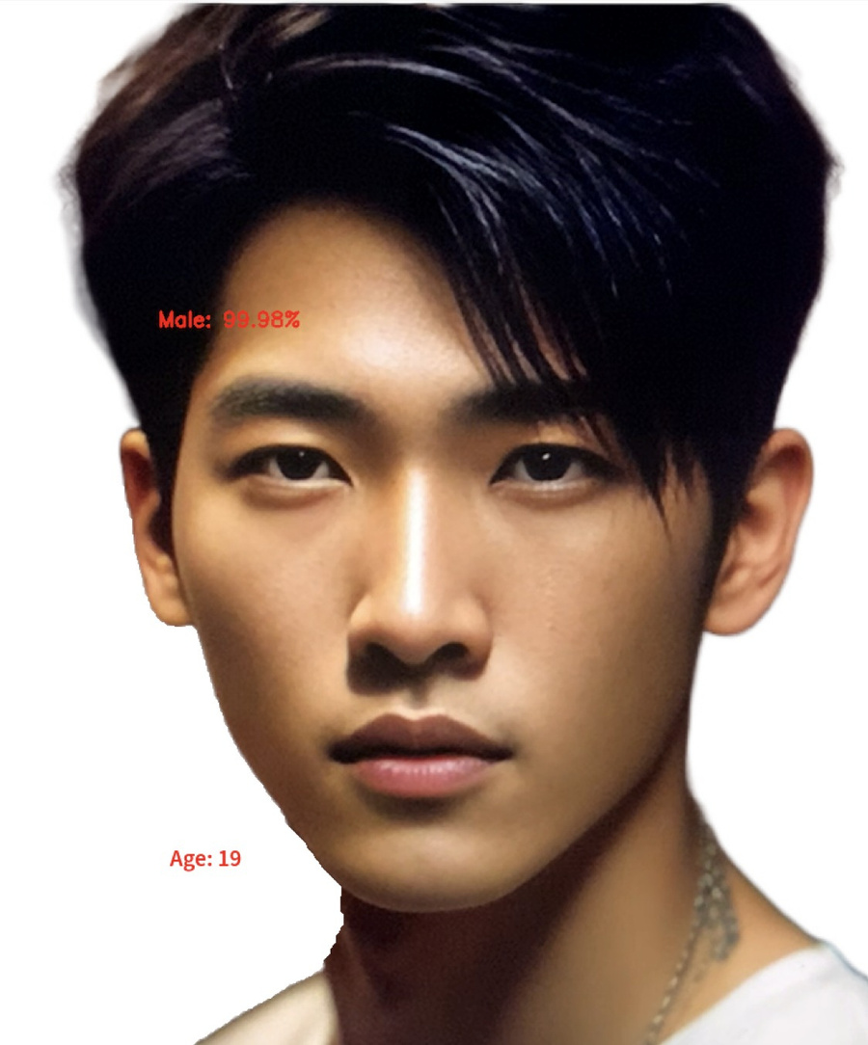
HOW DOES MOULEN WORKS
Moulen runs in real-time, meaning it can detect the age and gender of a person who is in front of the camera, using computer vision techniques.
It uses pre-trained models that were trained on large datasets to detect the facial features and classify the age and gender from them.

Slide 6




MOULEN IN THE FUTURE
IMPROVE
MODELS ACCURACY BY CONSIDER MORE DETECTING FACTORS LIKE CLOTHES AND BODY LANGUAGE
USE MOULEN ON THE BIG BOARDS IN THE ROADS
REAL-TIME TRACKING OF VIEWER ENGAGEMENT

Slide 7
BUSINESS PLAN
BASIC
PRO
PREMIUM
ENTERPRISE
1
2
3
4
$500
$900
$2499
$4999
2 weeks
1 Month
3 Month
6 Month

Slide 8
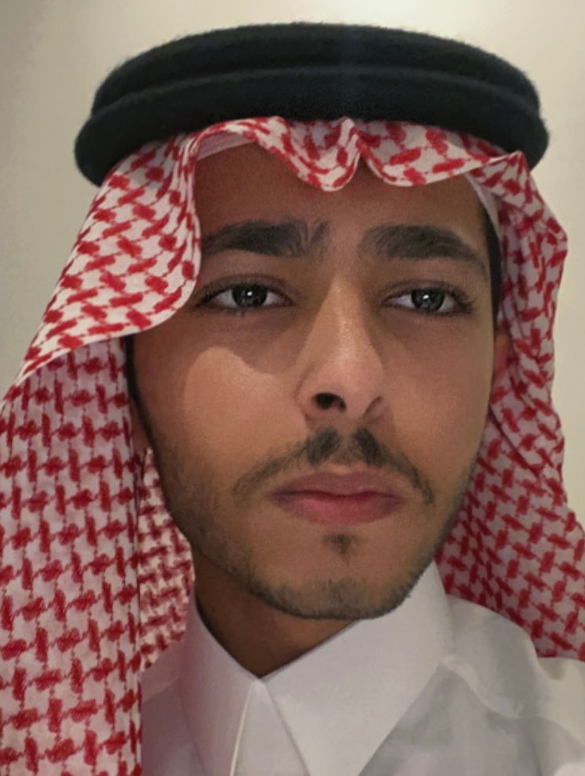
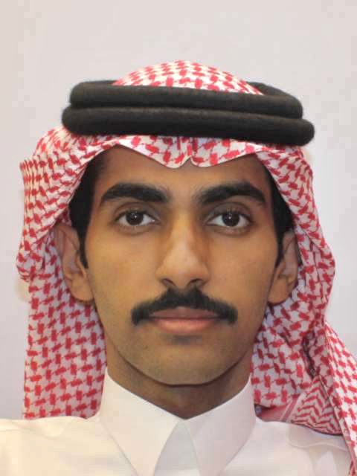
OUR TEAM
Sultan Alhawashleh
Mohammed Aldraibi
Fresh Graudate Information Systems
Software Engineering Student
SS.Alhawashleh@gmail.com
Mohammed.Aldddd@gmail.com

