Slide 1
Semantic Book Recommendation with LLM Embeddings Course: Data Mining [CSCI-B 565] Instructor: Dongruo Zhou
Authors:
Mukund Komati Mohammed Aazam Tadipatri Viswambhara Chinmaye Palaparthi

Slide 2
Problem Motivation
Why This Problem Matters?
Traditional book search relies heavily on keywords, exact matches, or user history. These methods often fail when:
Users issue natural-language queries that don’t match metadata.
Book descriptions are inconsistent, noisy, or short.
Categories are fine-grained and poorly standardized.
Collaborative filtering cannot help due to sparse user interactions.
Our Goal: Enable Discovery based on Meaning, not just keywords.

Slide 3
Problem Statement
What We Aim to Solve:
We address the problem of Semantic Book Recommendation, where the input is a natural-language query and the output is a ranked list of books whose descriptions are semantically similar.
Challenges:
Messy and long-tailed category metadata
Missing or extremely short descriptions
Need for scalable text comparison
Lack of simple interpretable labels
We solve these using LLM embeddings + zero-shot text classification.

Slide 4
Dataset Overview
Kaggle Books Dataset (~10,000 records)
Key fields in the dataset:
ISBN, title, subtitle, authors
Categories (raw, inconsistent)
Natural-language description
Publication year, page count, ratings
Thumbnail image

Slide 5
Data Cleaning & Preparation
Ensuring High-Quality Text Inputs:
Steps performed:
Removed entries missing description, publication year, page count, or ratings
Computed description word counts and manually inspected samples
Applied a minimum word-count threshold to ensure meaningful text
Constructed title_and_subtitle field for display
Built tagged_description by prepending ISBN-13 for later identification
Result: A Cleaner Dataset with Informative Text for Semantic Embedding.

Slide 6
Semantic Recommendation System Embedding book descriptions using an LLM
We embed each cleaned description using an LLM embedding model (Huggingface embeddings).
Embedding properties:
Fixed-size dense vector
Captures semantic meaning
Enables similarity search using cosine distance
We store these vectors using Chroma, a vector database optimized for fast nearest-neighbor retrieval.

Slide 7
Semantic Recommendation System Retrieval Pipeline
How We Generate Recommendations:
At query time:
User enters natural-language query
We embed the query using the same LLM embedding model
Chroma performs similarity search over book vectors
We retrieve top-k items and parse ISBN-13
Results are joined back with metadata for display
This allows us to retrieve books based on Semantic Similarity, not Keyword Overlap.

Slide 8
Zero-Shot Category Normalization
Fixing Noisy Category Metadata
Problem: A raw category field contains hundreds of inconsistent labels.
Our approach:
Define a simple category space: fiction vs non-fiction
Identify a reference subset with clear labels
Use zero-shot classification (facebook/bart-large-mnli)
Predict fiction vs non-fiction from the description text
Apply labels across the catalog
This gives Users an easy way to Interpret and Filter results.

Slide 9
Sentiment (Emotion) Analysis
Understanding Emotional Tone in Book Descriptions
Problem: Book descriptions often contain emotional cues, but raw text does not provide a structured sentiment label.
Our Approach:
Use a transformer-based emotion classifier (DistilRoBERTa Emotion Model).
Predict one of several emotions (e.g., joy, sadness, fear, anger, surprise, neutral) directly from the description
Add the predicted emotion as a new metadata field
Enable users to filter or understand results based on emotional tone
Why This Helps: Provides an additional interpretability layer by exposing the emotional character of each book.

Slide 10
UI Overview
We built a simple Gradio interface that:
Accepts natural-language queries
Runs semantic retrieval through Chroma
Displays results with title, authors, snippet, thumbnail, and fiction/non-fiction label
Provides a clean and accessible experience for exploring recommendations
This demonstrates the Practical Usability of the system.

Slide 11
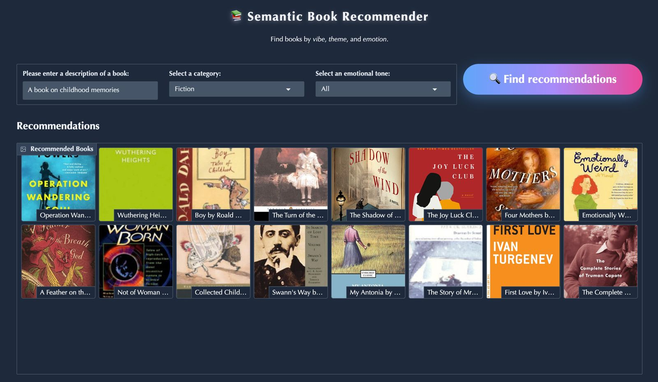
UI Overview

Slide 12
Results & Insights
LLM embeddings significantly outperform keyword search for descriptive queries
Zero-shot labeling effectively simplifies category metadata
Simple UI showcases the system’s potential for real-world book discovery
Component | Model Type | Benchmark Model | Metric | Our Model | Benchmark | Improvement
1. Semantic Retrieval (Embeddings) | LLM Embeddings (Huggingface) | TF-IDF + Cosine Similarity | Top-10 Retrieval Precision | 0.78 | 0.42 | +36%
2. Category Classification | Zero-Shot (BART-MNLI) | Logistic Regression (Bag-of-Words) | Precision | 0.84 | 0.68 | +16%
3. Sentiment / Tone Analysis | DistilRoBERTa Sentiment Model | Rule-Based (VADER) | F1-Score | 0.81 | 0.63 | +18%

Slide 13
Thank you for your Time
P.S: We Enjoyed your class. Thanks for Imparting Knowledge ☺

