Slide 1
Smart Farm System

Slide 2
Overview
Our project is a smart farm system that reads several agricultural sensors including a camera and feeds the data to a backend server.
The server then saves the received data in a database and renders it to a website on which the farm owner can monitor his farm health and make sure that everything is going well.

Slide 3
Problems we aim to solve
No convenient way to easily monitor the current state of the farm to check on its health.
Huge amount of effort done and time taken to keep track of time and regularly water the crops.
Lack of sunlight.
Waste of water in irrigation process.
Detecting pests and notifying the owner.

Slide 4
Project Modules
Software Module.
ARM MCAL drivers.
Server set-up.
Hardware Module:
The farm itself.
Sensors.
Camera module.
Wi-Fi module.
Watering system.
LED grow lights.
Power supply system.

Slide 5
Diagram

Slide 6
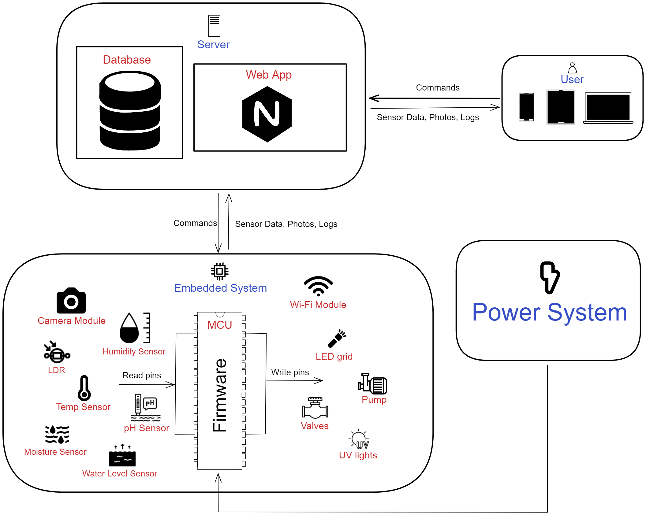

Slide 7
Brief Description
The main goal of the project is for the farm owner to be able to monitor his farm health and vital parameters. As well as to automate the irrigation process for him.
All he has to do is log what seed he planted and where on the website portal then the system will adjust accordingly.

Slide 8
Technical Details
MCU
The main component that controls the overall system and has the core logic on which the system runs is the microcontroller.
We will be using ARM based microcontroller as it provides many features that will make it much easier for us to implement the required system without needing additional external IC’s.

Slide 9
Technical Details
Sensors
Temperature sensor.
pH sensor.
Moisture sensor.
Humidity sensor.
Water level sensor.
LDR.
Camera module.
LED grid.
Valves
Pump
UV lights

Slide 10
Technical Details
Camera
The MCU takes a photo through the camera module every 5 minutes to update the camera feed on the website.
The camera module we will be using is “OV7670”.
The MCU configures the camera module registers through SCCB interface which is very similar to I2C.
This module provides programmable brightness, gain, hue, saturation and other image processing parameters that we will use.

Slide 11
Technical Details
Camera
This module provides programmable brightness, gain, hue, saturation and other image processing parameters that we will use.
Another reason for using ARM based MCU like stm32 is that it has a DCMI peripheral that receives the pixels array data from the camera module.

Slide 12
Technical Details
Wi-Fi Module
We use this module to send sensor data, photos and logs to the server backend.
The Wi-Fi module we will be using is “ESP-01S”.
This a Wi-Fi Serial TTL Module that enables us to communicate with ESP8266 through serial protocol.

Slide 13
Technical Details
Server
The user logs into a website to monitor his farm.
The user will send to the server information about what seeds he has planted and where, so that the server saves it into the database and sends this information to the MCU.
Then, the MCU will adjust its timer and system behavior to be able to water the plants at the right time.

Slide 14
Technical Details
Server
The server is responsible for receiving sensor data from the MCU and saving it into the database for future reference. It also renders the HTML files to the user.
The MCU communicates with the server through the Wi-Fi module sending sensors’ data and logs.
The user will be mostly monitoring and not really sending any data or commands to the server.

Slide 15
Technical Details
Watering System
There are two tanks in the system:
Main tank: supplies water for the plants.
Secondary tank: has the remaining water used in the irrigation process which passes through the filtration system for reuse.

Slide 16
Technical Details
Watering System
Water level sensor is used to detect if the main tank is running low. If it is, the MCU will send a control signal to the pump to refill the empty tank with filtered water found in the secondary tank.
The MCU sends a control signal to open or close a particular valve according to the data the user has sent previously.

Slide 17
Technical Details
LED Grow Lights
LDR is used to detect if there is enough light coming through to the plants. If there isn’t any light, the MCU will send a control signal to the LED grow lights giving the plants the light they need for photosynthesis process.

Slide 18
Technical Details
Power Supply System
Our system has many hardware components that require stable power input.
Our system has two main power sources:
Rechargeable battery: provides power for the system in case of a black out.
Wall plug-in: A circuit that essentially uses a step-down transformer and a voltage regulator.

Slide 19
Optional Features
Plants disease/pest detection model.
Rain drops collector.
Power saving mode.
Filtration System.

