Slide 1
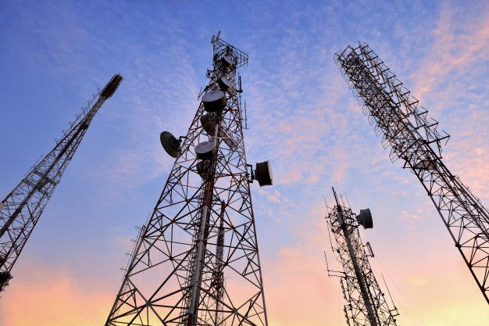
ChurnShield
A Predictive Analytics Framework to Combat Customer Attrition at SyriaTel

Slide 2

Overview
Goal: Prevent customer churn using data.
Why it matters: Retaining customers is cheaper than acquiring new ones.
Solution: Predict who might leave, why, and how to stop them.

Slide 3

Business Problem
Churn is rising at SyriaTel. Every lost customer = lost revenue.
Goal: Predict who might leave, why, and how to stop them.

Slide 4

Stakeholders
Executives: Protect revenue.
Customer Experience Teams: Address dissatisfaction.
Retention Teams: Create targeted offers and campaigns.

Slide 5
Understanding the Data
Source: SyriaTel dataset (via Kaggle).
Key Attributes:
- Demographics
- Service Plans
- Call Behavior
- Target: Has the customer churned
?

Slide 6
Data Preparation
Steps Taken:
- Cleaned missing/duplicate data
- Removed irrelevant columns
- Balanced the dataset
- Encoded text data
- Scaled numerical features

Slide 7
Exploratory Analysis
Key Insights:
- >3 Customer service calls → High churn
- International Plan → Higher churn risk
- Higher charges → Higher churn
- Voice mail → Less churn

Slide 8

Why Classification?
We're answering a Yes/No question: 'Will the customer churn?'
Classification helps us filter likely churners.
It's a smart alert system for retention.

Slide 9
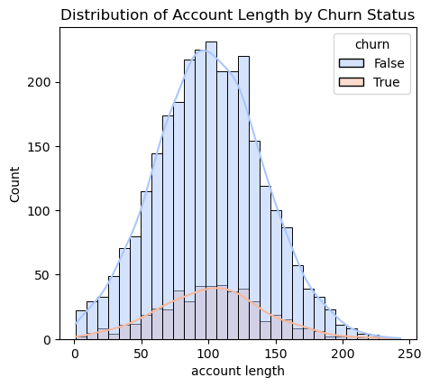
Distribution of Account length by Churn Status .

Slide 10
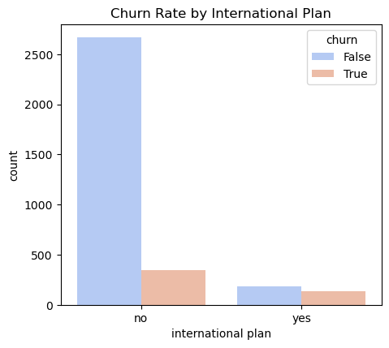
Churn Rate by International Plan.

Slide 11
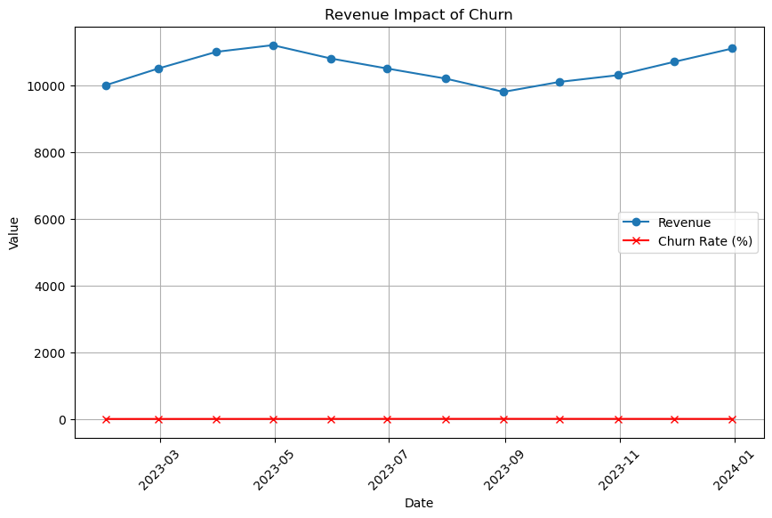
Revenue Impact Churn.

Slide 12
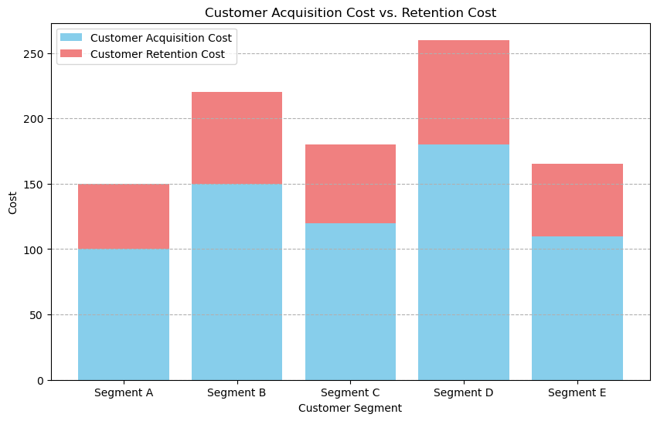
Customer Acquisition Cost vs Retention Cost.

Slide 13
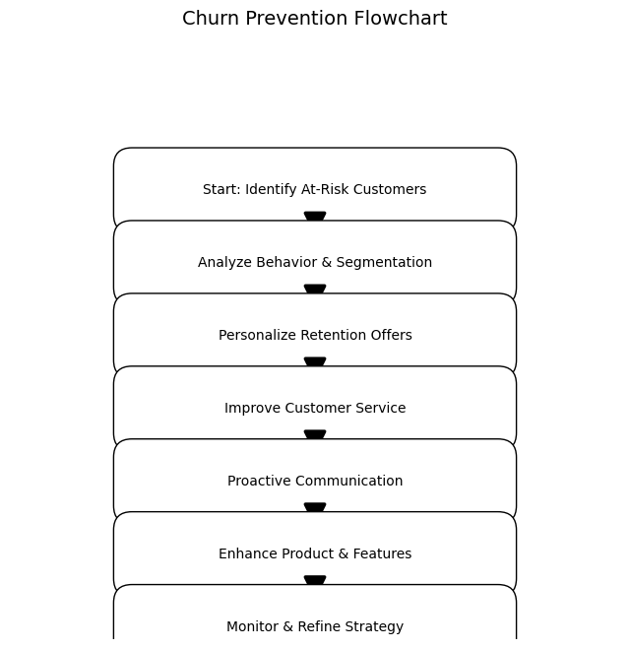
Churn Prevention Flowchart.

Slide 14
Models Used
Models we tested:
- Logistic Regression (simple)
- Decision Tree (strong)
- Gradient Boosting (best performance)

Slide 15

Model Results (Simplified)
Best Model: Gradient Boosting
- Accuracy: 92%
- Precision: 90%
- Recall: 94%
Conclusion: We can confidently flag most customers who are likely to churn.

Slide 16

Recommendations
- Target users with international plans or >3 service calls
- Offer personalized loyalty packages
- Act early to improve satisfaction

Slide 17
Next Steps
- Pilot a campaign with predicted churners
- Measure churn reduction
- Add model to CRM
- Keep improving as data grows

Slide 18
Thank You
Questions contact !
Let’s keep your customers happy—and loyal.

