Slide 1
Fundamental of Software Engineering SOEng2051
Chapter 2:Software processes & Software Process models
Department of Software Engineering

Slide 2
Outline
Software process
Process activities
Software process models
Coping with change
Rational Unified Process

Slide 3
Objectives
The objective of this chapter is to introduce you to the idea of a software process- a coherent set of activities for software production.
After this chapter you will:
Understand the concepts of software processes and software process models;
Have been introduced some generic software process models and when they might be used;
Know about the fundamental process activities of software requirements engineering, software development, testing, and evolution
Understand why processes should be organized to cope with changes in the software requirements and design.
Understand how the Rational Unified Process integrates good software engineering practice to create adaptable software processes

Slide 4
Software Processes
The set of activities and associated outcome that produce a software product.
Software engineers mostly carry out these activities.
These are four key process activities(high level), which are common to all software processes. These are:
Software specification
Software development
Software validation
Software evolution

Slide 5
Software specifications
The functionality of the software and constraints on its operation must be defined.
Detailed description of a software system to be developed with its functional and non-functional requirements.
Software development
The software to meet the requirement must be produced.
Designing, programming, documenting, testing, and bug fixing is done.
Software validation
The software must be validated to ensure that it does what the customer wants.
Evaluation software product is done to ensure that the software meets the business requirements and users needs.
Software evolution: The software must evolve to meet changing client needs.
It is a process of developing software initially, then timely updating it for various reasons.

Slide 6
Software Process Model
A software process model is an abstraction of the actual process, which is being described.
a simplified representation of a software process.
Each model represents a process from a specific perspective.
There are several various general models or paradigms of software development
Waterfall Model
RAD Model
Spiral Model
V-Model
Prototype Model
Incremental Model
Iterative Model
Big-bang Model
Agile Model

Slide 7
Software Development Life Cycle
Referred to as SDLC.
Also termed process model is a pictorial and diagrammatic representation of the software life cycle.
A life cycle model represents all the methods required to make a software product transit through its life cycle stages.
It also captures the structure in which these methods are to be undertaken.
Defines the general steps that are take to build software
Defines the responsibilities for team member during each step of phase.
Some of these steps may overlap, but generally define the phase of the projects.
If the steps are not successful the project may fall back to an earlier steps

Slide 8
SDLC Cycle
SDLC Cycle represents the process of developing software.
SDLC framework includes the following steps:
Requirement analysis
Defining
Designing
Coding
Testing
Deployment
Maintenance

Slide 9
Requirement analysis
Requirement Analysis is the most important and necessary stage in SDLC.
The senior members of the team perform it with inputs from all the stakeholders and domain experts.
Planning for the quality assurance requirements and identifications of the risks associated with the projects is also done at this stage.
Business analyst and Project organizer set up a meeting with the client to gather all the data like what the customer wants to build, who will be the end user, what is the objective of the product.
Before creating a product, a core understanding or knowledge of the product is very necessary.

Slide 10
For Example: A client wants to have an application which concerns money transactions.
In this method, the requirement has to be precise like what kind of operations will be done, how it will be done, in which currency it will be done, etc.
Once the required function is done, an analysis is complete with auditing the feasibility of the growth of a product.
In case of any ambiguity, a signal is set up for further discussion.
Once the requirement is understood, the SRS (Software Requirement Specification) document is created.
The developers should thoroughly follow this document and also should be reviewed by the customer for future reference

Slide 11
Defining Requirements
Once the requirement analysis is done, the next stage is to certainly represent and document the software requirements and get them accepted from the project stakeholders.
This is accomplished through "SRS"- Software Requirement Specification document which contains all the product requirements to be constructed and developed during the project life cycle.

Slide 12
Designing the Software
The next phase is about to bring down all the knowledge of requirements, analysis, and design of the software project. This phase is the product of the last two, like inputs from the customer and requirement gathering.

Slide 13
Developing the project
In this phase of SDLC, the actual development begins, and the programming is built.
The implementation of design begins concerning writing code.
Developers have to follow the coding guidelines described by their management and programming tools like compilers, interpreters, debuggers, etc. are used to develop and implement the code.

Slide 14
Testing
After the code is generated, it is tested against the requirements to make sure that the products are solving the needs addressed and gathered during the requirements stage.
During this stage, unit testing, integration testing, system testing, acceptance testing is done.
Deployment
Once the software is certified, and no bugs or errors are stated, then it is deployed.
Then based on the assessment, the software may be released as it is or with suggested enhancement in the object segment. After the software is deployed, then its maintenance begins.

Slide 15
Maintenance
Once when the client starts using the developed systems, then the real issues come up and requirements to be solved from time to time.
This procedure where the care is taken for the developed product is known as maintenance.

Slide 16
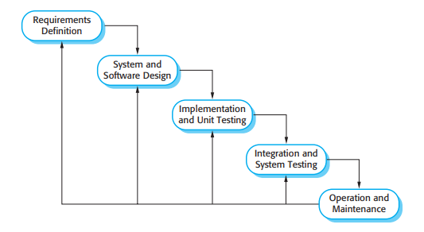
Software process model||Waterfall model
This model has five phases: Requirements analysis and specification, design, implementation and unit testing, integration and system testing, and operation and maintenance.
The steps always follow in this order and do not overlap.
The developer must complete every phase before the next phase begins.
This why it named Waterfall Model, because its diagrammatic representation resembles a cascade of waterfalls.

Slide 17
Waterfall model phases
Requirements analysis and specification phase
The aim of this phase is to understand the exact requirements of the customer and to document them properly.
Both the customer and the software developer work together so as to document all the functions, performance, and interfacing requirement of the software.
It describes the what of the system to be produced and not how.
In this phase, a large document called Software Requirement Specification (SRS) document is created which contained a detailed description of what the system will do in the common language.

Slide 18
Waterfall model phases
Design Phase:
This phase aims to transform the requirements gathered in the SRS into a suitable form which permits further coding in a programming language.
It defines the overall software architecture together with high level and detailed design.
All this work is documented as a Software Design Document (SDD).

Slide 19
Waterfall model phases
Implementation and unit testing:
During this phase, design is implemented.
If the SDD is complete, the implementation or coding phase proceeds smoothly, because all the information needed by software developers is contained in the SDD.
During testing, the code is thoroughly examined and modified.
Small modules are tested in isolation initially.
After that these modules are tested by writing some overhead code to check the interaction between these modules and the flow of intermediate output.

Slide 20
Waterfall model phases
Integration and System Testing:
This phase is highly crucial as the quality of the end product is determined by the effectiveness of the testing carried out.
The better output will lead to satisfied customers, lower maintenance costs, and accurate results.
Unit testing determines the efficiency of individual modules. However, in this phase, the modules are tested for their interactions with each other and with the system.

Slide 21
Waterfall model phases
Operation and maintenance phase: Maintenance is the task performed by every user once the software has been delivered to the customer, installed, and operational.
Discus
When to use SDLC Waterfall Model?
Advantages of Waterfall model?
Disadvantages of Waterfall model?

Slide 22
When to use SDLC Waterfall Model?
Some Circumstances where the use of the Waterfall model is most suited are:
When the requirements are constant and not changed regularly.
A project is short
The situation is calm
Where the tools and technology used is consistent and is not changing
When resources are well prepared and are available to use.

Slide 23
Advantages of Waterfall model
Simple to implement
Number of resources that are required for it is minimal.
The requirements are simple and explicitly declared;
Requirements are remain unchanged during the entire project development.
The start and end points for each phase is fixed, which makes it easy to cover progress.
The release date for the complete product, as well as its final cost, can be determined before development.
It gives easy to control and clarity for the customer due to a strict reporting system.

Slide 24
Disadvantage of waterfall model
The risk factor is higher, so this model is not suitable for more significant and complex projects.
This model cannot accept the changes in requirements during development.
It becomes dangerous to go back to the phase. For example, if the application has now shifted to the coding phase, and there is a change in requirement, It becomes tough to go back and change it.
Since the testing done at a later stage, it does not allow identifying the challenges and risks in the earlier phase, so the risk reduction strategy is difficult to prepare.

Slide 25
Software process model||RAD Model
What is RAD?
List and describe phase of RAD
When to use RAD
Pros and cons of RAD
reading assignment [including in any means of questions]…

Slide 26
Software process model|| Spiral Model
It is an evolutionary software process model that couples the iterative feature of prototyping with the controlled and systematic aspects of the linear sequential model.
It implements the potential for rapid development of new versions of the software.
Using the spiral model, the software is developed in a series of incremental releases.
During the early iterations, the additional release may be a paper model or prototype.
During later iterations, more and more complete versions of the engineered system are produced.

Slide 27
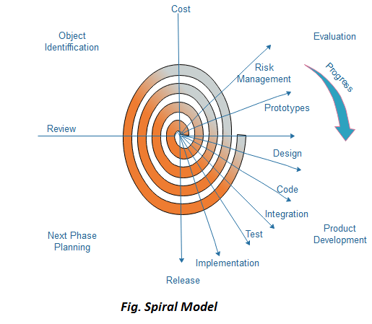
Spiral Model
Each cycle in the spiral is divided into four parts:

Slide 28
Four parts of spiral model
Objective setting:
Each cycle in the spiral starts with the identification of purpose for that cycle, the various alternatives that are possible for achieving the targets, and the constraints that exists.
Risk Assessment and reduction:
The next phase in the cycle is to calculate these various alternatives based on the goals and constraints. The focus of evaluation in this stage is located on the risk perception for the project.
Development and validation:
The next phase is to develop strategies that resolve uncertainties and risks. This process may include activities such as benchmarking, simulation, and prototyping.

Slide 29
Four parts of spiral model
Planning:
Finally, the next step is planned. The project is reviewed, and a choice made whether to continue with a further period of the spiral. If it is determined to keep, plans are drawn up for the next step of the project.
The development phase depends on the remaining risks. For example, if performance or user-interface risks are treated more essential than the program development risks, the next phase may be an evolutionary development that includes developing a more detailed prototype for solving the risks.

Slide 30
…continue
The risk-driven feature of the spiral model allows it to accommodate any mixture of a specification-oriented, prototype-oriented, simulation-oriented, or another type of approach.
An essential element of the model is that each period of the spiral is completed by a review that includes all the products developed during that cycle, including plans for the next cycle.
The spiral model works for development as well as enhancement projects.

Slide 31
When to use Spiral Model?
When deliverance is required to be frequent.
When the project is large
When requirements are unclear and complex
When changes may require at any time
Large and high budget projects

Slide 32
Advantages and disadvantages of spiral model
Advantages
High amount of risk analysis
Useful for large and mission-critical projects.
Disadvantages
Can be a costly model to use.
Risk analysis needed highly particular expertise
Doesn't work well for smaller projects.

Slide 33
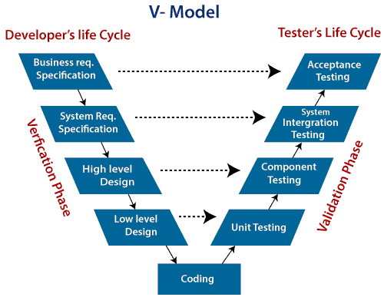
Software process model|| V-Model
V-Model also referred to as the Verification and Validation Model.
Each phase of SDLC must complete before the next phase starts.
It follows a sequential design process same as the waterfall model.
Testing of the device is planned in parallel with a corresponding stage of development.

Slide 34
…continue
Verification: It involves a static analysis method (review) done without executing code.
It is the process of evaluation of the product development process to find whether specified requirements meet.
Validation: It involves dynamic analysis method (functional, non-functional), testing is done by executing code. Validation is the process to classify the software after the completion of the development process to determine whether the software meets the customer expectations and requirements.
So V-Model contains Verification phases on one side of the Validation phases on the other side. Verification and Validation process is joined by coding phase in V-shape. Thus it is known as V-Model.

Slide 35
Verification Phase of V-model
Business requirement analysis: This is the first step where product requirements understood from the customer's side. This phase contains detailed communication to understand customer's expectations and exact requirements.
System Design: In this stage system engineers analyze and interpret the business of the proposed system by studying the user requirements document.
Architecture Design: The baseline in selecting the architecture is that it should understand all which typically consists of the list of modules, brief functionality of each module, their interface relationships, dependencies, database tables, architecture diagrams, technology detail, etc. The integration testing model is carried out in a particular phase.

Slide 36
Verification Phase of V-model
Module Design: In the module design phase, the system breaks down into small modules. The detailed design of the modules is specified, which is known as Low-Level Design
Coding Phase: After designing, the coding phase is started. Based on the requirements, a suitable programming language is decided. There are some guidelines and standards for coding.
Before checking in the repository, the final build is optimized for better performance, and the code goes through many code reviews to check the performance.

Slide 37
Validation Phase of V-model
Unit Testing: In the V-Model, Unit Test Plans (UTPs) are developed during the module design phase. These UTPs are executed to eliminate errors at code level or unit level. A unit is the smallest entity which can independently exist, e.g., a program module. Unit testing verifies that the smallest entity can function correctly when isolated from the rest of the codes/ units.
Integration Testing: Integration Test Plans are developed during the Architectural Design Phase. These tests verify that groups created and tested independently can coexist and communicate among themselves.

Slide 38
Validation Phase of V-model
System Testing: System Tests Plans are developed during System Design Phase. Unlike Unit and Integration Test Plans, System Tests Plans are composed by the client? Business team. System Test ensures that expectations from an application developer are met.
Acceptance Testing: Acceptance testing is related to the business requirement analysis part. It includes testing the software product in user atmosphere. Acceptance tests reveal the compatibility problems with the different systems, which is available within the user atmosphere. It conjointly discovers the non-functional problems like load and performance defects within the real user atmosphere.

Slide 39
When to use V-Model?
When the requirement is well defined and not ambiguous.
The V-shaped model should be used for small to medium-sized projects where requirements are clearly defined and fixed.
The V-shaped model should be chosen when sample technical resources are available with essential technical expertise.

Slide 40
Advantage (Pros) of V-Model:
Easy to Understand.
Testing Methods like planning, test designing happens well before coding.
This saves a lot of time. Hence a higher chance of success over the waterfall model.
Avoids the downward flow of the defects.
Works well for small plans where requirements are easily understood.

Slide 41
Disadvantage (Cons) of V-Model
Very rigid and least flexible.
Not a good for a complex project.
Software is developed during the implementation stage, so no early prototypes of the software are produced.
If any changes happen in the midway, then the test documents along with the required documents, has to be updated.

Slide 42
Incremental Model
Incremental Model is a process of software development where requirements divided into multiple standalone modules of the software development cycle.
Used to break down a project to smaller stages
In this model, each module goes through the requirements, design, implementation and testing phases. Every subsequent release of the module adds function to the previous release. The process continues until the complete system achieved.
Discus
The various phases of incremental model
When we use the Incremental Model
Pros and cons of Incremental Model

Slide 43
The various phases of incremental model
Requirement analysis:
In the first phase of the incremental model, the product analysis expertise identifies the requirements. And the system functional requirements are understood by the requirement analysis team.
To develop the software under the incremental model, this phase performs a crucial role.
Design & Development:
In this phase of the Incremental model of SDLC, the design of the system functionality and the development method are finished with success.
When software develops new practicality, the incremental model uses style and development phase.

Slide 44
…
Testing:
In the incremental model, the testing phase checks the performance of each existing function as well as additional functionality. In the testing phase, the various methods are used to test the behaviour of each task.
Implementation:
Implementation phase enables the coding phase of the development system.
It involves the final coding that design in the designing and development phase and tests the functionality in the testing phase.
After completion of this phase, the number of the product working is enhanced and upgraded up to the final system product

Slide 45
When we use the Incremental Model?
When the requirements are not clear
When time is to market is critical.
A project has a lengthy development schedule.
When Software team are not very well skilled or trained.
When the customer demands a quick release of the product.
You can develop prioritized requirements first.

Slide 46
Pros
Errors are easy to be recognized.
Easier to test and debug
More flexible.
Simple to manage risk because it handled during its iteration.
The Client gets important functionality early.

Slide 47
cons
Need for good planning
Total Cost is high.
Well defined module interfaces are needed

Slide 48
Software process model|| Iterative Model
In this Model, you can start with some of the software specifications and develop the first version of the software. After the first version if there is a need to change the software, then a new version of the software is created with a new iteration. Every release of the Iterative Model finishes in an exact and fixed period that is called iteration.
The Iterative Model allows the accessing earlier phases, in which the variations made respectively. The final output of the project renewed at the end of the Software Development Life Cycle (SDLC) process.

Slide 49
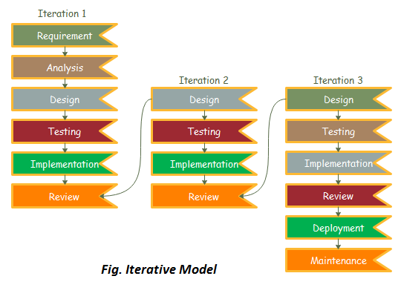
various phases of Iterative model

Slide 50
various phases of Iterative model
Requirement gathering & analysis: In this phase, requirements are gathered from customers and check by an analyst whether requirements will fulfil or not. Analyst checks that need will achieve within budget or not. After all of this, the software team skips to the next phase.
Design: In the design phase, team design the software by the different diagrams like Data Flow diagram, activity diagram, class diagram, state transition diagram, etc.
Implementation: In the implementation, requirements are written in the coding language and transformed into computer programmes which are called Software.
Testing: After completing the coding phase, software testing starts using different test methods. There are many test methods, but the most common are white box, black box, and grey box test methods.

Slide 51
…continue
Deployment: After completing all the phases, software is deployed to its work environment.
Review: In this phase, after the product deployment, review phase is performed to check the behaviour and validity of the developed product. And if there are any error found then the process starts again from the requirement gathering.
Maintenance: In the maintenance phase, after deployment of the software in the working environment there may be some bugs, some errors or new updates are required. Maintenance involves debugging and new addition options.

Slide 52
When to use the Iterative Model
When requirements are defined clearly and easy to understand.
When the software application is large.
When there is a requirement of changes in future.
Advantage (Pros) of Iterative Model:
Testing and debugging during smaller iteration is easy.
A Parallel development can plan.
It is easily acceptable to ever-changing needs of the project.
Risks are identified and resolved during iteration.
Limited time spent on documentation and extra time on designing.

Slide 53
Disadvantage (Cons) of Iterative Model:
It is not suitable for smaller projects.
More Resources may be required.
Design can be changed again and again because of imperfect requirements.
Requirement changes can cause over budget.
Project completion date not confirmed because of changing requirements.

Slide 54
Coping with change
Change is inevitable in all large software projects.
The system requirements change as businesses respond to external pressures, competition, and changed management priorities.
As new technologies become available, new approaches to design and implementation become possible.
Therefore whatever software process model is used, it is essential that it can accommodate changes to the software being developed.
Change adds to the costs of software development because it usually means that work that has been completed has to be redone.
This is called rework.

Slide 55
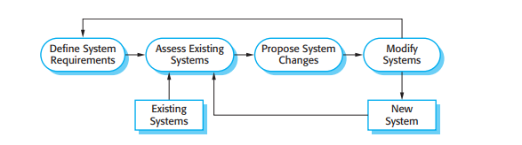
For example, if the relationships between the requirements in a system have been analysed and new requirements are then identified, some or all of the requirements analysis has to be repeated.
It may then be necessary to redesign the system to deliver the new requirements, change any programs that have been developed, and retest the system.
Two related approaches may be used to reduce the costs of rework:

Slide 56
Change anticipation, where the software process includes activities that can anticipate or predict possible changes before significant rework is required. For example, a prototype system may be developed to show some key features of the system to customers. They can experiment with the prototype and refine their requirements before committing to high software production costs.
Change tolerance, where the process and software are designed so that changes can be easily made to the system. This normally involves some form of incremental development. Proposed changes may be implemented in increments that have not yet been developed. If this is impossible, then only a single increment (a small part of the system) may have to be altered to incorporate the change.

Slide 57
In this section, we discuss two ways of coping with change and changing system requirements:
System prototyping, where a version of the system or part of the system is developed quickly to check the customer’s requirements and the feasibility of design decisions. This is a method of change anticipation as it allows users to experiment with the system before delivery and so refine their requirements. The number of requirements change proposals made after delivery is therefore likely to be reduced.
Incremental delivery, where system increments are delivered to the customer for comment and experimentation. This supports both change avoidance and change tolerance. It avoids the premature commitment to requirements for the whole system and allows changes to be incorporated into later increments at relatively low cost.
The notion of refactoring, namely, improving the structure and organization of a program, is also an important mechanism that supports change tolerance.

Slide 58
The Rational Unified Process
Rational Unified Process (RUP) is a software development process for object-oriented models.
It is also known as the Unified Process Model.
It is created by Rational corporation and is designed and documented using UML (Unified Modelling Language).
This process is included in IBM Rational Method Composer (RMC) product.
IBM (International Business Machine Corporation) allows us to customize, design, and personalize the unified process.

Slide 59
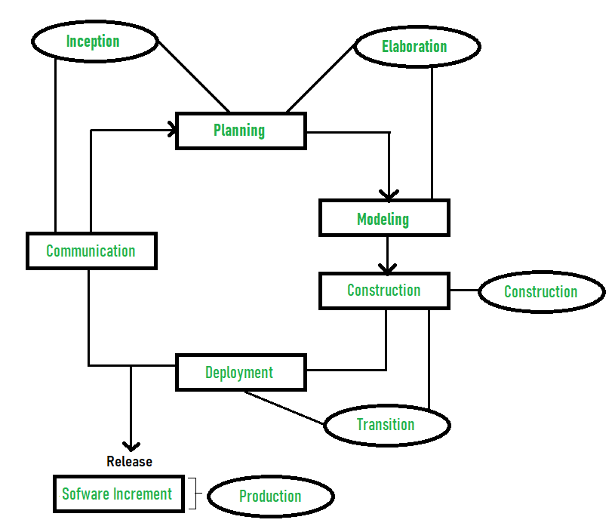

Slide 60
The Rational Unified Process …cont’d
RUP is proposed by Ivar Jacobson, Grady Bootch, and James Rambaugh.
Some characteristics of RUP include use-case driven, Iterative (repetition of the process), and Incremental (increase in value) by nature, delivered online using web technology, can be customized or tailored in modular and electronic form, etc.
RUP reduces unexpected development costs and prevents wastage of resources.
Phases of RUP :
Inception –Communication and planning are main.
Identifies Scope of the project using use-case model allowing managers to estimate costs and time required.
Customers requirements are identified and then it becomes easy to make a plan of the project.

Slide 61
Phase of RUP
Project plan, Project goal, risks, use-case model, Project description, are made.
Project is checked against the milestone criteria and if it couldn’t pass these criteria then project can be either cancelled or redesigned.
Elaboration:
Planning and modelling are main.
Detailed evaluation, development plan is carried out and diminish the risks.
Revise or redefine use-case model (approx. 80%), business case, risks.
Again, checked against milestone criteria and if it couldn’t pass these criteria then again project can be cancelled or redesigned.
Executable architecture baseline.

Slide 62
Phase of RUP
Construction:
Project is developed and completed.
System or source code is created and then testing is done.
Coding takes place.
Transition:
Final project is released to public.
Transit the project from development into production.
Update project documentation.
Beta testing is conducted.
Defects are removed from project based on feedback from public.

Slide 63
Phase of RUP
Production:
Final phase of the model.
Project is maintained and updated accordingly.

