Slide 1
Fundamental of Software Engineering
Chapter Four
Software Design
School of Computing
Department of Software Enginnering
2 June 2023

Slide 2
Software Design
The design is the blueprint of the system to be implemented in order to produce quality software
Software design involves a set of principles, concepts and practices that lead to the development of high quality software
For design, software engineers are looking more at the solution domain (rather than the problem domain when doing requirements)
The output is models that are used for system implementation, i.e. models that are architectural, interface, component-level and Data and deployment representations of the system

Slide 3
Relation of Software architecture to other development tasks
Requirements, desired qualities
Hardware Architecture
Domain Analysis, requirements Analysis and risk analysis
Software architecture design
Hardware Architecture Design
Modifications to requirements
Modification to hardware
Software architecture
Implementation constraints
Detailed Design, Coding, Integration, Testing
Development
tasks
Move forward
feedback

Slide 4
4 + 1 view model of software architecture
Software architecture refers to the high-level structure and organization of a software system. It defines the components of the system, their interactions, and the principles and guidelines for designing and building the software
allowing stakeholders to understand and communicate various aspects of the software system.
A logical view, which shows the key abstractions in the system as objects or object classes.
(The logical view is a perspective of software architecture that focuses on the organization and structure of the system's functionality and behavior)
44

Slide 5
4 + 1 view model of software architecture
A process view, which shows how, at run-time, the system is composed of interacting processes.
focuses on the system's runtime behavior and the interaction between its processes or threads. It captures how the system's components execute concurrently and communicate with each other to accomplish the desired functionality.
A development view, which shows how the software is decomposed for development.(focuses on the organization of the system's source code, development)
A physical view, which shows the system hardware and how software components are distributed across the processors in the system.
It describes how the software components are mapped to hardware resources and how the system is distributed across different nodes or environments.
44

Slide 6
Logical View
Functional
Requirements –
Deals with design,
packages, sub-
systems, and
classes, layers, …
Implementation
View – deals mostly
with programming
and organization of
the static software
modules & unit test
Logical View
Implementation View
Functional requirements
Analysts/ Designers
End-user
Programmers
Software management
Structure
Functionality
Use-Case View
Process View
Deployment View
System Integrators
System Engineering
Performance
Scalability, Concurrency,
Throughput, Parallelism…
System topology
Delivery, installation
Communication
A View is a complete description (an abstraction) of a system from a particular view-
point or perspective – covering particular concerns and omitting others not
relevant to this perspective.
Different ‘views’ from different ‘stakeholders; different concerns.
A Model is a complete representation.
Notes:
It is important to keep the discussion of this slide at a very high level. Examples of the 5 views are not provided. You may wish to go to the white board and show some examples. Several examples from earlier in this module can be used. For example, The sample Use-Case diagram can illustrate the use-case view. The sample class diagram can illustrate the logical view.
Also mention that the UML provides the notation we use to visualize these views.

Slide 7
Software Design
Software design model consists of 4 major designs:
Architectural Design
Data/Class Design
Interface Design
Component Design

Slide 8
Cont.…
Architectural Design - focuses on defining the overall structure and organization of a software system, including the major components, their interactions, and the system's high-level behavior. It determines the system's architecture, which serves as a blueprint for the implementation
An example of architectural design is the Model-View-Controller (MVC) pattern commonly used in web applications. In MVC, the architectural design separates the application into three main components: the Model (represents the data and business logic), the View (handles the user interface), and the Controller (manages the flow of data between the Model and View).
Data/class Design - Data or class design focuses on the internal structure of individual classes and the relationships between them. It involves designing the data models and class hierarchies, determining the attributes and methods of each class, and defining how they interact with each other. For example, in an e-commerce system, data design may involve creating classes such as "Product," "Order," and "Customer," along with their respective attributes and methods. The design ensures that the classes are organized, cohesive, and follow best practices such as encapsulation, inheritance, and association.

Slide 9
Cont.…
Interface Design - describes how the software elements, hardware elements, and end-users communicate with one another,
focuses on defining the interfaces or contracts between different components or modules of a system. It specifies how different parts of the system will interact and communicate with each other. Interface design ensures that components can be developed independently, as long as they adhere to the agreed-upon interfaces. For example, in a messaging application, interface design defines the methods and parameters required for sending and receiving messages between users or groups. It ensures that the messaging functionality can be implemented and integrated seamlessly across different modules.

Slide 10
Cont.…
Component-level Design –
component is self contained re usable unit of software
Component design focuses on designing the internal structure and behavior of individual components within a system. It involves breaking down larger modules or subsystems into smaller, reusable components and designing their internal structure and interfaces. Component design ensures that each component is self-contained, encapsulating a specific functionality or responsibility. For example, in a content management system, component design may involve designing components such as "User Management," "Content Publishing," and "Search Engine," each responsible for a specific aspect of the system's functionality.

Slide 11
The Design Process
The design is the blueprint of the system to be implemented in order to produce quality software • The quality guidelines used are:
The design must implement all of the explicit requirements contained in the analysis model, and it must accommodate all of the implicit requirements desired by the customer.
The design must be a readable, understandable guide for those who generate code and for those who test and subsequently support the software.
The design should provide a complete picture of the software, addressing the data, functional, and behavioral domains from an implementation perspective.

Slide 12
General Model of the Design Process

Slide 13
Why design is so important?
It is place where quality is fostered.
It provides us with representation of software that can be assessed for quality.
Only way that can accurately translate a customer’s requirements into a finished software product.
It serves as foundation for all software engineering activities.
Without design difficult to assess:
Risk
Test
Quality

Slide 14
Design Process and Design Quality
S/w design is an iterative process through which requirements are translated into a “blueprint” for constructing the s/w.
As design iteration occur, subsequent refinement leads to design representation at much lower levels of abstraction(solution domain).

Slide 15
Design quality attributes
Acronym FURPS –
Functionality
Usability
Reliability
Performance
Supportability

Slide 16
Design quality attributes
Usability: The design should be user-friendly, intuitive, and easy to understand, ensuring that users can accomplish their tasks efficiently and effectively. It includes aspects such as ease of learning, efficiency, satisfaction, and accessibility.
Performance: The design should be optimized for speed, responsiveness, scalability, and resource utilization. It involves considerations like minimizing response time, maximizing throughput, and efficiently utilizing system resources.
Reliability: The design should be dependable and exhibit high availability, fault tolerance, and error handling capabilities. It includes aspects such as robustness, resilience, recoverability, and adherence to quality standards.

Slide 17
Design quality attributes
Functionality: The design should meet the specified requirements and provide the intended features and capabilities. It involves ensuring that the system or product performs its intended tasks accurately and effectively. Functionality includes considerations such as feature completeness, correctness, compliance with specifications, and alignment with user needs.
Security: The design should address potential security risks and protect the system and its data from unauthorized access, data breaches, and other security threats. It includes aspects such as authentication, authorization, encryption, and secure communication.

Slide 18
Software architecture
A software architecture refers to the high-level structure and organization of a software system. It involves making design decisions that determine how various components of a system will interact and work together to achieve the desired functionality and quality attributes.
The software architecture of a web-based e-commerce application typically involves multiple layers or tiers, each responsible for different aspects of the system's functionality. Let's consider a three-tier architecture, which consists of the presentation layer, the application layer, and the data layer.

Slide 19
Software architecture
Presentation Layer: The presentation layer is responsible for the user interface and handling user interactions.
Application Layer: The application layer contains the business logic of the e-commerce application. It handles user requests, processes data, and coordinates the interaction between the presentation layer and the data layer.
Data Layer: The data layer is responsible for managing the storage and retrieval of data required by the e-commerce application. It includes databases, file systems, or other persistent storage mechanisms

Slide 20
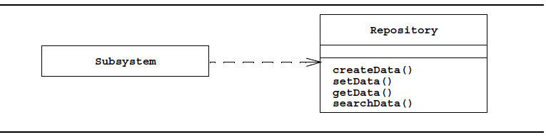
Software architecture
Some of architectural style
Repository architecture: An architecture where subsystems access and modify data from a single data structure called the central repository.
Control flow can be dictated either by the central repository
The repository architecture is typical for database management systems, such as a payroll system or a bank system.
Fig. Repository architecture (UML class diagram). Every subsystem depends only on a central data structure called the repository. The repository in turn, has no knowledge of the other subsystems.

Slide 21
Cont…
Model/View/Controller:
In the Model/View/Controller (MVC) architecture subsystems are classified into three different types:
model subsystems are responsible for maintaining domain knowledge,
It is developed such that they do not depend on any view or controller subsystem.
It maintain the central data structure.
view subsystems are responsible for displaying it to the user, and
Controller subsystems are responsible for managing the sequence of interactions with the user. It gather input from the user and send message to the model.

Slide 22
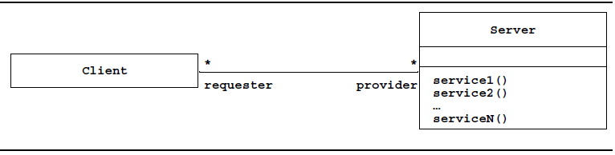
Cont…
Client/server architecture
In the client/server architecture a subsystem, the server, provides services to instances of other subsystems called the clients, which are responsible for interacting with the user.
The request for a service is usually done via a remote procedure call mechanism or a common object broker.
The client/server architecture is a generalization of the repository architecture.
Fig. Client/server architecture (UML class diagram).

Slide 23
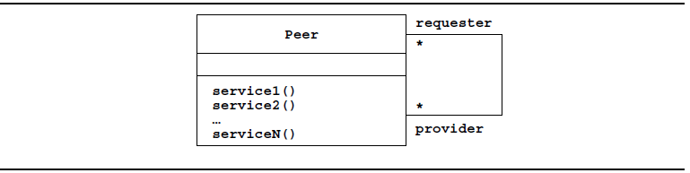
Cont…
A peer-to-peer architecture
It is a generalization of the client/server architecture in which subsystems can act both as client or as servers, in the sense that each subsystem can request and provide services.
The control flow within each subsystem is independent from the others except for synchronizations on requests.
Fig. Peer-to-peer architecture (UML class diagram).

Slide 24
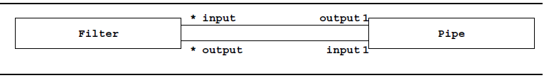
Cont…
Pipe and filter architecture
In this architecture subsystems process data received from a set of inputs and send results to other subsystems via a set of outputs.
The subsystems are called filters, and the associations between the subsystems are called pipes.
Each filter only knows the content and the format of the data received on the input pipes, not the filters that produced them.
Each filter is executed concurrently and synchronization is done via the pipes.
Most operating systems and programming languages provide a data stream mechanism; .
A Filter can have many inputs and outputs. A Pipe connects one of the outputs of a Filter to one of the inputs of another Filter.

Slide 25
6. Service Oriented Architecture
A business-centric IT architectural approach that supports integrating your business as linked, repeatable business tasks, or services. – IBM
(SOA) is an architectural style that promotes loose coupling and interoperability between software components or services. In an SOA, software systems are designed as a collection of independent services that communicate with each other over a network, providing specific functionalities as reusable and self-contained units.

Slide 26
7. Microservice Architecture
is an architectural development style that allows building applications as a collection of small autonomous services developed for a business domain.
Microservice architecture is an architectural style that structures a software application as a collection of small, loosely coupled, and independently deployable services. Each microservice focuses on a specific business capability and can be developed, deployed, and scaled independently, allowing for flexibility, scalability, and easier maintenance of the overall system.

Slide 27
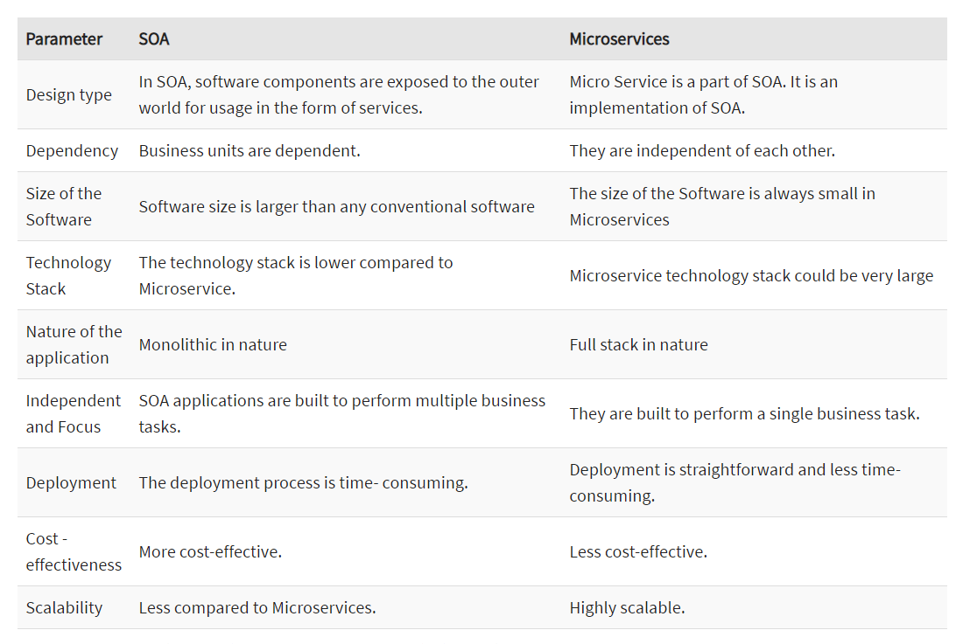
Service Oriented vs Microservice

Slide 28
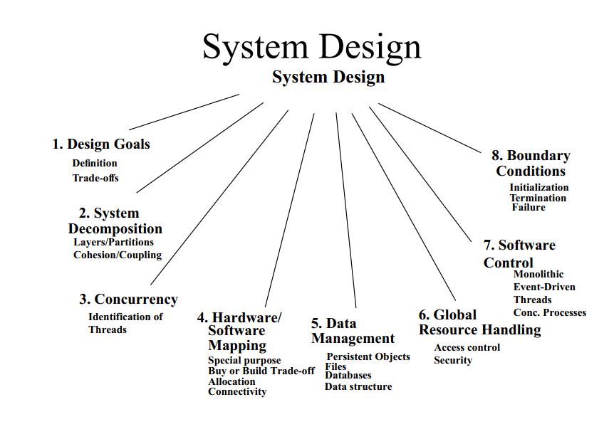
System Design

Slide 29
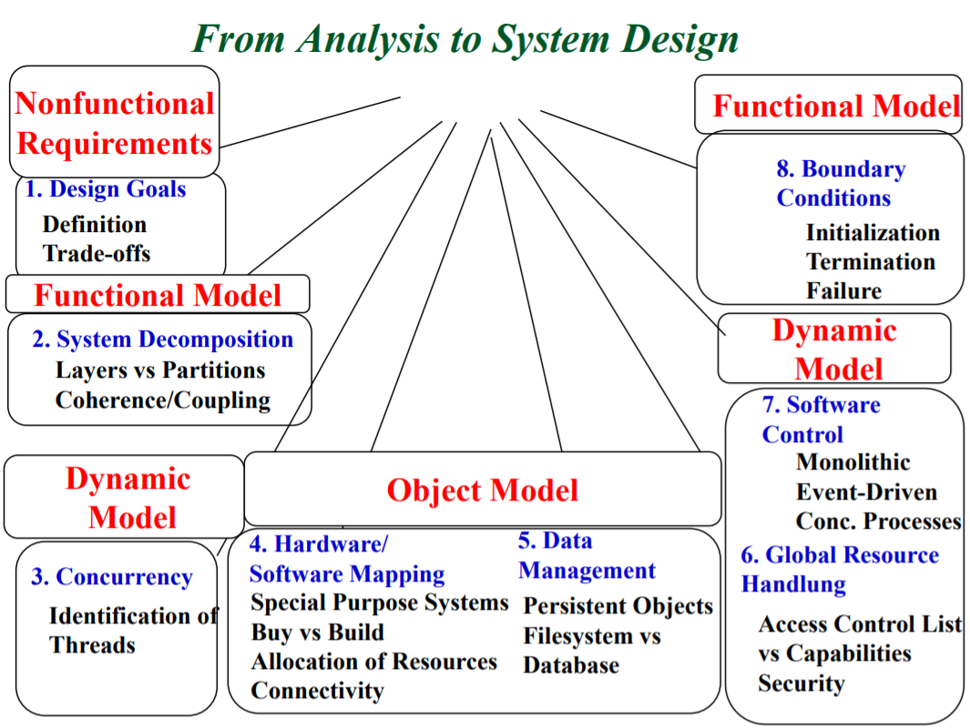
From Analysis to System Design

Slide 30
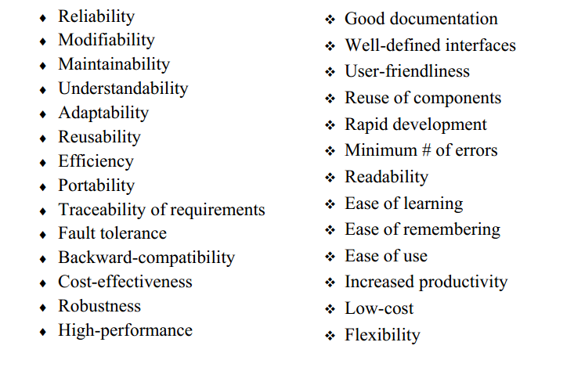
Design Goal

Slide 31
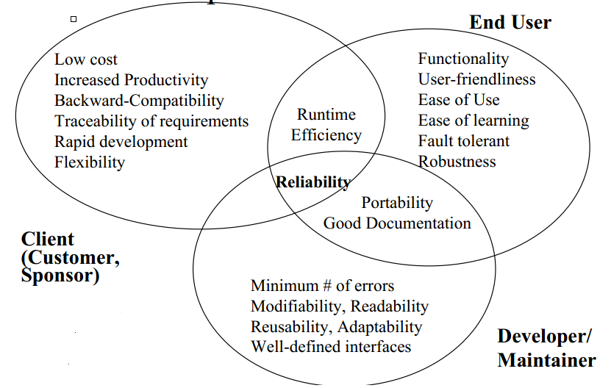
Relationship Between Design Goals

Slide 32
Typical Design Trade-offs
Functionality vs. Usability
Cost vs. Robustness
Efficiency vs. Portability
Rapid development vs. Functionality
Cost vs. Reusability
Backward Compatibility vs. Readability

Slide 33
Typical Design Trade-offs
In system design, trade-offs refer to the compromises that need to be made when making design decisions. These trade-offs involve making choices between different factors or attributes of a system, where improving one aspect may come at the cost of another. Here are some examples of
Performance vs. Scalability: Increasing performance often involves optimizing the system for speed and efficiency. However, this may limit its scalability, i.e., the ability to handle increasing workloads or accommodate a growing number of users. Balancing performance and scalability requires careful consideration of factors like hardware resources, caching strategies, and distributed computing techniques.

Slide 34
Typical Design Trade-offs
Flexibility vs. Complexity: Building a highly flexible system that can adapt to changing requirements typically involves introducing more complexity. Adding flexibility may require incorporating abstractions, configuration options, or customizable features, which can make the system harder to understand, maintain, or troubleshoot. Striking the right balance between flexibility and simplicity is crucial to avoid excessive complexity.
Security vs. Usability: Enhancing system security often involves implementing strict authentication mechanisms, encryption protocols, or access controls. However, these security measures may introduce additional steps or requirements that impact the system's usability. Designers must find the right balance between maintaining a secure system and providing a user-friendly experience.

Slide 35
Typical Design Trade-offs
Cost vs. Performance: Allocating more resources, such as additional servers or higher-performing hardware, can improve system performance. However, these enhancements come with increased costs. It is essential to assess the trade-off between investing in higher-performance resources and the resulting improvement in the overall system's performance, considering the budget and cost-effectiveness.
Consistency vs. Availability: In distributed systems, achieving strong consistency across all nodes can impact system availability. Strong consistency ensures that all replicas have the same view of data but may introduce delays or failures in case of network partitions. On the other hand, prioritizing availability allows the system to continue functioning even with inconsistent data across nodes. Choosing the right level of consistency and availability is a crucial trade-off in distributed system design.

Slide 36
System Decomposition
Subsystem (UML: Package)
Collection of classes, associations, operations, events and constraints that are interrelated
Seed for subsystems: UML Objects and Classes.
(Subsystem) Service:
Group of operations provided by the subsystem
Seed for services: Subsystem use cases

Slide 37
Cont.
Service is specified by Subsystem interface:
Specifies interaction and information flow from/to subsystem boundaries, but not inside the subsystem.
Should be well-defined and small.
Often called API: Application programmer’s interface, but this term should used during implementation, not during System Design

Slide 38
Structural Decomposition
Structural decomposition, also known as architectural decomposition, is a process in system design where a complex system is broken down into smaller, more manageable components or modules. It involves dividing the system's functionality, responsibilities, and interactions into cohesive and loosely coupled parts, creating a hierarchical structure.
The purpose of structural decomposition is to simplify the design, improve modularity, enhance reusability, and facilitate the understanding, development, and maintenance of the system.

Slide 39
Criteria for subsystem selection:
Most of the interaction should be within subsystems, rather than across subsystem boundaries (High cohesion).
Does one subsystem always call the other for the service?
Which of the subsystems call each other for service?
Primary Question:
What kind of service is provided by the subsystems (subsystem interface)?
Secondary Question:
Can the subsystems be hierarchically ordered (layers)?
What kind of model is good for describing layers and partitions?

Slide 40
Coupling and Cohesion
♦ Goal: Reduction of complexity while change occurs
♦ Cohesion measures the dependence among classes
High cohesion: The classes in the subsystem perform similar tasks and are related to each other (via associations)
Low cohesion: Lots of miscellaneous and auxiliary classes, no associations

Slide 41
Cont.
♦ Coupling measures dependencies between subsystems
High coupling: Changes to one subsystem will have high impact on the other subsystem (change of model, massive recompilation, etc.)
Low coupling: A change in one subsystem does not affect any other subsystem
♦ Subsystems should have a maximum cohesion and minimum coupling as possible:
How can we achieve high cohesion?
How can we achieve loose coupling?

Slide 42
Decomposition Guidelines
The aim of the design process is to identify loosely coupled, highly cohesive functions. Each function should therefore do one thing and one thing only
Cohesion – the degree to which a module performs one and only one function.
Coupling – the degree to which a module is connected to other modules in the system.

Slide 43
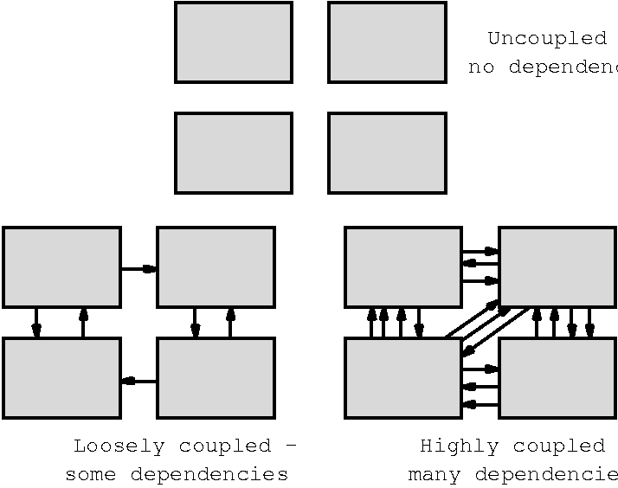
Coupling and Cohesion

Slide 44
Detailed Design
Concerned with producing a short design specification (minispec) of each function. This should describe the processing, inputs and outputs
These descriptions should be managed in a data dictionary
From these descriptions, detailed design descriptions, expressed in a PDL or programming language, can be produced

Slide 45
Object Oriented Design System design activities: From objects to subsystems
Outline
Identify design goals from the nonfunctional requirements
Design an initial subsystem decomposition
Map subsystems to processors and components
Decide storage
Define access control policies
Select a control flow mechanism
Identify boundary conditions

Slide 46
Object Oriented Design
Object-oriented design (OOD) is a software design paradigm that focuses on creating software systems by modeling them as a collection of objects that interact with each other.
OOD promotes modular design, code reusability, and maintainability, making it a popular approach in modern software development.
Key Concepts in Object-Oriented Design:
Objects: Objects are instances of classes that encapsulate data and behavior. They represent real-world entities or abstract concepts and interact with each other through messages.
Classes: Classes are blueprints or templates for creating objects. They define the attributes (data) and methods (behavior) that objects of that class will possess. Classes provide a way to define common characteristics and behavior for a set of objects.

Slide 47
Encapsulation: Encapsulation is the practice of bundling data and methods together within a class. It hides the internal details of an object and provides a well-defined interface for interacting with it. Encapsulation helps achieve data abstraction and improves code maintainability and reusability.
Inheritance: Inheritance allows classes to inherit attributes and methods from other classes, forming a hierarchical relationship. It facilitates code reuse by enabling the creation of specialized classes (subclasses) that inherit common features from a more general class (superclass). Subclasses can override or extend the inherited behavior as needed.

Slide 48
1. Identifying Design Goals
Is the first step of system design, It identifies the qualities that our system should focus on; which are mostly inferred from the nonfunctional requirements or from the application domain.
Example: considering the nonfunctional requirements for MyTrip
Design goals for MyTrip
Reliability: MyTrip should be reliable [generalization of nonfunctional requirement 2].
Fault Tolerance: MyTrip should be fault tolerant to loss of connectivity with the routing service [rephrased nonfunctional requirement 2].
Security: MyTrip should be secure, i.e., not allow other drivers or nonauthorized users to access another driver’s trips [deduced from application domain].
Modifiability: MyTrip should be modifiable to use different routing services [anticipation of change by developers].

Slide 49
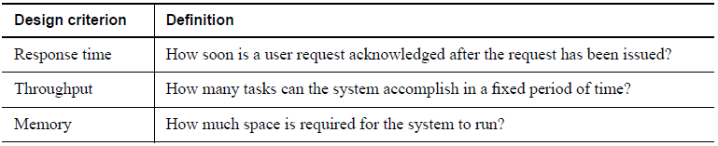
Cont…
list a number of possible design criteria.
Performance
dependability
cost
maintenance and
end user criteria.
Performance criteria: include the speed and space requirements imposed on the system.

Slide 50
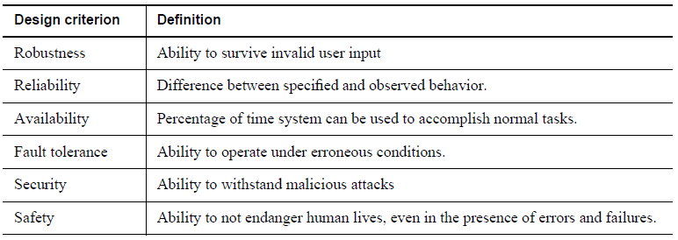
Cont..
Dependability criteria: determine how much effort should be expended in minimizing system crashes and their consequences. How often can the system crash? How available to the user should the system be? Are there safety issues associated with system crashes? Are there security risks associated with the system environment?

Slide 51
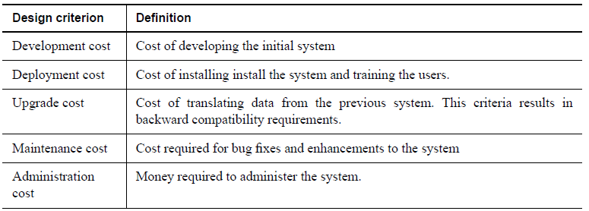
Cont…
Cost criteria: include the cost to develop the system, to deploy it, and to administer it.

Slide 52
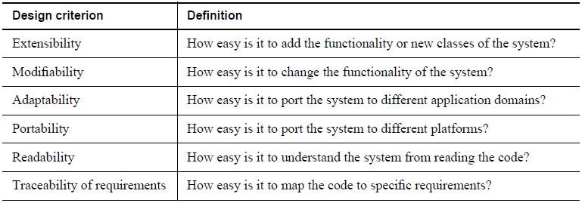
Cont…
Maintenance criteria: determine how difficult it is to change the system after deployment. How easily can new functionality be added? How easily can existing functions be revised? Can the system be adapted to a different application domain? How much effort will be required to port the system to a different platform?

Slide 53
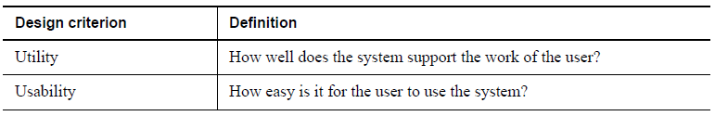
Cont…
End user criteria: include qualities that are desirable from a users’ point of view that have not yet been covered under the performance and dependability criteria.
N.B. Developers need to prioritize design goals and trade them off against each other. E.g it is unrealistic to develop software that is safe, secure, and cheap. Some of the common trade-off are:
Space vs. speed
Delivery time vs. functionality
Delivery time vs. quality
Delivery time vs. staffing

Slide 54
2. Identifying subsystems
Identifying subsystems involves breaking down a system into smaller, cohesive units that have specific responsibilities and functionalities. These subsystems work together to achieve the overall system objectives.
Example: Let's consider a social media platform as our system. The primary goal of the social media platform is to enable users to create profiles, connect with friends, post updates, and interact with each other.
Identify major functionalities: Start by identifying the major functionalities or features of the system. In our example, some major functionalities may include user management, friend connections, posting updates, and interaction (comments, likes).
Define subsystems based on responsibilities: Analyze the identified functionalities and determine the responsibilities that can be grouped together. Each subsystem should have a clear, well-defined responsibility. For example:
User Management Subsystem: Handles user registration, login, authentication, and account management.
Friendship Subsystem: Manages friend connections, friend requests, and the social graph.

Slide 55
2. Identifying subsystems
Identify interactions between subsystems: Consider the interactions and dependencies between subsystems. In our example, the subsystems would interact in the following ways:
User Management interacts with Friendship Subsystem for friend recommendations and managing friend lists.
Post Subsystem interacts with User Management for associating posts with specific users and managing privacy settings.
Interaction Subsystem interacts with Post Subsystem for adding comments, likes, and sharing functionality.

Slide 56
2. Identifying subsystems
Refine subsystems: Further breakdown each subsystem into smaller components as necessary, based on their responsibilities and complexity. For instance, the User Management Subsystem may have components like user authentication, profile management, and account settings.
By identifying subsystems, we can better understand the system's structure and organization, ensuring that each subsystem has well-defined responsibilities. This modular approach allows for better code organization, reuse, and maintenance. Additionally, it facilitates parallel development by enabling teams to work on different subsystems concurrently.

Slide 57
3. Mapping subsystems to processors and components
Mapping subsystems to processors and components involves assigning the identified subsystems of a system to specific hardware processors or software components. This mapping is done to optimize performance, distribute workload, and ensure efficient utilization of resources. Let's consider an example to illustrate this mapping process:
Example: Let's say we have a web-based e-commerce system with the following identified subsystems:
Product Management Subsystem
User Management Subsystem
Order Management Subsystem
Payment Processing Subsystem
Inventory Management Subsystem

Slide 58
3. Mapping subsystems to processors and components
Identify available processors and components: Determine the available hardware processors (e.g., servers, machines) or software components (e.g., microservices, modules) in the system architecture that can host the subsystems. This could include web servers, application servers, databases, or other specialized components.
Analyze subsystem requirements: Assess the requirements of each subsystem, such as performance, scalability, availability, and data storage needs. Consider factors like expected user load, processing capabilities, and the need for high availability or fault tolerance.

Slide 59
3. Mapping subsystems to processors and components
Map subsystems to processors and components: Based on the analysis, map the identified subsystems to appropriate processors or components. Consider the following factors:
Performance: Assign subsystems with high-performance requirements to processors or components with higher processing capabilities.
Scalability: Distribute subsystems across multiple processors or components to ensure scalability and handle increasing user loads.
By mapping subsystems to processors and components, the system architecture is optimized for performance, scalability, and resource utilization. It allows for efficient distribution of workload and ensures that each subsystem is assigned to the most suitable processing or component resources in the system.

Slide 60
UML Deployment Diagrams
UML deployment diagrams: are used to depict the relationship among run-time components and hardware nodes.
Components are self-contained entities that provide services to other components or actors. E. g. Web server, provides services to Web browsers.
In UML deployment diagrams, nodes are represented by boxes containing component icons.
Dependencies between components are represented by dashed arrows.

Slide 61
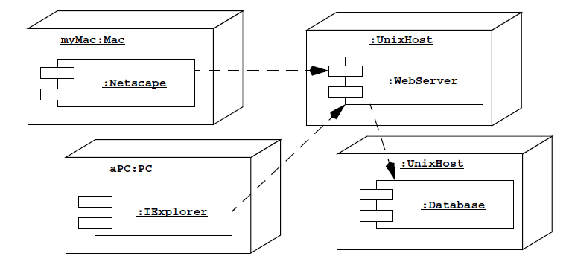
Cont…
Fig. A UML deployment diagram representing the allocation of components to different nodes and the dependencies among components. Web browsers on PCs and Macs can access a WebServer that provides information from a Database.

Slide 62
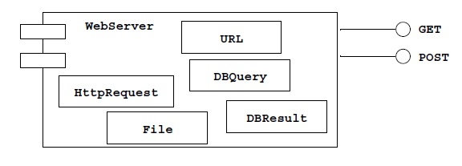
Cont…
Fig. Refined view of the WebServer component (UML deployment diagram). The WebServer component provides two interfaces to browsers: A browser can either request the content of a file referred by a URL (GET) or post the content of a form (POST). The WebServer component contains five classes: URL, HttpRequest, DBQuery, File, and DBResult.

Slide 63
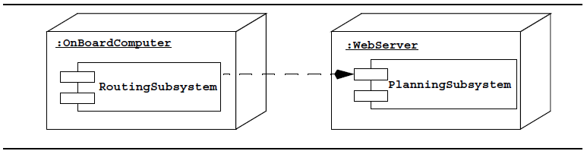
Example In MyTrip
Example In MyTrip, we deduce from the requirements that PlanningSubsystem and RoutingSubsystem run on two different nodes:
In the MyTrip subsystem We select a Unix machine as the virtual machine for the :WebServer and the Web browsers on onboard computer
Fig. Allocation of MyTrip subsystems to hardware (UML deployment diagram). RoutingSubsystem runs on the OnBoardComputer while PlanningSubsystem runs on a WebServer.

Slide 64
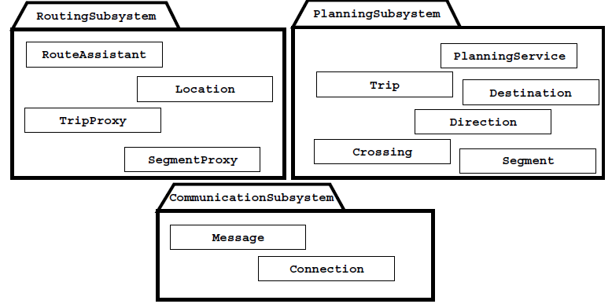
Cont…
Allocating objects and subsystems to nodes
After identification of virtual machines , objects and subsystems are assigned to nodes. This often triggers the identification of new objects and subsystems for transporting data among the nodes.
Example: in MyTrip system both RoutingSubsystem and PlanningSubsystem share the objects. thus we create new subsystem to support this communication: coommunicationSubsystem.
FIG. Revised design model for MyTrip (UML Class diagram, associations omitted for clarity).

Slide 65
4. Defining Persistent Data Stores
Where and how data is stored in the system impacts the system decomposition.
The selection of a specific database management system can also have implications on the overall control strategy and concurrency management.
we first need to identify which objects need to be persistent. The persistency of objects is directly inferred from the application domain.
E.g. In Mytrip - current trip in Rroutngsubsystem-file, location X
- entire trip in PlanningSubsystem-database

Slide 66
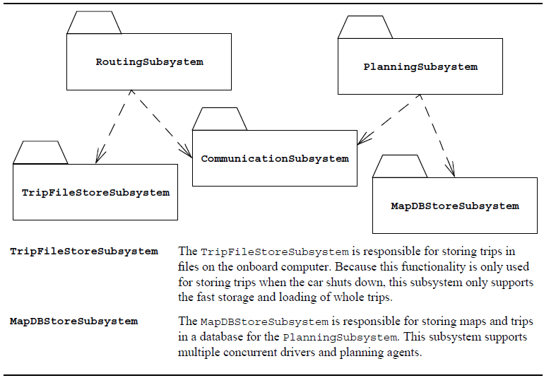
Cont…
Fig. Subsystem decomposition of MyTrip after deciding on the issue of data stores (UML class diagram, packages collapsed for clarity).

Slide 67
5. Defining access control
In multiuser systems, different actors have access to different functionality and data. We modeled these distinctions by associating different use cases to different actors.
During system design, we model access by examining the object model, by determining which objects are shared among actors, and by defining how actors can control access.
Depending on the security requirements on the system, we also define how actors are authenticated to the system (i.e., how actors prove to the system who they are) and how selected data in the system should be encrypted.

Slide 68
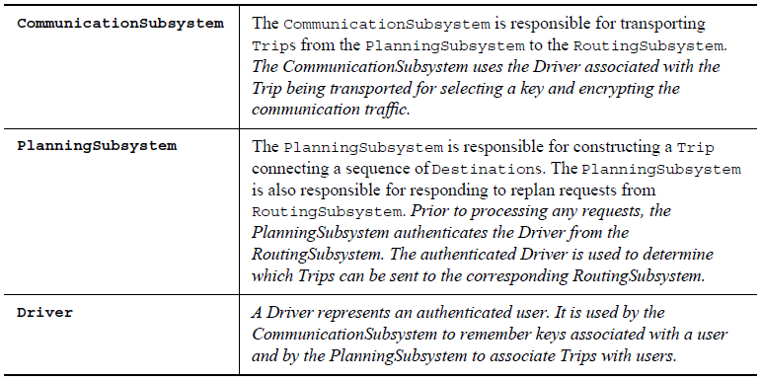
Cont…
Fig. Revisions to the design model stemming from the decision to authenticate Drivers and encrypt communication traffic. The text added to the model is in italics.

Slide 69
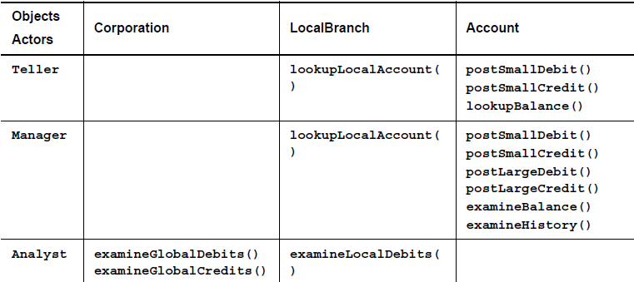
Cont…
Access matrix: Is a table where the rows of the matrix represents the actors of the system. The columns represent classes whose access we control.
An entry (class, actor) in the access matrix is called an access right and lists the operations that can be executed on instances of the class or by the actor.
Fig. Access matrix for a banking system.

Slide 70
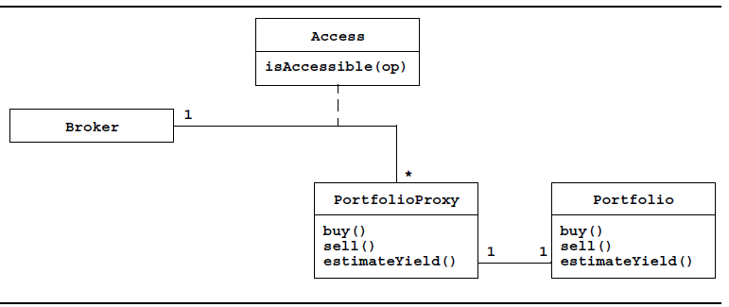
Cont…
An access matrix only represents static access control. This means that access rights can be modeled as attributes of the objects of the system.
In a model if the access rights is allocated dynamically in the system, this type of access is called dynamic access control.
Fig. Dynamic access implemented with a protection Proxy.

Slide 71
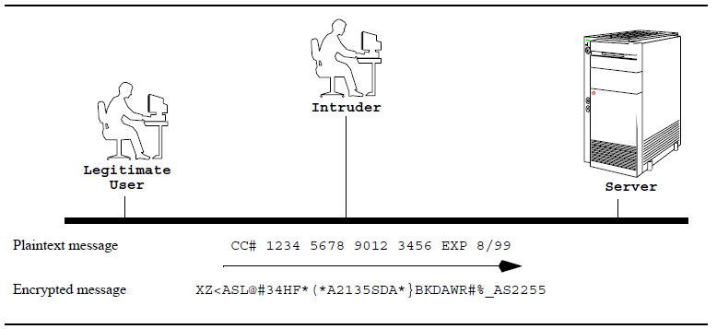
Cont…
In an environment where resources are shared among multiple users, authentication is usually not sufficient.
Encryption is used to prevent such unauthorized accesses. Using an encryption algorithm, we can translate a message, called plaintext, into a encrypted message, called a ciphertext,

Slide 72
6. Designing the global control flow
Designing the global control flow in system design involves planning and organizing the sequence of operations and interactions between various components and modules of the system. It defines the overall structure and flow of execution within the system. Here are some key considerations for designing the global control flow:
Identify System Components: Start by identifying the major components or modules of the system. These components can represent different functionalities or subsystems within the overall system.

Slide 73
Cont…
Define High-Level Interactions: Determine the high-level interactions between the identified components. This involves understanding how data, control, and messages flow between the components, and how they collaborate to achieve the system's objectives.
Determine Control Dependencies: Analyze the dependencies and relationships between the components to identify the control flow dependencies. This includes identifying which components are responsible for initiating certain actions or operations and how they interact with other components.

Slide 74
7.Identifying boundary conditions
It is deciding how the system is started, initialized, and shut down, and how to deal with major failures, such as data corruption, whether they are caused by a software error or a power outage.
Considering the MyTrip system our system design doesn’t address the following questions:
How MyTrip is initialized.
How are maps loaded into the PlanningService?
How is MyTrip installed in the car?
How does MyTrip know which PlanningService to connect to?
How are drivers added to the PlanningService?
We discover a set of use cases that has not been specified. We call these the system administration use cases, which specify the system during startup and shutdown phases.

Slide 75
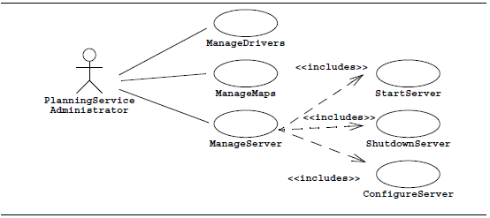
Cont…
Modify the analysis model for MyTrip to include the administration use cases : ManageDrivers, to add, remove, and edit drivers; ManageMaps, to add, remove, and update maps used to generate trips; and ManageServer, to perform routine configuration, start-up, and shutdown. StartServer, part of ManageServer.
Fig. Administration use cases for MyTrip (UML use case diagram).

Slide 76
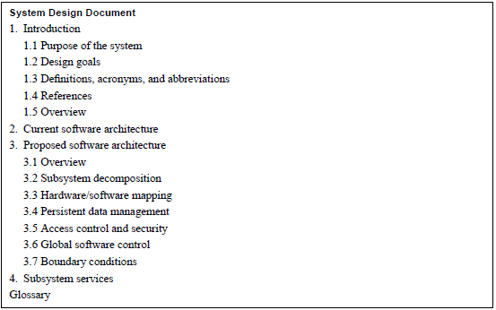
Documenting system design

Slide 77
Thank You!
Q?

